Slide 1
Lessons from the Little Book of Big Lies: A Journey into Inner Fitness
Download the PowerPoint and access the recording: www.ncperkins.org/presentations
Notes:
Chris
We are here to help promote employment and training in the great state of North Carolina.
Through these monthly workshops, we are going to ….
And bring in special guests to let you know about …
Please download this PowerPoint file and use it anyway you can to help get folks on a career pathway.
The reference showing from where the information was found, as well as the contact information for our guests is in the Notes section under each slide.
Get the PowerPoint on our NCPerkins.org website on our Presentations and Webinars page.
Here is the direct address on the screen.

Slide 2
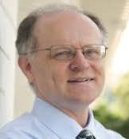
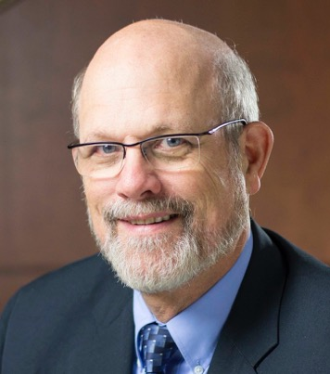
Chris Droessler Career and Technical Education
Dr. Bob Witchger Career and Technical Education Director
Notes:
Robert J. Witchger Ed.D.
Director Career and Technical Education
North Carolina Community College System
200 W. Jones Street
(919) 807-7126
witchgerb@nccommunitycolleges.edu
Chris Droessler
Career and Technical Education Coordinator
North Carolina Community College System
DroesslerC@nccommunitycolleges.edu

Slide 3
Next Workshop – Tomorrow at 9 am
The State of North Carolina’s Economy: Economic Conditions and the Workforce
Jessica Englert - Assistant Secretary of Workforce Solutions - NC Commerce
Betty McGrath - Employment Statistics Director - NC Commerce
https://register.gotowebinar.com/register/1845681309827019791
Download this PowerPoint ncperkins.org/presentations
Notes:
The next workshop
https://register.gotowebinar.com/register/1845681309827019791

Slide 4
NC Employment and Training Association (NCETA)
Malinda Marsh
NCETA President (www.nceta.org)
NCWorks Career Center, Chatham County
NCperkins.org/presentations
Notes:
This is an NCETA workshop.
This workshop is sponsored by NCETA
Malinda Marsh will explain
======
Malinda Marsh
NCETA President
malinda.amarsh@gmail.com

Slide 5
NCETA Conference 2021
September 8-10, 2021
Hotel Ballast in Wilmington
www.nceta.org
Notes:
nceta.org

Slide 6
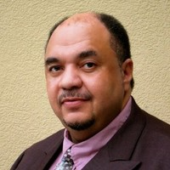
William Wooten
Executive Director of Human Resource & Operations
Weldon City Schools
Notes:
William Wooten
Executive Director of Human Resource & Operations
Weldon City Schools

Slide 7
Tina Lifford
Aunt Vi from OWN's Queen Sugar & Inner Fitness Advocate and Strategist
Notes:
https://www.theinnerfitnessproject.com/
Gilda Squire
Squire Media & Management, Inc. 212-928-8090
gildasquire@verizon.net
TINA LIFFORD
Hollywood veteran Tina Lifford plays the vivacious breakout character Aunt Vi on the critically acclaimed television drama, Queen Sugar. She has played over 100 characters in her long-standing career, including notable roles on Scandal and Parenthood.
Equally accomplished behind the camera, Tina is the respected playwright of THE CIRCLE, a play about how seven diverse women navigate the choppy waters of life together; author of The Little Book of BIG LIES (Harper Collins, November 2019); and CEO of The Inner Fitness Project, a personal development network committed to making the practices and benefits of “Inner Fitness” as familiar, well understood and accessible as those of physical fitness.
Tina refers to herself as an Inner Fitness Advocate and Strategist, providing information and life strategies that build a strong, resilient inner Self capable of masterfully navigating life's challenges and opportunities. In particular, Tina's focus offers a lifeline to women who have come to the sobering realization that a mate, career, money and a big house...and even the kids they love deeply...don’t fulfill the “something’s missing” that only a rich relationship with one’s Self provides.
Through the Inner Fitness lens, Tina encourages every woman, no matter her age, to acknowledge the Self that lives inside of her, embrace her innate worth and learn to take her power back from old hurt, in order to BE fully alive and thrive.

Slide 8
Lessons from the Little Book of Big Lies: A Journey into Inner Fitness
Download the PowerPoint and access the recording: www.ncperkins.org/presentations
Notes:
Please download this PowerPoint file and use it anyway you can to help get folks on a career pathway.
The reference showing from where the information was found, as well as the contact information for our guests is in the Notes section under each slide.
Get the PowerPoint on our NCPerkins.org website on our Presentations and Webinars page.
Here is the direct address on the screen.

Slide 9
Next Workshop – Tomorrow at 9 am
The State of North Carolina’s Economy: Economic Conditions and the Workforce
Jessica Englert - Assistant Secretary of Workforce Solutions - NC Commerce
Betty McGrath - Employment Statistics Director - NC Commerce
https://register.gotowebinar.com/register/1845681309827019791
Download this PowerPoint ncperkins.org/presentations
Notes:
The next workshop
https://register.gotowebinar.com/register/1845681309827019791

Slide 10
October Workshop
Solomon McAuley
Notes:
The next workshop

