Slide 1
Perkins Update
April 12, 2022

Slide 2
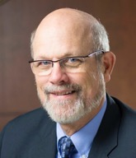
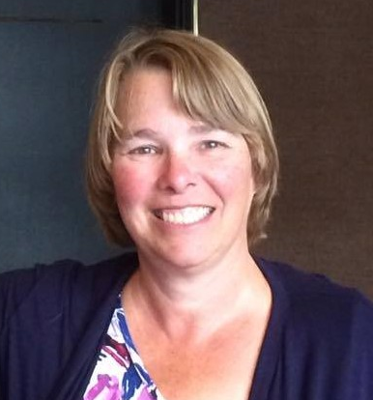
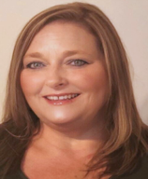
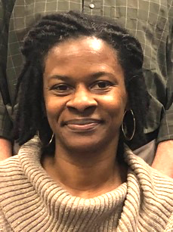
Team Perkins
Bob Witchger
Tony Reggi
Patti Coultas
Mary Olvera
Darice McDougald
Notes:
Dr. Bob Witchger
919-807-7126
WitchgerB@nccommunitycolleges.edu
Dr. Tony R. Reggi
919-807-7131
ReggiA@nccommunitycolleges.edu
Patti Coultas
919-807-7130
CoultasP@nccommunitycolleges.edu
Dr. Mary Olvera
919-807-7120
OlveraM@nccommunitycolleges.edu
Darice McDougald
919-807-7219
McDougaldD@nccommunitycolleges.edu

Slide 3
Purpose of Perkins
Develop more fully the academic knowledge and technical and employability skills of secondary education students and postsecondary education students who elect to enroll in CTE curriculum programs and programs of study
Notes:
The Strengthening Career and Technical Education for the 21st Century Act reauthorized and updated the Carl D. Perkins Career and Technical Education Act of 2006 to become the current Carl D. Perkins Career and Technical Education Act of 2006 as amended by the Strengthening Career and Technical Education for the 21st Century Act (Perkins V)
This updated act stresses:
- Academic, Technical, and Employability Skills
- Funding Secondary and Postsecondary CTE
- Focusing on Students who elect to enroll in CTE Programs of Study

Slide 4
Dynamic CLNA
Dr. Thom Brooks, Executive Vice President

Slide 5
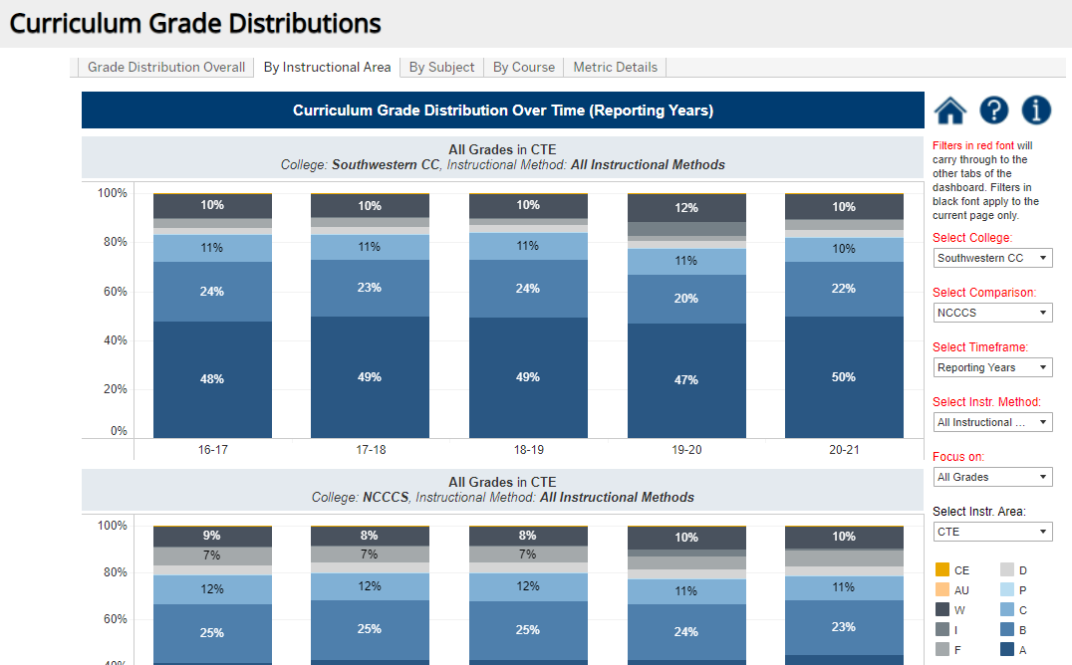
Southwestern CC Student Performance

Slide 6
Getting to that data dashboard
https://www.nccommunitycolleges.edu/analytics/dashboards
Click on “Curriculum Student Progress and Success”
Click on “Curriculum Grade Distributions”
Click on tab “By Instructional Area”
Select college on right side
Select CTE under “select instructional area” drop down box on right

Slide 7
Perkins 101 Workshop and Annual Meeting
Perkins 101
Highlighting history
Perkins V Act
EDGAR
Operational procedures
Annual Meeting
Procedures for Applying for Funding for 2022-23
Procedures for managing the grant (Handbook)
How to use the NCPerkins moodle

Slide 8
Attendance options
Virtually:
Perkins 101 Workshop: Wednesday, April 13 from 9am-12pm Annual Meeting: Tuesday, April 19 from 9am-12pm
** Register now ncperkins.org/presentations
In-Person with SkillsUSA:
Auditorium II, Koury Center, Greensboro Perkins 101 Workshop: April 27 1-4pm Annual Meeting: April 28, 9am-12pm
** See email for registration link

Slide 9
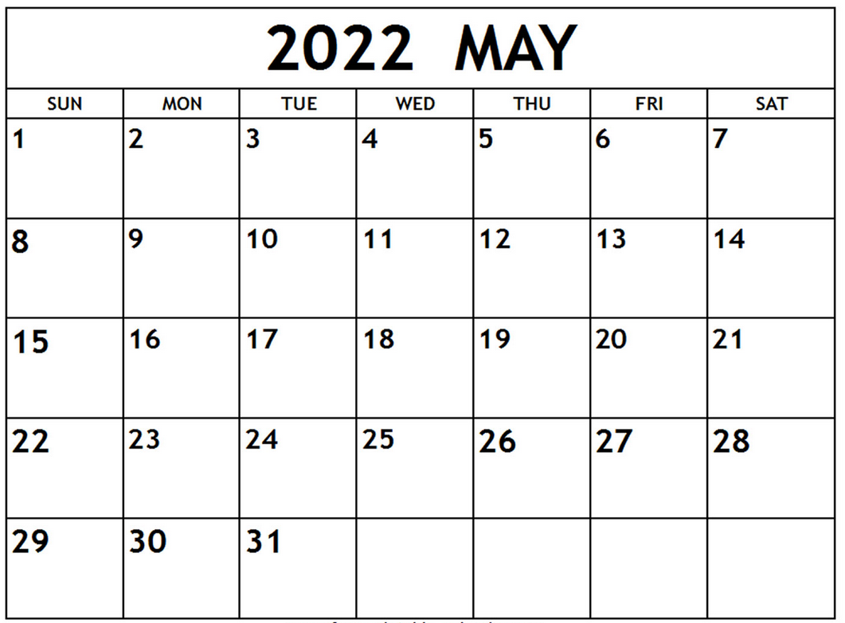
Deadline coming!
All modifications
must be
submitted by
May 15th

Slide 10
End of Year Perkins Summary
What career development activities has the college implemented in the past program year to help students in enrolling in CTE programs of study?
In what ways is the college working to improve the retention of CCP CTE students beyond high school graduation in the AAS Pathway?
What practices has your college implemented this year to market to or enhance special populations participation and performance in CTE Programs of study?

Slide 11
Perkins summary continued
Highlight 4 professional development activities offered to CTE faculty during the past year
In what ways has the college’s CLNA informed the integration of academic, technical and employability skills in the classroom?
What are 3 specific activities the college has implemented to increase progress and success? (technical attainment and or persistence)
How have Perkins funds made a difference this year?

Slide 12
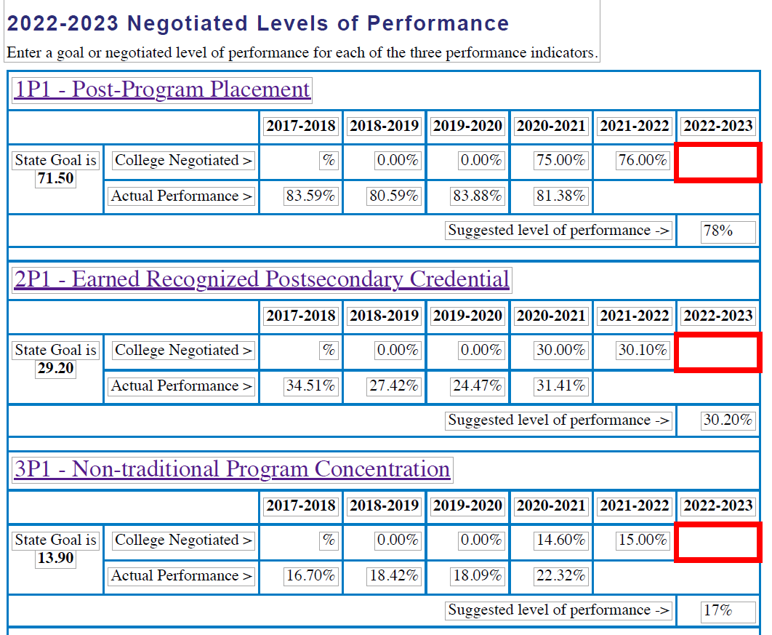
Negotiated Levels of Performance

Slide 13
Dashboard showing Negotiated Levels of Performance

Slide 14
End-Of-Year Promising Practice Video
Hold horizontally when filming

Slide 15
2022-23 Perkins Documents Due June 3rd

Slide 16
Performance Partnership Webinars
April 14 3-4pm: Promising Practices to Close Equity Gaps Associated with Student Completion
June 16 3-4pm: Personas Project: Personifying Student Data to Improve Performance
For descriptions and registration see flyer uploaded on NCPerkins.org/presentations for February 8, 2022

Slide 17
NACTEi Spring Conference
https://nactei.org/conference/
May 9th is a preconference with Brustein and Manasevit on EDGAR. This is a separate registration & fee www.bruman.com

Slide 18
NCWorks Partnership Conference
https://www.nccommerce.com/jobs-training/workforce-professionals-tools-resources/ncworks-training-center/ncworks-partnership
Notes:
https://www.nccommerce.com/jobs-training/workforce-professionals-tools-resources/ncworks-training-center/ncworks-partnership

Slide 19
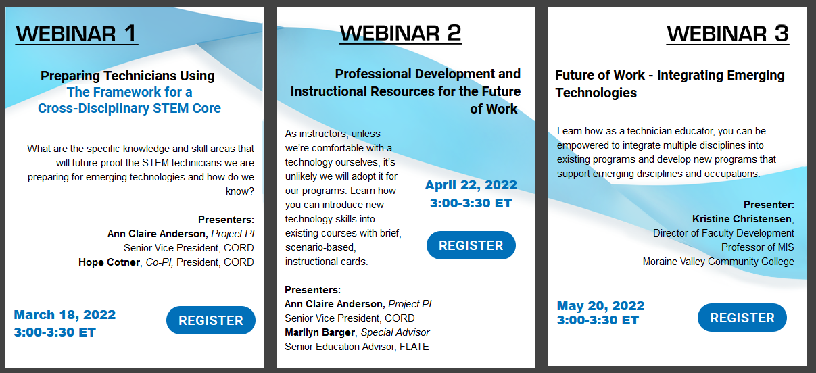
From CORD
Complete
https://www.preparingtechnicians.org/webinars/
Notes:
https://www.preparingtechnicians.org/webinars/

Slide 20
Perkins Monthly Updates
2nd Tuesday of the month (not December) from 9-10 am
Next update is August 9, 2022
Registration link https://www.ncperkins.org/presentations/
Attendance (or viewing the recording within 30 days) is recorded on monitoring rubric. Recording may be found at same link as registration.
Notes:
Register now and let the system remind you.

Slide 21
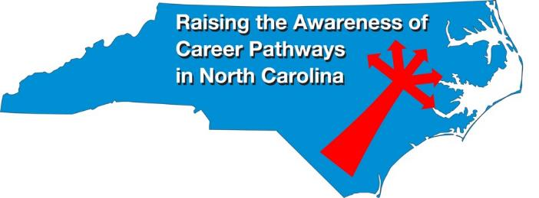
Raising the Awareness of Career Pathways Webinars
3rd Wednesday of the month from 9-10am
Next webinar is April 20, 2022
Come explore careers in Respiratory Therapy
Registration link: https://www.ncperkins.org/presentations/

Slide 22
NC*NET
NC-NET (NC Network for Excellence in Teaching) Professional learning in partnership with CORD
www.nc-net.info
Offerings:
NC Academy - facilitator-led online courses for faculty, upcoming offering on Curriculum Development for Integrated Instruction.
Self-Paced Professional Development: Teaching Contextually, Teaching Employability Skills, Adjunct Faculty Roadmap, and Exploring Stackable Credentials
Online instructor resources
Notes:
https://www.ncperkins.org/presentations/

Slide 23
Promising Practice Video 2021
Johnston Community College
Creating program videos highlighting nontraditional students
https://www.ncperkins.org/video/video.php?v=Johnston-2021&y=2021
See all the videos:
https://www.ncperkins.org/video/
Notes:
Stop video at 3:55
March 2022
Nash
Mayland
April 2022
Lenoir
Johnston
May 2022
James_Sprunt
Halifax
Gaston
Forsyth
Fayetteville
Edgecombe
Durham
Davidson
Craven
Coastal_Carolina
Central_Piedmont
Carteret
Cape_Fear
Caldwell
Brunswick
Blue_Ridge
Beaufort
AB_Tech

Slide 24
Technical assistance is available
We are here to help!
Team Perkins is available by phone, email, TEAMS, or in-person

Slide 25
Perkins/CTE Team
Dr. Bob Witchger Director, Career & Technical Education WitchgerB@nccommunitycolleges.edu 919-807-7126
Dr. Tony R. Reggi Coordinator, Career & Technical Education ReggiA@nccommunitycolleges.edu 919-807-7131
Patti Coultas Coordinator, Career & Technical Education CoultasP@nccommunitycolleges.edu 919-807-7130
Dr. Mary Olvera Coordinator, Career & Technical Education OlveraM@nccommunitycolleges.edu 919-807-7120
Darice McDougald CTE Administrative Assistant McDougaldD@nccommunitycolleges.edu 919-807-7219
Notes:
http://www.ncperkins.org/course/view.php?id=6

