Slide 1
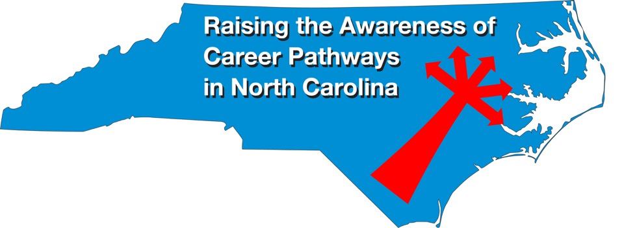
Cyber Crime Technology May 15, 2024
Download the PowerPoint and access the recording: www.ncperkins.org/presentations

Slide 2
Career & Technical Education Team
Bob Witchger
Tony Reggi
Patti Coultas
Mary Olvera
Stefanie Schroeder
Darice McDougald
Lane Freeman
Jennifer McLean
Aaron Mabe

Slide 3
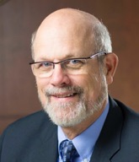
Dr. Bob Witchger
Executive Director of Perkins Career and Technical Education
Notes:
Dr. Robert (Bob) Witchger
NCCCS, CTE Director
919-807-7126
witchgerb@nccommunitycolleges.edu

Slide 4
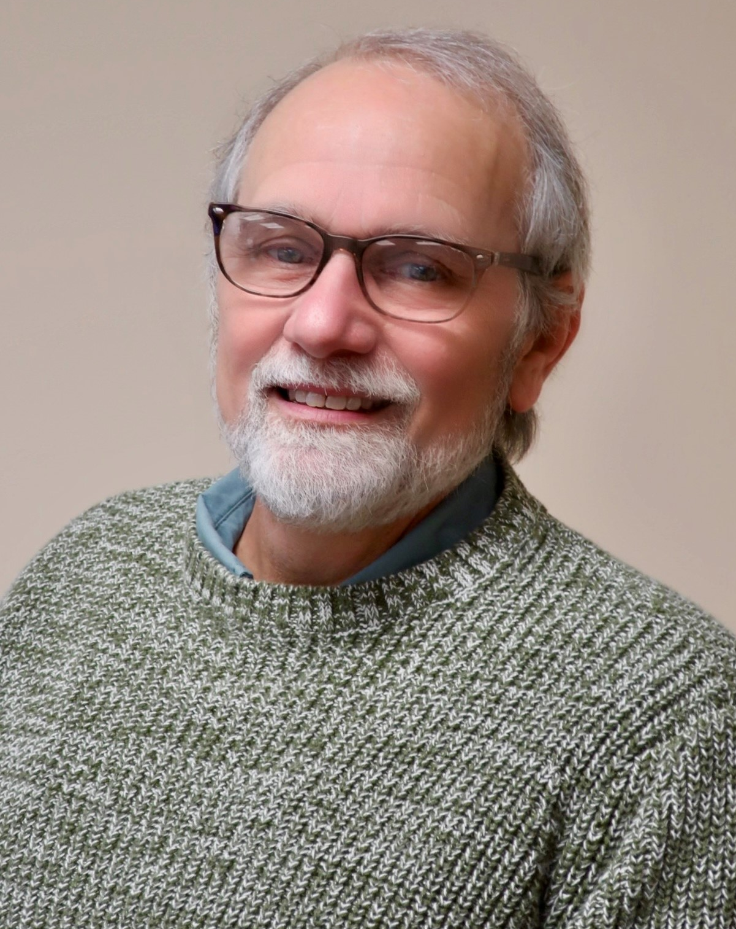
Dr. Tony Reggi
Associate Director of Perkins Career and Technical Education
Notes:
Tony Reggi
919-807-7131
reggia@nccommunitycolleges.edu

Slide 5
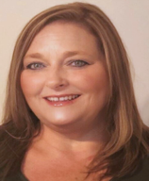
Dr. Mary Olvera
State Director of Teacher Education, Public Services, and Perkins Special Populations
Notes:
Dr. Mary Olvera
Career and Technical Education Coordinator & Program Administrator
Public Service Technologies, Agriculture and Natural Resources Technologies, and Commercial Artistic Productions
North Carolina Community College System Office
919-807-7120
olveram@nccommunitycolleges.edu

Slide 6
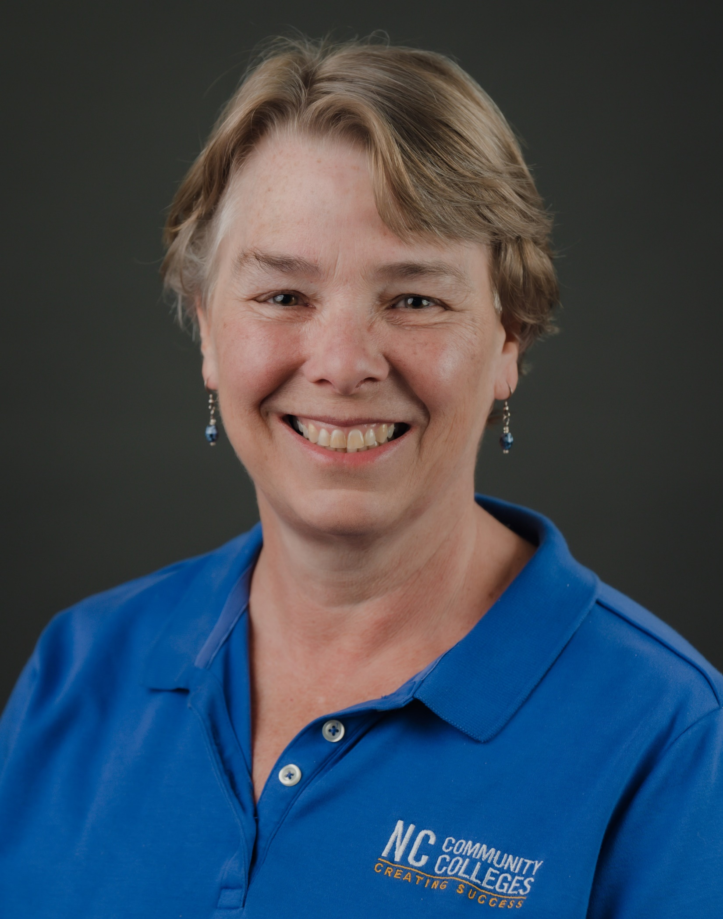
Patti Coultas
Assistant Director of Perkins Career and Technical Education - East
Notes:
Patti Coultas
919-807-7130
coultasp@nccommunitycolleges.edu

Slide 7
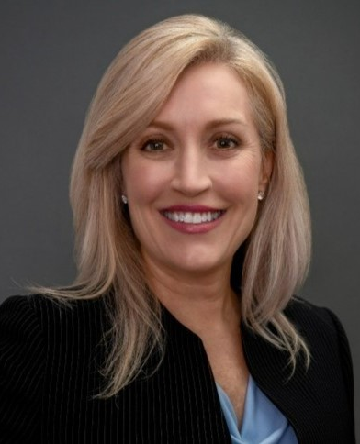
Stefanie Schroeder
Assistant Director of Perkins Career and Technical Education - West
Notes:
Stefanie Schroeder
919-807-7232
schroeders@nccommunitycolleges.edu

Slide 8
Dr. Hilmi Lahoud
Senior State Director of Business and Information Technology and Academic Programs Operations
Notes:
Hilmi A. Lahoud, Ph.D. Senior Program Administrator, Business and Information Technology Programs
Academic and Student Services Phone: 919-807-7116 lahoudh@nccommunitycolleges.edu

Slide 9
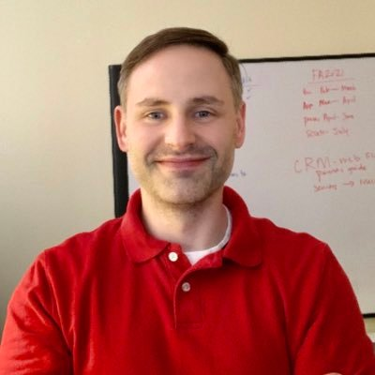
Aaron Mabe
State Director of Dual Enrollment and Agriculture & Natural Resources Technology
Notes:
Aaron Mabe
919-807-7098
mabea@nccommunitycolleges.edu

Slide 10
Cybercrime Investigators
Job responsibilities may include:
Analyzing computer systems and networks following a crime.
Recovering data that was either destroyed or damaged.
Gathering computer and network information.
Reconstructing cyberattacks.
Working in a multi-jurisdictional or cross-jurisdictional environment.
Preparing expert reports on highly complex technical matters.
Consulting with clients, supervisors, and managers.
Continually developing investigative and cybersecurity skills through research and training.
Recovering password-protected/encrypted files and hidden information.
Assessing software applications, networks, and endpoints for security flaws.
Identifying and recommending methods for the preservation and presentation of evidence.
Notes:
https://nccareers.org/occupation-profile/291292/1284

Slide 11
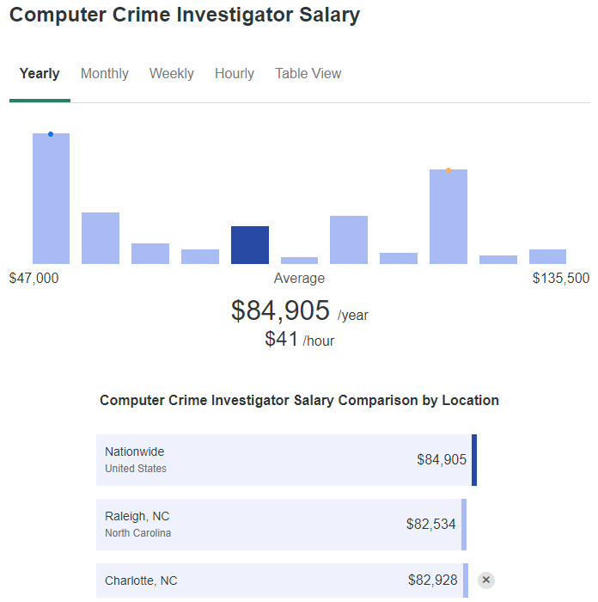
Data from ZipRecruiter
Notes:
Salary: Computer Crime Investigator (May, 2024) US (ziprecruiter.com)

Slide 12
Cyber Crime Technology (A55210)
This curriculum will prepare students to enter the field of computer crime investigations and private security. Students completing this curriculum will be capable of investigating computer crimes, properly seize and recover computer evidence and aid in the prosecution of cyber criminals.
Course work in this curriculum will include a division of work in the disciplines of criminal justice and computer information systems. Additionally, students will be required to take specific cyber crime classes.
Graduates should qualify to become computer crime investigators for local or state criminal justice agencies. Also, these graduates should be competent to serve as computer security specialists or consultants with private business.
Offered at:
Cape Fear CC
Guilford Tech
McDowell Tech
South Piedmont
Southwestern
Stanly
Notes:
Associate Degree Program at NC Community Colleges
https://ncccsstg.wpengine.com/wp-content/uploads/2023/11/A55210_Cyber_Crime_Tech_SP07v10.pdf

Slide 13
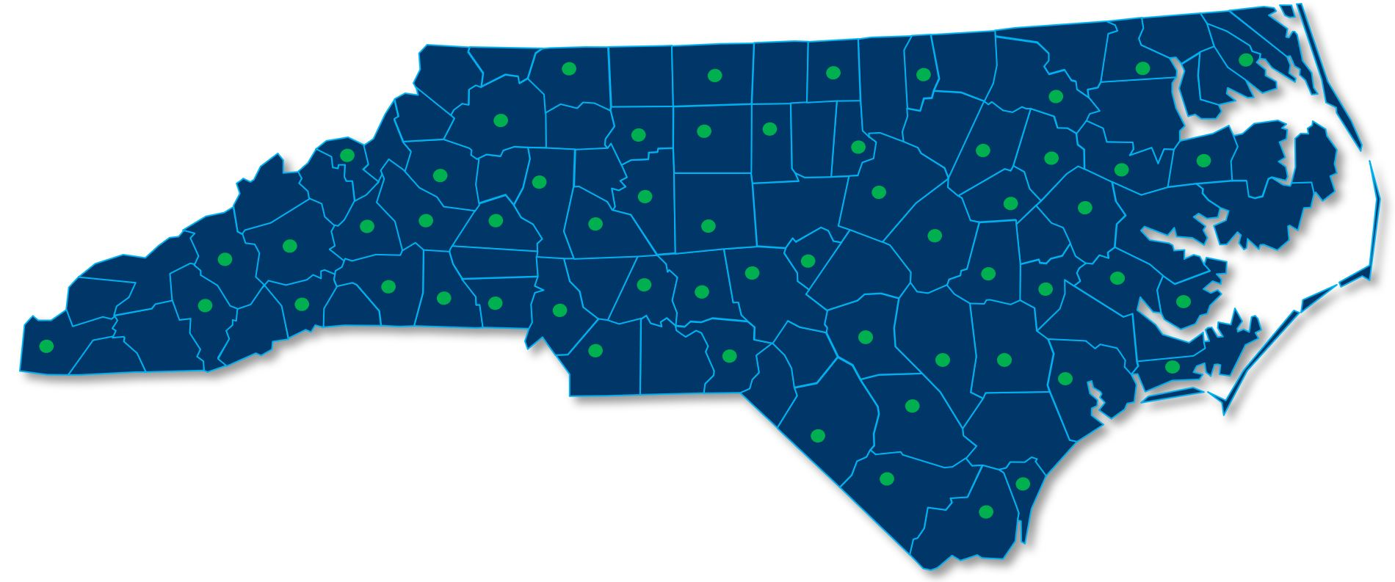
Information Technology (A25590)
All 58 NC community colleges offer the Information Technology (A25590) program and offer security courses as part of the degree. Colleges may offer a specialty in security, cybersecurity, or cybercrime technology under the Information Technology degree.

Slide 14
Forsyth Technical Community College
Tony Brown
Department Chair, Davis iTech Cybersecurity Center
Notes:
Thomas (Tony) Brown, Forsyth Technical Community College, Department Chair, Davis iTech Cybersecurity Center tbrown@forsythtech.edu 336-906-2846

Slide 15
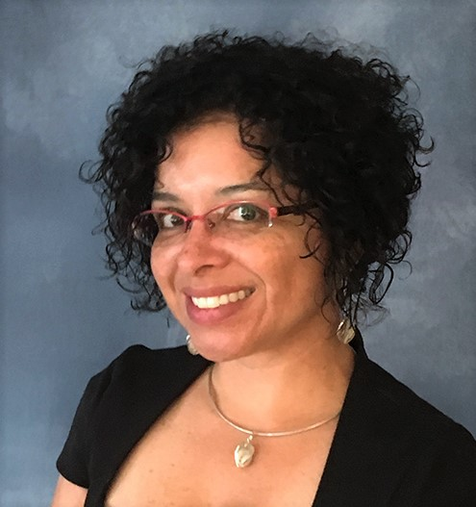
Forsyth Technical Community College
Flora Calerón-Steck
Education Partnerships Executive Director
Notes:
Flora Calderón-Steck, Education Partnerships Executive Director fcalderon-steck@forsythtech.edu 336-734-7633

Slide 16
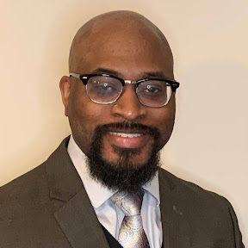
Central Piedmont Community College
Joe Little
Associate Dean of Technology, Technology Division
Notes:
Joe Little
Associate Dean of Technology, Technology Division
Central Piedmont Community College
Central Campus, Levine Technology Building, LT5109
P.O. Box 35009 Charlotte, NC 28235
t 704.330.6513
joe.little@cpcc.edu

Slide 17
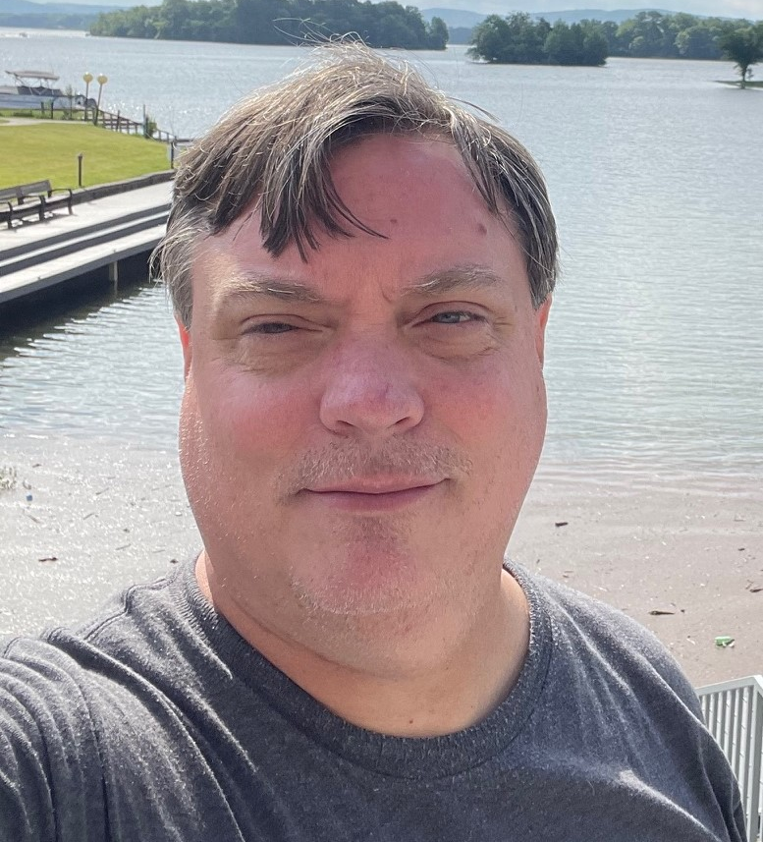
Mitchell Community College
Jason Lands
Program Chair of Information Technology
Notes:
Jason Lands, Program Chair Information Technology
Mitchell Community College
219 N. Academy Street
Mooresville, NC 28115
MCB-212
(704)-978-1321 Office
jlands@mitchellcc.edu

Slide 18
Writeblocker

Slide 19
Digital Processing Ring

Slide 20
Digital Processing Ring Demonstration

Slide 21
Wilkes Community College
Jere Miles
Lead Instructor, Information Technology
Notes:
Jere Miles
Lead Instructor, Information Technology
Department of Business & Public Service Technologies
Wilkes Community College
Thompson Hall 115
(336) 838-6437
jdmiles944@wilkescc.edu
https://www.wilkescc.edu/cyber-center

Slide 22
Piedmont Community College
Christopher Davis
Dean of Business Solutions and Emerging Technologies
Notes:
Christopher S. Davis MSITM |
Dean of Business Studies and Emerging Technologies
Piedmont Community College | PO Box 1197 | 1715 College Drive | Roxboro, NC 27573
O: 336.322.2155 | Chris.Davis@piedmontcc.edu

Slide 23
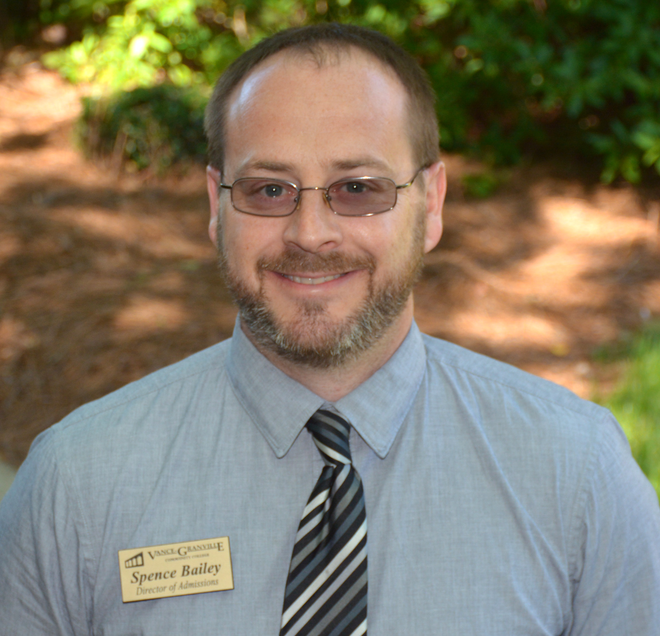
Vance-Granville Community College
Spence Bailey
Program Head/Instructor, Information Technology
Notes:
Spence Bailey
Program Head/Instructor, Information Technology
Vance-Granville Community College
200 Community College Road
P.O. Box 917, Henderson, NC 27536
baileys@vgcc.edu
(252) 738-3437

Slide 24
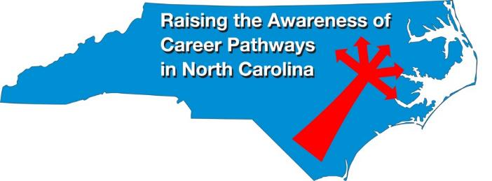
Raising the Awareness of Career Pathways Monthly Webinars
Held on the 2nd Wednesday of each month 9am-10am
2024-25 Career topic schedule coming in August.
All will be posted on www.ncperkins.org/presentations

