Slide 1
Postsecondary CTE
2019-2020 Annual Perkins Planning Meeting
April 10, 2019
Greensboro, NC
www.ncperkins.org

Slide 2
Notes:
Perkins Handbook

Slide 3
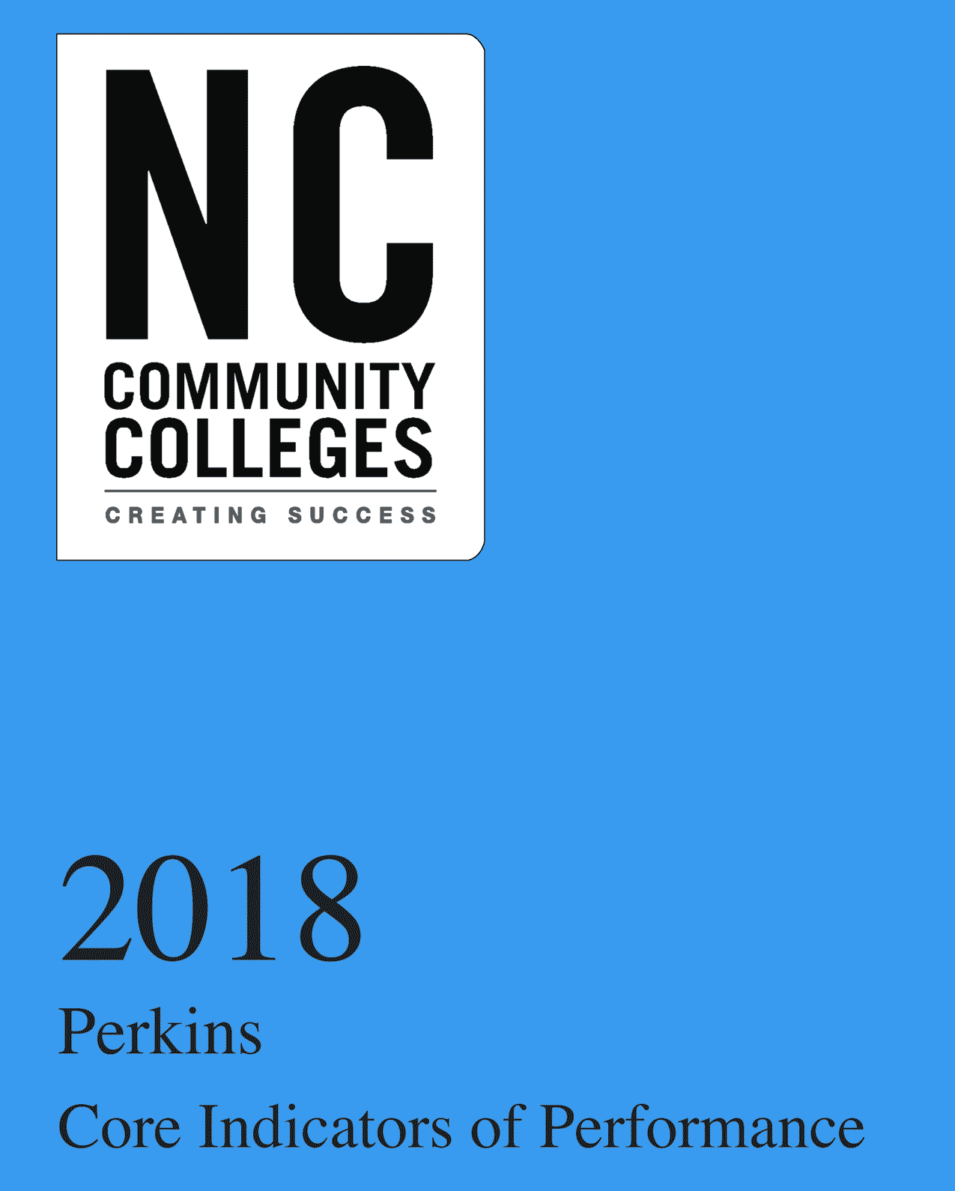
Notes:
The Perkins Data Book

Slide 4
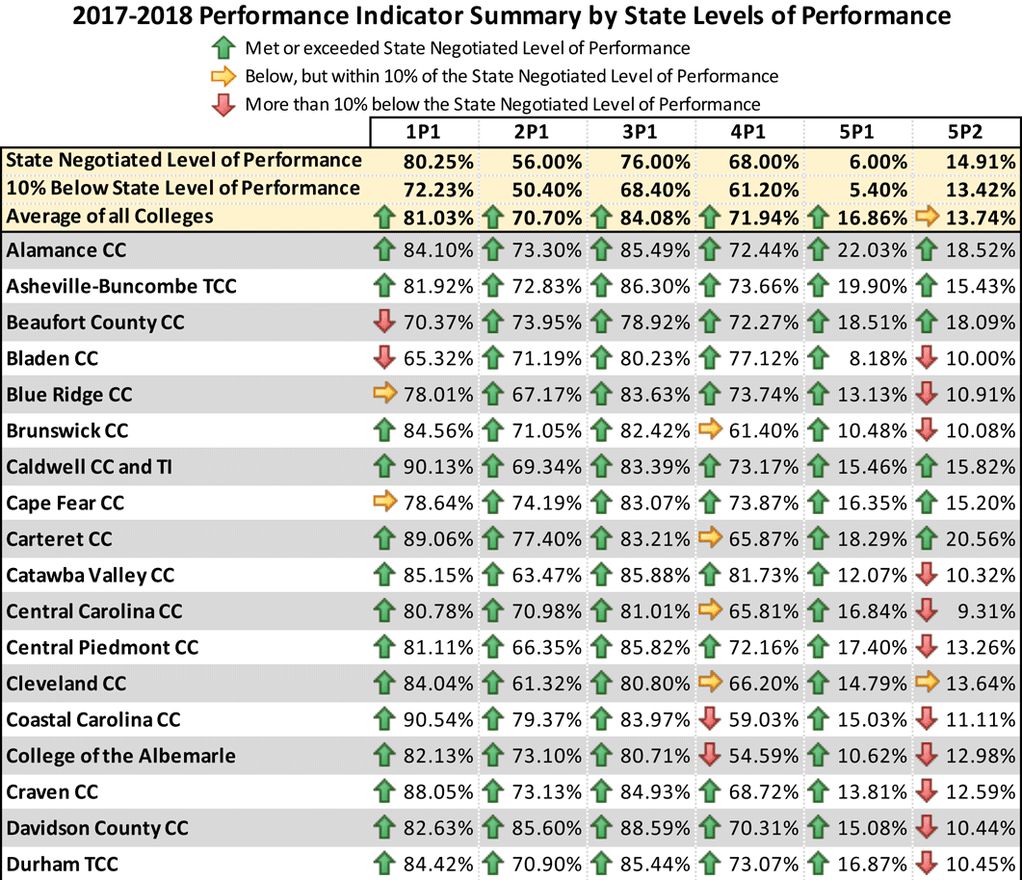
Notes:
Page 3 in the data book

Slide 5
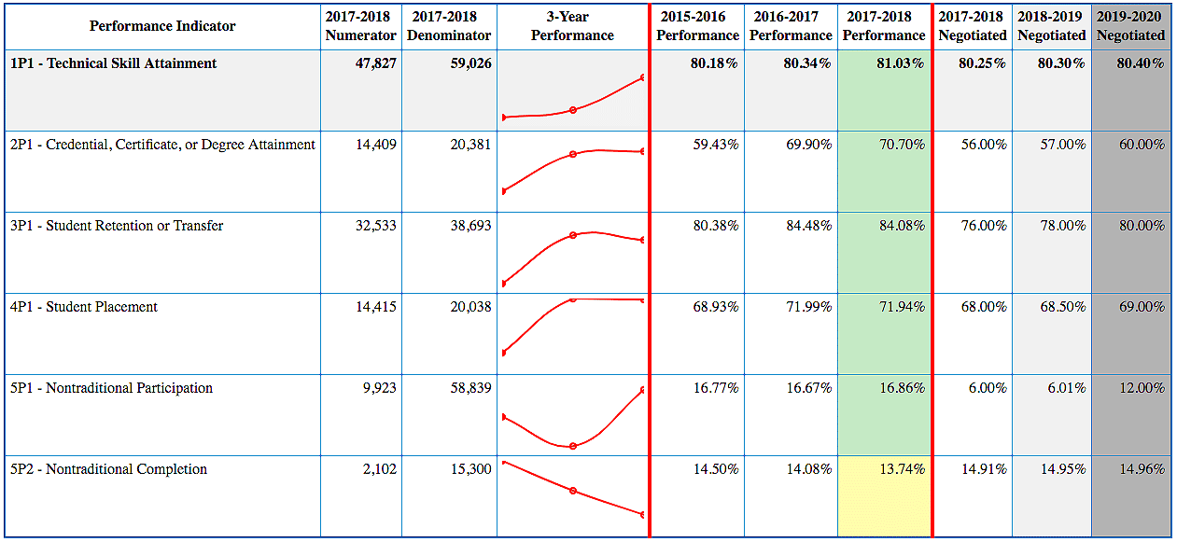
Statewide Performance 2017-2018

Slide 6
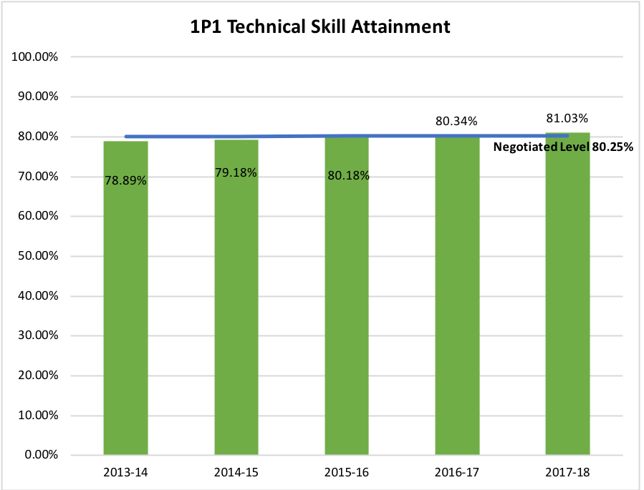
Notes:
Page 23

Slide 7
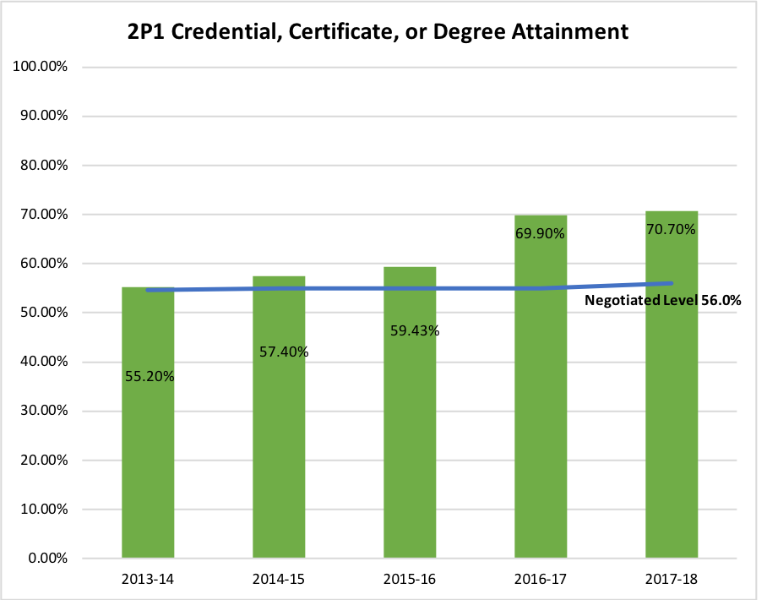
Notes:
Page 39

Slide 8
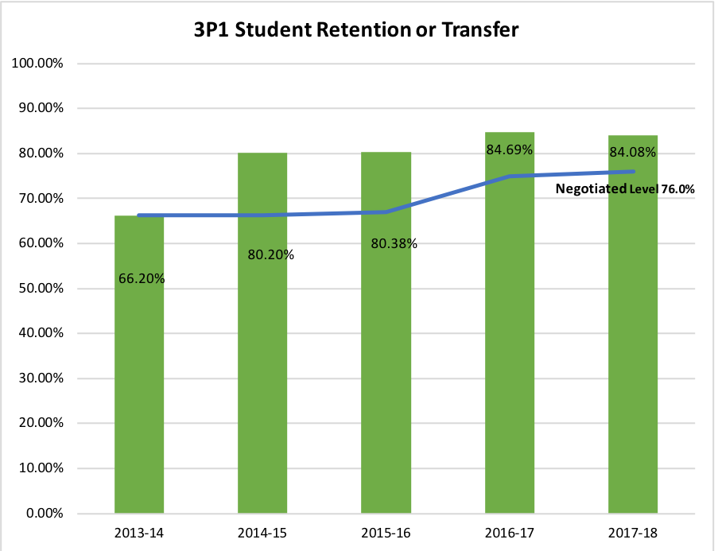
Notes:
Page 55

Slide 9
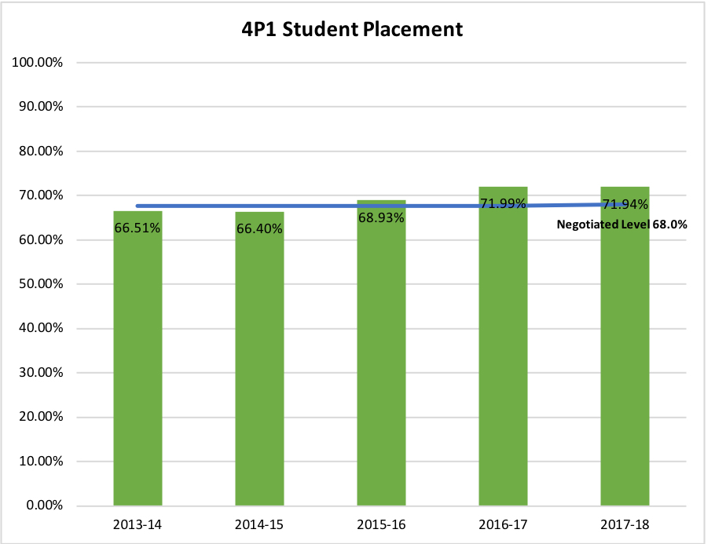
Notes:
Page 71

Slide 10
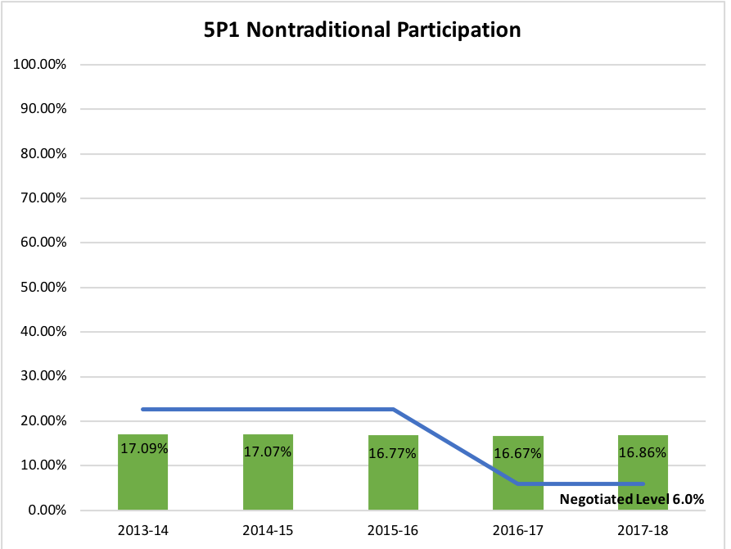
Notes:
Page 87

Slide 11
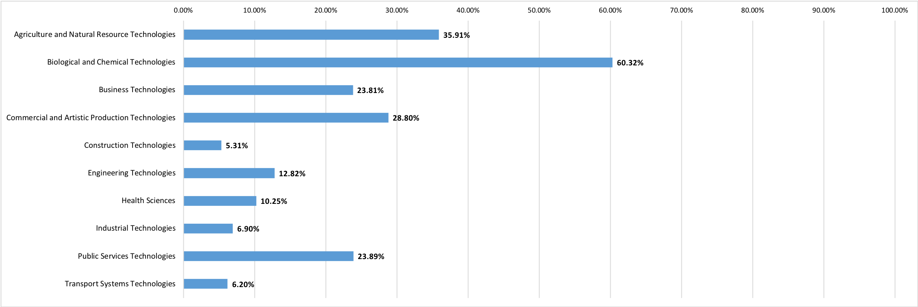
5P1 by Program

Slide 12
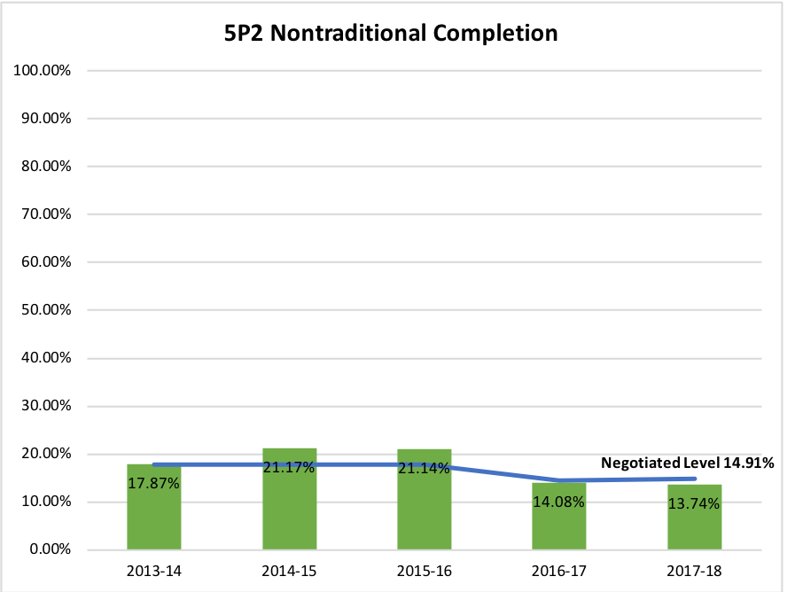
Notes:
Page 103

Slide 13
5P1 Nontraditional Participation -- by Ethnicity & Gender
6.00% State Negotiated level
30.71% Hispanic Female
29.47% African American Female
28.86% Other Female
24.93% White Female
7.88% Other Male
7.21% African-American Male
6.02% White Male
5.37% Hispanic Male
Notes:
You can see that the participation rate for females, in all ethnic classes is above the state negotiated level, yet the participation rate for all males is much lower

Slide 14
Nontraditional Programs

Slide 15
Men need to be Aware of these Nontraditional Programs
Associate Degree Nursing
Cosmetology
Dental Assisting
Dental Hygiene
Dietetic Technician
Early Childhood Education
Esthetics Technology
Health Information Technology
Health Science: Therapeutic & Diagnostic Services/Nurse Aide
Manicuring/Nail Technology
Medical Assisting
Medical Laboratory Technology
Nurse Aide
Nursing Assistant
Occupational Therapy Assistant
Opththalmic Medical Assistant
Optical Apprentice
Paralegal Technology
Pharmacy Technology
Phlebotomy
Physical Therapist Assistant
Practical Nursing
Radiation Therapy Technology
School Age Education
Speech-Language Pathology Assistant
Surgical Technology
Therapeutic & Diagnostic Services/Medical Assisting
Therapeutic & Diagnostic Services/Phlebotomy
Therapeutic Massage
Veterinary Medical Technology

Slide 16
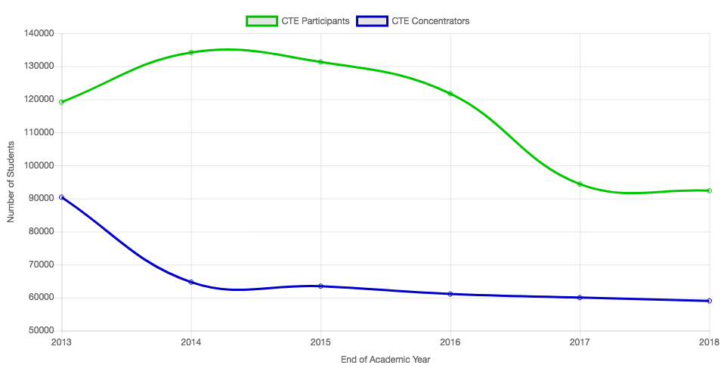
CTE Participants vs Concentrators

Slide 17
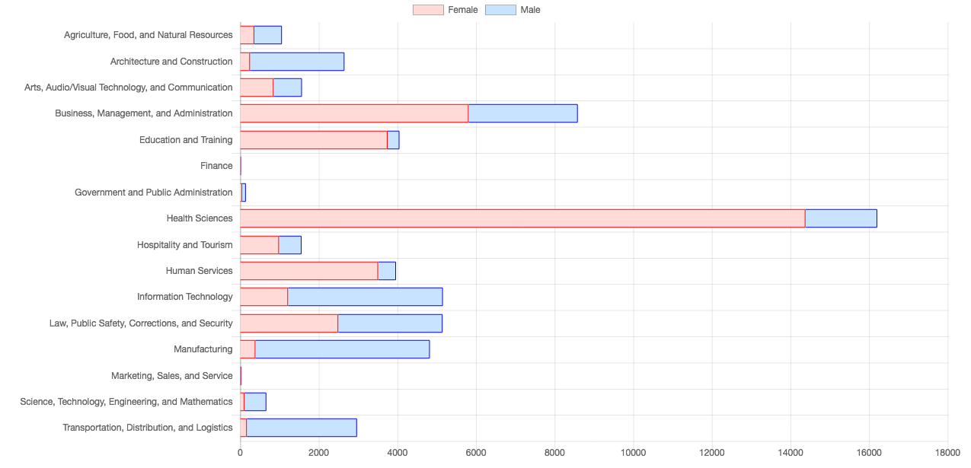
CTE Concentrators 2017-2018 by 16 Career Clusters

Slide 18
Notes:
The Perkins Data Book

Slide 20
Perkins/CTE State Staff
Dr. Bob Witchger Director, Career & Technical Education WitchgerB@nccommunitycolleges.edu 919-807-7126
Dr. Tony R. Reggi Coordinator, Career & Technical Education ReggiA@nccommunitycolleges.edu 919-807-7131
Patti Coultas Coordinator, Career & Technical Education CoultasP@nccommunitycolleges.edu 919-807-7130
Chris Droessler Coordinator, Career & Technical Education DroesslerC@nccommunitycolleges.edu 919-807-7068
Darice McDougald CTE Administrative Assistant McDougaldD@nccommunitycolleges.edu 919-807-7219
Notes:
http://www.ncperkins.org/course/view.php?id=6

