Slide 1
Healthcare Career Pathways at GTCC
A Story of Partnership

Slide 2
Basic Skills Plus Program
Basic Skills Plus offers transitions and career pathway support to students preparing for entry into employment and postsecondary education programs.
Students performing at the adult secondary education level and who are co-enrolled in occupational and adult education courses while earning their adult high school diploma or a recognized high school equivalency credential are eligible for Basic Skills Plus.
The key advantage for eligible students is that tuition course registration fees for continuing education courses may be waived by approved pathways

Slide 3
Current Career Pathways at GTCC 2015-2016
Global Logistics
Aviation
Future Programs
Nurse Assistant Training Program

Slide 4
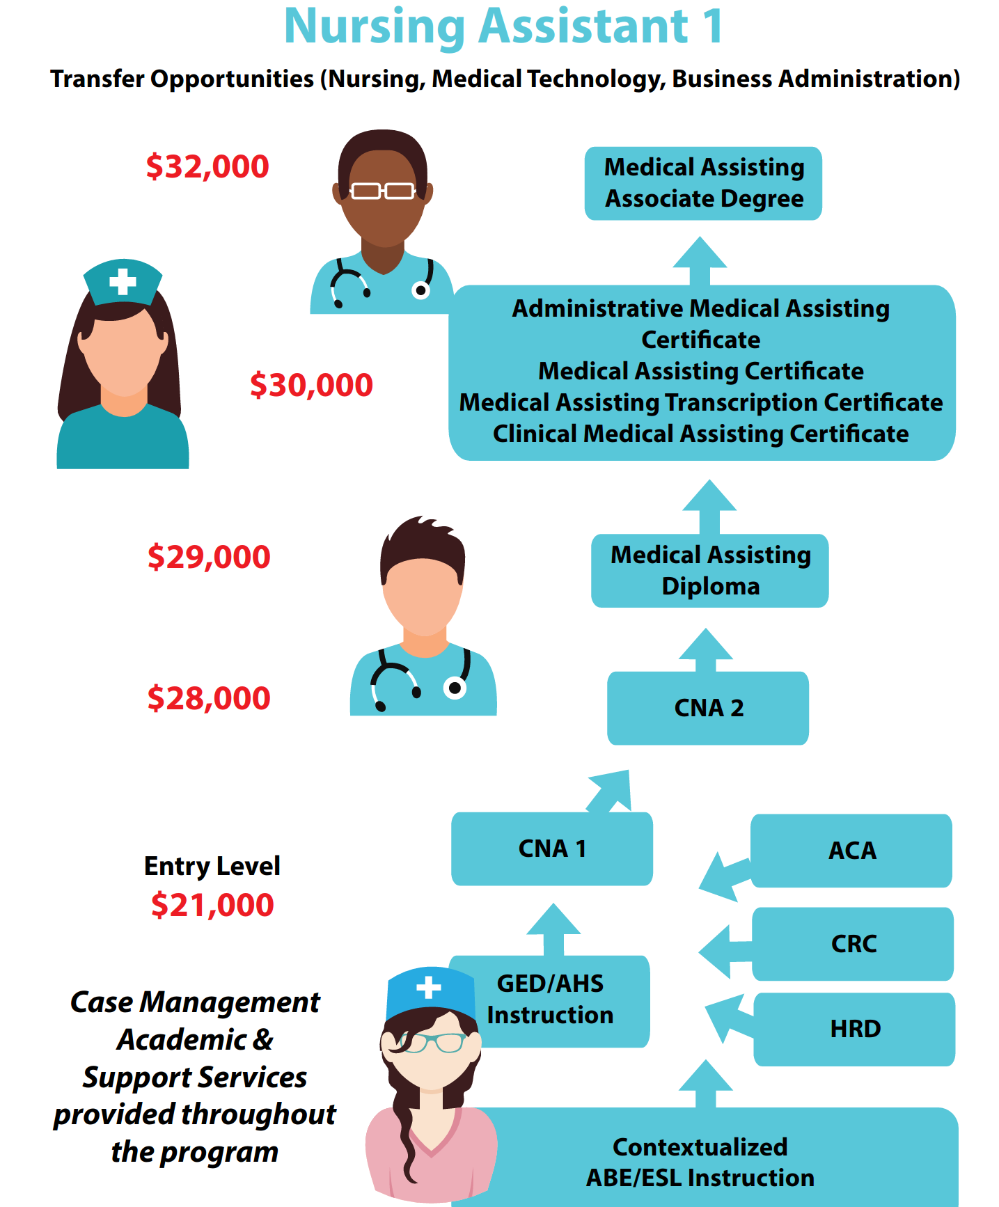
Nursing Assistant Career Pathway

Slide 5
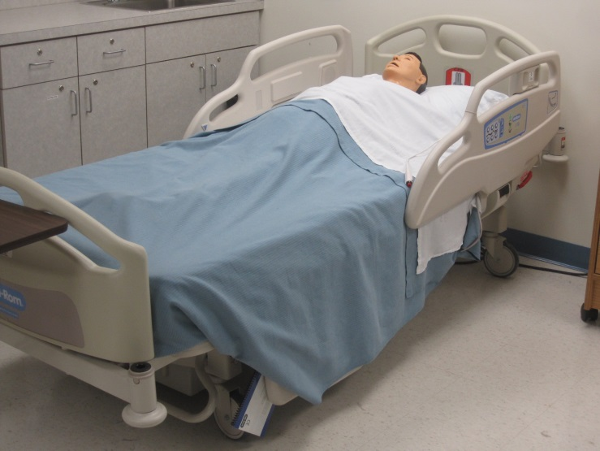
LOCATED ON 3 CAMPUSES

Slide 6
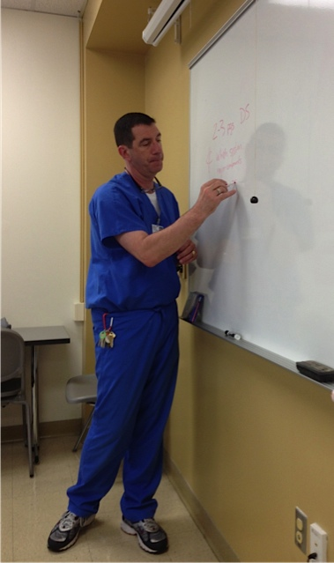
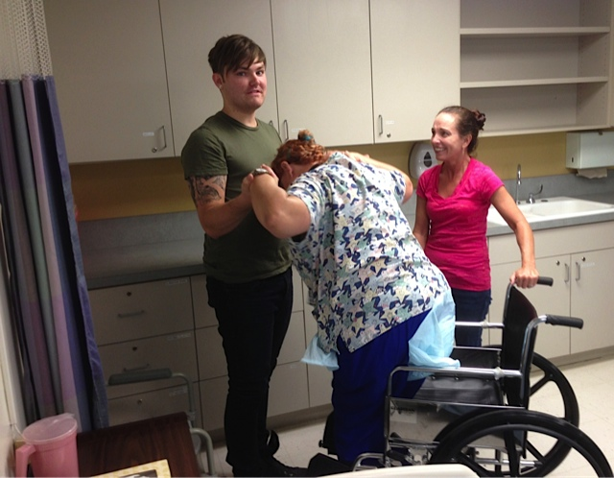
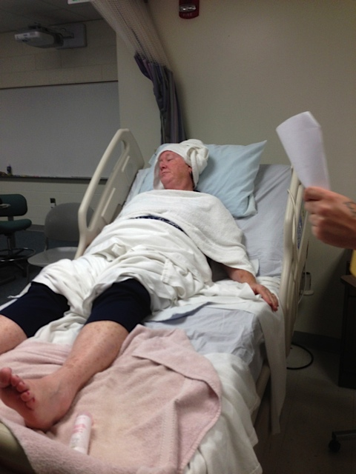
Instructors
CREDENTIALS
65% BSN and/or MSN
Combined 520 years RN experience
2 Full-time Faculty and 44 Part-time Adjunct Faculty
Theory ratio is 1:20 students
Lab/Clinical ratio 1:10

Slide 7
CONTENT COVERED IN THEORY
PYSCHOLOGICAL EFFECTS OF AGING
END OF LIFE
BODY SYSTEMS
MENTAL HEALTH AND ILLNESS
RESTRAINT ELIMINATION
DEMENTIA AND ALZHEIMER’S DISEASE
RESIDENT ENVIRONMENT AND SAFETY
COMMUNICATION
FAMILY AND FAMILY SUPPORT
PERSON CENTERED CARE
RESTORATIVE CARE
COGNITIVE CHANGES DUE TO AGING
PAIN
BODY MECHANICS
NUTRITION
CRITICAL THINKING
NURSING PROCESS AND CARE PLAN
DIGINITY
LAWS AND ETHICS
INFECTION PREVENTION

Slide 8
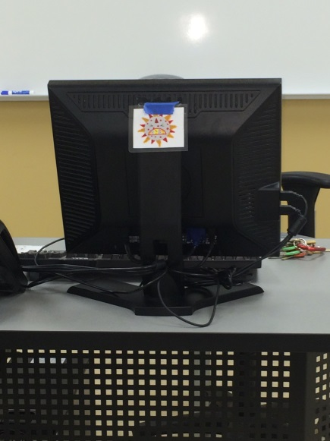
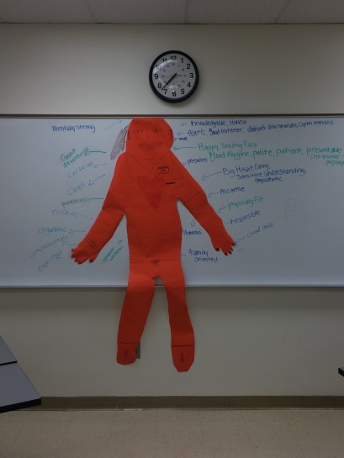
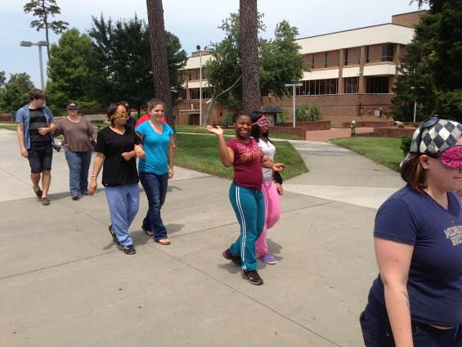
ACTIVE LEARNING

Slide 9
PROGRAM STATISTICS
98%
PASSED STATE WRITTEN EXAM
(STATE AVERAGE 92%)
543
GRADUATES in 2015
80%
PASSED STATE
SKILLS TEST
(STATE AVERAGE 72%)
80%
PLAN TO ADVANCE TO OTHER HEALTHCARE CAREERS.
(Nursing, Rad.Tech, PT Assistant, etc.)

Slide 14
YOUNG ADULT CAREER PATHWAYING

Slide 15
ASSESMENT AND CAREER EXPLORATION
Structured assessments to ensure that customers are academically capable to participate in structured training environments and are ready for work:
Test for Adult Basic Education (TABE)
Career Readiness Certification
Customers and Talent Development Consultants collaboratively explore career opportunities and suitability within the field:
ONET Interest Profiler
Holland Code
Career Exploration Tool – “Woofound”

Slide 16
PLANNING TO BRIDGE THE GAP
Individualized employment Plans:
Plans include short and long term training and employment goals
Inclusion of immediate training needs
Connecting needs to stackable credentials
Job placement assistance
Service provision
Wrap-around service approach
Financial assistance is a major barrier
Books, uniforms, equipment, vaccinations, transportation, childcare…..
Ongoing Career Guidance
Additional funding for locally recognized trainings within industry
Job Placement Assistance
Designated Employment Consultants and use of work-based learning programs to assist with entry into field

Slide 17
MAKING IT WORK: MEET R.T.
Barriers Presented
Homelessness
Unemployed with Limited Transportation
Financially unable to fund training
Services Provided
Training and Support Service Assistance
Transportation Assistance
Job Placement and Housing Referral
Stacking Credentials
Adult Companion Certificate (Oct ‘15)
Certified Nursing Assistant Certification (Dec ‘15)
Medication Administration Aide Certification (Feb ‘16)
In process of applying for LPN Program (Aug ’16)
Outcomes to date:
Obtained Housing (Jan ’16)
Working in Industry as CNA!

Slide 18
QUESTIONS?
Martha Bergman
Dean, Adult Education
GTCC
mabergman@gtcc.edu
Chris Rivera
Project Director
NCWorks
christopher.rivera@rescare.com
Warren Crow
Dir. Health Careers
GTCC
rwcrow@gtcc.edu

