Slide 1
Professional Development & Technical Assistance
September 13, 2016

Slide 2
NC-NET Resources
North Carolina Network for Excellence in Teaching
http://www.nc-net.info/
Important Resources
NC-NET Academies
NC-NET Practicums
Adjunct Faculty Toolkit
Career Pathways Course
Employability Skills Toolkit
College Contacts

Slide 3
NC-NET Academies
Six-week facilitator-led online courses
Courses are free
CTE faculty receive a stipend for completing the course
Small colleges have registration priority
Topics offered in 2016-17
From Good Teaching To Student Learning: An Adjunct Faculty Primer
Technology Bootcamp I: Incorporating The Latest Tools For Effective Instruction
Incorporating Active Learning Strategies In The College Classroom
Technology Bootcamp II: More Tools For Reaching Students
Technology Bootcamp III: Reaching Students With Video

Slide 4
NC-NET Practicum
Collaborative Curriculum Development for Creating Integrated Instruction
An intensive facilitated online practicum on integrated curriculum development
Course Dates: March 10 – April 24, 2017; Final projects due May 1
Practicum Objectives
Interdisciplinary teams will create classroom ready projects that:
Integrate career and technical content and academic concepts—reinforcing both
Use real-world scenarios to engage students and make content relevant
Foster critical thinking, collaboration, and other skills valued by employers
Encourage instructors to use active, authentic assessment techniques
Faculty Nomination and Selection
NC-NET campus liaisons and other college leaders are eligible to nominate faculty members for the practicum using the online nomination form. Nominees will be reviewed and up to 30 faculty members will be selected. As with other Academy courses, tuition is free. Practicum completers will receive a $250 stipend. Nominations will open in late October. Faculty members from mathematics, science, and career-technical (CTE) disciplines will be eligible for nomination.

Slide 5
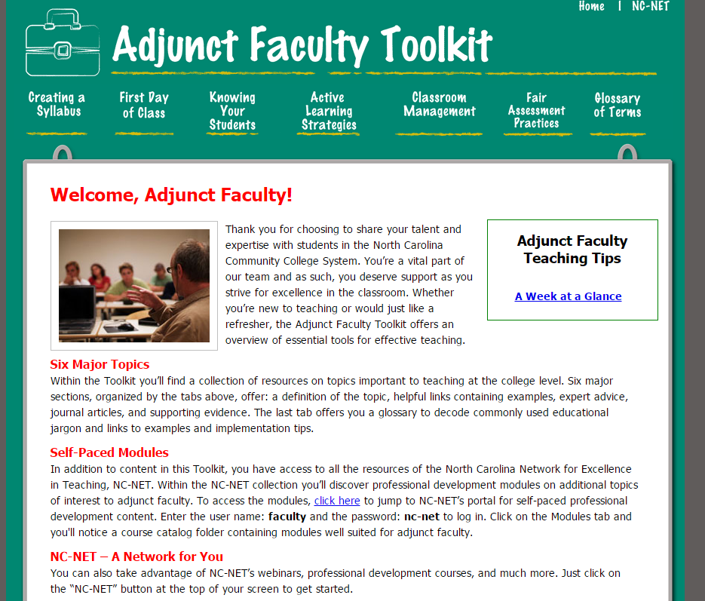
Adjunct Faculty Toolkit
Self-paced, free resource for adjuncts
Great for adjuncts who are new to the NCCCS
Great for adjuncts new to teaching

Slide 6
Career Pathways Course
Great resource for those beginning pathway work!

Slide 7
Employability Skills Toolkit
Lesson plans and resources for:
Interpersonal skills & teamwork
Communication
Integrity & professionalism
Problem solving & decision making
Initiative & dependability
Information processing
Adaptability & lifelong learning
Entrepreneurship

Slide 8
NC-NET College Liaisons
The person designated as the campus liaison will receive communications related to NC-NET professional development
Please take a look at the list of liaisons and verify that the correct person is listed. If you need to appoint a new liaison for your campus, please let me know.
http://www.nc-net.info/liaisons.php

Slide 9
We Would Like Your Feedback!
What type of professional development or technical assistance opportunities would benefit your faculty and students?
Please complete the survey found in the Perkins Online Data System
http://www.ncperkins.org/mod/feedback/view.php?id=372

