Slide 1
A Great time to Rediscover YOUR HOW
Solomon McAuley, Centralina NextGen Specialist
Thursday, October 8, 2020

Slide 2
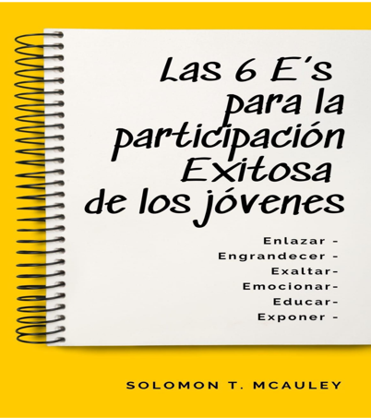
Who Am I?
A BELIEVER
A BROTHER
A FATHER
A FRIEND
A MENTOR
A MOTIVATOR
A SON
A TEACHER
THE AUTHOR OF:
THE 6 E’S TO SUCCESSFUL YOUTH ENGAGEMENT (English and Spanish)
SOLOMONMCAULEY.COM

Slide 3
Today we will discuss
How to become “UNSTUCK”
R.O.A.D Method (Rip off and duplicate)
Do the neighbors know YOUR name?

Slide 4
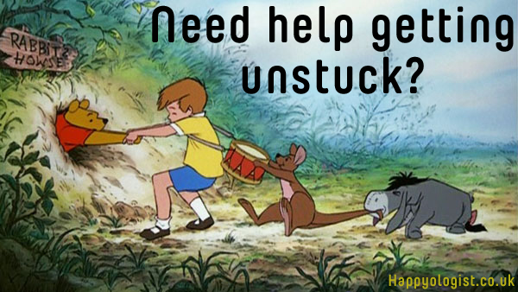
How to become UNSTUCK
The work we do with WIOA at times can get so routine that we must force ourselves to think outside the box. That could be talking to others throughout the state that is doing the same work or even finding new ways to provide the same or better services.
Revisit the work you have done for the last 3 to 6 months. Revisit how you explain WIOA services, practice with coworkers on your delivery, Revisit case files, and ask yourself did you do all you could do to provide services to your customers?
We must remember with WIOA we must change our mindset from thinking EVERYONE should be served the same EXACT way for the same EXACT length of time.

Slide 5
How to become UNSTUCK
Stop assuming EVERYONE you enroll is on the same level
Stop assuming EVERYONE you enroll with embrace what you are serving and how you are serving it
-A big misconception (especially with youth & young adults) is that people will not speak up for themselves when they feel you are wasting their time
Stop assuming EVERYONE you enroll have the same barriers
-You know how we do; we have gotten so good with enrollments we check the boxes we assume fit our customers never allowing ourselves to discover who they really are

Slide 6
R.O.A.D Method (Rip off and duplicate)
If there are similarities, it's simply because the same thoughts that occurred to other people also occurred to me. (Brad Bird)
WHY reinvent the wheel?
-it is to duplicate a basic method that has already previously been created or optimized by others.

Slide 7
R.O.A.D Method (Rip off and duplicate)
YOU are NOT the first one to operate a Federal Funded service
YOU are NOT the first one to lead a WIOA funded service
WE are NOT the first state to have to figure out how to adapt to WIOA services
WE are not the only ones having to redefine HOW we do the work

Slide 8
R.O.A.D Method (Rip off and duplicate)
Find a state that is doing it well, seek their advice, and see what you can use from them and MAKE IT YOUR OWN
-At times you need someone that knows what you are doing that can provide a different perspective than the one you and or your team has

Slide 9
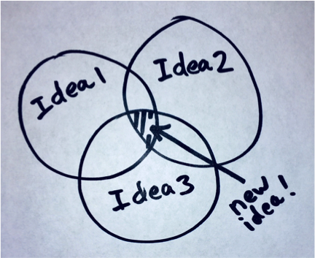
R.O.A.D Method (Rip off and duplicate)
At times you can start with your ideas, get another perspective and a new idea is created!

Slide 10
Do the neighbors know YOUR NAME?
We should be in the business of sharing what we do with anyone who will listen OUTSIDE of our professional circle
We have little to no issues telling each other what we are doing well, we create monthly and annual reports to outline what we have done well, while our neighbors have NO CLUE as to what we do.

Slide 11
Do the neighbors know YOUR NAME?
They may see a sign up that reads NCWORKS Career Center and will still tell someone they do not know what goes on in there, but it use to be the UNEMPLOYMENT OFFICE
It is almost like being on the campaign trail you got to be willing to invest in marketing, local newspapers (front covers), local social media platforms etc.

Slide 12
Do the neighbors know YOUR NAME?
They may not know YOUR NAME, but do they know what YOU offer?
We base a lot of what we do on word of mouth, so let me ask you a question; if people are not coming to inquire about services are they not hearing what you are doing or is it that what you are doing is not as effective as you thought it was?
-We cannot speak to how a potential customer or current customer view our services UNLESS we ask them.

Slide 13
Do the neighbors know YOUR NAME?
Social Media is just ONE way to advertise our services, but we must also know there are some people that still look forward to reading a good newspaper or receiving a brochure in the mail.

Slide 14
A few things Centralina’s doing :
Assuring that follow-up is being done often
Attending virtual events and sharing information with community partners
Increasing our Social Media presence
NextGen also host info sessions virtually which allows anyone who is interested in services to learn more about it and also get an interest form to complete
Continuing to discuss news ways of getting the word out about services

Slide 16
Contact Information
Solomon McAuley, Centralina NextGen Specialist
smcauley@centralina.org
(704) 345-2725
Centralinaworks.com

