Slide 1
Aunt Bertha – The Social Care Network
Download the PowerPoint and access the recording: www.ncperkins.org/presentations
Notes:
Chris
We are here to help promote employment and training in the great state of North Carolina.
Through these monthly workshops, we are going to ….
And bring in special guests to let you know about …
Please download this PowerPoint file and use it anyway you can to help get folks on a career pathway.
The reference showing from where the information was found, as well as the contact information for our guests is in the Notes section under each slide.
Get the PowerPoint on our NCPerkins.org website on our Presentations and Webinars page.
Here is the direct address on the screen.

Slide 2
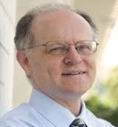
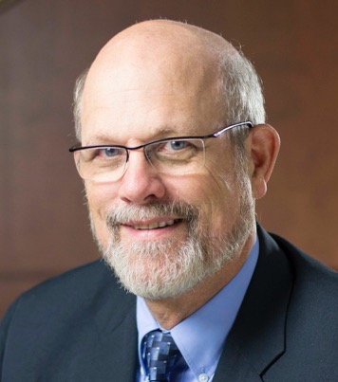
Chris Droessler Career and Technical Education
Dr. Bob Witchger Career and Technical Education Director
Notes:
Your hosts for today’s workshop:
Robert J. Witchger Ed.D.
Director Career and Technical Education
North Carolina Community College System
200 W. Jones Street
(919) 807-7126
witchgerb@nccommunitycolleges.edu
Chris Droessler
Career and Technical Education Coordinator
North Carolina Community College System
DroesslerC@nccommunitycolleges.edu

Slide 3
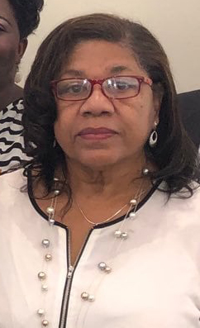
NC Employment and Training Association (NCETA)
Malinda Marsh
NCETA President (www.nceta.org)
NCWorks Career Center, Chatham County
NCperkins.org/presentations
Notes:
This is an NCETA workshop.
This workshop is sponsored by NCETA
Malinda Marsh, president of NCETA, will explain.
======
Malinda Marsh
NCETA President
malinda.amarsh@gmail.com

Slide 4
NCETA Conference 2021
September 8-10, 2021
Hotel Ballast in Wilmington
www.nceta.org
Notes:
We moved our Spring conference to the Fall .
We will be back in Wilmington on September 8, 2021.
=====
nceta.org

Slide 5
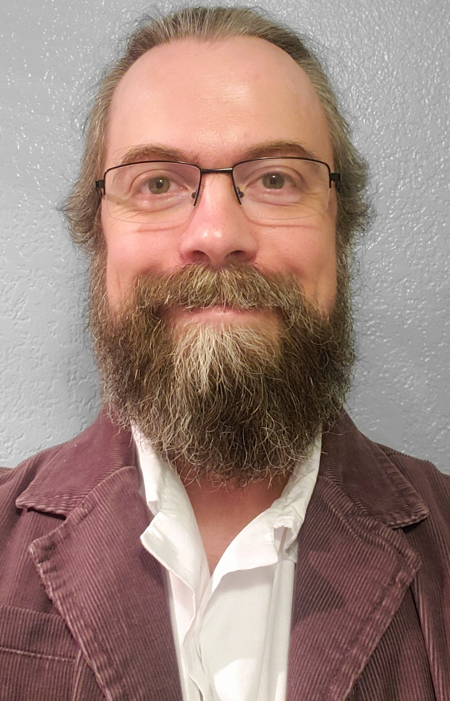
Chris Douglas
Customer Success Manager
Aunt Bertha – The Social Care Network
Notes:
Chris Douglas (he/his)
Customer Success Manager
Meeting Scheduler: https://app.hubspot.com/meetings/cdouglas Chris Douglas <cdouglas@auntbertha.com>
512-717-3023
cdouglas@auntbertha.com
Aunt Bertha | The Social Care Network
https://www.findhelp.org/

Slide 6
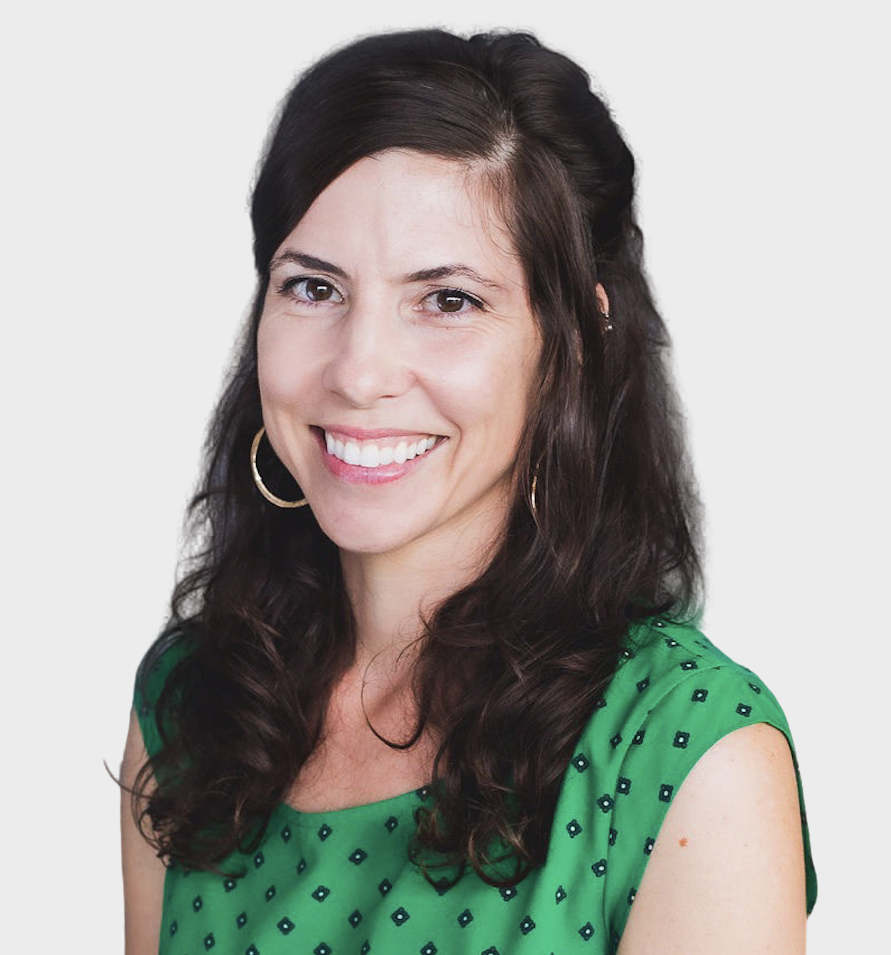
Elaine Cray
Community Engagement Manager
Aunt Bertha – The Social Care Network
Notes:
Elaine Cray
Community Engagement Manager
919.749.5394
ecray@auntbertha.com
Schedule a call with me
Aunt Bertha | The Social Care Network
https://www.findhelp.org/

Slide 7
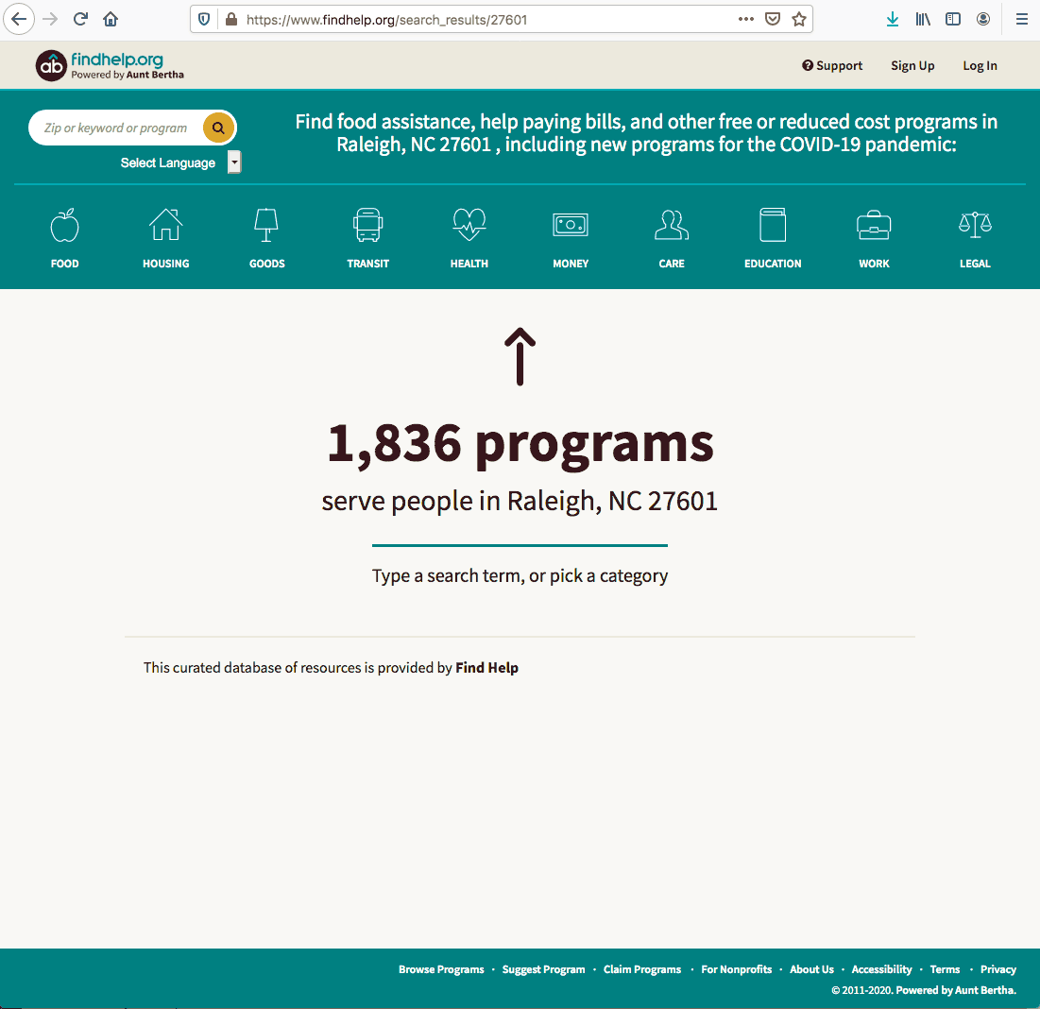
Notes:
https://www.findhelp.org/search_results/27601
=======
Chris Douglas (he/his)
Customer Success Manager
Meeting Scheduler: https://app.hubspot.com/meetings/cdouglas Chris Douglas <cdouglas@auntbertha.com>
512-717-3023
cdouglas@auntbertha.com
Aunt Bertha | The Social Care Network
https://www.findhelp.org/

Slide 8
NC Community College Resource Finder
Notes:
The NC Community College Resource Finder: https://nccommunitycolleges.auntbertha.com/
======
Chris Douglas (he/his)
Customer Success Manager
Meeting Scheduler: https://app.hubspot.com/meetings/cdouglas Chris Douglas <cdouglas@auntbertha.com>
512-717-3023
cdouglas@auntbertha.com
Aunt Bertha | The Social Care Network
https://www.findhelp.org/

Slide 9
NC Community College Resource Finder
Notes:
The NC Community College Resource Finder: https://nccommunitycolleges.auntbertha.com/
======
Chris Douglas (he/his)
Customer Success Manager
Meeting Scheduler: https://app.hubspot.com/meetings/cdouglas Chris Douglas <cdouglas@auntbertha.com>
512-717-3023
cdouglas@auntbertha.com
Aunt Bertha | The Social Care Network
https://www.findhelp.org/

Slide 10
FTCC Search Box
Notes:
An example of how colleges share the link with students as a "search box" (search boxes can be on any page): https://www.faytechcc.edu/campus-life/
======
Chris Douglas (he/his)
Customer Success Manager
Meeting Scheduler: https://app.hubspot.com/meetings/cdouglas Chris Douglas <cdouglas@auntbertha.com>
512-717-3023
cdouglas@auntbertha.com
Aunt Bertha | The Social Care Network
https://www.findhelp.org/

Slide 11
Example College Program
Notes:
Example of a college program listed (Food Pantry from Wilkes): https://www.findhelp.org/wilkes-community-college--wilkesboro-nc--prowler-pantry/4863499158421504?ref=ab_redirect
=====
Chris Douglas (he/his)
Customer Success Manager
Meeting Scheduler: https://app.hubspot.com/meetings/cdouglas Chris Douglas <cdouglas@auntbertha.com>
512-717-3023
cdouglas@auntbertha.com
Aunt Bertha | The Social Care Network
https://www.findhelp.org/

Slide 12
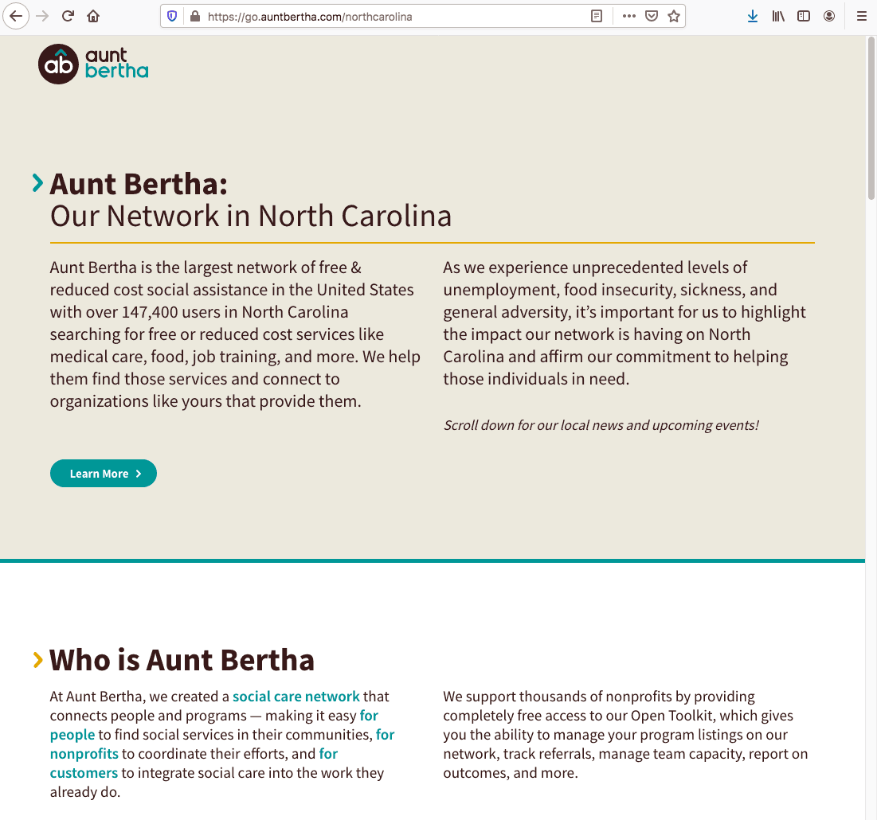
Aunt Bertha – NC Page
Notes:
Our North Carolina page with all upcoming events in NC, community partners, etc.: https://go.auntbertha.com/northcarolina
=====
Chris Douglas (he/his)
Customer Success Manager
Meeting Scheduler: https://app.hubspot.com/meetings/cdouglas Chris Douglas <cdouglas@auntbertha.com>
512-717-3023
cdouglas@auntbertha.com
Aunt Bertha | The Social Care Network
https://www.findhelp.org/

Slide 13
Download the PowerPoint and access the recording: www.ncperkins.org/presentations
Notes:
Please download this PowerPoint file and use it anyway you can to help get folks on a career pathway.
The reference showing from where the information was found, as well as the contact information for our guests is in the Notes section under each slide.
Get the PowerPoint on our NCPerkins.org website on our Presentations and Webinars page.
Here is the direct address on the screen.

Slide 14
The Next NCETA Workshop
December 4, 2020 @ 9 am
Total Package Re-Entry Program
When individuals are released from prison or jail, it's a brand new world for most of them. How do we effectively serve this unique population as they strive to reconnect?
www.ncperkins.org/presentations
Notes:
The next workshop

