Slide 1
Catawba and Alexander Advanced Manufacturing Pathways Project

Slide 2
Starting the Process
Secondary and Postsecondary CTE Career Pathways joined efforts with the Department of Commerce in order to address regional economic and workforce needs while incorporating various educational and workforce strategies to streamline the pipeline to work.
*NCWorks Career Pathway Update

Slide 3
Advanced Manufacturing Pathway Partners
Aptar Alexander County Schools
Continental Catawba County Schools
GKN Driveline Hickory Public Schools
Technibilt Newton-Conover City Schools
Tenowo Western Piedmont Workforce
Sarstedt Development Board
ZF Chassis Catawba Valley Community
College

Slide 4
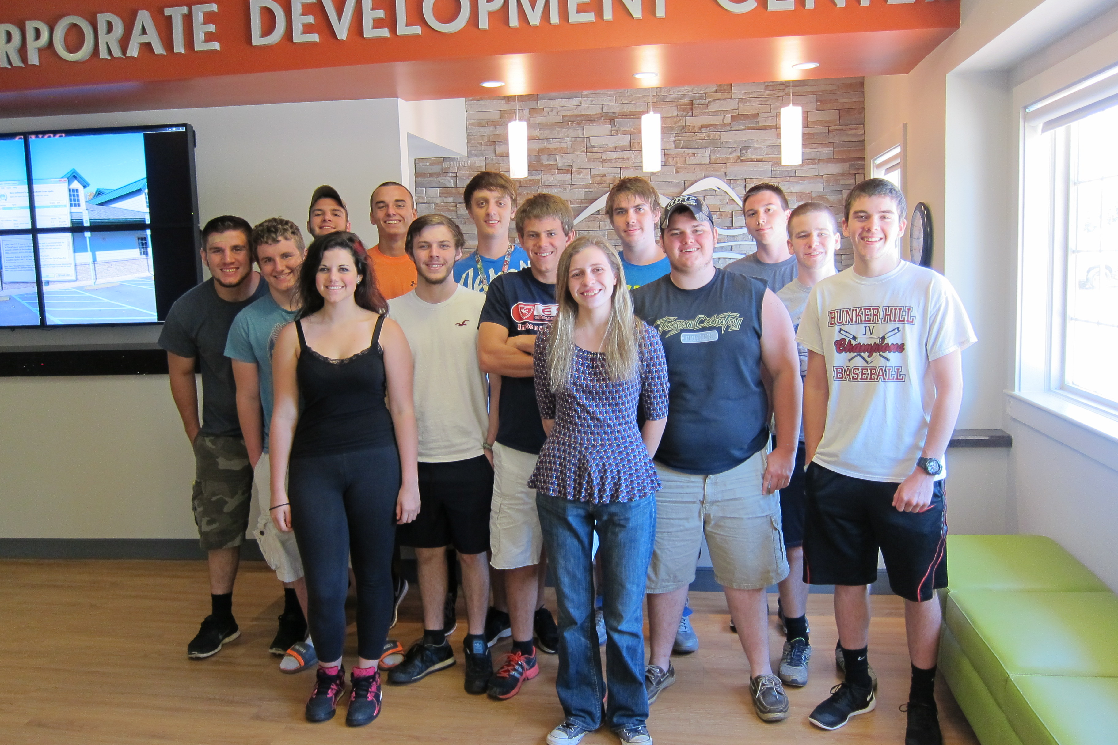
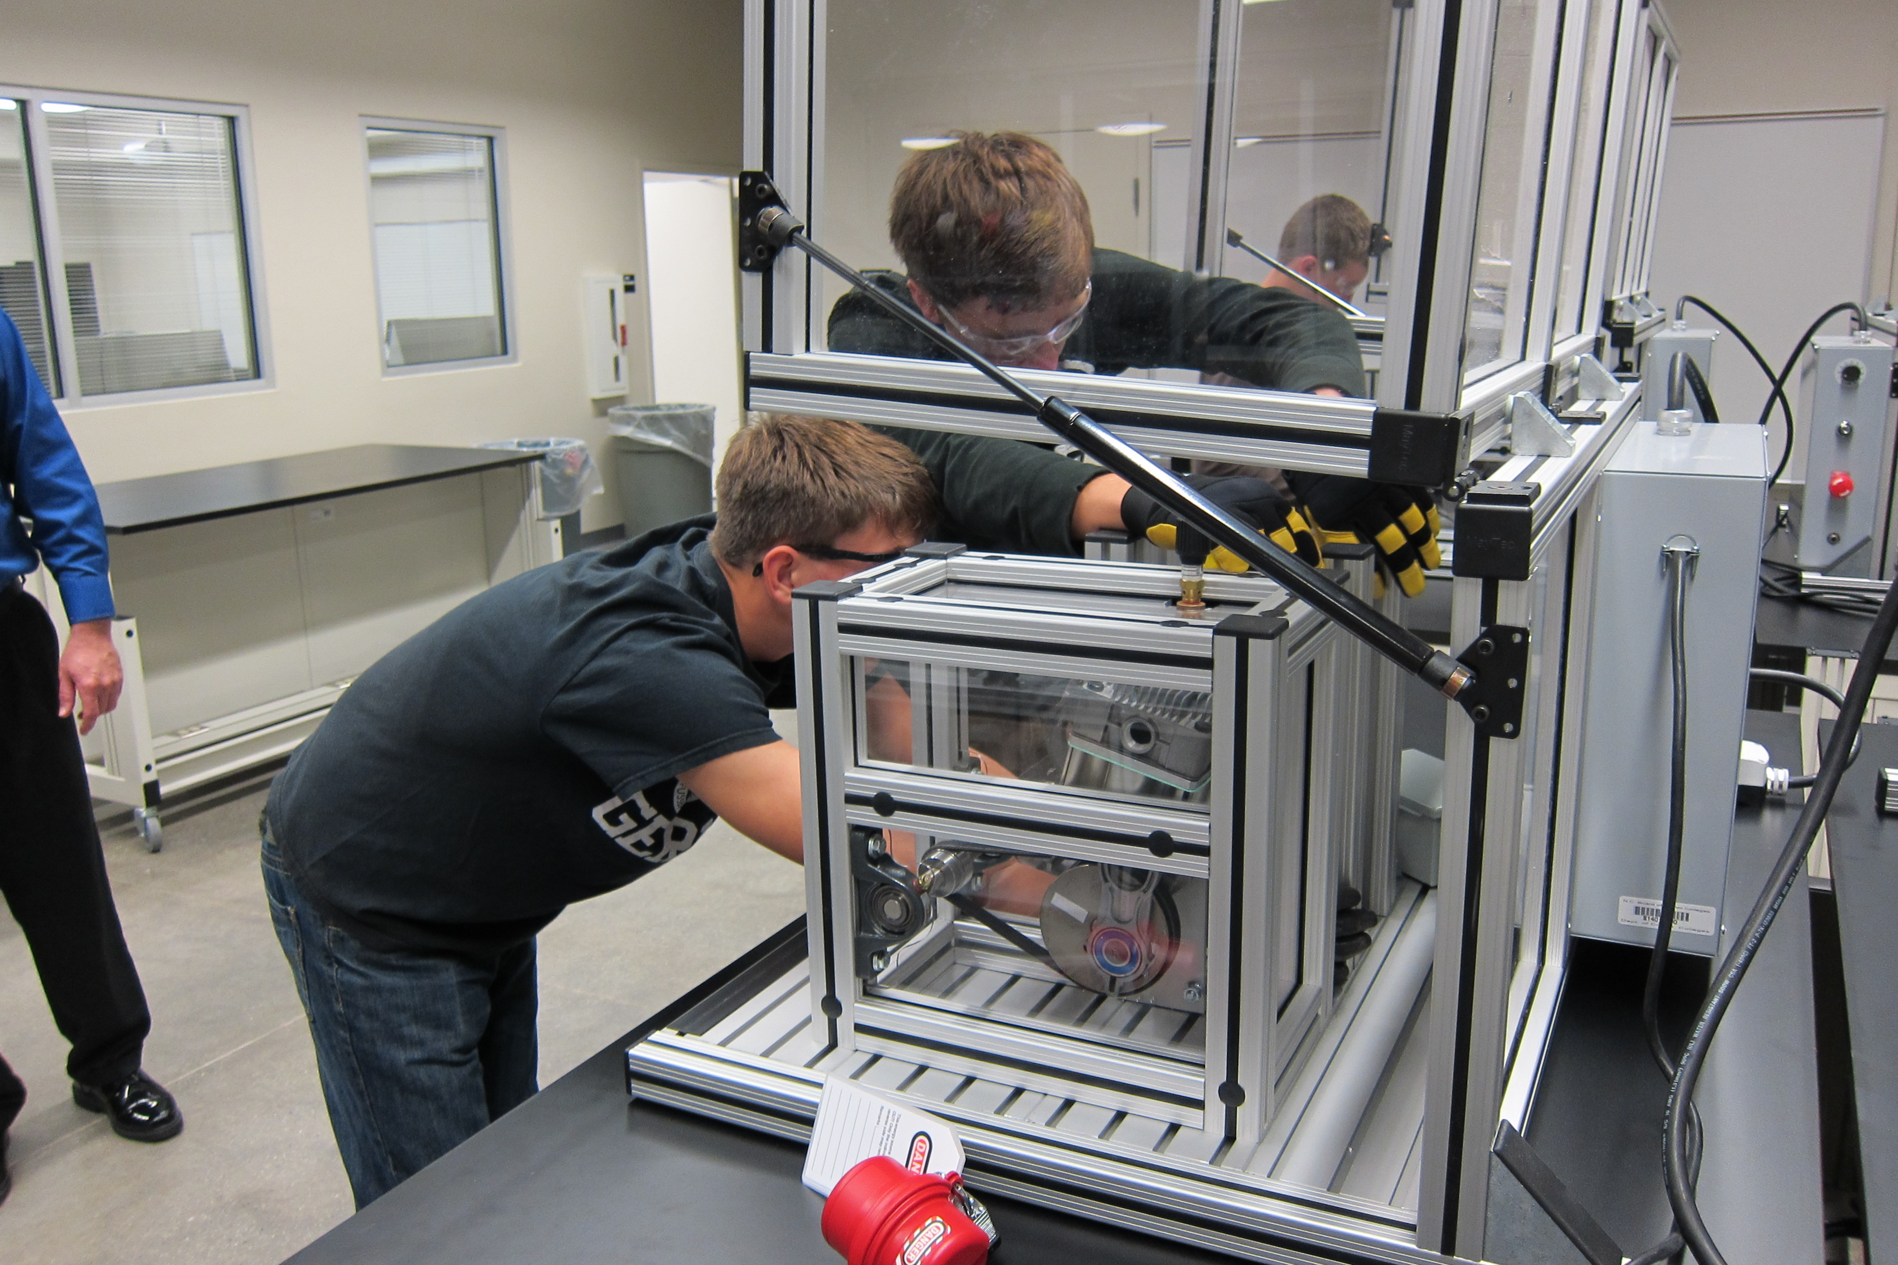
The Mechatronics Pathway includes entry and exit points in high school, continuing education, and curriculum. Industry recognized credentials are available for continuing education and curriculum.

Slide 5
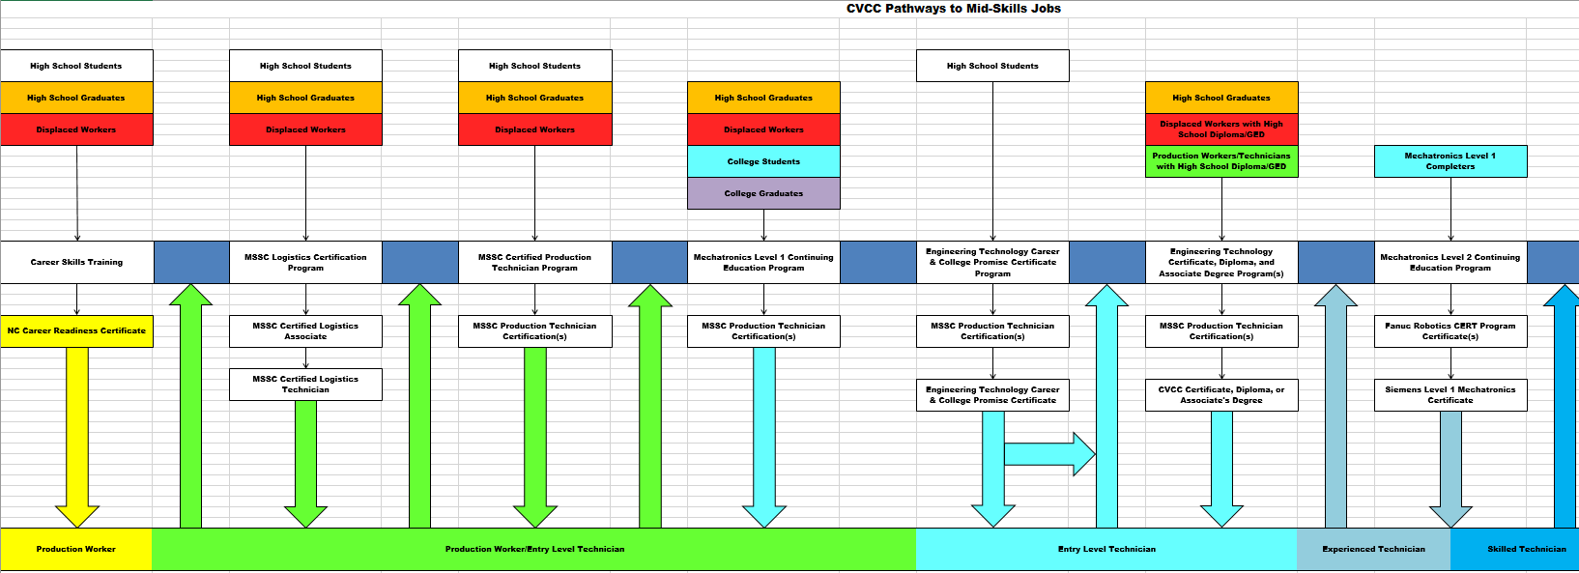
CVCC Pathways to
Mid-Skills Jobs

Slide 6
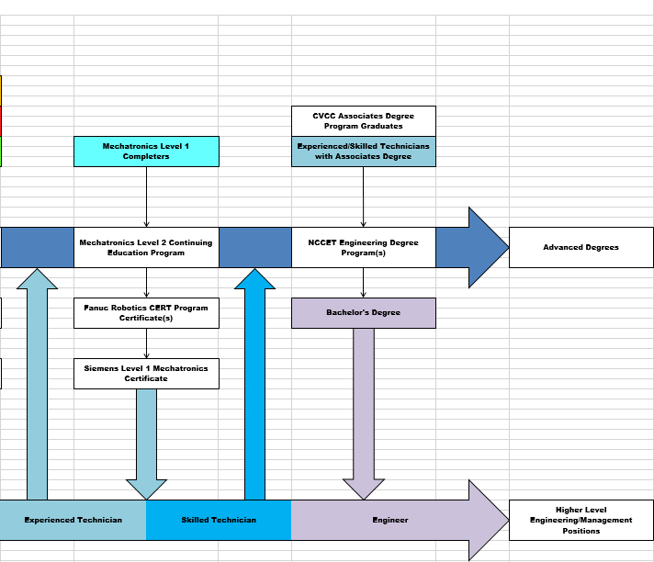
CVCC Pathways to
Mid-Skills Jobs

Slide 7
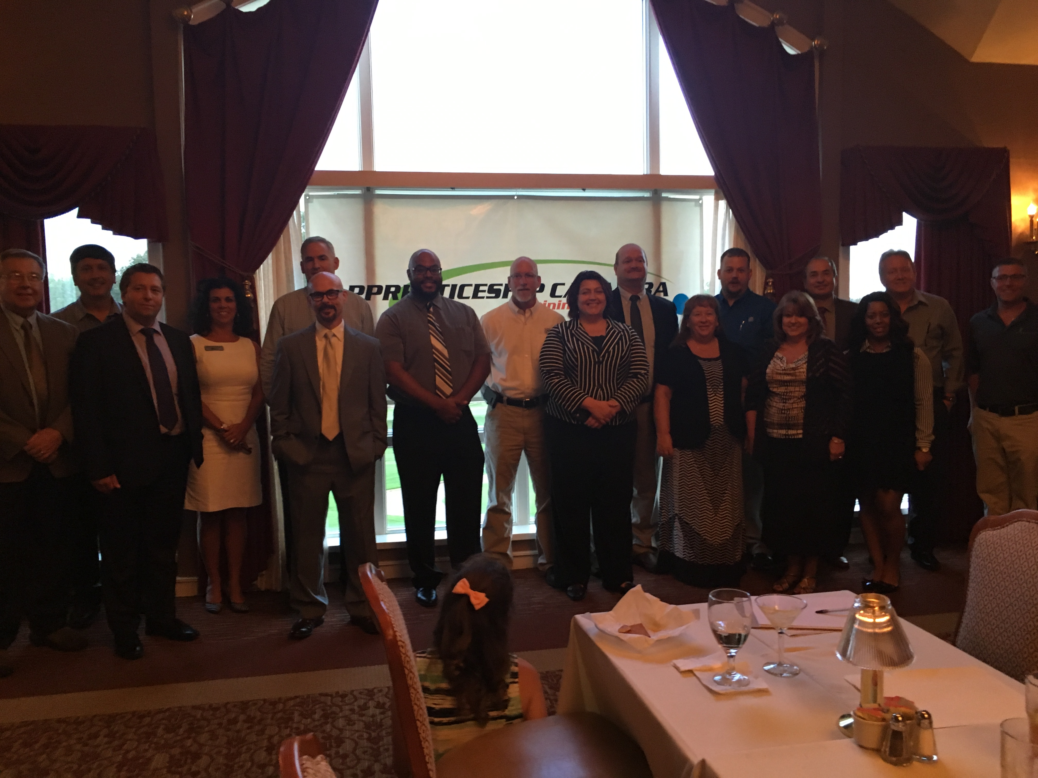
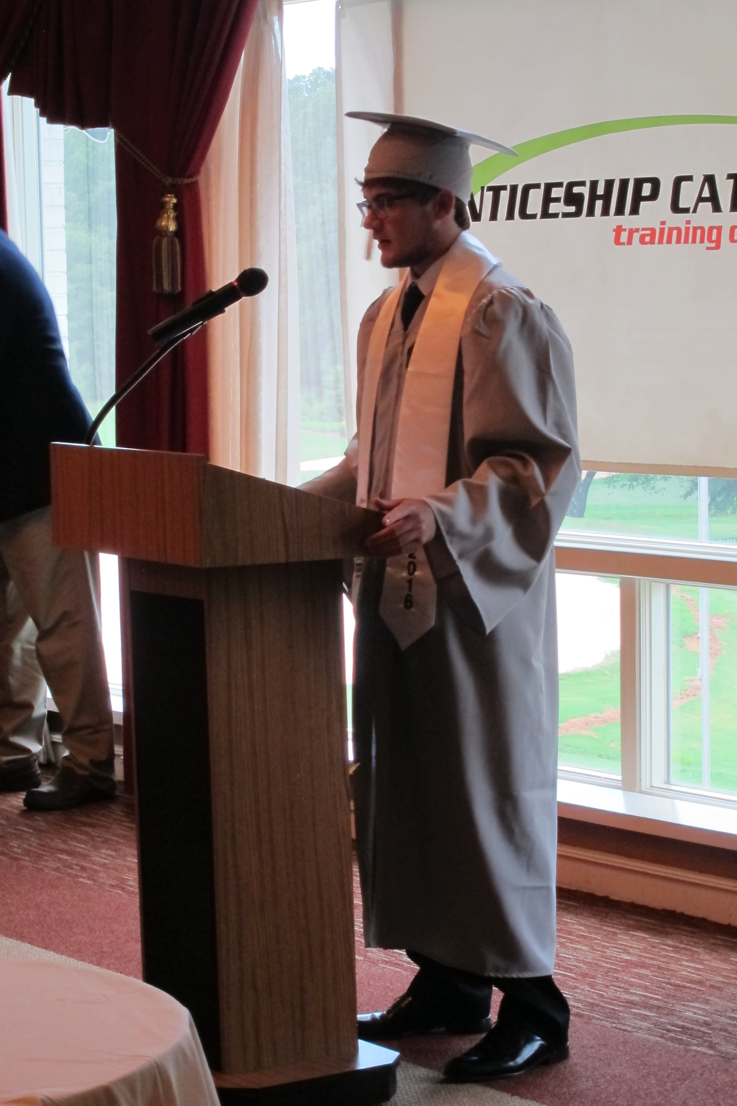
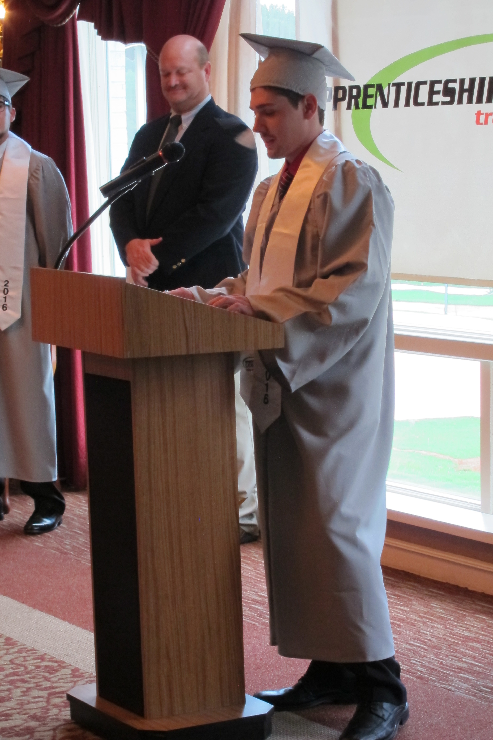
Employer Engagement

Slide 8
Employer Engagement
12-18 apprentices that will provide seamless transitions from high school to community college.
31 apprentices to date
2 apprentices graduated August 2016
10-20 pre-apprentices/summer
Fall 2016/Spring 2017
October/November recruitment process with high school juniors and seniors
December/January Open Houses will start at partner companies
March/April Orientation Week
June Pre-Apprenticeship ( 6 weeks )
August Signing Ceremony and beginning of apprenticeship

Slide 9
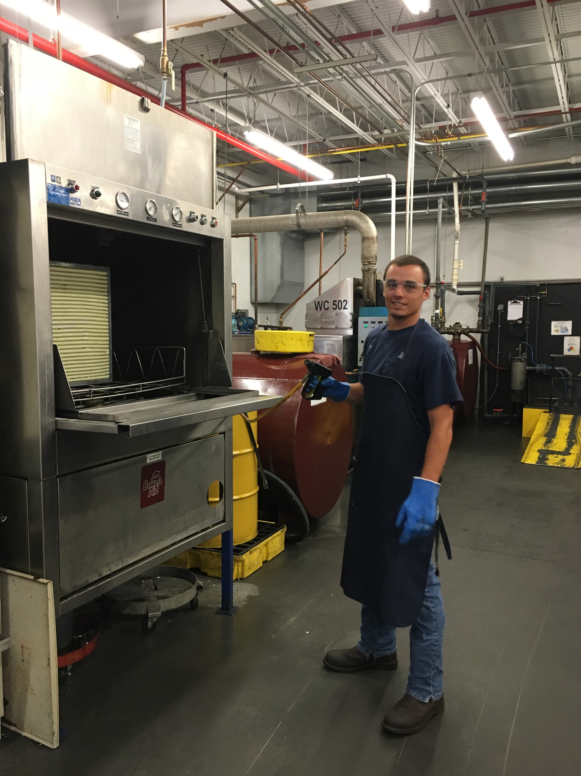
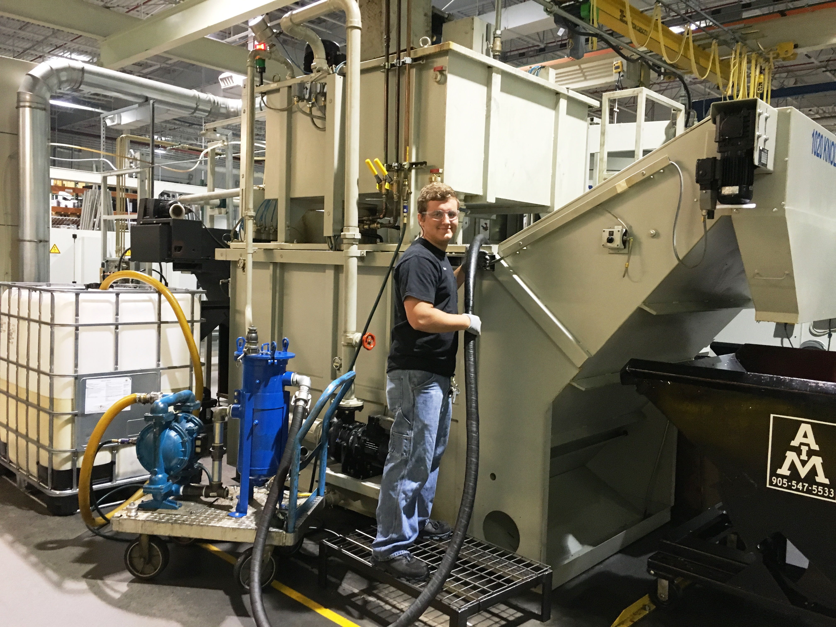
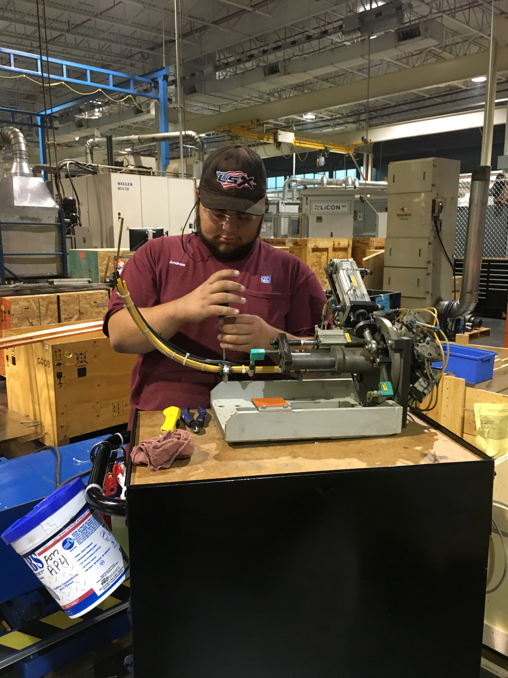
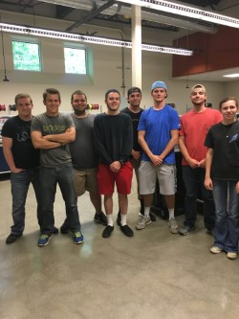
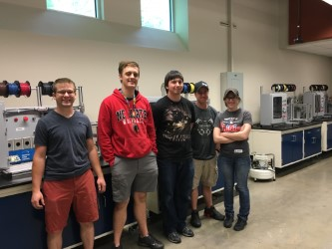

Slide 10
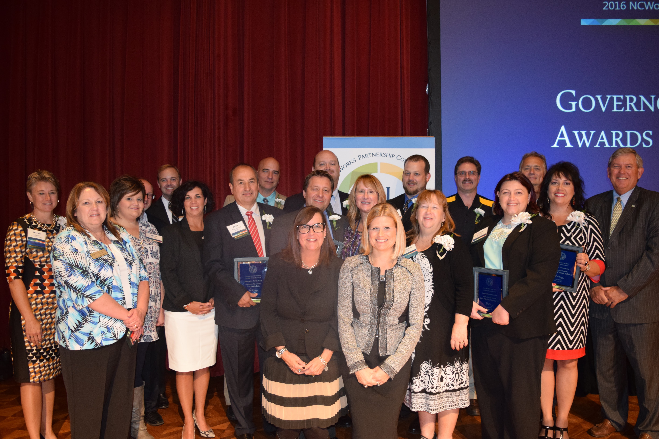

Slide 11
What does the FUTURE of apprenticeship look like at CVCC?
Along with its partners, CVCC has readied the area to grow and sustain apprenticeships for post-secondary students in CTE programs of study.
The Catawba Valley Community College Advancing Post-Secondary Apprenticeship Project will concentrate on developing a statewide model for advancing and supporting apprenticeships for post-secondary students.

Slide 12
What does the FUTURE of apprenticeship look like at CVCC?

