Slide 1
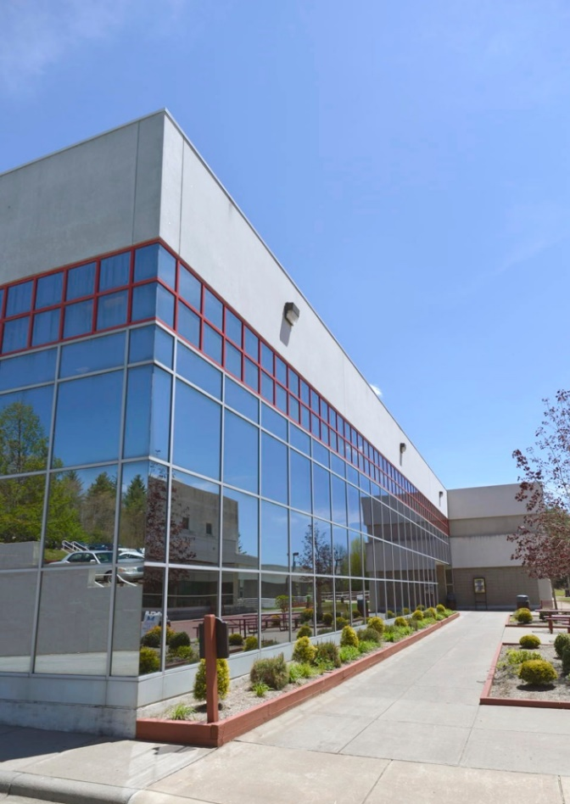
Mayland Community College
CTE
Mid-year Perkins

Slide 2
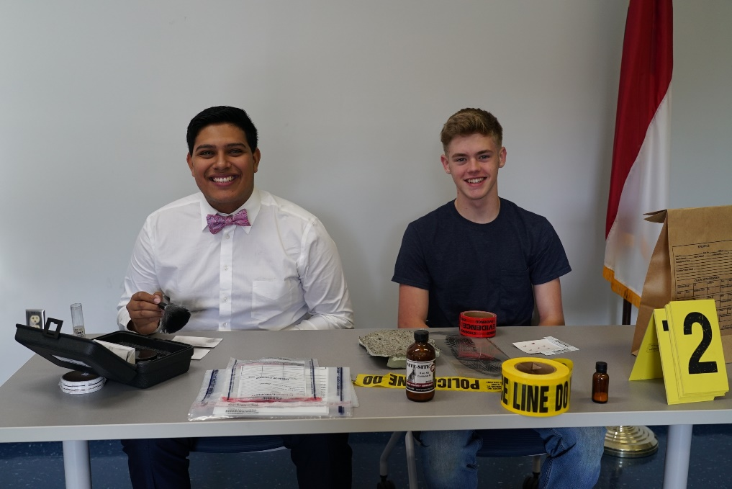
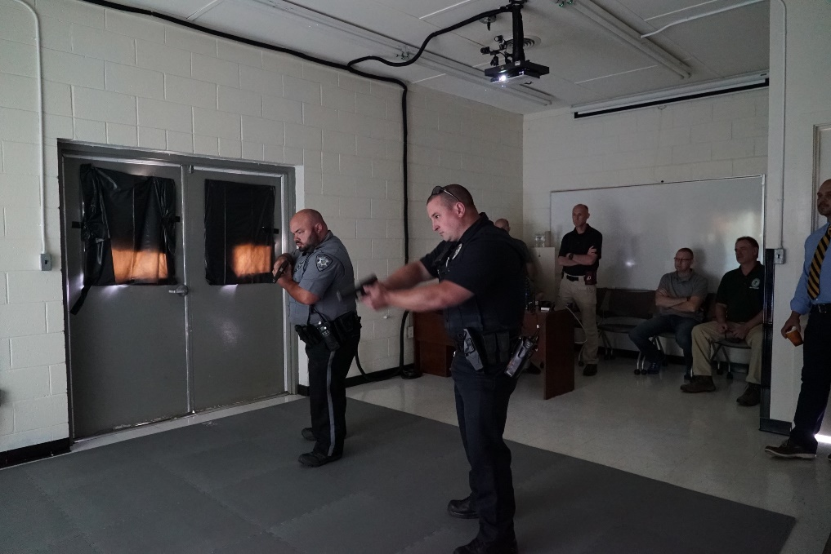
How Perkins Funds Make a Difference
Updated CJC instructional resources
Created a mobile lab for use in traditional and high school classes. Used at Career Fairs as a recruitment tool. Lab includes:
Sketch a Cop software
Drug ID Board
Alcohol vision goggles
Blood Splatter Kit
Incorporated use of the Big Interview software into CTE programs
Currently required in Business Admin and IT
Earmarked money for professional development.
ACTE Conference
Mine Safety Training for welding faculty

Slide 3
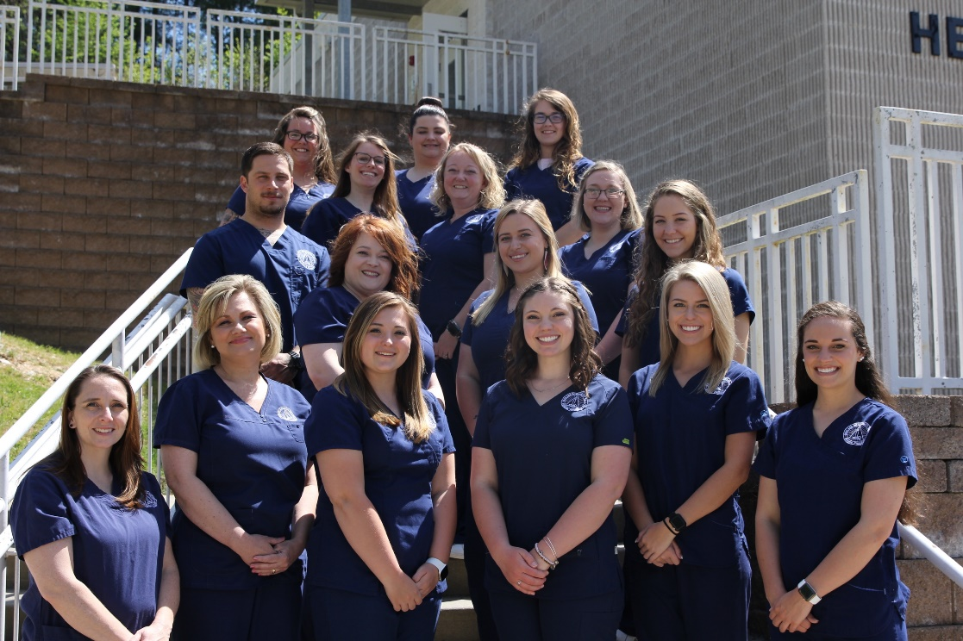
How MCC Conducted CLNA
What Pathways Reviewed?
Health Science:
Associate Degree Nursing
Practical Nursing Diploma
Nurse Aide Certificate
Applied Engineering Technology:
AAS Applied Engineering Technology Degree
Applied Engineering Technology Diploma
Applied Engineering Technology Mechanical Design Diploma
Applied Engineering Technology Mechanical Design Certificate
Applied Engineering Technology Machining Processes Diploma
Applied Engineering Technology Machining Processes Certificate
Applied Engineering Technology Mechatronics Certificate

Slide 4
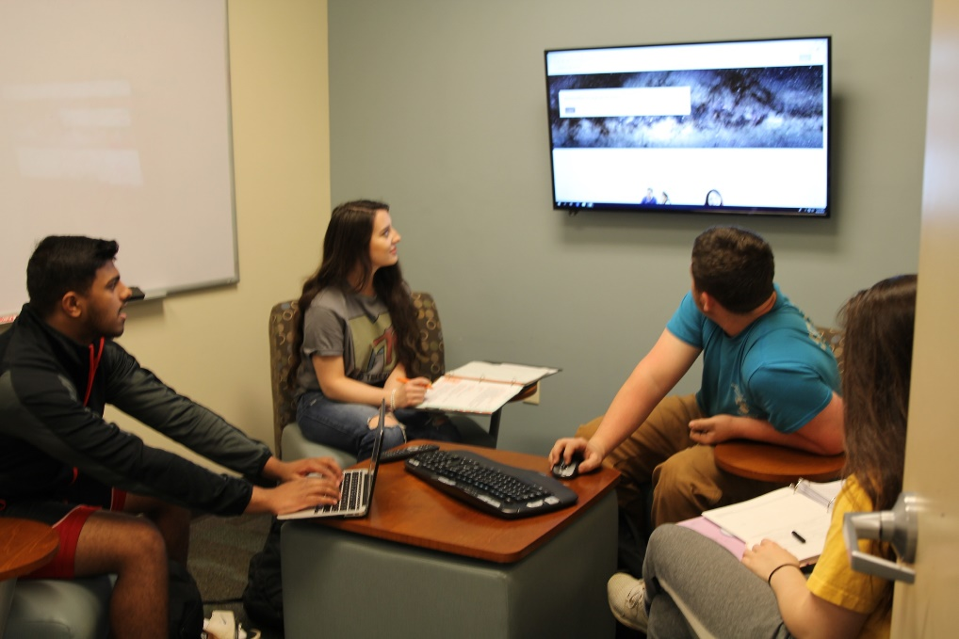
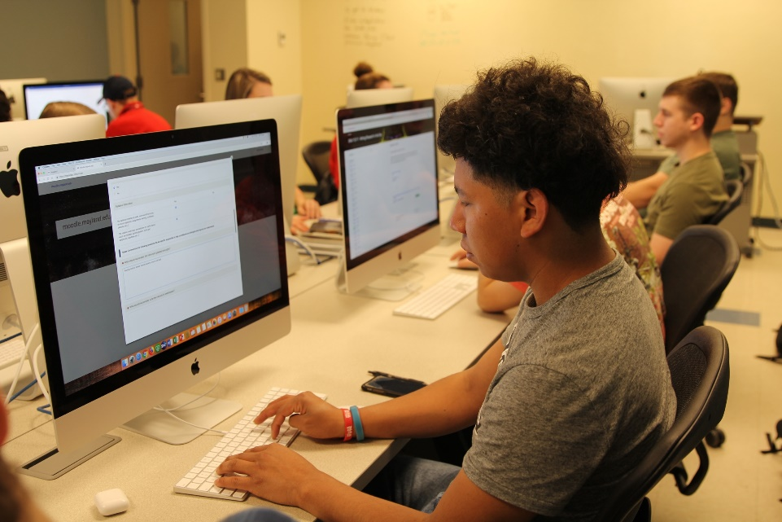
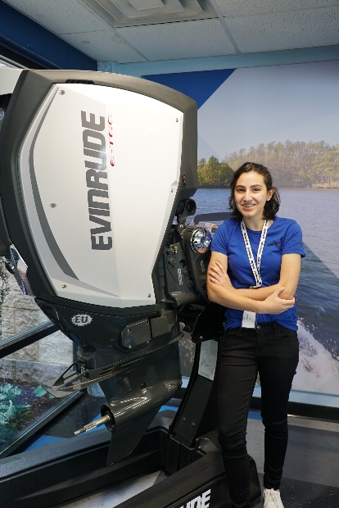
GAPS
Recruitment of non-traditional students and Information dissemination to high schools
Inadequate recruitment efforts and information dissemination to high schools
Poor English and Math skills
Lack of gender diversity
Soft Skills training needed
Professional Development for faculty

Slide 5
Secondary School Involvement
Tri-County CTE Business Advisory Board
Twice per year meeting of CTE in the three county area. Nine Council Members representing Education, and Business and Industry.
One meeting devoted to discussion of CLNA and gaining perspective from Business and Industry partners into gaps in 9 to 14 pathways
Multiple meetings with leadership in each of three county school systems both as a group and individually.
Successes and challenges
Relevance of each pathway-demographic and workforce data
Challenges with dissemination of information to students
Professional development with CC registrar and high school counselors
Community Partnerships
MHHS

Slide 6
WIOA Involvement
Tri-County CTE Business Advisory Board
Director of HCWD invited to speak during a session on conducting the CLNA.
As a group, reviewed regional labor market information …
Chair of High Country Workforce Development Executive Board also serves as Chair of Mayland Board of Trustees
NCWorks Career Center located on MCC campus.
Mayland is the provider for WIOA services in the service area, hold the contract.

Slide 7
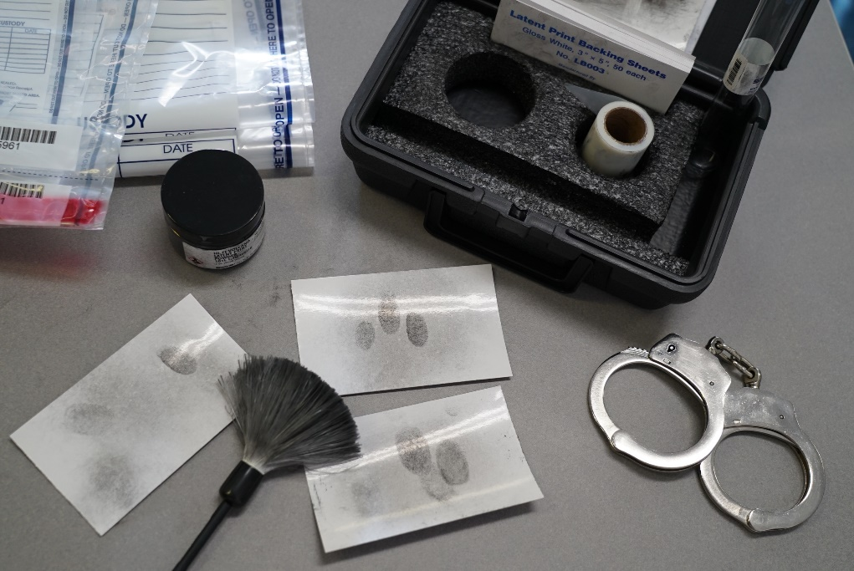
Promising Practice
Hosted a Middle School Forensics Day
NC BioNetwork provided delivery materials
Faculty worked with the students in lab settings to “analyze clues and solve a crime”
98 students attended
Event will be repeated in March
Placed student interns with local employers
Two non traditional electronic engineering students completed summer internships
Students were offered employment upon graduation

Slide 8
Budget Update
Expended on Professional Development Activities:
ACTE Conference-Raleigh, October 2019
Human Services attended: Juvenile Justice and Teen Courts workshop hosted by NC Department of Public Safety at CVCC- September 2019 and MY Community Cares Trauma Summit, Burnsville –September 2019
Welding Faculty attended: Mine Safety and Health Administration Training Part 48- Spruce Pine NC January 2020
Welding high school students attended: Construction Career Day, Haywood County Fairgrounds, October 2019
Expended on Instructional Supplies & Equipment:
CJC
Fatal Vision Alcohol Program Kit
Drug Identification Kit
Various classroom resources-Blood typing kits and forensic items
Human Services:
Video Series--- Resilience and Paper Tiger
IT
Raspberry etc.

