Slide 1
Sharing our Promising Practices: Learning from each other
Tuesday, February 28, 2017
Pitt Community College
Wednesday, March 1, 2017
Catawba Valley Community College
Bob Witchger Career and Technical Education Director
Julia Hamilton, Tony Reggi, & Chris Droessler Career and Technical Education Coordinators
Get the PowerPoint → www.ncperkins.org/presentations
Notes:
Welcome
We will be posting this PowerPoint as well as a recording of this meeting to the ncperkins.org/.
=====
www.ncPerkins.org/presentations
Feb/March 2017

Slide 2
State CTE Staff
Dr. Bob Witchger - Director, Career and Technical Education
WitchgerB@nccommunitycolleges.edu 919-807-7126
Dr. Tony R. Reggi - Coordinator, Career & Technical Education
ReggiA@nccommunitycolleges.edu 919-807-7131
Dr. Julia Hamilton - Coordinator, Career and Technology Education
HamiltonJ@nccommunitycolleges.edu 919-807-7130
Chris Droessler - Coordinator, Career and Technical Education
DroesslerC@nccommunitycolleges.edu 919-807-7068
Vacant – Administrative Assistant, Career and Technical Education
XxxxxxxxxX@nccommunitycolleges.edu 919-807-7129

Slide 3
Agenda
9:00 Gathering
9:30 Perkins Update Overview Purpose and Goals
10:00 Accountability - Perkins Data Book
How are colleges are using the book to improve performance
10:30 Colleges report out from Local Plan
Snacks and light lunch will be provided during the meeting
2:00 Discussion about 2017-18 Perkins year
2:30 Dismissal

Slide 4
Perkins Update Overview Purpose and Goals
Thanks for all you do
Vision
Mission
Perkins Focus
Improvement Strategies through Leadership
MOA – Equity in Education
Scope of Work
Data to Enhance CTE
Activities to Contemplate toward Improvement
What do our Data tell us?
Notes:
Bob

Slide 5
Notes:
Data Book - Julia

Slide 6
Discussion Questions
Based on what I have learned today, what ideas do I have to improve implementation of the Perkins basic grant at my college with the goal of enhancing Career and Technical Education.
As I come to better understand rigorous programs of study with the three elements; Career Advising, Integrated Classes grades 9-14, and Work-based Learning:
What can we do to better communicate the elements of pathways?
What can we do to improve transitions from high school to community college?
What can we do to better engage employers?
What can we do to better implement work-based learning?
What are some strategies to enhance the skills of our technical faculty?

Slide 7
Notes:
Alamance Community College

Slide 8
Notes:
Alamance Community College

Slide 9
Notes:
Alamance Community College

Slide 10
Notes:
Asheville-Buncombe Technical Community College

Slide 11
Notes:
Asheville-Buncombe Technical Community College

Slide 12
Notes:
Asheville-Buncombe Technical Community College

Slide 13
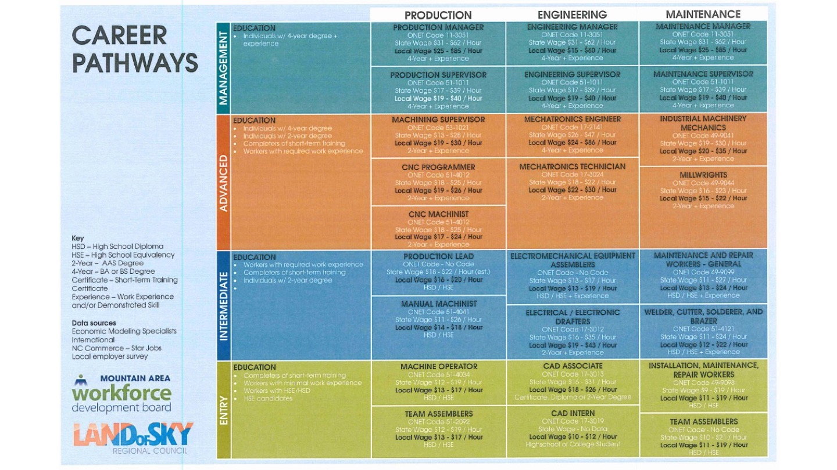
Notes:
Asheville-Buncombe Technical Community College

Slide 14
Notes:
Asheville-Buncombe Technical Community College

Slide 15
Notes:
Asheville-Buncombe Technical Community College

Slide 16
Notes:
Asheville-Buncombe Technical Community College

Slide 17
Notes:
Asheville-Buncombe Technical Community College

Slide 18
Notes:
Asheville-Buncombe Technical Community College

Slide 19
Notes:
Beaufort County Community College

Slide 20
Notes:
Beaufort County Community College

Slide 21
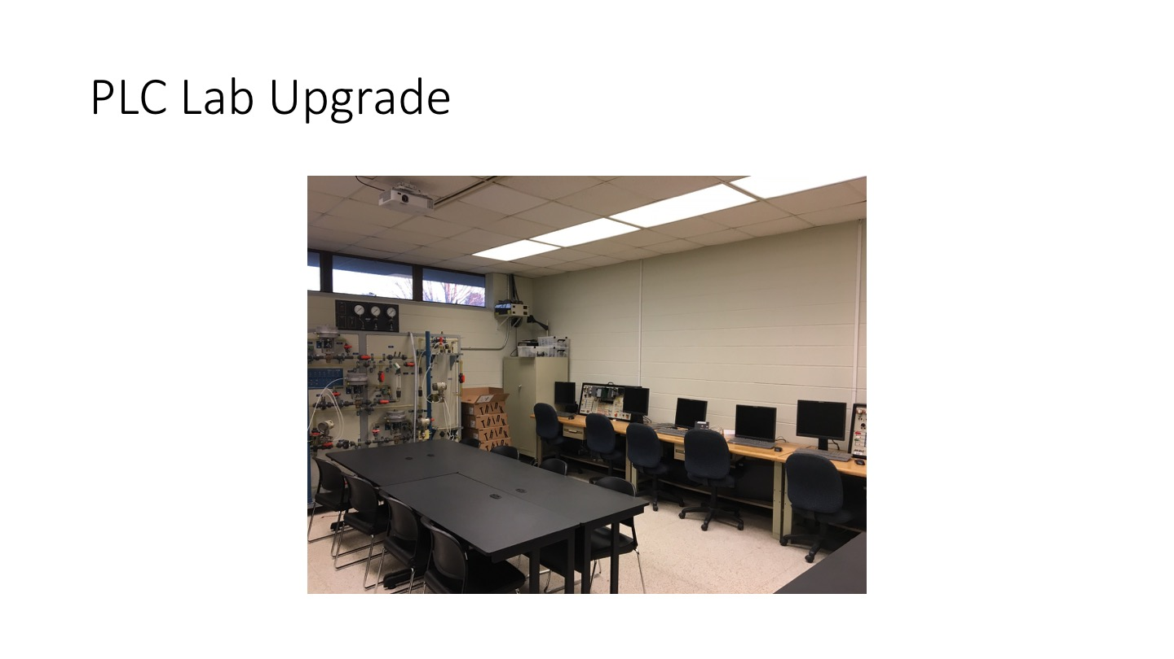
Notes:
Beaufort County Community College

Slide 22
Notes:
Beaufort County Community College

Slide 23
Notes:
Beaufort County Community College

Slide 24
Notes:
Bladen Community College

Slide 25
Notes:
Bladen Community College

Slide 26
Notes:
Bladen Community College

Slide 27
Notes:
Blue Ridge Community College

Slide 28
Notes:
Blue Ridge Community College

Slide 29
Notes:
Blue Ridge Community College

Slide 30
Notes:
Blue Ridge Community College

Slide 31
Notes:
Blue Ridge Community College

Slide 32
Notes:
Blue Ridge Community College

Slide 33
Notes:
Brunswick Community College

Slide 34
Notes:
Brunswick Community College

Slide 35
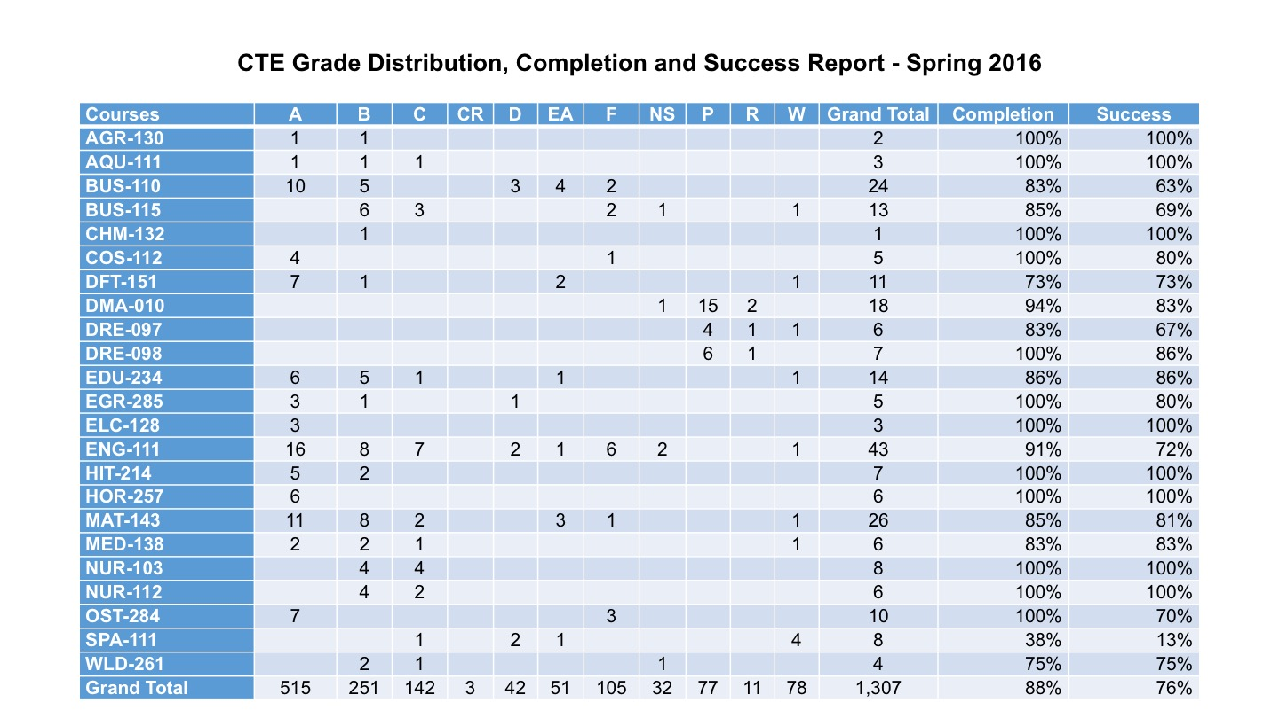
Notes:
Brunswick Community College

Slide 36
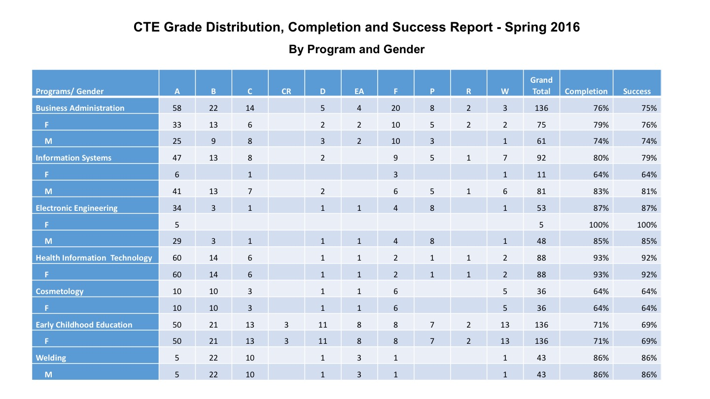
Notes:
Brunswick Community College

Slide 37
Notes:
Brunswick Community College

Slide 38
Notes:
Caldwell Community College and Technical Institute

Slide 39
Notes:
Caldwell Community College and Technical Institute

Slide 40
Notes:
Caldwell Community College and Technical Institute

Slide 41
Notes:
Cape Fear Community College

Slide 42
Notes:
Cape Fear Community College

Slide 43
Notes:
Cape Fear Community College

Slide 44
Notes:
Cape Fear Community College

Slide 45
Notes:
Carteret Community College

Slide 46
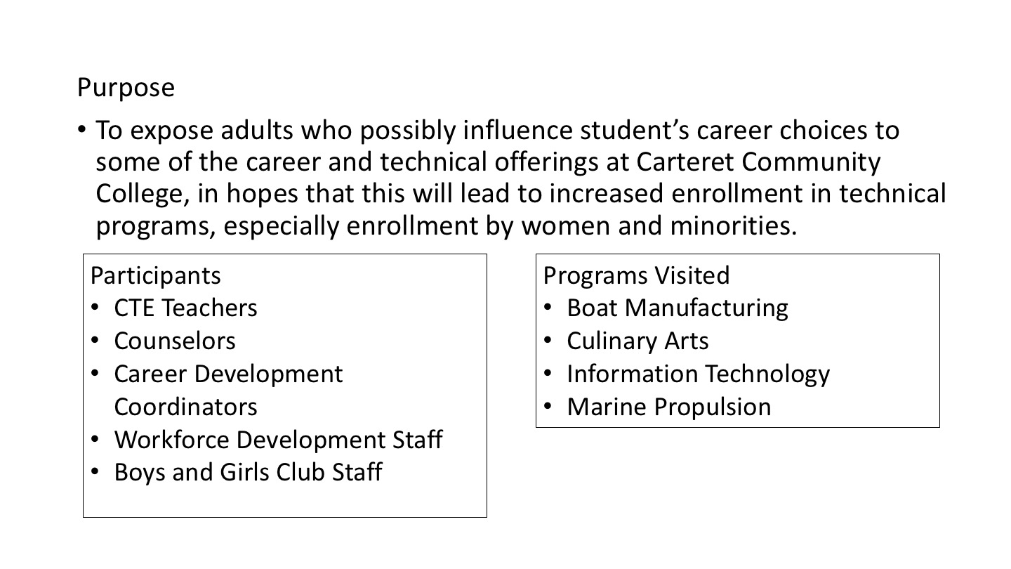
Notes:
Carteret Community College

Slide 47
Notes:
Carteret Community College

Slide 48
Notes:
Carteret Community College

Slide 49
Notes:
Catawba Valley Community College

Slide 50
Notes:
Catawba Valley Community College

Slide 51
Notes:
Catawba Valley Community College

Slide 52
Notes:
Central Carolina Community College

Slide 53
Notes:
Central Carolina Community College

Slide 54
Notes:
Central Carolina Community College

Slide 55
Notes:
Central Piedmont Community College

Slide 56
Notes:
Central Piedmont Community College

Slide 57
Notes:
Central Piedmont Community College

Slide 58
Notes:
Central Piedmont Community College

Slide 59
Notes:
Cleveland Community College

Slide 60
Notes:
Cleveland Community College

Slide 61
Notes:
Cleveland Community College

Slide 62
Notes:
Coastal Carolina Community College

Slide 63
Notes:
Coastal Carolina Community College

Slide 64
Notes:
Coastal Carolina Community College

Slide 65
College of The Albemarle
Notes:
College of The Albemarle

Slide 66
Notes:
Craven Community College
Pamlico Community College

Slide 67
Notes:
Craven Community College
Pamlico Community College

Slide 68
Notes:
Craven Community College
Pamlico Community College

Slide 69
Notes:
Craven Community College
Pamlico Community College

Slide 70
Notes:
Davidson County Community College

Slide 71
Notes:
Davidson County Community College

Slide 72
Notes:
Davidson County Community College

Slide 73
Notes:
Davidson County Community College

Slide 74
Notes:
Durham Technical Community College

Slide 75
Notes:
Durham Technical Community College

Slide 76
Notes:
Durham Technical Community College

Slide 77
Edgecombe Community College
Notes:
Edgecombe Community College

Slide 78
Notes:
Fayetteville Technical Community College

Slide 79
Notes:
Fayetteville Technical Community College

Slide 80
Notes:
Fayetteville Technical Community College

Slide 81
Notes:
Forsyth Technical Community College

Slide 82
Notes:
Forsyth Technical Community College

Slide 83
Notes:
Forsyth Technical Community College

Slide 84
Notes:
Gaston College

Slide 85
Notes:
Gaston College

Slide 86
Notes:
Gaston College

Slide 87
Notes:
Gaston College

Slide 88
Notes:
Guilford Technical Community College

Slide 89
Notes:
Guilford Technical Community College

Slide 90
Notes:
Halifax Community College

Slide 91
Notes:
Halifax Community College

Slide 92
Notes:
Halifax Community College

Slide 93
Notes:
Halifax Community College

Slide 94
Notes:
Halifax Community College

Slide 95
Notes:
Halifax Community College

Slide 96
Notes:
Haywood Community College

Slide 97
Notes:
Haywood Community College

Slide 98
Notes:
Haywood Community College

Slide 99
Notes:
Isothermal Community College

Slide 100
Notes:
Isothermal Community College

Slide 101
Notes:
Isothermal Community College

Slide 102
Notes:
Isothermal Community College

Slide 103
Notes:
James Sprunt Community College

Slide 104
Notes:
James Sprunt Community College

Slide 105
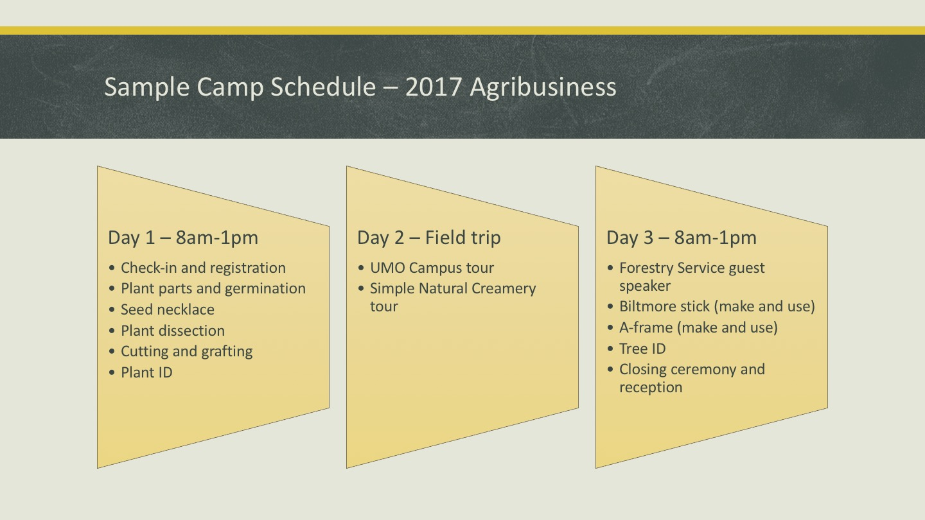
Notes:
James Sprunt Community College

Slide 106
Johnston Community College
Notes:
Johnston Community College

Slide 107
Notes:
Lenoir Community College

Slide 108
Notes:
Lenoir Community College

Slide 109
Notes:
Lenoir Community College

Slide 110
Notes:
Lenoir Community College

Slide 111
Notes:
Lenoir Community College

Slide 112
Martin Community College
Notes:
Martin Community College

Slide 113
Notes:
Mayland Community College

Slide 114
McDowell Technical
Community College
Notes:
McDowell Technical Community College

Slide 115
Notes:
Mitchell Community College

Slide 116
Notes:
Mitchell Community College

Slide 117
Notes:
Mitchell Community College

Slide 118
Notes:
Montgomery Community College
Randolph Community College

Slide 119
Notes:
Montgomery Community College
Randolph Community College

Slide 120
Notes:
Montgomery Community College
Randolph Community College

Slide 121
Notes:
Montgomery Community College
Randolph Community College

Slide 122
Notes:
Nash Community College

Slide 123
Notes:
Nash Community College

Slide 124
Notes:
Nash Community College

Slide 125
Notes:
Nash Community College

Slide 126
Notes:
Nash Community College

Slide 127
Notes:
Craven Community College
Pamlico Community College

Slide 128
Notes:
Craven Community College
Pamlico Community College

Slide 129
Notes:
Craven Community College
Pamlico Community College

Slide 130
Notes:
Craven Community College
Pamlico Community College

Slide 131
Notes:
Piedmont Community College

Slide 132
Notes:
Piedmont Community College

Slide 133
Notes:
Piedmont Community College

Slide 134
Notes:
Pitt Community College

Slide 135
Notes:
Pitt Community College

Slide 136
Notes:
Pitt Community College

Slide 137
Notes:
Pitt Community College

Slide 138
Notes:
Montgomery Community College
Randolph Community College

Slide 139
Notes:
Montgomery Community College
Randolph Community College

Slide 140
Notes:
Montgomery Community College
Randolph Community College

Slide 141
Notes:
Montgomery Community College
Randolph Community College

Slide 142
Notes:
Richmond Community College

Slide 143
Notes:
Richmond Community College

Slide 144
Notes:
Richmond Community College

Slide 145
Notes:
Roanoke-Chowan Community College

Slide 146
Notes:
Roanoke-Chowan Community College

Slide 147
Notes:
Roanoke-Chowan Community College

Slide 148
Notes:
Robeson Community College

Slide 149
Notes:
Robeson Community College

Slide 150
Notes:
Robeson Community College

Slide 151
Notes:
Rockingham Community College

Slide 152
Notes:
Rockingham Community College

Slide 153
Notes:
Rockingham Community College

Slide 154
Notes:
Rowan-Cabarrus Community College

Slide 155
Notes:
Rowan-Cabarrus Community College

Slide 156
Notes:
Rowan-Cabarrus Community College

Slide 157
Notes:
Sampson Community College

Slide 158
Notes:
Sampson Community College

Slide 159
Notes:
Sampson Community College

Slide 160
Sandhills Community College
Notes:
Sandhills Community College

Slide 161
Notes:
South Piedmont Community College

Slide 162
Notes:
South Piedmont Community College

Slide 163
Notes:
South Piedmont Community College

Slide 164
Notes:
Southeastern Community College

Slide 165
Notes:
Southeastern Community College

Slide 166
Notes:
Southeastern Community College

Slide 167
Notes:
Southwestern Community College

Slide 168
Notes:
Southwestern Community College

Slide 169
Notes:
Southwestern Community College

Slide 170
Notes:
Stanly Community College

Slide 171
Notes:
Stanly Community College

Slide 172
Notes:
Stanly Community College

Slide 173
Notes:
Stanly Community College

Slide 174
Surry Community College
Notes:
Surry Community College

Slide 175
Notes:
Tri-County Community College

Slide 176
Notes:
Tri-County Community College

Slide 177
Notes:
Tri-County Community College

Slide 178
Notes:
Tri-County Community College

Slide 179
Notes:
Tri-County Community College

Slide 180
Notes:
Vance-Granville Community College

Slide 181
Notes:
Vance-Granville Community College

Slide 182
Notes:
Vance-Granville Community College

Slide 183
Notes:
Wake Technical Community College

Slide 184
Notes:
Wake Technical Community College

Slide 185
Notes:
Wake Technical Community College

Slide 186
Notes:
Wake Technical Community College

Slide 187
Notes:
Wake Technical Community College

Slide 188
Notes:
Wake Technical Community College

Slide 189
Notes:
Wake Technical Community College

Slide 190
Notes:
Wake Technical Community College

Slide 191
Notes:
Wake Technical Community College

Slide 192
Notes:
Wayne Community College

Slide 193
Notes:
Wayne Community College

Slide 194
Notes:
Wayne Community College

Slide 195
Notes:
Western Piedmont Community College

Slide 196
Notes:
Western Piedmont Community College

Slide 197
Notes:
Western Piedmont Community College

Slide 198
Notes:
Western Piedmont Community College

Slide 199
Wilkes Community College
Notes:
Wilkes Community College

Slide 200
Notes:
Wilson Community College

Slide 201
Notes:
Wilson Community College

Slide 202
Notes:
Wilson Community College

Slide 203
Notes:
Wilson Community College

Slide 204
Discussion Questions
Based on what I have learned today, what ideas do I have to improve implementation of the Perkins basic grant at my college with the goal of enhancing Career and Technical Education.
As I come to better understand rigorous programs of study with the three elements; Career Advising, Integrated Classes grades 9-14, and Work-based Learning:
What can we do to better communicate the elements of pathways?
What can we do to improve transitions from high school to community college?
What can we do to better engage employers?
What can we do to better implement work-based learning?
What are some strategies to enhance the skills of our technical faculty?

Slide 205
Sharing our Promising Practices: Learning from each other
Tuesday, February 28, 2017
Pitt Community College
Wednesday, March 1, 2017
Catawba Valley Community College
Bob Witchger Career and Technical Education Director
Julia Hamilton, Tony Reggi, & Chris Droessler Career and Technical Education Coordinators
Get the PowerPoint → www.ncperkins.org/presentations
Notes:
Welcome
We will be posting this PowerPoint as well as a recording of this meeting to the ncperkins.org/.
=====
www.ncPerkins.org/presentations
Feb/March 2017

