Slide 1
Supporting Special Populations November 14, 2022
Download the PowerPoint and access the recording: www.ncperkins.org/presentations

Slide 2
Career & Technical Education Team
Bob Witchger
Tony Reggi
Patti Coultas
Mary Olvera
Anne Bacon
Darice McDougald
Lane Freeman
Aaron Mabe

Slide 3
Perkins V Special Populations
Disabilities;​
Economically disadvantaged
Non-traditional fields ​
Single-parents, including single pregnant women​
Out-of-workforce individuals
English learners
Homeless individuals
In, or aged out of, the foster care system
Youth with a parent who is in armed forces
J. Major racial and ethnic groups (Added from ESEA)

Slide 4
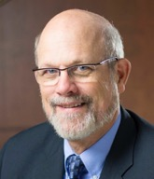
Dr. Bob Witchger
CTE Director, Team Perkins
Notes:
Dr. Robert (Bob) Witchger
NCCCS, CTE Director
919-807-7126
witchgerb@nccommunitycolleges.edu

Slide 5
Dr. Tony Reggi
CTE Associate Director,
Notes:
Tony Reggi
919-807-7131
reggia@nccommunitycolleges.edu

Slide 6
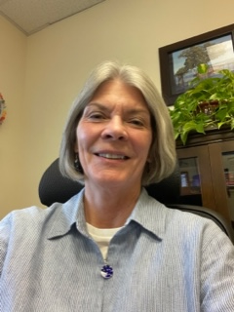
Dr. Trudie Hughes
Associate Director, Disability Services and Title IX

Slide 7
Shannon Baker
North Carolina Dept. of Public Instruction
Education Consultant Special Populations/Civil Rights/Equity

Slide 8
Oscar Hernandez
English Language Learner

Slide 9
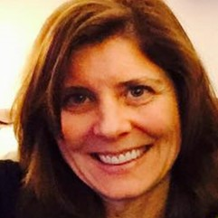
Glenna Osborne, M.Ed., CESP
Disability Services
Director of Transition Services
Clinical Psychiatry Instructor

Slide 10
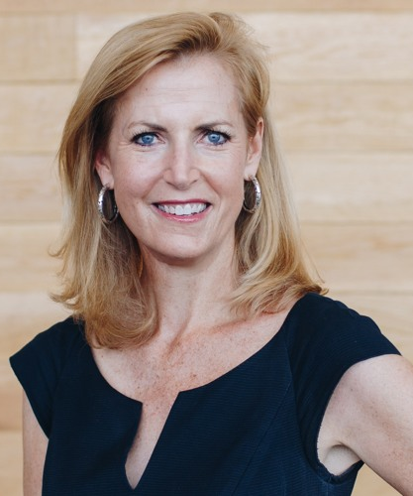
Caroline Sullivan
NC Business Committee for
Education
Executive Director

Slide 11
Sally Tallman
Non-Traditional Field
Landscape Architect
Business Owner

Slide 12
Sally Tallman
Owner, Designer – Women with Tools
Hobbyist turned side job
Landscape Architecture through Wake Tech
Planned on launching in Spring after watching for winter sales to gain cheaper business equipment
Growth struggles: getting loyal part time employees during growth
Gender struggles: male dominated field where people have assumptions
Continuing education: not expensive but you have to find time
Help from schools: flexible with assignments, grants
General tips: let people help and ask for it within your community

Slide 13
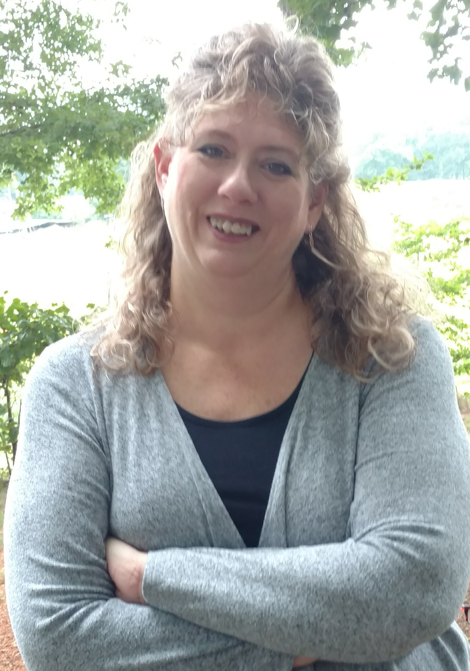
Deanna Jones
Single-parent student
Regional Specials
Employment Services for Central NC

Slide 14
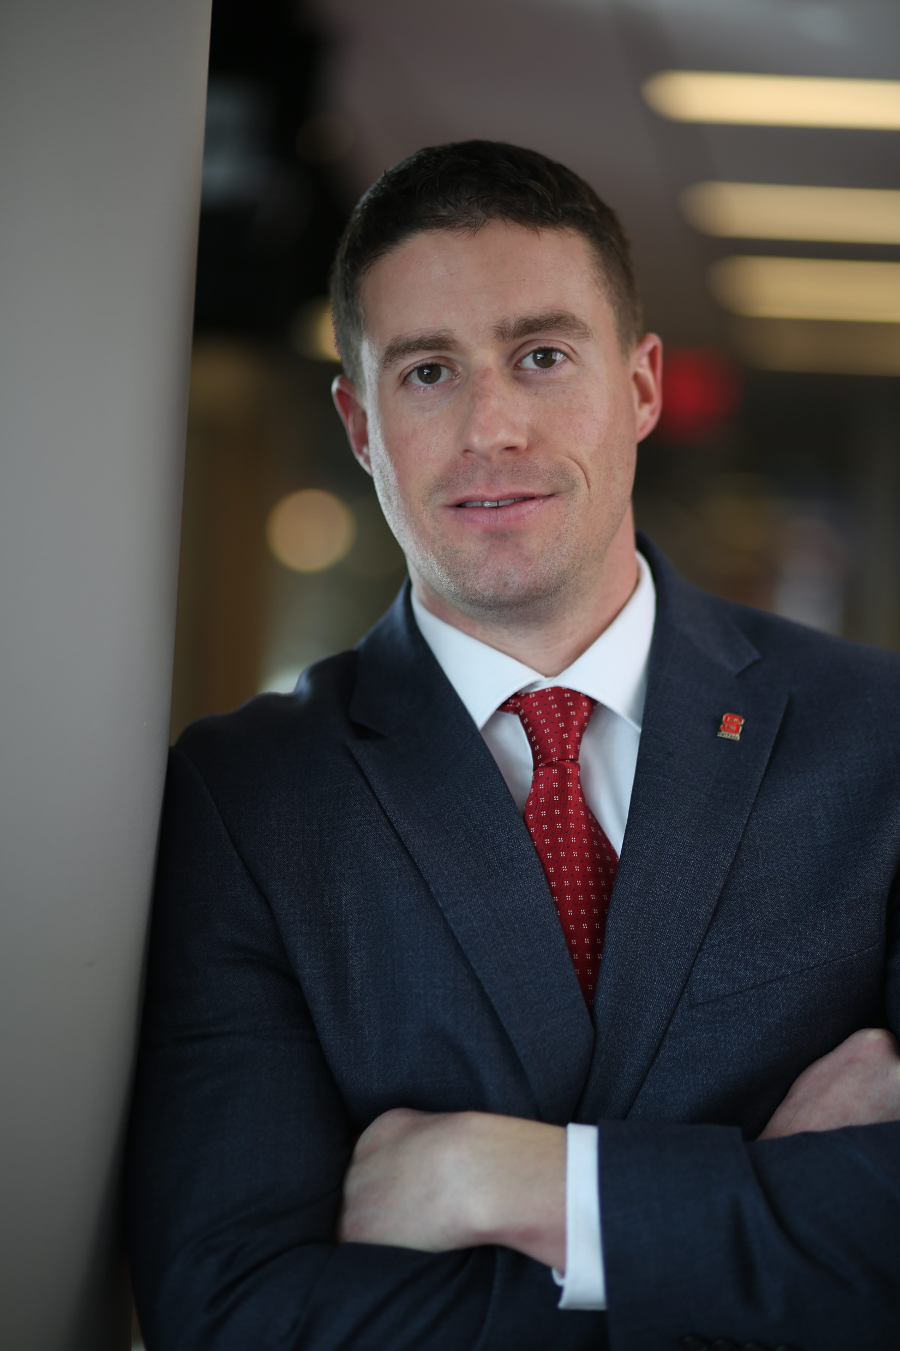
Nick Drake
Military-Connected Students
Director of Jeffrey Wright
Military and Veteran Services

Slide 15
Military-Connected Student Engagement
Division of Academic and Student Affairs
Military dependents are a distinct subgroup
Enrollment/Admissions challenges
Barriers to persistence
Lessons learned | Best Practices
Nick Drake | Director of Jeffrey Wright Miliary and Veteran Services
NC State University
nrdrake@ncsu.edu | 919.515.5041 | veterans.ncsu.edu

Slide 16
LiNC-IT (Linking NC with Innovative Talent) is an internship program for early career autistic professionals.
https://linc-it.org/

Slide 17
North Carolina Business Committee for Education is a nonprofit in the Office of the Governor that focuses on work-based learning.
Is an internship for early career autistic professionals. LiNC-IT uses state funding to support job coaches for employers and interns. Over 90% of interns that have completed their internships are now in permanent positions.

Slide 18
The Collaborative
North Carolina Business Committee for Education
Autism Society of North Carolina
Capital Area Workforce Development
NC Office of the Governor
NC Office of State and Human Resources
NC Department of Health and Human Services – Vocational Rehabilitation
NC Council of Developmental Disabilities
UNC TEACCH Autism Center

Slide 19
About 1 in 44 children has been identified with autism spectrum disorder (ASD) according to estimates from CDC’s Autism and Developmental Disabilities Monitoring (ADDM) Network. [Read article]
ASD is more than 4 times more common among boys than among girls. [Read article]
Studies in Asia, Europe, and North America have identified individuals with ASD with an average prevalence of between 1% and 2%. [Data table pdf icon[235 KB, 6 Pages, 508]]
About 1 in 6 (17%) children aged 3–17 years were diagnosed with a developmental disability, as reported by parents, during a study period of 2009-2017. These included autism, attention-deficit/hyperactivity disorder, blindness, and cerebral palsy, among others. [Read summary]
ASD is reported to occur in all racial, ethnic, and socioeconomic groups. [Read summary external icon] [Read article]

Slide 20
Barriers to landing and maintaining a job
Difficulty with traditional applications
Getting “in the door”
Difficulty with interviewing (groups, social banter/chitchat)
Marketing yourself appropriately to your audience
Employers’ understanding of autism and accommodations
Transportation
Social demands included in the job
Lack of skills such as accepting corrective feedback, asking for needed supports
Notes:
Reoccurring/common barriers to landing the job for some people.
EX: what are traditional applications: Precreening, experience and gaps in employment
Following up and networking.

Slide 21
Advantages of disclosing with LiNC-IT
Companies are more understanding of your needs and willing to make accommodations.
Companies are seeking out neurodiverse talent and embracing the skills and perspective that individuals with ASD often bring.
Employers recognize that people with autism often offer unique problem-solving skills, higher focus, and more productivity.
Employers value dependability and loyalty.
Individuals with ASD diversify the workplace, offering organizations a competitive edge.

Slide 22
National: 37.5%
LiNC-IT 90%
Successful employment requires a comprehensive model of support:
Onboarding people: matching to the correct jobs, adapting the hiring process.
ASD specific teaching and supports: organization, emotion regulation, and social skills
ASD training for support staff and employers
Long-Term Supports: recognizing supports may change over time, but the need is always present.
Awareness of neurodiversity needs in the work force and expertise to address those needs.

Slide 23
LiNC-IT’s role with the employer
Train businesses
Autism awareness
Neurodiverse supports
Identify compatible jobs for all interns
Help employers tailor interview process to needs of individuals with autism
Train peer mentors
Provide supports on the job that benefit you and your employer

Slide 24
Notes:
Change text on the slide

Slide 25
Phase 1: Recruitment & Development
Work with LiNC-IT on:
Job/internships identification
Interview process
Orientation
Training
Learning skills to enhance employability
Sign up with agencies offering autism-specific employment supports.
ASNC
TEACCH

Slide 26
Need: Managers want training on supporting autistic adults.
Time is more precious than ever.
Setting aside large blocks of dedicated time for training is a luxury many managers do not have.
Current methods resulted in training being 1-1 manager to autism support specialist. This was unsustainable with autism incident rates.
Needed flexibility to meet the time and training needs of employers.
Solution: On Demand training on autism for employers that is manageable.
Notes:
I added this slide: Mike

Slide 27
Phase 2: Employability and Skills Training
Work on a good internship match for you and employer
Teach soft skills that you will need specific to the site
Modify the interview so you can demonstrate your skills
Offer support during the interview for you and employer
Assist with disclosure and advocacy

Slide 28
Phase 3: Internship
Help locate paid internship opportunities, which are typically 12 weeks long but can vary
Educate employer on hiring and support of individuals
Provide support to ensure success on the job
Identify site-specific accommodations
Assist with coworker relations
Identify related opportunities to enhance your internship

Slide 29
Phase 4: Job
Recognize this is an internship, which could lead to a job offer
Work to find jobs within the company
Evaluate the internship experience with you and the employer
After the internships, what comes next?
Job offer?
Complete degree program/more education/certification
Experience added to resume for job search

Slide 30
Typical Accommodations
(success enablers)
Based upon the individual’s needs
Examples:
Designated work area/lunch area
Support to interact with employer
Written communication
Autism employee resource group
What do you think you might need?
Notes:
We recognize that every employee is different. Obtaining accommodations that fits them is necessary.
Here are some of the typical ones we may see as we work with companies.
Thoughts on what you know you need?

Slide 31
“I bring a new perspective to my team, and I work with exceptional speed and efficiency.”
– LiNC-IT intern
“We are really happy with the LiNC-IT program and the support we get from NCBCE, UNC TEACCH, and ASNC, and we are already seeing true business value from the diversity of thought, skills, and experiences these candidates bring.
-Ro Lissenden
“Our brains work inherently different than somebody who isn’t autistic. So, we’re gonna look at it differently. It’s just part of our existence.”
– LiNC-IT intern
We see NC and the Triangle as a perfect environment to attract, support, and foster talent that sees the world a little differently - becoming the go-to location for neurodiverse talent and their families.”
-Todd Lineberger

Slide 32
Employers who are benefitting from the LiNC-IT recruiting process:
Alamance Community College
Bank of America
BioAgilytix
Biogen
Carrboro Arts Center
Caterpillar
Corning
Credit Suisse
Fidelity Investments
Fokus Labs
General Electric
JP Morgan
Lenovo
NC Business Committee for Education
NC Department of Commerce
NC Department of Health and Human Services
NC Department of Information Technology
NC Department of Public Instruction
NC Department of Public Safety
NC Department of Revenue
NC Department of Transportation
NC Office of the Governor
Novozymes North America
Participate
PassionIT Group
Penny Mac
Red Hat
Revature
SAS
Sears
Smithfield Foods
State Employees Credit Union
Technica Editorial Services
UNC Genetics
UNC Healthcare
Wake Technical Community College
Wells Fargo
Linking North Carolina with Innovative Talent
The current unemployment rate for individuals with ASD is 86%, despite having the skills and education employers need.
LiNC-IT works to reduce the unemployment rate and to improve the workplace experience.
Public/private partnership of government, nonprofits, and employers.
Leverages vocational rehabilitation funding from the NC Department of Health and Human Services with high quality service providers who are experts in supporting individuals with autism.

Slide 34
“LiNC-IT offers its employer partners the opportunity to engage with a new, untapped pool of highly skilled talent at a time where new talent pipelines are sorely needed. Creating neurodiverse talent initiatives not only brings enormous positive impact to neurodivergent individuals, but to society at large, while having a positive effect on organizational performance.”
-Harvard Project on Workforce Development
https://linc-it.org/wp-content/uploads/2022/08/LiNC-IT-evaluation-workforce-development-project-at-Harvard-University.pdf
Notes:
Find something in the conclusion for a quote.

Slide 35
“In recognition of World Autism Month in North Carolina and to help people with Autism Spectrum Disorder (ASD) succeed in the workplace, Governor Roy Cooper has announced a pilot program to provide career coaching to state employees with ASD who need support in applying for promotions or job changes within state government.”
Governor Cooper Announces New Career Coaching Program to Support State Employees with Autism Spectrum Disorder | NC Gov. Cooper

Slide 36
Higher Education Collaborative
Current Education Partners:
The North Carolina Higher Education Collaborative (NCHEC) is a consortium of universities, colleges and other educational organizations in North Carolina dedicated to creating equity in the availability, access, and quality of paid degree-related internships for North Carolina students who identify as autistic.
Partnering universities and colleges also provide an array of services and programs dedicated to educating faculty, staff, and campus employers in addition to serving our students both academically and in their career development.
NC State University
NCCU
Piedmont Community College
Queens University
Shaw University
UNCA
UNC-CH
UNCA
UNC Charlotte
UNCG
UNC-Pembroke
UNCW
Wake Forrest University
Wake Tech
Western Carolina University
William Peace University
ASU
Cape Fear Community College
Central Piedmont Community College
College of the Albemarle
Davidson College
Duke University
East Carolina University
Elon University
Fayetteville State
Johnson C Smith
Meredith College
Nash Community College
NC A and T University

Slide 37
Higher Education Collaborative
PS education is a primary goal for 4 out of 5 students .
36% attended post secondary education of any kind (2-year or 4-year colleges or vocational education).
Of those individuals, 80% enrolled in a community college.
In NC there are approximately 3000 students with autism in college between the ages of 18-21
Less than 20% of college students graduated/were on track to graduate 5 years after high school.
Non-academic challenges:
Organization & time management
Social skills
Coping with anxiety
Independent living skills
Career supports

Slide 38
Higher Education Collaborative
Expecting continued increase of ASD students in post secondary settings.
Variety of departments: Career Services, Academic Advising, Accessibility Services, Employer Relations, Student Services, Admissions and Recruitment, Department of Education, DEI Administrators
Discussions of support ideas, services, opportunities, needs, etc.
Upcoming: resource library and student presentation and opportunity for Q and A.
Opportunities: topic ideas, next steps
Please join! Send a request to join with the email you would like to use for meeting information to: emma.friesen@nc.gov

Slide 39
Questions?

