Slide 1
Perkins Update
January 11, 2022

Slide 2
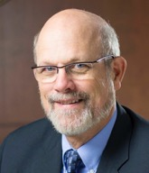
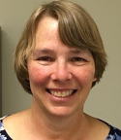
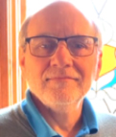
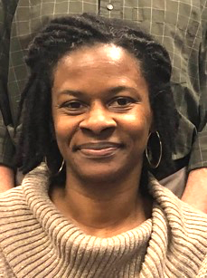
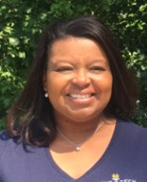
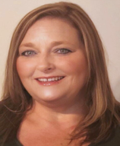
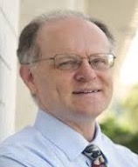
Team Perkins
Bob Witchger
Patti Coultas
Tony Reggi
Darice McDougald
Michelle Lair
Mary Olvera
Chris Droessler
Notes:
Dr. Bob Witchger
919-807-7126
WitchgerB@nccommunitycolleges.edu
Dr. Tony R. Reggi
919-807-7131
ReggiA@nccommunitycolleges.edu
Patti Coultas
919-807-7130
CoultasP@nccommunitycolleges.edu
Dr. Mary Olvera
919-807-7120
OlveraM@nccommunitycolleges.edu
Michelle Lair
919-807-72227
LairM@nccommunitycolleges.edu
Chris Droessler
919-807-7068
DroesslerC@nccommunitycolleges.edu
Darice McDougald
919-807-7219
McDougaldD@nccommunitycolleges.edu

Slide 3
Purpose of Perkins
Develop more fully the academic knowledge and technical and employability skills of secondary education students and postsecondary education students who elect to enroll in CTE curriculum programs and programs of study
Notes:
The Strengthening Career and Technical Education for the 21st Century Act reauthorized and updated the Carl D. Perkins Career and Technical Education Act of 2006 to become the current Carl D. Perkins Career and Technical Education Act of 2006 as amended by the Strengthening Career and Technical Education for the 21st Century Act (Perkins V)
This updated act stresses:
- Academic, Technical, and Employability Skills
- Funding Secondary and Postsecondary CTE
- Focusing on Students who elect to enroll in CTE Programs of Study

Slide 4
Promising Practice Video 2021
Rockingham Community College
Conducted a program demand gap analysis to determine the actual labor market needs for the area
https://www.ncperkins.org/video/video.php?v=Rockingham-2021&y=2021
See all the videos:
https://www.ncperkins.org/video/
Notes:
August 2021
Wilson
Wilkes
September 2021
Wayne
Vance-Granville
October 2021
Stanly
Southeastern
November 2021
South Piedmont
Rowan-Cabarrus
January 2022
Rockingham
Robeson
February 2022
Pitt-Martin
Pamlico
March 2022
Nash
Mayland
April 2022
Lenoir
Johnston
May 2022
James_Sprunt
Halifax
Gaston
Forsyth
Fayetteville
Edgecombe
Durham
Davidson
Craven
Coastal_Carolina
Central_Piedmont
Carteret
Cape_Fear
Caldwell
Brunswick
Blue_Ridge
Beaufort
AB_Tech

Slide 5
Basic Grant
Budget modifications
Supply chain issues – equipment ordered, delivered, paid for in program year
Budget ideas
Professional development
Mini grants
Extra Duty – stipends are not allowed as there are no deliverables
Enhance CLNA
Update Career Pathways
Expand Work-based Learning
Other ideas?

Slide 6
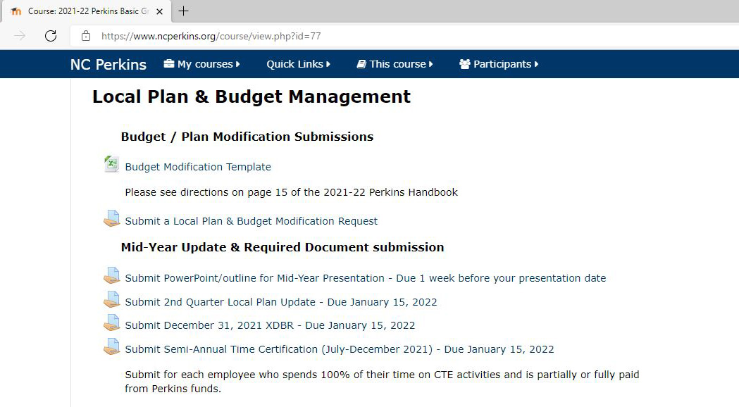

Slide 7
Mid-Year Reviews - Reminder
Colleges grouped by affinity group
Present in random order
Colleges expected to stay all day
College will show Power Point from their computer
Send videos to Chris
Jan 12, 13, 14, 18, 20, 21, 2022
8am to 1pm
Sign up at ncperkins.org/presentations

Slide 8
Mid-Year Reviews - Agenda
Introductions
Performance indicators – performance vs negotiated
College presentation
Have CLNA findings improved CTE?
Share a Promising Practice
How is college coping under COVID-19?
Budget and spending plan
Comments and questions

Slide 9
Mid-Year Reviews January 12, 2022
Brunswick CC
College of The Albemarle
Halifax CC
James Sprunt CC
Martin & Roanoke-Chowan
Mayland CC
McDowell TCC
Montgomery CC
Piedmont CC
Tri-County CC

Slide 10
Mid-Year Reviews January 13, 2022
Beaufort County CC
Bladen CC
Blue Ridge CC
Carteret CC & Pamlico CC
Mitchell CC
Rockingham CC
Sampson CC
South Piedmont CC
Southeastern CC
Wilson CC

Slide 11
Mid-Year Reviews January 14, 2022
Caldwell CC and TI
Coastal Carolina CC
Craven CC
Haywood CC
Isothermal CC
Randolph CC
Southwestern CC
Western Piedmont CC
Wilkes CC

Slide 12
Mid-Year Reviews January 18, 2022
Cleveland CC
Johnston CC
Lenoir CC
Nash CC
Robeson CC
Sandhills CC
Surry CC
Vance-Granville CC
Wayne CC

Slide 13
Mid-Year Reviews January 20, 2022
Alamance CC
Asheville-Buncombe TCC
Catawba Valley CC
Davidson-Davie CC
Durham TCC
Edgecombe CC
Gaston College
Richmond CC
Stanly CC

Slide 14
Mid-Year Reviews January 21, 2022
Cape Fear CC
Central Carolina CC
Central Piedmont CC
Fayetteville TCC
Forsyth TCC
Guilford TCC
Pitt CC
Rowan-Cabarrus CC
Wake TCC

Slide 15
High School to Community College Articulation Agreement
College credit earned for high school course on list
joins secondary and postsecondary CTE programs of study
Shortens education pathway
Great for college recruitment

Slide 16
High School to Community College Articulation Agreement
State Agreement since 1999
Local Agreement

Slide 17
High School to Community College Articulation Agreement – State Agreement
Updating the list of course matches – Spring 2022
State staff review
CAO leads review teams
Local review teams with HS teacher and CC instructor
Chief Academic Officer reviews final data
State Board for ratification

Slide 18
High School to Community College Articulation Agreement – Local Agreement
New guide to developing a local agreement will be released soon
College credit for local high school courses
Recruiting tool for college
Not all colleges use same curriculum for same course
College meets with local school administrative units in their area
Have CC instructors meet with HS teachers to discuss commonality in coursework
Chief Academic Officer has final say in granting credit

Slide 19
Promising Practice Video 2021
Robeson Community College
New PLCs, motion controllers, and motors
https://www.ncperkins.org/video/video.php?v=Robeson-2021&y=2021
See all the videos:
https://www.ncperkins.org/video/
Notes:
August 2021
Wilson
Wilkes
September 2021
Wayne
Vance-Granville
October 2021
Stanly
Southeastern
South Piedmont
Rowan-Cabarrus
Rockingham
Robeson
Pitt-Martin
Pamlico
Nash
Mayland
Lenoir
Johnston
James_Sprunt
Halifax
Gaston
Forsyth
Fayetteville
Edgecombe
Durham
Davidson
Craven
Coastal_Carolina
Central_Piedmont
Carteret
Cape_Fear
Caldwell
Brunswick
Blue_Ridge
Beaufort
AB_Tech

Slide 20
Leadership Projects
Continuing Projects
Proposed
CORD
SkillsUSA-NC
EDU Curriculum review and update
Cyber Security
Apple Swift
Success Coach training with Student Services
BLET Curriculum Development
Distance Learning meetings
Career Clusters Guide
Addressing gaps in Equity and other statewide CLNA identified gaps
Marketing CTE
Other Ideas?

Slide 21
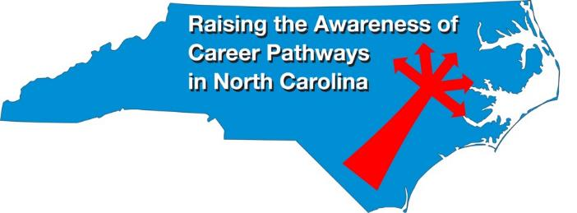
Raising the Awareness of Career Pathways Webinars
January 19, 2022 @ 9am
Come explore careers in Sustainability
https://register.gotowebinar.com/register/1989221456711239696
See all upcoming and past webinars at https://www.ncperkins.org/presentations/

Slide 22
Perkins Updates
2nd Tuesday of the month (not December)
9 am
Via GoToWebinar
Find the registration links at NCperkins.org/presentations
Notes:
Register now and let the system remind you.

Slide 23
CTE Training
Training online - www.ncperkins.org
Perkins Update Webinars - Second Tuesday
Career Pathways Webinars - Third Wednesday
Additional webinars on popular topics:
CLNA
Programs of Study
Career Pathways
At your College by request
https://www.ncperkins.org/presentations/
Notes:
https://www.ncperkins.org/presentations/

Slide 24
Technical assistance is available
We are here to help!
Team Perkins is available by phone, email, TEAMS, etc.
Your CTE Coordinator will be traveling to your college throughout the year.

Slide 25
Perkins/CTE State Staff
Dr. Bob Witchger Director, Career & Technical Education WitchgerB@nccommunitycolleges.edu 919-807-7126
Dr. Tony R. Reggi Coordinator, Career & Technical Education ReggiA@nccommunitycolleges.edu 919-807-7131
Patti Coultas Coordinator, Career & Technical Education CoultasP@nccommunitycolleges.edu 919-807-7130
Dr. Mary Olvera Coordinator, Career & Technical Education OlveraM@nccommunitycolleges.edu 919-807-7120
Michelle Lair Coordinator, CCP and Career & Technical Education LairM@nccommunitycolleges.edu 919-807-7227
Chris Droessler Coordinator, Career & Technical Education DroesslerC@nccommunitycolleges.edu 919-807-7068
Darice McDougald CTE Administrative Assistant McDougaldD@nccommunitycolleges.edu 919-807-7219
Notes:
http://www.ncperkins.org/course/view.php?id=6

