Slide 1
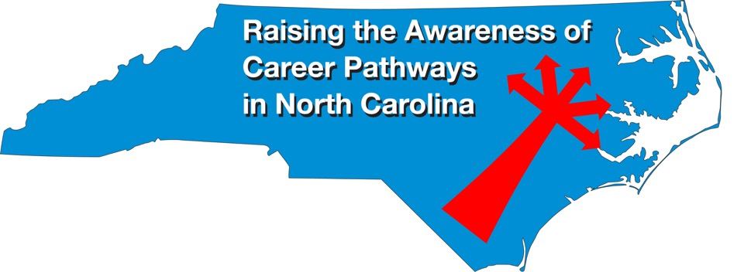
August 18, 2021 Careers in Diesel Mechanics
Download the PowerPoint and access the recording: www.ncperkins.org/presentations
Notes:
Chris
We are here to help promote the great jobs, often unknown, in the great state of North Carolina.
Through these monthly meetings, we are going to let you know about some great career opportunities in North Carolina.
And bring in special guests to let you know about the great career opportunities in North Carolina.
Please download this PowerPoint file and use it anyway you can to help get folks on a career pathway.
The reference showing from where the information was found, as well as the contact information for our guests is in the Notes section under each slide.
Get the PowerPoint on our NCPerkins.org website on our Presentations and Webinars page.
Here is the direct address on the screen.
-----
Many of the videos shown during this webinar can be found here:
https://www.ncperkins.org/video/

Slide 2
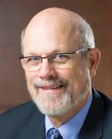
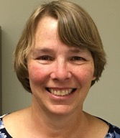
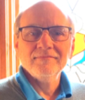
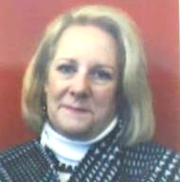
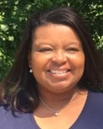
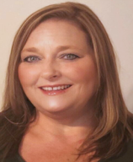
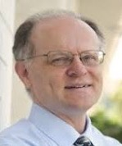
Raising the Awareness of Career Pathways in North Carolina
Bob Witchger
Patti Coultas
Tony Reggi
Cheryl Cox
NC Dept of Public Instruction
Michelle Lair
Mary Olvera
Chris Droessler
Notes:
Chris
I always say our webinars are like radio but with pictures.
And here are a few pictures of your hosts for these monthly explorations into career pathways.
(Why does the photographer have the best photo?)
Our contact information is in the notes section under this slide.
Dr. Bob Witchger
919-807-7126
WitchgerB@nccommunitycolleges.edu
Dr. Tony R. Reggi
919-807-7131
ReggiA@nccommunitycolleges.edu
Patti Coultas
919-807-7130
CoultasP@nccommunitycolleges.edu
Dr. Mary Olvera
919-807-7120
OlveraM@nccommunitycolleges.edu
Michelle Lair
919-807-72227
LairM@nccommunitycolleges.edu
Chris Droessler
919-807-7068
DroesslerC@nccommunitycolleges.edu
Cheryl Cox
NC Department of Public Instruction
919-807-3814
Cheryl.Cox@dpi.nc.gov

Slide 3
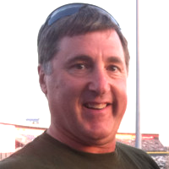
Frank Scuiletti
Program Coordinator: Construction, Engineering, Industrial, Transportation, Criminal Justice,
Fire Protection, & Work-Based Learning
Notes:
Frank Scuiletti
scuilettif@nccommunitycolleges.edu

Slide 4
Transportation Technologies Faculty Professional Development
Please inform your Transportation Technology faculty
We will be meeting in person or virtually in the fall
Topics to include:
Faculty report out on teaching and strategies used/developed during the pandemic
Enhancing Secondary and Postsecondary Career Pathways
ASE Accreditation (NATEF)
State-wide association for Transportation Technology faculty
Perkins Basic Grant funds can be used for this travel

Slide 5
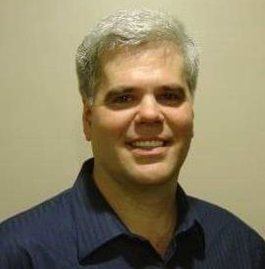
Jim Pressly
Trade, Technology, Engineering, and Industrial Education Consultant: Automotive Service, Collision Repair, Welding, and Metal Manufacturing.
Notes:
919-807-3887
james.pressly@dpi.nc.gov

Slide 6
Community College Programs in Diesel Mechanics
Agricultural Systems Technology (A60410)
Automotive Light-Duty Diesel Technology (D60430)
Diesel and Heavy Equipment Technology (A60460)
Notes:
https://www.nccommunitycolleges.edu/academic-programs/nc-community-college-system-catalog

Slide 7
Agricultural Systems Technology (A60410)
Wake Technical Community College
Wilkes Community College
Notes:
https://www.nccommunitycolleges.edu/academic-programs/nc-community-college-system-catalog

Slide 8
Automotive Light-Duty Diesel Technology (D60430)
Blue Ridge Community College
Pitt Community College
Randolph Community College
Rowan-Cabarrus Community College
Notes:
https://www.nccommunitycolleges.edu/academic-programs/nc-community-college-system-catalog

Slide 9
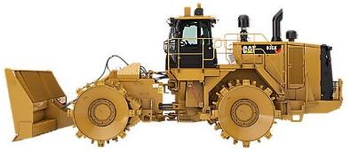
Diesel and Heavy Equipment Technology (A60460)
Asheville-Buncombe Technical Community College
Cape Fear Community College
Carteret Community College
Central Piedmont Community College
Coastal Carolina Community College
Davidson County Community College
Forsyth Technical Community College
Guilford Technical Community College
James Sprunt Community College
Johnston Community College
Wake Technical Community College
Wilkes Community College
Notes:
https://www.nccommunitycolleges.edu/academic-programs/nc-community-college-system-catalog

Slide 10
Diesel and Heavy Equipment Technology (A60460)
Course work may include transportation systems theory, braking systems, climate control, design parameters, drive trains, electrical/electronic systems, engine repair, engine performance, environmental regulations, materials, product finish, safety, steering/suspension, transmission/transaxles, and sustainable transportation, depending on the program major area chosen.
The Diesel and Heavy Equipment Technology program prepares individuals to apply technical knowledge and skills to repair, service, and maintain diesel engines in vehicles such as heavy-duty trucks over one-ton classification, buses, ships, railroad locomotives, and equipment; as well as stationary diesel engines in electrical generators and related equipment.
Notes:
https://www.nccommunitycolleges.edu/academic-programs/nc-community-college-system-catalog

Slide 11
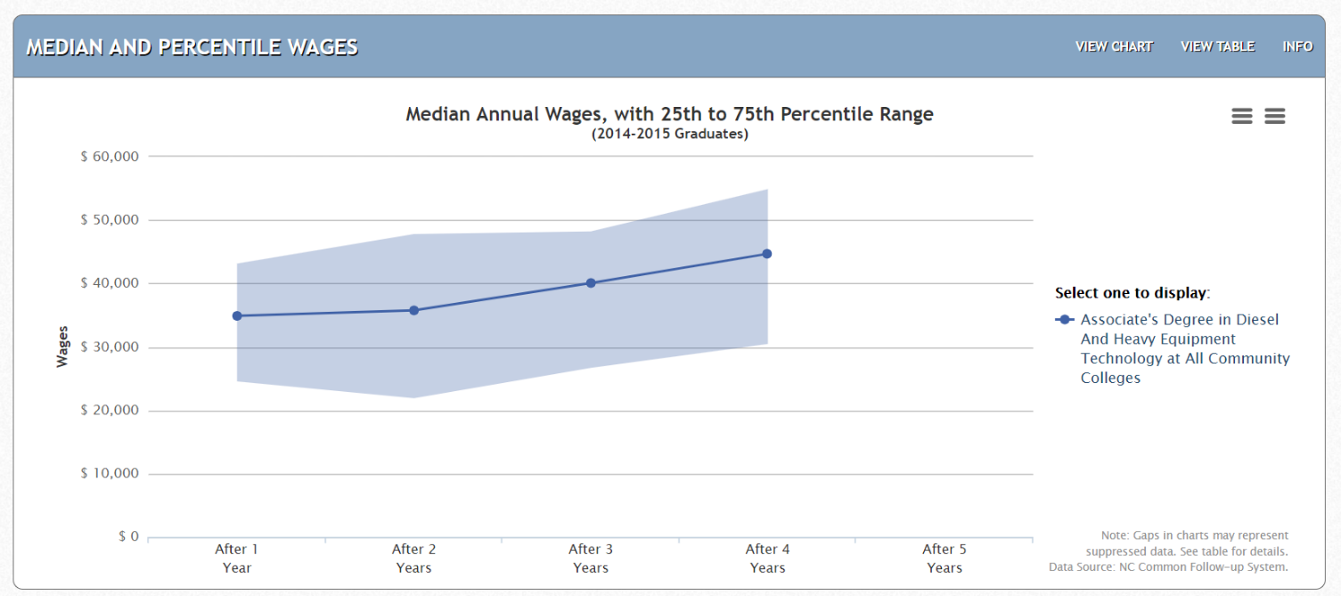
Heavy Equipment Technologies – NC Graduates
Data from NCTower.com
Notes:
https://www.nctower.com/output/ncccs/9662/2015/

Slide 12
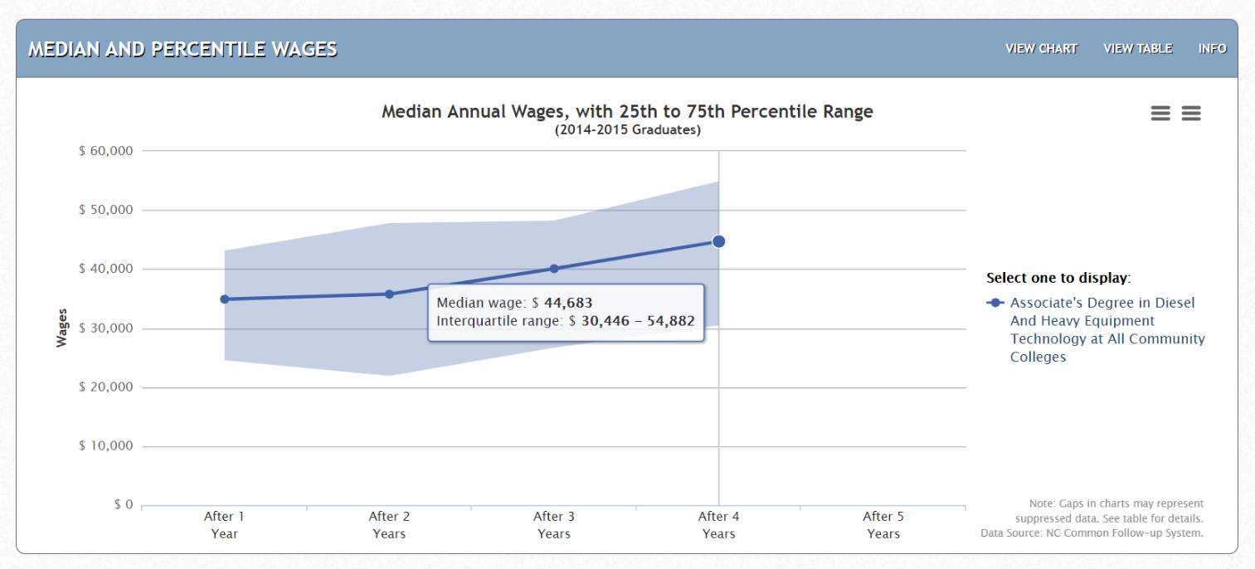
Heavy Equipment Technologies – NC Graduates
Data from NCTower.com
Notes:
https://www.nctower.com/output/ncccs/9662/2015/

Slide 13
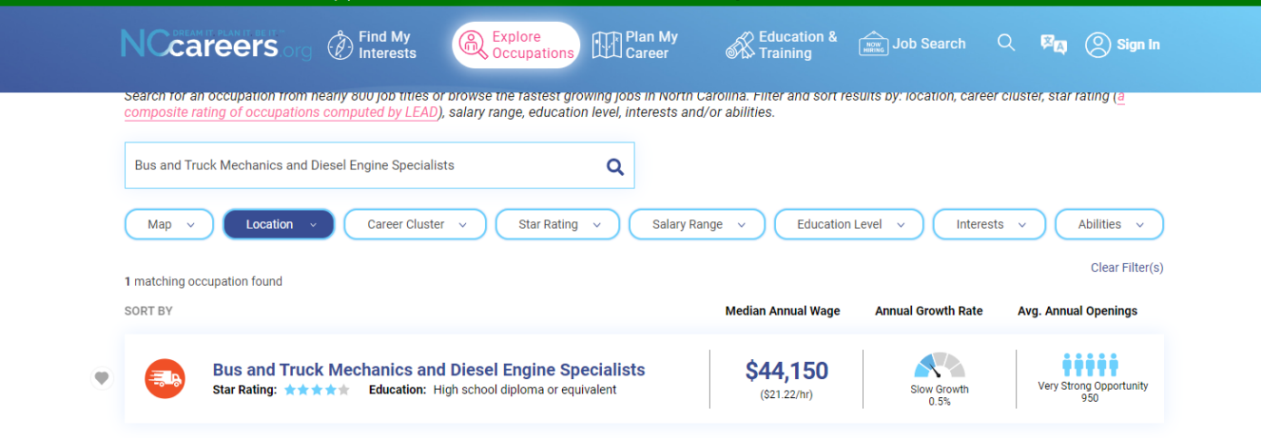
Notes:
https://nccareers.org/occupation-profile?search-title=mechanic&title=mechanic&field_alternative_titles_value=&field_area_target_id_1=All&field_area_target_id_1=1284&area-dropdown=1284&area-dropdown=All&nid=all#explore-occupation-start

Slide 14
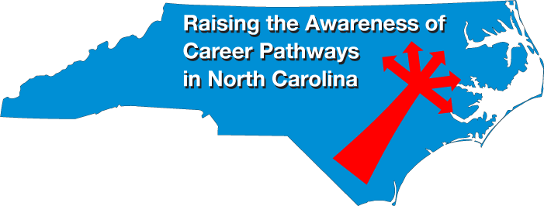
Notes:
www.ncperkins.org/presentations

Slide 15
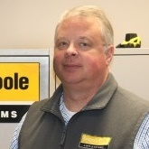
Mark Wallace
Talent Acquisition Manager
Gregory Poole Equipment Company
Notes:
Mark Wallace,
Talent Acquisition Manager at Gregory Poole Equipment
mark.wallace@gregpoole.com

Slide 16
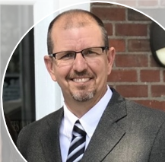
Tony Bennett
Master Technician – Service Sales Rep.
Gregory Poole Equipment Company
Notes:
Tony Bennett, Diesel Mechanic at Gregory Poole Equipment
Bennett, Tony
Tony.Bennett@gregpoole.com

Slide 17
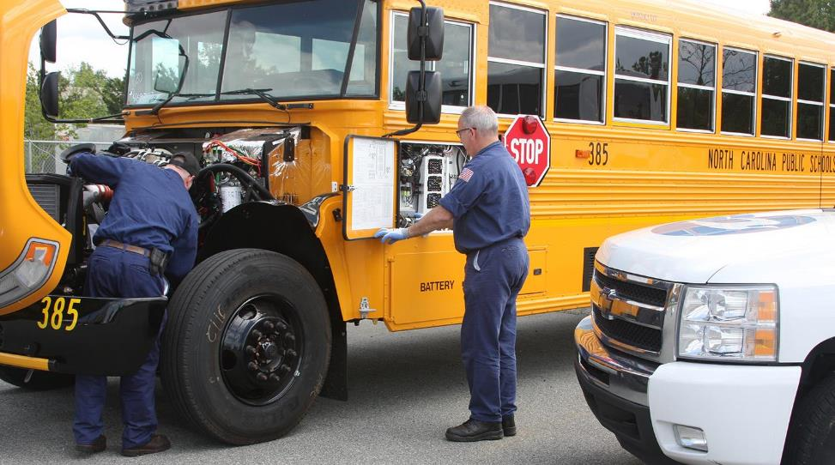
Notes:
https://www.gregorypoole.com/

Slide 18
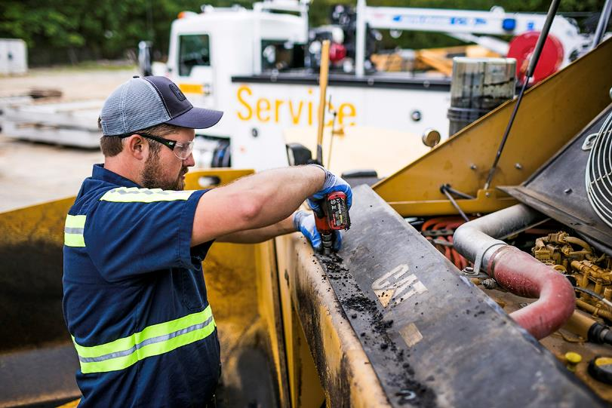
Notes:
https://www.gregorypoole.com/

Slide 19
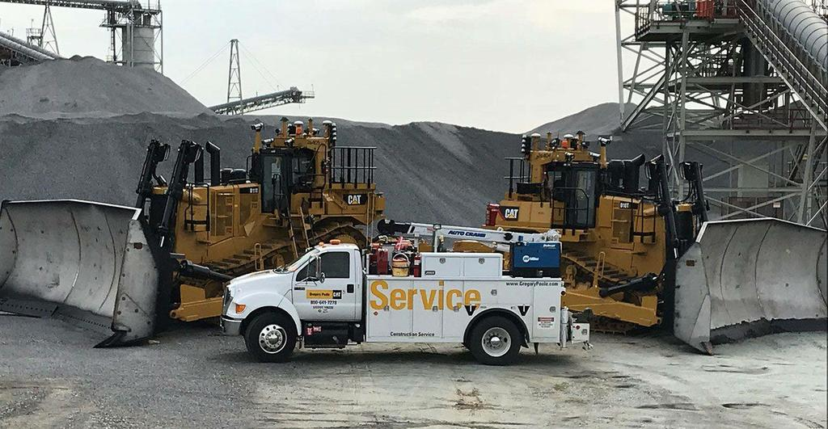
Notes:
https://www.gregorypoole.com/

Slide 20
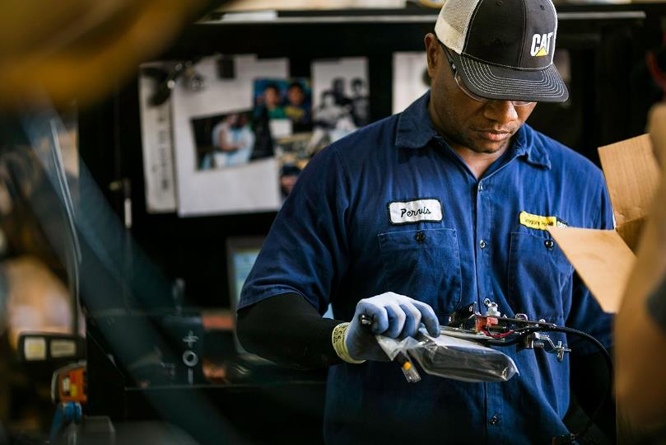
Notes:
https://www.gregorypoole.com/content/uploads/2020/03/technician.jpg

Slide 21
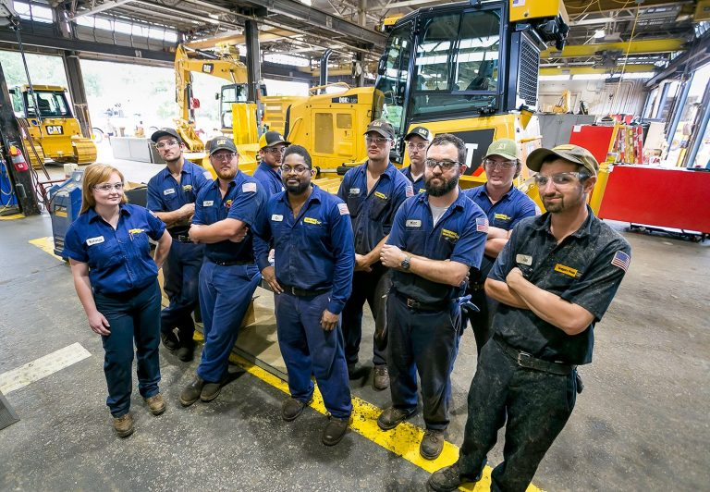
Notes:
https://www.gregorypoole.com/content/uploads/2020/03/Shop-Service-768x532.jpg

Slide 22
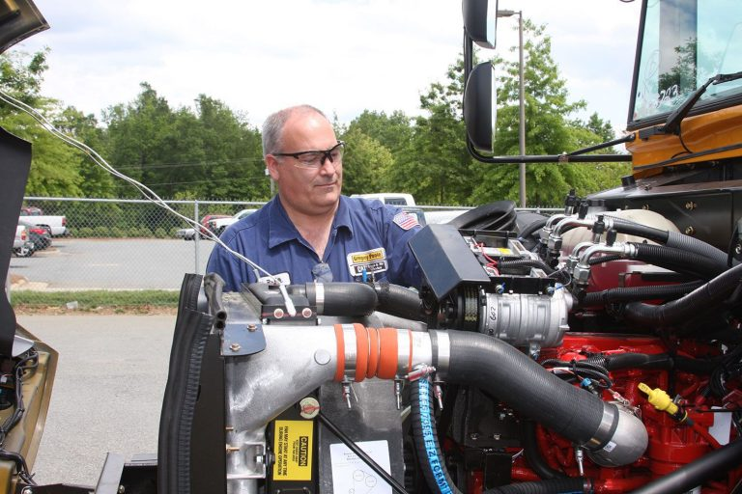
Notes:
https://www.gregorypoole.com/content/uploads/2019/01/Bus-Service-768x512.jpg

Slide 23
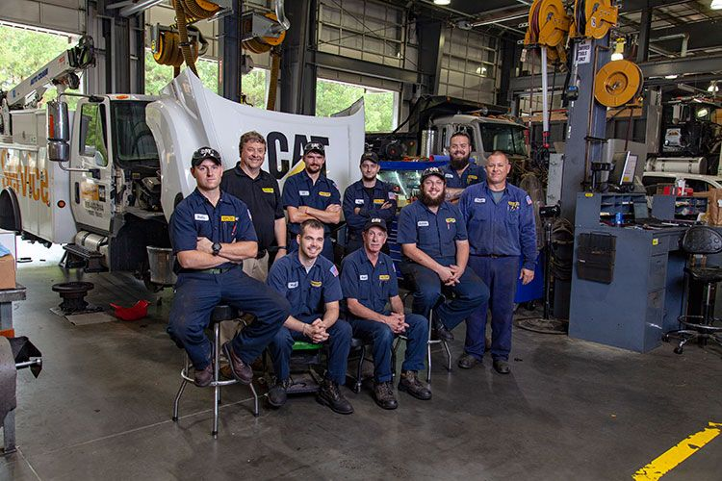
Notes:
https://www.gregorypoole.com/content/uploads/2019/01/TruckServiceTeam.jpg

Slide 24
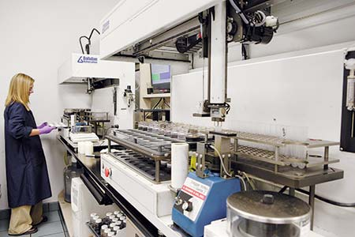
Notes:
https://www.gregorypoole.com/content/uploads/2016/02/C323643.jpg

Slide 25
Notes:
www.ncperkins.org/presentations

Slide 26
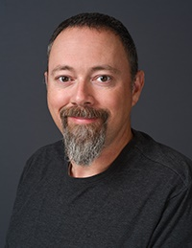
Spencer Dagenhardt
Lead Instructor Diesel and Heavy Equipment
Wilkes Community College
Notes:
Spencer Dagenhardt
spdagenhardt309@wilkescc.edu

Slide 27
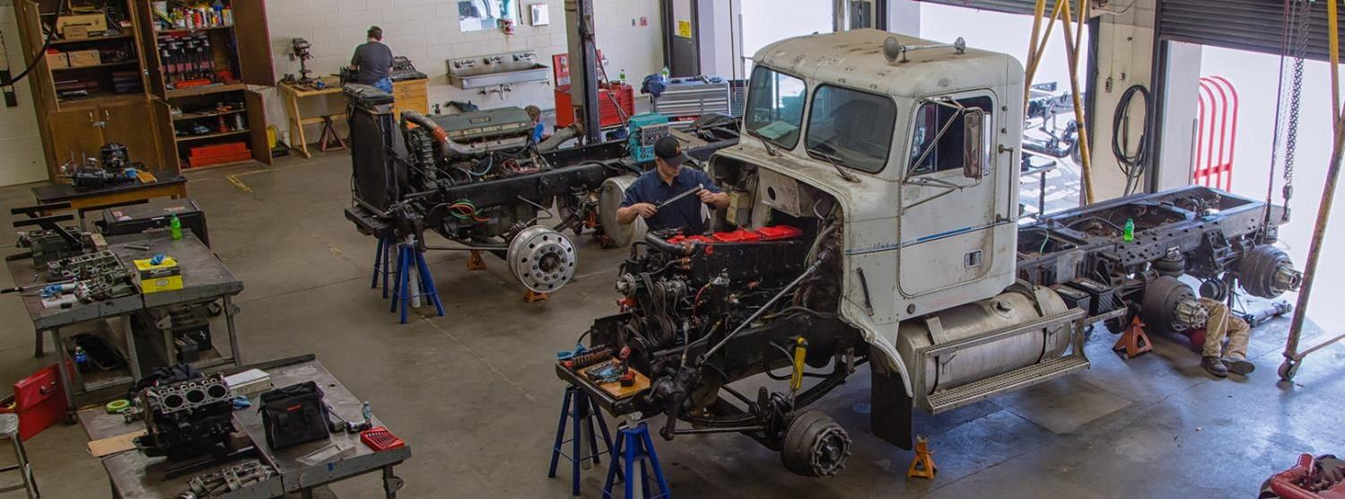
Wilkes Community College
Notes:
Wilkes Community College
https://www.wilkescc.edu/programs/transportation/diesel/

Slide 28
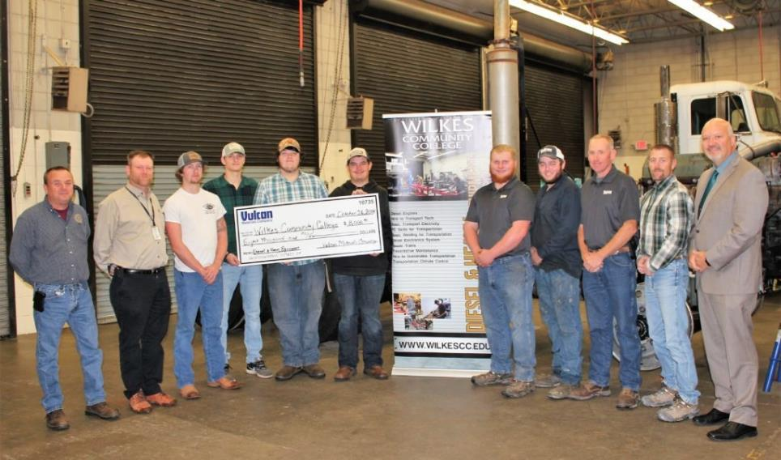
Wilkes Community College
Notes:
Wilkes Community College
https://www.wilkescc.edu/wp-content/uploads/2018/11/2018-11-9_Vulcan-Materials-awards-8000-to-WCC-1024x663.jpg

Slide 29
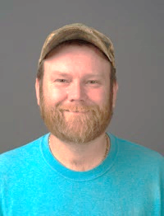
Hardin Kennedy III
Chair of Transportation Technology Programs
Wilkes Community College
Notes:
Hardin Kennedy, Transportation Technologies Chair and instructor, Wilkes Community College
Hardin Kennedy
hckennedy819@wilkescc.edu

Slide 30
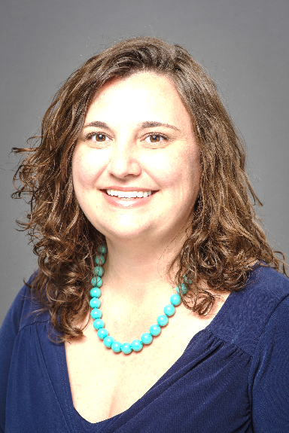
Bekah Gardner
Director of College Access
Wilkes Community College
Notes:
Bekah Gardner
Director of College Access Wilkes Community College 336.838.6492
rkgardner419@wilkescc.edu

Slide 31
Notes:
Bekah Gardner
Director of College Access Wilkes Community College 336.838.6492
rkgardner419@wilkescc.edu

Slide 32
Notes:
Bekah Gardner
Director of College Access Wilkes Community College 336.838.6492
rkgardner419@wilkescc.edu

Slide 33
Notes:
Bekah Gardner
Director of College Access Wilkes Community College 336.838.6492
rkgardner419@wilkescc.edu

Slide 34
Notes:
www.ncperkins.org/presentations

Slide 35
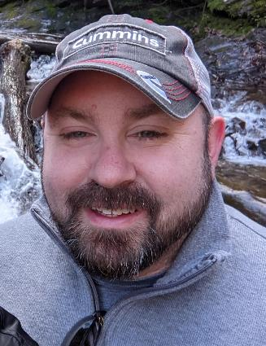
Patrick Freeland
Program Director and Instructor
Cape Fear Community College
Notes:
Patrick Freeland, Program Director and instructor
Cape Fear Community College
pcfreeland39@cfcc.edu
Patrick Freeland
Program Director CFCC
Diesel and Heavy Equipment Technology
(910)362-7149
pcfreeland39@mail.cfcc.edu
Promotional video
https://www.youtube.com/watch?v=HHgjBFi-zU0&t=193s

Slide 36
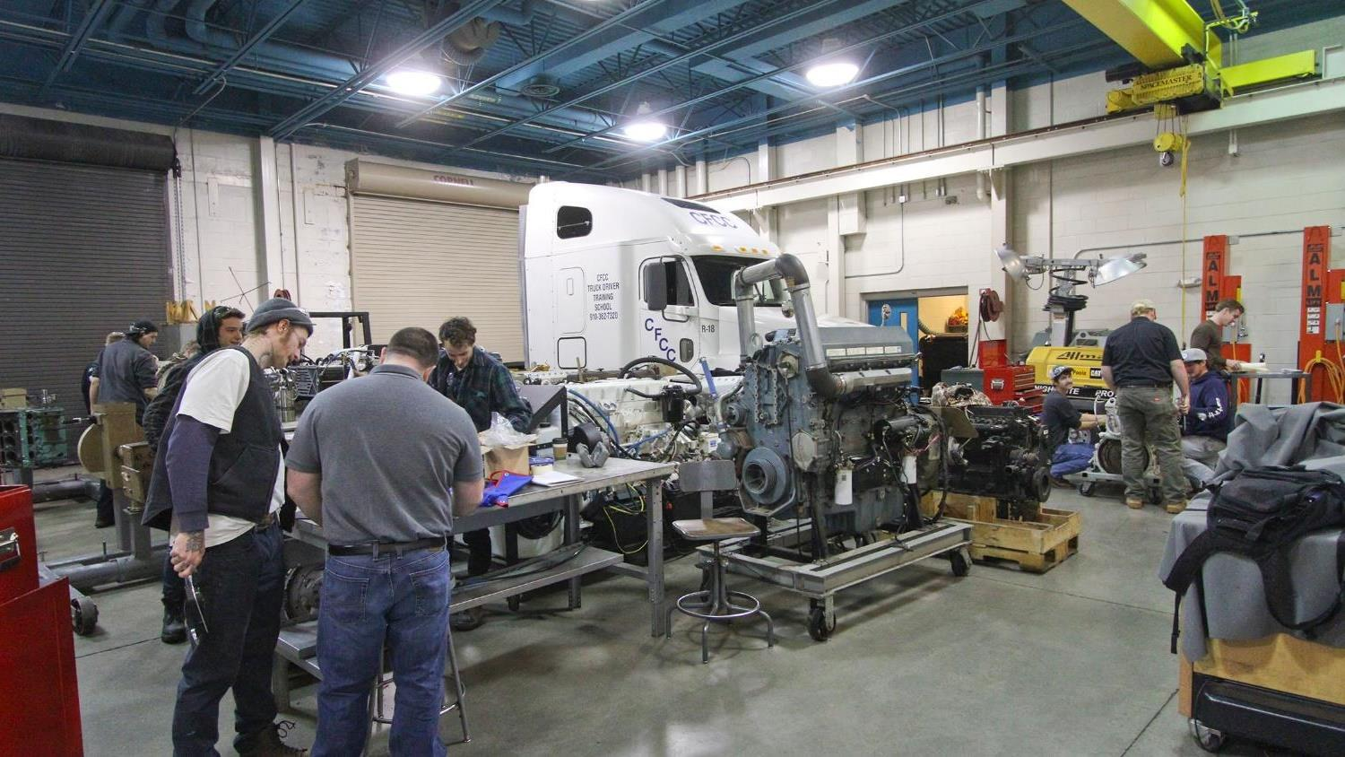
Notes:
Patrick Freeland, Program Director and instructor
Cape Fear Community College

Slide 37
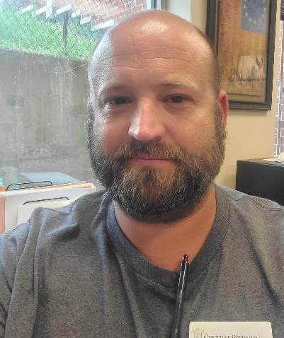
Jeremy Taylor
Transport Systems Technologies Program Chair
Central Piedmont Community College
Notes:
Jeremy Taylor Program Chair - Instructor HET, Transportation Systems Technology Division Central Piedmont Community College Merancas Campus, TS Building P.O. Box 35009 Charlotte, NC 28235 t 704.330.4181 | f 704.330.xxxx
jeremy.taylor@cpcc.edu
transport.systems@cpcc.edu

Slide 38
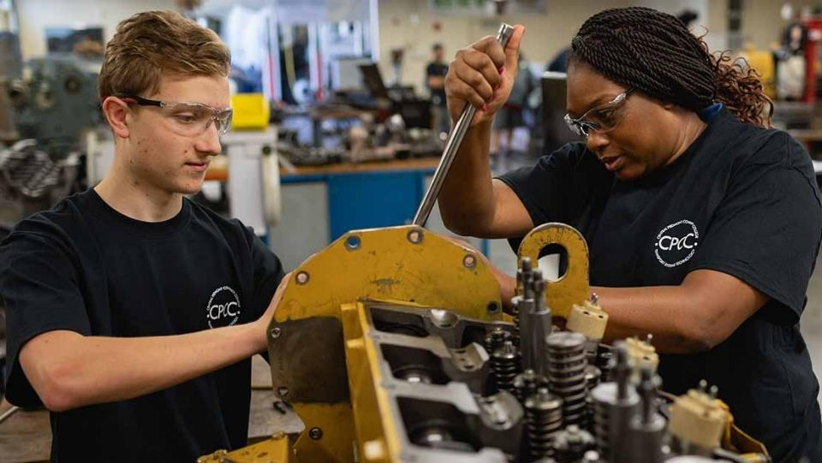
Notes:
Central Piedmont Community College
https://www.cpcc.edu/programs/diesel-and-heavy-equipment-technology

Slide 39
David G. Taylor
Cummins Sales and Service
Technician Apprentice Program Leader
Notes:
Cummins Diesel Apprenticeship with Central Piedmont Community College
David G. Taylor
Cummins Sales and Service
Technician Apprentice Program Leader, North America
Charlotte NC
Mobile: 704-562-9958
david.g.taylor@cummins.com
Working Right. | careers.cummins.com
Video - Powering Your Potential - The Cummins Technician Apprentice Program
https://cummins.hubs.vidyard.com/watch/s1GUkKLPVy6nCK61X7QV7N

Slide 40
Notes:
Cummins Diesel Apprenticeship with Central Piedmont Community College
David G. Taylor
Cummins Sales and Service
Technician Apprentice Program Leader, North America
Charlotte NC
Mobile: 704-562-9958
david.g.taylor@cummins.com
Working Right. | careers.cummins.com
Video - Powering Your Potential - The Cummins Technician Apprentice Program
https://cummins.hubs.vidyard.com/watch/s1GUkKLPVy6nCK61X7QV7N

Slide 41
Notes:
Cummins Diesel Apprenticeship with Central Piedmont Community College
David G. Taylor
Cummins Sales and Service
Technician Apprentice Program Leader, North America
Charlotte NC
Mobile: 704-562-9958
david.g.taylor@cummins.com
Working Right. | careers.cummins.com
Video - Powering Your Potential - The Cummins Technician Apprentice Program
https://cummins.hubs.vidyard.com/watch/s1GUkKLPVy6nCK61X7QV7N

Slide 42
Notes:
www.ncperkins.org/presentations

Slide 43
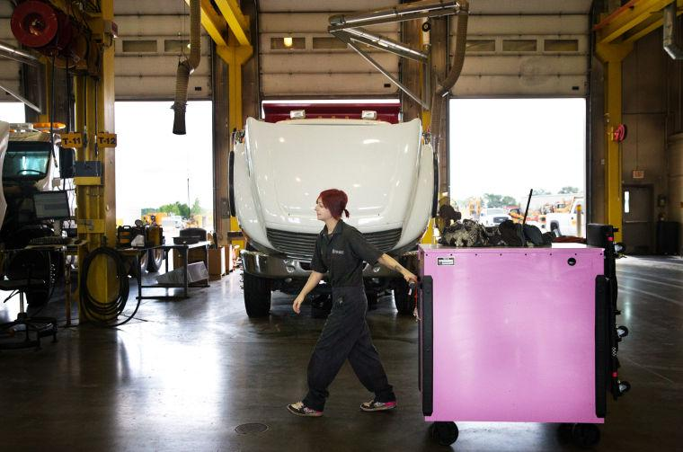
Notes:
https://bloximages.newyork1.vip.townnews.com/omaha.com/content/tncms/assets/v3/editorial/c/66/c666ef50-59ab-508f-a224-1632a20ec3eb/5332fe0d859ad.image.jpg?resize=760%2C503

Slide 44
Notes:
www.ncperkins.org/presentations

Slide 45
Notes:
https://www.industryweek.com/talent/article/21171697/manufacturing-adds-27000-jobs-in-july-as-wages-grow

Slide 46
NC Advanced Manufacturing Careers Awareness Week
September 27 through October 1, 2021
National MFG Day - October 1, 2021 (first Friday in October)
Find an event: https://www.creatorswanted.org/find-events/
Register your event https://www.creatorswanted.org/register-event/
MFG Day Resources: https://www.creatorswanted.org/resources/
Notes:
https://creatorswanted.org/mfgday/

Slide 47
NC Advanced Manufacturing Careers Awareness Week
September 27 through October 1, 2021
Asheville NC on Oct 1, 2021, 9am to 3pm Mathis Electronics: Electronics engineering and assembly to manufacturing tour
Sanford NC on Oct 1, 2021, 9am to 3pm Cashion Fishing Rods: Facility tour of manufacturing site
Greensboro NC (Virtual Event) on October 8, 2021 PPG: PPG Manufacturing Day (powder coating industry)
Plus many virtual events across the country
Notes:
https://creatorswanted.org/find-events/

Slide 48
Raising the Awareness of Career Pathways in North Carolina
Next meeting is September 15, 2021 –
Careers in Paralegal and Legal Assistant
Download the PowerPoint and access the recording: www.ncperkins.org/presentations
Notes:
Our next meeting like this one will be on ------.
(We will skip December and be back in January.)
You can go to the NCPerkins website to register for that meeting.
We'll also send you a reminder, since you are now on our mailing list.
So go ahead and sign up for all the meetings, and you'll be reminded the day before.
If you liked something you saw here, send folks to the recording. Find it at that same web page.

