Slide 1
Perkins Update Webinar
March 9, 2021

Slide 2
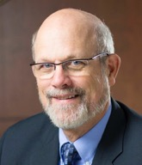
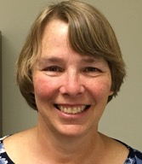
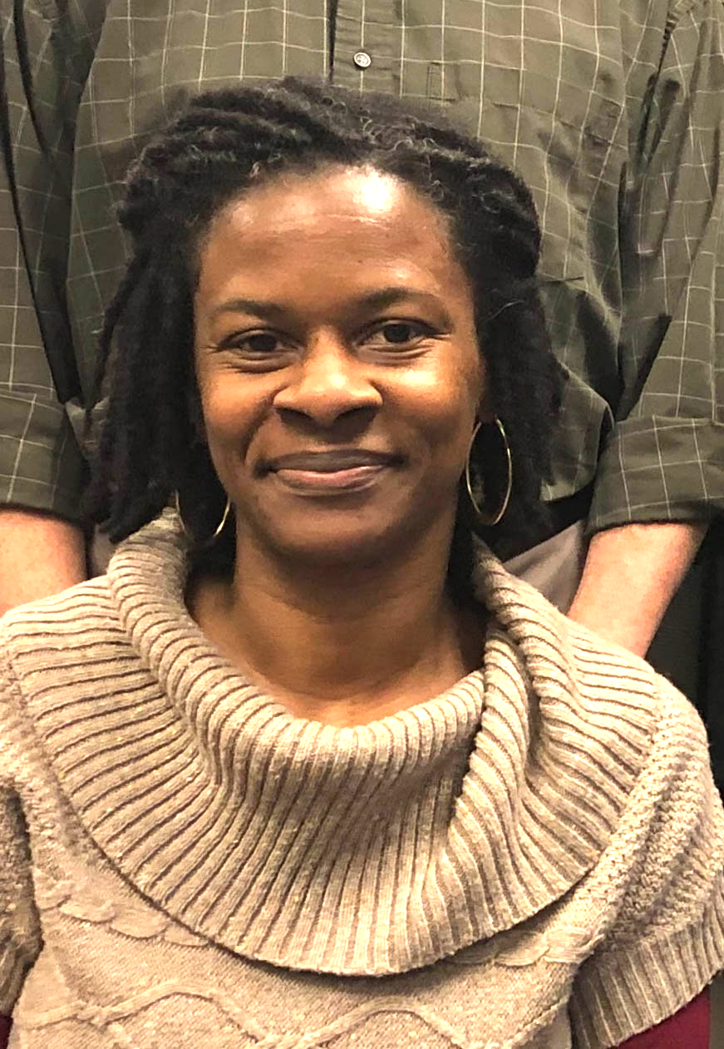
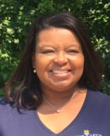
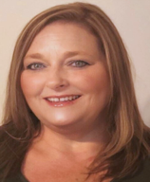
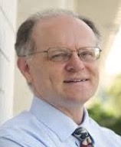
Team Perkins
Bob Witchger
Patti Coultas
Tony Reggi
Darice McDougald
Michelle Lair
Mary Olvera
Chris Droessler
Notes:
Dr. Bob Witchger
919-807-7126
WitchgerB@nccommunitycolleges.edu
Dr. Tony R. Reggi
919-807-7131
ReggiA@nccommunitycolleges.edu
Patti Coultas
919-807-7130
CoultasP@nccommunitycolleges.edu
Dr. Mary Olvera
919-807-7120
OlveraM@nccommunitycolleges.edu
Michelle Lair
919-807-72227
LairM@nccommunitycolleges.edu
Chris Droessler
919-807-7068
DroesslerC@nccommunitycolleges.edu
Darice McDougald
919-807-7219
McDougaldD@nccommunitycolleges.edu

Slide 3
COVID-19 Follow Up
How are you all doing?
What’s happening at your College?
What can we do to assist you?

Slide 4
Purpose of Perkins
Develop more fully the academic knowledge and technical and employability skills of secondary education students and postsecondary education students who elect to enroll in CTE programs and programs of study
Notes:
The Strengthening Career and Technical Education for the 21st Century Act reauthorized and updated the Carl D. Perkins Career and Technical Education Act of 2006 to become the current Carl D. Perkins Career and Technical Education Act of 2006 as amended by the Strengthening Career and Technical Education for the 21st Century Act (Perkins V)
This updated act stresses:
- Academic, Technical, and Employability Skills
- Funding Secondary and Postsecondary CTE
- Focusing on Students who elect to enroll in CTE Programs of Study

Slide 5
What’s Happening in Raleigh
MOA – Civil Rights Reviews
Plan and Budget Review - Consistency with CLNA
Accountability Measures – Dashboard, Future Negotiated Levels
Pathways Survey - Early Glimpse
Monitoring for equipment and time
Site Monitoring
Ideas for 2021-22 Leadership Projects

Slide 6
Promising Practice Videos 2020
Pitt Community College
Training to increase effectiveness of online courses
Quality Matters training for instructors
Course Development Academy
https://www.ncperkins.org/video
Notes:
Sept 2020
AB-Tech
Coastal Carolina
October 2020
Mitchell
Tri-County
November 2020
Haywood
Pamlico
January 2021
Rowan-Cabarrus
Isothermal
February 2021
Johnston
March 2021
Randolph
Pitt
Blue Ridge
Cape Fear
Mayland
Carteret
Sandhills
Central Piedmont
Wilson
Cleveland
Craven
Wilkes
Durham
Forsyth
Southwestern
Halifax
McDowell
Nash
Richmond
Wayne
Robeson
Caldwell
Rockingham
South Piedmont
Edgecombe
Western Piedmont
Southeastern
Catawba Valley
Stanly
Surry
Wake Tech
Fayetteville
Gaston
Vance-Granville
Sampson
Guilford
Central Carolina
Lenoir
Martin
Brunswick
Davidson
Roanoke-Chowan
James Sprunt
Bladen
College of Albemarle

Slide 7
CLNA – Begin with the End in Mind
Are we developing students with skills to meet industry needs?
Do we have adequate classes to meet the demand, in a sequence to educate/grow skilled individuals, in a quality manner?
Are we offering programs where there are or will be jobs?
How are we building new and/or modernizing existing CTE Programs of Study to meet emerging industry demands?
Are we retaining our faculty, improving their teaching skills, and recruiting new individuals for the teaching profession?
How are we assisting our special populations in developing skills for real jobs?

Slide 8
Comprehensive Local Needs Assessment (CLNA)
Each college engages their community to discuss:
Evaluation of Student Performance
Size, Scope, and Quality of the Programs
Programs Aligned to State, Regional, and Local Labor Market Needs
Fully Implemented Programs of Study
Recruitment, Retention, and Training of CTE Educators
Improving Access and Equity for All Students

Slide 9
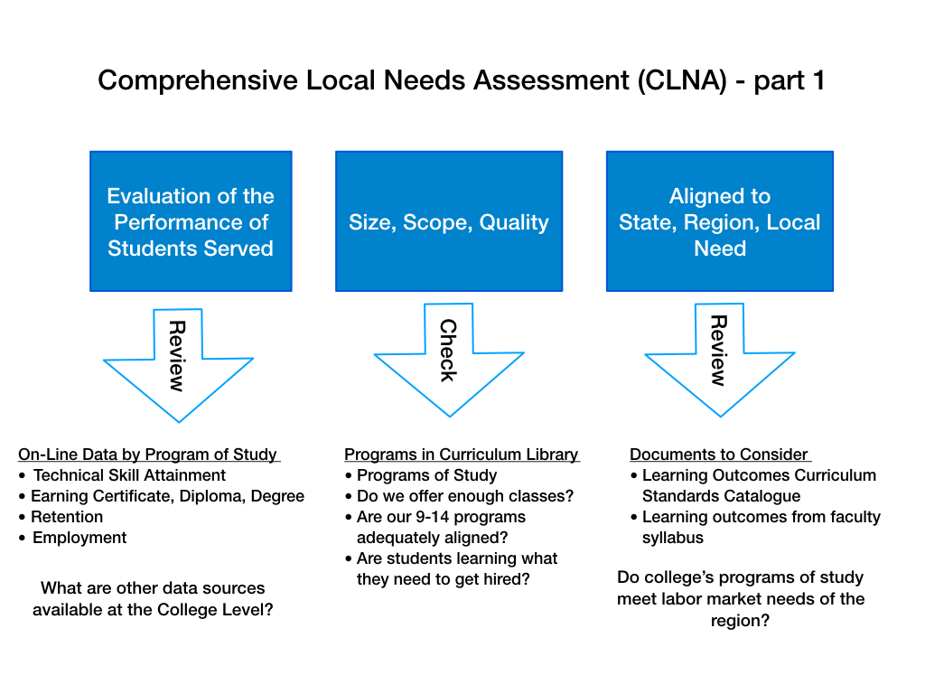

Slide 10
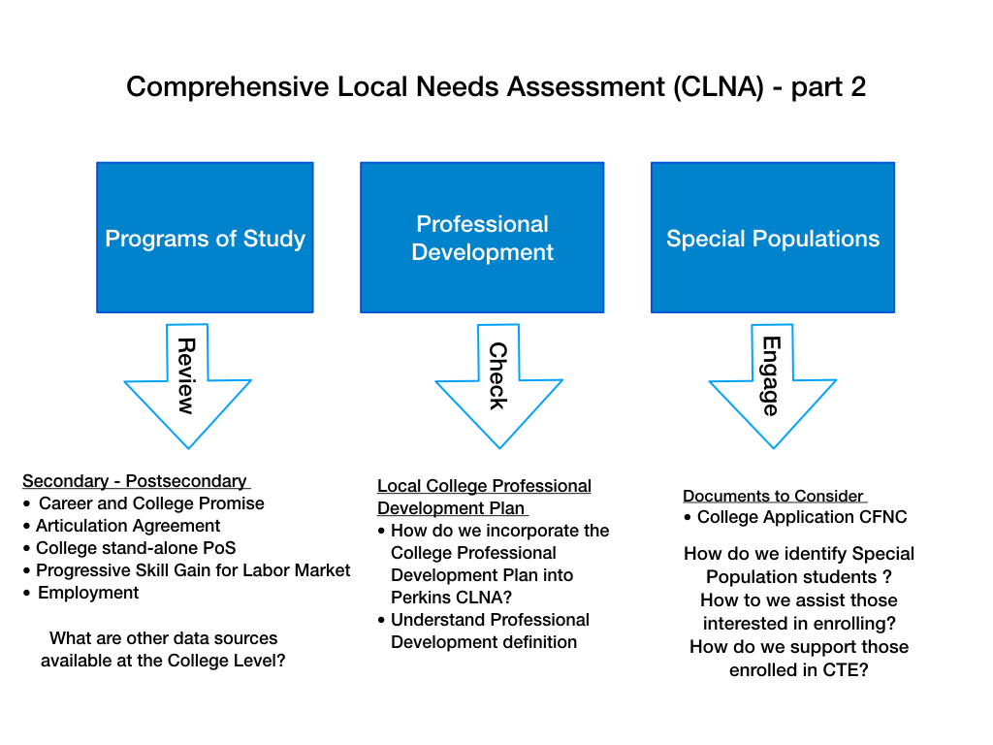

Slide 11
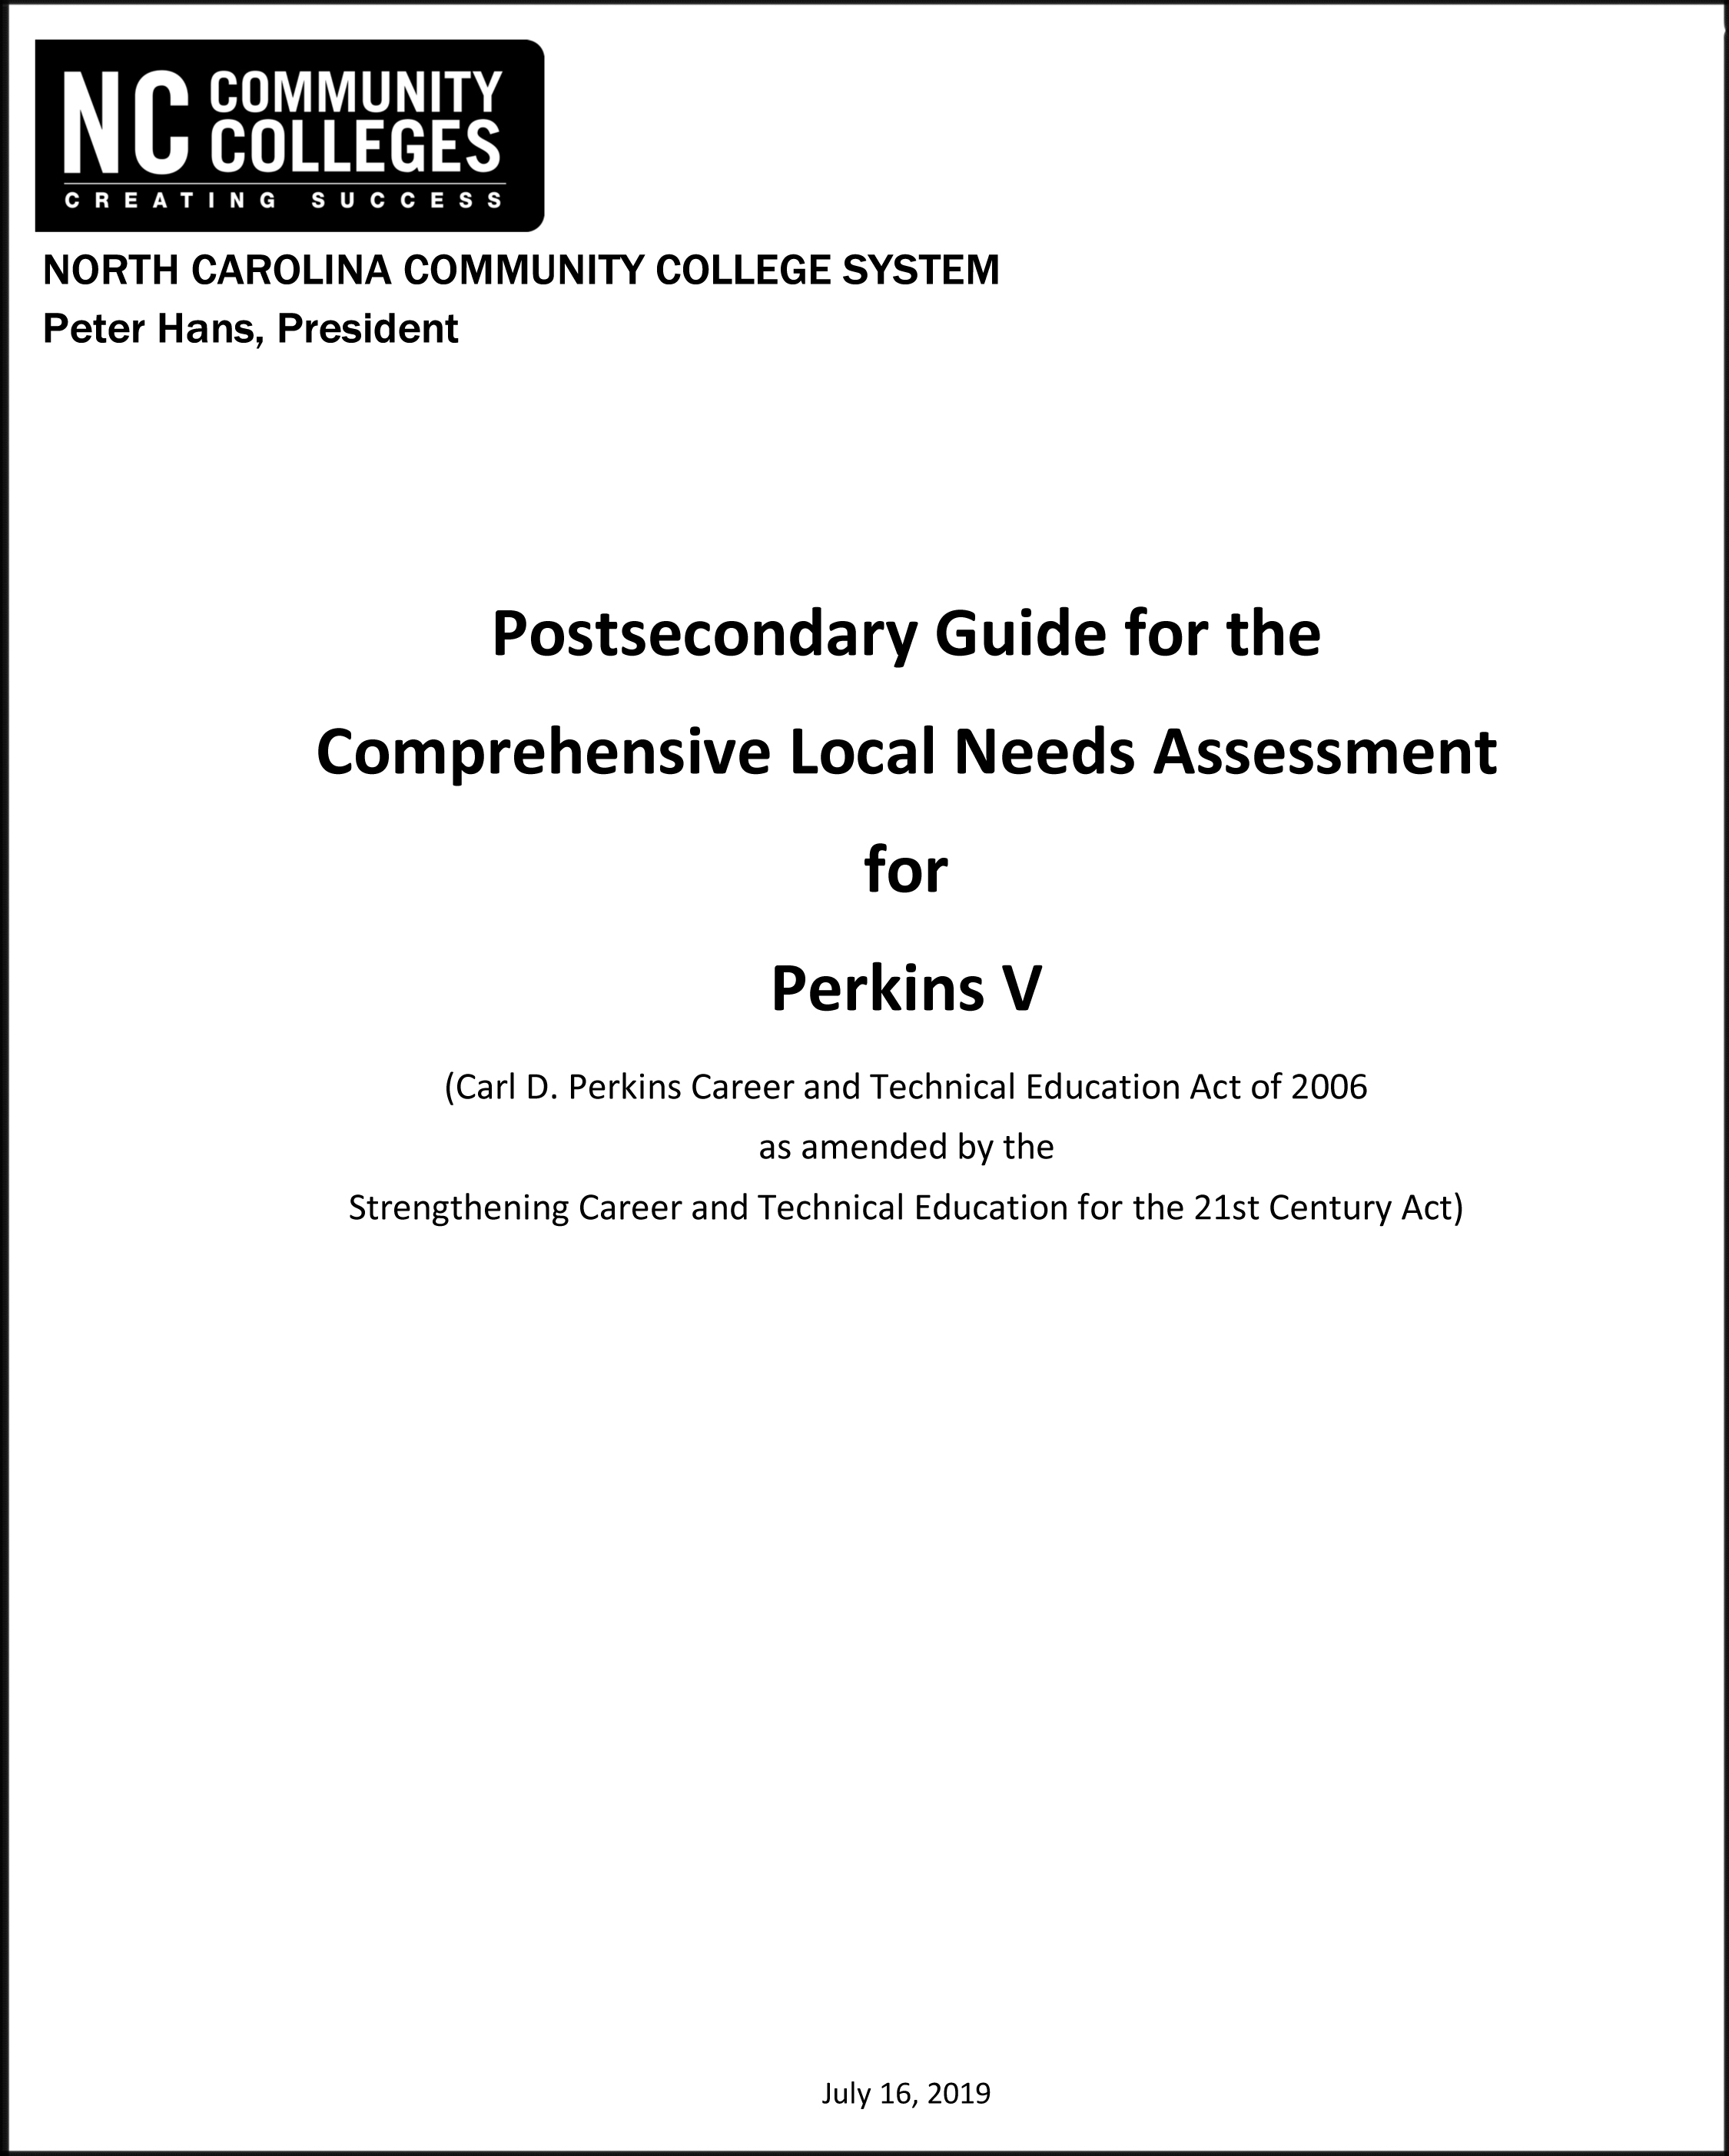
Notes:
Get a copy of the guide here:
https://www.ncperkins.org/

Slide 14
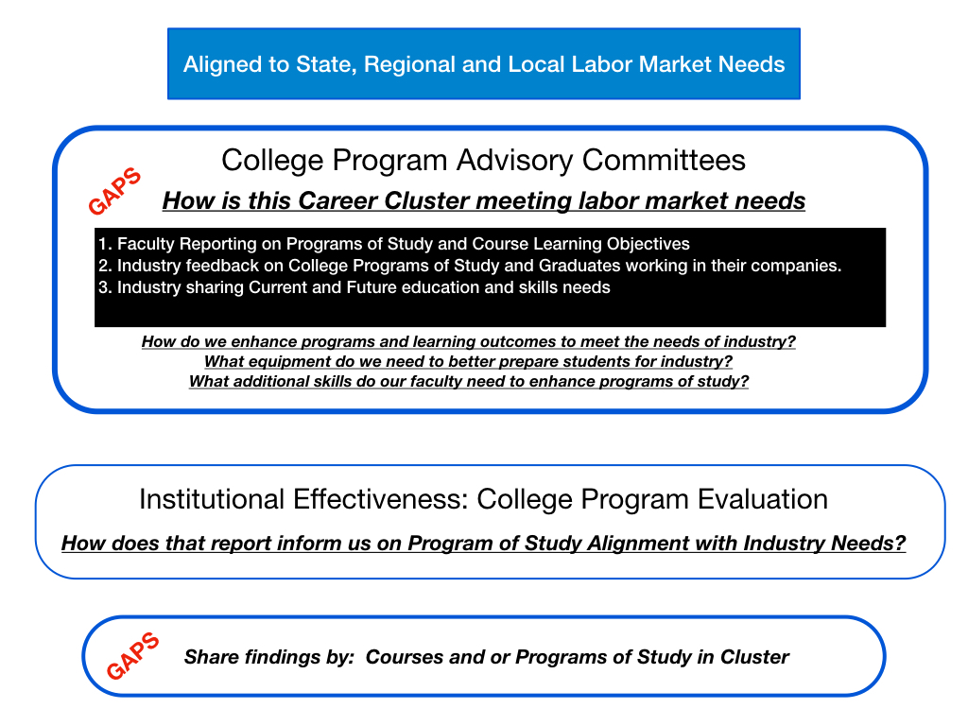

Slide 18
Gene Loflin
Asheville-Buncombe Technical Community College
Notes:
Gene Loflin <williameloflin@abtech.edu>

Slide 19
Pam Gibson
Fayetteville Technical Community College
Notes:
Pamela Gibson <gibsonp@faytechcc.edu>

Slide 20
Marianne Herring
Coastal Carolina Community College
Notes:
Herring, Marianne <herringm@coastalcarolina.edu>

Slide 21
Sarah Sawyer
Craven Community College
Notes:
﻿Sarah Sawyer <sawyers@cravencc.edu>

Slide 22
New CLNA?
If you conduct a new CLNA, then update your application to match.

Slide 23
Updated Equipment Purchasing Policy
Perkins funding may be used for the purchase of equipment in advance of a new programs starting in the summer or fall of the next academic year if:
The NC State Board of Community Colleges has approved the program,
A Comprehensive Local Needs Assessment has been submitted and approved by the NCCCS CTE Team, and
A plan and budget has been approved by the NCCCS CTE Team.

Slide 24
Equipment Purchases for New Programs
The equipment must be purchased, received, and paid for all within the same grant year.
Note that Perkins funds may not be used as the primary source for new program equipment, but to supplement the college’s funding to start the new program.
For all other equipment purchases, the policy of purchasing the equipment and having it in place and in use must be followed.

Slide 25
Perkins Annual Meeting
To be held during the regular April Perkins Monthly Update, but for an extended amount of time.
The handbook will be emailed to you before the end of March.
Mandatory attendance, either for live session or a recording will be available for viewing later.
April 13th, 9AM – 12 noon via GoTo Webinar.
Link at NCPerkins.org/presentations

Slide 26
NCperkins.org Moodle
New look next week

Slide 27
Connecting HS CTE Programs to CC Programs
Notes:
Michelle

Slide 28
End-of-Year Reviews
Sign up for a time slot here:
https://www.ncperkins.org/review/
"special consideration?" = Pathways
Connect to the Reviews here:
https://www.ncperkins.org/presentations/

Slide 29
Promising Practice Videos 2020
Randolph Community College
Advancing Manufacturing upgrades
4 modular conveyers to create a work cell in Advanced Manufacturing
New PLCs in PLC Lab
https://www.ncperkins.org/video
Notes:
Sept 2020
AB-Tech
Coastal Carolina
October 2020
Mitchell
Tri-County
November 2020
Haywood
Pamlico
January 2021
Rowan-Cabarrus
Isothermal
February 2021
Johnston
March 2021
Randolph
Pitt
Blue Ridge
Cape Fear
Mayland
Carteret
Sandhills
Central Piedmont
Wilson
Cleveland
Craven
Wilkes
Durham
Forsyth
Southwestern
Halifax
McDowell
Nash
Richmond
Wayne
Robeson
Caldwell
Rockingham
South Piedmont
Edgecombe
Western Piedmont
Southeastern
Catawba Valley
Stanly
Surry
Wake Tech
Fayetteville
Gaston
Vance-Granville
Sampson
Guilford
Central Carolina
Lenoir
Martin
Brunswick
Davidson
Roanoke-Chowan
James Sprunt
Bladen
College of Albemarle

Slide 30
SkillsUSA
April 20-22 Virtual State Competition
May 5-6 Connect to My Future conference
June 21-24 National Leadership and Skills Confernece
National: https://www.skillsusanc.org/
State: https://www.skillsusa.org/

Slide 31
SkillsUSA Connect to My Future Conference
SkillsUSA’s Connect to My Future conference is a two-day virtual conference designed to allow students to explore career pathways and connect directly with employers.
May 5-6, 2021
Registration opens March 15.
One-time chapter registration fee of $25 covers all of your students.
National: https://www.skillsusanc.org/

Slide 32
2021 ApprenticeshipNC Annual Conference
April 27, 28, 2021
8:30 am to 12:30 pm each day
Free
https://register.gotowebinar.com/register/7684553148246083597
Notes:
Registration page
https://register.gotowebinar.com/register/7684553148246083597

Slide 33
Raising the Awareness of Career Pathways Webinars
March 17, 2021 @ 9am
Come explore careers in Simulation and Game Development
https://register.gotowebinar.com/register/8352859401321845006
See all upcoming and past webinars at https://www.ncperkins.org/presentations/

Slide 34
CTE Training
Training online - www.ncperkins.org
Perkins Update Webinars - Second Tuesday
Career Pathways Webinars - Third Wednesday
At your College by request
https://www.ncperkins.org/presentations/
Notes:
https://www.ncperkins.org/presentations/

Slide 35
Perkins Updates
2nd Tuesday of the month
9 am
Via GoToWebinar
Find the registration links at NCperkins.org/presentations
Notes:
Register now and let the system remind you.

Slide 36
Perkins/CTE State Staff
Dr. Bob Witchger Director, Career & Technical Education WitchgerB@nccommunitycolleges.edu 919-807-7126
Dr. Tony R. Reggi Coordinator, Career & Technical Education ReggiA@nccommunitycolleges.edu 919-807-7131
Patti Coultas Coordinator, Career & Technical Education CoultasP@nccommunitycolleges.edu 919-807-7130
Dr. Mary Olvera Coordinator, Career & Technical Education OlveraM@nccommunitycolleges.edu 919-807-7120
Michelle Lair Coordinator, CCP and Career & Technical Education LairM@nccommunitycolleges.edu 919-807-7227
Chris Droessler Coordinator, Career & Technical Education DroesslerC@nccommunitycolleges.edu 919-807-7068
Darice McDougald CTE Administrative Assistant McDougaldD@nccommunitycolleges.edu 919-807-7219
Notes:
http://www.ncperkins.org/course/view.php?id=6

