Slide 1
Perkins Update
August 8, 2023

Slide 2
Career & Technical Education Team
Bob Witchger
Tony Reggi
Patti Coultas
Mary Olvera
vacant
Darice McDougald
Lane Freeman
Jennifer McLean
Aaron Mabe

Slide 3
Hiring a CTE Coordinator
Currently

Slide 4
Curriculum Programs Team
Michelle Lair
Dr. Lori Byrd
Dr. Hilmi Lahoud
Aaron Mabe
Todd Roth
Nedra Dixon
Peyton Bell
Gail Robertson
Reyna Rodriguez
Mary Olvera

Slide 5
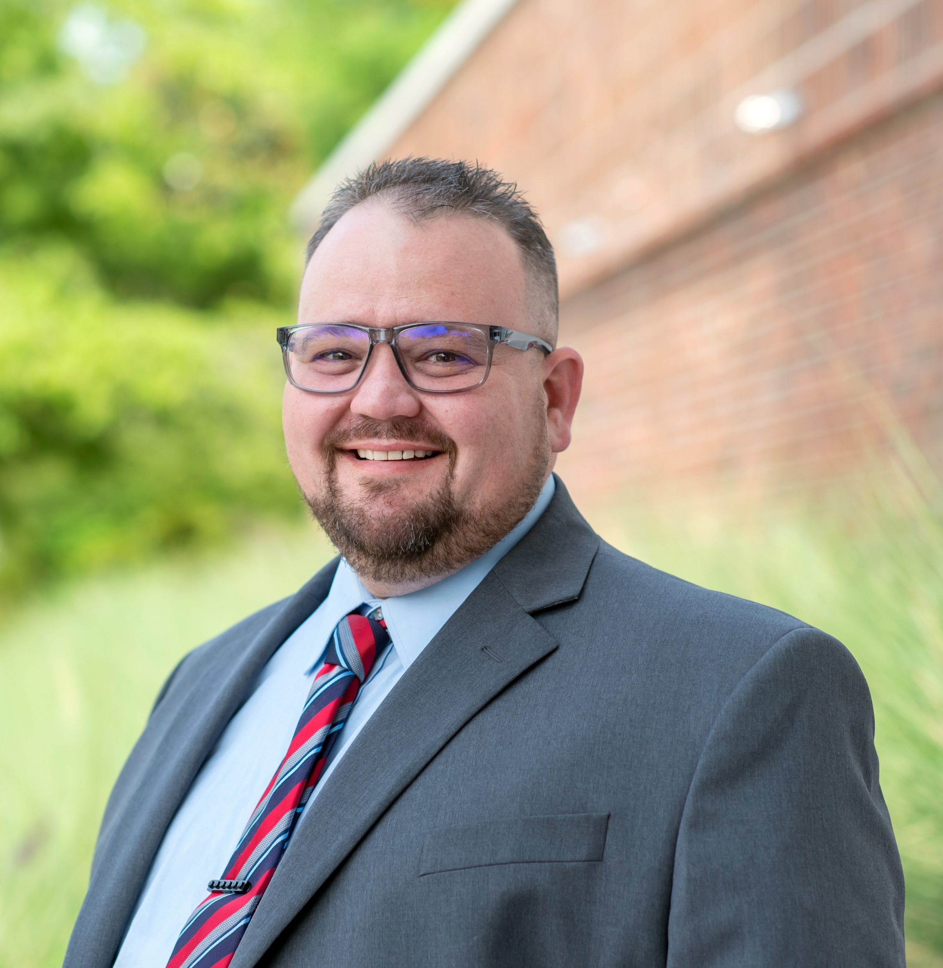
Welcome a new Program Administrator!
Todd Roth
Program Areas: Construction, Engineering, Industrial, and Transportation Technologies
Started August 1, 2023
rotht@nccommunitycolleges.edu
919-807-7107

Slide 6
Purpose of Perkins
Develop more fully the academic knowledge and technical and employability skills of secondary education students and postsecondary education students who elect to enroll in CTE curriculum programs and programs of study
Notes:
The Strengthening Career and Technical Education for the 21st Century Act reauthorized and updated the Carl D. Perkins Career and Technical Education Act of 2006 to become the current Carl D. Perkins Career and Technical Education Act of 2006 as amended by the Strengthening Career and Technical Education for the 21st Century Act (Perkins V)
This updated act stresses:
- Academic, Technical, and Employability Skills
- Funding Secondary and Postsecondary CTE
- Focusing on Students who elect to enroll in CTE Programs of Study

Slide 7
Response to Federal Audit: Overarching CLNA
Identify gaps and needs through the:
Evaluation of student performance by subpopulation on Perkins core indicators.
Evaluation of the CTE programs offered (size, scope, quality, and alignment to workforce needs).
Evaluation of the progress toward implementing CTE 9-14 Programs of Study.
Evaluation of CTE educators and support professionals: recruitment, retention and training activities.
Evaluation of progress toward implementing equal access to CTE for all students.

Slide 8
2022-23 Perkins data coming soon
Perkins performance indicator data to be updated in September or October.
CLNA Guide is being updated to include overarching CLNA requirement and template

Slide 9
Perkins Webinar for Business Office Staff*
Topics
What is Perkins?
Comprehensive Local Needs Assessment
Perkins V Required Uses & Voc Codes
Optional Voc Codes
Perkins Admin
WIOA Infrastructure contribution
Equipment
Wages/Payroll
CTSOs
Reserve/Special Projects
Perkins Process
Approved plans, budgets, and modifications
Budget Reports and what we review
Coming Soon!
*And anyone else who may find it beneficial

Slide 10
Leadership Projects
Through Leadership we are planning several projects this year:
Continual support for CORD
Continual support for Skills USA
CORD has released its annual training agenda it has been sent to your college's NC NET Contact
ABLR Special Populations
Cyber Security
Apple
Virtual Reality
Red Hat

Slide 11
Career Exploration Guides
Let us know if you need any!
40/case
Contact Darice to order them
Mcdougaldd@nccommunitycolleges.edu
Available online at https://nccareers.org/printables-tools

Slide 12
ACTE Vision
Empowering educators to deliver high quality CTE programs that ensure all students are positioned for career success.

Slide 13
ACTE/NCACTE Organizational Membership
ACTE/NCACTE Organizational Membership was approved during the NCACTE Assembly of Delegates meeting in July.
Organizational Membership is for a governmental unit and their staff. The organization’s designated teachers, faculty, administrators, and career guidance and academic counselors involved in career and technical education (CTE) programs will have full individual professional member benefits as long as they remain in their position at the institution.
Additional information and application will be provided to all Community Colleges soon.

Slide 14
NCACTE PACE
Postsecondary, Adult and Career Education Division (PACE)
President: Pam Gibson, Fayetteville Tech
President Elect: Nicole Thompson, Carteret Community College
Secretary: Bena Weires, Carteret Community College Career Coach
https://www.acteonline.org/northcarolina/

Slide 15
ACTE PACE Conference
September 20-22
https://www.acteonline.org/postsecondarycteevent/

Slide 16
Proposed Alignment and Curriculum Enhancement Projects
Cosmetology
Advertising and Graphic Design
Dental
Human Service
Medical Office Administration & Health Care Management
Accounting and Finance
Business Administration – follow-up
EDU follow-up

Slide 17
Lane Freeman, Director of Online Learning
Professional Development Offerings
Leveraging AI to increase faculty efficiency and engagement in the classroom
Fostering Self-Regulation in Dual Enrollment and CCP Students
High-engagement Online Learning Strategies
Moodle Mastery Series Update – Course Re-Design
Virtual Reality- 2024 Immersive Conference Planning

Slide 18
Student Support Services – Career Development
One-on-one career counseling sessions with experienced staff who help students explore their interests, strengths, and career goals. These staff provide guidance on potential career paths, skill development opportunities, and educational pathways, assisting students in making informed decisions about their professional futures.
Colleges support students in their transition from education to employment by providing job placement assistance. This includes workshops on resume writing, interview preparation, and networking strategies. Additionally, community colleges often collaborate with local businesses and industries to create internship and job opportunities for students, enhancing their chances of securing relevant and rewarding employment upon graduation

Slide 19
Career Coaching – NC Career Coach Program
Career coaching involves working with a professional community college coach embedded in the local high school who helps students identify and clarify their career aspirations and objectives.
Through targeted discussions and assessments, the coach assists students in setting realistic and achievable career goals, creating actionable plans aligning these goals to a community college pathway, and staying focused on their professional development journey.

Slide 20
Advising with a CTE Focus
Integrating Career Goals with Academic Pathways: Academic advising with a career and technical education (CTE) focus involves aligning students' academic choices with their specific career aspirations. Advisors collaborate with students to identify CTE programs and courses that best complement their interests and skills, ensuring that the educational path chosen enhances their employability and prepares them for success in their desired technical fields.
Coordinating Work-based Learning (WBL) Opportunities: CTE-focused academic advisors facilitate WBL experiences, such as internships, apprenticeships, and industry partnerships. They guide students in accessing hands-on training and real-world exposure within their chosen career fields, allowing them to gain practical skills, build professional networks, and increase their marketability in the job market upon graduation.

Slide 21
Aaron Mabe. Program Coordinator for Career & College Promise
CTE CCP Pathways/POS
Section 14 of the CPRM, CCP Operating Procedures
Career Pathways: CC and K12 Partnerships
HS to CC Articulation Agreement Implementation

Slide 22
Monitoring Perkins
Equipment – If spending more than 65% of budget on equipment
Split Time and Effort – Any position meeting this definition is monitored
Site monitoring – Rubric determines who is at most risk

Slide 23
Budget Updates
Application for 2023-24 through 2026-27
State Board of Community Colleges budget approval process
Carry Over questionable – final figures still being calculated

Slide 24
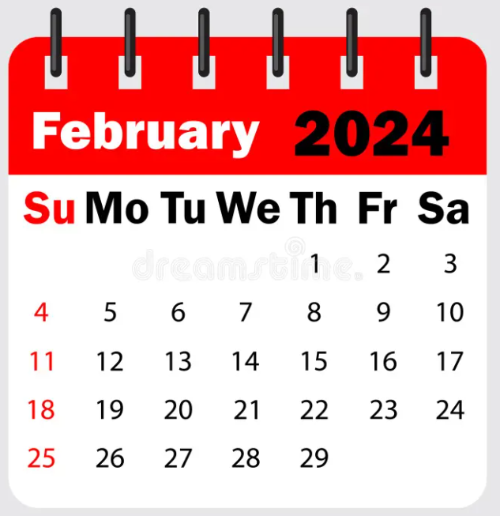
Mid-Year Review and Grant Technical Assistance
Caraway Conference Center
Room & dinner will be available starting February 5th
Please plan on staying the entire time to network and listen to other college’s promising practices.
Room and board paid by Perkins Leadership.
Colleges must pay for mileage.

Slide 25
Promising Practice Video from 2022-2023
Fayetteville Technical Community College
Mac Lab

Slide 26
Perkins Monthly Updates 2023-24
Sept 12, 2023
Oct 10, 2023
Nov 14, 2023
Dec 12, 2023
Jan 9, 2024
Feb 13, 2024
Mar 12, 2024
Apr 9, 2024
May 14, 2024
Jun 11, 2024
 Register now so they are on your calendar! www.ncperkins.org/presentations
Attendance (or viewing the recording within 30 days) is recorded on monitoring rubric. Recording may be accessed at the same link as the registration.
Notes:
Register now and let the system remind you.

Slide 27
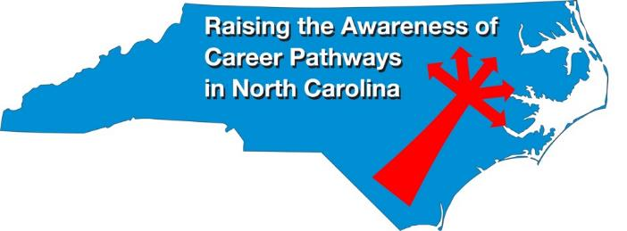
Raising the Awareness of Career Pathways Monthly Webinars
Every 3rd Wednesday of the month
Starting September 20th
Register for all webinars at www.ncperkins.org/presentations

Slide 28
https://www.ncpn.info
Nov. 8 – 10 In Charlotte

Slide 29
Technical Assistance is available
We are here to help!
Team Perkins is available by phone, email, virtually, or in-person

