Slide 1
Perkins Update
March 12, 2024

Slide 2
Career & Technical Education Team
Bob Witchger
Tony Reggi
Patti Coultas
Mary Olvera
Stefanie Schroeder
Darice McDougald
Lane Freeman
Jennifer McLean
Aaron Mabe

Slide 3
Purpose of Perkins
Develop more fully the academic knowledge and technical and employability skills of secondary education students and postsecondary education students who elect to enroll in CTE curriculum programs and programs of study
Notes:
The Strengthening Career and Technical Education for the 21st Century Act reauthorized and updated the Carl D. Perkins Career and Technical Education Act of 2006 to become the current Carl D. Perkins Career and Technical Education Act of 2006 as amended by the Strengthening Career and Technical Education for the 21st Century Act (Perkins V)
This updated act stresses:
- Academic, Technical, and Employability Skills
- Funding Secondary and Postsecondary CTE
- Focusing on Students who elect to enroll in CTE Programs of Study

Slide 4
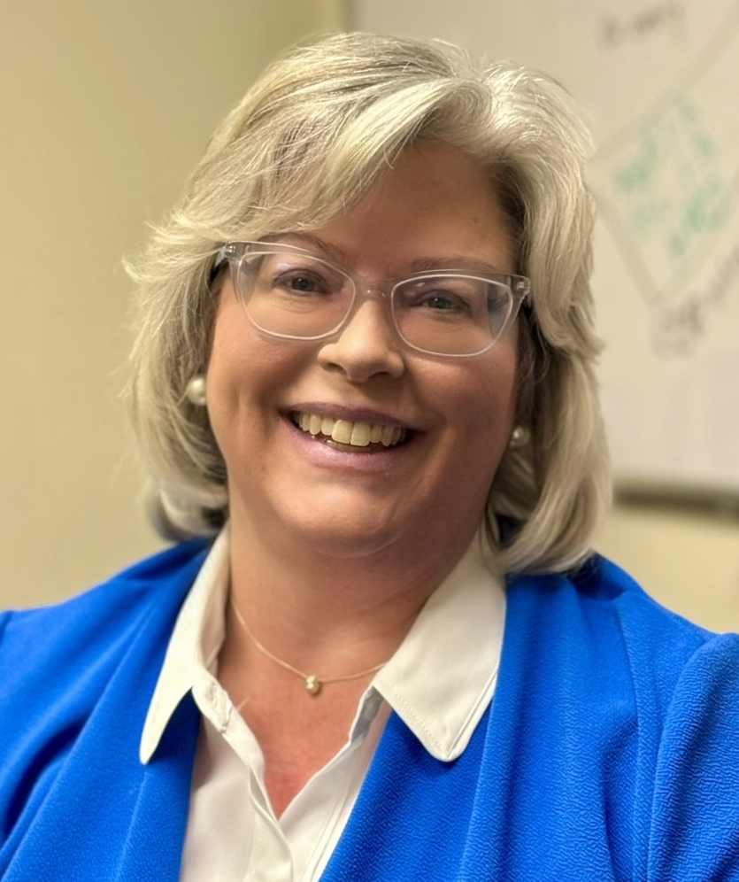
Melissa Smith
State Director of Health Sciences
Notes:
smithm@nccommunitycolleges.edu

Slide 5
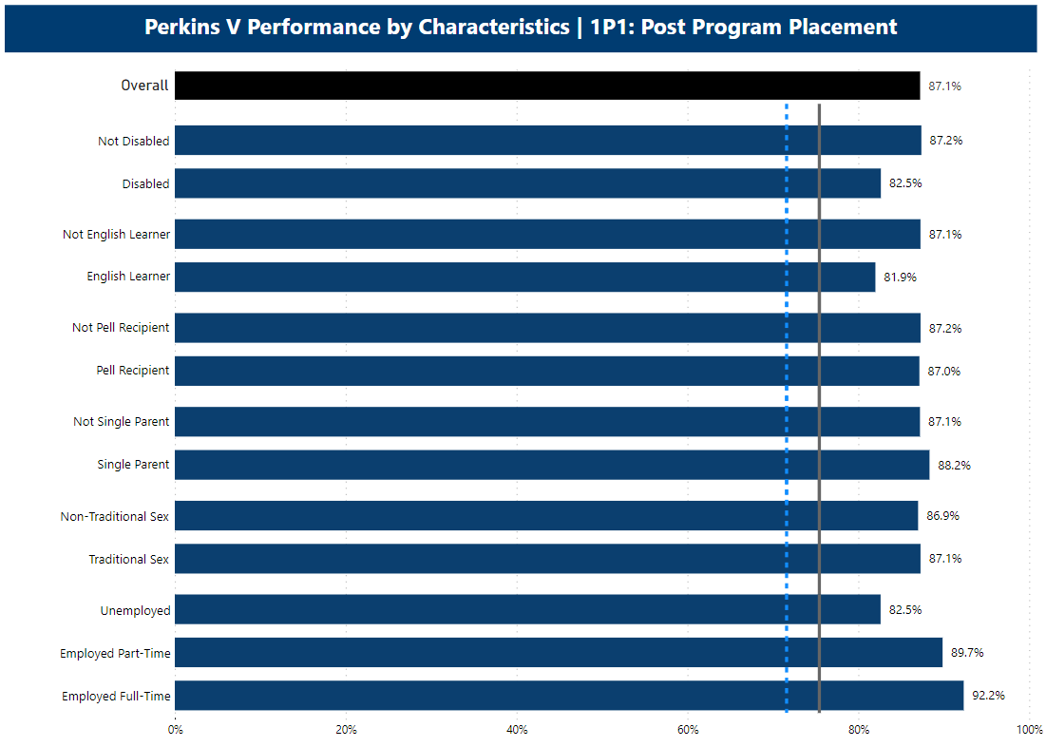
Power BI Data Dashboards
Provide disaggregated data for each Perkins indicator for all CTE concentrators
Recording of the Dashboard Rollout presentation https://youtu.be/l7FiBpsbXaw?si=9JSr2PycglGNqjcV
Each college’s Data Coordinator has access to Power BI
Notes:
https://youtu.be/l7FiBpsbXaw?si=9JSr2PycglGNqjcV

Slide 6
Local Levels of Performance
Perkins V Section 113(b)(4)(A)(i)(III) “…be higher than the average actual performance levels of the previous 2 program years…”
Therefore, we averaged the last two years and added 0.01% to be higher.
All colleges will have this calculation, even if previous negotiated levels were higher
Alamance Community College:
1P1 83.35% 2P1 30.27% 3P1 19.70%

Slide 7
State Proposed Levels 2024-2027 school years Public Comment
The North Carolina Community College System (NCCCS) is seeking public comment on its proposal to update the Career and Technical Education (CTE) State Determined Levels of Performance (SDPLs) for the three Postsecondary Perkins V Performance Indicators. The new SDPLs will cover the 2024-25 through 2027-28 school years and will comply with The Strengthening Career and Technical Education for the 21st Century Act (Perkins V) Section 113 (b)(3)(B)(ii) and North Carolina General Statutes (115C Article 10).

Slide 8
State Determined Levels of Performance
Proposed Levels | 2024-25 | 2025-26 | 2026-27 | 2027-28
1P1 | 84.82% | 84.83% | 84.84% | 84.85%
2P1 | 40.41% | 40.42% | 40.43% | 40.44%
3P1 | 22.60% | 22.61% | 22.62% | 22.63%
Please direct all comments to Dr. Bob Witchger, witchgerb@nccommunitycolleges.edu by March 31, 2024.

Slide 9
Planning for 2024-2025
Annual Meeting
April 23, 2024 9am-12pm
Virtual: GoTo Meeting link found in NCPerkins.org/presentations (and in notes below)
Print Handbook before the webinar
Anticipated Allotment
Notes:
https://register.gotowebinar.com/register/2380208915805242198

Slide 10
Site Monitoring Colleges
Basic understanding of Grant documents
Review of CLNA
Review of Local Plan and required use of funds
CTE Faculty and staff interviews to better understand how they are incorporated in Perkins V planning and implementation
Review XDBR

Slide 11
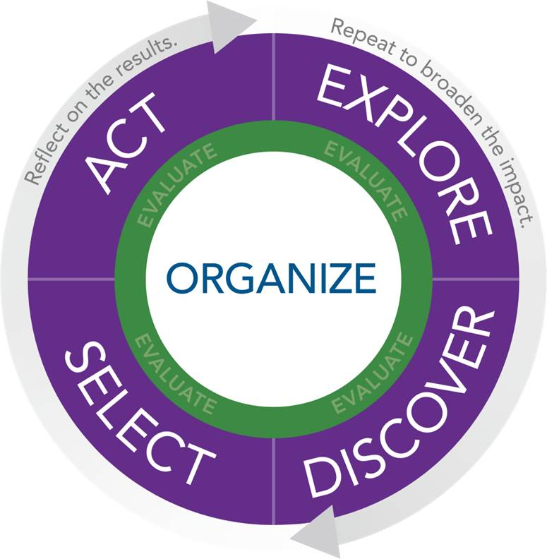
NAPE's Equity in Perkins V Workshop
NAPE's Equity in Perkins V engages educators in the foundational work of building an equity lens and provides guided learning experiences to apply equity principles to local data sets.
NAPE’s Equity in Perkins V workshop utilizes the NAPE PIPETM instructional improvement process as a model to scaffold institutional improvement to address the needs of marginalized student groups and the opportunities available within high-skill, high-wage, and in-demand fields. In this multi-day program, participants will develop the mindset, knowledge, and skills necessary to address the equity gaps in Career and Technical Education programs.
April 2 - 3, 2024 Caraway Conference Center
Example of Impact
“I so appreciate the introduction to so many crucial aspects of the work & the invitation/resources to explore more deeply”
~ Educator

Slide 12
NCETA Spring Conference
Get info from Jennifer

Slide 13
9-14 PATHWAYS CONSULTATION
This training offers a deep dive into all secondary engagement opportunities by reviewing best practices, local data, and inter-office collaborations, e.g. career advising, articulation, and CCP pathways. Sessions typically last about 2-3 hours at no cost to the college.
If interested, please email Aaron Mabe,
mabea@nccommunitycolleges.edu

Slide 14
Curriculum Alignment Projects
2023-2024 in progress:
Human Services Technologies
and multiple projects with EDU
Coming this spring:
Advertising Graphic Design
Information Technology
Health Management Technician, Medical Office Administration and Health Management Technician
Tentative next year
Cosmetology
Culinary
There is still time to get your faculty involved!

Slide 15
Director of Online Learning Updates
2024 Immersive Learning Conference:
Career Coaches may apply now at the NCCCS Website under “Events.”
Perkins Leadership Funding covers room and food costs.
Individual institutions responsible for transportation.
Opportunity for networking and exploring technology in education.
For more information, visit:
www.ncccsimmersivelearningconference.com
Notes:
https://www.nccommunitycolleges.edu/events/copy-of-2024-immersive-learning-conference-for-career-coaches-and-counselors/

Slide 16
Promising Practice Video from 2022-2023
Gaston Community Colleges
Promotional videos for HVAC, Professional Development and Vehicle Driving Simulator

Slide 17
Virtual Office Hours for Technical Assistance
2nd Tuesday of the month 1-2pm
4th Wednesday of the month 9-10
** See NCPerkins course announcements for TEAMS link
Need help?
Let's meet.
CTE Team Perkins
Virtual
Office Hours
Drop in to ask a CTE Coordinator your questions

Slide 18
Perkins Monthly Updates 2023-24
Apr 9, 2024
May 14, 2024
Jun 11, 2024
Attendance (or viewing the recording within 30 days) is recorded on monitoring rubric. Recording may be accessed at the same link as the registration.
Notes:
Register now and let the system remind you.

Slide 19
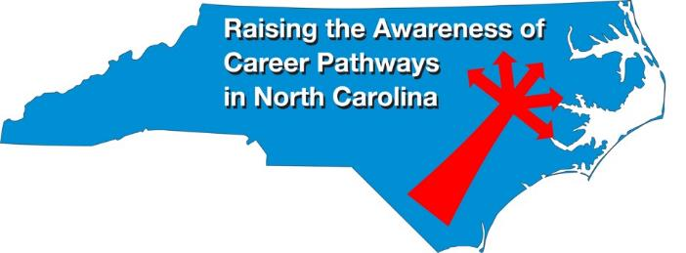
Raising the Awareness of Career Pathways Monthly Webinars
Mar. 20 – Business Administration
Apr. 17 – Public Safety
May 15 – Cyber Crime Technology
Register for all webinars at www.ncperkins.org/presentations

Slide 20
Technical Assistance is available
We are here to help!
Team Perkins is available by phone, email, virtually, or in-person

