Slide 1
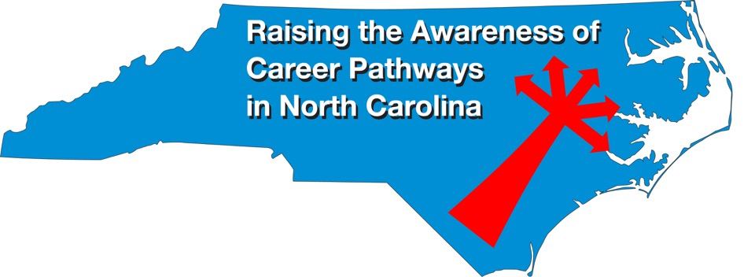
February 17, 2021 Careers in Public Safety
Download the PowerPoint and access the recording: www.ncperkins.org/presentations
Notes:
Chris
We are here to help promote the great jobs, often unknown, in the great state of North Carolina.
Through these monthly meetings, we are going to let you know about some great career opportunities in North Carolina.
And bring in special guests to let you know about the great career opportunities in North Carolina.
Please download this PowerPoint file and use it anyway you can to help get folks on a career pathway.
The reference showing from where the information was found, as well as the contact information for our guests is in the Notes section under each slide.
Get the PowerPoint on our NCPerkins.org website on our Presentations and Webinars page.
Here is the direct address on the screen.
-----
Many of the videos shown during this webinar can be found here:
https://www.ncperkins.org/video/

Slide 2
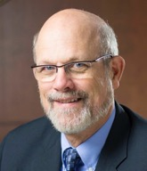
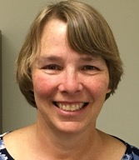
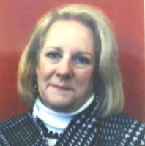
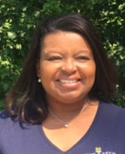
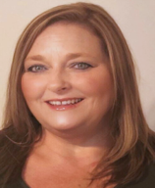
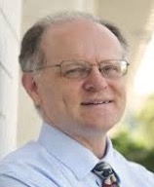
Raising the Awareness of Career Pathways in North Carolina
Bob Witchger
Patti Coultas
Tony Reggi
Cheryl Cox
NC Dept of Public Instruction
Michelle Lair
Mary Olvera
Chris Droessler
Notes:
Chris
I always say our webinars are like radio but with pictures.
And here are a few pictures of your hosts for these monthly explorations into career pathways.
(Why does the photographer have the best photo?)
Our contact information is in the notes section under this slide.
Dr. Bob Witchger
919-807-7126
WitchgerB@nccommunitycolleges.edu
Dr. Tony R. Reggi
919-807-7131
ReggiA@nccommunitycolleges.edu
Patti Coultas
919-807-7130
CoultasP@nccommunitycolleges.edu
Dr. Mary Olvera
919-807-7120
OlveraM@nccommunitycolleges.edu
Michelle Lair
919-807-72227
LairM@nccommunitycolleges.edu
Chris Droessler
919-807-7068
DroesslerC@nccommunitycolleges.edu
Cheryl Cox
NC Department of Public Instruction
919-807-3814
Cheryl.Cox@dpi.nc.gov

Slide 3
Notes:
www.ncperkins.org/presentations

Slide 4
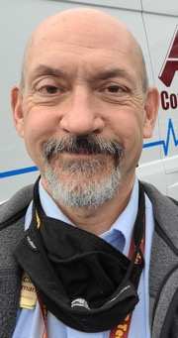
Clint Gorman
Dean of Emergency Services
Asheville-Buncombe Technical Community College
Bob
Notes:
Clinton Gorman
clintoncgorman@abtech.edu
Clint Gorman (Interim Chair) Phone: (828) 782-2123 Email: clintoncgorman@abtech.edu

Slide 5
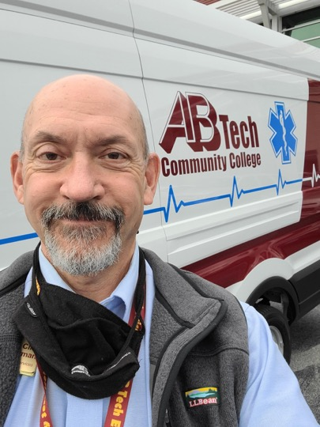
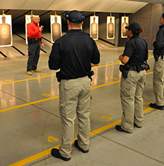
Notes:
Clinton Gorman
clintoncgorman@abtech.edu
Clint Gorman (Interim Chair) Phone: (828) 782-2123 Email: clintoncgorman@abtech.edu

Slide 6
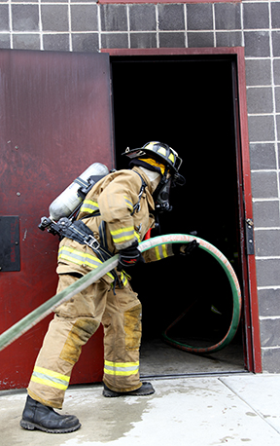
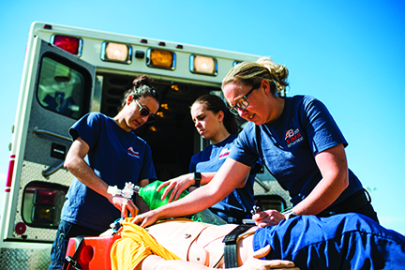
Notes:
Clinton Gorman
clintoncgorman@abtech.edu
Clint Gorman (Interim Chair) Phone: (828) 782-2123 Email: clintoncgorman@abtech.edu

Slide 7
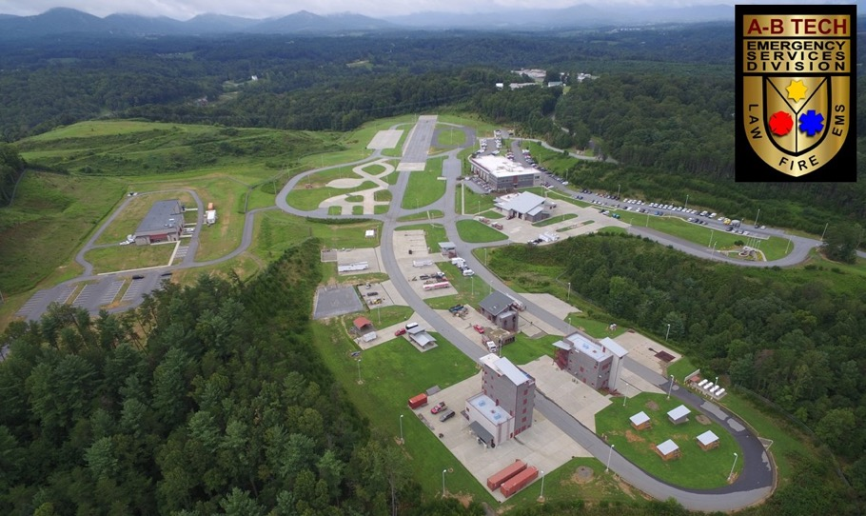
Notes:
Clinton Gorman
clintoncgorman@abtech.edu
Clint Gorman (Interim Chair) Phone: (828) 782-2123 Email: clintoncgorman@abtech.edu

Slide 8
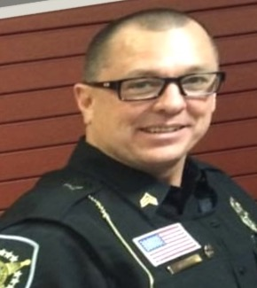
Michael Murphy
Sergeant
Buncombe County Sheriff’s Office
Notes:
Sgt. Michael Murphy
Buncombe County Sheriff’s Office
60 Court Plaza, 4th Floor
Asheville, NC 28801
Non-Emergency Calls
(828) 250-6670
======
Clinton Gorman
clintoncgorman@abtech.edu
Clint Gorman (Interim Chair) Phone: (828) 782-2123 Email: clintoncgorman@abtech.edu

Slide 9
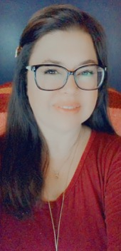
Stacy Workman
Public Safety Administration Chair
Criminal Justice Technology Instructor
Asheville-Buncombe Technical Community College
Tony
Notes:
Stacy Workman
Public Safety Administration Chair
Criminal Justice Technology Instructor
Asheville-Buncombe Technical Community College
stacybworkman@abtech.edu

Slide 10
Notes:
Stacy Workman
Public Safety Administration Chair
Criminal Justice Technology Instructor
Asheville-Buncombe Technical Community College
stacybworkman@abtech.edu

Slide 11
Notes:
Stacy Workman
Public Safety Administration Chair
Criminal Justice Technology Instructor
Asheville-Buncombe Technical Community College
stacybworkman@abtech.edu

Slide 12
Notes:
www.ncperkins.org/presentations

Slide 13
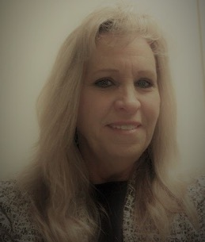
Janie Slaughter
Department Head, Criminal Justice
Wake Technical Community College
Bob
Notes:
Janie Slaughter
jjslaughter@waketech.edu
919-866-5169
Professor Slaughter Department Chair Criminal Justice-Forensic Science-Public Safety Administration
Wake Tech Community College 919-866-5169

Slide 14
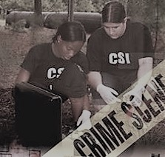
Notes:
Janie Slaughter
jjslaughter@waketech.edu]
919-866-5169
Professor Slaughter Department Chair Criminal Justice-Forensic Science-Public Safety Administration
Wake Tech Community College 919-866-5169

Slide 15
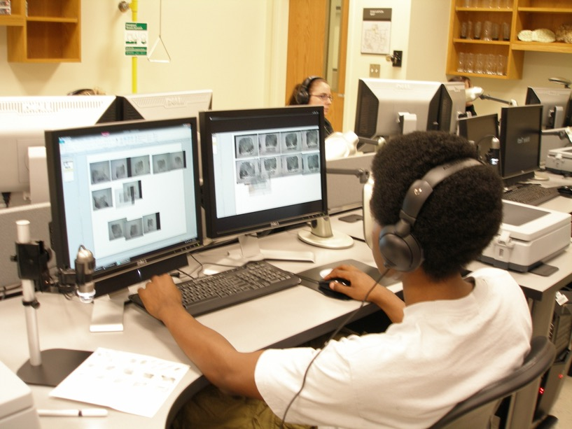
Notes:
Janie Slaughter
jjslaughter@waketech.edu]
919-866-5169
Professor Slaughter Department Chair Criminal Justice-Forensic Science-Public Safety Administration
Wake Tech Community College 919-866-5169

Slide 16
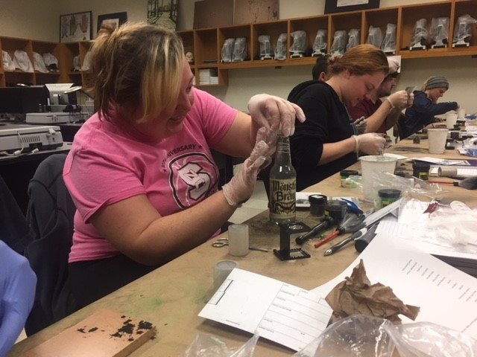
Notes:
Janie Slaughter
jjslaughter@waketech.edu]
919-866-5169
Professor Slaughter Department Chair Criminal Justice-Forensic Science-Public Safety Administration
Wake Tech Community College 919-866-5169

Slide 17
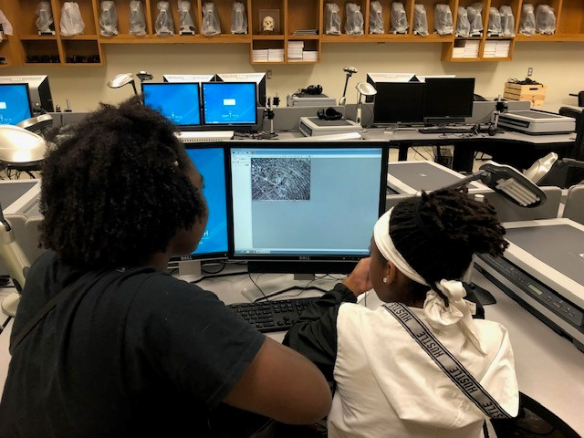
Notes:
Janie Slaughter
jjslaughter@waketech.edu]
919-866-5169
Professor Slaughter Department Chair Criminal Justice-Forensic Science-Public Safety Administration
Wake Tech Community College 919-866-5169

Slide 18
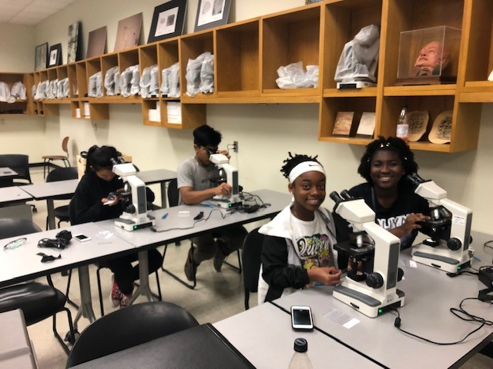
Notes:
Janie Slaughter
jjslaughter@waketech.edu]
919-866-5169
Professor Slaughter Department Chair Criminal Justice-Forensic Science-Public Safety Administration
Wake Tech Community College 919-866-5169

Slide 19
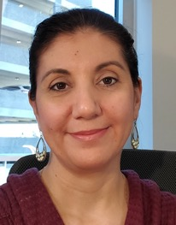
Rebecca Heinrich
Instructor 9M Forensic Science
Wake Technical Community College
Bob
Notes:
Heinrich, Rebecca rheinrich@waketech.edu
919-866-5813
919-448-4081

Slide 20
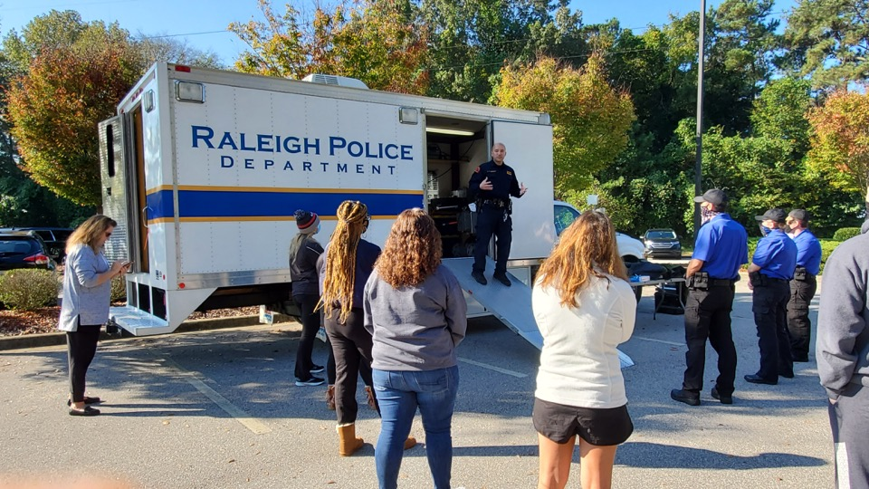
Notes:
Heinrich, Rebecca rheinrich@waketech.edu
919-866-5813
919-448-4081

Slide 21
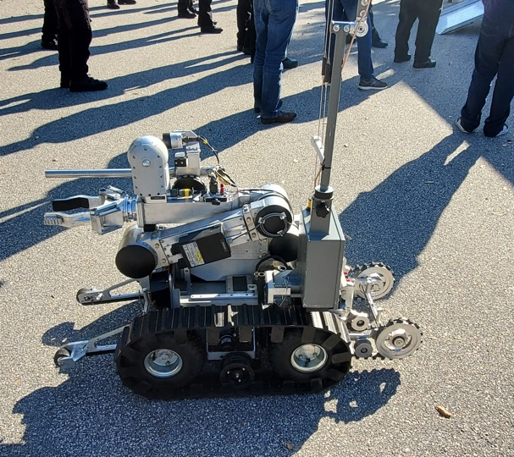
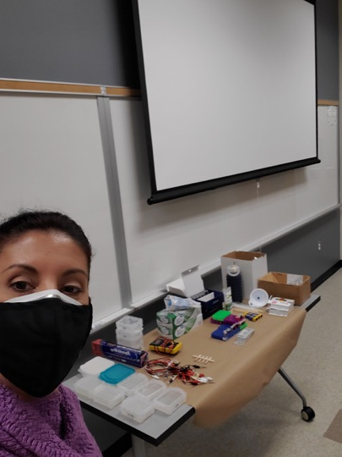
Notes:
Heinrich, Rebecca rheinrich@waketech.edu
919-866-5813
919-448-4081

Slide 22
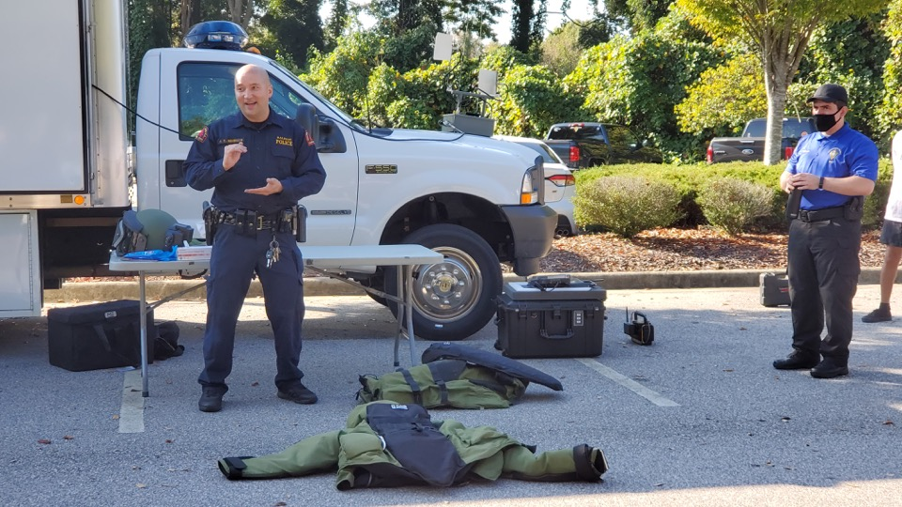
Notes:
Heinrich, Rebecca rheinrich@waketech.edu
919-866-5813
919-448-4081

Slide 23
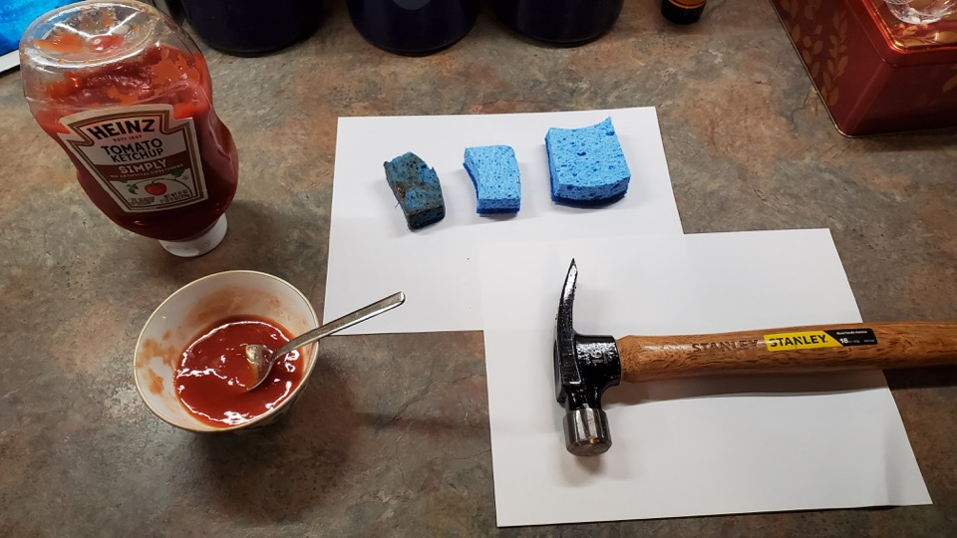
Notes:
Heinrich, Rebecca rheinrich@waketech.edu
919-866-5813
919-448-4081

Slide 24
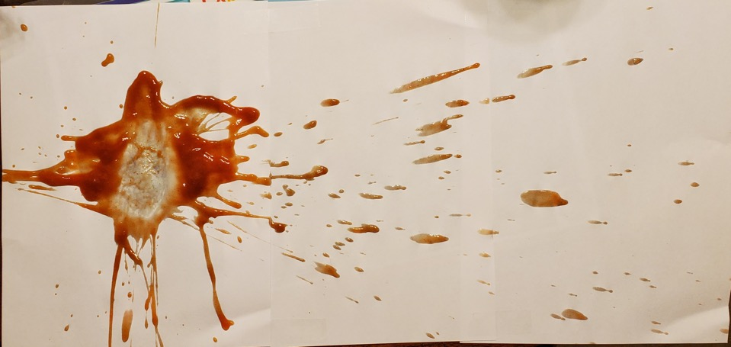
Notes:
Heinrich, Rebecca rheinrich@waketech.edu
919-866-5813
919-448-4081

Slide 25
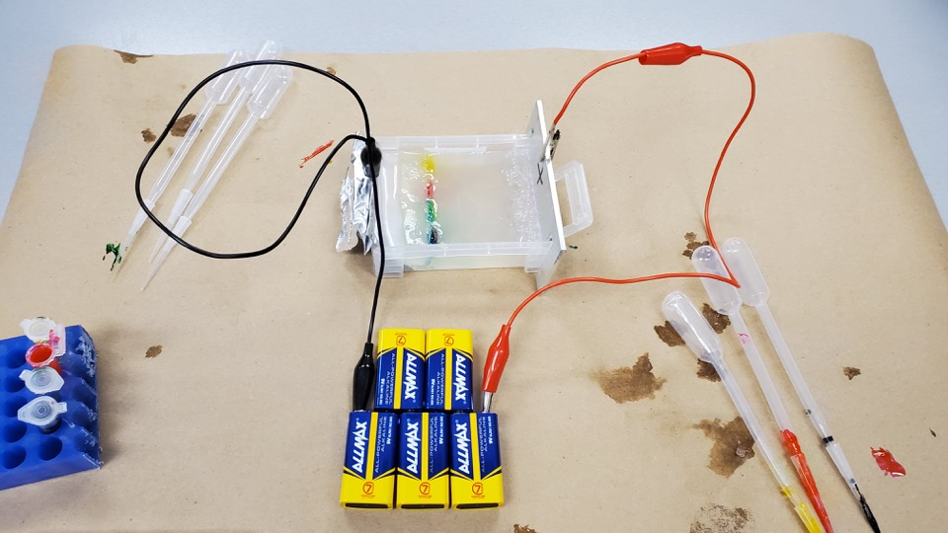
Notes:
Heinrich, Rebecca rheinrich@waketech.edu
919-866-5813
919-448-4081

Slide 26
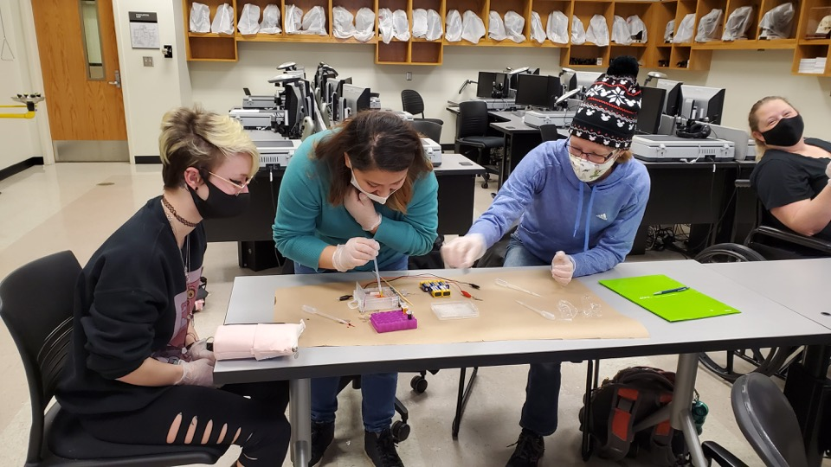
Notes:
Heinrich, Rebecca rheinrich@waketech.edu
919-866-5813
919-448-4081

Slide 27
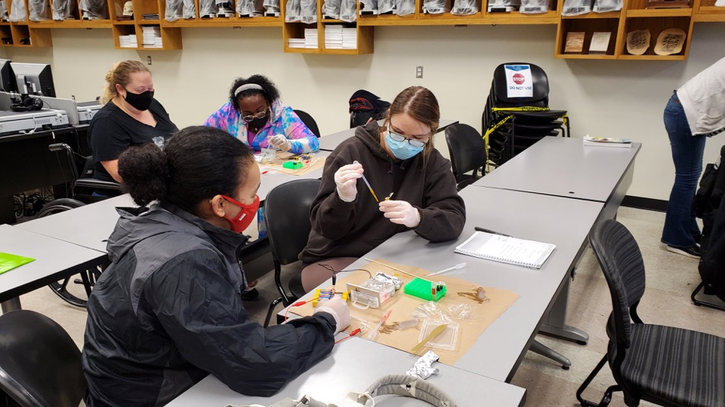
Notes:
Heinrich, Rebecca rheinrich@waketech.edu
919-866-5813
919-448-4081

Slide 28
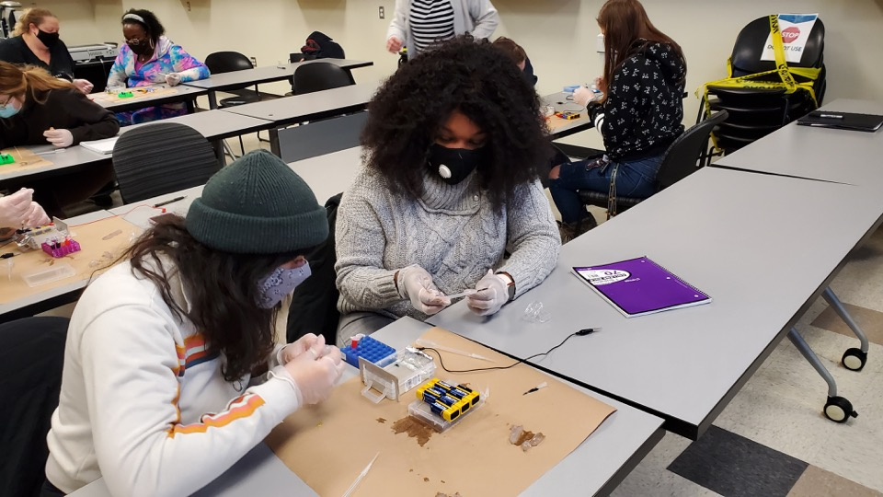
Notes:
Heinrich, Rebecca rheinrich@waketech.edu
919-866-5813
919-448-4081

Slide 29
Notes:
www.ncperkins.org/presentations

Slide 30
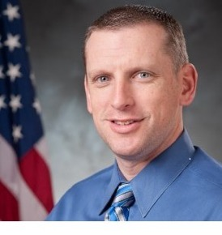
Justin Ovaska
Program Director for Criminal Justice Technology and Public Safety Administration
Cape Fear Community College
Tony
Notes:
Justin Ovaska
Program Director, Criminal Justice Technology & Public Safety Administration
CFCC-North Campus
McKeithan Center (NA), room 326
4500 Blue Clay Rd.
Castle Hayne, NC 2842
Office Phone- (910) 362-7383 Email- jlovaska42@cfcc.edu Cell- (910) 409-2499 https://cfcc.edu/public-safety-administration/ https://cfcc.edu/criminal-justice/
" The function of education is to teach one to think intensively and to think critically. Intelligence plus character–that is the goal of true education.“ Martin Luther King, Jr.

Slide 31
Tony
Notes:
Justin Ovaska
Program Director, Criminal Justice Technology & Public Safety Administration
CFCC-North Campus
McKeithan Center (NA), room 326
4500 Blue Clay Rd.
Castle Hayne, NC 2842
Office Phone- (910) 362-7383 Email- jlovaska42@cfcc.edu Cell- (910) 409-2499 https://cfcc.edu/public-safety-administration/ https://cfcc.edu/criminal-justice/
" The function of education is to teach one to think intensively and to think critically. Intelligence plus character–that is the goal of true education.“ Martin Luther King, Jr.

Slide 32
Tony
Notes:
Justin Ovaska
Program Director, Criminal Justice Technology & Public Safety Administration
CFCC-North Campus
McKeithan Center (NA), room 326
4500 Blue Clay Rd.
Castle Hayne, NC 2842
Office Phone- (910) 362-7383 Email- jlovaska42@cfcc.edu Cell- (910) 409-2499 https://cfcc.edu/public-safety-administration/ https://cfcc.edu/criminal-justice/
" The function of education is to teach one to think intensively and to think critically. Intelligence plus character–that is the goal of true education.“ Martin Luther King, Jr.

Slide 33
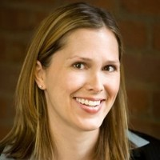
Pamela Hollern, J.D.
Program Director, Paralegal Technology
Guilford Technical Community College
Tony
Notes:
Pamela Hollern, J.D.
Program Director, Paralegal Technology
Guilford Technical Community College
E-mail: pehollern@gtcc.edu
Direct: 336-334-4822, Ext 53077
Physical Address: Greensboro Campus Center, Office 119
3505 E. Wendover Avenue Greensboro, NC 27405
Mailing Address: P.O. Box 309, Jamestown, NC 27282

Slide 34
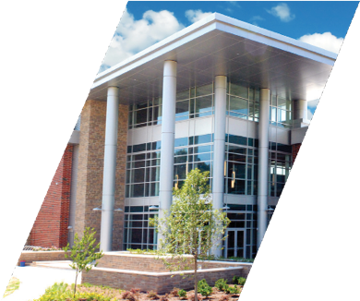
PARALEGAL TECHNOLOGY
Notes:
Pamela Hollern, J.D.
Program Director, Paralegal Technology
Guilford Technical Community College
E-mail: pehollern@gtcc.edu
Direct: 336-334-4822, Ext 53077
Physical Address: Greensboro Campus Center, Office 119
3505 E. Wendover Avenue Greensboro, NC 27405
Mailing Address: P.O. Box 309, Jamestown, NC 27282

Slide 35
Notes:
Pamela Hollern, J.D.
Program Director, Paralegal Technology
Guilford Technical Community College
E-mail: pehollern@gtcc.edu
Direct: 336-334-4822, Ext 53077
Physical Address: Greensboro Campus Center, Office 119
3505 E. Wendover Avenue Greensboro, NC 27405
Mailing Address: P.O. Box 309, Jamestown, NC 27282

Slide 36
Notes:
Pamela Hollern, J.D.
Program Director, Paralegal Technology
Guilford Technical Community College
E-mail: pehollern@gtcc.edu
Direct: 336-334-4822, Ext 53077
Physical Address: Greensboro Campus Center, Office 119
3505 E. Wendover Avenue Greensboro, NC 27405
Mailing Address: P.O. Box 309, Jamestown, NC 27282
Paralegal Podcast
https://drive.google.com/file/d/1Cxw1kdLZ5R9KVBZP0OfyX-TOc_xchNf-/view

Slide 37
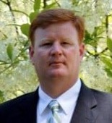
Josh Crisp
Regional Emergency Services Training Center
Gaston Community College
Tony
Notes:
Josh Crisp, Director
Regional Emergency Services Training Center
Gaston College
201 Highway 321 South
Dallas, NC 28034
704-922-6258 | Office
www.gaston.edu
crisp.josh@gaston.edu

Slide 38
Gaston College
Fire Protection Technology Degree
Public Safety Administration
Employment Outlook
Community College vs. Four Year Institution
Continuing Education/ Certification Training
Tony
Notes:
Josh Crisp, Director
Regional Emergency Services Training Center
Gaston College
201 Highway 321 South
Dallas, NC 28034
704-922-6258 | Office
www.gaston.edu
crisp.josh@gaston.edu

Slide 39
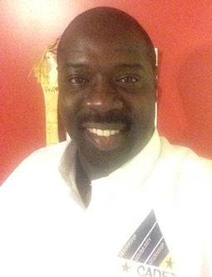
Travis Askew
Magistrate
State of NC in Bertie County
Notes:
Travis Askew
Magistrate
State of NC in Bertie County
travisaskew2@gmail.com

Slide 40
Notes:
Travis Askew
Magistrate
State of NC in Bertie County
travisaskew2@gmail.com

Slide 41
Notes:
Travis Askew
Magistrate
State of NC in Bertie County
travisaskew2@gmail.com

Slide 42
Notes:
Travis Askew
Magistrate
State of NC in Bertie County
travisaskew2@gmail.com

Slide 43
Notes:
Travis Askew
Magistrate
State of NC in Bertie County
travisaskew2@gmail.com

Slide 44
Notes:
Travis Askew
Magistrate
State of NC in Bertie County
travisaskew2@gmail.com

Slide 45
Notes:
Travis Askew
Magistrate
State of NC in Bertie County
travisaskew2@gmail.com

Slide 46
Notes:
Travis Askew
Magistrate
State of NC in Bertie County
travisaskew2@gmail.com

Slide 47
Notes:
Travis Askew
Magistrate
State of NC in Bertie County
travisaskew2@gmail.com

Slide 48
Notes:
Travis Askew
Magistrate
State of NC in Bertie County
travisaskew2@gmail.com

Slide 49
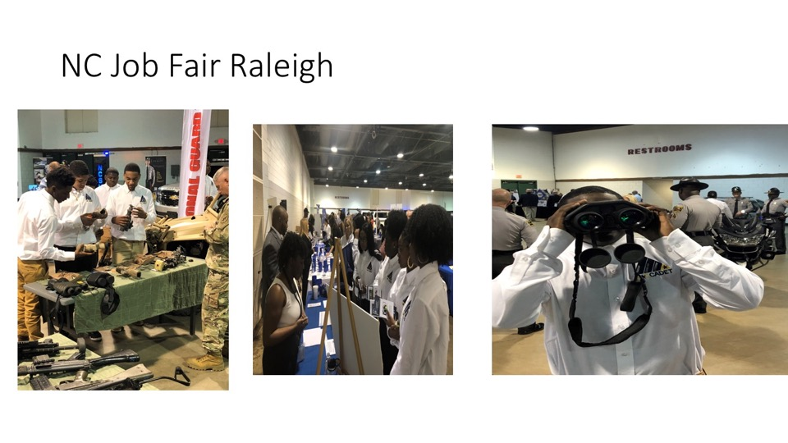
Notes:
Travis Askew
Magistrate
State of NC in Bertie County
travisaskew2@gmail.com

Slide 50
Notes:
Travis Askew
Magistrate
State of NC in Bertie County
travisaskew2@gmail.com

Slide 51
Notes:
Travis Askew
Magistrate
State of NC in Bertie County
travisaskew2@gmail.com

Slide 52
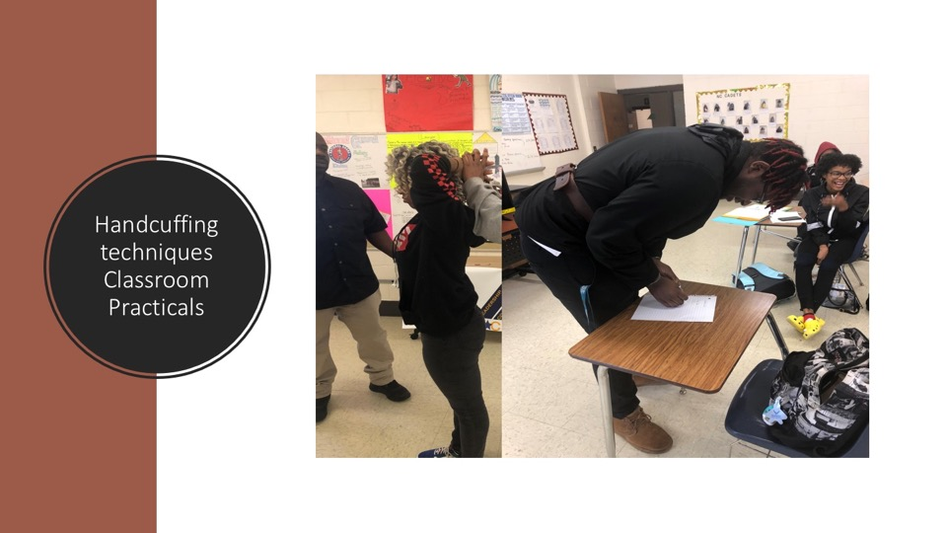
Notes:
Travis Askew
Magistrate
State of NC in Bertie County
travisaskew2@gmail.com

Slide 53
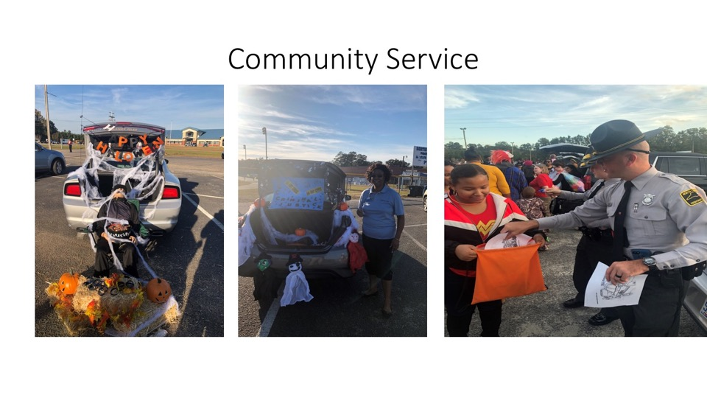
Notes:
Travis Askew
Magistrate
State of NC in Bertie County
travisaskew2@gmail.com

Slide 54
Notes:
Travis Askew
Magistrate
State of NC in Bertie County
travisaskew2@gmail.com

Slide 55
Notes:
Travis Askew
Magistrate
State of NC in Bertie County
travisaskew2@gmail.com

Slide 56
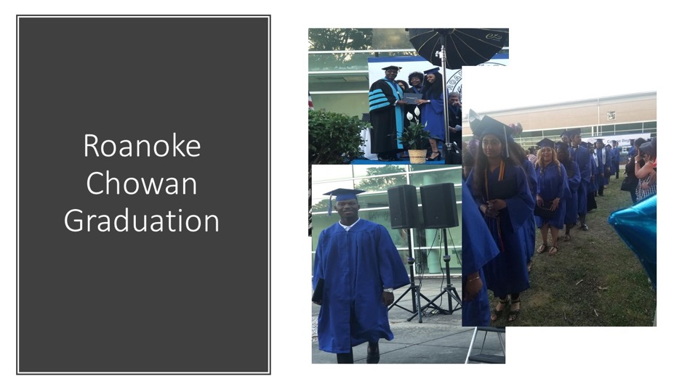
Notes:
Travis Askew
Magistrate
State of NC in Bertie County
travisaskew2@gmail.com

Slide 57
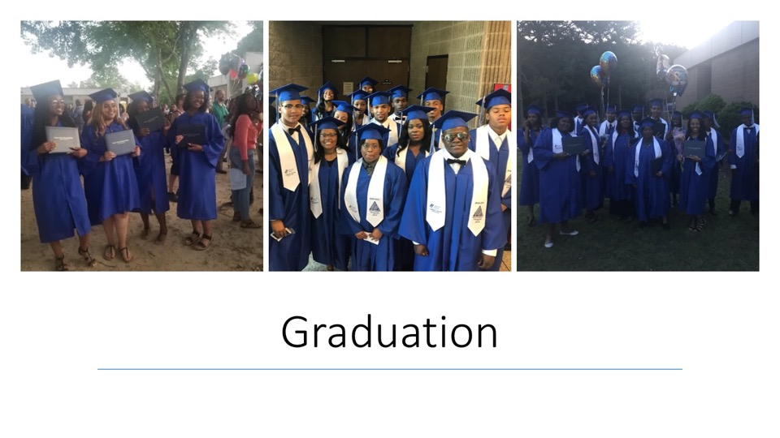
Notes:
Travis Askew
Magistrate
State of NC in Bertie County
travisaskew2@gmail.com

Slide 58
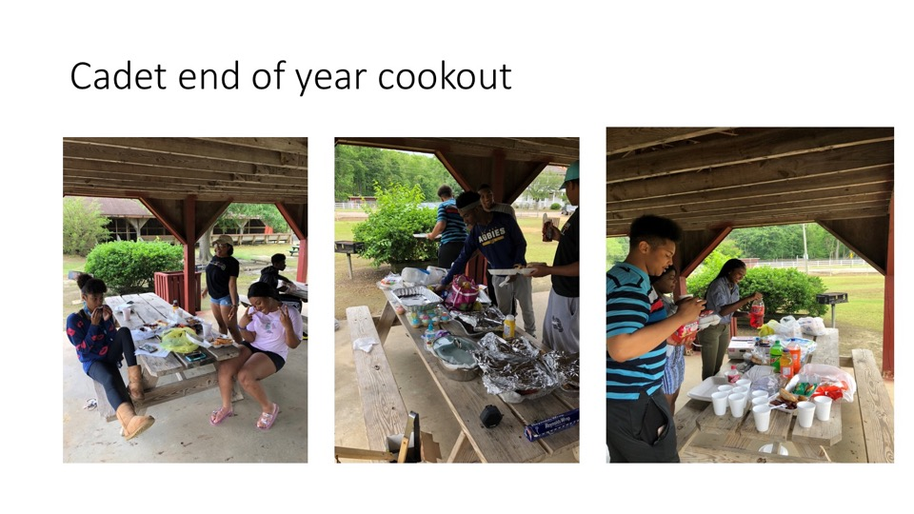
Notes:
Travis Askew
Magistrate
State of NC in Bertie County
travisaskew2@gmail.com

Slide 59
Tracy McPherson
Director, Public Safety Training Programs
NC Community College System
Notes:
Tracy McPherson
Director, Public Safety Training Programs
NC Community College System
mcphersont@nccommunitycolleges.edu
919-807-7117

Slide 60
Raising the Awareness of Career Pathways in North Carolina
Next meeting is March 17, 2021 – Information Technology
Download the PowerPoint and access the recording: www.ncperkins.org/presentations
Notes:
Our next meeting like this one will be on ------.
(We will skip December and be back in January.)
You can go to the NCPerkins website to register for that meeting.
We'll also send you a reminder, since you are now on our mailing list.
So go ahead and sign up for all the meetings, and you'll be reminded the day before.
If you liked something you saw here, send folks to the recording. Find it at that same web page.

