Slide 1
Perkins Update Webinar
November 10, 2020

Slide 2
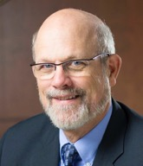
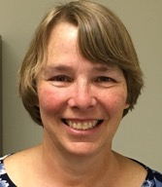
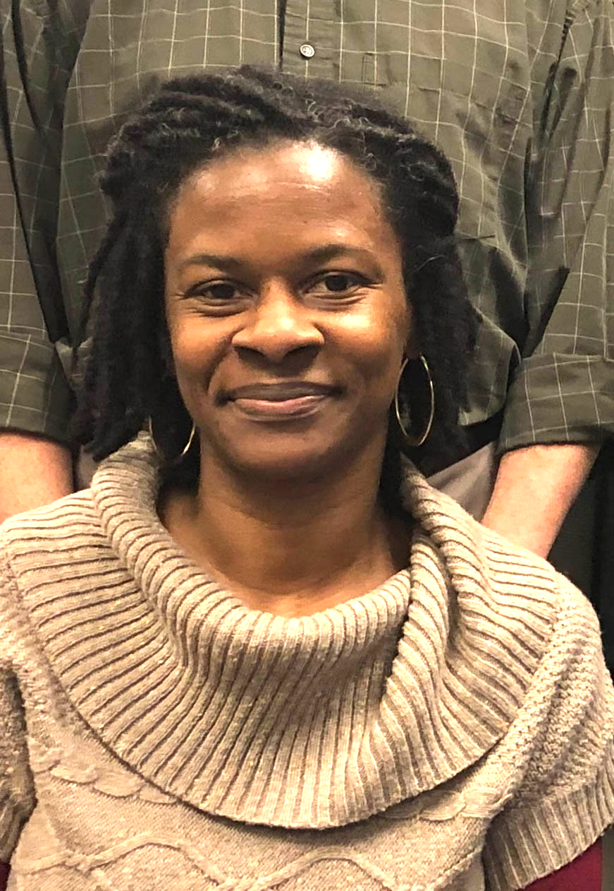
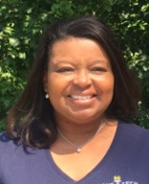
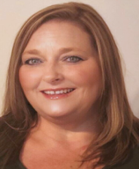
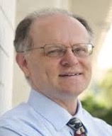
Team Perkins
Bob Witchger
Patti Coultas
Tony Reggi
Darice McDougald
Michelle Lair
Mary Olvera
Chris Droessler
Notes:
Dr. Bob Witchger
919-807-7126
WitchgerB@nccommunitycolleges.edu
Dr. Tony R. Reggi
919-807-7131
ReggiA@nccommunitycolleges.edu
Patti Coultas
919-807-7130
CoultasP@nccommunitycolleges.edu
Dr. Mary Olvera
919-807-7120
OlveraM@nccommunitycolleges.edu
Michelle Lair
919-807-72227
LairM@nccommunitycolleges.edu
Chris Droessler
919-807-7068
DroesslerC@nccommunitycolleges.edu
Darice McDougald
919-807-7219
McDougaldD@nccommunitycolleges.edu

Slide 3
COVID-19 Follow Up
How are you all doing?
What’s happening at your College?
What can we do to assist you?

Slide 4
Purpose of Perkins
Develop more fully the academic knowledge and technical and employability skills of secondary education students and postsecondary education students who elect to enroll in CTE programs and programs of study
Notes:
The Strengthening Career and Technical Education for the 21st Century Act reauthorized and updated the Carl D. Perkins Career and Technical Education Act of 2006 to become the current Carl D. Perkins Career and Technical Education Act of 2006 as amended by the Strengthening Career and Technical Education for the 21st Century Act (Perkins V)
This updated act stresses:
- Academic, Technical, and Employability Skills
- Funding Secondary and Postsecondary CTE
- Focusing on Students who elect to enroll in CTE Programs of Study

Slide 5
Promising Practice Videos 2020
Haywood Community College
Daily Tip series for faculty to help encourage them during COVID-19
https://www.ncperkins.org/video
Notes:
Sept 2020
AB-Tech
Coastal Carolina
October 2020
Mitchell
Tri-County
November 2020
Haywood
Pamlico
December 2020
Rowan-Cabarrus
Isothermal
Johnston
Randolph
Pitt
Blue Ridge
Cape Fear
Mayland
Carteret
Sandhills
Central Piedmont
Wilson
Cleveland
Craven
Wilkes
Durham
Forsyth
Southwestern
Halifax
McDowell
Nash
Richmond
Wayne
Robeson
Caldwell
Rockingham
South Piedmont
Edgecombe
Western Piedmont
Southeastern
Catawba Valley
Stanly
Surry
Wake Tech
Fayetteville
Gaston
Vance-Granville
Sampson
Guilford
Central Carolina
Lenoir
Martin
Brunswick
Davidson
Roanoke-Chowan
James Sprunt
Bladen
College of Albemarle

Slide 6
Carryover Funds
Need modified budget
Your final allocation before the carryover funds is “Total Allotment” in the FY 2020-21 State Aid Allocations and Budget Policies, page 31-34.
Carryover funds should be approved at the November 20 State Board meeting.
Budget must reflect CLNA
Modified budgets are due January 8, 2021

Slide 7
Perkins Monitoring Update
Monitoring Dates – January through May 2021
Equipment
Time and Effort
Site

Slide 8
Mid-year Reviews
January 19, 21, 26, 28, February 2, 2021
How the Perkins funds made a difference to CTE at your college
How the college conducted the comprehensive local needs assessment (CLNA)
Share a CTE promising practice
Budget update
Notes:
Each college will have 10-15 minutes to report on the progress of their Perkins basic grant. The presentation could include the following:
How the Perkins funds made a difference to CTE at your college
How CTE programs were improved.
How CTE Programs of Study were enhanced.
How students are better prepared for the workplace.
How the college conducted the comprehensive local needs assessment (CLNA)
What pathways were reviewed.
What gaps or needs were discovered.
How the secondary schools were involved in the process.
How your local WIOA office/ staff was involved in the process.
Share a CTE promising practice
One project funded by Perkins to share with the other colleges.
What the funding paid for.
Reflections from the staff, faculty, students, businesses.
Budget update
How the monies have been spent so far.
Items/services purchased.
How this year’s spending might be different under the CLNA.
Plan for spending the remainder of the funds before June 30, 2021.
Comments, Questions, Suggestions:
Questions from the Perkins Staff and others in attendance

Slide 9
Free Universal Design for Learning On-line Workshop Series
Notes:
www.ncperkins.org/udl/

Slide 10
UDL Workshop Series sessions 1 & 2
www.ncperkins.org/udl/
Workshop # 1: October 20, 2020 2:30-3:30
UDL 101: What is Universal Design for Learning and Why Do We Need It Right Now?
With the wide variety of students now entering higher education who have constant and varying demands on their time and attention, how can we reach and teach everyone? Even more so, how can we leverage the diversity of learners in our classes to create a better learning experience for all students with a richer, more nuanced understanding of our world? This workshop will introduce participants to the neuroscience based principles of Universal Design for Learning, how these principles are applied, and why it should matter to us and our students.
Workshop # 2: October 27, 2020 2:30-3:30
The WHY of Learning: Engaging ALL Students (not just the ones you wish were in your class)
How can you motivate and engage all of the students in your classroom? What strategies can help right away and what can we plan for long term to help struggling students? How can we motivate students to want to learn the material in the first place, even when they have a hard time motivating themselves? This workshop presents participants with neuro-science based UDL strategies to motivate and engage students!
Notes:
www.ncperkins.org/udl/

Slide 11
UDL Workshop Series sessions 3 & 4
www.ncperkins.org/udl/
Workshop # 3: November 3, 2020 2:30-3:30
The HOW of Learning: Assessment with UDL Principles in Mind
What are executive functions and how do they affect student learning? This presentation helps instructors to create new ways of thinking about assessments and course design to get better results from students right away! Let's learn how to best help our students and make our lives a lot easier in the process!
Workshop # 4: November 10, 2020 2:30-3:30
The WHAT of Learning: Creating Resourceful, Knowledgeable Learners
How can we make sure that we take down all barriers to learning so that our students can learn and thrive? What little things can we do, what big ideas should we keep in mind? This presentation will guide instructors in how to best offer information to students in a way that reaches and teaches a diverse array of learners.
Notes:
www.ncperkins.org/udl/

Slide 12
Promising Practice Videos 2020
Pamlico Community College
Expand the size and scope of Welding
CAD, 3-D printers, portable virtual welder
Portable welder tracks student work, improvement
https://www.ncperkins.org/video
Notes:
Sept 2020
AB-Tech
Coastal Carolina
October 2020
Mitchell
Tri-County
November 2020
Haywood
Pamlico
December 2020
Rowan-Cabarrus
Isothermal
Johnston
Randolph
Pitt
Blue Ridge
Cape Fear
Mayland
Carteret
Sandhills
Central Piedmont
Wilson
Cleveland
Craven
Wilkes
Durham
Forsyth
Southwestern
Halifax
McDowell
Nash
Richmond
Wayne
Robeson
Caldwell
Rockingham
South Piedmont
Edgecombe
Western Piedmont
Southeastern
Catawba Valley
Stanly
Surry
Wake Tech
Fayetteville
Gaston
Vance-Granville
Sampson
Guilford
Central Carolina
Lenoir
Martin
Brunswick
Davidson
Roanoke-Chowan
James Sprunt
Bladen
College of Albemarle

Slide 13
Raising the Awareness of Career Pathways Webinars
November 18, 2020 @ 9am
Come explore the new NCCareers.org website
Helps you to discover careers that match your career interests
https://register.gotowebinar.com/register/5236610349597012493
See all upcoming and past webinars at https://www.ncperkins.org/presentations/
Notes:
https://register.gotowebinar.com/register/5236610349597012493

Slide 14
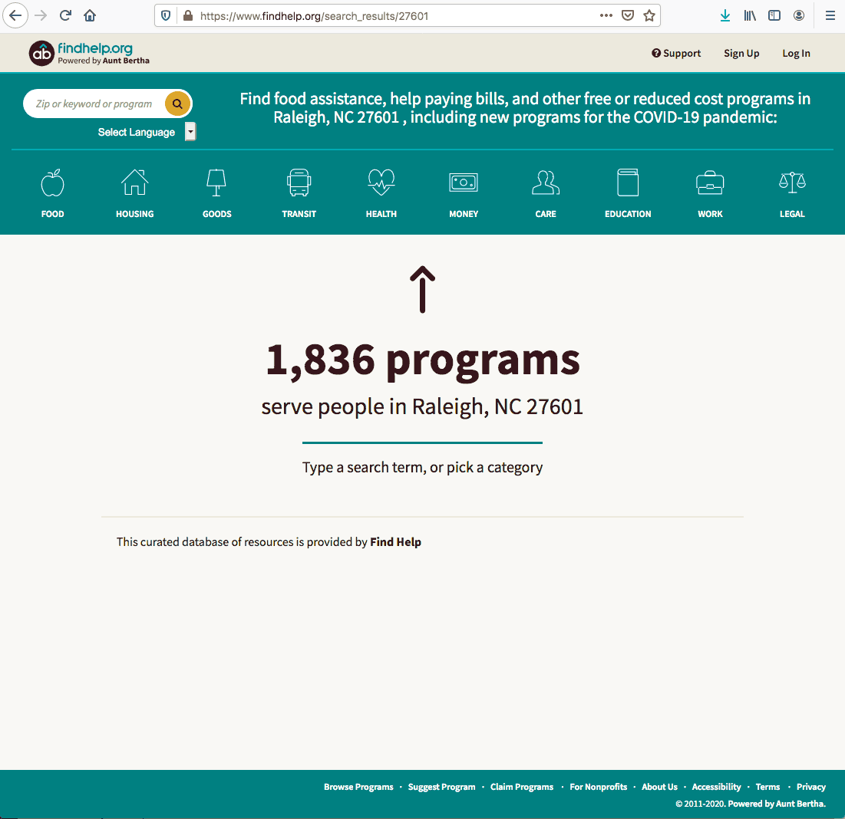
NCETA Workshops
Thursday, November 19 @ 3 pm
FindHelp.org
Aunt Bertha’s network connects people seeking help and verified social care providers that serve them.
Monthly webinar series for workforce professionals
Replaces the spring NCETA Conference
https://register.gotowebinar.com/register/2698468026529449740
Notes:
https://register.gotowebinar.com/register/2698468026529449740
NCETA Workshop -
For over 50 years, the North Carolina Employment and Training Association (NCETA) has been helping front-line workforce development professionals by sponsoring an annual conference, workshops, and networking opportunities.
We are launching a new series of workshops designed to improve workforce development in North Carolina.

Slide 15
CTE Training
Training online - www.ncperkins.org
Perkins Update Webinars - Second Tuesday
Career Pathways Webinars - Third Wednesday
At your College by request
https://www.ncperkins.org/presentations/
Notes:
https://www.ncperkins.org/presentations/

Slide 16
Perkins Updates
2nd Tuesday of the month
9 am
Via GoToWebinar
Find the registration links at NCperkins.org/presentations
Next Update: Tuesday, January 12, 2021
Notes:
Register now and let the system remind you.

Slide 17
Perkins/CTE State Staff
Dr. Bob Witchger Director, Career & Technical Education WitchgerB@nccommunitycolleges.edu 919-807-7126
Dr. Tony R. Reggi Coordinator, Career & Technical Education ReggiA@nccommunitycolleges.edu 919-807-7131
Patti Coultas Coordinator, Career & Technical Education CoultasP@nccommunitycolleges.edu 919-807-7130
Dr. Mary Olvera Coordinator, Career & Technical Education OlveraM@nccommunitycolleges.edu 919-807-7120
Michelle Lair Coordinator, Career & Technical Education LairM@nccommunitycolleges.edu 919-807-7227
Chris Droessler Coordinator, Career & Technical Education DroesslerC@nccommunitycolleges.edu 919-807-7068
Darice McDougald CTE Administrative Assistant McDougaldD@nccommunitycolleges.edu 919-807-7219
Notes:
http://www.ncperkins.org/course/view.php?id=6

