Slide 1
PERKINS PROMISING PRACTICES
Perkins Drive In Meeting/Mid Year Review
Forsyth Tech Winston-Salem, NC
January 29, 2019
www.wpcc.edu

Slide 2
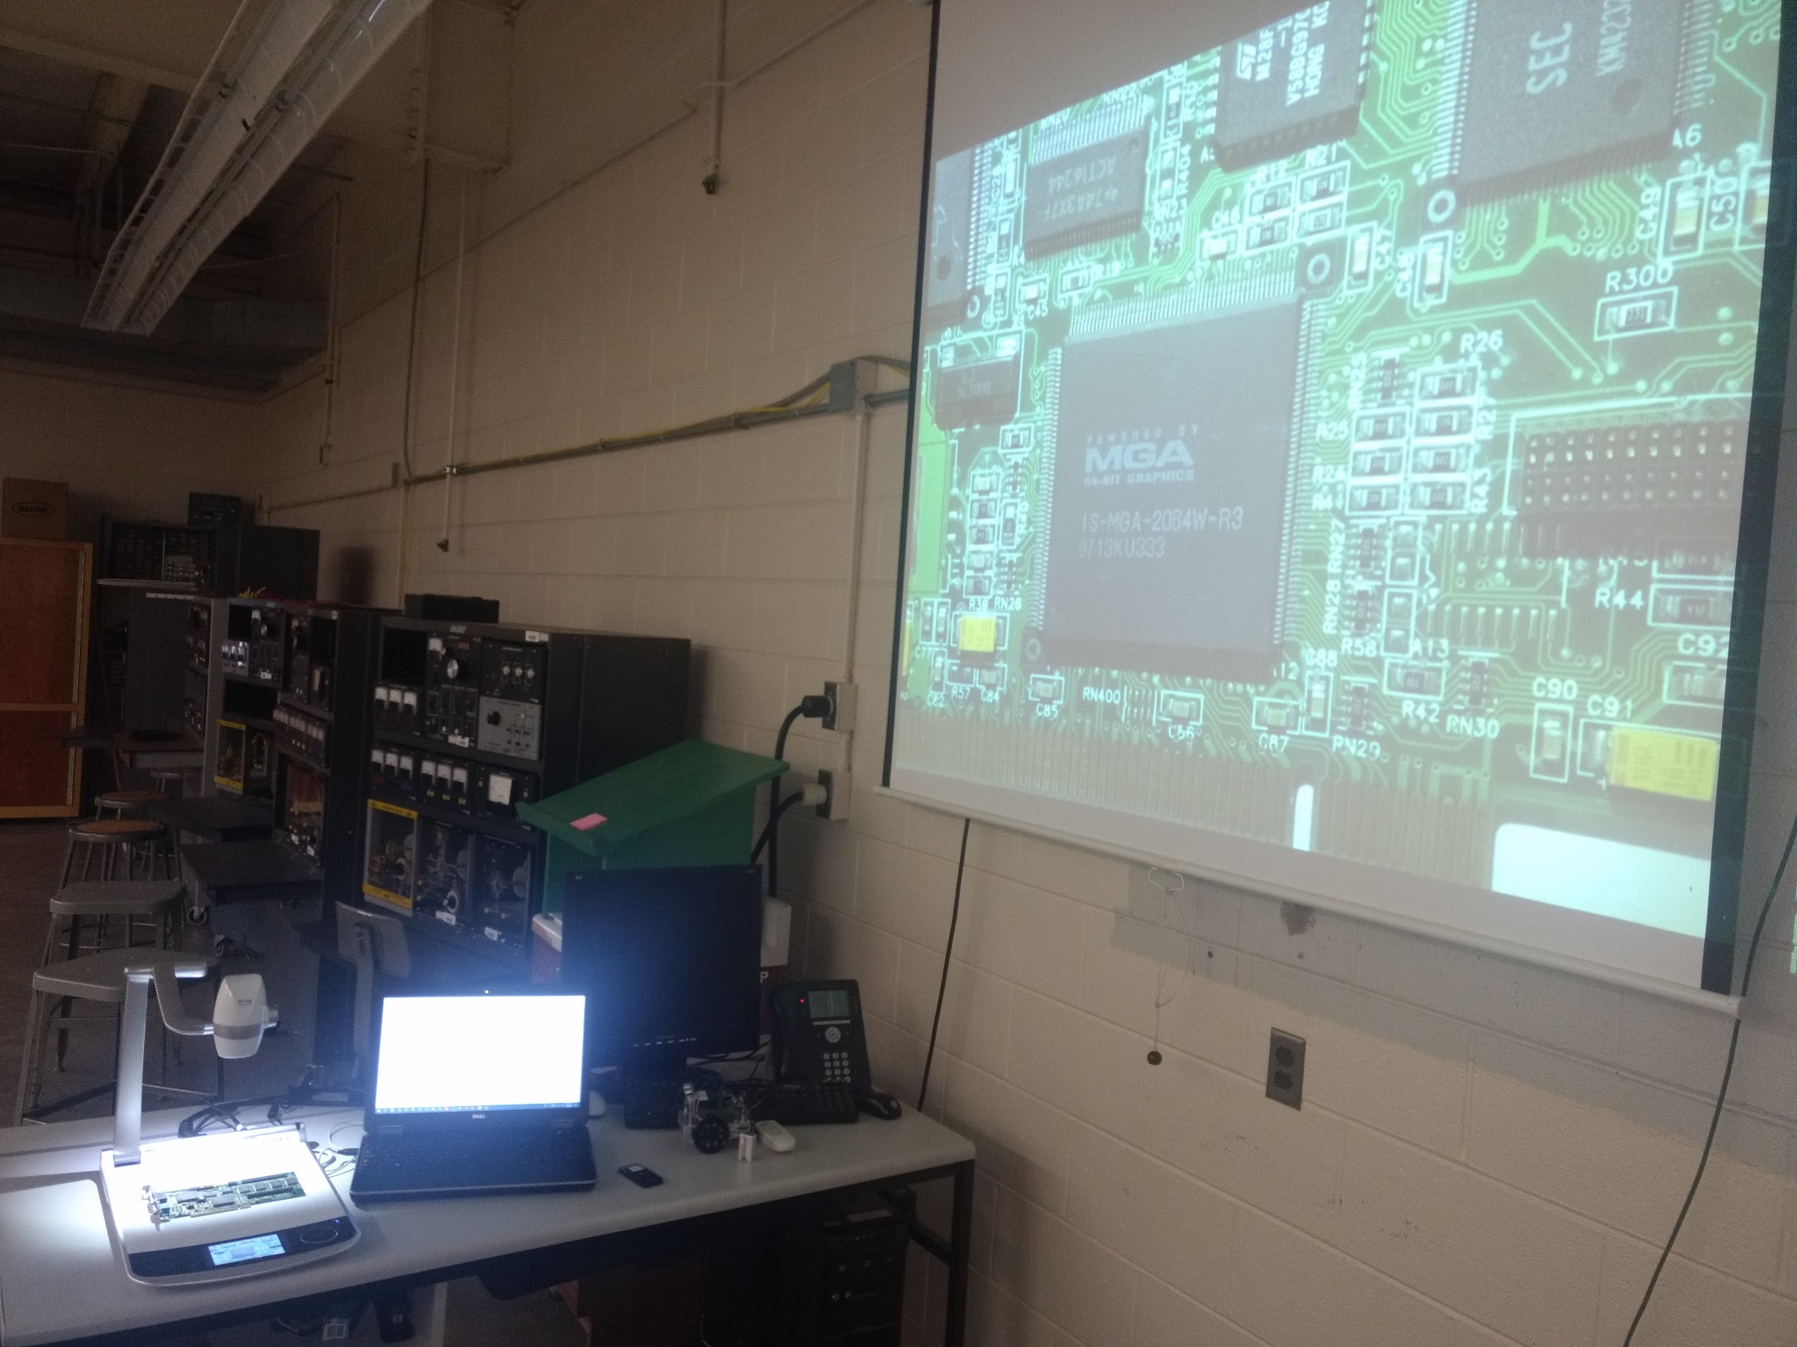
Perkins funding makes a difference: Computer & Electrical Engineering
Source: Cheryl Shuffler/BCPS
Notes:
How Perkins funds made a difference to CTE at Western Piedmont
How CTE programs were improved:
Using Perkins funds, we have added a High Definition Digital Document Camera in our Computer/Electrical engineering lab.
How CTE Programs of Study were enhanced:
The purchase of this camera has enhanced the CTE programs by adding new capability in schematic and blueprint display, detailed micro circuitry review, and design presentation.

Slide 3
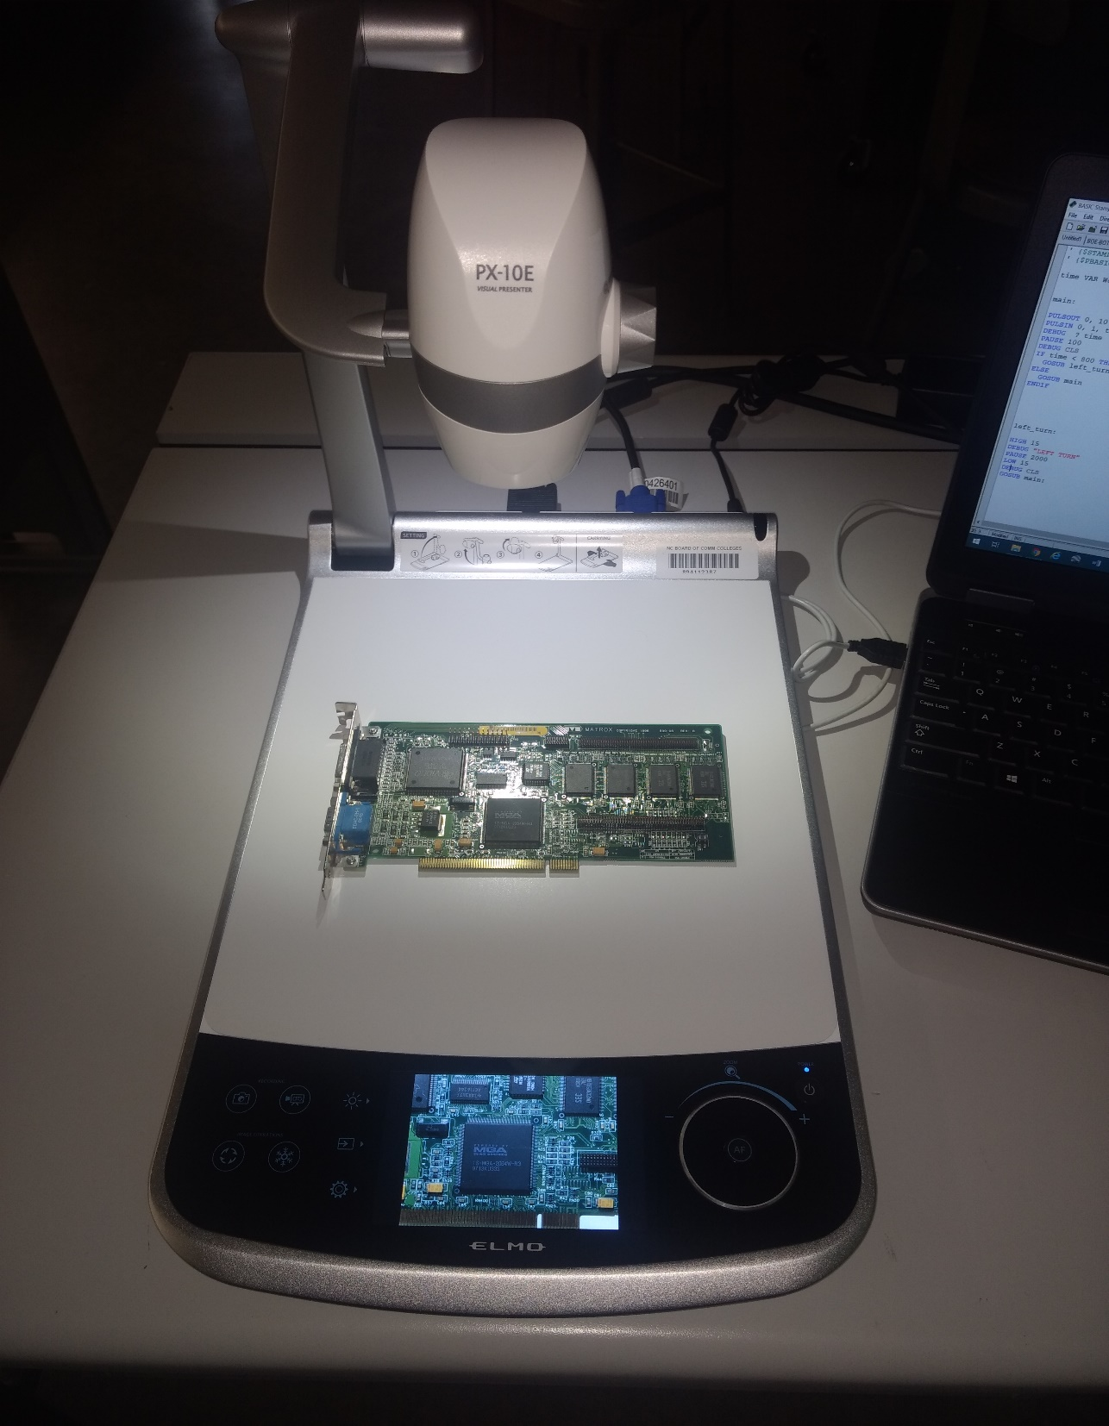
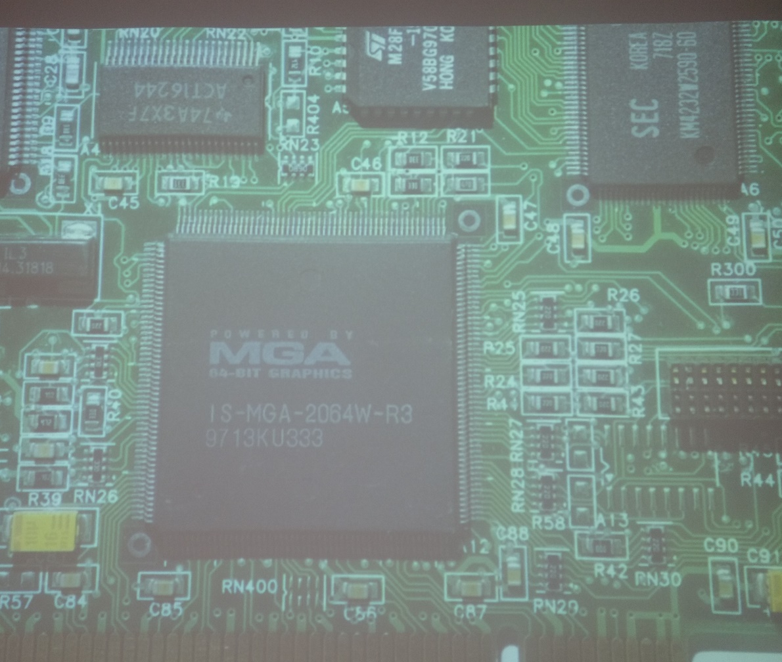
High Definition Digital Document Camera
Source: Cheryl Shuffler/BCPS
Notes:
How Perkins funds made a difference to CTE at Western Piedmont
How students are better prepared for the workplace.
This addition will increase students' understanding of various blueprints and detailed micro circuitry in new ways. Clearly, students can literally can more easily see the information which with goal of greater comprehension. Students will be better equipped for the demands of local employers with this knowledge.

Slide 4
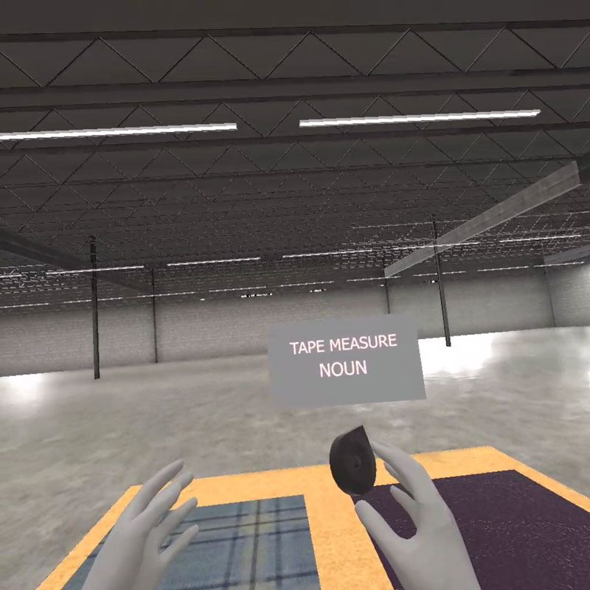
Perkins funding makes a difference: Digital effect & animation technology simulation and game design technology
Source: Cheryl Shuffler/BCPS
Notes:
How Perkins funds made a difference to CTE at Western Piedmont
How CTE programs were improved:
Western Piedmont’s Simulation and Game Design program working with CVCC’s Furniture Academy to create a simulated training experience for Limited English Proficiency students participating in the Furniture Academy. The simulation models focused on tools and safety. This new piece of equipment will be used frequently by SGD students however DEAT students will benefit as well. The VR equipment comes with a video camera that allows students to capture VR video content at either 180 or 360 degrees.

Slide 5
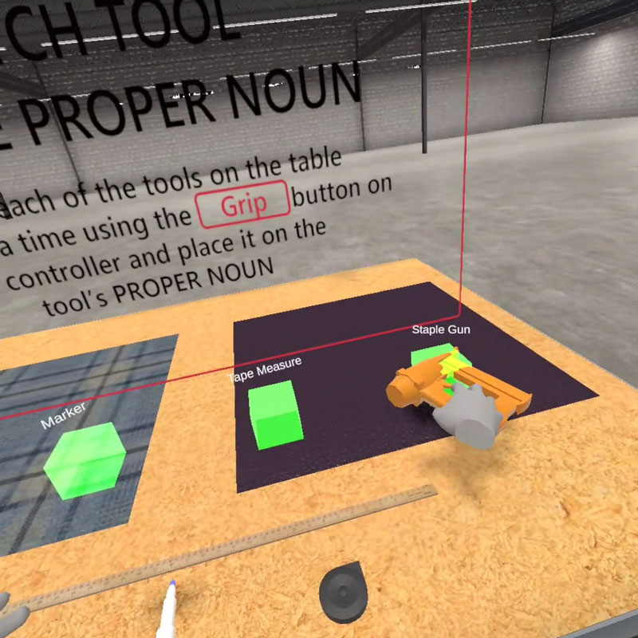
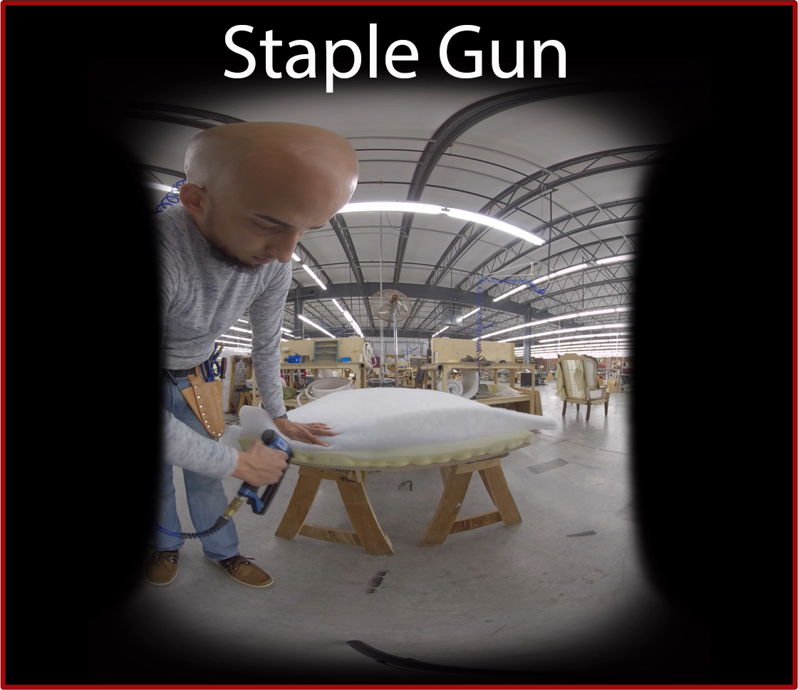
Oculus Quest Virtual Reality Equipment
Source: Cheryl Shuffler/BCPS
Notes:
How Perkins funds made a difference to CTE at Western Piedmont
How the programs were enhanced: Oculus Quest is a particular VR device: It’s not tethered to a computer and it facilitates classroom use with VR. You can have 10 people in a room using the equipment. SGD students are engaged in the skill sets that are specific to that headset and beginning the process of development for this particular headset. It’s tricky because it’s not a computer. Students have to get past that and then make the assets and game play work.
It’s critical to plan equipment requests around industry demand. Equipment like Oculus Quest is an up and coming equipment being used in our regional industry markets.
How students are better prepared for the workplace:
SGD/DEAT Coordinator “You have to encourage students that when you get into this line of work – you have to enjoy learning something new and be up to the challenges of dealing with new technology.” In addition to the equipment purchase, DEAT/SGD will also use funds for professional development and to support subscriptions for the classroom (modeling, and VF effects) – trying to help minimize textbook costs.

Slide 6
Conducting the Comprehensive Local needs Assessment
Engineering Technology Program Area: Computer Engineering Technology Electrical Engineering Technology Mechanical Engineering Technology Mechatronics Engineering Technology | Industrial Technologies Program Area: Computer-Integrated Machining Industrial Systems Technology Welding Technology | Health Sciences Program Area: Medical Laboratory Technology
Source: Cheryl Shuffler/BCPS
Notes:
How the college conducted the comprehensive local needs assessment (CLNA)
Three program areas were reviewed (outlined above)
What gaps or needs were discovered:
For Medical Laboratory Technology - primary gap
In order to increase enrollment to meet the needs of the community’s clinical affiliates, the program needs to be able to accept greater than 20 students beginning as freshman in order to produce enough quality graduates to meet local market demands. Clinical partners are reporting a growing number of vacancies in addition to a national shortage of qualified clinical laboratory technicians and technologists. A survey to industry partners showed 95 openings projected in the next 10 years based on current vacancies and age - not including other openings in clinics and nearby research and reference labs nor routine turnover. Increased graduates to meet vacancies has been the topic of advisory meetings for the past three years.
Currently has one full time faculty overseeing the program. In order to properly address the critical need shortage, the college needs to hire another full-time Medical Laboratory Technology faculty member (and be in alignment with accreditation requirements).
For Engineering Technology and Industrial Technology:
The primary gap has been that Western Piedmont doesn’t have enough students and we can not meet industry demand. Furthering that, the college has less females enrolled in these programs compared to males. The % of Hispanic male students (5P1) are performing under the college’s negotiated rate of 5.50%.
The college’s completion rate for CTE areas overall is 55% while the completion rates for Engineering Technologies is at 25%, Industrial Technologies has a completion rate of 30% and Health Sciences has a completion rate of 45% - all programs are underperforming in seeing students reach the finish line.
How the secondary schools were involved in the process:
Western Piedmont and Burke County Public Schools have worked collaboratively throughout last fall - keeping each other abreast of the progress of the respective CLNAs and sharing industry, student/parent, and community data. This partnership has worked well primarily because of already established communication outlets including monthly Burke Partners in Education meetings and Work in Burke Meetings - hosted by our local economic development arm but attended by both the college and the school system. In addition, the school system’s CTE staff are now housed on Western Piedmont’s campus in an effort to deep the collaborative relationship.
How your local WIOA office/ staff was involved in the process. Western Piedmont works collaboratively with NCWorks and Western Piedmont Council of Government -a staff person has an office in our Student Services department. In addition, the college partners with Rossworks (a WIOA contractor who works with NCWorks). These folks were canvassed about the needs they were seeing and we also had a review of how their services could benefit our students.

Slide 7
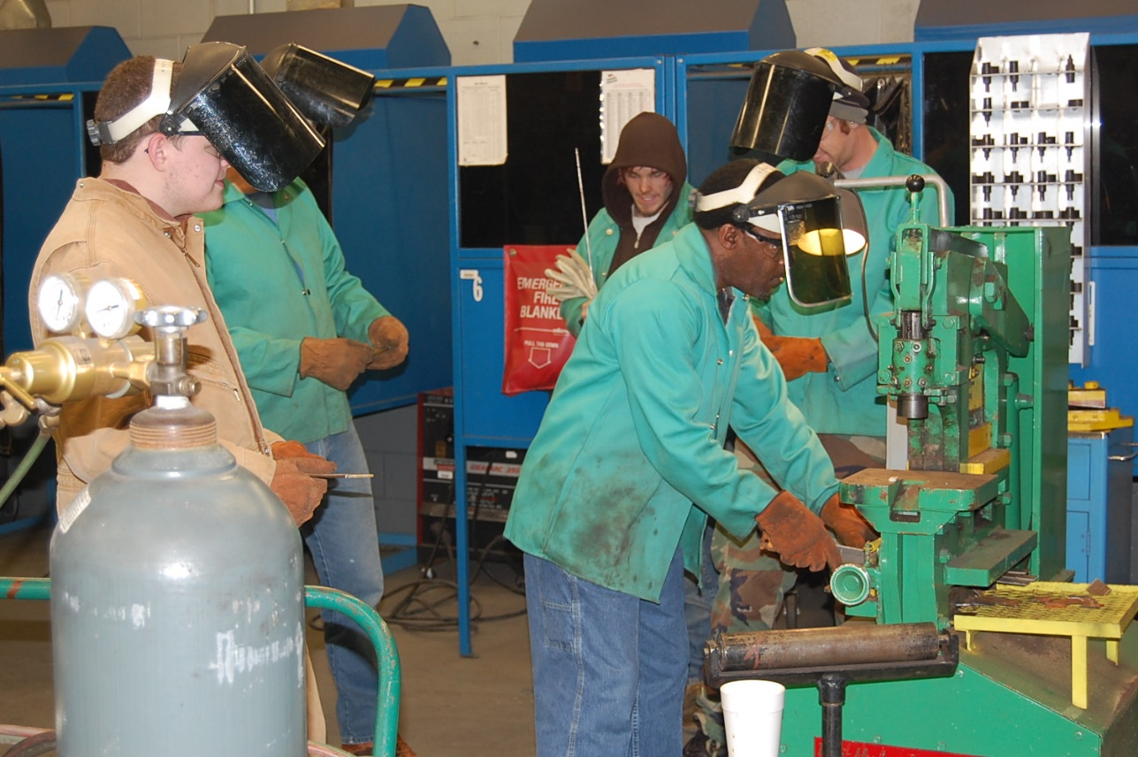
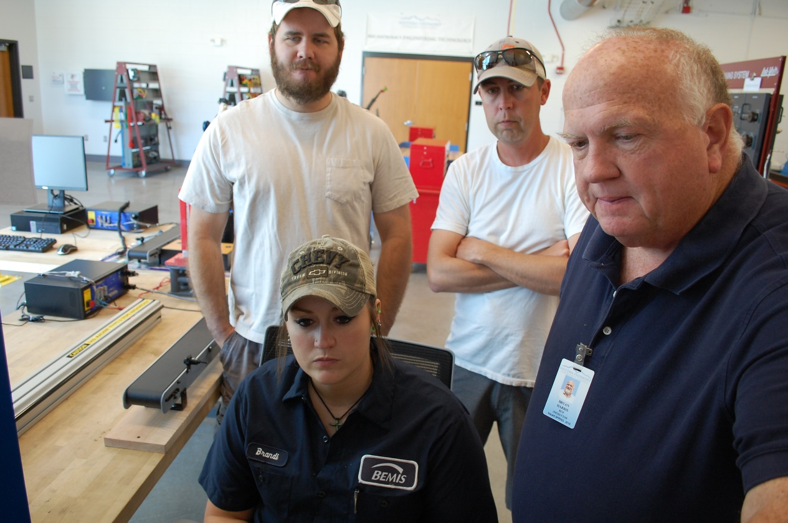
CTE Promising practice Mechatronics Technology Welding Technology
Source: Cheryl Shuffler/BCPS
Notes:
Share a CTE promising practice
One project funded by Perkins to share with the other colleges and b.) what the funding paid for:
Western Piedmont has allocated $20,000 for the Welding Technology program to purchase a fume extractor system and make booth upgrades.
The college also allocated $42,500 for a LabVolt trainer and a LabVolt laser alignment system
c. Reflections from the staff, faculty, students, businesses.
Per our Dean and faculty: Both purchases are examples of Western Piedmont’s process of starting minimally but adequately and then scaling up - essentially being mindful of the limited funding and planning accordingly. For the Mechatronics program, the planning process began in mind with a typical class size of 8 to 10 students. The program was equipped with the basic, bare minimum for year 1. Now we are in year 4 of the program with class sizes ranging from 12 to 16 students. With a larger class size, it’s necessary to double the hands-on lab equipment so that the students receive the necessary hands-on, experiential learning necessary to be prepared for industry. Our Mechatronics instructor has reflected on the fact that his own Masters was more theoretical with not enough hands on learning. He feels providing students with experiential learning opportunities is where community colleges shine.
The practice of scaling up is also seen in our welding purchase. The ability to use Perkins funds throughout the years has given us the flexibility to expand out into the high schools. Without Perkins funding over the last five years, Western Piedmont wouldn’t have been able to expand into three locations - the college and then establishing welding shops in two of the four high schools in our county. Our dean told me that, over the last three years, he realized that welding is frequently the gateway to engineering, skilled trades, and other offerings at Western Piedmont for high school students who are hands-on learners.

Slide 8
2019-20 Perkins Budget Update XDBR Summary
Total Perkins Equipment Budgeted: $97,221 | Other Perkins Funding Budgeted: $53,991 | Total Perkins Funded Allotted: $151,212
Unencumbered Equipment Balance: $79,425.65 | Balance of Remaining Unencumbered funds: $13,595.44 | Total funds left to spend by year’s end: $93,021.09
Source: Cheryl Shuffler/BCPS
Notes:
Budget update
& b. How the monies have been spent so far and Items/services purchased:
hermatocrit readout device for Medical Lab,
Camera, gear, microphone kit for DEAT
Certification supplies and the document camera for Computer and Electrical Engineering
Professional Development for Cosmetology, Mechanical Engineering, Mechatronics, Medical Lab, and Recreation Therapy
Software purchases for Paralegal,
In addition to equipment, Western Piedmont is using funds for professional development to ensure that CTE faculty are updated on changes within their fields.
C. How this year’s spending might be different under the CLNA.
This year’s been spread across multiple program areas where that will not be the case under the CLNA. While we will focused on a limited number of program areas of two years, we also will lose the nimbleness of responding to a variety CTE program needs within an academic year.
Plan for spending the remainder of the funds before June 30, 2020. Our Perkins team (including the CFO) have no concerns with spending the reminder of funds before June 30, 2020
Planned spending for: 3-D printer and processing equipment ($6,700); labvolt trainer and lab volt laser alignment equipment ($42,500); Welding booth upgrades/fume extractor & large shop bandsaw ($24,500), Verifsurf equipment for Machining ($4,500), and CGCookie, and other software licenses for Simulation and Game Design ($11,080.25)+11080.25

