Slide 1
Strengthening the Workforce through the Comprehensive Local Needs Assessment with Background on Perkins V
Perkins V
Dr. Tony Reggi and Dr. Bob Witchger
NC Perkins
Notes:
Perkins 101
October 2021

Slide 2
What is Perkins?
Perkins is a federal program meant to improve and enhance CTE programs.
The Perkins Act was originally authorized in 1984; the most recent authorization is Perkins V in 2018 with significant changes
Postsecondary funding to colleges is based the number of students enrolled in a CTE Programs of study and receiving a Pell Grant.
Perkins is federal money to high schools and community colleges following the Perkins V Act and EDGAR guidelines for federal funds.

Slide 3
Purpose of Perkins V
Develop more fully the academic knowledge and technical and employability skills of secondary education students and postsecondary education students who elect to enroll in CTE curriculum programs and programs of study
Notes:
The Strengthening Career and Technical Education for the 21st Century Act reauthorized and updated the Carl D. Perkins Career and Technical Education Act of 2006 to become the current Carl D. Perkins Career and Technical Education Act of 2006 as amended by the Strengthening Career and Technical Education for the 21st Century Act (Perkins V)
This updated act stresses:
- Academic, Technical, and Employability Skills
- Funding Secondary and Postsecondary CTE
- Focusing on Students who elect to enroll in CTE Programs of Study

Slide 4
Special Populations – Perkins V, Section 3(48)
Individuals with disabilities;
Individuals from economically disadvantaged families, including low-income youth and adults;
Individuals preparing for non-traditional fields;
Single-parents, including single pregnant women;
Out-of-workforce individuals;
English learners;
Homeless individuals described in section 725 of the McKinney-Vento Homeless Assistance Act (42 U.S.C. 11434a);
Youth who are in, or have aged out of, the foster care system; and
Youth with a parent who –
Is a member of the armed forces (as such term is defined in section 101(a)(4) of title 10, U.S.C.); and
Is on active duty (as such term is defined in section 101(d)(10 of such title).

Slide 5
Mission
Actively engage employers and stakeholders in the development and implementation of CTE programs of study that lead to employment
Enhance CTE Programs of Study (POS)
Strengthen faculty technical skills
Support Special Populations enrolled in CTE programs
Align with NC Community College System Strategic Plan
Notes:
Our mission deals with enhancing leveling the field and engaging the employers
Curriculum Standards are the framework for the POS
Our authority comes from the legislative act of 2006
fine-tuned for North Carolina in our state plan

Slide 6
Perkins V Themes
Determine & address program gaps & needs with stakeholders
Incorporate work-based learning
Support special populations enrolled in CTE Programs of Study
Become an active partner of the greater workforce system
Promote awarding of technical certificates, diplomas and degrees
Listen to and engage employers in teaching, learning, and training
Recruit, Retain, and Support CTE Faculty

Slide 7
Perkins V: Secondary-Postsecondary Partnership
Prepare students for work through education and training
Middle School
High School
Postsecondary
Grades 5,6,7,8
Grades 9,10,11,12
Grades 13,14 & Beyond
Informed
Begin Concentration
Postsecondary Concentrator
Hone Skills - Credentials
Notes:
Graphic from middle school to College
WBL Foundation in Engaging Employers and Companies in the classroom and beyond.
Career Fairs, Tours, Mentors, Day in Industry
Co –p, Internships,
WBL 120, even Apprenticeship.

Slide 8
In receiving CTE funds the college:
Verifies Pell and Bureau of Indian Affairs Count (BIA)
Signs Perkins Grant Assurances
Accepts the Perkins Funds
Conducts the Comprehensive Local Needs Assessment
Completes an Application for Funds
Completes the Annual Local Plan and Budget
Implements the Local Plan (modifies if needed)
Completes a mid year report
Completes an end of year report

Slide 9
College Funding for Basic Grant, is determined as a % of the whole, currently college split about $13,600,000.
Colleges verify the number of students enrolled in CTE curriculum program of study (AAS) and receiving a Pell grant.
Students fully enrolled in curriculum programs of study (POS), meeting requirements in section 135.
For 2023 -24 the funded participants are calculated on students enrolled in a community college completing 12 credit hours in a technical program of study.

Slide 10
College Funding for Basic Grant, a % of the whole
If there were 1,000 eligible students at 4 colleges and we had $10,000,000 available to fund the basic grant to colleges
College, one had 100 students with 12 credit hours in CTE 10% = $ 1,000,000
College, two had 200 students with 12 credit hours in CTE 20% = $ 2,000,000
College, three had 400 students with 12 credit hours in CTE 40% = $ 4,000,000
College, four had 300 students with 12 credit hours in CTE 30% = $ 3,000,000

Slide 11
College Assurances - College Agrees to:
Administer the grant
Ensure equipment in a public agency
Follow proper fiscal control and accounting procedures
Provide reports as requested
Include opportunities for faculty and agency participation in program planning
Ensure Applications and Evaluations are open to the public
Have procedures for dissemination information for research if requested
Program equipment purchases cannot benefit the agency or
Use funds to promote high skill, high wage or in demand industry sectors \
Not supplant funds to increase the use of local/state funds that in absence of federal funds would be available to programs and services
Funds shall assist programs with sufficient size, scope, and quality to improve CTE Program

Slide 12
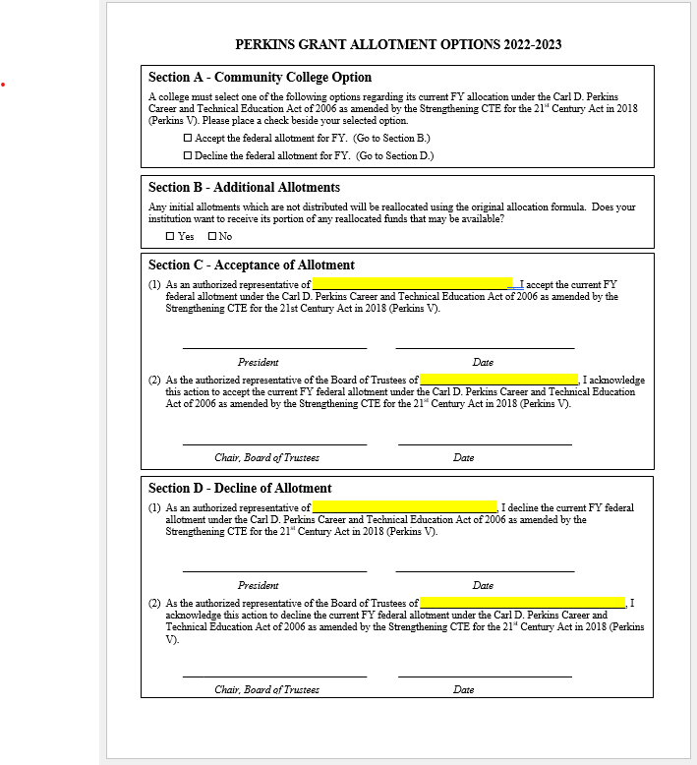

Slide 13
Summary of the Comprehensive Local Needs Assessment - parts A & B
Student Performance
Size, Scope, Quality
Aligned to
State, Region, Local
Needs
Review
Check
Engage
On-Line Data by Program of Study
Employment
Students Earning Certificate, Diploma, Degree
Special Pops Performance
Technical Skills Attainment
What other data sources are available at the college level?
Programs in Curriculum Library
Programs of Study
Curriculum Standards
Does college teach enough classes?
Are college's 9-14 programs adequately aligned?
Are students learning?
Graduates meet employer needs?
Documents to Consider
Learning Outcomes
Curriculum Standards Catalogue
Learning outcomes from faculty syllabus
Programs of study meet local labor market needs?
Notes:
Evaluation uses local and state data including the dashboards.
Program Reviews enrollment, outcomes, grade distribution, faculty certifications, course work on line and seated,

Slide 14
Summary of the Comprehensive Local Needs Assessment - parts C, D, & E
Implementation of Programs of Study
Faculty & Staff
Access and Equity
Review
Check
Engage
Documents to Consider
Equal access for all students.
Success of Special Populations
How do we identify Special Population students?
How do we recruit and assist those interested in enrolling?
How do we support those enrolled in CTE?
Recruitment, Retention, Training
Local college recruitment, retention, and professional development plans
Review College SACS plan for Faculty Professional Development
Secondary - Postsecondary
Evaluation of Implementation
IE Program Review
What are other data sources available at the college level?

Slide 15
The Application
The application addresses key parts of the comprehensive local needs assessment and asks the following questions:
What CTE programs will the college fund?
How will the college collaborate with WIOA?
How will academic and technical skills of CTE students be improved?
How will work-based learning be offered and encouraged?
How will high school students gain postsecondary credit and credentials?
How will the college gain, maintain, and retain CTE faculty?
How does the college serve the nine Perkins Special Populations and ESEA subgroups
Notes:
Here is a good overview the application
Fund
Collaborate WIOA
Improving Skills
Serving Special Pops
What CTE program areas will the college fund with Perkins funds?
How will the college collaborate with their workforce stakeholders and partners? (including WIOA)
How will the college improve the academic and technical skills of CTE students?
What are strategies the college will implement to serve Special Populations enrolled in CTE programs of study?

Slide 16
NC Local Plan Excel Template

Slide 17
End of Year Planning
Promising Practice Video to share an activity that may be beneficial to other colleges in implementing Perkins V.
Local Plan End of Year Status Update: Complete the last two columns summarizing status. Don’t forget to update Equipment and Salary tabs.
End of Year Report: The Questions are in NCPerkins

Slide 18
Comprehensive Local Needs Assessment
The college agrees to conduct a CLNA every two years for programs of study they wish to supplement with Perkins funds.
The college agrees to engage the 8 key stakeholders (CLNA Team) (outlined in the Act) in the CLNA process.
First: The CLNA team reviews the Post Secondary Performance measures disaggregated student data across all CTE programs in reference to key performance indicators, employment, earning credentials and participation in non-traditional program.

Slide 19
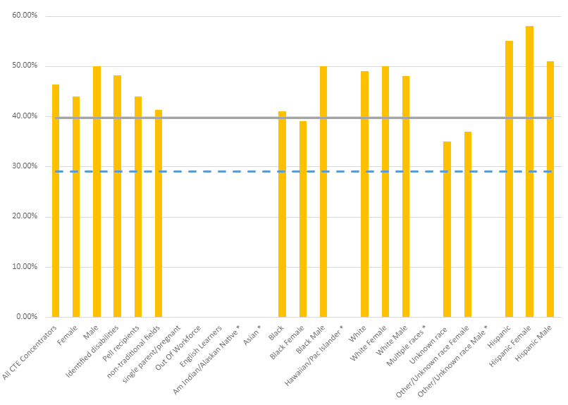
Data Analysis for Gaps in Performance
Local Neg. Level
What gaps can you identify?
Not achieving negotiated local level:
Black Females
Unknown Race
Other/Unknown Female
Note
* means data is suppressed.
“Other/Unknown race” is a combination of races other than Black and White when subdividing by gender.

Slide 20
Comprehensive Local Needs Assessment
Second the Team looks at all or selected CTE programs for
Student performance;
Size scope and quality of each program;
Course work & learning outcomes aligned to local labor market needs;
Integration of secondary and postsecondary pathways/programs of study;
Recruitment, retention and training of CTE Faculty and Staff;
Gaps in performance of special populations.
A summary of this work is submitted with the local application.

Slide 21
CLNA– Collaborate with Stakeholders to Strengthen the Workforce
High Schools
Continuing Education
Employers
CONSIDER
Are we meeting workforce needs?
How are we collaborating with partners?
How can we help all populations who have elected to enroll in our CTE Programs of Study?
How are individuals referred to us for further Education and Training?
WIOA Title II
Workforce Board
Chamber of Commerce
Homeless Coalition
Vocational Rehabilitation
Local Agencies
Notes:
In the CLNA, the Perkins Community Colleges Reach out and asks their stakeholders, how are we doing, how can we collaborate, how can we help the individuals you serve, how might your refer some to us for further education and training - to earn that postsecondary credential and help strengthen our workforce.

Slide 22
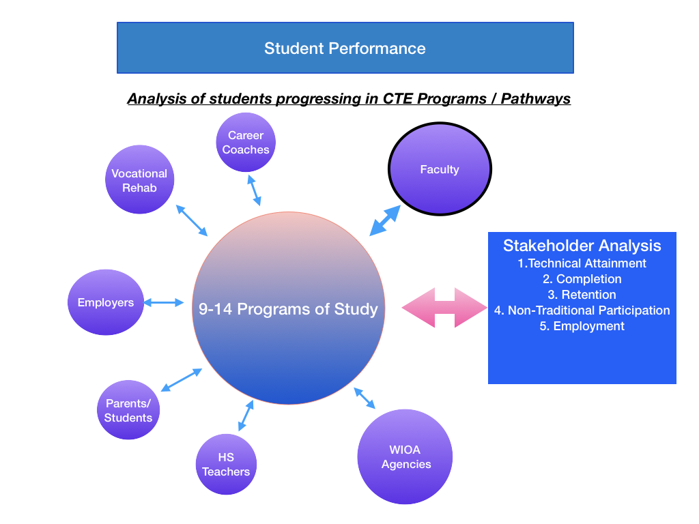

Slide 24
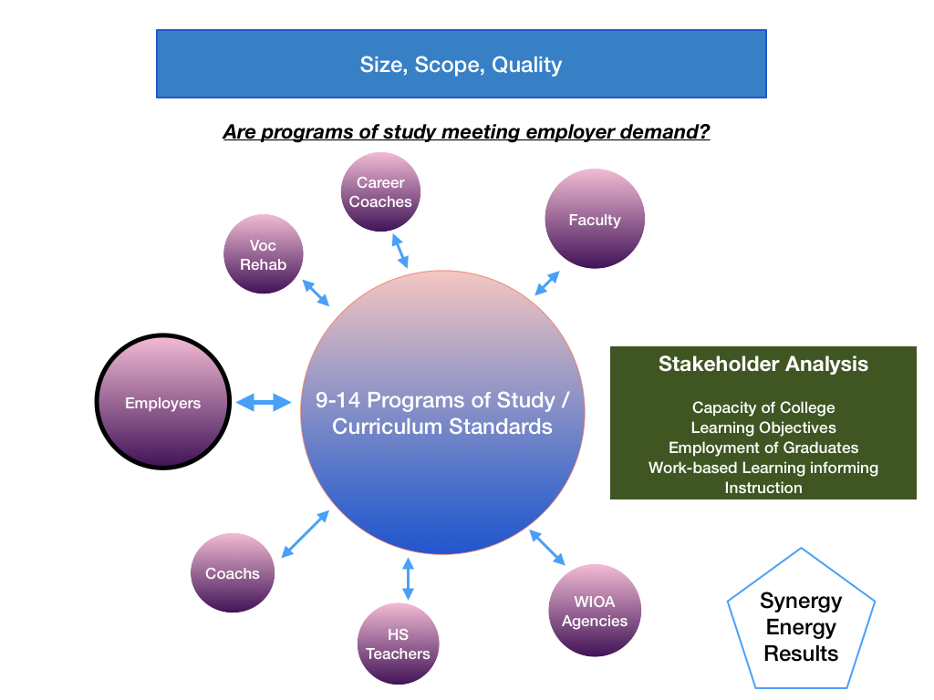

Slide 26
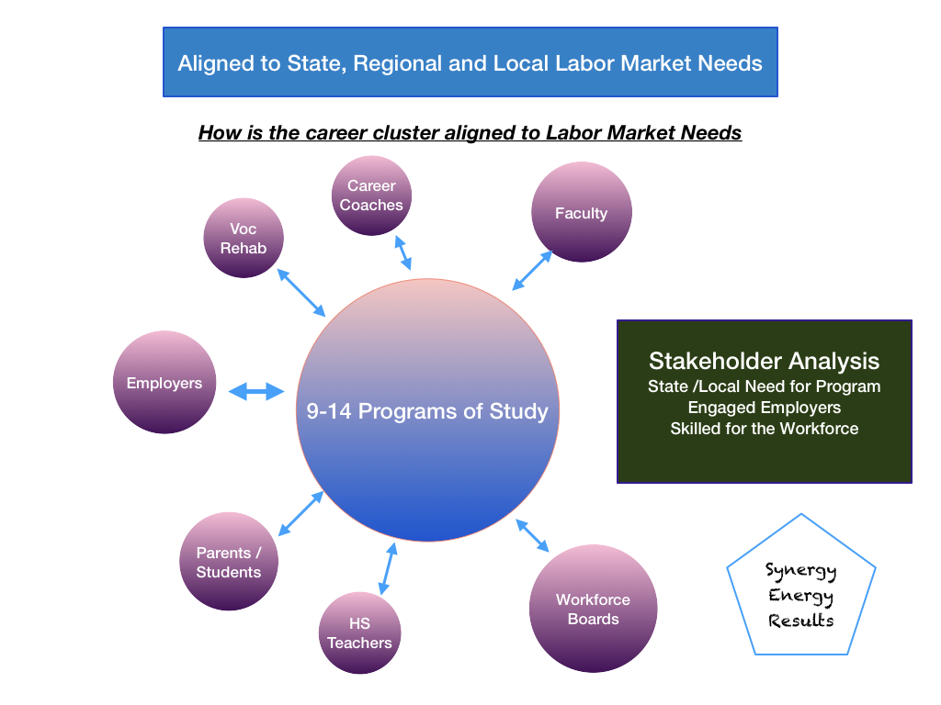

Slide 27
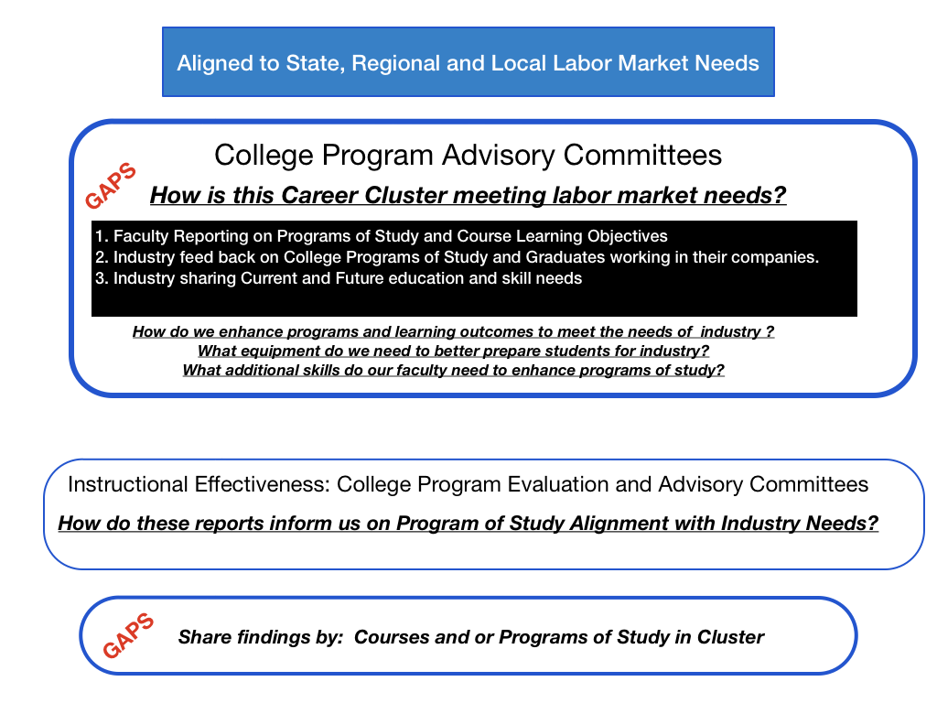

Slide 29
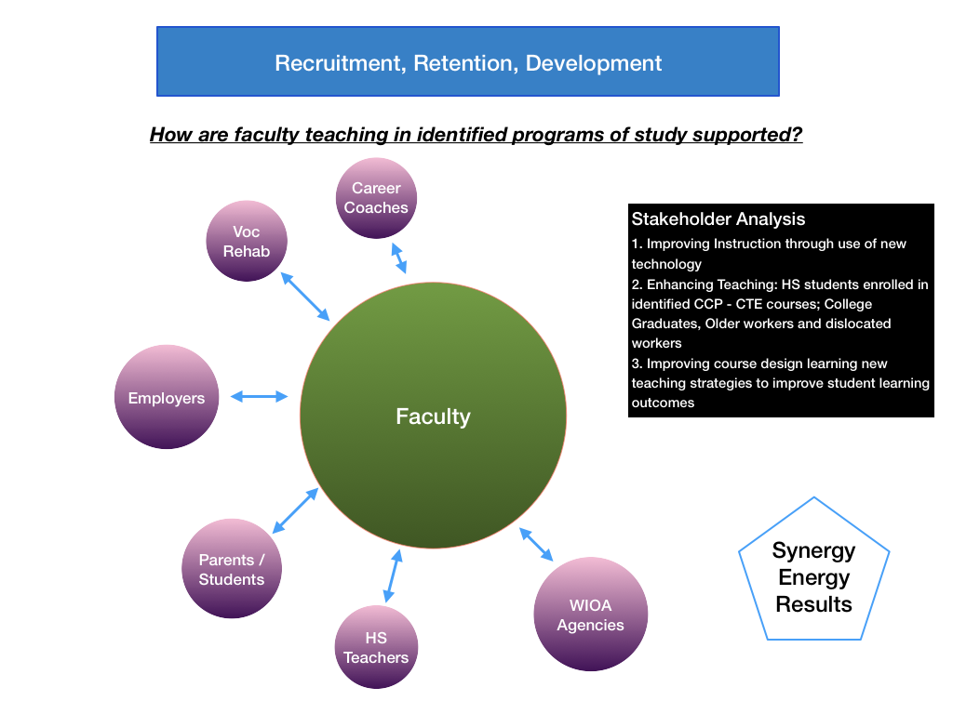

Slide 30
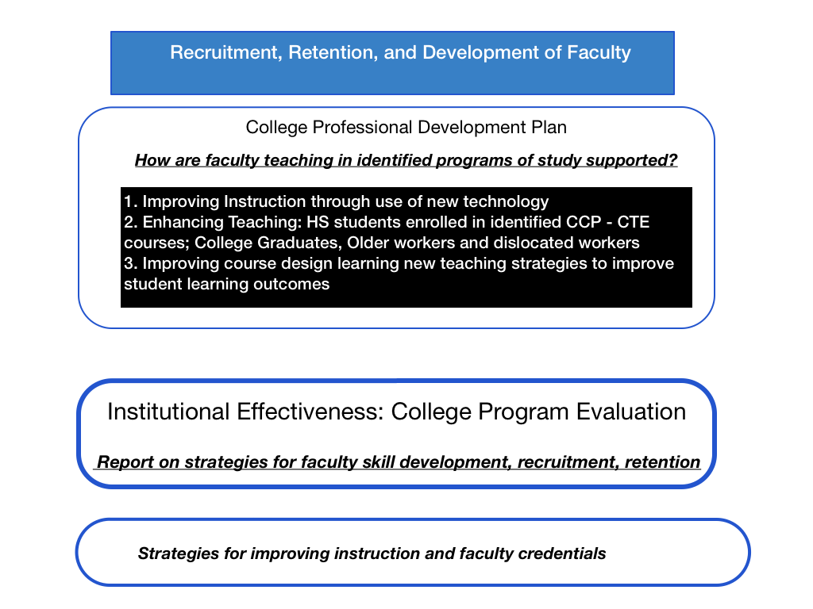

Slide 31
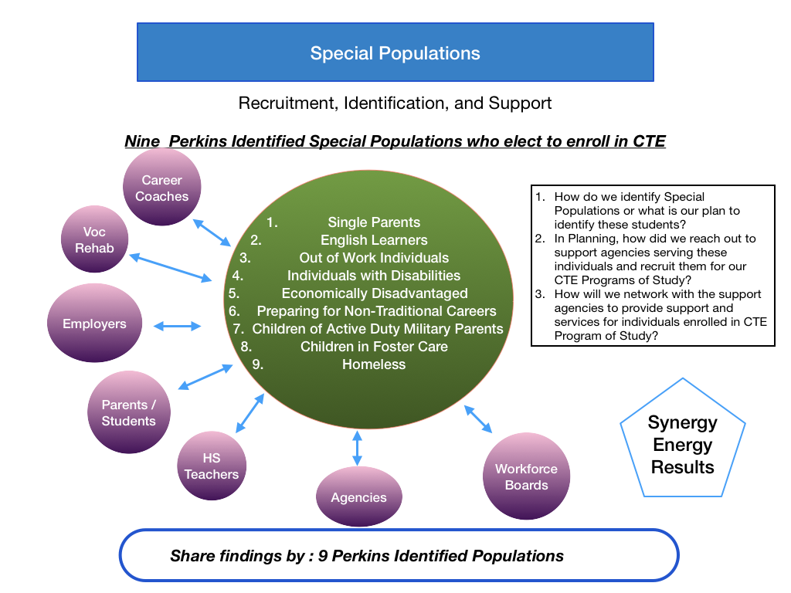

Slide 33
CLNA Summary Sheet Template
Briefly explain Gaps in each part of the CLNA as applicable to this program area.
These Gaps will directly link to activities funded on the activities/budget form.
Notes:
While the typical need assessment is pages in length, Staff has simplified your summary sheet to high the highlights for our review and inclusion in the application.
Ask to see your college CLNA, see how WBL is incorporated into the plan,
Hiring staff, Released Time, Project based

Slide 34
Summary Form
College:
Date Submitted:
Program Area:
Which Program Titles within this Program Area will be funded with Perkins during 2020-21? List the program code of the highest credential offered (C, D or A). Also, indicate if In-Demand (ID), High Skill (HS) or High Wage (HW). For example, A35230 ID-HS-HW for an AAS in Electric Line Construction Technology.
Team/Stakeholders involved - must include required participants, see Perkins §134(d)
Representative | Name | Institution/Position

Slide 35
Summary Form Continued
6. Briefly explain gaps in each part of the CLNA as applicable to this program area. These gaps will directly
link to activities funded on the activities/budget form.
A. Student performance
B1. Size, scope, and quality of program
B2. Alignment to local/regional labor market needs
C. Progress toward implementing 9-14 career pathways programs of study
D. Recruitment, retention, and training of faculty and staff
E. Progress toward improving access and equity for all students

Slide 36
Perkins Application
Applications are required by Perkins V
Informed by the CLNA and guide the annual plan and budget.
They are good for 4 years and can updated if the answers significantly change.

Slide 37
Application Question 1
Check the Programs Areas that have current CLNAs.
Other: _____________________________________________ Focused on All CTE curriculum students or faculty for a specific gap or need
Agriculture &/Nat. Resources Tech Biological & Chemical Tech Business Tech Commercial & Artistic Production Tech Construction Tech | Engineering Tech Health Tech Industrial Tech Public Service Tech Transportation Tech

Slide 38
Application Question 2
For Program Areas to be supplemented with Perkins Funds, provide the following Information:
Describe the process used to determine which CTE programs were selected to be reviewed for the CLNA.
Describe how you decided which gaps you chose to address with Perkins funding.
Describe any new program title(s) the college will fund with Perkins.
How will the college inform students, including students who are members of special populations, about the college’s CTE Programs?

Slide 39
Application Question 3
How will the college collaborate with workforce development boards (WIOA), other local workforce agencies, and industry partners to provide:
Career exploration and career development coursework?
Current information on employment opportunities in CTE fields that are in-demand, high-wage or high-skill?
An organized system of career guidance and counseling?
Activities such as work-based learning and job-placement activities that support the programs of study and blend resources to improve student retention, completion, and employment in occupations with a sustainable wage.

Slide 40
Application Question 4
How will the college improve the academic and technical skills of CTE students?
CTE Curriculum/Program Reviews take place every ____ years.
Describe how working with advisory committees strengthens the academic and technical education components of CTE programs.
Describe strategies that will be implemented to improve academic and technical attainment.

Slide 41
Application Question 5
How does/will the college:
Provide activities to prepare special populations for occupations that are in-demand, high-wage or high-skill?
Prepare (recruit and support) CTE participants for non-traditional fields?
Provide equal access for special populations in CTE programs?
Ensure members of special populations are not discriminated against?

Slide 42
Application Question 6
Describe the variety of work-based learning opportunities the college provides (will provide) to CTE students.
Include how the college will work with industry, advisory committees, NC Work centers to expand these opportunities.
Describe how the college includes opportunities such as Apprenticeship, internships, preceptorships, work study, service learning, other WBL, and Career Technical Student Organizations to support students.

Slide 43
Application Question 7
The college will provide opportunities for students to gain post-secondary credits while still attending high school through:
☐ Career and College Promise
☐ Local/Regional Articulation Agreements
☐ Statewide Articulation Agreement

Slide 44
Application Question 8
Describe the college process for recruiting diverse CTE faculty, staff, and administrators.
Provide a description of how the college supports preparation and retention of faculty, staff and administrators through professional development and training opportunities to maintain and enhance professional skills.
(Note: Most colleges have a professional development plan for CTE faculty and staff skill development and credentialing. You may summarize that program here and link to college master professional development plan.)

Slide 45
Application Question 9
How will the college address disparities and gaps between special populations and all CTE Concentrators for each performance indicator for each of the plan years?
(Refer to Special Population Performance Data Graphs)

Slide 46
NC CTE Plan of Work
Spelled out in Carl D. Perkins Career and Technical Education Act
Outlined in the North Carolina 2020-23 Four-Year CTE State Plan
Reflected in each community college's CTE plan
Notes:
Our mission deals with enhancing leveling the field and engaging the employers
Our authority comes from the legislative act of 2006
fine-tuned for North Carolina in our state plan

Slide 47
Perkins Annual Local Plan and Budget
Identifies strategies the college will implement to address gaps in performance around 5 required activities to improve gaps identified in the CLNA and highlighted in the Application.
This annual plan can be modified as needed

Slide 48
Local Plan and Budget
Perkins V requires specific use of funds, to provide
Career Development;
Faculty Professional Development;
Students with skills necessary to pursue careers in high skill, high wage, or in-demand industry sectors or occupations;
Support for the integration of academic skills into CTE programs of study;
Elements that support implementation of CTE programs that result in increasing student achievement in : 1P1 Employment, 2P1 Credentials, and 3P1 Non-Traditional Participation. (25)

Slide 49
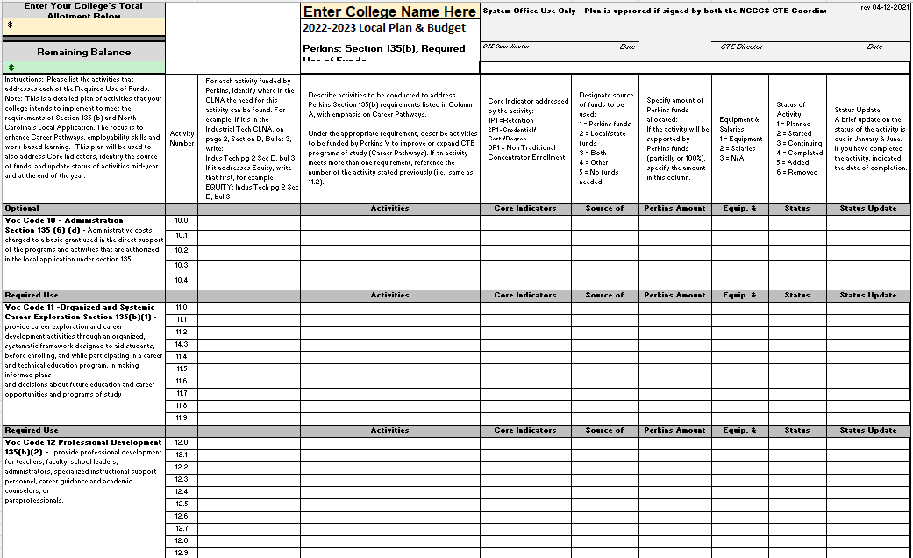

Slide 50
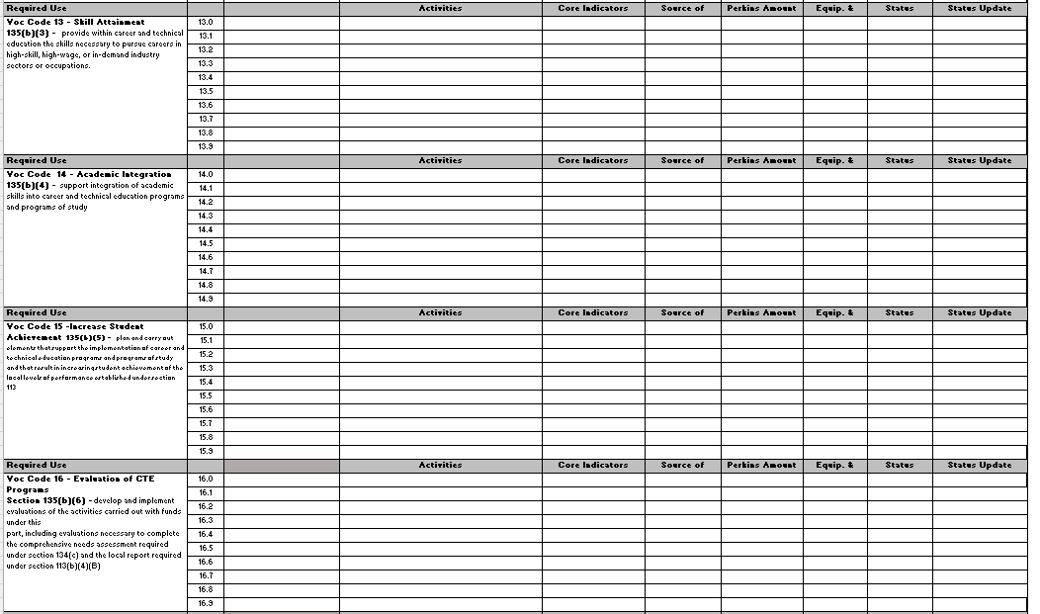

Slide 51
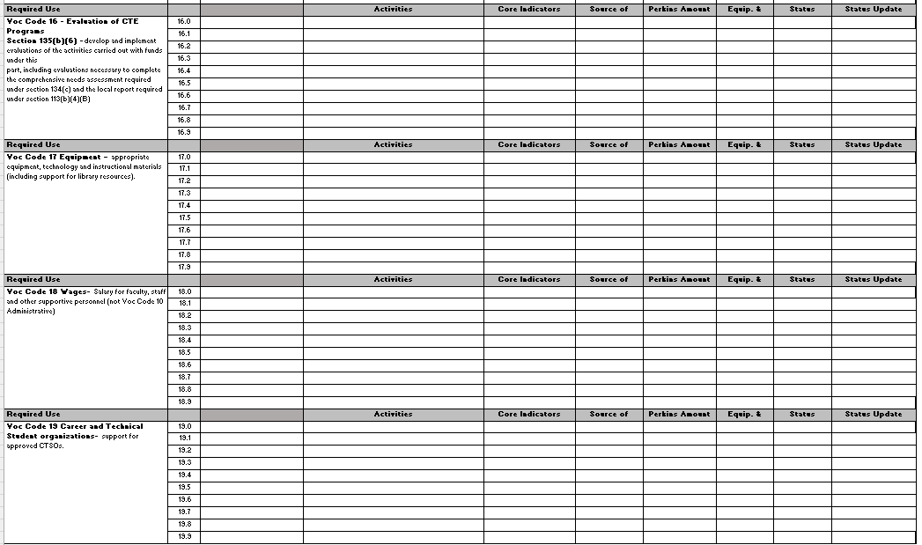

Slide 52
Local Plan and Budget – Approval Before Obligation
Local Plan and Budget - General Guidance in April
Due in June
Local Plan and Budget must be approved before spending begins
Cannot reimburse retroactively
Word to the Wise: Follow it or amend it

Slide 53
Local Plan Considerations
Is it allowable?
Is it necessary and reasonable?
Is it allocable?
Does is supplement and not supplant?
Is it consistent with college policies?
Is it within GAAP (generally accepting accounting principles)?
Does it conform with your application?
Is it adequately documented?
Does it relate to a core indicator?
Is it defensible?

Slide 54
Common Local Plan Pitfalls
Activity description not aligned with a need/gap identified in your CLNA summary
Activity does not align with Required Activity (voc code)
Activity description not aligned with required activities or job descriptions
All pieces of the activity are not described
Too much/too little information
Justification for continued funding missing
Evaluation measures
Insufficiently focused use of funds
Adhere to what’s typically been done
Notes:
Activity description not aligned with budget entries and job descriptions – Counselors working with all students, no documentation
All pieces of the activity not described – Positions and Duties not described
Too much/too little information
Data to support funding; special populations - % of Special Pops enrolled in CTE programs
Justification for continued funding – Why keep staff working with the program year after year (Faculty 3 year Limit)
Evaluation measures – Tie in with Institutional Effectiveness
Insufficiently focused
Adhere to what’s typically been done

Slide 55
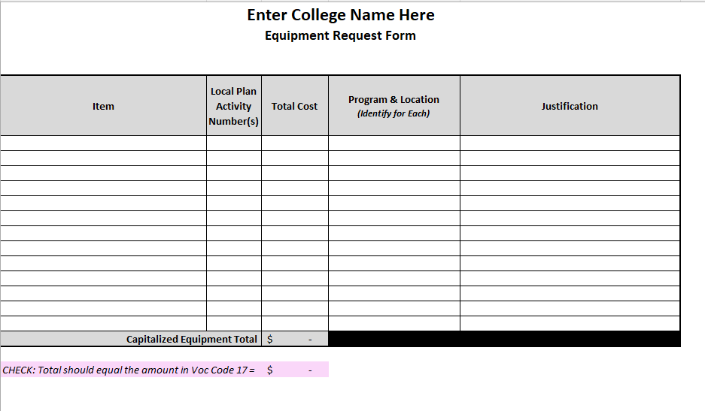

Slide 56
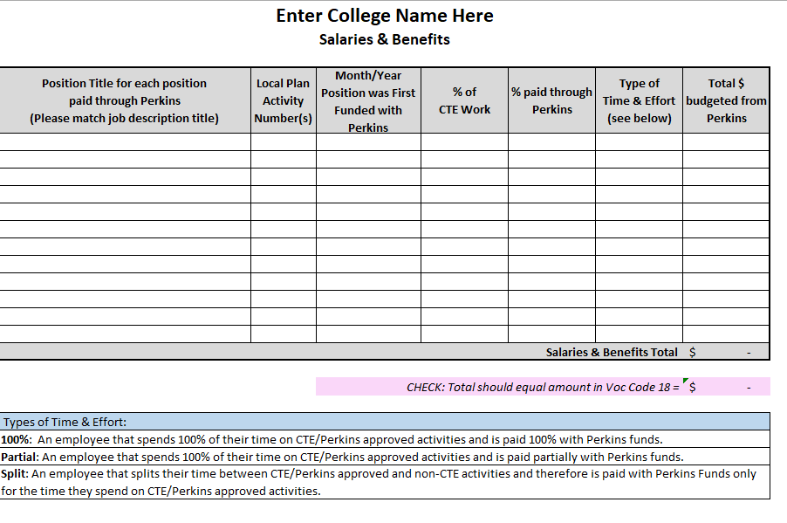

Slide 57
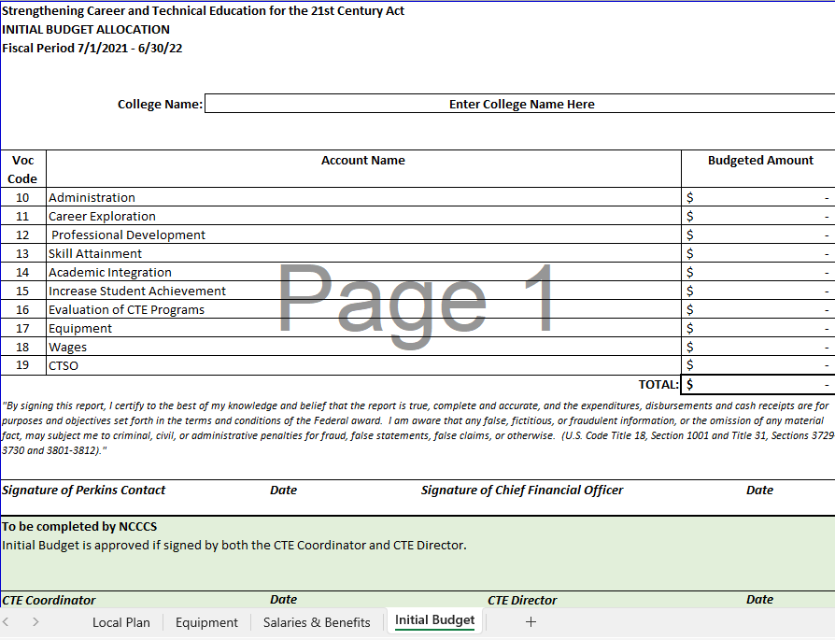

Slide 58
Evolution of Perkins Program
1905: Advocates for "practical education" argue for broader public-school curriculum that prepares graduates for jobs
1917: Smith-Hughes Vocational Education Act ($1.7M)
1936: George-Deen Act increased funding ($14.5M)
1968: Replacement legislation introduced by Rep. Perkins ($365M)
1984: Perkins I - vocational education improvement, special populations

Slide 59
Evolution of Perkins Program
1990: Perkins II - integration of vocational and academic education
1998: Perkins III - technology and workforce preparation
2006: Perkins IV - career and technical education with increased academic preparation; preparation for high-wage, high-skill occupations for tomorrow’s workforce through programs of study
2018: Perkins V – Driven by the Comprehensive Local Needs Assessment (CLNA) with closer alignment to Workforce Innovation Opportunity Act (WIOA) emphasis on high-skill, high-wage and high-demand occupations in the local labor market.

Slide 60
Perkins Emphasis
1964 - State Planning – Set up Vocational Education
1968 - Include Special Populations in Vocational Education
1984 - Equal Access to CTE - Affirmative Action
1990 - High School and Community College - Tech Prep
1998 - Programs of Study - Intense work
2006 - Rigorous Programs of Study, High-Skill Training
2019 - Work-Based Learning, Employability Skills, CLNA
Notes:
Summary

Slide 61
Collaboration with Federal & State Education and Workforce Programs
Secondary and Postsecondary Education collaborating to develop career pathways from Education to Work
High School CTE
WIOA – Title II (Basic Skills)
WIOA Workforce Boards
Agencies serving our students – DHHS, Vocational Rehabilitation,
How are you working with these Agencies

Slide 62
Collaboration with Federal & State Education and Workforce Programs
High School CTE - Framework of Academic and Technical Education - CCP, Articulation
WIOA – Title II (Basic Skills) – On Ramp to Further Education
WIOA Workforce Boards – Funding, NC Works,
NC Commerce- LMI Career Funding
Agencies serving our students – DHHS, Vocational Rehabilitation,
How are you working with these Agencies

Slide 63
WIOA Collaboration with Federal Programs
State CTE Plan
Partner in CLNA
Local College CTE Plan
WIOA infrastructure funding
How is Perkins written into WIOA?

Slide 64
Special Populations – Perkins V, Section 3(48)
Individuals with disabilities;
Individuals from economically disadvantaged families, including low-income youth and adults;
Individuals preparing for non-traditional fields;
Single-parents, including single pregnant women;
Out-of-workforce individuals;
English learners;
Homeless individuals described in section 725 of the McKinney-Vento Homeless Assistance Act (42 U.S.C. 11434a);
Youth who are in, or have aged out of, the foster care system; and
Youth with a parent who –
Is a member of the armed forces (as such term is defined in section 101(a)(4) of title 10, U.S.C.); and
Is on active duty (as such term is defined in section 101(d)(10 of such title).

Slide 65
Common Local Plan Pitfalls
Activity description not aligned with a need/gap identified in your CLNA summary
Activity does not align with Required Activity (voc code)
Activity description not aligned with required activities or job descriptions
All pieces of the activity are not described
Too much/too little information
Justification for continued funding missing
Evaluation measures
Insufficiently focused use of funds
Adhere to what’s typically been done
Notes:
Activity description not aligned with budget entries and job descriptions – Counselors working with all students, no documentation
All pieces of the activity not described – Positions and Duties not described
Too much/too little information
Data to support funding; special populations - % of Special Pops enrolled in CTE programs
Justification for continued funding – Why keep staff working with the program year after year (Faculty 3 year Limit)
Evaluation measures – Tie in with Institutional Effectiveness
Insufficiently focused
Adhere to what’s typically been done

Slide 66
Perkins/CTE State Staff
Dr. Bob Witchger Director, Career & Technical Education WitchgerB@nccommunitycolleges.edu 919-807-7126
Dr. Tony R. Reggi Coordinator, Career & Technical Education ReggiA@nccommunitycolleges.edu 919-807-7131
Patti Coultas Coordinator, Career & Technical Education CoultasP@nccommunitycolleges.edu 919-807-7130
Dr. Mary Olvera Coordinator, Career & Technical Education OlveraM@nccommunitycolleges.edu 919-807-7120
Anne Bacon Coordinator, Career and Technical Education
Bacona@nccommunitycolleges.edu 919-807-7232
Darice McDougald CTE Administrative Assistant McDougaldD@nccommunitycolleges.edu 919-807-7219
Notes:
http://www.ncperkins.org/course/view.php?id=6

