Slide 1
Perkins Update
February 14, 2023

Slide 2
Career & Technical Education Team
Bob Witchger
Tony Reggi
Patti Coultas
Mary Olvera
Anne Bacon
Darice McDougald
Lane Freeman
Aaron Mabe

Slide 3
Purpose of Perkins
Develop more fully the academic knowledge and technical and employability skills of secondary education students and postsecondary education students who elect to enroll in CTE curriculum programs and programs of study
Notes:
The Strengthening Career and Technical Education for the 21st Century Act reauthorized and updated the Carl D. Perkins Career and Technical Education Act of 2006 to become the current Carl D. Perkins Career and Technical Education Act of 2006 as amended by the Strengthening Career and Technical Education for the 21st Century Act (Perkins V)
This updated act stresses:
- Academic, Technical, and Employability Skills
- Funding Secondary and Postsecondary CTE
- Focusing on Students who elect to enroll in CTE Programs of Study

Slide 4
Promising Practice Video 2022
Rockingham Community College
Student Services Fair
See all the videos: https://www.ncperkins.org/video/
Notes:
August:
Catawba Valley Nash
September
Alamance
October – no video
November
Southwestern
February
Rockingham Student Services Fair

Slide 5
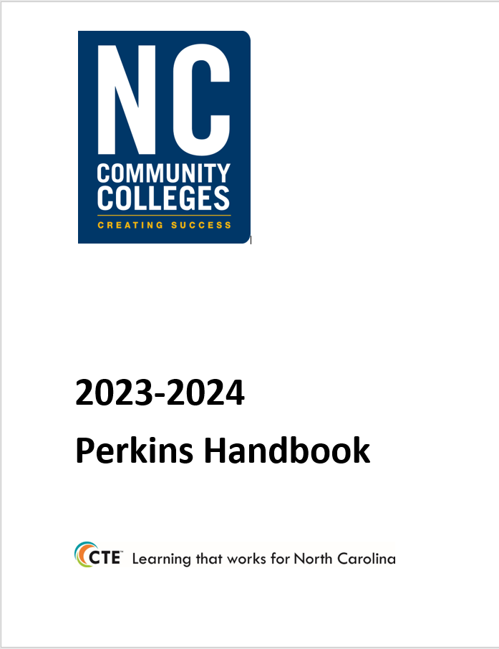
Plan Ahead! EDGAR and Perkins Annual Meeting
Tuesday, April 18th
Koury Convention Center
EDGAR specific to Perkins
9am - noon
Perkins Annual Meeting
1pm – 5pm

Slide 6
SkillsUSA State Competition
Wednesday, April 19th
Greensboro Coliseum
Postsecondary Competition and awards ceremony

Slide 7
End of Year Planning
Promising Practice Video to share an activity that may be beneficial to other colleges in implementing Perkins V.
Local Plan End of Year Status Update: (Last Two Column completed summarizing what was planned and completed)
End of Year Report (next two pages)

Slide 8
End of Year Report
Briefly answer each of the following questions based on Perkins required activities:
What career development activities has the college implemented in the past program year to help students in enrolling in CTE programs of study?
In what ways is the college working to improve the retention of CCP CTE students beyond high school graduation in the AAS Pathway?
What practices has your college implemented this year to recruitment to or enhance special populations participation in and their performance in CTE Programs of study? (Recruitment and Performance)
More

Slide 9
End of Year Report continued
Highlight 4 professional development activities offered to CTE faculty during the past year
In what ways has the college’s CLNA informed the integration of academic, technical and employability skills in career pathways or program of study?
What are 3 specific activities the college has implemented to increase student progress and success? (1p1 Employment, 2p1 Credentials, and 3p1 Non-traditional Participation)
Overall, how has Perkins funding made a difference at your college this year?

Slide 10
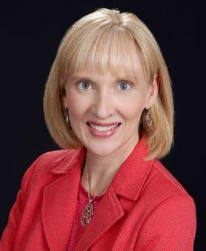
Hope Cotner
Center for Occupational Research and Development
President/CEO
Notes:
https://www.nc-net.info/building-career-pathways/#
Hope Cotner
President/CEO
Center for Occupational Research and Development
hcotner@cord.org

Slide 11
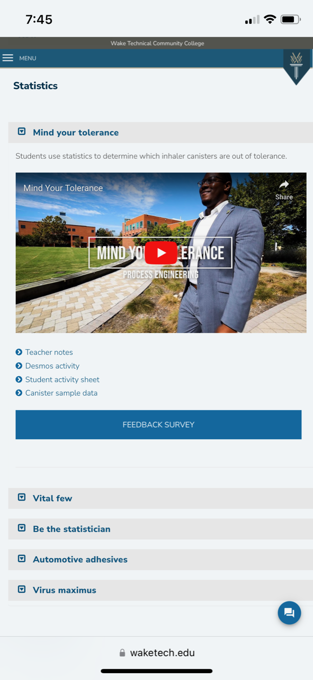
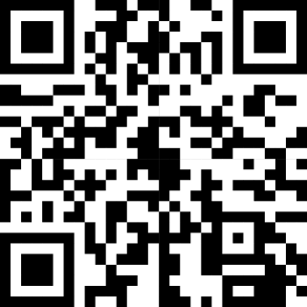
Connecting Industry to Mathematics Instruction
NSF-ATE project focused on integrating industry-inspired lessons into HS and college math courses (Stats, Technical Math, Pre-Calc Algebra and Trig)
Lessons use launch/explore/discuss pedagogy – facilitate active learning, offer engaging videos that introduce students to a broad range of careers that use math and feature diverse professionals successful in the field.
20 lessons available now; 35 total in April (Free and classroom ready)
Free professional development workshops available this spring/summer
Contact Jay Martin at jemartin@waketech.edu to schedule a workshop for your college.
Contact Hope Cotner at hcotner@cord.org to host a regional workshop for NC-NET.

Slide 12
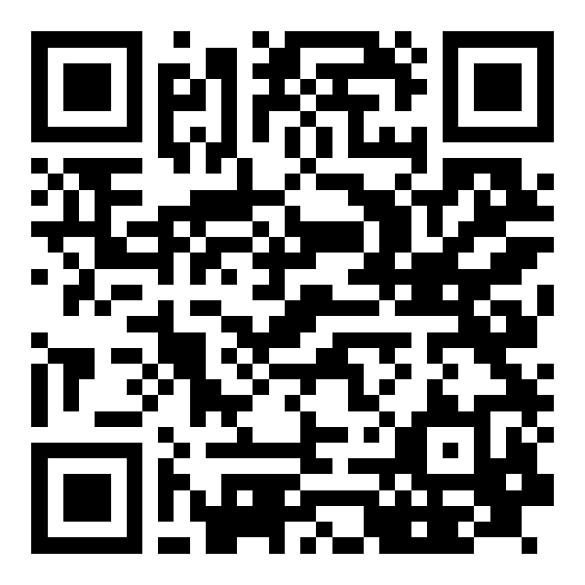
Academy Courses
Facilitator-Led:
Enriching Courses by Crossing Content Boundaries March 10 – April 21
Cyber for Non-IT Instructors March 31 – April 24
Habits of Happy Teachers: Perspectives on Thriving in Education April 15 – May 19
On-Demand:
Start Teaching Today: 4-course series
What Do I Need for the First Day of Class?
How Do I Create a Positive Classroom Climate to Support Adult Learners?
How Can I Enrich the Learning Experience? Making “A-ha!” Happen
How Do I Know What They Know? Incorporating Authentic Assessment Practices
Employability Skills for Student Success in the Workplace: 3-course series (Coming this Spring)
Effective Workplace Communication
Critical Thinking for the 21st Century
Collaborative Problem-solving

Slide 13
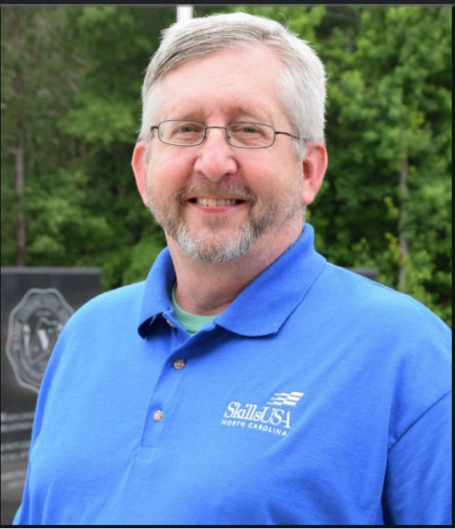
Wil van der Meulen
SkillsUSA North Carolina Post Secondary Support Director
wil@skillsusanc.org
https://bit.ly/wilskillsusanc
Contact Form
My SkillsUSA Journey
Virtual Vcard

Slide 14
See PowerPoint from SkillsUSA
The PowerPoint Wil shared has been uploaded separately, except his first and last slides.

Slide 15
The Ask….
Needing some volunteers to pilot this project at your campus.
Wil van der Meulen
Postsecondary Support Director
bit.ly/wilskillsusanc

Slide 16
Perkins Monthly Updates
2nd Tuesday of the month from 9-10 am
Register now for all of them https://www.ncperkins.org/presentations/
Upcoming dates:
March 14, 2023
April 11, 2023
May 9, 2023
June 13, 2023
Attendance (or viewing the recording within 30 days) is recorded on monitoring rubric. Recording may be accessed at the same link as the registration.
Notes:
Register now and let the system remind you.

Slide 17
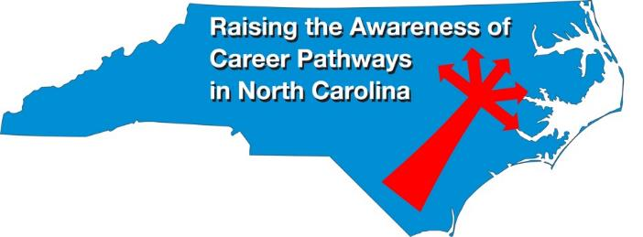
Raising the Awareness of Career Pathways Webinars
February 15 Machine Programming (CNC)
March 15 Occupational Therapy Assistants
April 19 Food Industry canceled
May 17 Entrepreneurship
June 21 Non-Profit Leadership and Management
Register for all webinars at www.ncperkins.org/presentations

Slide 18
NCPN
Consider submitting a proposal! 3/31/23 deadline
https://www.ncpn.info/2023-call-for-proposals/

Slide 19
ACTE
https://www.acteonline.org/postsecondarycteevent/

Slide 20
Technical Assistance is available
We are here to help!
Team Perkins is available by phone, email, virtually, or in-person

