Slide 1
Postsecondary CTE
Annual Perkins Planning Meeting
April 27, 2017
Greensboro, NC
www.ncperkins.org

Slide 2
Perkins/CTE State Staff
Dr. Bob Witchger Director, Career & Technical Education WitchgerB@nccommunitycolleges.edu 919-807-7126
Dr. Tony R. Reggi Coordinator, Career & Technical Education ReggiA@nccommunitycolleges.edu 919-807-7131
Dr. Julia Hamilton Coordinator, Career & Technical Education HamiltonJ@nccommunitycolleges.edu 919-807-7130
Chris Droessler Coordinator, Career & Technical Education DroesslerC@nccommunitycolleges.edu 919-807-7068
Jennifer Holloway CTE Administrative Assistant HollowayJ@nccommunitycolleges.edu 919-807-7129

Slide 3
Postsecondary Perkins
Basic Grant - Enhancing Programs of Study
Leadership Grant - Pushing the Envelope
FAUPL - Performance and Accountability
Methods of Administration - Equity
Career Pathways Grant - RFP

Slide 4
Basic Grant
Enhance CTE –Links to high school
Employers - Listening, acting, engaging
Develop more fully the academic, technical and professional skills of faculty
Encourage partnerships with stakeholders

Slide 5
Basic Grant - required activities
Strengthen the Academic, Career and Technical Skills of Students
Secondary to Postsecondary Linkages
All Aspects of Industry
Develop, Improve, or Expand the use of Technology
Professional Development
Evaluation of CTE Programs
Initiate, Improve, Expand, or Modernize CTE Programs
Size, Scope, and Quality
Activities for Special Populations

Slide 6
Leadership Grant
Assessment of CTE
Expand the use of technology
Professional developments programs
Support and improve CTE programs
Support partnerships
Serve state correctional institutions
Support programs for special populations
Provide technical assistance to our colleges

Slide 7
Leadership Grant
2016-2017
2017-2018
Automotive
SkillsUSA
Pathways
Career Coaches
RN to BSN
Competency-Based Education
Accounting
Competency-Based Education
Career Cluster Guide
SkillsUSA
WIOA
Apprenticeship
Articulation
CORD / NC-NET
Survey

Slide 8
2017-18 Leadership Grants Survey
Find survey on ncPerkins Moodle
http://www.ncperkins.org/mod/feedback/view.php?id=845

Slide 9
Research/Presentations/Webinars
Partnership with NCWorks Training Center
Presentations/webinars
Preparing Youth for Careers of the Future
Help Folks Discover their Passion and Turn it into a Career
Working with youth who are like Dr. Sheldon Cooper from the TV series "The Big Bang Theory"
Keeping our Youth out of Trouble with the Law
Hot Jobs of the Future
Career Information: What it is, and Why it’s Important
Employers and Educators Developing Quality Career Pathways with WIOA
Notes:
Chris's presentations

Slide 10
Perkins Performance Indicators
1P1 - Students who attain a 2.5 GPA or higher
2P1 - Students who complete a credential, certificate, diploma or degree
3P1 - Students who continue in CTE (retention or transfer)
4P1 - Students who are placed in a job (employment)
5P1 - Students who enroll in nontraditional program of study
5P2 - Students who complete a nontraditional program of study

Slide 11
Monitoring - Basic Grant
Career and Technical Education activities
Secondary students earning postsecondary credit
Improve academic and technical skills of students
Understanding all aspects of industry
Taught to challenging standards
Professional development for staff in CTE POS
Inform stakeholders of CTE ACT
Continuous improvement
Risk monitoring

Slide 12
Monitoring – Risk Factors
Attendance at webinars and meetings
Timeliness of paperwork
New staff
General performance measures
Local plan
Percentage of budget in one area
Participation in Articulation Agreement update

Slide 13
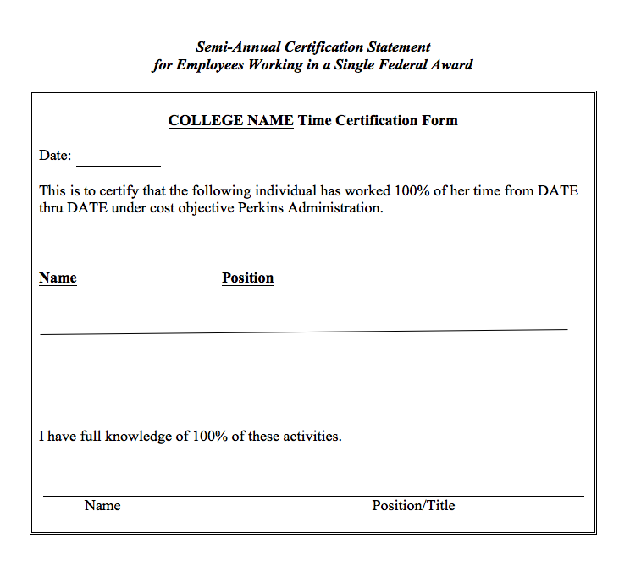

Slide 14
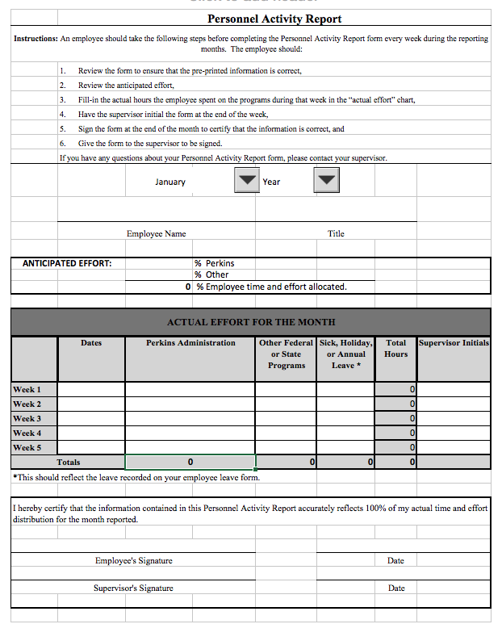
Notes:
Hours spent on Perkins Activities (CTE)
Hours spent on other actiitie

Slide 15
Methods of Administration (MOA) of Federal CTE Programs
Student accessibility
Student access
Equity in teaching faculty, enrolled students, and support staff

Slide 16
Methods of Administration of Federal CTE Programs Checklist
Administrative - Notice of non-discrimination
Site location and student eligibility
Equity recruitment
Admissions
Student financial assistance
Counseling and prevocational programs
Services for students with disabilities
Accessibility 504-ADA
Comparable facilities
Work study, cooperative education, job placement, apprenticeship
Employment

Slide 17
Writing the Local Plan
Contact information
Allotment - Accept or reject
Required use of funds - Focusing the grant
Assurances (UPDATED)
Local plan and budget document - Pathways, accountability, enhancement
Budget allocation - Pathways, equipment, staffing
Required activities - What difference does the funding make?
Permissible activities -
Supplanting - Equipment, supplies

Slide 18
2017-18 Budget - General Guidance
Equitable distribution of funds
All required activities are to be accomplished with Perkins or other funding sources
Keep salaries under 50%
Keep equipment under 50%
Fund Work-Based Learning at least 20%
Fund Faculty Professional Development at least 20%
Budget modification accepted through the third quarter.

Slide 19
Perkins Allocation 2017-18
For planning purposes use the same funding level as in fy2016-17 for fy2017-18 and expect some changes.
The federal education budget may be cut 20%
Pell Numbers have small tenths-of-a-percent changes among colleges
With uncertainty, we will use the 2016-17 allocations for planning purposes.
Anticipate adjustments

Slide 20
Consortia
Form a leadership team
Joint planning
Develop programs that will be mutually beneficial
Collaborative use of funds

Slide 21
Postsecondary CTE
Annual Perkins Planning Meeting
April 27, 2017
Greensboro, NC
www.ncperkins.org

