Slide 1
Perkins Update Webinar
February 9, 2021

Slide 2
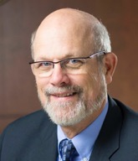
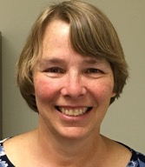
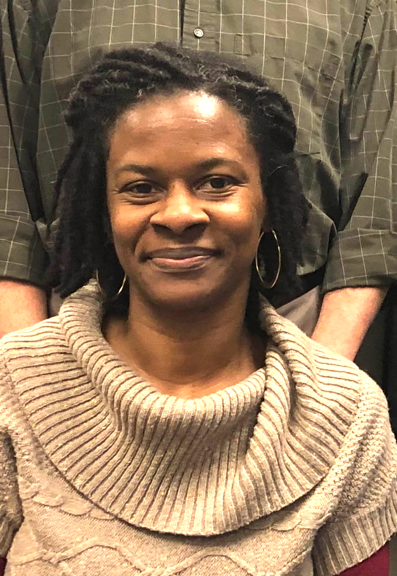
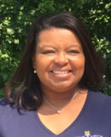
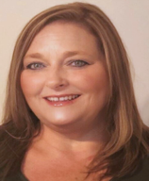
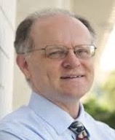
Team Perkins
Bob Witchger
Patti Coultas
Tony Reggi
Darice McDougald
Michelle Lair
Mary Olvera
Chris Droessler
Notes:
Dr. Bob Witchger
919-807-7126
WitchgerB@nccommunitycolleges.edu
Dr. Tony R. Reggi
919-807-7131
ReggiA@nccommunitycolleges.edu
Patti Coultas
919-807-7130
CoultasP@nccommunitycolleges.edu
Dr. Mary Olvera
919-807-7120
OlveraM@nccommunitycolleges.edu
Michelle Lair
919-807-72227
LairM@nccommunitycolleges.edu
Chris Droessler
919-807-7068
DroesslerC@nccommunitycolleges.edu
Darice McDougald
919-807-7219
McDougaldD@nccommunitycolleges.edu

Slide 3
COVID-19 Follow Up
How are you all doing?
What’s happening at your College?
What can we do to assist you?

Slide 4
Purpose of Perkins
Develop more fully the academic knowledge and technical and employability skills of secondary education students and postsecondary education students who elect to enroll in CTE programs and programs of study
Notes:
The Strengthening Career and Technical Education for the 21st Century Act reauthorized and updated the Carl D. Perkins Career and Technical Education Act of 2006 to become the current Carl D. Perkins Career and Technical Education Act of 2006 as amended by the Strengthening Career and Technical Education for the 21st Century Act (Perkins V)
This updated act stresses:
- Academic, Technical, and Employability Skills
- Funding Secondary and Postsecondary CTE
- Focusing on Students who elect to enroll in CTE Programs of Study

Slide 5
What’s Happening in Raleigh
MOA – Civil Rights Reviews
Annual Pell letter and BIA form – due Feb 17
Plan and Budget Review - Consistency with CLNA
Pell Verification – Students Primary Code, Participant Definition
Accountability Measures – Dashboard, Future Negotiated Levels
Pathways Survey - Early Glimpse

Slide 6
New CLNA?
If you conduct a new CLNA, then update your application to match.

Slide 7
Promising Practice Videos 2020
Johnston Community College
Program Developers to look at new programs
https://www.ncperkins.org/video
Notes:
Sept 2020
AB-Tech
Coastal Carolina
October 2020
Mitchell
Tri-County
November 2020
Haywood
Pamlico
January 2021
Rowan-Cabarrus
Isothermal
February 2021
Johnston
Randolph
Pitt
Blue Ridge
Cape Fear
Mayland
Carteret
Sandhills
Central Piedmont
Wilson
Cleveland
Craven
Wilkes
Durham
Forsyth
Southwestern
Halifax
McDowell
Nash
Richmond
Wayne
Robeson
Caldwell
Rockingham
South Piedmont
Edgecombe
Western Piedmont
Southeastern
Catawba Valley
Stanly
Surry
Wake Tech
Fayetteville
Gaston
Vance-Granville
Sampson
Guilford
Central Carolina
Lenoir
Martin
Brunswick
Davidson
Roanoke-Chowan
James Sprunt
Bladen
College of Albemarle

Slide 8
Mid-Year Reviews
Thoughts, ideas, and trends
Recordings at https://www.ncperkins.org/presentations/

Slide 9
Indicator Performance Trends
Based on 2019-2020 performance and 2020-2021 negotiated level
1P1 - 3 colleges are on track to be below their negotiated level
2P1 - 17 colleges are on track to be below their negotiated level
3P1 - 10 colleges are on track to be below their negotiated level
https://www.ncperkins.org/data/status.php
Notes:
https://www.ncperkins.org/data/status.php

Slide 10
Monitoring – February through May
Equipment - Looking at Program Area, Equipment and Supplies Purchased
Staff Time and Effort –
Upload semi-annual Time and Effort forms
Upload job descriptions for all Perkins-funded positions
College Site Monitoring – General Requirements, CLNA, Faculty Interview

Slide 11
Ideas for 2021-22 Leadership Projects
State-wide significance
Enhancing Career and Technical Education Programs of Study
Potential Spring 2021 projects

Slide 12
NC-NET.info
Notes:
https://www.nc-net.info/

Slide 13
Skills USA – Virtual Competitions for 2021

Slide 14
How to Recruit Women Online to STEM/CTE during a Pandemic
Friday, February 12 at 2pm
Free
The presenter has 15 case studies on her organization’s website of schools she’s helped increase female enrollment in STEM and CTE in a year or less, and here’s the thing: she’s also helped increase male enrollment at the same time.
Register here – https://womentech.iwitts.org/webinar

Slide 15
Linkages with WIOA (Workforce Innovation and Opportunity Act)
Linkages with Local Area Directors
Sharing our Comprehensive Local Needs Assessments
Registration with NC Works – Career Support Services (Support student tuition, books, supplies, equipment)

Slide 16
Promising Practice Videos 2020
Randolph Community College
Advanced Manufacturing
https://www.ncperkins.org/video
Notes:
Sept 2020
AB-Tech
Coastal Carolina
October 2020
Mitchell
Tri-County
November 2020
Haywood
Pamlico
January 2021
Rowan-Cabarrus
Isothermal
February 2021
Johnston
Randolph
Pitt
Blue Ridge
Cape Fear
Mayland
Carteret
Sandhills
Central Piedmont
Wilson
Cleveland
Craven
Wilkes
Durham
Forsyth
Southwestern
Halifax
McDowell
Nash
Richmond
Wayne
Robeson
Caldwell
Rockingham
South Piedmont
Edgecombe
Western Piedmont
Southeastern
Catawba Valley
Stanly
Surry
Wake Tech
Fayetteville
Gaston
Vance-Granville
Sampson
Guilford
Central Carolina
Lenoir
Martin
Brunswick
Davidson
Roanoke-Chowan
James Sprunt
Bladen
College of Albemarle

Slide 17
Raising the Awareness of Career Pathways Webinars
February 17, 2021 @ 9am
Come explore careers in Public Safety
https://register.gotowebinar.com/register/14211594780253454
See all upcoming and past webinars at https://www.ncperkins.org/presentations/

Slide 18
CTE Training
Training online - www.ncperkins.org
Perkins Update Webinars - Second Tuesday
Career Pathways Webinars - Third Wednesday
At your College by request
https://www.ncperkins.org/presentations/
Notes:
https://www.ncperkins.org/presentations/

Slide 19
Perkins Updates
2nd Tuesday of the month
9 am
Via GoToWebinar
Find the registration links at NCperkins.org/presentations
Notes:
Register now and let the system remind you.

Slide 20
Perkins/CTE State Staff
Dr. Bob Witchger Director, Career & Technical Education WitchgerB@nccommunitycolleges.edu 919-807-7126
Dr. Tony R. Reggi Coordinator, Career & Technical Education ReggiA@nccommunitycolleges.edu 919-807-7131
Patti Coultas Coordinator, Career & Technical Education CoultasP@nccommunitycolleges.edu 919-807-7130
Dr. Mary Olvera Coordinator, Career & Technical Education OlveraM@nccommunitycolleges.edu 919-807-7120
Michelle Lair Coordinator, CCP and Career & Technical Education LairM@nccommunitycolleges.edu 919-807-7227
Chris Droessler Coordinator, Career & Technical Education DroesslerC@nccommunitycolleges.edu 919-807-7068
Darice McDougald CTE Administrative Assistant McDougaldD@nccommunitycolleges.edu 919-807-7219
Notes:
http://www.ncperkins.org/course/view.php?id=6

