Slide 1
Perkins Update
February 8, 2022

Slide 2
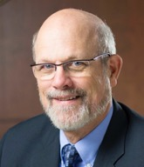
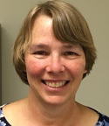
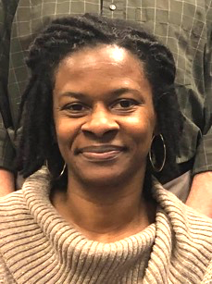
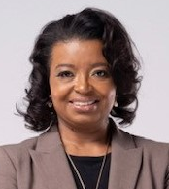
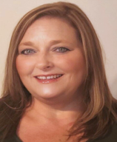
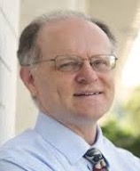
Team Perkins
Bob Witchger
Patti Coultas
Tony Reggi
Darice McDougald
Michelle Lair
Mary Olvera
Chris Droessler
Notes:
Dr. Bob Witchger
919-807-7126
WitchgerB@nccommunitycolleges.edu
Dr. Tony R. Reggi
919-807-7131
ReggiA@nccommunitycolleges.edu
Patti Coultas
919-807-7130
CoultasP@nccommunitycolleges.edu
Dr. Mary Olvera
919-807-7120
OlveraM@nccommunitycolleges.edu
Michelle Lair
919-807-72227
LairM@nccommunitycolleges.edu
Chris Droessler
919-807-7068
DroesslerC@nccommunitycolleges.edu
Darice McDougald
919-807-7219
McDougaldD@nccommunitycolleges.edu

Slide 3
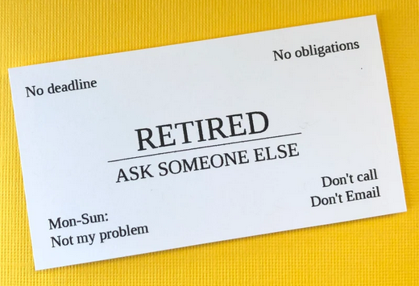
Team Perkins Changes
Michelle Lair has been promoted to Director of Academic Programs. She will continue as the CCP CTE contact until that that position is filled.
Congratulations!
Chris Droessler is retiring. He will continue to work with Team Perkins part time through the month of February.
Congratulations!

Slide 4
Purpose of Perkins
Develop more fully the academic knowledge and technical and employability skills of secondary education students and postsecondary education students who elect to enroll in CTE curriculum programs and programs of study
Notes:
The Strengthening Career and Technical Education for the 21st Century Act reauthorized and updated the Carl D. Perkins Career and Technical Education Act of 2006 to become the current Carl D. Perkins Career and Technical Education Act of 2006 as amended by the Strengthening Career and Technical Education for the 21st Century Act (Perkins V)
This updated act stresses:
- Academic, Technical, and Employability Skills
- Funding Secondary and Postsecondary CTE
- Focusing on Students who elect to enroll in CTE Programs of Study

Slide 5
Promising Practice Video 2021
Pamlico Community College
New equipment for the cosmetology and esthetics programs
Link
See all the videos:
https://www.ncperkins.org/video/
Notes:
August 2021
Wilson
Wilkes
September 2021
Wayne
Vance-Granville
October 2021
Stanly
Southeastern
South Piedmont
Rowan-Cabarrus
Rockingham
Robeson
Pitt-Martin
Pamlico
Nash
Mayland
Lenoir
Johnston
James_Sprunt
Halifax
Gaston
Forsyth
Fayetteville
Edgecombe
Durham
Davidson
Craven
Coastal_Carolina
Central_Piedmont
Carteret
Cape_Fear
Caldwell
Brunswick
Blue_Ridge
Beaufort
AB_Tech

Slide 6
February is CTE Month, we appreciate You!
https://governor.nc.gov/media/2920/open

Slide 7
Key Parts of the CLNA
Assess:
Student Performance
Size, Scope & Quality
Labor market alignment
Implementing Programs of Study
Recruitment, retention, & training of CTE faculty and staff
Improving equity and access

Slide 8
CLNA at your Advisory Committee Meetings
Alamance Community College
Wilson Community College
Documents discussed today are on the NCPerkins.org front page
The PowerPoint is on the
NCPerkins.org/presentations page

Slide 9
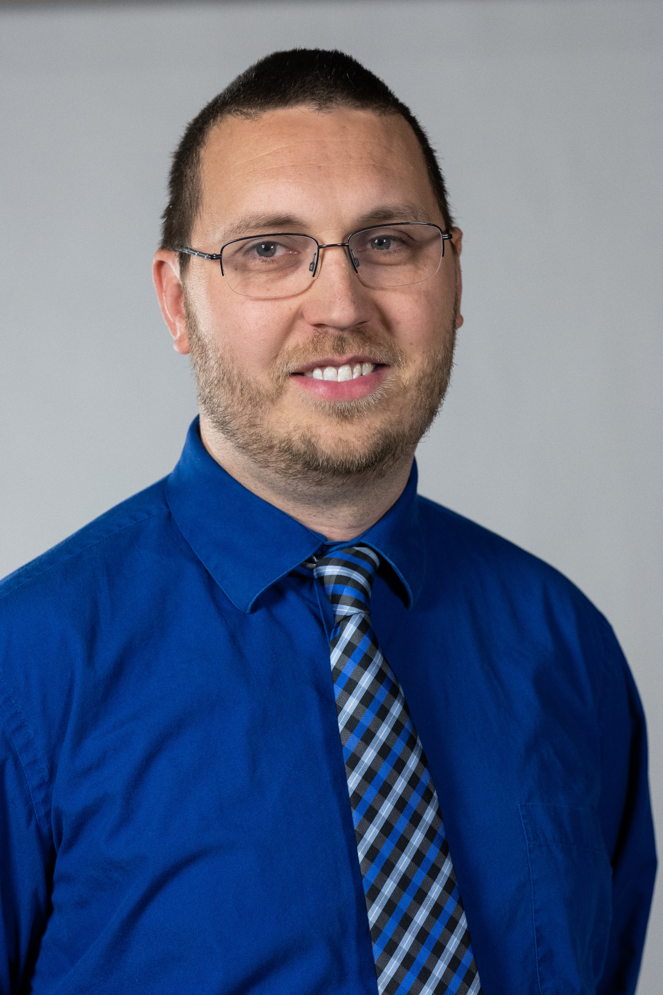
Justin Snyder
Dean of Industrial Technologies​
Alamance Community College​
Notes:
Justin Snyder
Justin.Snyder@alamancecc.edu
336-506-4279

Slide 10
Alamance Community College
Sample
Industry Work Session

Slide 11
Agenda
Meeting Objectives
Introductions
Progam Overview
Community College Flexibility
Industry Discussion
Next Steps

Slide 12
Objectives
Strengthen Industry Alignment
Develop/Strengthen Partnerships
Create New Opportunities
Listen

Slide 13
Introductions
Name
Company
What do you hope to take away from today’s session?

Slide 14
Program Overview
The Culinary Arts Program provides students with the education and training necessary to assume positions in a variety of food service settings including fine dining, full-service restaurants, clubs, hotels, bakeries, health care facilities, resorts and catering operations. The culinary arts curriculum is accredited by the American Culinary Federation, which goes beyond the state guidelines for culinary education. Upon graduation students are eligible for their first level of culinary certification, “Certified Culinarian” CC.

Slide 15
Community College Flexibility
Scheduling
Curriculum (Credit)
Associate Degree, Diplomas, Certificates
Career and College Promise
Continuing Education/Workforce Development (Non-Credit)
Apprenticeship
Work Based Learning
Customized Training

Slide 17
What types of positions does your company typically hire?
Notes:
Programmers? Operators, etc?
Think outside of CIM and the industrial Division? Business, Accounting IT, etc.
Howm many people do you typically hire per year? Full Time or Part Time?

Slide 18
What are the three most important non-industry specifc skills you want in a employee?

Slide 19
What should an ACC graduate offer your business?
Notes:
What skills should they show up to the company with?
Specific processes should they know?
Should they be required to take basic Welding, AUTO CAD, etc?

Slide 20
How important is it to train your incumbent workers?
Notes:
What types of skills do they need?
Long term vs Short Term training?
Moring, Afternoon , Night?
Your place or ours?

Slide 21
Recruitment
Notes:
What would make our students more attractive?
How can we get you to use ACC more?
Have you registered with our Career Services?
Linkedin?

Slide 22
Certification: Yes or No?
Certified Culinarian

Slide 23
Accreditation:
Valuable or Not?
Notes:
Does it make change your opinion of us? Better or no different?
Important for Parents in recruitment?

Slide 24
Notes:
Would you be interested in another conversation about apprenticeship?
Do you see value in this?

Slide 25
Should the culinary program place a greater emphasis on production?
Notes:
Is it important for a student to be exposed to them all?
Or focus more time on one or two?

Slide 26
How should ACC _______ set ourselves apart from others?
Notes:
We currently have …..
Should we have a mixture of manufacturers to train our students on?

Slide 27
What type of equipment do we need to be training our students on?

Slide 28
Thoughts on Proposed Programs

Slide 29
How can we partner to support each other?
Notes:
Work Based Learning?
Interviews for students?
Shop Tours?
Scholarships for students?
Helping with recruitment?

Slide 30
Next Steps

Slide 31
Rob Holsten
Vice President of Academic Affairs
Wilson Community College

Slide 32
Advisory Committee Meeting Guide
Wilson Community College developed guidelines to provide a structure for Advisory Committee meeting that ensure appropriate information is shared and received to guide the CLNA development.

Slide 33
Advisory Committee Meeting Guide
Introductions
Advisory Committee Purpose (Stakeholder engagement to ensure quality programming that meets the needs of students and employers)

Slide 34
Advisory Committee Meeting Guide - Continued
3. Program Information
Program Description/Program of Study
Faculty Overview
Student Population Overview
Equipment/Technology
Facilities

Slide 35
Advisory Committee Meeting Guide - Continued
4. Program Data
Enrollment/FTE
Program/Course Success Data
Graduates
Certifications/Licensures
5. Local/Regional Labor Market Needs
Labor Market Demands/Projections
Graduate Employment Data
Work-Based Learning

Slide 36
Advisory Committee Meeting Guide - Continued
6. Marketing/Recruitment
7. Discussion Topics
What gaps exist in each area?
What is needed to address these gaps?
What other issues need to be addressed?
What changes should be considered for the program?
What can WCC do to better meet workforce needs?
What additional stakeholders should be included? Perkins V guidance.

Slide 37
Starting the CLNA Assessment Process
Determine Goals
Justify Programs Selected
Increase students earning industry certifications
Strengthen industry advisory board engagement
Close Equity Gaps
Identify Stakeholders and Leadership. Team
Build a stronger pathway system between education, workforce and Community Leaders
Make a plan for seeking feedback
Industry Advisory Boards may provide feedback
Convene regularly
Broaden advisory group membership
Gather and Develop the materials
Disaggregated student performance data
Student Surveys
Program Evaluations

Slide 38
Review Data, Programs, Labor Market
1. Student Performance
How are students performing, where are the gaps
Aggregate and disaggregated the federal accountability measures
Focus Groups, Evaluation Team…
2. Size, Scope, Quality
Sufficient Programs to meet the need
9-14 Vertically aligned education course work
Quality of Delivery - Student Outcomes
3. Labor Market Alignment
Programs of Study offered meet the and Long and Short term need of employees
Focus on high skill, high wage, in-demand occupations
Feedback from Advisory committee
SREB Pathway Review, College and Career Pathway Framework, Essential Elements of Pathway Quality, CTE POS Framework

Slide 39
Review 9-14 Programs of Study, Faculty Skills
4. Implementing Programs of Study
Challenging State Academic Standards
Addressing Academic, Technical, and Employability Skills
Aligned with Needs of Industries in the economy
From all aspects of industry to occupation specific instruction
Attainment of Recognized postsecondary credential
5. Recruitment, Retention, and Training of CTE Educators
College Professional Development Plan
Mentoring
Faculty Skills aligned with program needs and student learning outcomes

Slide 40
Serve Special Populations Enrolled in CTE
6. Improving Equity and Access
Equal access for CTE Programs – Review Student participation data
Discuss Strategies to overcome barriers
Assistance in meeting College levels of performance
Program Delivery with accommodations, modifications, support services
Prepare for High Skill, High wage, in-demand industry sectors
Focus on INDIVIDUALS:
Disabilities; Economic Disadvantaged;
Preparing for non-traditional jobs; Single Parents
Out of workforce; English learners;
Homeless, Youth in Foster Care, Youth with parents in military.

Slide 41
State Follow Up with Colleges
Key Questions:
Outline how you implemented these sections
What partners/stakeholders were involved in the process?
What were the initial findings?

Slide 42
Pell and BIA - Update
E-mail will be sent to you, Chief Financial Officer, and President totaling your CTE Participants with Pell Grants
Complete the form by identifying the number of students in 2020-21 who…
Are recipients of assistance from the Bureau of Indian Affairs; and
Are enrolled in curriculum CTE programs and have attempted at least one CTE course; and
Are not receiving a Pell grant.

Slide 43
Do you have documents overdue?
2nd Quarter Plan Update
XDBR as of December 31, 2021
Semi-annual time certifications – only due if you have employees paid with Perkins funds
Local Articulated Course List
Pathways
Please contact your CTE Coordinator if you need assistance

Slide 44
Upcoming Spring Perkins Workshop
Perkins 101 2-3 Hours
Highlighting history and operational procedures
Includes the Perkins V Act and EDGAR
Annual Meeting 2-3 Hours
Procedures for Applying for Funding for 2022-23
Procedures for managing the grant
Consider the benefits of In-Person Meeting vs. Virtual Meeting

Slide 45
Perkins 101 Workshop and Annual Meeting
Three options: (There will be a vote after we review these)
Regionally one day in-person: from 9am-3pm Wednesday, April 13 East – Johnston CC (Smithfield) Tuesday, April 19 West – Western Piedmont CC (Morganton)
Virtually: Perkins 101 Workshop: Wednesday, April 13 from 9am-12pm Annual Meeting: Tuesday, April 19 from 9am-12pm
In-Person with SkillsUSA: Koury Center, Greensboro 101 Workshop: April 27 1-4pm Annual Meeting: April 28, 9-12, then you’re free if you wish to attend the SkillsUSA Post-secondary competition and awards ceremony at the convention center

Slide 46
Leadership Projects
Current Projects
Proposed
CORD
SkillsUSA-NC
EDU Curriculum Alignment Project
ABLR Disability Inclusion Project
Cyber Security
Apple Swift
Success Coach training with Student Services
BLET Curriculum Development
Distance Learning meetings
Career Clusters Guide
Addressing gaps in Equity and other statewide CLNA identified gaps
Marketing CTE
Other Ideas?

Slide 47
Performance Partnership Webinars
February 17 3-4pm: Promising Practices to Close Dual Enrollment Access Gaps
March 17 3-4pm: Promising Practices for Minority Student Recruitment
April 14 3-4pm: Promising Practices to Close Equity Gaps Associated with Student Completion
June 16 3-4pm: Personas Project: Personifying Student Data to Improve Performance
For descriptions and registration see flyer uploaded on NCPerkins.org/presentations for this Perkins Update February 8, 2022

Slide 48
Professional Learning Opportunity
Notes:
www.ncworkforcetraining.com

Slide 49
Dates and Topics

Slide 50
NACTEi Spring Conference
https://nactei.org/conference/
May 9th is a preconference with Brustein and Manasevit on EDGAR. This is a separate registration & fee www.bruman.com

Slide 51
We encourage you to present a best practice!
https://nactei.org/presenters/

Slide 52
Perkins Monthly Updates
2nd Tuesday of the month (not December) from 9-10 am
Next update is March 8, 2022
Registration link https://www.ncperkins.org/presentations/
Attendance (or viewing the recording within 30 days) is recorded on monitoring rubric. Recording may be found at same link as registration.
Notes:
Register now and let the system remind you.

Slide 53
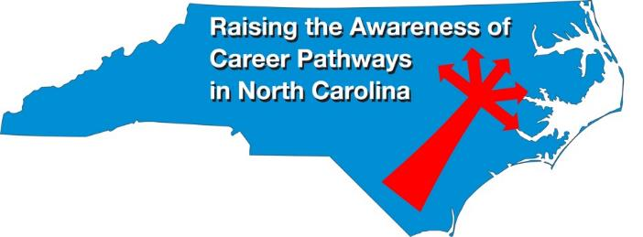
Raising the Awareness of Career Pathways Webinars
3rd Wednesday of the month from 9-10am
Next webinar is February 16, 2022
Come explore careers in Veterinary Medical Technology
Registration link: https://www.ncperkins.org/presentations/

Slide 54
NC*NET
NC-NET (NC Network for Excellence in Teaching) Professional learning in partnership with CORD
www.nc-net.info
Offerings:
NC Academy - facilitator-led online courses for faculty, upcoming offering on Curriculum Development for Integrated Instruction. Enrollment begins February 19th.
Self-Paced Professional Development: Teaching Contextually, Teaching Employability Skills, Adjunct Faculty Roadmap, and Exploring Stackable Credentials
Online instructor resources
Notes:
https://www.ncperkins.org/presentations/

Slide 55
Promising Practice Video 2021
Pitt-Martin Community College Consortium
Pitt CC: Quality Matters building better online courses program
Martin CC: Career exploration during the pandemic
https://www.ncperkins.org/video/video.php?v=Pitt-Martin-2021&y=2021
See all the videos:
https://www.ncperkins.org/video/
Notes:
Stop video at 3:55
August 2021
Wilson
Wilkes
September 2021
Wayne
Vance-Granville
October 2021
Stanly
Southeastern
November 2021
South Piedmont
Rowan-Cabarrus
January 2022
Rockingham
Robeson
February 2022
Pitt-Martin
Pamlico
March 2022
Nash
Mayland
April 2022
Lenoir
Johnston
May 2022
James_Sprunt
Halifax
Gaston
Forsyth
Fayetteville
Edgecombe
Durham
Davidson
Craven
Coastal_Carolina
Central_Piedmont
Carteret
Cape_Fear
Caldwell
Brunswick
Blue_Ridge
Beaufort
AB_Tech

Slide 56
Technical assistance is available
We are here to help!
Team Perkins is available by phone, email, TEAMS, or in-person

Slide 57
Perkins/CTE Team
Dr. Bob Witchger Director, Career & Technical Education WitchgerB@nccommunitycolleges.edu 919-807-7126
Patti Coultas Coordinator, Career & Technical Education CoultasP@nccommunitycolleges.edu 919-807-7130
Chris Droessler Coordinator, Career & Technical Education DroesslerC@nccommunitycolleges.edu 919-807-7068
Michelle Lair Director, Academic Programs LairM@nccommunitycolleges.edu 919-807-7227
Darice McDougald CTE Administrative Assistant McDougaldD@nccommunitycolleges.edu 919-807-7219
Dr. Mary Olvera Coordinator, Career & Technical Education OlveraM@nccommunitycolleges.edu 919-807-7120
Tony R. Reggi Coordinator, Career & Technical Education ReggiA@nccommunitycolleges.edu 919-807-7131
Notes:
http://www.ncperkins.org/course/view.php?id=6

