Slide 1
Perkins Update
May 9, 2023

Slide 2
Career & Technical Education Team
Bob Witchger
Tony Reggi
Patti Coultas
Mary Olvera
Anne Bacon
Darice McDougald
Lane Freeman
Aaron Mabe

Slide 3
Purpose of Perkins
Develop more fully the academic knowledge and technical and employability skills of secondary education students and postsecondary education students who elect to enroll in CTE curriculum programs and programs of study
Notes:
The Strengthening Career and Technical Education for the 21st Century Act reauthorized and updated the Carl D. Perkins Career and Technical Education Act of 2006 to become the current Carl D. Perkins Career and Technical Education Act of 2006 as amended by the Strengthening Career and Technical Education for the 21st Century Act (Perkins V)
This updated act stresses:
- Academic, Technical, and Employability Skills
- Funding Secondary and Postsecondary CTE
- Focusing on Students who elect to enroll in CTE Programs of Study

Slide 4
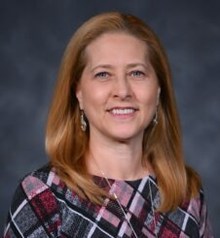
NCACTE PACE
PACE = Postsecondary, Adult & Career Education
Pam Gibson
Dean of Engineering & Applied Technologies
Fayetteville Technical Community College
Discussion on starting a
postsecondary division of NCACTE
Notes:
https://www.acteonline.org/about/structure/divisions/postsecondary-adult-and-career-education-division/

Slide 5
Perkins as Last Dollar for Student Support
Perkins may be used for student support (child care expenses, transportation, etc.) IF and ONLY IF other funds are sought out first and are unavailable/insufficient. Your college Student Services colleagues (e.g. Financial Aid Director) can help.
Exceptions may be made by the CTE Director if stop-gap (temporary upfront) support is needed while the student is seeking other help.
Funds may only be used for CTE students when a CLNA covers the program or functional need and if the CLNA references the need.
Example: a Health Care CLNA mentions child care funding support as a need of its students or an overarching CLNA (covering all CTE areas) identifies the need
You may modify an existing CLNA to include a need if you have consulted with relevant stakeholders and included these names/titles in the CLNA.

Slide 6
Sample process for child care subsidy IF the college's policy/Student Services office supports it
Student explores eligibility/ returns with signed documentation from DSS/SWCD on eligibility/ineligibility for Subsidized Child Care
Stop-gap funding for child care (1-2 mos. max) while student explores Subsidized Child Care eligibility (DSS/SWCD)
College keeps excellent records for state or federal monitoring
If unmet need, authorize payment to child care provider (not student) Pay after care is provided and documentation collected
Careful records on each student served
Notes:
-This guidance only pertains to Perkins funding
-Please work closely with your Student Services office and follow your college policies
-Cannot reduce amount paid to CTE students from Child Care Grant (supplantation)
DSS: County Dept. Of Social Services
SWCD: Southwestern Child Development Commission (15 western counties)

Slide 7
Last-Dollar Student Support Thought Process
Need identified in one or more CLNAs
Confirm college does not have (sufficient) resources to meet need
College reaches out to community organizations that could potentially meet need
College maintains whatever resource commitment it already has to CTE students
Perkins contacts work closely with Student Services/ any other part of college that provides student support
Proposed process set up internally, collaboratively
Perkins contact runs proposed process by CTE Coordinator
Show your CTE Coordinator your proposed process for last-dollar student support before proceeding!

Slide 8
Career Exploration Guides
An email was sent last week, please
return it asap
Available online at https://nccareers.org/printables-tools

Slide 9
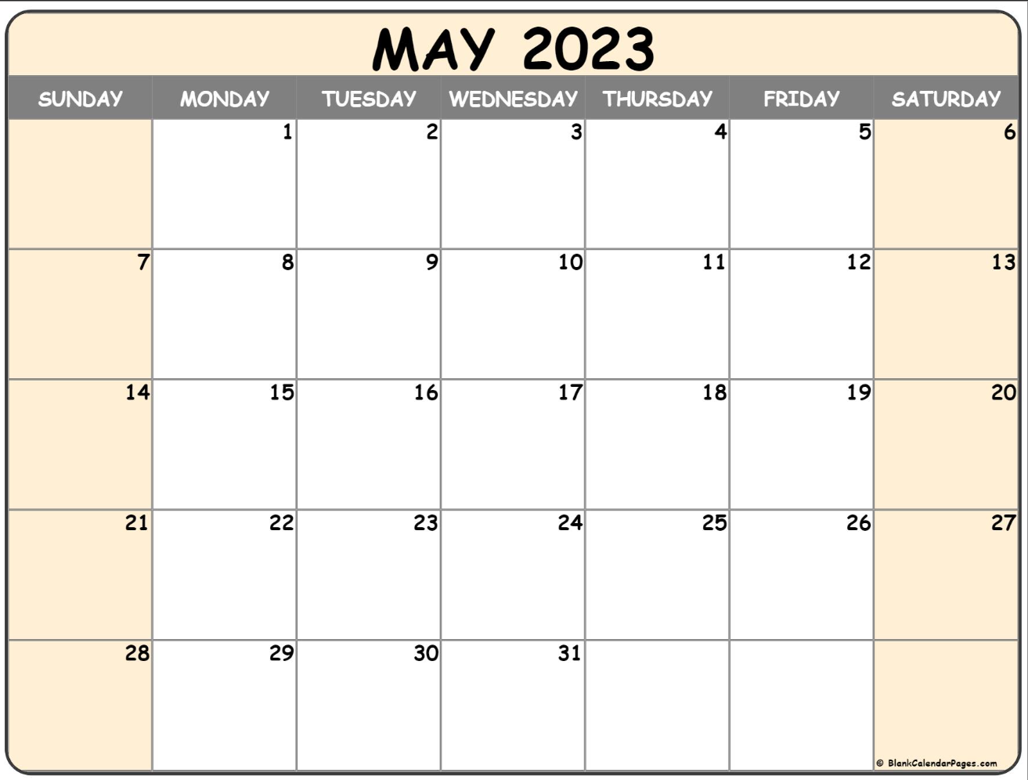
Final Perkins Modification
Modification Deadline
is May 15, 2023
DUE

Slide 10
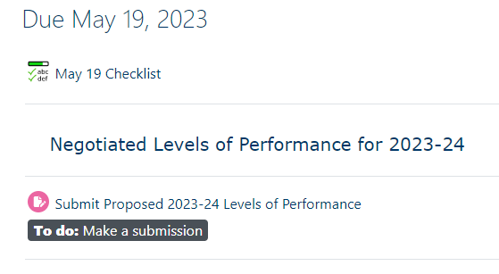
Negotiated Levels of Performance for 2023-2024 Due May 19th
The NLP form was emailed to you by Darice in mid-April. Enter a level for each of the core indicators of performance and once signed, submit in NCPerkins. If we agree we will sign and return, if not, we will contact you to negotiate the level.
Submit here

Slide 11
End of Year Documents – Due May 19th
Final Local Plan & Budget Status Update Make sure the plan reflects the last approved modified budget and complete the last two columns of the plan. Don’t forget to update the equipment and salaries tabs.
End of Year Report: The Questions are in NCPerkins.org
Promising Practice Video to share an activity that may be beneficial to other colleges in implementing Perkins V. Please plan to show it during our online session the week of June 5-7.

Slide 12
EOY Reviews Online Meetings
June 5 – 9
8am – 4pm Monday – Friday (except noon on Friday)
Registration coming this week

Slide 13
Additional EOY Documents Due July 7th
XDBR for June 30, 2023
NOTE! The final XDBR must show the approved budget and expenditures, ask your budget office to print an XDBR before modifying the budget to meet expenditures (an EOY task)
Semi-annual Time Certifications January – June 2023
Remember to get this form signed if employees are leaving at the end of the semester!

Slide 14
Equipment Monitoring
You have been contacted if you are being monitored
Documents are due May 15th
Meeting to be scheduled after documents are reviewed
All colleges: always remember to itemize your equipment on the Equipment tab of the Local Plan

Slide 15
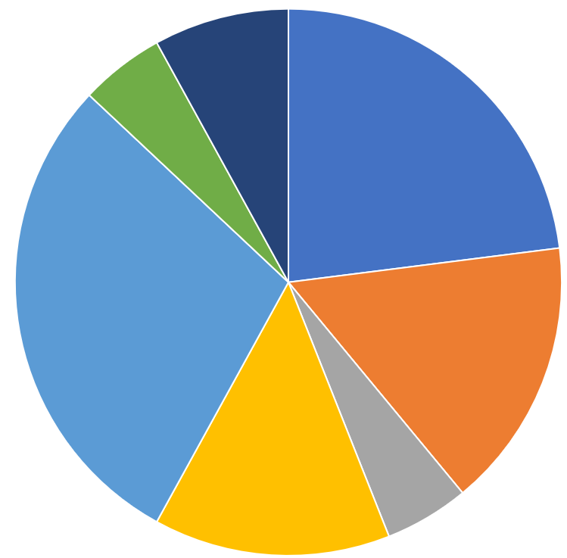
2023-24 Allotment Calculation
Planning allotment coming soon

Slide 16
Planning for next year – Due June 2nd
The 2023-24 course is in NCPerkins.org
Enter all 5 types of contacts (can i.d. > 1 per role)
Submit Signed Allotment Options
Submit Signed Assurances
Submit local plan and budget
Submit job descriptions for all Perkins funded positions through payroll

Slide 17
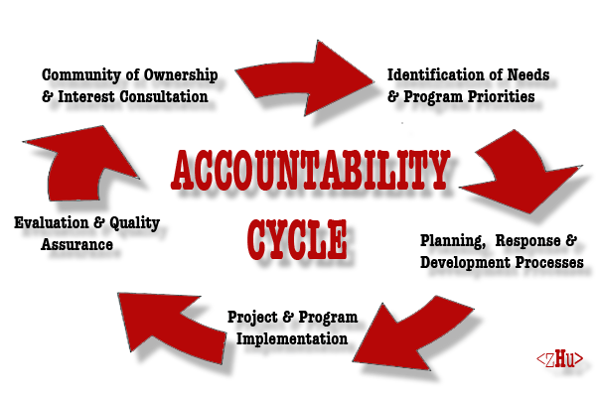
June/July in-person/virtual discussion
Discussion 2023-24 program year either in-person or virtually to
Review plan and budget
Discuss CLNA connections
Approve or revise and resubmit

Slide 18
Perkins Monthly Updates
Last webinar in 2022-23:
June 13, 2023
Attendance (or viewing the recording within 30 days) is recorded on monitoring rubric. Recording may be accessed at the same link as the registration.
Notes:
Register now and let the system remind you.

Slide 19
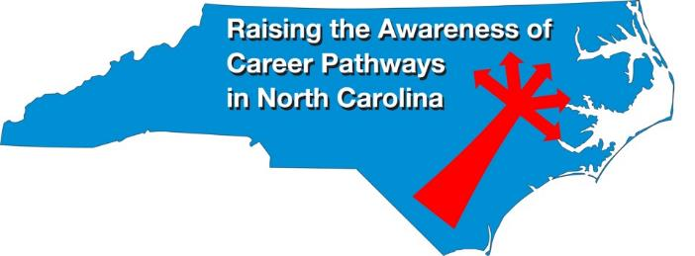
Raising the Awareness of Career Pathways Webinars
May 17 Entrepreneurship postponed
June 21 Non-Profit Leadership and Management
Register for all webinars at
www.ncperkins.org/presentations

Slide 20
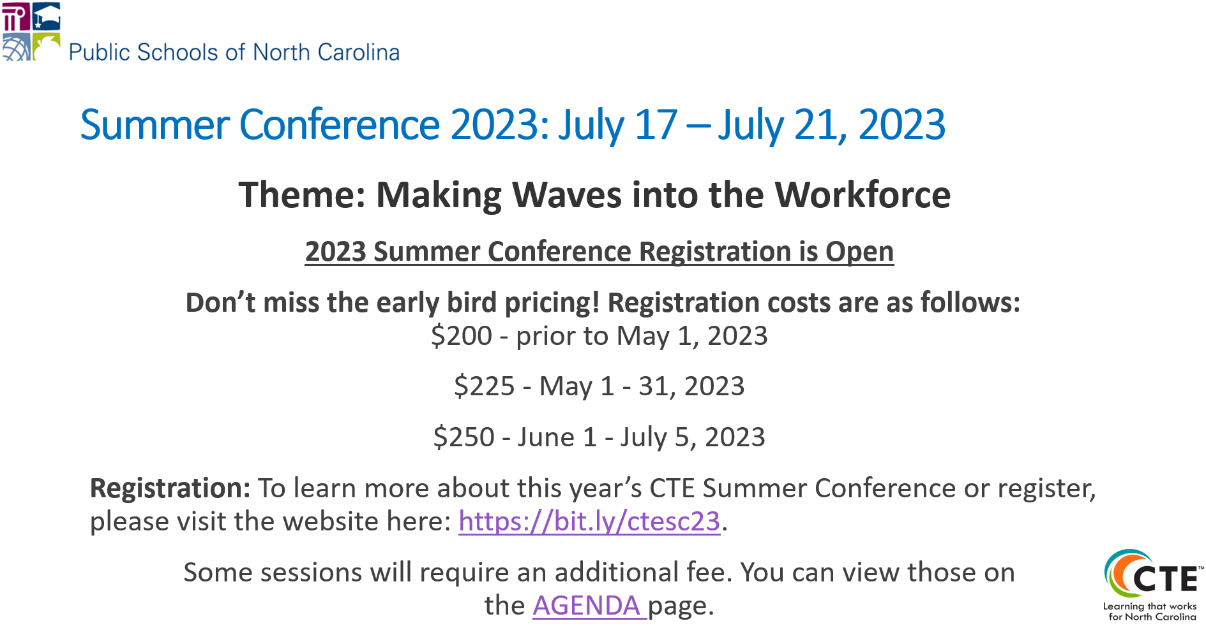
Secondary CTE Summer Conference Twin City Quarter, Winston-Salem
Notes:
https://na.eventscloud.com/website/45818/home/

Slide 21
ACTE PACE Conference
September 20-22
https://www.acteonline.org/postsecondarycteevent/

Slide 22
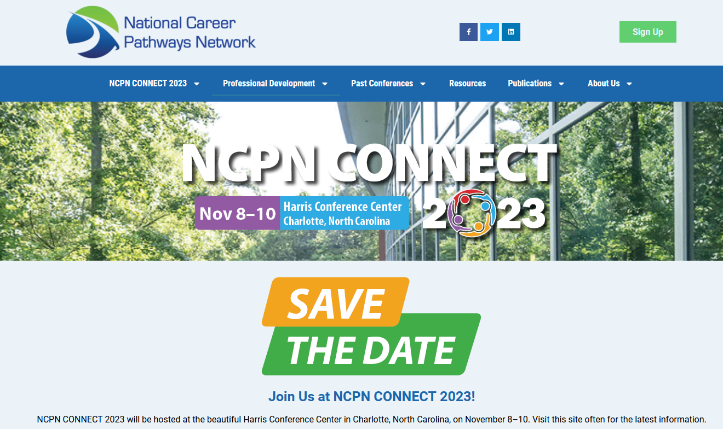
https://www.ncpn.info
Nov. 8 – 10 In Charlotte!

Slide 23
Technical Assistance is available
We are here to help!
Team Perkins is available by phone, email, virtually, or in-person

