Slide 1
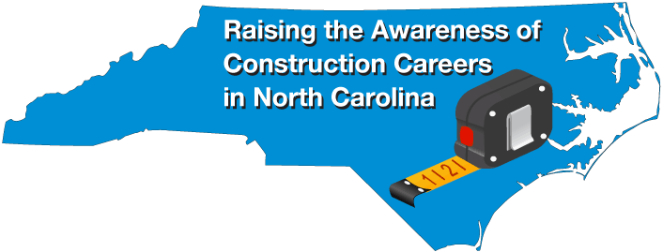
April 9-13, 2018
Bob Witchger
Chris Droessler
NC Community Colleges
Cheryl Cox
NC Department of Public Instruction
NCperkins.org/construction

Slide 2
Notes:
Lots of folks left the construction industry during the recession.
Now the construction industry is working to rebuild their labor pool.
The problem is that there are not enough folks in the pipeline training for jobs in the construction industry.
Lots of high schools have dropped their construction programs, and most community colleges have moved construction to Continuing Education.
How do we get more folks to consider careers in construction?
===
http://constructionlabor.com/construction-demand-is-outpacing-skilled-labor/

Slide 3
Architecture and Construction Career Cluster - NC projected change in employment 2014-2024
4,990 Construction Laborers
4,470 First-Line Supervisors of Construction Trades and Extraction Workers
4,410 Carpenters
2,480 Electricians
1,970 Heating, Air Conditioning, and Refrigeration Mechanics and Installers
1,550 Electrical Power-Line Installers and Repairers
1,520 Construction Managers
1,470 Operating Engineers and Other Construction Equipment Operators
1,360 Painters, Construction and Maintenance
1,330 Plumbers, Pipefitters, and Steamfitters
1,120 Cement Masons and Concrete Finishers
920 Brickmasons and Blockmasons
880 Helpers--Electricians
710 Roofers
570 Construction and Related Workers, all other
520 Helpers--Brickmasons, Blockmasons, Stonemasons, and Tile and Marble Setters
470 Construction and Building Inspectors
440 Helpers--Pipelayers, Plumbers, Pipefitters, and Steamfitters
420 Drywall and Ceiling Tile Installers
390 Pipelayers
380 Sheet Metal Workers
370 Helpers--Carpenters
340 Paving, Surfacing, and Tamping Equipment Operators
330 Security and Fire Alarm Systems Installers
310 Architects, Except Landscape and Naval
300 Insulation Workers, Floor, Ceiling, and Wall
220 Excavating and Loading Machine and Dragline Operators
170 Helpers, Construction Trades, all other
170 Septic Tank Servicers and Sewer Pipe Cleaners
160 Floor Sanders and Finishers
160 Hazardous Materials Removal Workers
150 Structural Iron and Steel Workers
140 Structural Metal Fabricators and Fitters
130 Tile and Marble Setters
120 Helpers--Roofers
110 Floor Layers, Except Carpet, Wood, and Hard Tiles
110 Glaziers
80 Fence Erectors
80 Earth Drillers, Except Oil and Gas
80 Mechanical Door Repairers
70 Helpers--Painters, Paperhangers, Plasterers, and Stucco Masons
60 Landscape Architects
40 Building Cleaning Workers, all other
40 Carpet Installers
40 Riggers
30 Plasterers and Stucco Masons
20 Control and Valve Installers and Repairers, Except Mechanical Door
10 Stationary Engineers and Boiler Operators
0 Pile-Driver Operators
0 Explosives Workers, Ordnance Handling Experts, and Blasters
-10 Electrical and Electronics Repairers, Powerhouse, Substation and Relay
-30 Mechanical Drafters
-50 Manufactured Building and Mobile Home Installers
-80 Surveying and Mapping Technicians
-90 Highway Maintenance Workers
Notes:
There are over 200,000 people employed in North Carolina in construction occupations.
This shows the projected growth in number of positions over this ten year period.
Thus, North Carolina needs an estimated 4,410 more Carpenters in 2024 than it had in 2014.

Slide 4
Vision
To raise the awareness of Construction Careers across North Carolina
To provide an opportunity for students and parents to visit community colleges to learn of the many opportunities for training in the trades
To provide an opportunity to Students and Parents to talk to employers in their community about president and future employment opportunities in their construction businesses

Slide 5
What?
Curriculum, continuing education, and basic skills coming together to coordinate a career fair or other activities
Invite local construction businesses to the college for a career fair activity
Use your imagination and ideas to help raise the awareness of building trades careers.

Slide 6
Activities
Construction site tours
Open house
Hands-on
Job fair
Presentations to students
Day-time events and evening events
Invite the media
Let the community know what goes on behind that big exterior wall
Notes:
There are all kinds of evets you can hold during this week to promote what you are doing and hopefully get your future employees interested.
Open Houses could occur at a community college or at a construction site, or at the headquarters for a construction company.

Slide 7
Who?
Middle school students, teachers, counselors, and parents
High school students, teachers, counselors, and parents
Current and future community college students
College graduates
NCWorks Career Center participants
General community

Slide 8
Construction Week Website
www.ncperkins.org/construction
Event Calendar (builtinnc)
Promotional Materials
Planning Meetings/webinars
Partners
Participating Colleges
Notes:
The go-to website for all events in North Carolina is
NC Perkins dot org slash construction
There you will find the calendar of events, promotional materials, information about our planning meetings, like this one, and our partners and our participating colleges.
Lots of good stuff on that web site.
Stick a bookmark on that page, so you can keep checking it as we get closer to the big week.
======
www.ncperkins.org/construction

Slide 9
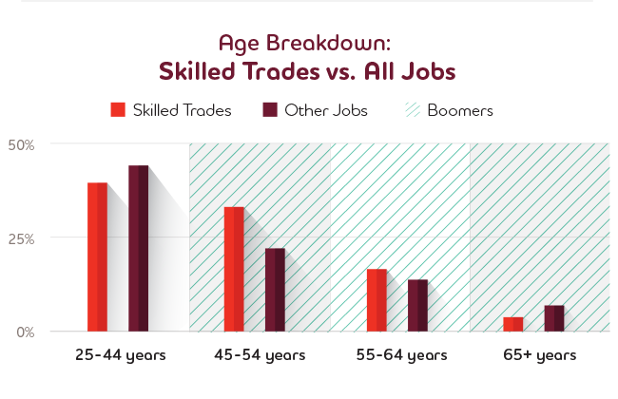
Notes:
======
https://www.adeccousa.com/employers/resources/skilled-trades-in-demand/

Slide 10
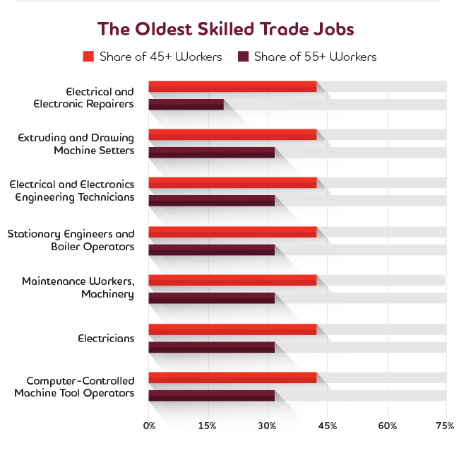
Notes:
======
https://www.adeccousa.com/employers/resources/skilled-trades-in-demand/

Slide 11
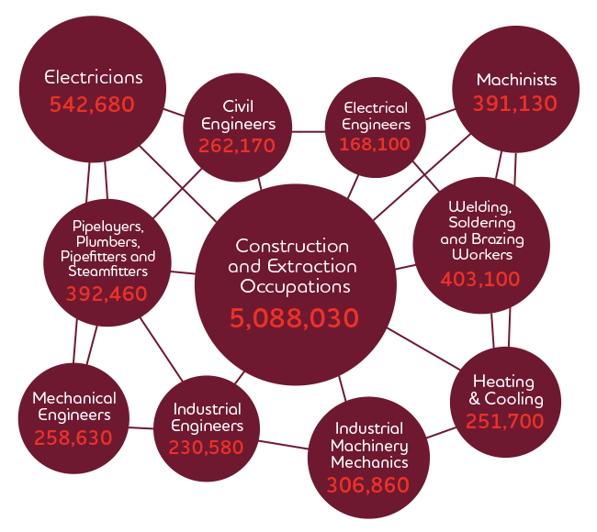
Baby Boomers hold a sizable majority of the following positions. It’s time to figure out how we’re going to fill them.
Notes:
======
https://www.adeccousa.com/employers/resources/skilled-trades-in-demand/

Slide 12
Next Planning Meetings
January 30, 2018 @ 9 a.m.
February 27, 2018 @ 9 a.m.
March 27, 2018 @ 9 a.m.
April 24, 2018 @ 9 a.m.
NCperkins.org/construction
Notes:
Last Tuesday in the month
Find the details and registration information on the NC perkins website.
======
http://www.ncperkins.org/construction
April 9-13, 2018

Slide 13
Ashleigh Potuznik BYF Manager
NCCER
Notes:
Ashleigh Potuznik | BYF Manager
NCCER 13614 Progress Boulevard | Alachua, FL, 32615 Toll Free 888.622.3720 X
apotuznik@nccer.org "THE STANDARD FOR DEVELOPING CRAFT PROFESSIONALS"

Slide 14
Paul Heidepriem
SkillsUSA
Notes:
skillsusanc@gmail.com

Slide 15
Peyton Holland
SkillsUSA
Notes:
skillsusanc@gmail.com

Slide 16
Betsy Bailey
Carolinas AGC
Notes:
Betsy Bailey, CAE
Director, NC Government Relations&Building Division
3737 Glenwood Avenue Suite 100 Raleigh, NC 276127
(704) 372-1450 x5725
bbailey@carolinasagc.org

Slide 17
Bill Stricker
Carolinas AGC
Notes:
Bill Stricker
Vice President, Operations&Workforce Development
4824 Parkway Plaza Blvd. Suite 115 Charlotte, NC 28217
(704) 372-1450 x5213
bstricker@carolinasagc.org

Slide 18
Ed Dent
Bladen Community College

Slide 19
Craig Pendergraft
NCDPI Construction Curriculum Coordinator
Notes:
919-807-3881
craig.pendergraft@dpi.nc.gov

Slide 20
Wil van der Meulen
Nash CC

Slide 21
xx

Slide 22
xx

Slide 23
Frank Scuiletti
Program Coordinator: Construction, Engineering, Industrial, Transport, Criminal Justice, Fire Protection, & Work-Based Learning NCCCS

Slide 24
Michael Mitchell Hunter Macfarlane Megan Lewis
Lowe's
Notes:
Michael Mitchell Hunter Macfarlane Megan Lewis

Slide 25
Ellis Powell
Carolina Asphalt Pavement Association, Inc.
Notes:
919-524-2395

Slide 26
Amy Schroeder
NCDPI Career Development Coordinator
Notes:
919-807-3937
amy.schroeder@dpi.nc.gov
Pronounced Shra - der with a long "A" sound.

Slide 27
Cheryl Cox
NCDPI Work-Based Learning
Notes:
919-807-3937
amy.schroeder@dpi.nc.gov
Pronounced Shra - der with a long "A" sound.

Slide 28
Marianne Herring
Coastal Carolina CC

Slide 29
Rodessa Mitchell
Winston-Salem
Chamber of Commerce
Notes:
https://www.winstonsalem.com/education-programs/construction-industry-council/
Ms. Mitchell’s contact information: (336)728-9222, e-mail: mitchell@winstonsalem.com.
Forsyth Technical Community College

Slide 30
Kathryn P. Castelloes
NC Apprenticeship Director

Slide 31
NC Apprenticeship Conference
April 12-13, 2018
Notes:
The NC Apprenticeship Conference will be during our Construction Careers Awareness Week.

Slide 32
Margaret Roberton
Associate Vice President - Workforce Development - Continuing Education NCCCS

Slide 33
Josh Cilley
Buckner Companies

Slide 34
Buddy Hughes
Piedmont Communication Services, Inc.
NC Home Builders Association
Notes:
Piedmont Telephone Membership Corporation
Piedmont Communication Services, inc.
NC Home Builders Association

Slide 35
Tim Norman
NC State Board of Examiners of Electrical Contractors
Notes:
ncbeec.org

Slide 36
Tim Eldridge

Slide 37
xx

Slide 38
xx

Slide 39
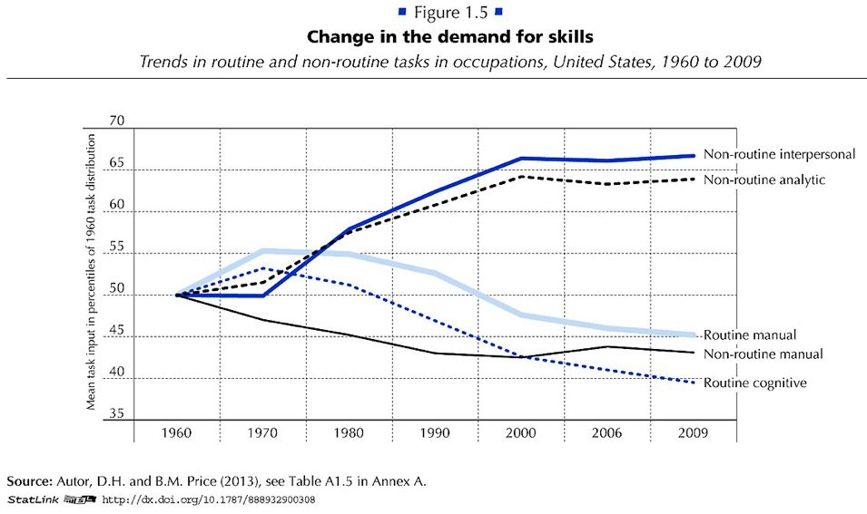
Notes:
Employers want employees that can do non-routine work.
They want folks that can identify and solve new problems.
Gone are the jobs that required routine manual labor.
The computers and robots can take care of that.
===
http://www.oecd.org/site/piaac/
https://www.oecd.org/site/piaac/
-----
OECD Skills Outlook 2013
http://skills.oecd.org/skillsoutlook.html
First Results from the Survey of Adult Skills
OECD_Skills_Outlook_2013.pdf
Key Findings
SkillsOutlook_2013_KeyFindings.pdf
Summary
9789264204256-sum-en.pdf
-----
PIAAC Results Released
On Oct. 8, 2013, the Organization for Economic Cooperation and Development (OECD) released the results of the Program for International Assessment of Adult Competencies, (PIAAC). This direct assessment was conducted with nationally representative samples from 23 countries from adults ages 16 through 65. It is an international household survey to assess the cognitive and workplace skills needed for success in the 21st-century global economy. The results are designed to help public, private, educational, and philanthropic sectors work with a shared language and set of benchmarks to enhance cooperation around the development and implementation of economic, education, and social policies that strengthen adult skills. The survey is intended to be administered every 10 years, making this a baseline report to set benchmarks against which countries and sectors can measure their improvement efforts. Multiple reports, datasets, and several data tools were released with the results, including:
The OECD Skills Outlook 2013: First Results from the Survey of Adult Skills, a freely available book in PDF form;
a summary, Skilled for Life? Key Findings;
a brief U.S. report, Survey of Adult Skills, First Results: United States; and
a report from the U.S. Department of Education’s National Center for Educational Statistics, Literacy, Numeracy, and Problem Solving in Technology-Rich Environments Among U.S. Adults: Results from the Program for the International Assessment of Adult Competencies 2012: First Look, was published on Oct. 18, once the U.S. federal government was re-opened. This report highlights the U.S. performance in the international data and unique U.S. demographic characteristics.
On Nov. 12, 2013, the OECD-authored report, Time for the United States to Reskill? What the Survey of Adult Skills Says, will be released. This report was funded by OVAE to offer a more detailed profile of low-skilled adults in the U.S. It will also identify policy implications and offer broad policy recommendations for the U.S.
Links to all of these resources, as well as events and press coverage, may be found at www.piaacgateway.com.
This article relies heavily on data included in the NCES “First Look” report. Further analysis of the PIAAC data will appear in future issues of OVAE Connection.
The Survey
The PIAAC assessment focuses on the working-age adult population, and measures cognitive and workplace skills necessary for successful participation in the 21st century society and global economy. In the U.S., as in all of the countries participating, 5,000 individuals were surveyed to create a nationally representative dataset. An additional 5,000 people will be surveyed for a supplement that will be added to the data set in 2015.
Drawing from a rich background questionnaire, the PIAAC measures relationships among respondents’ educational background, parental educational attainment, work history and skills, occupational attainment, use of information and communications technology, and cognitive skills in the domains of literacy, numeracy, and problem solving in technology-rich environments.
Findings are presented in the First Look report as country averages, and tables are used to place countries’ performances above, at, or below the international average. Within each domain, performance is also reported as a percentage of the population that performs in five levels of proficiency: Below Level 1, Level 1, Level 2, Level 3, and combined Levels 4/5, Level descriptors can be found in the First Look report in Exhibit B-1 for literacy, B-3 for numeracy, and B-5 for problem-solving in a technology-rich environment. Performance below Level 2 is considered “weak” or “low.”
The assessment is unique in that it is the first international literacy survey that is both adaptive and administered on a laptop computer. Given as a household survey, respondents were allowed to choose whether to take the assessment on a laptop or with pencil and paper. In the U.S., nearly 80 percent of respondents completed the survey on the computer, which means that they passed an initial screening test on basic computer use and navigation.
The direct measure of cognitive and workplace skills in this study creates a much more nuanced perspective on skills than the more commonly reported measure of educational attainment. For example, the attainment category of “some college,” which appears on many surveys of adult skills, says very little about the knowledge, skills, and abilities of an individual, and is rarely accompanied by information on the courses taken, training completed, and skills gained. Having more information about skills, including where they are learned and how they are used, as this survey provides, will inform educators, workforce development stakeholders, human resource personnel, employers, and policymakers about the mechanisms that are effective in increasing the skill and talent inventory in regions, sectors, and across the country.
Key Findings
On three domains (literacy, numeracy, and problem-solving in a technology-rich environment) the U.S. average performance is significantly lower than the international average. Within domains, the U.S. profile shows a large portion of adults with skills below Level 2, and small percentages of adults with strong skills in the upper level.
In the literacy domain, the U.S. average percentile performance is 270; the international average is 273. Within the domain, the U.S. profile shows 4 percent at Below Level 1, 14 percent at Level 1, 34 percent at Level 2, 36 percent at Level 3, and 12 percent at the combined Level 4/5. The U.S. has an equivalent percentage of adults in the highest level as the international average, 12 percent (see First Look, Figure 2A).
In the numeracy domain, the U.S. average performance is 253; the international average is 269. Within the domain, the U.S. profile shows 10 percent at Below Level 1, 20 percent at Level 1, 34 percent at Level 2, 27 percent at Level 3, and 9 percent at the combined Level 4/5. The U.S. has a lower percentage of adults in the highest level than the international average, which is 12 percent (see First Look, Figure 2B).
In problem-solving in a technology-rich environment, the U.S. average performance is 277; the international average is 283. Within the domain, which reports only four levels, the U.S. profile shows 20 percent at Below Level 1, 41 percent at Level 1, 33 percent at Level 2, and 6 percent at Level 3. The U.S. has a lower percentage of adults in the highest level than the international average, which is 8 percent (see First Look, Figure 2C).
The PIAAC item framework is aligned to previous international literacy assessments, allowing trend analysis for the past 20 years. The First Look report shows that the average U.S. literacy score for adults on the PIAAC is not significantly lower than it was in 2003-08 as reported on the International Adult Literacy Survey (IALS), but is lower than the average score was in 1994-98 as reported on the Adult Literacy and Lifeskills Survey (ALL) (Tables 1-A and 1-B). The average U.S. numeracy score on the PIAAC is lower than it was in 2003-08 as reported in the IALS.
Implications
These survey findings show that the U.S. has significant basic skill weaknesses within the adult working-age population in comparison to other industrialized countries. This skill profile has negative implications for the growth and strength of the U.S. economy and middle class. Although two-thirds of the low-skilled respondents in the U.S. sample are employed, they are not employed in jobs with high wages.
The findings show that work tasks influence skills. Adults who report frequently using literacy, numeracy, and problem-solving skills in their daily work routines have greater proficiencies in those skills. The reverse is also shown in the data: Workers in low-skilled jobs may have fewer opportunities to use and enhance their skills (see First Look, Figures 8 A, B, and C).
Weak skills have implications for civic life as well, as has been demonstrated in previous surveys of adult literacy. Adults with weak skills are less likely to vote or volunteer in their communities, and more likely to suffer poor health. In fact, adults with low skills are four times more likely to report “fair” or “poor” health than those with strong skills (see First Look, Figures 10 A, B, and C). This relationship is twice as strong as the international average.
Moreover, a concerning trend emerges in this data set. Unlike most other countries surveyed, in the U.S., younger cohorts’ skills are not surpassing the older cohorts’ skills. This has serious implications for the future of our workforce and underscores the need for continuing education and training.

Slide 40
NC Construction Careers Awareness Week
April 9-13, 2018
NCperkins.org/construction

Slide 41
Perkins/CTE State Staff
Dr. Bob Witchger Director, Career & Technical Education WitchgerB@nccommunitycolleges.edu 919-807-7126
Dr. Tony R. Reggi Coordinator, Career & Technical Education ReggiA@nccommunitycolleges.edu 919-807-7131
Dr. Julia Hamilton Coordinator, Career & Technical Education HamiltonJ@nccommunitycolleges.edu 919-807-7130
Chris Droessler Coordinator, Career & Technical Education DroesslerC@nccommunitycolleges.edu 919-807-7068
Jennifer Holloway CTE Administrative Assistant HollowayJ@nccommunitycolleges.edu 919-807-7129

