Slide 1
North Carolina
Dr. Bob Witchger, CTE Director
Chris Droessler, CTE Program Administrator
Notes:
Bob Witchger
witchgerb@nccommunitycolleges.edu
919-807-7126
919-807-7219
Chris Droessler
droesslerc@nccommunitycolleges.edu
919-807-7068

Slide 2
Postsecondary Perkins Data Portal
Used by colleges for Comprehensive Local Needs Assessment and Local Application
https://www.ncperkins.org/data/
Organized by:
Individual Colleges
Compare Colleges
State Summary

Slide 3
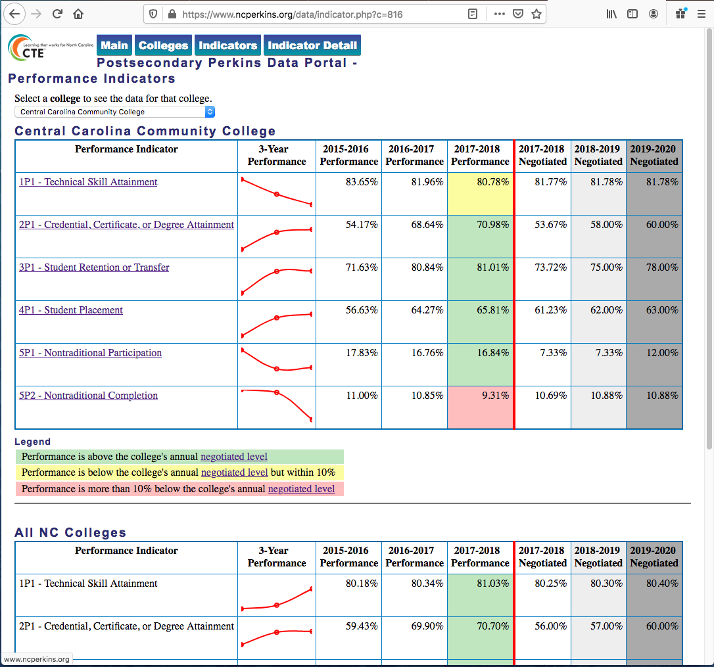
Notes:
Here we are looking at a single college.
We see their performance in each indicator for the last three years.
The graph show upward and downward movement between years.
Color code is how well they met their negotiated level for each indicator. Green is above negotiated level.
Yellow is below, but within 90% of the level.
Red s below the 90% level, which indicates a need for an improvement plan.
The state levels are shown at the bottom of the web page.
If we click on 1P1, it takes us to a web page …

Slide 4
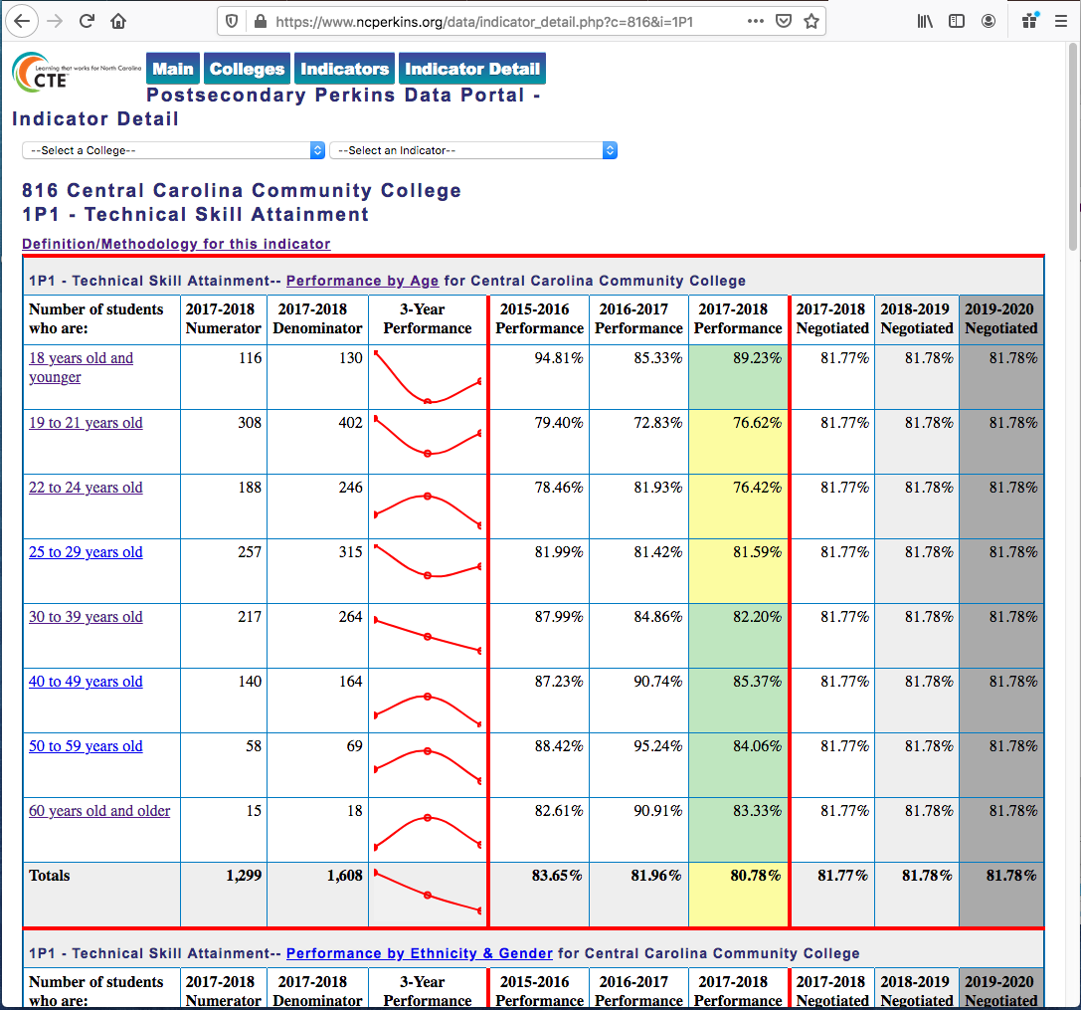
Notes:
where we break this indicator down by age …

Slide 5
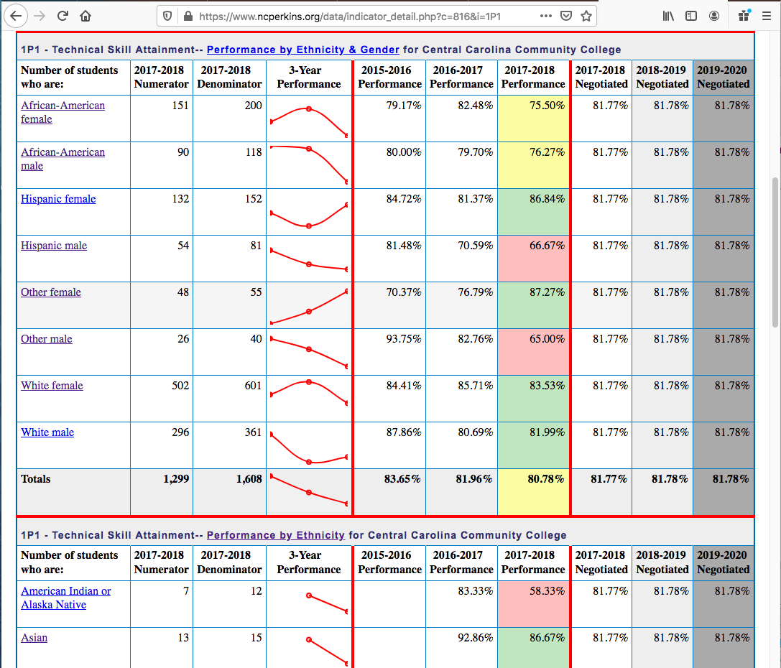
Notes:
ethnicity and gender …

Slide 6
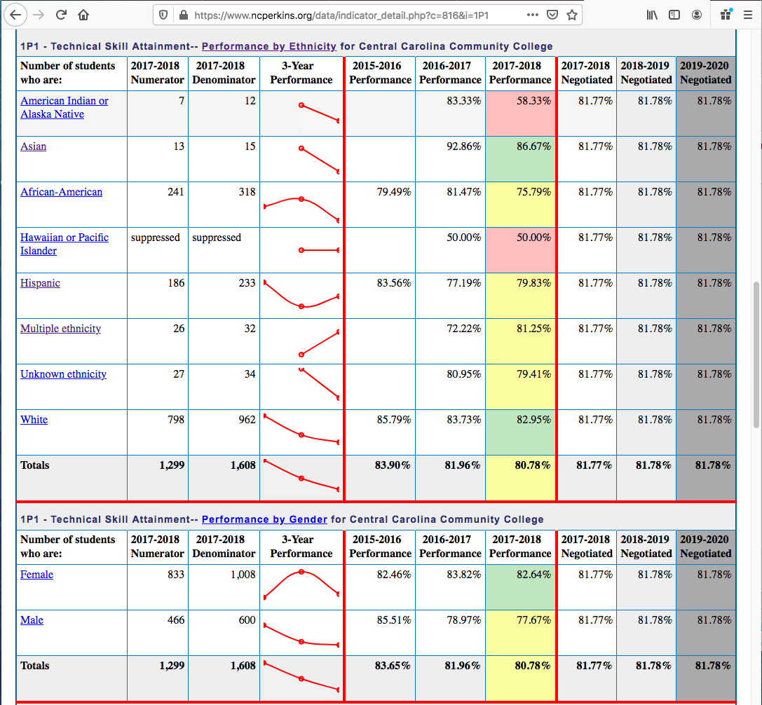
Notes:
Just Ethnicity or Gender …

Slide 7
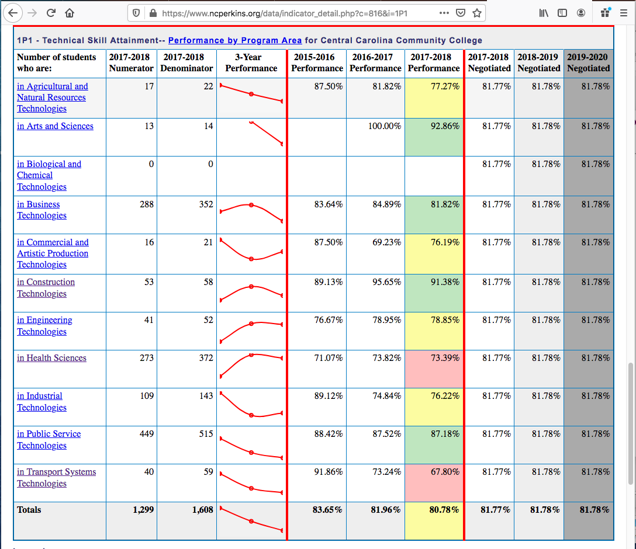
Notes:
and by our CTE program areas.
Colleges can see where they are doing well and where they need to look for ways to improve.

Slide 8
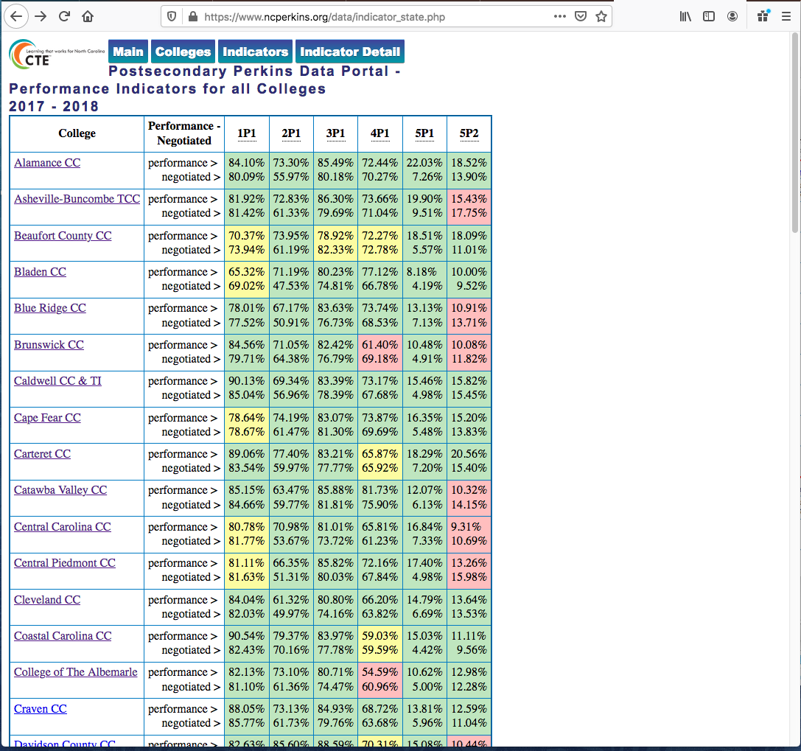
Notes:
We can Compare indicators across all 58 colleges and look for the red cells.
Here you see the negotiated level and the actual performance for each college.

Slide 9
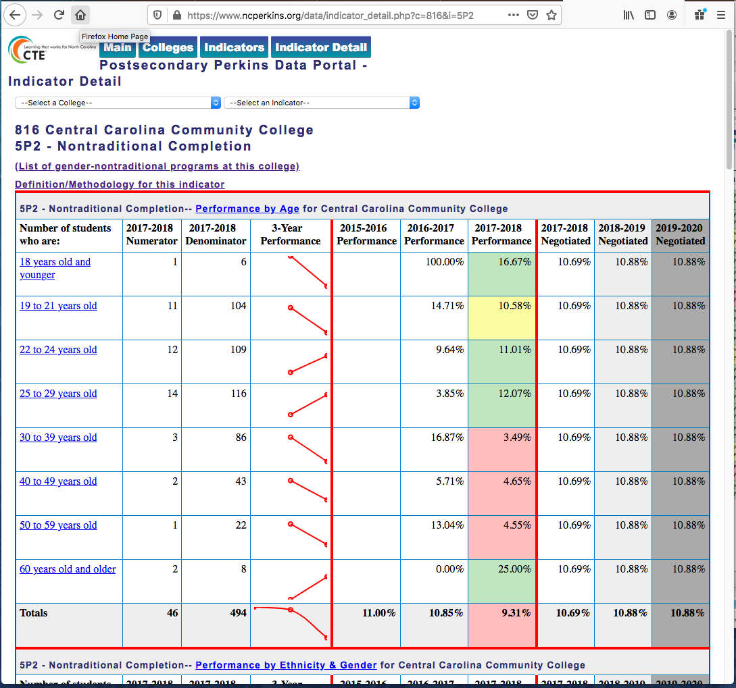
Notes:
Here is 5P1 for this same college.
Notice the link near top of table for List of gender-nontraditional programs. Click that and …

Slide 10
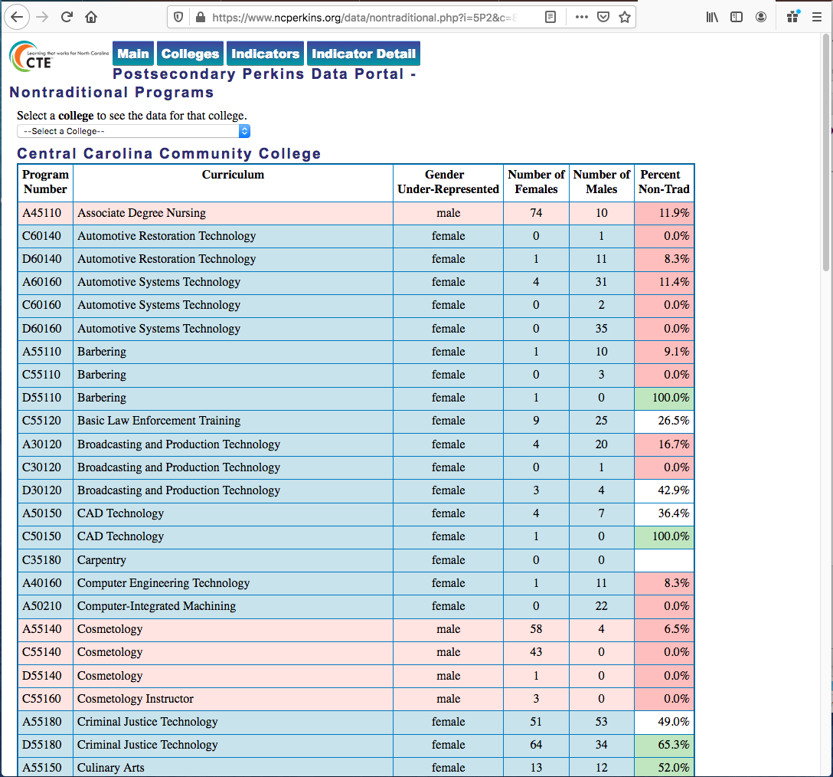
Notes:
Here is the list of gender-nontraditional programs at this college.
The program list is color-coded by dominate gender. Blue are the boy jobs.
Numbers show the CTE Participants for each gender.
The last column is color-coded to show status.
Red means below 25 percent non-traditional gender.
White is between 25 and 50 percent
Green indicates over 50 percent non-traditional gender.
Red indicates areas that need to be addressed.

Slide 11
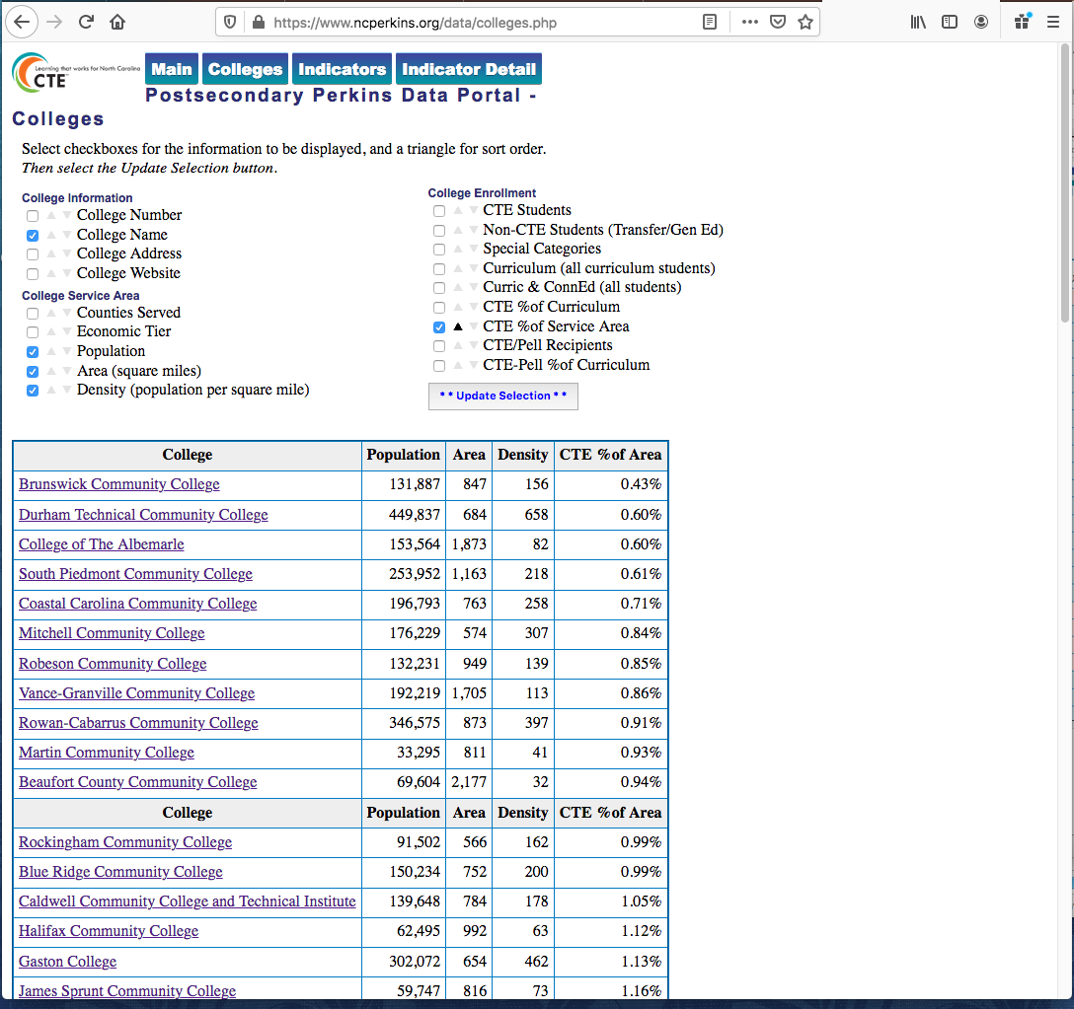
Notes:
On this page you can select any of these parameters you see near the top of the page.
In this case we are looking at the density of the college's service area, which is usually one to three counties.
The last column shows the number of CTE students as a percentage of the service area population.
You can see here the lowest is point-four-percent of the population, whereas the highest is over three-and-a-half-percent of the population.

Slide 12
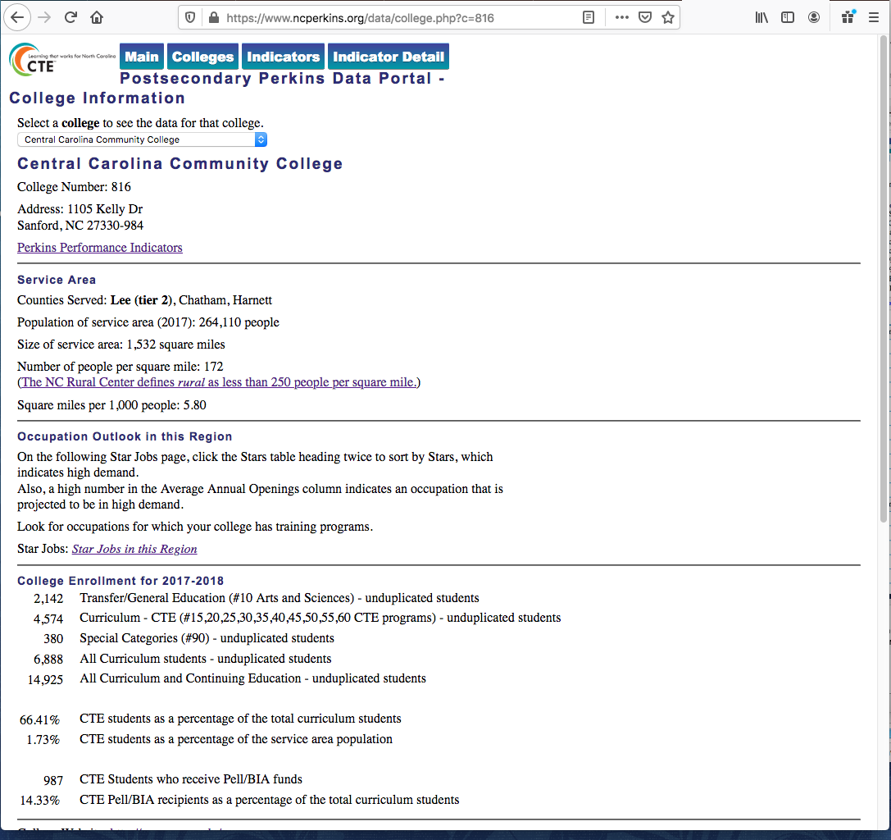
Notes:
Here is a page that shows all of this data for a single college.
Also notice the link to the Star Jobs, which is the way our state lists the projected high demand jobs in a particular region of the state.
Thus, when creating a Comprehensive Needs Assessment, the job projections for that region is right here.

Slide 13
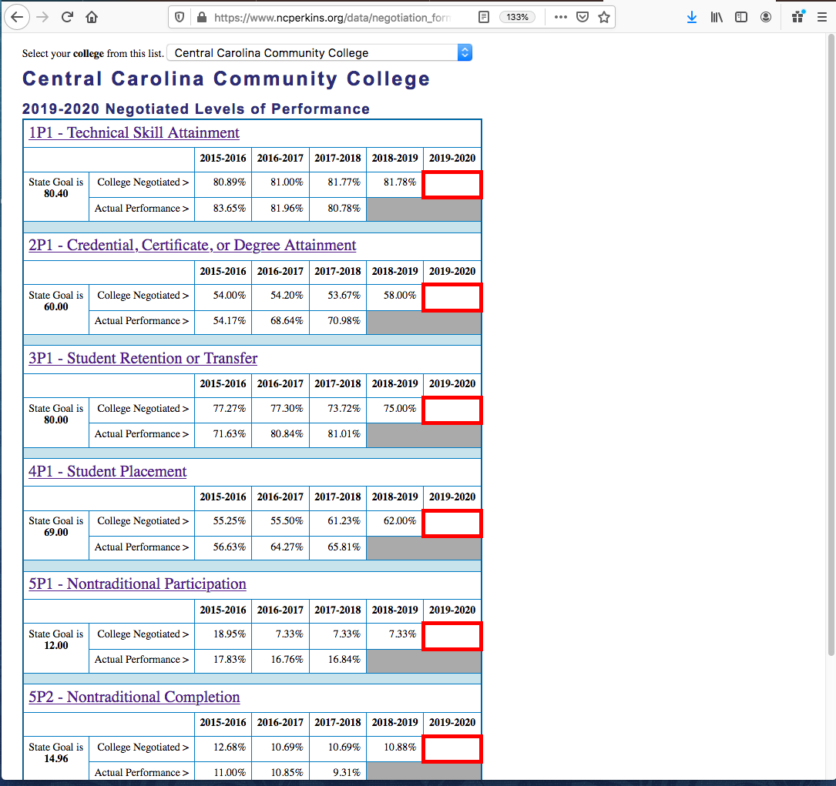
Notes:
Here is a hidden page that we used to help the college enter their negotiated level for this year.
It uses the same data in the database.
Rather than doing a mail emerge like we have done in the past, we just sent them all to this page, where they selected their college at the top of the page,
entered their negotiated levels for each indicator and then print it out.
There are signature lines at the bottom of the page.

Slide 14
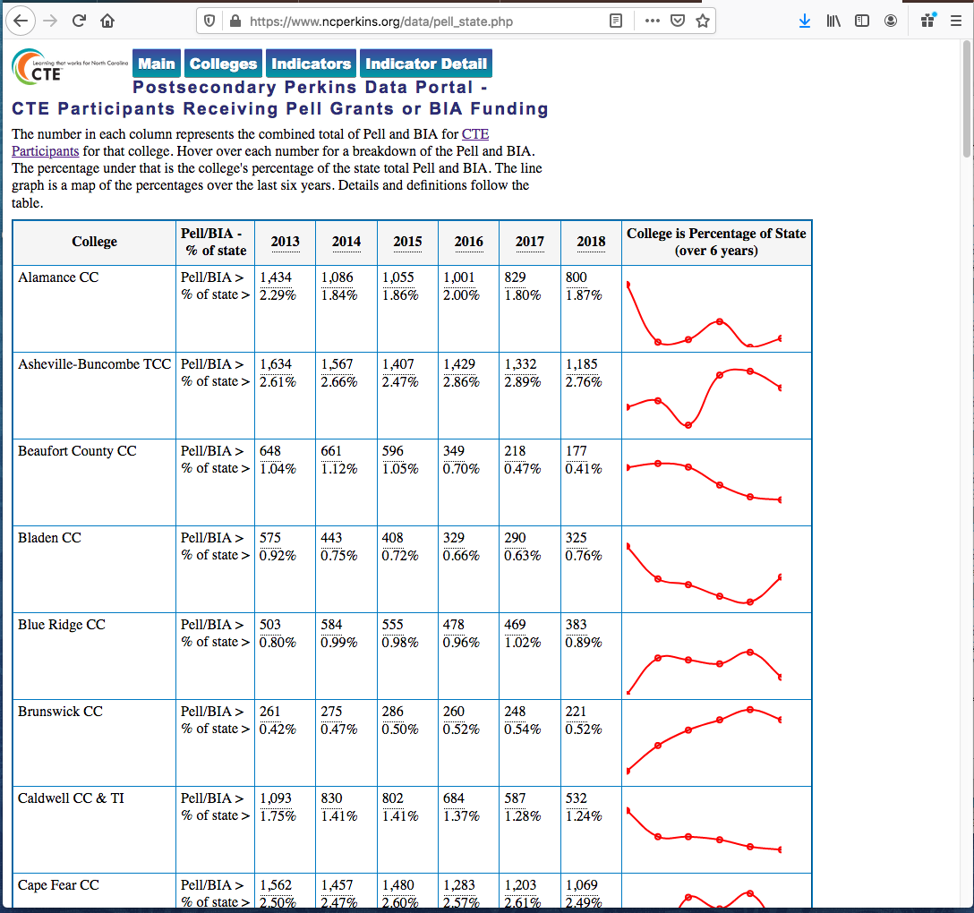
Notes:
Colleges want to know why their Perkins allocation goes up or down each year if we have the same funding at the state level.
Using the same data, we can show on this page a six-year progression of the number of CTE students receiving a Pell grant,
and the graph shows the trend of the percentage of the state funding that college receives.
Thus, their number of students may drop slightly, but they may receive a higher allotment.
On this chart, if you hover over the number, you get the breakdown of Pell vs BIA.
Using this data, colleges know the importance of ensuring that all students who could possibly qualify for Pell grants, register for one.

Slide 15
Postsecondary Perkins Data Portal
https://www.ncperkins.org/data/
22 dynamic web pages (so far)
12,152 lines of HTML & PHP code
Does not include Javascript files borrowed from others
52 tables in MySQL database
each year and indicator is a different table
Uses Chart JS to make the line graphs
Notes:
FYI - behind the scenes statistics on our Postsecondary Perkins Data Portal

Slide 16
North Carolina
Dr. Bob Witchger, CTE Director
Chris Droessler, CTE Program Administrator
Notes:
Bob Witchger
witchgerb@nccommunitycolleges.edu
919-807-7126
919-807-7219
Chris Droessler
droesslerc@nccommunitycolleges.edu
919-807-7068

