Slide 1
Toward an Understanding of Career Pathways
Pathways to Prosperity,
Career and College Promise Pathways,
9-14 CTE Pathway,
NC Works Certified Pathways
Dr. Bob Witchger
Director of Career and Technical Education
NC Community College System
WitchgerB@nccommunitycolleges.edu
(919) 607-6376
Notes:
Career Pathways has many different meanings
1. CC - Courses students take toward a diploma
2. HS - CCP - Courses students take in a sequence leading to a certificate, diploma
3. Basic Skills - Courses including basic reading and math, coupled with Technical Classes
4. Strategy in an apprenticeship program leading to full certification as Journeyman
5. Series of jobs, life experiences, leading to current employment

Slide 2
Career Pathway
How would you define Career Pathway ?
Notes:
Take Paper and Write your definitions.
First - How would you define it.
Second - What does it mean to you, effect you, impact your life?
Share with your neighbor.

Slide 3
Career Pathway
What does
“Career Pathway”
Mean to You?
Notes:
Take Paper and Write your definitions.
First - How would you define it.
Second - What does it mean to you, effect you, impact your life?
Share with your neighbor.

Slide 4
Career Pathways
Framework for Education and Training
Common Language
Streamline Preparation to Careers
Address Regional Labor Shortages
Listen and Engage Employers Upfront
Notes:
I would like to discuss career pathways in context of North Carolina’s efforts
to develop a Framework in education and training.
to provide a common understanding or a common language of education and/or training courses
to encourage courses that are streamlined for end user our students, clients, or individuals
seeking assistance in their education, skill upgrading, or re-employment
Programs of study or Training that address regional labor shortages and
that encourage us to listen to and engage employers first as
we are developing employment and training and or education programs.

Slide 5
History of Pathways
Pathways to Prosperity - A framework for all
Meet future employer demand with credentials
Offer postsecondary credentials and license
Encourage technical skill building for the "Forgotten Half"
Stress foundational "Soft Skills" and learning on the job
Notes:
Some of the early work in our state began with Pathways to Prosperty and the work of Harvard Graduate school where Bob Schwartz and Bill Simons, conducted research that revolved around meeting future employer demands, listening to the employers need for credentialed workers with skills beyond high school but probably yet not a full four year baccalaureate degree addressing the need of many that have been forgotten in our education and training world.
Programs design to address our drop outs and students not university bound providing them with skills, (we have no individual to waste,) to encourage the engagement of our forgotten half, in and with Foundational or soft skills and then the basic technical skills for entry into the job market

Slide 6
Pathways to Prosperity
Address the Dropout rate
Stress workplace & classroom
Address need for skills beyond high school
Provide for Articulated & Focused Training
Notes:
Pathways to Prosperty addressed
Our Drop Outs, probably better engaged in our basic skills programs and workforce development training programs
Pathways that stressed workplace learning and classroom training
Addressing the needs of skills beyond high school you not a full degree
Meeting the needs of our employers and providing for training that builds on each other, acknowledges the skills of individuals as they enter our workforce and focused on “Specific Job Training”
Training that meets the needs of the labor market not….
Almost an ongoing quicker fix to an immediately identified labor shortage

Slide 7
Career Pathway
How would you define Job-Driven Training?

Slide 8
Job-Driven Training
“Training that is responsive to the needs of employers in order to effectively place ready-to-work Americans in jobs that are available now or train them in the skills needed for better jobs.”
“FACT SHEET: Ready to Work At a Glance: Job-Driven Training and American Opportunity,”
Notes:
Across all or our pathway work, training needs to be responsive,
producing ready to work individual for todays jobs
with the option to train for better jobs, what some call on and off ramps,
Developing skills individuals can grow with.

Slide 9
Career Pathway
What are some elements or characteristics of a Job-Driven Training Program?

Slide 10
Job-Driven Training
Engage Employers
Earn and Learn
Smart Choices
Measurement Matters
Stepping Stones
Open Doors
Regional Collaboration
Notes:
IN the early work of career pathways, Vice President Joe Biden talked to workforce development and community colleges leaders in a white house summit in 2014 and set seven key provisions, elements to build into job training programs in the future. These elements have been incorporated into our Career Pathway work from the beginning. We have encouraged our pathways projects to incorporate these principles,
you will hear - these phrases or iterations of them - as you study pathway and as I summarize them for you as we talk through the development of pathways in the next 10 minutes, and
Demonstrate how these elements are infused in our Certified Pathway System.

Slide 11
1. Engage with Employers
Involve employers up front
Determine local and regional hiring needs
Get the employer’s perspective
Adapt training to meet employer / Labor Market needs
Advisory and beyond
Notes:
Element 1 – Work up-front with employers to determine local or regional hiring needs and to Design training programs that are responsive to those needs.
Key are Regional Hiring Needs,
The Employer Perspective we incorporate in our programs to meet workforce needs,
and to engage in meeting the needs of the growing labor market, we are asked to
listen and engage deeply with employer well beyond our traditional advisory programs.

Slide 12
2. Earn and Learn
Offer work-based learning
Exploratory - Explore work first-hand
Experiential - Experience work first-hand
Engaged/Involved - Integrate work into education and training programs
Notes:
The 2nd element : “Earn and Learn” identifies strategies we put together so that individuals receive training that is outside the classroom and in the work-place.
Earning a living wage is key to a well developed training program in career pathways.
Some examples include paid internships, pre-apprenticeships, Registered Apprenticeships (RA), and on-the-job training (OJT).
In this second element work-based learning opportunities with employers—including on-the- job training, internships, and pre-
apprenticeships and Registered Apprenticeship are part of the training paths leading to employment.

Slide 13
3. Use Data - Smart Choices
Data-Driven Accountability
What it taught - Programs of Study related to work
Likelihood of getting a job
Notes:
The third element of a job driven training program asks that employment and training programs use data to drive accountability and inform employer engagement strategies.
Comprehensive and accessible labor market data can facilitate two important processes:
this data can drive your employer outreach, and it can inform consumers on real opportunities.

Slide 14
4. Measurement Matters
Earnings and Employment
Employment by Sector
Employers by Training Group, Program, Class & Retention
Notes:
The 4th element of job-driven career pathway training states that
programs should measure and evaluate the employment outcomes of participants
to assess the quality of training programs.
Having this information allows training providers and job seekers to make informed
choices about the training providers continue to offer and training the job seekers chooses -
break the data down by employer by sector. by Trainees, and with retention statistics

Slide 15
5. Stepping Stones
Seamless Progression
Steps, Progression
Advancement, Credentials
Come and Go - Open entry and open exit
Notes:
The 5th element of job-driven training requires that employment placement show a stepping stone approach to success.
In practice, this means a training process shows a progression and advancement,
with integration of training and education leading to credentials and opening the option for on and off ramps, open entry / open exit allowing individuals to stop out and work full time or enter full time advanced education through out their pathway.

Slide 16
6. Opening Doors
Serve those with barriers
"Chip away" at barriers to employment
Provide supportive services and collaborate
Provide tools for job developers, trainers, and employers
Notes:
The sixth elements “opening doors,” speaks to the heart of organizations executing training programs HVRP:
organizations doing employment services should do whatever possible to remove barriers to employment.
This principle demands that programs help open access to employment opportunities for those who are most in need and who have the most significant barriers.
Its about special populations, hard to serve, most in need. — Folks we are called to give the preferential option to the poor to raise them up and to level the playing field
That the common element behind all our federal job training programs, Education and training is to the to be the great leveler
Lift up those that are down trodden. We are all called to this work, not only by federal mandates but by our call to this work of skills building, as it’s building for the dignity of all.

Slide 17
7. Regional Collaboration
Workforce Boards
Job Centers
Chamber of Commerce
Community Colleges and Universities
k-12 Local Education Agencies
Labor Organizations
Philanthropic Organizations
Human Service Agencies
Vocational Rehabilitation
Independent Living Centers
Notes:
The 7th and final principle of job-driven training asks providers to coordinate major players in local and regional employment services.
The list of partners or what some call stakeholders is long, it includes: Workforce Investment Boards and the American Job Centers they oversee, higher education institutions, labor organizations, k-12 education, philanthropic organizations, state and local human service agencies, vocational rehabilitation agencies, Medicaid agencies, centers for independent living, supported employment providers, community- and faith-based organizations, and other non -profit organizations.
It takes a community , it takes collaboration, it takes common sense, it takes commitment
As front line workers, you understand this principles, you work with many of these groups on a daily basis,

Slide 18
Job Driven Training
Impacts:
Employers
Training providers
Unemployed workers
“FACT SHEET: Ready to Work At a Glance: Job-Driven Training and American Opportunity,”
Notes:
These seven principles impact Employers, Training Providers and the unemployed
It takes Commitment by all for pathways to work, for pathways to become certified.
Now I would like to show you a graphic to try and bring home some to he work we have begun on career pathways.
One idea of how all these pieces go together.
While this is from one pilot we are currently operating, I will attempt to demonstrate for you in the remaining portions of this presentation how these elements can morf into certified pathways.
And them my colleague Dion will give you an update of her work on certifying pathways, in efforts to ensure we are all on the same page. The $$ available to move forward

Slide 19
Career Pathway
If you were going to put together a job-driven training program or a framework for career pathways of a High Schools to Community College pathway, what elements would you put into the design?

Slide 20
2014 Vision
CTE Career Pathways
Advising
Program of Study
Assessment Interest, Ability, Skills
HS - Academic and Technical
Comprehensive Career advising
Credentials
Work
CC - Academic and Technical
Interviews
Labor Market Information
Experiential/Work Based Learning
Career Plan
Certifications
Diploma
Degree
9, 10, 11, 12, 13, 14
Engaged Employers
Assessment of Competencies,
& Credentials,
Placement in Education / Training
Notes:
When we first started out, JoAnne, Catherine and Myself developed a two year RFP, to test some on these pathway elements BEGIN BUILD
The basic elements are Career Advising, Programs of Study or Training, Leading to work - A streamlined approach to preparing the workforce
Briefly - Career Advising includes, Advising, Assessments, Sharing Labor Market Information and the Developing an individual career plan, employability plan, or strategy to move toward work
The program of study in this 9-14 case include high school and then community college career and technical education courses with experiential work based learning
We asked each grantee to test out this career advising and training or programs of study or classroom and work based learning. finally we have interviews and then work
Unique to these elements were the upfront assessment of individuals skills, competencies, and credential that might allow for advanced placement in the training continuum.
This was our concept, a concept laid out in come 5 pages of the RFP, Elements that we are continuing to test as we enter the last months of this pilot grant and elements you will here some of the successes and failures through our break our sessions during this conference.
Graphic Highlighting Three Main Components
Career Advising
Programs of Study – Work Based Learning, Stackable Credentials, Multiple Entry and Exit,

Slide 21
Career Pathway
Here is how the course schedule might look for a High School

Slide 22
Building the Pathways
Toward Workforce Credentials
(Rigorous) Programs of Study (Classes are examples)
Level | Courses |  |  |  |  |  |  |  | Certifications & Degrees
9 | English 1 | Algebra I or Integrated Math I | Environmental Earth Science | World History | Health/PE | MSITA Word, PPT | Small Business Entrepreneurship | Freshman Career Management | MSITA Certifications (2)
10 | English 11 | Geometry or Integrated Math II | Physical Science | Civics | Principles of Business & Finance | MSITA Excel, Access | Business Law | MSITA Website or Database | MSITA Certifications (2)
11 | English 111 | Algebra II or Integrated Math III | Biology | BUS 151 | BUS 110 Intro to Business | Accounting I | BUS 137 Principles of Management | BUS 135 Principles of Supervision | MSITA Certification(1) MOS Career Readiness - CRC
12 | English IV | 4th Math Aligned with sudent’s plan | US History Part A | MAT 115 Mathematical Models | US History Part B | Accounting II | ENG 114 Professional Research & Reporting | BUS 115 Business Law I | High School Diploma QuickBooks Certification CC Certificate
Core Courses
CTE High school courses
Community college courses
Articulated Courses
Labor Market Value $$
Articulated credits - MSITA for CIS110
Online Course on Demand See CC course requirements for each degree
Notes:
Would like to share with your four additional pictures of programs of study the middle or key portion of pathways to better describe how these pathways training component might be put together
Here we see the high school students earning college credit and credential as they graduate from high school with some credentials and possible certification.
As opportunities for credentials are identified, they would be integrated into the matrix as an option and part of the path.

Slide 23
Building the Pathway 9-14
High School and Community College
(Rigorous) Programs of Study (Classes are examples)
Level | Courses |  |  |  |  |  |  |  | Certifications & Degrees
9 | English 1 | Algebra I or Integrated Math I | Environmental Earth Science | World History | Health/PE | MSITA Word, PPT | Small Business Entrepreneurship | Freshman Career Management | MSITA Certifications (2)
10 | English 11 | Geometry or Integrated Math II | Physical Science | Civics | Principles of Business & Finance | MSITA Excel, Access | Business Law | MSITA Website or Database | MSITA Certifications (2)
11 | English 111 | Algebra II or Integrated Math III | Biology | BUS 151 | BUS 110 Intro to Business | Accounting I | BUS 137 Principles of Management | BUS 135 Principles of Supervision | MSITA Certification(1) MOS Career Readiness - CRC
12 | English IV | 4th Math Aligned with sudent’s plan | US History Part A | MAT 115 Mathematical Models | US History Part B | Accounting II | ENG 114 Professional Research & Reporting | BUS 115 Business Law I | High School Diploma QuickBooks Certification CC Certificate
Summer | COE 112 (coop) | COE 110 World of Work | ACA 111 College Student Success
1 | MKT 220 Advertising & Sales | ACC 120 Principles of Financial Accounting | ENG 111 Expository Writing | BUS 116 Business Law II | BUS 260 Business Communications | BUS 240 Business Ethics | ACC 129 Individual Income Taxes | ACC 121 Principles of Managerial Accounting | Business Administration Diploma 44 hours
2 | Social Science Elective | BUS 239 Business Applications Seminar | ECO 252 Principles of Macroeconomics | Humanities Fine Arts Elective |  |  |  |  | Business Administration AAS Degree 65-73 hours
Core Courses
CTE High school courses
Community college courses
Articulated Courses
Labor Market Value $$
Articulated credits - MSITA for CIS110
Online Course on Demand See CC course requirements for each degree
Notes:
This graphic is a model for high school and one or two years of college leading to an AAS degree with credentials that area stackable, stackable credentials that might allow for open entry and exit along the pathway.
The College Certificate, Diploma, and Degree Courses would be added to the Program of Study

Slide 24
Building the Pathway
Engaging Employers
(Rigorous) Programs of Study (Classes are examples)
Core CoursesE
CTE High school courses
Community college courses
Articulated Courses
Experienced/Work Based Learning
Level | Courses |  |  |  |  |  |  |  | Certifications & Degrees
9 | English 1 | Algebra I or Integrated Math I | Environmental Earth Science | World History | Health/PE | MSITA Word, PPT | Small Business Entrepreneurship | Freshman Career Management | MSITA Certifications (2)
10 | English 11 | Geometry or Integrated Math II | Physical Science | Civics | Principles of Business & Finance | MSITA Excel, Access | Business Law | MSITA Website or Database | MSITA Certifications (2)
11 | English 111 | Algebra II or Integrated Math III | Biology | BUS 151 | BUS 110 Intro to Business | Accounting I | BUS 137 Principles of Management | BUS 135 Principles of Supervision | MSITA Certification(1) MOS Career Readiness - CRC
12 | English IV | 4th Math Aligned with sudent’s plan | US History Part A | MAT 115 Mathematical Models | US History Part B | Accounting II | ENG 114 Professional Research & Reporting | BUS 115 Business Law I | High School Diploma QuickBooks Certification CC Certificate
Summer | COE 112 (coop) | COE 110 World of Work | ACA 111 College Student Success
1 | MKT 220 Advertising & Sales | ACC 120 Principles of Financial Accounting | ENG 111 Expository Writing | BUS 116 Business Law II | BUS 260 Business Communications | BUS 240 Business Ethics | ACC 129 Individual Income Taxes | ACC 121 Principles of Managerial Accounting | Business Administration Diploma 44 hours
2 | Social Science Elective | BUS 239 Business Applications Seminar | ECO 252 Principles of Macroeconomics | Humanities Fine Arts Elective |  |  |  |  | Business Administration AAS Degree 65-73 hours
Tours
Project B Learning
Shadowing
OJT / OJL
Co-Op
Apprenticeship
Articulated credits - MSITA for CIS110
Online Course on Demand See CC course requirements for each degree
Employer Engagement
Notes:
Here we see how employers or their intermediary would review
CTE Learning Outcomes, Certificates, and again review the certificates.
Engage in work based learning that may be progressive in nature, exploratory early on , general work experience teaching the fundamentals as the students progress along the path and finally the Engage, training integrated into and supporting the daily classroom instruction.
This is a draft to get you thinking and to receive your comments as we finish developing the proposal.

Slide 25
Building the Pathway
Short-Term Career Center / Continuing Education
Level | Courses |  |  |  |  | Certifications & Degrees
Career Center Coordinator | Basic Reading and Math | Health | LPN |  |  | Certifications (2)
2
Tours
Project B Learning
Shadowing
OJT / OJL
Co-Op
Apprenticeship
Employer Engagement
Notes:
This is a graphic demonstrating how short term training or continuing education may be displayed in the pathway,
The Upfront career advising, upgrading of basic reading and math skills for a specific pathways and then immediate or concurrent integration to specific skill training leading to certificated and work…
Note exploratory, experiential, and infused work based learning can be integrated into the pathway.
Lets take a quick breath….
In its most recent career pathway tool kit the department of education and department of labor identifies 6 characteristics of pathways,
See how these build on the work of the vice president and see how they parallel some of our current work and future certified pathways
These characteristics are:
1.
2.
3.
4.
5.
6.

Slide 26
Career Pathway
Now let’s look at what several state agencies thought might go into a Pathway and call it Comprehensive.

Slide 27
Evaluation
Labor Market Demand
Certified Career Pathway
Employer Engagement
Career Advising
Skill Training
Work
Collaboration
Notes:
OK,
This is my new graphic, a way to view North Carolina’s Certified Pathways.
Notice all the elements needed for certification from the to top
Employer Engagement
Career Advising
Skills Training - I took some license in relabeling this I will come into conform as we sell it out
Work
Collaboration
Labor Market Information
Evaluation

Slide 28
Employer Engagement
Key role in developing the pathway
Actively involved in review of curriculum
Redesigned to meet industry & educational standards
Suggest strategies & opportunities for WBL
Evaluate & Recommend Credentials & Certifications
We Listen!
"How can we help you?"
Notes:
Here are five elements to consider when writing your proposal on employer engagement
We listen first
Employers play a key role
Are actively involved
training is redesigned blending industry needs and educational standards BALANCING
Offer suggestions and opportunities for WBL
Evaluate our programs and recommend credentials that may ben earned and assessments that my be given at the conclusion leading to certifications local employers will accept as one of the door openers to employment

Slide 29
Labor Market Demand
Employer Engagement
Career Advising
Education &
Skill Training
Work
Demand
Hire
GAP - Shortage of Qualified Workers
NEED & GROWTH - Quantity of Workers
Credentials
Skills
Work Based Learning
Learning Outcomes
Notes:
Here is another way to look at employer engagement around the Labor Market Demand

Slide 30
Collaboration
LEA
CC
WDB
Univ
Community
Industry
Commitment & Support
Buy into Model & Process
Deliver a Consistent Message
Notes:
Collaboration is a key component.
We need the community to support that pathway
to help hold each other accountable and to be ready to offer assistance and the pathway initially builds out, grows, matures and evolves in our communities.
It is through Support of the model and process and through a consistent message pathways will grow in our communities

Slide 31
Career Advising
Selecting Pathway, Education, & WBL
Advising Team
Middle School
High School
Community College
University
Career Center
Professional Development
Joint staff
Advising on Certified Pathways
Setting Career Goals
WBL Explore, Experience, Engage
Advising Skills
CDF - Listening,, Sharing LMI, Sharing Options
Individual Assessment of Interest, Abilities, Skills
Sharing Labor Market Information: Projections; Pathway Requirements; Certifications; & Employment Options
Career Planning & Goal Setting
Notes:
Career Advising in a certified pathways system includes, middle school, high school, community college, an option for the university and local career centers…
Professional development is needed and
Consistent advising skills around the pathways will help grow our pathway system
Typically for the individual career advising and an individual plan is the first step

Slide 32
Career Advising & Employability Plan
Career Awareness
Career Plan
Assessment of Interests, Abilities, Skills
Assessment Prior Learning & Credentials
Assessment of Specific Pathway ID Skills
Identification of the Individuals Career Goal
Articulation Coordination
Program of Study Academic and Techincal Training
Academic & Technical Courses
Education & or Training Program
Credit for: Experiences, Articulated Courses Plan and Path Streamlined for Individual
Exploratory -Shadowing, Mentoring
Experiential - Work Foundational Skills
Engaged - Supportive of Classroom Education
Work-Based Learning
Jobs within the cluster
Ability to engage in work
Reengage in education or training
Continuous Education /Training to meet Career Goal
Career Goal
Work
Notes:
This is what a career plan may look like- Step to the job
Self Awareness through Assessments - notice the employer input on Identified Skills Needed
Program of Study - Education , Training, Credit and Articulation Streamlined for the individual
WorkBased Learning - Exploratory, Experiential, Engage all recommended in the initial plan and then later supported in the framework
Career Goal - including options for stackable credentials, re-engaging in further education and training
THIS IS NOT BACKFILLING BECAUSE WE HAVE SLOTS IN A CLASS
YET... it may be a step toward

Slide 33
Training / Programs of Study
Programs mapped to Labor Market Needs
Academic & Technical courses work together
Work-Based Learning opportunities integrated
Employability skills into classroom study
Credentials recognized by education & industry
Courses articulated HS->CC &/or Training->CC
Notes:
Six Elements of Training Programs
Mapped to the Labor market
Academic and Technical courses blended
Integrated Work Based Learning
Employability Skills incorporated into the training
Opportunity to earn credentials recognized by local industry and stackable fore easy reentry
Course articulated from HS to CC or from Training TO CC _ AAS to University

Slide 34
Articulation and Coordination
Program of Study / Training
Student
Graduate
Dislocated
Worker
Under Employed
Unemployed
Career Changer
Middle School
High School Diploma
Community College AAS
W o r k
Basic Skills Plus
Community College AA
Certificate
Diploma
Degree
Continuing Education
Customized Training
University
Proprietary School / Training
Apprenticeship
Notes:
Here is the build out
Many Types of Individual entering career advising
Multiple options for education and training
Multiple exit point to work into jobs requiring various skills

Slide 35
Articulation and Coordination
Program of Study / Training
Built to meet Employer's Needs
Allow for Stackable Credentials
toward certifications and degrees
open doors back to training
Allow for Open entry / exit to work
Notes:
In summary - The training redeveloped or reformulated for Certified Career pathways
Is build to meet employer needs
Allows for stackable credentials that may be the ticket to further placement in the training continuum through open entry and exit and an individual climbs the wall of employment opportunities in a career pathway programs

Slide 36
Work-Based Learning
Industry Tours
Cooperative Education
Apprenticeships
Volunteer Experiences
Pre-Apprenticeship
Junior Achievement
Transitional Programs
Job Shadowing
Project-Based Learning
School-Based Enterprise
Part-Time Work
Internships
Service Learning
On-the-Job Training
Notes:
I would be remiss if I did not briefly touch on work based learning
This is beyond the high school or community college credit bearing WBL.
These is a short list of 14 strategies

Slide 37
Work-Based Learning
Engages employers along the pathway
Offers individual opportunities to explore careers and work first-hand
Provides individuals guidance from mentors
Stresses an understanding of the culture of work
Builds Foundational Skills: Communication, Team work, On Time, Sharing
Enhances theory from training or from classroom Instruction
Builds skills identified by employers, educators and training providers
Notes:
Work based learning provides opportunities to
Engage Employers
Offer students opportunities to explore work and meet and gain a mentor
Under the culture of work and key foundational or soft skills of communication, team work, time
as it enhances classroom training, builds on classroom training and further engages the individual in the real work
Work base learning build skills identified by employers, taught by trainers and education and engages on the job training providers

Slide 38
Work-Based Learning
Exploratory
Exploring Work
Job Shadowing
Employer Videos
Employer Projects in Class
Industry Tours
Junior Achievement
Experiential
Foundational Skills &
Soft Skills
PT Work
Volunteer
Projects in Class
Internship
Service Learning
Junior Achievement
CSO
Engaged
Classroom learning
applied on the job
Cooperative Education
Apprenticeship
Internships
Structured Volunteer
Structured Service Learning
Structured OJT
Notes:
Work based learning has three key element that of
Exploring work through programs such as job shadowing
Offering work experience to inform and build out foundational skills
To engage the individual in productive work through structured work process that build the skills learned in the classroom

Slide 39
NCCBE - Navigator
Work-based learning -- easy, consistent, and scalable.
Accessibility to the real-world
Work-based learning activities
Building the talent pipeline
Aggregating and leveraging resources
Online marketplace
Learn about work through work
Notes:
Educators need easy access to real-world, work-based learning activities to help prepare students for real-life success and to help build the talent pipeline employers need. This means aggregating resources in one, consistent place and eliminating the administrative burdens traditionally associated with leveraging those resources. The Navigator, developed in partnership with Fidelity Investments, is an online marketplace that brings together members of the employer, educator, and workforce development communities. Whether it is through activities that enable students and job seekers to learn about work (e.g., guest speakers), learn through work (e.g., career competitions), or learn for work (e.g., apprenticeships), this platform makes “stepping in” to work-based learning easy, consistent, and scalable.

Slide 40
Work
Career Pathways offer:
Career Ladder
Job opportunities based on Skills & Credentials
Opportunity to develop skills & advance through the pathway
Jobs identified by employers
Example Jobs in a Career Pathway
Welder
Machine Operator
Machine Maintenance
Machinist
Engineering Tech
Mechanical Engineer
Example Jobs in a Career Pathway
CNA
LPN
RN
Nurse Practitioner
Notes:
1. Pathways properly designed prepare the individual for workforce needs
2. There can my multiple entry point into the workforce
3. Entry, based in part, by credentials earned provide opportunities for advancement as the individual progresses in work ... and further education and training.
Here are several examples of jobs in a pathway…

Slide 41
Certified Career Pathways
Labor Market Demand
Employer Engagement
Career Advising
Ed. Program of Study /
Skill Training
Work
ç
Collaboration
Notes:
It is the intent of the North Carolina Employment and Training Association and our members and partners in this conference to provide you with an overview of pathways, talk to individuals who work have begun putting certified pathways together, and to provide insights into pathway elements as you go back to you communities and enter into the conversation on building this important element in WIOA,
Important strategy in PERKINS,
Important concept in our DHHS legislation.
Thanks for coming to the conference,,,,,
There is one more concept wi Oulw like to leave you with before I turn the program over to Dion Our State Director for Pathways It is that of the Intermediary

Slide 42
WIOA Career Pathway
Section 3 of the Workforce Innovation and Opportunity Act (29 U.S.C. 3102) defines Career Pathway, what elements do you think are in that definition?

Slide 43
WIOA on Career Pathways
A combination of rigorous and high-quality education, training, and other services
Aligns with skill needs of industries
Prepares individuals to be successful in a full range of secondary or postsecondary options including apprenticeships
Includes counseling and support to individuals achieving education and career goals
Includes, as appropriate, education offered concurrently with and in the same context as workforce preparation activities and training for a specific occupation or career cluster

Slide 44
WIOA on Career Pathways
Organizes education, training and other services to meet particular need of an individual in a manner that accelerates education and career advancement.
Enables an individual to attain a secondary school diploma or at least a recognized equivalent and at least 1 recognized postsecondary credential
Helps an individual enter or advance within a specific occupation or occupational cluster

Slide 45
Career Pathway
An Implemented Career Pathway in action

Slide 46
Coordination of Regional Pathways
Secondary CTE
Goodwill
Coordinating Regional Activities
Linking Information and Resources
Engaging Employers
Career Advising
Work Based Learning
Open Entry and Exit
Programs of Study
Education and Training
Job Placement
PostSecondary CTE
Regional Agencies
Adult Ed Title II
Workforce Boards
NC WORKS
NC WORKS

Slide 47
Coordinating Pathways toward Collaboration
Certified Criteria/ WIOA Criteria | Engage Employers | Demand In Informed Driven | Career Awareness | Collaborative | Articulation Coordination | Wor- Based Learning | Multiple Entry Exit | Evaluation
Aligns Industry
Individiual Success
Counseling
Education Training
Organize Accelerate
Diploma PS/Credential
Occupational Entry /Advance

Slide 48
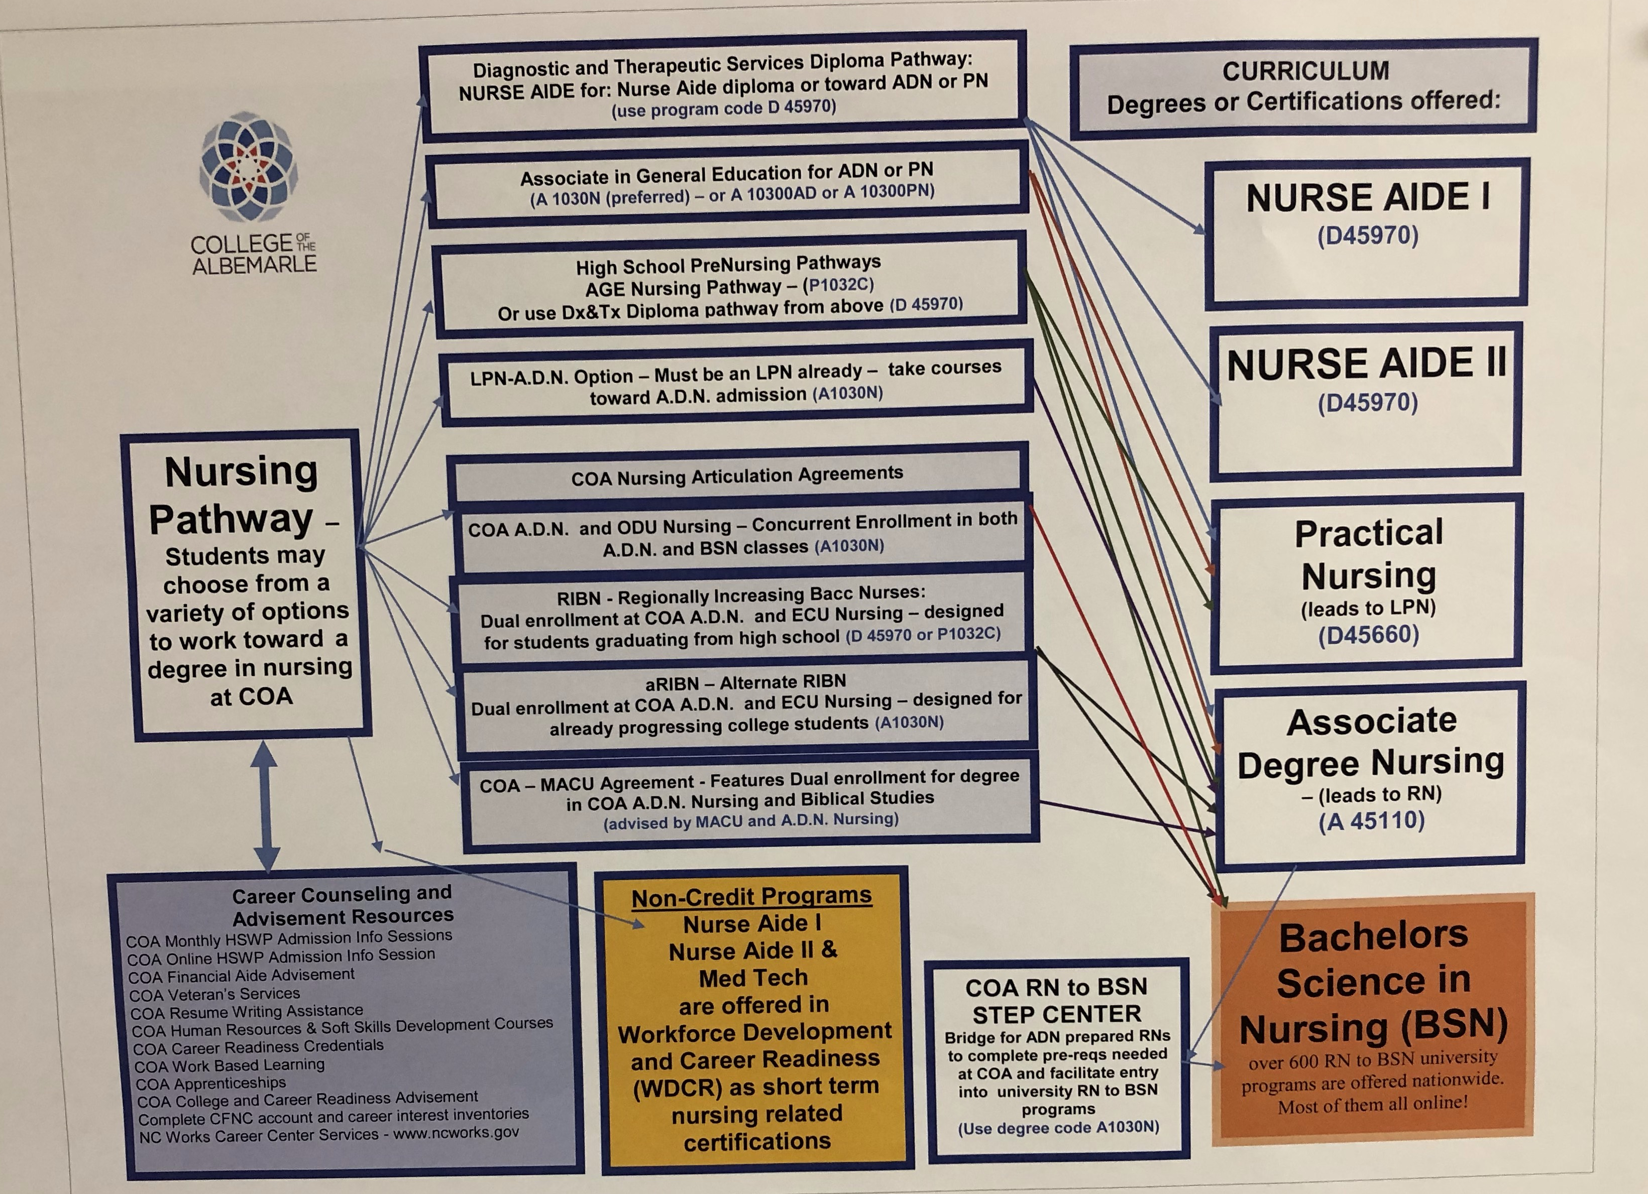

Slide 49
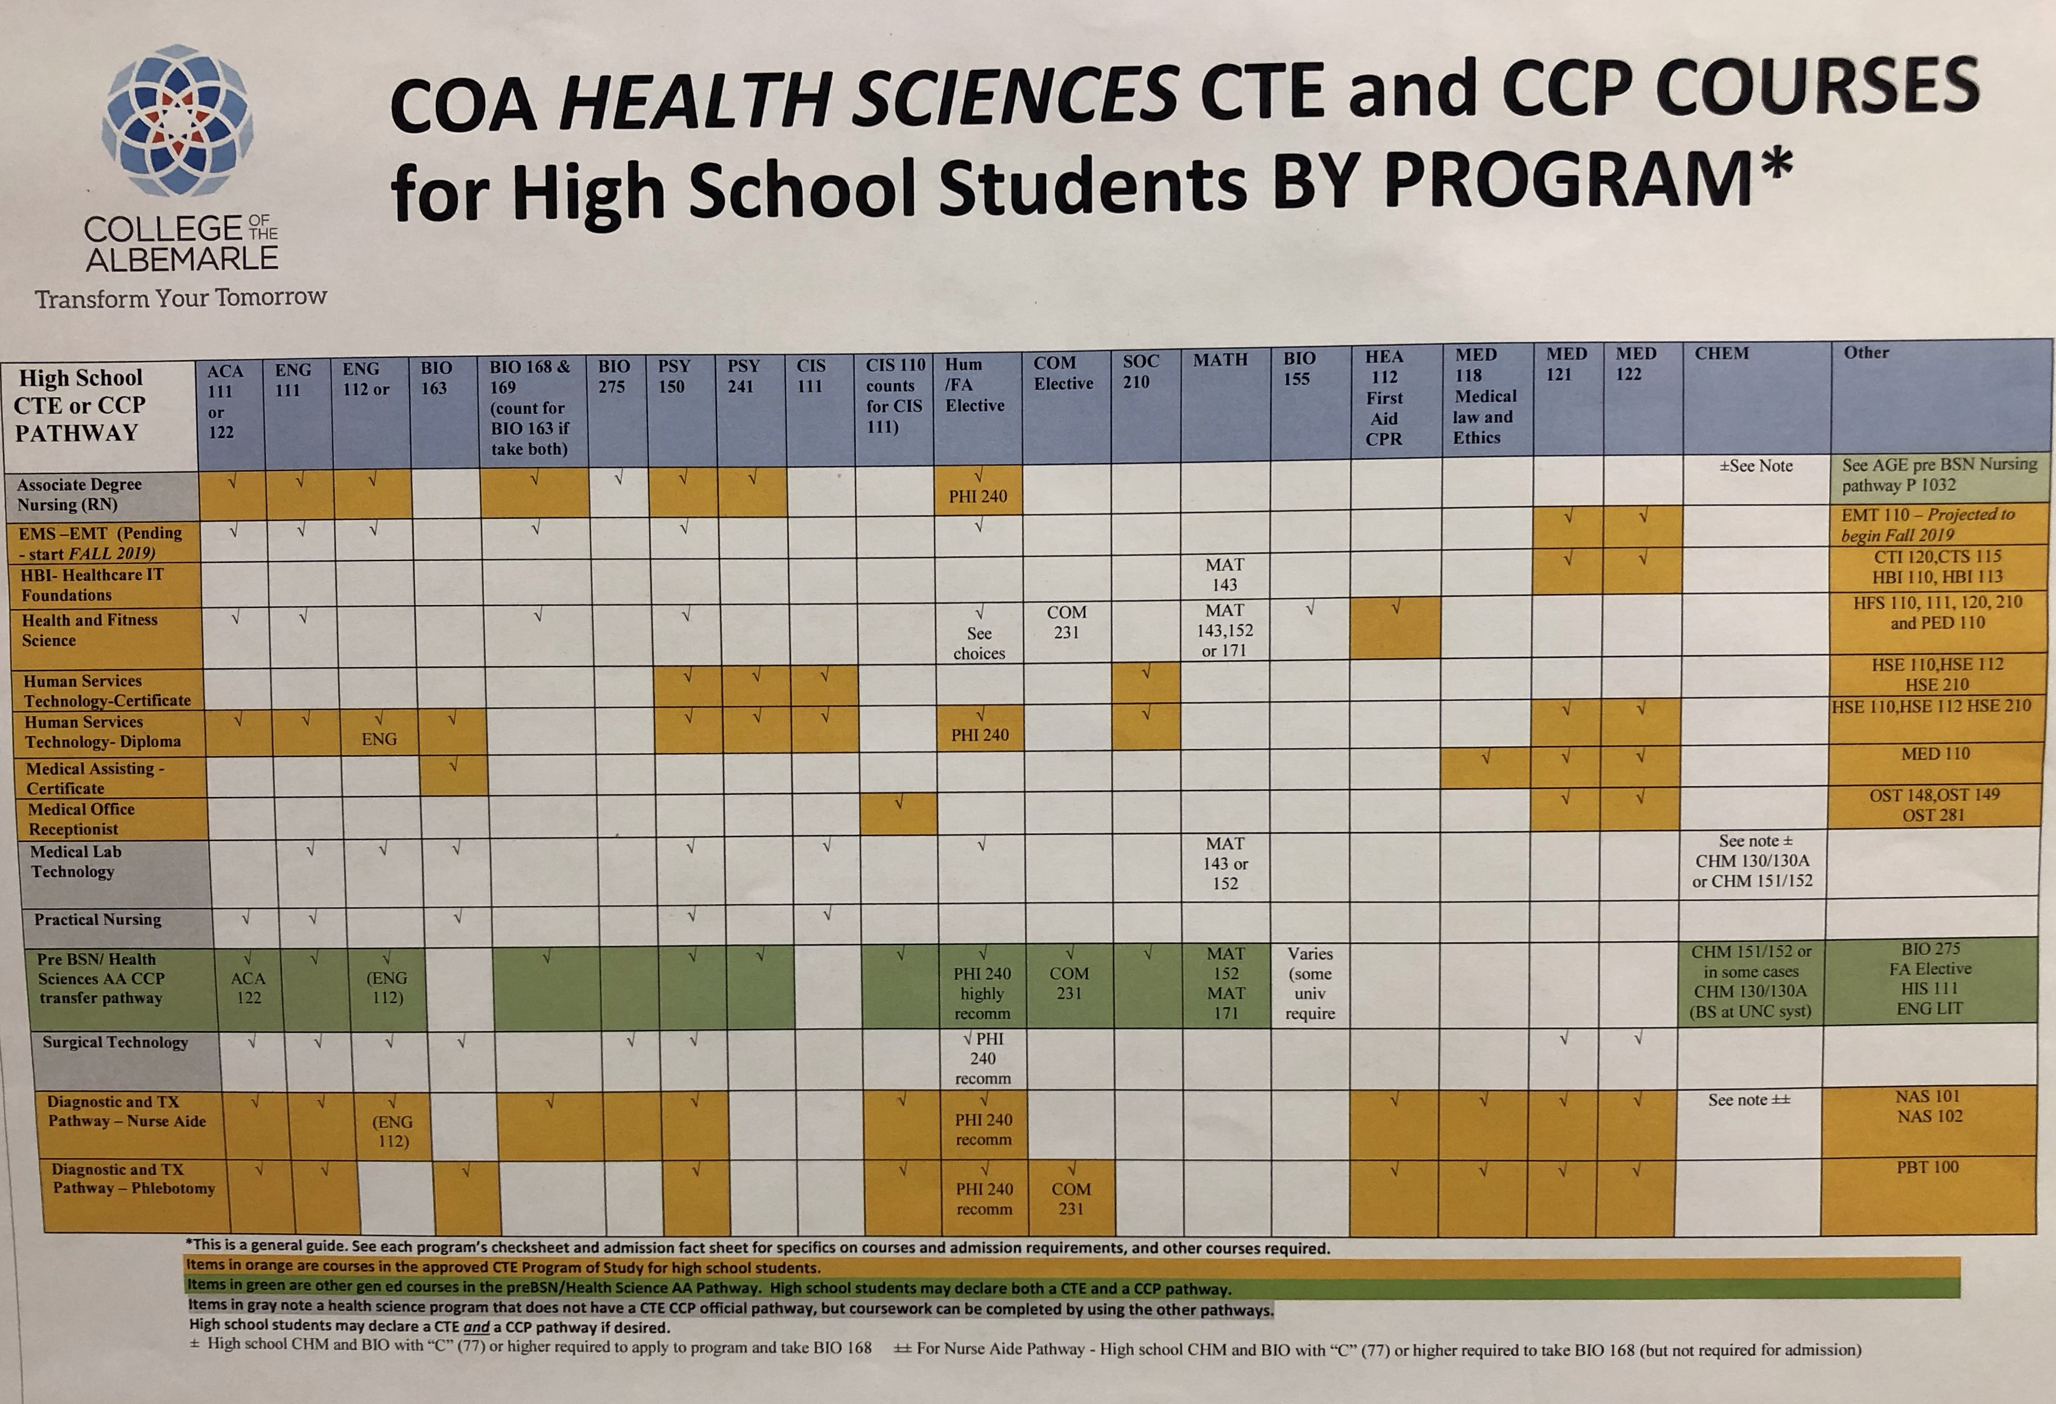

Slide 52
Intermediary
Works in one sector
Working Knowledge of Industry, its Nuances and Job Requirements
Provides the Employer Voice in Pathway Development, Courses, Work-Based Learning, Internships
Employer Ownerships
Coordinator with industry Work-Based Learning experiences
Notes:
When I have had the opportunity to study pathways at NCSU, through Harvard, and with one tour of a project in SWITZERLAND, this concept of intermediary keep tugging at me. so much so I will probably release several grants this fall for consortia to develop further the concept of intermediary.
This is a often misused and misunderstood concept —-
Here is one understanding the concept of the intermediary
An expert in the field of study in the pathway- such as health care professional or Engineer
One that has a burning knowledge of the industry its nuances, skills required for various job, and has actually working that field
One that can provide the employer voice in the development of training programs and in the alignment of curriculum courses in HS AND CC.

Slide 53
Intermediary
Provides ideas, strategies, information
To Students before Work-Based Learning Experiences
To Employers before Students Visit Sites
To Faculty on teaching Techniques and Methods
To Employers and Faculty before Faculty Industry Visits
Facilitates Job Placement
Relationships with Education and Training
Notes:
Work with industry before students set foot in the industry to better make use of the time and training opportunities.
To facilitate job placements
To encourage openings
to build relationship with colleges and training centers in pathways
Employers are engaged in their businesses
They have to be to open. Maintain and build their company and to be successful
Human resources or Human capital is just one area of concern
It is an area if we coordinate and focus our resources, knowledge and efforts in that we we can be that asset to our local employers
Stem is her
Skills beyond high school are necessary for growing out business
Cooperation, coordination, and combining our our efforts will have a catalyst effect

Slide 54
Career Pathway
Perkins V
Looking at theTransition
Strengthening Career and Technical Education

Slide 55
Perkins V
Needs Assessment
Accountability Measures Performance
Alignment of CTE Programs of Study to Labor Market
Size, Scope and Quality of Programs
Implementing Comprehensive Programs of Study
Recruitment and Retention of Faculty
Improving Program Access and Equity

Slide 56
Perkins V
Local Application
Results of Comprehensive Needs Assessment
Funding for Specific CTE Course Offerings and Why
Collaborate for Career Development & Exploration
Develop Well-Rounded Students - Academic & Technical Skills

Slide 57
Perkins V
Local Application
5. Prepare Special Populations for Self Sufficiency
6. Incorporate WBL into Programs of Study
7. Offer Postsecondary Credentials
8. Recruit, Prepare, and Retain Faculty
9. Address disparities of Performance – Special Populations

Slide 58
Perkins V
Potential Implementation Process
Set up Local Leadership Team with Feedback
Review & Integrate State Education & Workforce Goals
Develop a Regional Vision and Goals
Align Programs of Study to Local Labor Market
Develop Programs of sufficient Size, Scope, & Quality
Recruitment and Retention of CTE Faculty
Set in Place Strategies for Improving Equity and Access

Slide 59
Career and Technical Education / Job Training
Collaboration - Stakeholders
Engage Employers - Up Front
Earn and Learn - Work Based Learning
Smart Choices - Labor Market - Gaps
Measurement Matters - Performance
Stepping Stones -Seamless Education/Training
Open Doors - Special Populations
Notes:
Perkins V has many of the Early Job Driven Training Elements: These elements have been incorporated into our Career Pathway work from the beginning. Compare these with Perkins V and consider how you might infused these in our Certified Pathway System.

Slide 60
Toward an Understanding of Career Pathways
Thanks for all you do !
Dr. Bob Witchger
Director of Career and Technical Education
NC Community College System
WitchgerB@nccommunitycolleges.edu

