Slide 1
Perkins Update
November 12, 2024

Slide 2
NCCCS Programs/Perkins Staff
Peyton Bell Director of Curriculum Management
Patti Coultas Assistant Director of Perkins CTE - East
Dr. Lisa Eads Associate Vice President of Programs
Dr. Lane Freeman Director of Online Learning Programs and Student Services
Dr. Trudie Hughes State Director of Disability Services and Title IX
Dr. Hilmi Lahoud Sr State Director of Business & IT and Academic Programs Operations
Aaron Mabe State Director of Dual Enrollment and Ag & Natural Resources Technology
Darice McDougald Perkins Program Specialist
Dr. Jennifer McLean State Director of Advising and Coaching
Dr. Mary Olvera State Director of Teacher Ed., Public Services, & Perkins Special Populations
Ashley Parrott State Director of College Ready Graduates and Developmental Education
Dr. Tony Reggi Associate Director of Perkins CTE
Reyna Rodriguez Director of Course Management and Credentialing
Todd Roth State Director of Skilled Trades and Work Based Learning
Stefanie Schroeder Assistant Director of Perkins CTE – West
Melissa Smith Senior State Director of Health Science Programs
Dr. Bob Witchger Executive Director of Perkins CTE

Slide 3
Purpose of Perkins V
Develop more fully the academic knowledge and technical and employability skills of secondary education students and postsecondary education students who elect to enroll in CTE curriculum programs and programs of study.

Slide 4
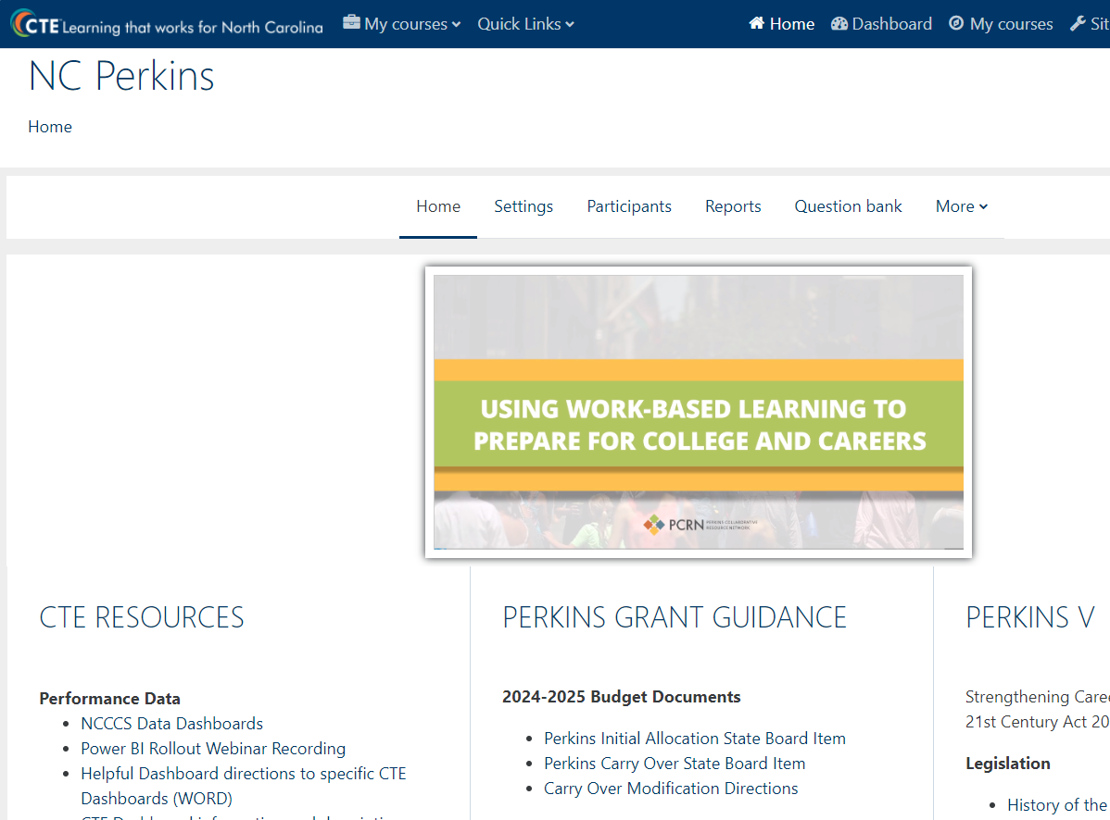
Carry-over Modifications
Submit both:
Updated Excel Local Plan and Budget (Excel)
Signed Budget Modification Form
* Detailed directions can be found on NCPerkins.org

Slide 5
In-Person Mid-Year Review
February 4-5, 2025​
​Caraway Conference Center​
You may arrive the evening of Feb. 3rd​
All expenses are covered (lodging & meals) except travel (mileage & meals during ​travel)​

Slide 6
Mid-Year Documents
Local Articulated Course List (or document stating your college doesn’t have one)
9-14 Career Pathways
Local Plan status update (Excel file with last two columns updated to current status)
December 31, 2024, XDBR Budget Report
Semi-annual time certifications for July-December 2024
Mid-Year Report
Due
January 10,
2025

Slide 7
Mid-Year Report
A brief written update on
How is the implementation of your college's local plan going? Please include if spending is on track – bullets, or no more than 500 words, and
Is there anything the Perkins Team can do to assist your college?
** No PowerPoint or video

Slide 8
Debarment Policy Update
§2 CFR 200.332 Requirements for pass-through entities.
A pass-through entity must:
(a) Verify that the subrecipient is not excluded or disqualified in accordance with § 180.300. Verification methods are provided in § 180.300, which include confirming in SAM.gov that a potential subrecipient is not suspended, debarred, or otherwise excluded from receiving Federal funds.
2 CFR §180.300 What must I do before I enter into a covered transaction with another person at the next lower tier?
When you enter into a covered transaction with another person at the next lower tier, you must verify that the person with whom you intend to do business is not excluded or disqualified. You do this by:
(a) Checking SAM.gov Exclusions; or
(b) Collecting a certification from that person; or
(c) Adding a clause or condition to the covered transaction with that person.
eCFR :: 2 CFR Part 180 -- OMB Guidelines to Agencies on Government-Wide Debarment and Suspension (Nonprocurement)

Slide 9
CLNA Sections
A
B
C
D
E
Student Performance
Size, Scope, Quality and Labor Market Alignment
Progress Toward Implementing Pathways
CTE Educator Recruitment, Retention, and Professional Development
Improving Equity and Access
Today’s Webinar

Slide 10
Student Performance
Perkins V Section 134(c)(2)(A)
An evaluation of the performance of the students served by the eligible recipient with respect to state determined and local levels of performance established pursuant to section 113, including an evaluation of performance for special population and each subgroup described in section 1111(h)(1)(C)(ii) of the Elementary and Secondary Education Act of 1965.

Slide 11
Performance Indicators
1P1 – Postsecondary Retention and Placement The percentage of CTE concentrators who, during their second quarter after program completion, remain enrolled in postsecondary education, are in advanced training, military services, or a service program that receives assistance under title I of the National and Community Service Act of 1990, are volunteers as described in section 5(a) of the Peace Corps Act or are placed or retained in employment.
2P1 – Curriculum certificate, diploma, or associate degree The percentage of CTE concentrators who receive a recognized postsecondary credential during participation or within 1 year of program completion.
3P1 – Non-traditional Program Enrollment The percentage of CTE concentrators in career and technical programs and programs of study that lead to non-traditional fields.

Slide 12
CTE Concentrators defined
Perkins V Section 113(b)(4)(i)(II) requires colleges to make “meaningful progress toward improving the performance of all CTE concentrators, including special populations and subgroups.
Perkins V Section 3(12) defines CTE concentrator as a student who has earned at least 12 CTE credits within a CTE program or program of study.
NCCCS calculates it as a student with a CTE primary program code who has earned at least 12 CTE credits within that program or program of study.

Slide 13
Negotiated Levels of Performance
Perkins V Section 113(b)(4)(i) paraphrased
Each college shall agree to accept the State determined levels of performance…or negotiate with the State to reach agreement on new local levels of performance. When being adjusted, the level must be higher than the average actual performance level of the previous 2 program years.
For 2024-25, local levels were set at each college’s 2-year average actual performance plus 0.01%

Slide 14
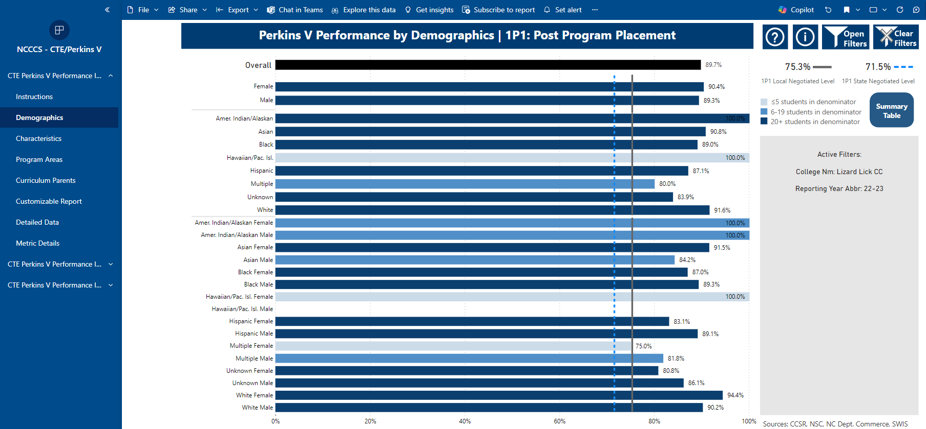
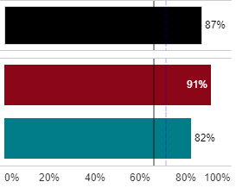
Compare Performance to NLP
Dashboards indicate the state and local NLP
---- Blue dashed line is for the State’s NLP
---- Gray solid line is for the College’s NLP

Slide 15
Special Populations as defined by Perkins V*
Individuals with disabilities;
Individuals from economically disadvantaged families, including low-income youth and adults;
Individuals preparing for non-traditional fields;
Single-parents, including single pregnant women;
Out-of-workforce individuals;
English learners;
Homeless individuals described in section 725 of the McKinney-Vento Homeless Assistance Act (42 U.S.C. 11434a);
Youth who are in, or have aged out of, the foster care system; and
Youth with a parent who –
Is a member of the armed forces (as such term is defined in section 101(a)(4) of title 10, U.S.C.); and
Is on active duty (as such term is defined in section 101(d)(1) of such title).
*Perkins V, Section 3(48)

Slide 16
ESEA Student Sub-groups
(A) Economically disadvantaged students;
(B) Students from major racial and ethnic groups;
Children with disabilities; and
English language learners.
Elementary & Secondary Education Act of 1965, Section 1111(c)(2)(B) Referenced in Perkins Section 114(e)(8)(B)(i)
Additional Group

Slide 17
What are you looking for in the data?
At a minimum, review
Are there any student groups that aren’t achieving the state and local levels of performance?
Are there any student groups that aren’t as successful as others?
Any Student Performance gaps that are identified are to be written on the College’s CLNA Summary

Slide 18
Thinking about those gaps?
Are the identified gaps significant? Your team may want to dig into why the gap exists.
Once a potential cause is identified, consider possible actions to close the gap.
Does this activity meet college goals? Create an action plan.
Does the action plan include activities that can be funded by Perkins?

Slide 19
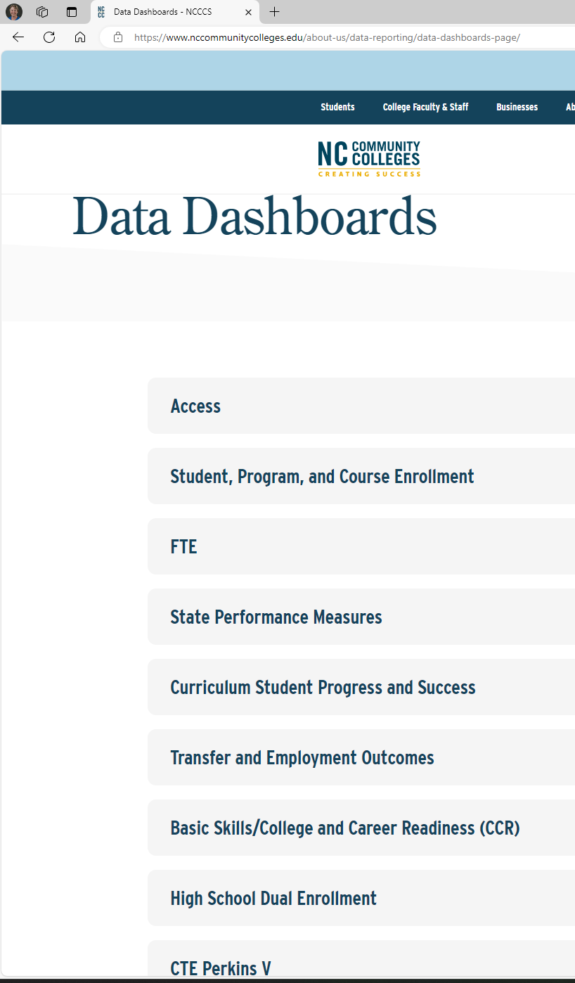
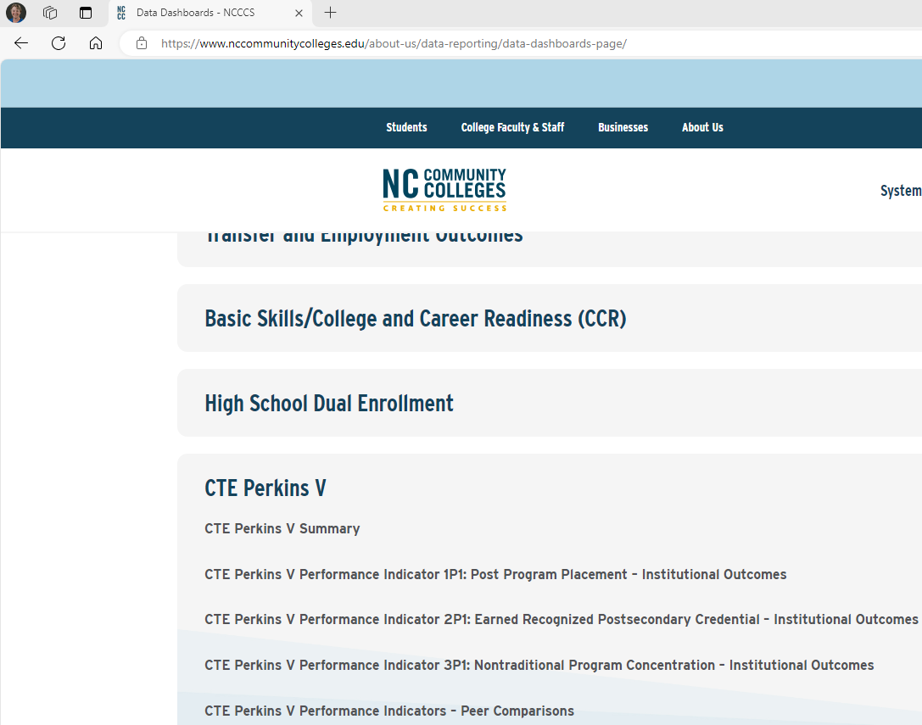
NC Community College Public Dashboards
1
Open https://www.nccommunitycolleges.edu
Note that the public dashboards suppress data if there are fewer than 20 students in the denominator
2
3
4

Slide 20
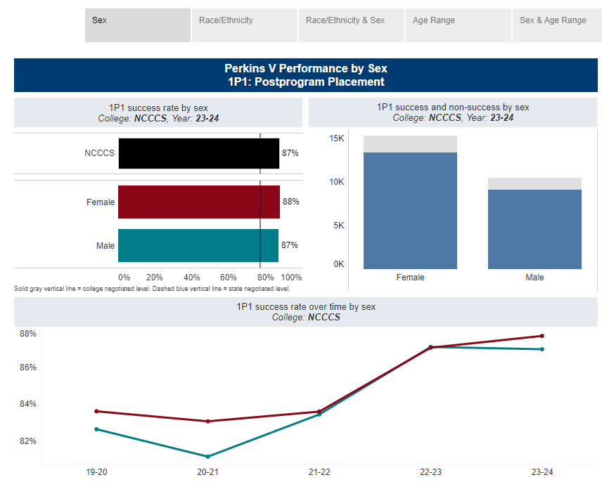
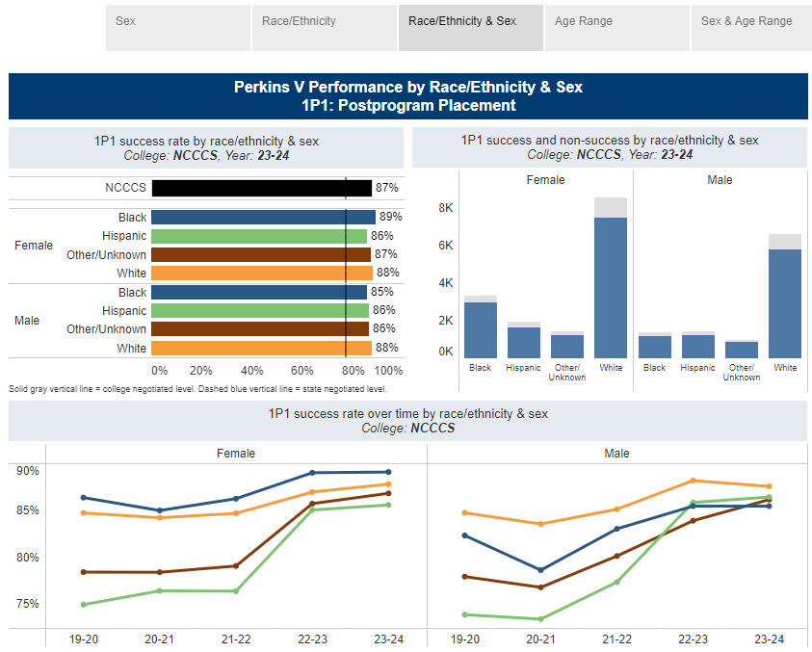
Public Dashboards show 5-year trends
2023-2024 Data is now on the Dashboards

Slide 21
Unsuppressed Data for All CTE Students
Password protected data provides information for all students

Slide 22
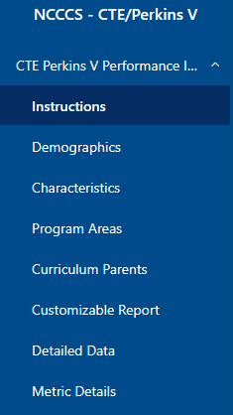
Four Main Bar Chart Options
Demographics – gender, race, ethnicity, and race/ethnicity and gender
Characteristics – Perkins defined special population
Program Areas – 10 CTE program areas as defined by NCCCS (programs with codes starting with 15-60, NOT 10)
Curriculum Parents – The CTE certificate, diploma and associate degree programs offered at the college

Slide 23
Required Evidence
At a minimum, each college must review the disaggregated data for each of the 4 main bar charts and identify gaps for each of the 3 Performance Indicators.
CLNA Section A: Student Performance

Slide 24
Demographics
Are there any student groups that aren’t achieving the state and local levels of performance?
Are there any student groups that aren’t as successful as others?

Slide 25
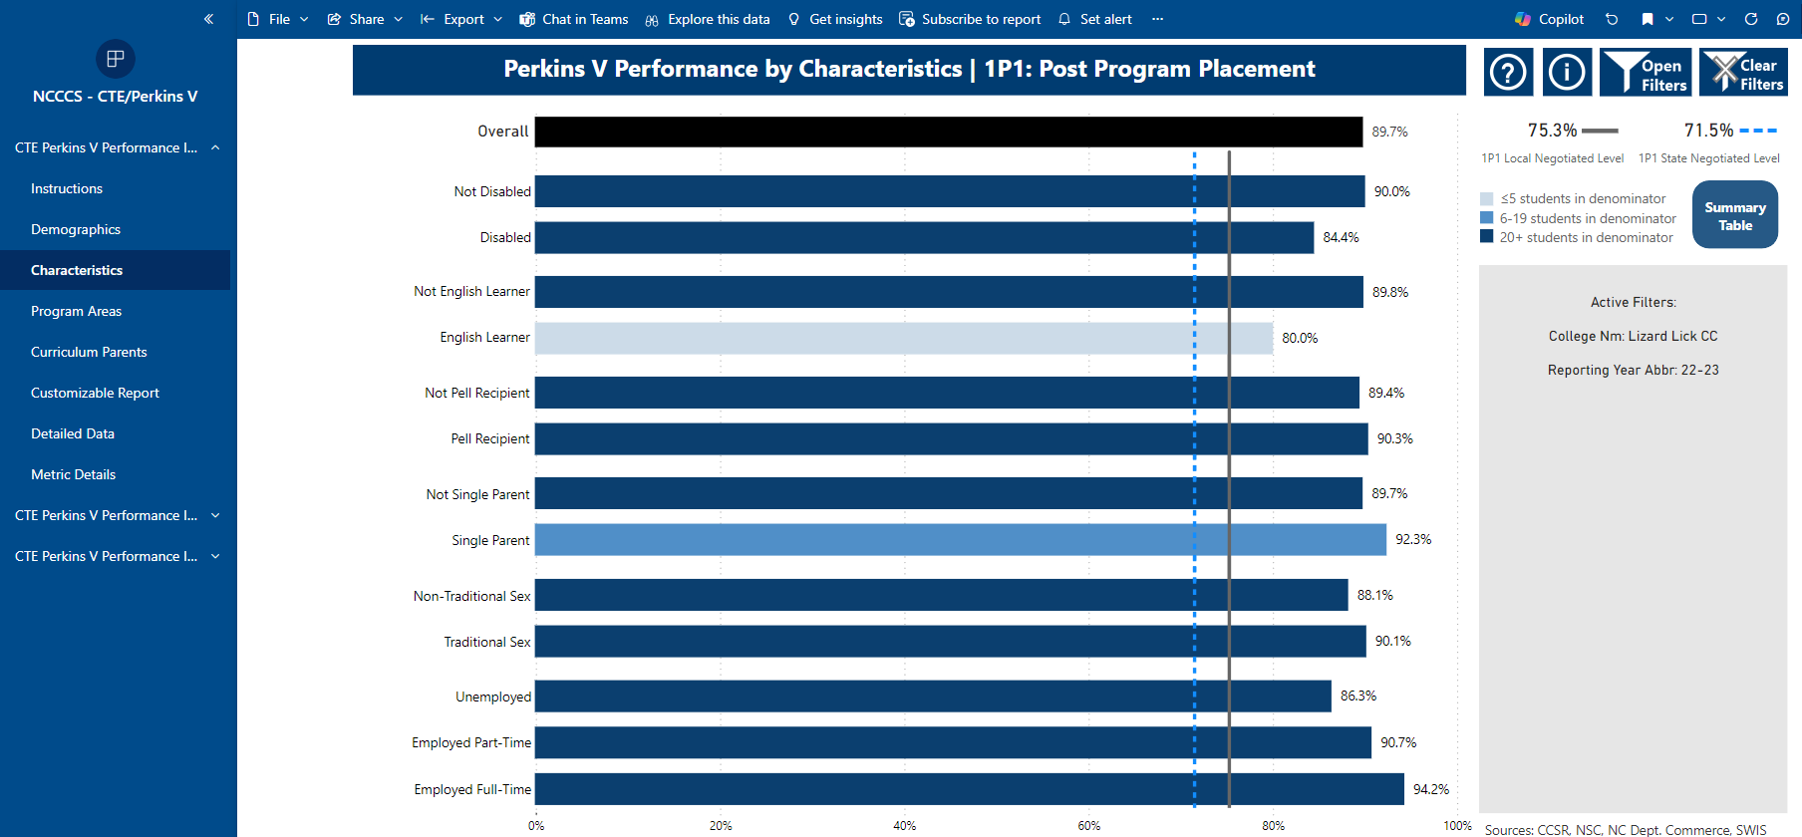
Characteristics
Are there any student groups that aren’t achieving the state and local levels of performance?
Are there any student groups that aren’t as successful as others?

Slide 26
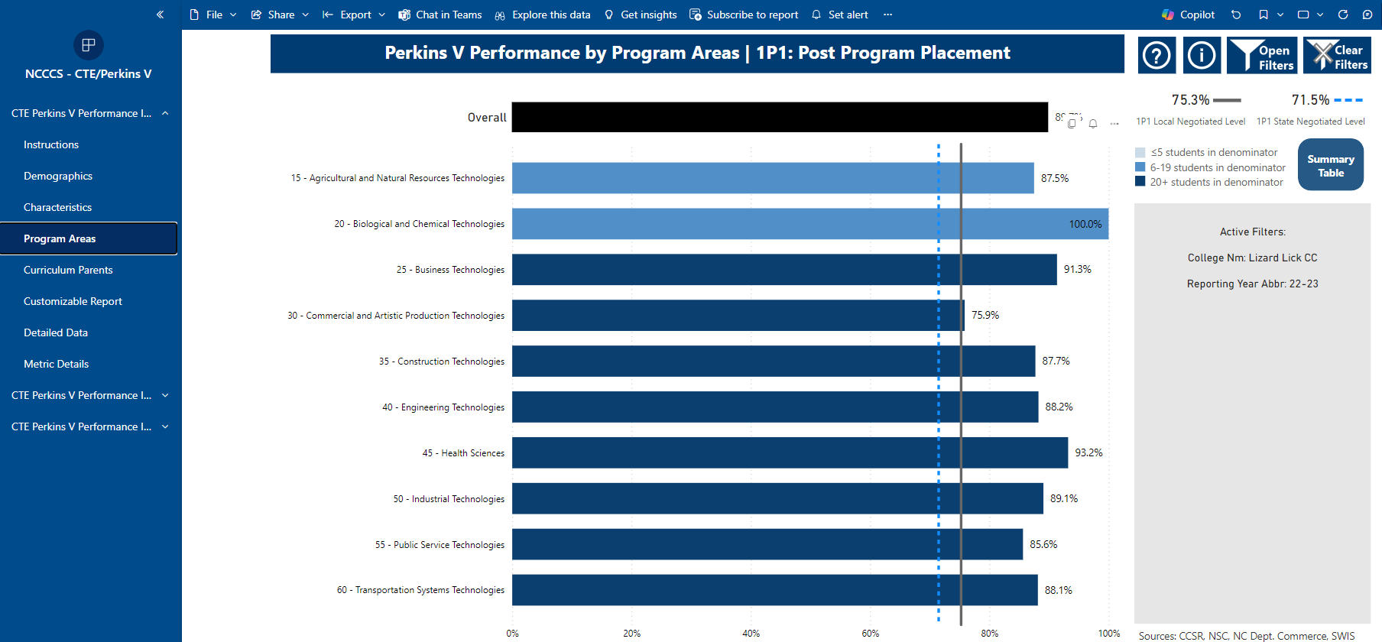
Program Areas
Are there any student groups that aren’t achieving the state and local levels of performance?
Are there any student groups that aren’t as successful as others?

Slide 27
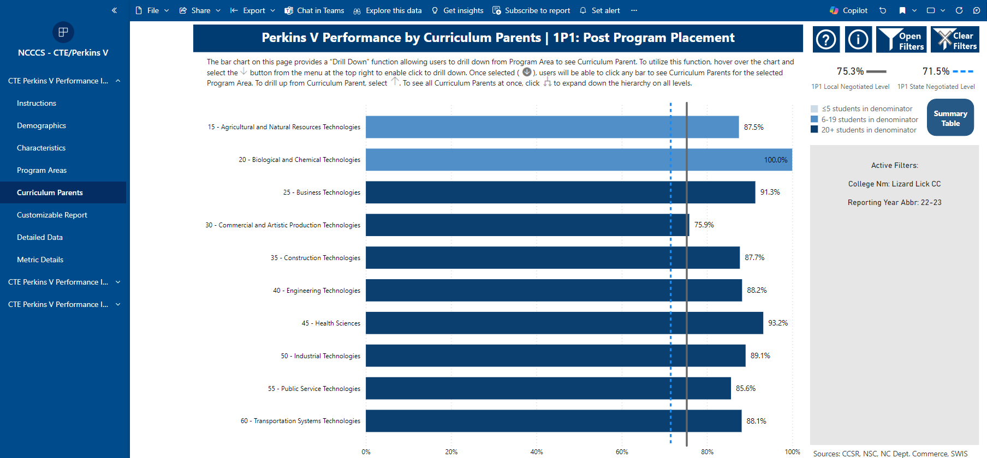
Curriculum Parents – first screen

Slide 28
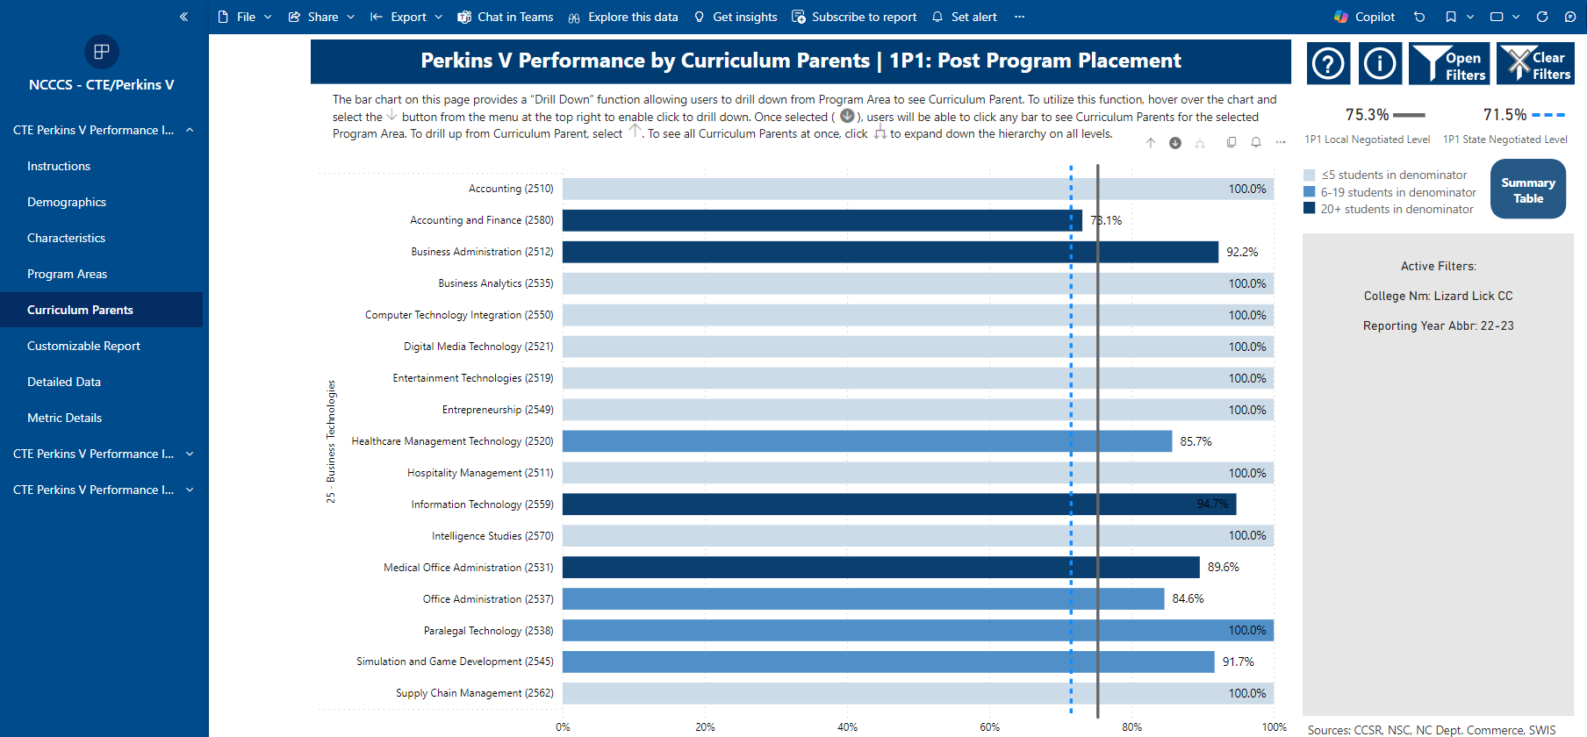
Curriculum Parents – Drill down view
Are there any student groups that aren’t achieving the state and local levels of performance?
Are there any student groups that aren’t as successful as others?

Slide 29
Dashboards for each Indicator
There are Power BI dashboards for each performance indicator with the same four main options.
Repeat these reviews for 2P1 and 3P1

Slide 30
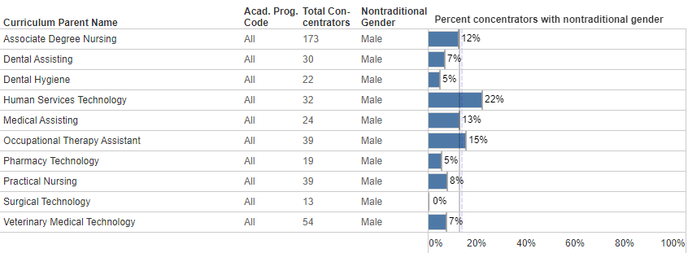
A word about calculating 3P1
The denominator is the number of CTE Concentrators that are in the category...
Drilling down into health curriculum parents, this graph shows that the programs have different success rates. The column "Total concentrators" shows the total number for each curriculum parent.
For example, of the 173 CTE Concentrators in the ADN program, 12% are nontraditional.
In the graph above, the denominator is the number of students in the column for a program area. The success rate is calculated by determining what percentage of the total column is nontraditional in that program.
For example, of the 400+ CTE Concentrators enrolled in Health Sciences programs, 11% are nontraditional.

Slide 31
Additional Data to Consider
Drilling down into the Perkins Indicator Data
State Performance Measures
Other local data
Optional

Slide 32
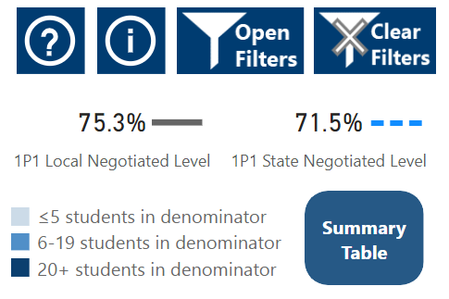
Summary Table Color Coding
≥ 10% above Local Negotiated Level
≥ 10% below Local Negotiated Level

Slide 33
Summary Tables to drill down deeper
Select the Options(s) in order you want the data disaggregated

Slide 34
Summary Table Example
Select the Options(s) in order you want the data disaggregated, for example, Pell then Single Parent Status
1st
2nd Ctrl-click
Are there any student groups that aren’t as successful as others?
Is the N in the denominator enough to justify a gap?

Slide 35
Optional: State Performance Measures
State Performance Measures are available in both the Public and Power BI Dashboards
PM2 Student Success Rate in College-Level English: Index score based on % of first-time associate degree-seeking and transfer pathway students passing a credit-bearing English course with a “C” or better within three years of their first fall term of enrollment.
PM3 Student Success Rate in College-Level Math: Same as English (PM2) except for a math course
PM4 First Year Progression and Persistence: Index score based on the % of first-time fall credential-seeking students who graduate prior to or enroll in postsecondary education during the subsequent fall term.
PM5 Curriculum Completion: Index score based on % of first-time fall credential-seeking curriculum students who have graduated, transferred, or are still enrolled during the fourth academic year with 42 successfully completed non-developmental hours. (NOTE This will count certificate and some diploma completers as not successful if they do not remain enrolled)
PM6 Licensure and Certification Pass Rate: Index score of first-time test-taker results on licensure and certification exams. Exams included in this measure are state-mandated exams which candidates must pass before becoming active practitioners.

Slide 36
Cosmetology
Exploring Reasons for a Gap
1P1 shows that Cosmetology post-program placement is below the negotiated level
Consider that the PM6 Licensure Pass Rate shows 63% are passing the exam
Once a potential cause is identified, consider possible actions to close the gap.
Create an action plan. Does this activity meet college goals?
Does the action plan include activities that can be funded by Perkins?

Slide 37
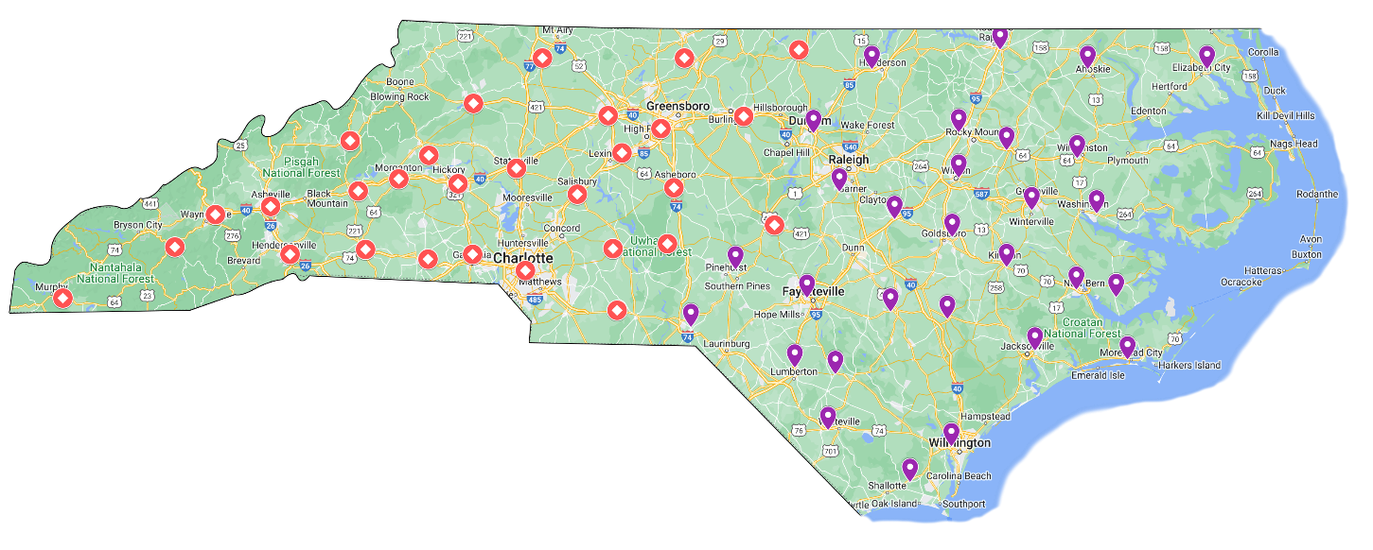
Contact us with your questions!
MAIN CONTACTS
West: Stefanie Schroeder schroeders@nccommunitycolleges.edu
East: Patti Coultas coultasp@nccommunitycolleges.edu

Slide 38
Virtual Office Hours for Technical Assistance
Need help?
Let's meet!
2nd Tuesday of the month 1-2pm
4th Wednesday of the month 9-10am
** Teams link at the top of NCPerkins.org/presentations
Drop in to ask the NCCCS CTE Perkins Team your questions

Slide 39
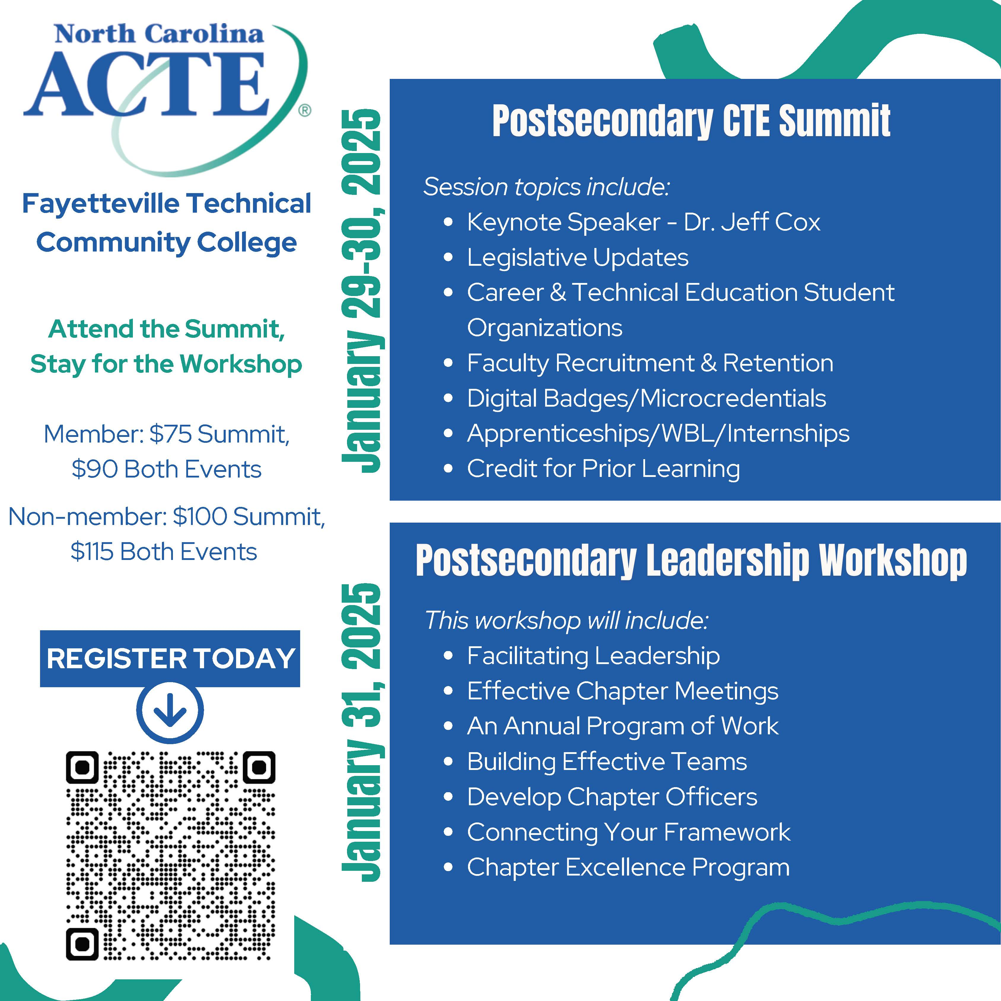

Slide 40
THANK YOU!

