Slide 1
Perkins Update
March 14, 2023

Slide 2
Career & Technical Education Team
Bob Witchger
Tony Reggi
Patti Coultas
Mary Olvera
Anne Bacon
Darice McDougald
Lane Freeman
Aaron Mabe

Slide 3
Purpose of Perkins
Develop more fully the academic knowledge and technical and employability skills of secondary education students and postsecondary education students who elect to enroll in CTE curriculum programs and programs of study
Notes:
The Strengthening Career and Technical Education for the 21st Century Act reauthorized and updated the Carl D. Perkins Career and Technical Education Act of 2006 to become the current Carl D. Perkins Career and Technical Education Act of 2006 as amended by the Strengthening Career and Technical Education for the 21st Century Act (Perkins V)
This updated act stresses:
- Academic, Technical, and Employability Skills
- Funding Secondary and Postsecondary CTE
- Focusing on Students who elect to enroll in CTE Programs of Study

Slide 4
Promising Practice Video 2022
Haywood Community College
Virtual Immersive Learning
See all the videos: https://www.ncperkins.org/video/
Notes:
August:
Catawba Valley Nash
September
Alamance
October – no video
November
Southwestern
February
Rockingham Student Services Fair
March
Haywood Virtual Immersive Learning

Slide 5
State Articulation Agreement Update
Vote Letter sent March 15th
Submit by March 31st
DUE

Slide 6
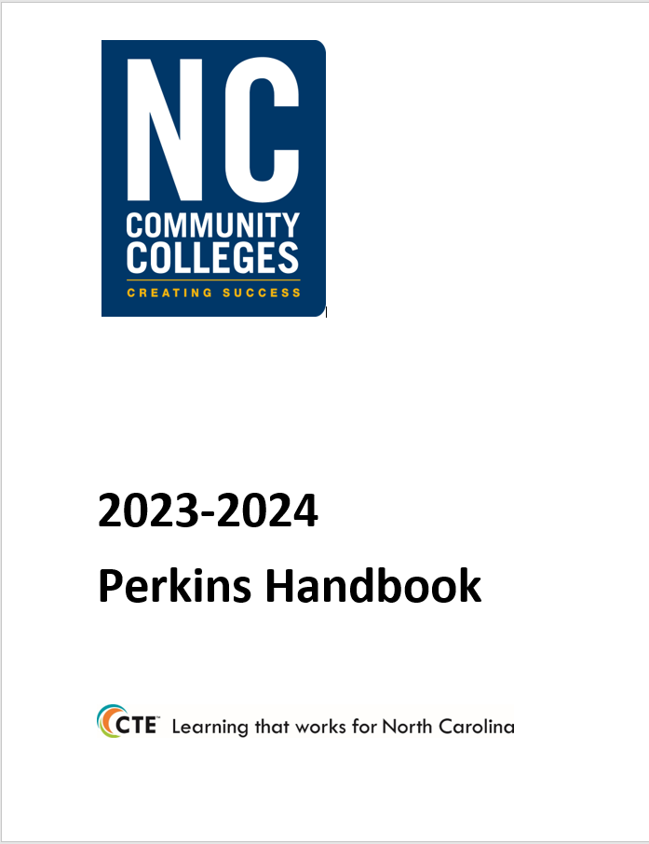
Plan Ahead! EDGAR and Perkins Annual Meeting
Tuesday, April 18th
Koury Convention Center, Greensboro
EDGAR specific to Perkins 9am – noon
Lunch on your own noon-1pm
Perkins Annual Meeting 1pm – 5pm

Slide 7
SkillsUSA State Competition
Wednesday, April 19th
Greensboro Coliseum
Postsecondary Competition (starts at 9am)
Postsecondary Awards Ceremony (7:30pm)
Dr. Kimberly Gold, NCCCS Executive VP, Chief of Staff, will be speaking at the awards ceremony

Slide 8
CLNA Accountability Measures
There are 3 postsecondary performance indicators. This data is for CTE Concentrators in curriculum programs.
CTE concentrators are CTE Curriculum students who have earned at least 12 CTE credits who have been coded in a certificate, diploma, or degree CTE program.
To improve an indicator, an analysis of all CTE Concentrators in all CTE programs must be reviewed in relation to the college’s negotiated level of performance.
Perkins V also requires disaggregation of the indicators by special population to review any gaps in performance.

Slide 9
Performance Indicator Data Analysis
Postsecondary Performance Indicators
1P1: Postprogram Placement: The percentage of CTE Concentrators who completed a CTE program of study during the previous reporting year, who remain enrolled in postsecondary education or are placed in employment during the subsequent fall semester.
2P1: Earned Recognized Postsecondary Credential: The percentage of CTE Concentrators who received a recognized postsecondary credential (Certificate, Diploma, and/or Associate Degree) during the reporting year.
3P1: Nontraditional Program Concentration: The percentage of nontraditional CTE Concentrators in programs of study that are nontraditional for their gender.

Slide 10
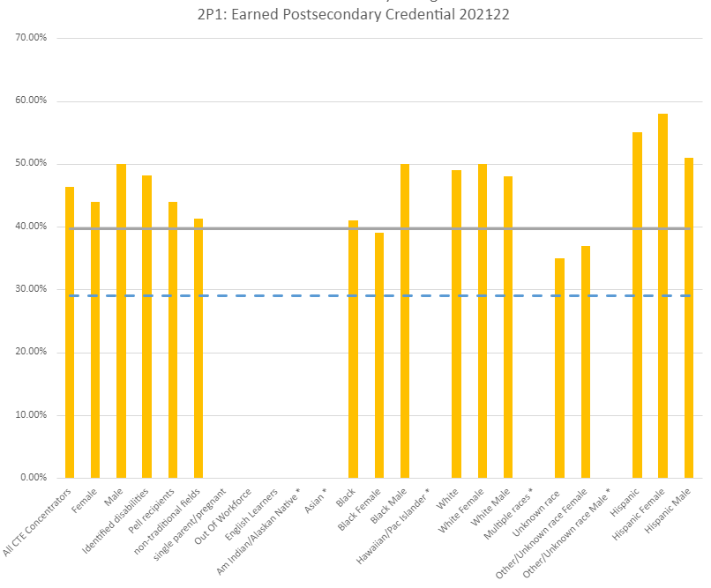
Example bar chart
College
State
No data for these 3 yet
* Data suppressed < 20

Slide 11
Data Analysis for Gaps in Performance
Local Neg. Level
What gaps can you identify?
Not achieving negotiated local level:
Black Females
Unknown Race
Other/Unknown Female
Note
* means data is suppressed.
“Other/Unknown race” is a combination of races other than Black and White when subdividing by gender.

Slide 12
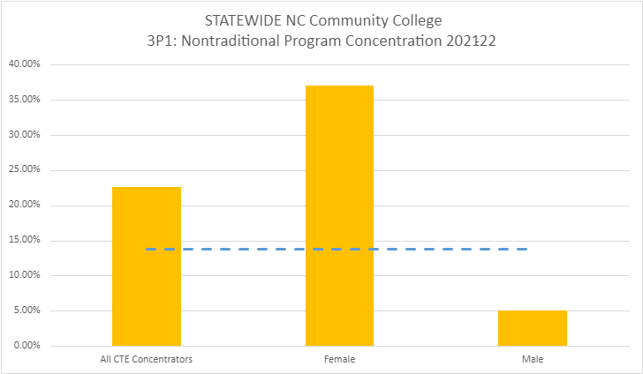
3P1 Statewide
Time to work on recruiting males into nontraditional programs!

Slide 13
Submit Data Analysis Summary to NCPerkins
Course: Comprehensive Local Needs Assessment & Application
Section: Performance Indicator Data Analysis
Use Template Provided in Moodle
Submit completed report to “Submit Performance Indicator Data Analysis” link
DUE
May 19, 2023

Slide 14
Perkins Application
Applications are required by Perkins V
They are separate from the annual plan/budget and CLNA, they are informed by the CLNA and should guide the plan/budget.
They are good for 4 years, but may need to be updated if the answers significantly change.
Do Not cut and paste from your CLNA. CLNAs are gap statements, the application is about overviews and processes.

Slide 15
Application Question 1
Check the Programs Areas that have current CLNAs.
Other: _____________________________________________ Focused on All CTE curriculum students or faculty for a specific gap or need
Agriculture &/Nat. Resources Tech Biological & Chemical Tech Business Tech Commercial & Artistic Production Tech Construction Tech | Engineering Tech Health Tech Industrial Tech Public Service Tech Transportation Tech

Slide 16
Application Question 2
For Program Areas to be funded, provide the following Information:
Describe the process used to determine which CTE programs were selected to be reviewed for the CLNA.
Describe how you decided which gaps you chose to address with Perkins funding.
Describe any new program title(s) the college will fund with Perkins.
How will the college inform students, including students who are members of special populations, about the college’s CTE Programs?

Slide 17
Application Question 3
How will the college collaborate with workforce development boards (WIOA), other local workforce agencies, and industry partners to provide:
Career exploration and career development coursework?
Current information on employment opportunities in CTE fields that are in-demand, high-wage or high-skill?
An organized system of career guidance and counseling?
Activities such as work-based learning and job-placement activities that support the programs of study and blend resources to improve student retention, completion, and employment in occupations with a sustainable wage.

Slide 18
Application Question 4
How will the college improve the academic and technical skills of CTE students?
CTE Curriculum/Program Reviews take place every ____ years.
Describe how working with advisory committees strengthens the academic and technical education components of CTE programs.
Describe strategies implemented to improve academic and technical attainment in the last four years.

Slide 19
Application Question 5
How does/will the college:
Provide activities to prepare special populations for occupations that are in-demand, high-wage or high-skill?
Prepare (recruit and support) CTE participants for non-traditional fields?
Provide equal access for special populations in CTE programs?
Ensure members of special populations are not discriminated against?

Slide 20
Application Question 6 & 7
Describe the variety of work-based learning opportunities the college provides (will provide) to CTE students.
Include how the college will work with industry, advisory committees, NC Work centers to expand these opportunities.
Describe how the college includes opportunities such as Apprenticeship, internships, work study, WBL, PTE, and Career Technical Student Organizations to support students.
The college will provide opportunities for students to gain post-secondary credits while still attending high school through:
☐ Career and College Promise
☐ Local/Regional Articulation Agreements
☐ Statewide Articulation Agreement

Slide 21
Application Question 8
Describe the college process for recruiting diverse CTE faculty, staff, and administrators.
Provide a description of how the college supports preparation and retention of faculty, staff and administrators through professional development and training opportunities to maintain and enhance professional skills.
(Note: Most colleges have a professional development plan for CTE faculty and staff skill development and credentialing. It will be enough to summarize that program here and link to college master professional development plan.)

Slide 22
Application Question 9
How will the college address disparities and gaps between special populations and all CTE Concentrators for each performance indicator for each of the plan years?
(Refer to Special Population Performance Data Graphs)

Slide 23
Submit Application to NCPerkins
Course: Comprehensive Local Needs Assessment & Application
Section: Perkins Grant Application
Use Template Provided in Moodle
Submit completed report to “Submit Completed 2024-27 Application” link
DUE
May 19, 2023

Slide 24
Perkins Modification Deadline!
Modification Deadline is May 15, 2023
NOTE! The final budget XDBR must show the approved budget, do not modify the budget to equal Perkins expenditures. If your budget office needs to do that, have them produce an XDBR for us first.

Slide 25
End of Year Planning
Promising Practice Video to share an activity that may be beneficial to other colleges in implementing Perkins V.
Local Plan End of Year Status Update: Complete the last two columns summarizing status. Don’t forget to update Equipment and Salary tabs.
End of Year Report: The Questions are in NCPerkins

Slide 26
End of Year Report
Briefly answer each of the following questions based on Perkins required activities:
What career development activities has the college implemented in the past program year to help students in enrolling in CTE programs of study?
In what ways is the college working to improve the retention of CCP CTE students beyond high school graduation in the AAS Pathway?
What practices has your college implemented this year to recruitment to or enhance special populations participation in and their performance in CTE Programs of study? (Recruitment and Performance)
More

Slide 27
End of Year Report continued
Highlight 4 professional development activities offered to CTE faculty during the past year
In what ways has the college’s CLNA informed the integration of academic, technical and employability skills in career pathways or program of study?
What are 3 specific activities the college has implemented to increase student progress and success? (1p1 Employment, 2p1 Credentials, and 3p1 Non-traditional Participation)
Overall, how has Perkins funding made a difference at your college this year?

Slide 28
Perkins Monthly Updates
2nd Tuesday of the month from 9-10 am
Register now for all of them https://www.ncperkins.org/presentations/
Upcoming dates:
April 11, 2023
May 9, 2023
June 13, 2023
Attendance (or viewing the recording within 30 days) is recorded on monitoring rubric. Recording may be accessed at the same link as the registration.
Notes:
Register now and let the system remind you.

Slide 29
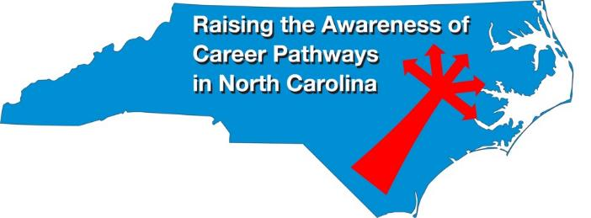
Raising the Awareness of Career Pathways Webinars
March 15 Occupational Therapy Assistants
April 19 Food Industry (SkillsUSA)
May 17 Entrepreneurship
June 21 Non-Profit Leadership and Management
Register for all webinars at
www.ncperkins.org/presentations

Slide 30
NAPE Equity Summit
https://napequity.org

Slide 31
NCETA Spring Conference
May 3-5th
Hilton Raleigh, North Hills
www.nceta.org

Slide 32
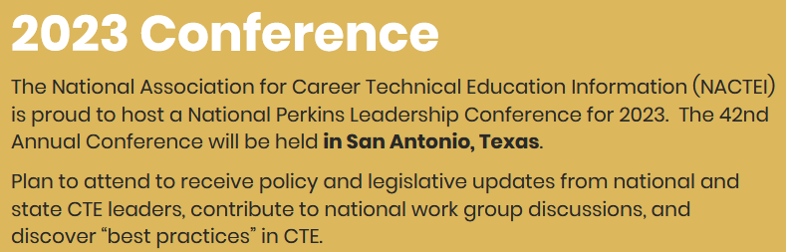
nactei National Perkins Leadership Conference
May 22-25th
https://nactei.org/conference/

Slide 33
ACTE
September 20-22
https://www.acteonline.org/postsecondarycteevent/

Slide 34
NCPN
Consider submitting a proposal! 3/31/23 deadline
November 8-10
https://www.ncpn.info/2023-call-for-proposals/

Slide 35
Technical Assistance is available
We are here to help!
Team Perkins is available by phone, email, virtually, or in-person

