Slide 1
Career Pathways and Uniform Articulation Agreement in Early Childhood Education

Slide 2
Purpose of this Session
Provide an overview of the uniform articulation agreement in early childhood education between the UNC System and the North Carolina Community College System
Explore career pathway options in the field of early childhood education
Examine opportunities to support student awareness of career pathway options in the field

Slide 3
Uniform ECE Articulation Agreement

Slide 4
Early Childhood Articulation Senate Bill 315
The system wide articulation agreement for early childhood education programs entered into between The University of North Carolina and the Community College System began with the 2018-2019 academic year.

Slide 5
What does this mean for our local Associate in Applied Science degree program?
Essentially there are three options within the A55220 Early Childhood AAS degree for students :
“Career Entry” (aka terminal AAS) option
Licensure Transfer option
Non-Licensure Transfer option

Slide 6
Meeting ECE Workforce Needs
Issues driving the need for a seamless career pathway in early childhood education include:
Those in the field are aging out.
Younger individuals are not choosing to enter the field.
There is a misconception that all jobs in early childhood education are low-paying or that all jobs in the field are in child care locations.
Compensation is still an issue that cannot be addressed separately from education.
Creating a seamless educational pathway between systems (high school – college – career) can meet the workforce needs while saving students time and money.

Slide 7
Teacher BK Licensure Anticipated Openings
The North Carolina Department of Commerce projects North Carolina will continue to see an increase in job openings for preschool and kindergarten teachers based on occupational trends 2014-2024 .
Expansion of NC Pre-K and Early Head Start have resulted in an increased need for early educators with a bachelor degree and Birth to Kindergarten teaching license.

Slide 8
Non-Licensure Early Childhood Openings
The need for early educators with a bachelor degree in early education without a teaching license is also expanding in North Carolina.
The North Carolina Department of Commerce projects North Carolina will continue to see an increase in job openings for early childhood administrators based on occupational trends 2014-2024.

Slide 9
Non-Licensure Early Childhood Openings
As the demand for family support programs increases and as individuals retire from agencies such as
Smart Start
Division of Child Development and Early Education
Child Care Resource and Referral
Etc.
These opportunities are typically not in an early childhood/preschool classroom.
Instead, individuals work in agencies that provide support to children and families, child care providers, and local communities.

Slide 10
Career and College Promise (CCP), CTE Pathways, and Stackable Credentials
“The most expensive course a student takes is one s/he doesn't need.” – Thom Chesney

Slide 11
Career and College Promise (CCP) Session Law - SL2011-0145
The purpose of Career and College Promise is to offer structured opportunities for qualified high school students to dually enroll in community college courses that provide pathways that lead to a certificate, diploma, degree, or state/industry recognized credentials as well as provide entry-level job skills – tuition free.

Slide 12
Stackable Credentials

Slide 13
High School Early Childhood 1 and 2
Early Childhood Education Infant Toddler Certificate
Early Childhood Education Preschool Certificate
Early Childhood Education AAS Degree
Early Childhood Education Administration Certificate
Early Childhood Education Bachelor Degree

Slide 14
Student Awareness: Helping Students Navigate ECE Career Options

Slide 15
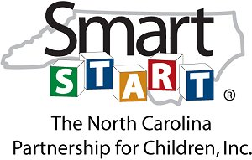
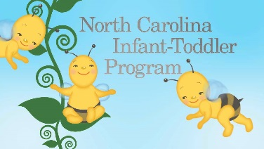
So Where Do Early Childhood Education Graduates Work?

Slide 16
Teachers of Young Children
Job Possibilities:
Child care centers
Private preschool programs
Head Start programs
Publicly-funded prekindergarten programs
Recommended Education:
Child Development Associate (CDA) Credential
Associate’s degree in Early Childhood Education/Child Development
Bachelor’s degree in Early Childhood Education/Child Development
Typical Salary Range: $17,490 – $54,780
Source: Child Care Services Association, 2018

Slide 17
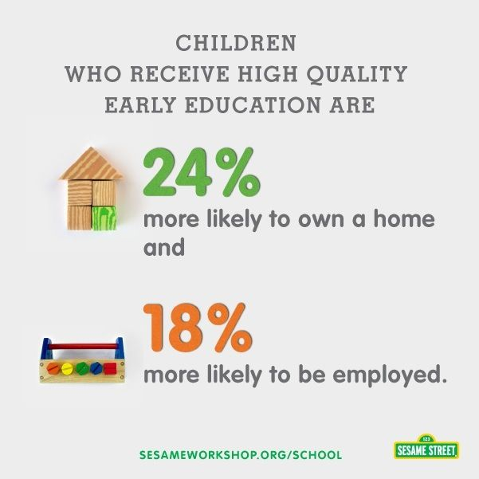
Administrators/Directors of Child Care Centers
Job Possibilities:
Child care centers
Private preschool programs
Head Start programs
Publicly-funded prekindergarten programs
Recommended Education:
Associate’s degree in Early Childhood Education/Child Development
Bachelor’s degree in Early Childhood Education/Child Development
Graduate degree in Early Childhood Education/Administration
Typical Salary Range: $29,980 – $85,240
Source: Child Care Services Association, 2018

Slide 18
Professional Development Coordinators, Instructors and Trainers
Job Possibilities:
Colleges & universities
High schools
Child care resource and referral agencies
Professional associations (example: NAEYC)
Public and nonprofit agencies (example: Smart Start)
Self-employment (example: Consultant)
Recommended Education:
Associate’s degree in Early Childhood Education/Child Development
Bachelor’s degree in Early Childhood Education/Child Development
Graduate degree in Early Childhood Education/Administration
Typical Salary Range: $30,560 – $73,620
Source: Child Care Services Association, 2018

Slide 19
Technical Assistance Specialists
Job Possibilities:
Child care resource and referral agencies
Professional associations
Public and non-profit agencies
Recommended Education:
Graduate degree in Early Childhood Education/Child Development
Typical Salary Range: $ 30,560 – $73,620
Source: Child Care Services Association, 2018

Slide 20
Regulators
Job Possibilities:
Child and Adult Care Food Program (CACFP)
Child care licensing (DCDEE)
State prekindergarten offices (Office of Early Learning)
County/state departments of social services or education
Office of Head Start
Recommended Education:
Graduate degree in Early Childhood Education/Child Development/Social Work
Typical Salary Range: $28,330 – $90,900
Source: Child Care Services Association, 2015

Slide 21
Family Specialists/Counselors
Job Possibilities:
Child care resource and referral agencies
Head Start programs
Local departments of social services
Health and mental health agencies
Community agencies
Recommended Education:
Bachelor’s or Graduate degree in Early Childhood Education/Child Development, Public Health, Social Work or Nursing
Typical Salary Range: $24,660- $55,910
Source: Child Care Services Association, 2015

Slide 22
Sales Representatives
Job Possibilities:
Corporations or for-profit companies (example: Kaplan, Hatch, Lakeshore)
Recommended Education:
Bachelor’s degree in Early Childhood Education/Child Development or Human Services
Typical Salary Range: $28,550 – $86,100
Source: Child Care Services Association, 2015

Slide 23
Resources
Career & College Promise: http://www.nccommunitycolleges.edu/academic-programs/career-college-promise
Careers in ECE: http://www.childcareservices.org/wp-content/uploads/2013/09/North-Carolina-Careers-in-Early-Childhood-Directory-2018.pdf
NAEYC Standards for Professional Preparation: http://www.naeyc.org/positionstatements/ppp
NC ECE Data Repository: http://www.childcareservices.org/repository/index.php
NC TOWER Data Source: https://nctower.com/landing/index.html
Uniform ECE Articulation Agreement: https://www.nccommunitycolleges.edu/academic-programs/college-transferarticulation-agreements/uniform-articulation-agreement-associate-early-childhood
Uniform ECE Articulation Agreement with Salary/Job Data: https://www.nccommunitycolleges.edu/sites/default/files/state-board/program/prog_08_-_early_childhood_articulation_agreement.pdf

Slide 24
Early Childhood Education Pathway Examples
Career and College Promise (CCP)

Slide 25
CCP- Infant & Toddler Career Pathway
High School
Early Childhood 1 & 2 (Can articulate for EDU 119 Intro to Early Childhood Education - 4 credits)
High School/Community College Career & College Promise Certificate
Infant Toddler Care Certificate 16 Credits (complete during Junior/Senior year) (12 credits remaining if Early Childhood 1 & 2 articulates from HS)
Infant Toddler CDA - National Credential (Head Start)
Complete the Infant Toddler Care Certificate at local community college during high school (courses meet the 120 hours of professional education requirement)
EDU 119 (credit from high school)*
EDU 131 Child Family and Community*
EDU 153 Health, Safety & Nutrition*
EDU 234 Infants, Toddlers, & Twos * Courses also included in the Preschool Certificate and Administrator Certificate
EDU 144 Child Development I
After high school graduation, complete:
480 hours of professional experience with infants and toddlers
Professional Portfolio & Family Questionnaires
Formal Observation and CDA Assessment
To receive articulated credit, students must enroll at the community college within two years of their high school graduation date and meet the following criteria:
Final grade of B or higher in the course and
A score of 90 or higher on the standardized CTE post-assessment

Slide 26
CCP– Preschool Pathway
High School
Early Childhood 1 & 2 (Can articulate for EDU 119 Intro to Early Childhood Education - 4 credits)
High School/Community College Career & College Promise Certificate
Early Childhood/Preschool Certificate 16 Credits (complete during Junior/Senior year) (12 credits remaining if Early Childhood 1 & 2 articulates from high school)
Preschool CDA - National Credential (Head Start) Complete after high school graduation
Complete the Early Childhood/Preschool Certificate at local community college (meets the 120 hours of professional education requirement for the National Infant-Toddler CDA Credential Competencies)
EDU 119 (credit from high school)*
EDU 131 Child Family and Community*
EDU 153 Health, Safety & Nutrition* * Courses also included in the Infant/Toddler Certificate
EDU 145 Child Development II
480 hours of professional experience with infants and toddlers
Professional Portfolio & Family Questionnaires
Formal Observation and CDA Assessment
To receive articulated credit, students must enroll at the community college within two years of their high school graduation date and meet the following criteria:
Final grade of B or higher in the course and
A score of 90 or higher on the standardized CTE post-assessment
EDU 146 Child Guidance

Slide 27
CCP – Early Childhood Education Administration Pathway
High School
Early Childhood 1 & 2 (Can articulate for EDU 119 Intro to Early Childhood Education - 4 credits)
High School/Community College Career & College Promise Early Childhood Education Administration Certificate
Early Childhood/Administration Certificate 16 Credits (complete during Junior/Senior year) (12 credits remaining if Early Childhood 1 & 2 articulates from high school)
Associate in Applied Science (AAS) Early Childhood Education (Complete after high school graduation)
64-76 credits in the AAS degree including:
To receive articulated credit, students must enroll at the community college within two years of their high school graduation date and meet the following criteria:
Final grade of B or higher in the course and
A score of 90 or higher on the standardized CTE post-assessment
Courses in the early childhood diploma, the infant/toddler certificate, and early childhood/preschool certificate are included in the AAS degree
15 credits of Gen Ed (6 hours from communications, 3 hours from each of the following – humanities/fine arts, social/behavioral sciences, and natural sciences/mathematics)
49 credits from major hours
0-7 credits from other required hours
EDU 119 (credit from high school)*
EDU 131 Child Family and Community*
EDU 153 Health, Safety & Nutrition*
EDU 261 Admin I
EDU 262 Admin II * Courses also included in the Infant/Toddler Certificate and Preschool Certificate

Slide 28
Early Childhood Education High School Community College University Transfer Pathway Example
High School
Early Childhood 1 & 2 (Can articulate for EDU 119 Intro to Early Childhood Education - 4 credits)
Community College Associate in Applied Science (AAS) Early Childhood Education
64-76 credits in the AAS degree including:
University UNC-Greensboro Human Development/Family Studies Early Care and Education Degree & Birth to Kindergarten Degree
60 credits from the AAS degree transfers into the university
To receive articulated credit, students must enroll at the community college within two years of their high school graduation date and meet the following criteria:
Final grade of B or higher in the course and
A score of 90 or higher on the standardized CTE post-assessment
15 credits of Gen Ed (6 hours from communications, 3 hours from each of the following – humanities/fine arts, social/behavioral sciences, and natural sciences/mathematics)
49 credits from major hours (Includes 4 hours of articulated high school credit for EDU 119)
0-7 credits from other required hours
Courses in the infant/toddler certificate, preschool certificate, and administrator certificate are included in the AAS degree
HDFS online Early Care and Education Degree and Birth to Kindergarten Degree programs are reserved for students who completed a 2-year Applied Associates (AAS) degree in Early Childhood at a North Carolina Community College
62 credits will remain of the 122 credits required for the BA/BS degree after the 64 hours transfer from the community college.
Opportunity to continue and earn a masters or PhD in the field after completion of the BA/BS
Submit NC Credential Equivalency Form to DCDEE
Employment

Slide 29
Early Childhood Education
Career Options and Job Opening Examples

Slide 30
Teacher BK Licensure Anticipated Openings
Forsyth County leaders released a plan in September 2016 to create universal preschool in Forsyth County by the year 2020.
An additional 2,971 children would have access to Pre-K in addition to the 1,079 children currently served by publicly funded programs, such as NC Pre-K, Head Start, and Title I.
With this increase, an additional 165 preschool teaching positions will be needed in Forsyth County to staff new classrooms and maintain the same child/staff classroom ratio as NC Pre-K classrooms.
Durham County leaders released their proposal in March 2017 to expand preschool access.
Durham County’s proposal includes expanded access for approximately 1,200 four-year old children from low income families.
The expansion would create an additional 67 preschool teaching positions in the county.

Slide 31
Teacher BK Licensure Anticipated Openings
In 2017, Asheville and Buncombe County leaders released a similar plan
additional 99 preschool teaching positions adding 78 children to the preschool rolls.
Mecklenburg County is also considering expansion of preschool program access. In September 2017, the Charlotte Observer described the county commissioners’ plan to expand preschool access to an additional 6,576 children over the course of six years.
Mecklenburg County has approximately 12,000 four-year olds in living in the county, necessitating creation of 365 new preschool teaching positions.

