Slide 1
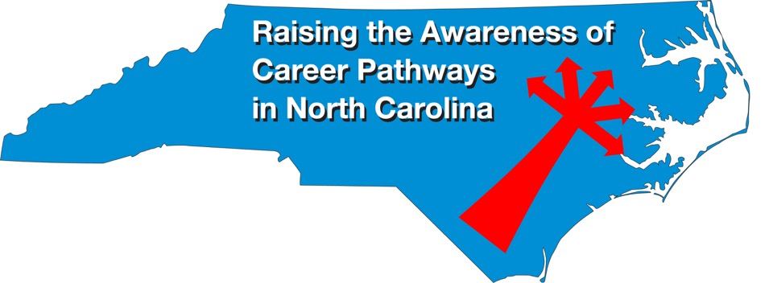
March 20, 2024 Business Administration
Download the PowerPoint and access the recording: www.ncperkins.org/presentations
Notes:
Good morning. Welcome to our monthly career pathways webinar.
We are here to help promote the great jobs, often unknown, in the great state of North Carolina.
Through these meetings, we are going to let you know about some great career opportunities in North Carolina.
And bring in special guests talk about these opportunities.
Please download this PowerPoint file and use it anyway you can to help get folks on a career pathway.
In the notes section of the PowerPoint, you will find any reference from where the information was found, as well as the contact information for the speaker.
Get the PowerPoint on our NCPerkins.org website on our Presentations and Webinars page.
The direct address is on the screen, just scroll down to today’s date.
-----
Many of the videos shown during this webinar can be found here:
https://www.ncperkins.org/video/

Slide 2
Career & Technical Education Team
Bob Witchger
Tony Reggi
Patti Coultas
Mary Olvera
Stefanie Schroeder
Darice McDougald
Lane Freeman
Jennifer McLean
Aaron Mabe

Slide 3
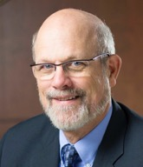
Dr. Bob Witchger
CTE Director, Team Perkins NCCCS
Notes:
Dr. Robert (Bob) Witchger
NCCCS, CTE Director
919-807-7126
witchgerb@nccommunitycolleges.edu

Slide 4
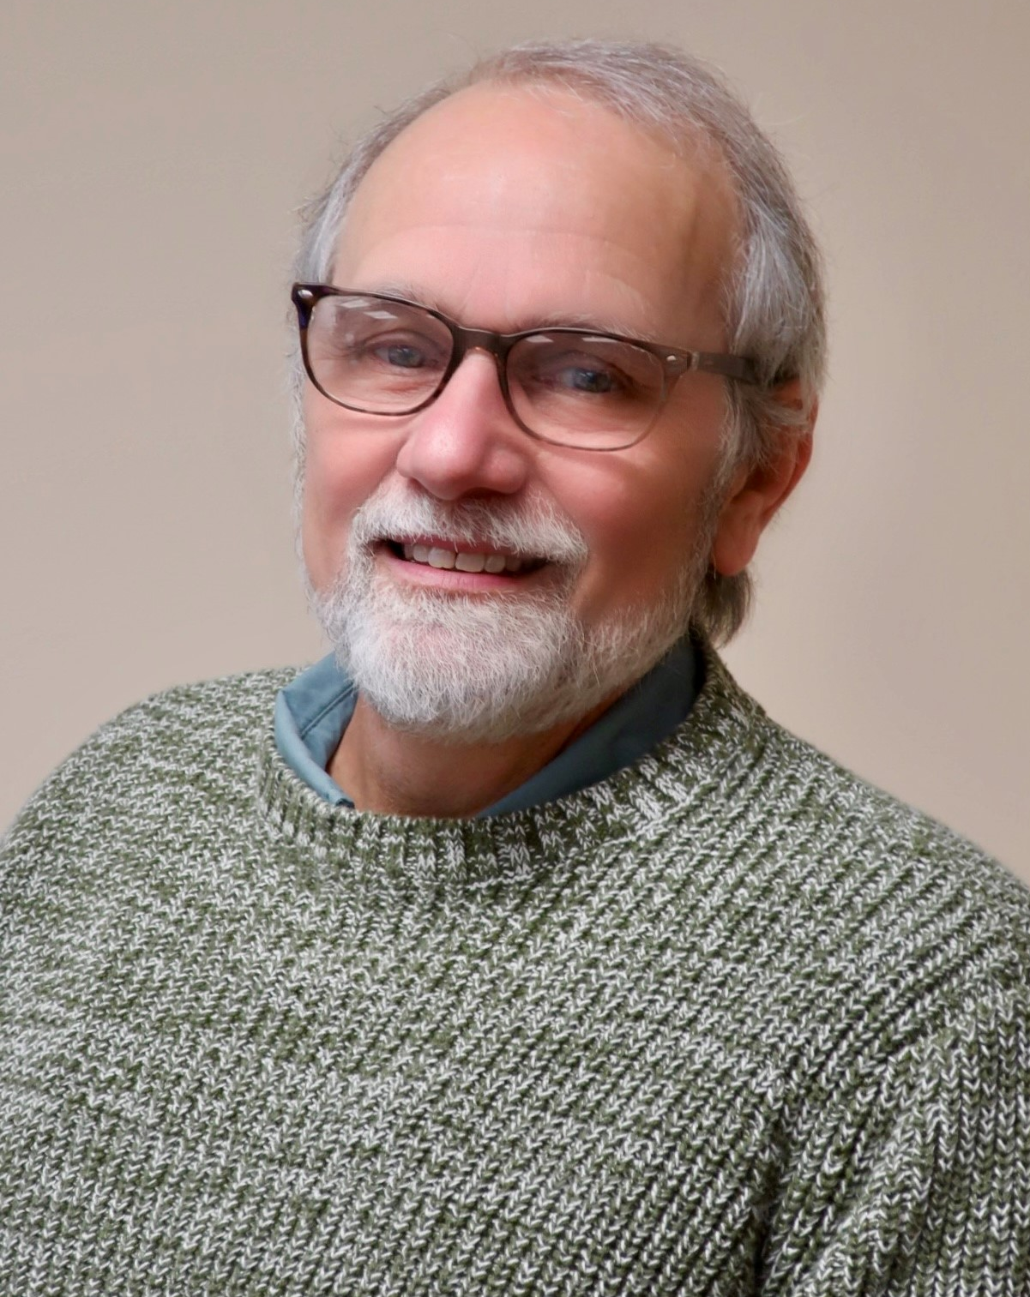
Dr. Tony Reggi
CTE Associate Director, Team Perkins, NCCCS
Notes:
Tony Reggi
919-807-7131
reggia@nccommunitycolleges.edu

Slide 5
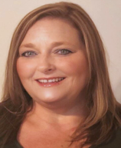
Dr. Mary Olvera
CTE Coordinator and Program Administrator
Public Service Technologies, Agriculture and Natural Resources Technologies, and Commercial Artistic Productions
Notes:
Dr. Mary Olvera
Career and Technical Education Coordinator & Program Administrator
Public Service Technologies, Agriculture and Natural Resources Technologies, and Commercial Artistic Productions
North Carolina Community College System Office
919-807-7120
olveram@nccommunitycolleges.edu

Slide 6
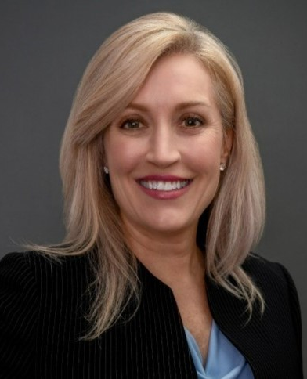
Stefanie Schroeder
CTE Coordinator
Notes:
Stefanie Schroeder
919-807-7232
schroeders@nccommunitycolleges.edu

Slide 7
Dr. Hilmi Lahoud
Senior Program Administrator – Business and Information Technology Programs
Notes:
Hilmi A. Lahoud, Ph.D. Senior Program Administrator, Business and Information Technology Programs
Academic and Student Services Phone: 919-807-7116 lahoudh@nccommunitycolleges.edu

Slide 8
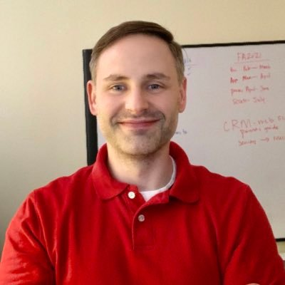
Aaron Mabe
Career & College Promise Coordinator
Notes:
Aaron Mabe
919-807-7098
mabea@nccommunitycolleges.edu

Slide 9
Jennifer Weisz
Forsyth Technical Community College
Program Coordinator, Business Administration, Public Administration & International Business, and Business Technologies Department, Business & Information Technologies Division
Notes:
Mrs. Jennifer Weisz, MBA, MA Program Coordinator, Business Administration, Public Administration & International Business Accounting and Business Technologies Department, Business & Information Technologies Division
Forsyth Technical Community College Main Campus, 252 Hauser Hall 2100 Silas Creek Parkway | Winston-Salem, NC 27103
jweisz@forsythtech.edu 336.734.7167

Slide 10
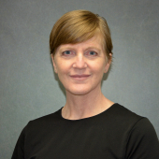
Carolyn Porter
Southwestern Community College
Business Department Chair
Business Administration – Program Coordinator/Instructor
Notes:
cporter@southwesterncc.edu
828.339.4232
800.447.4091, ext. 4232

Slide 11
Cynthia King
Beaufort County
Community College
Lead Instructor, Business Administration
Notes:
Cynthia King
Cynthia.king@beaufortccc.edu
252-940-6318

Slide 12
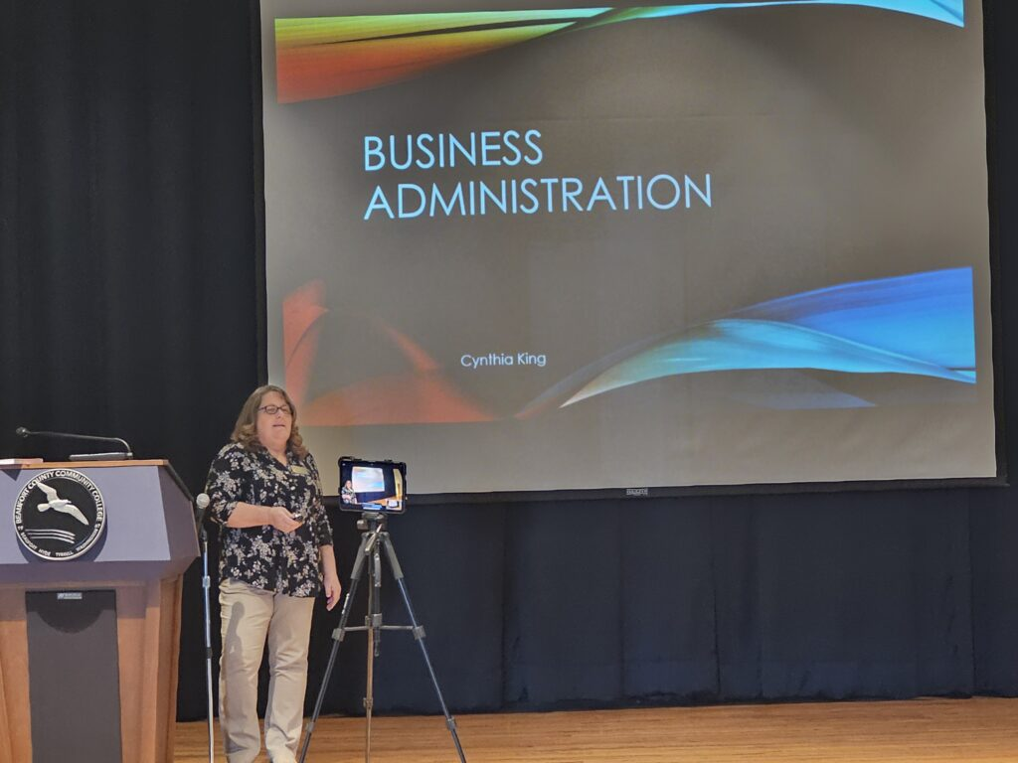
Notes:
This is me giving a presentation for the NE NC Career Pathways quarterly meeting 3/13/2024

Slide 13
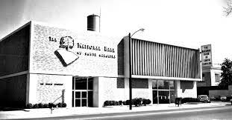
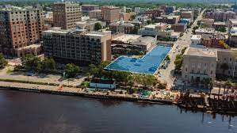
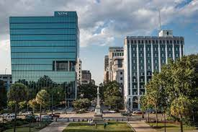
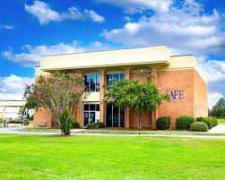
Notes:
Worked at these different Banks over the years
National Bank of Sc (2 locations: Sumter and Columbia SC) Wachovia Bank on the river in Wilmington NC SAFE Federal Credit Union at Shaw AFB and Sumter SC

Slide 14
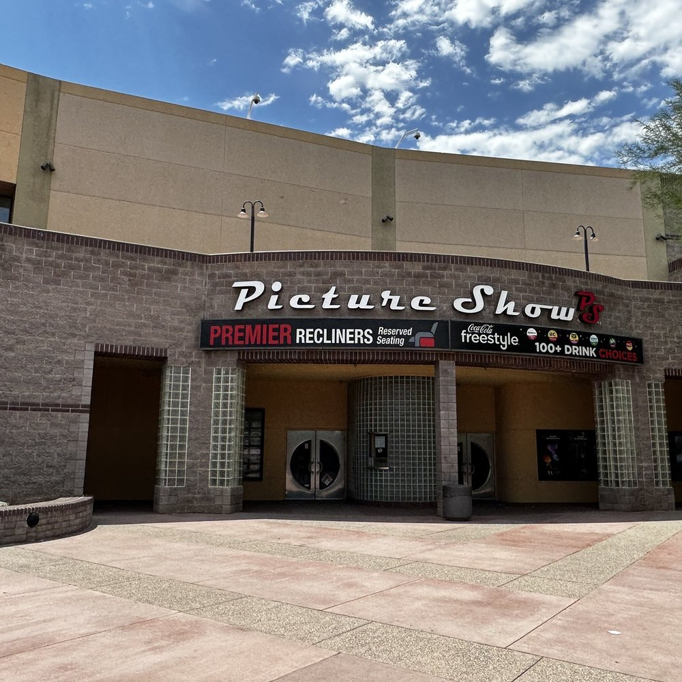
Notes:
I managed this Multi-complex cinema out in Mesa AZ at the Superstition Springs Mall

Slide 15
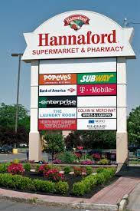
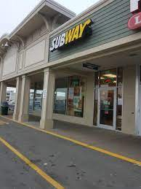
Notes:
Subway that I owned in Albany NY with a business partner that I meet in college.

Slide 16
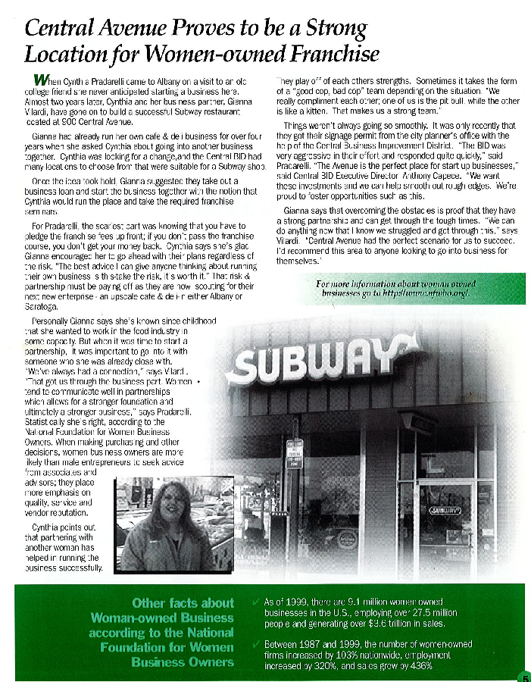
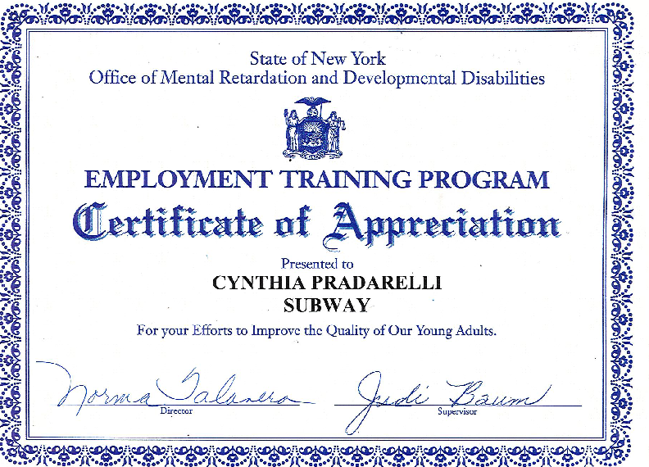
Notes:
As a business owner I helped those with disabilities learn job skills. Loved giving back to the community.

Slide 17
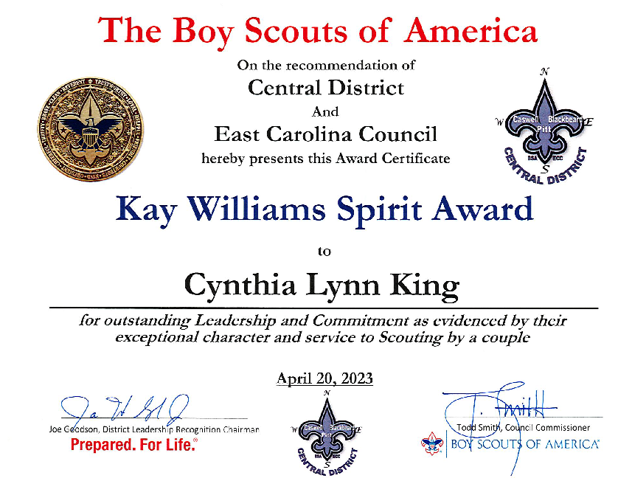
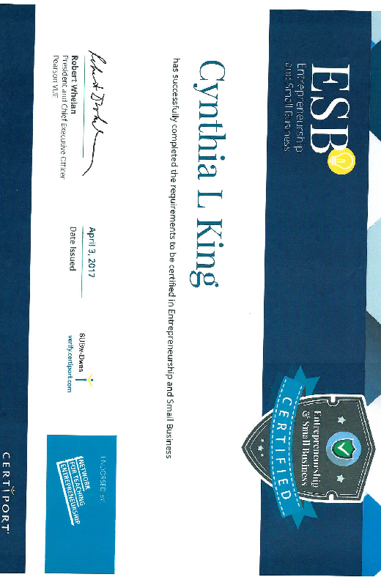

Slide 18
Business Administration (A25120)
The Business Administration curriculum is designed to introduce students to the various aspects of the free enterprise system. Students will be provided with a fundamental knowledge of business functions, processes, and an understanding of business organizations in today’s global economy. Course work includes business concepts such as accounting, business law, economics, management, and marketing. Skills related to the application of these concepts are developed through the study of computer applications, communication, team building, and decision making. Through these skills, students will have a sound business education base for lifelong learning. Graduates are prepared for employment opportunities in government agencies, financial institutions, and large to small business or industry.
Link to Business Administration Curriculum Standard
Notes:
Associate Degree Program at NC Community Colleges
https://www.nccommunitycolleges.edu/academic-programs/nc-community-college-system-catalog

Slide 19
Subject Areas (Tracks)
General Business Administration
Banking and Finance
Business Data Analytics *
Entrepreneurship Management *
Human Resources Management
International Business Management
Leadership *
Marketing
Nonprofit Administration and Management *
Operations Management
Project Management *
Public Administration
Sports Management *
* New subject area

Slide 20
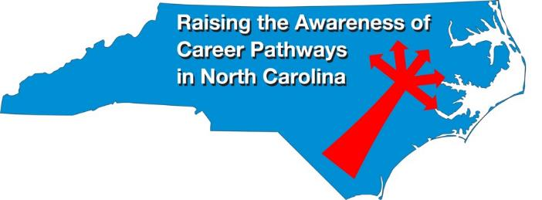
Raising the Awareness of Career Pathways Webinars
Apr. 17, 2024 – Public Safety
May 15, 2024 – Cyber Crime Technology
Register for all webinars at www.ncperkins.org/presentations

