Slide 1
Perkins Update
March 11, 2025

Slide 2
Purpose of Perkins V
Develop more fully the academic knowledge and technical and employability skills of secondary education students and postsecondary education students who elect to enroll in CTE curriculum programs and programs of study
Notes:
The Strengthening Career and Technical Education for the 21st Century Act reauthorized and updated the Carl D. Perkins Career and Technical Education Act of 2006 to become the current Carl D. Perkins Career and Technical Education Act of 2006 as amended by the Strengthening Career and Technical Education for the 21st Century Act (Perkins V)
This updated act stresses:
- Academic, Technical, and Employability Skills
- Funding Secondary and Postsecondary CTE
- Focusing on Students who elect to enroll in CTE Programs of Study

Slide 3
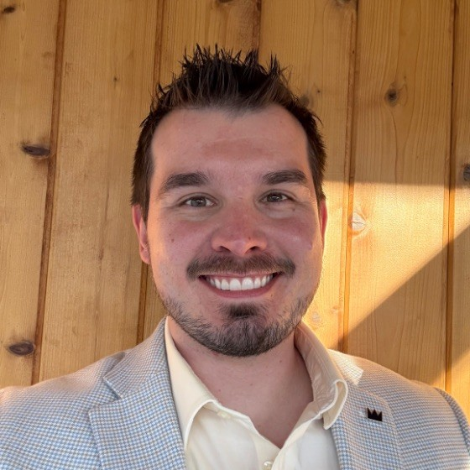
Introducing Dr. Robert Van Dyke
Executive Director of Postsecondary Perkins Strategy and Grant Administration
vandyker@nccommunitycolleges.edu

Slide 4
Perkins Career & Technical Education (CTE) Team
Rob Van Dyke Executive Director of Postsecondary CTE
Patti Coultas Assistant Director of Perkins CTE - East
Stefanie Schroeder Assistant Director of Perkins CTE – West
Tony Reggi Associate Director of Perkins CTE
Darice McDougald Perkins Program Specialist
EMAIL: Last name, first initial @nccommunitycolleges.edu

Slide 5
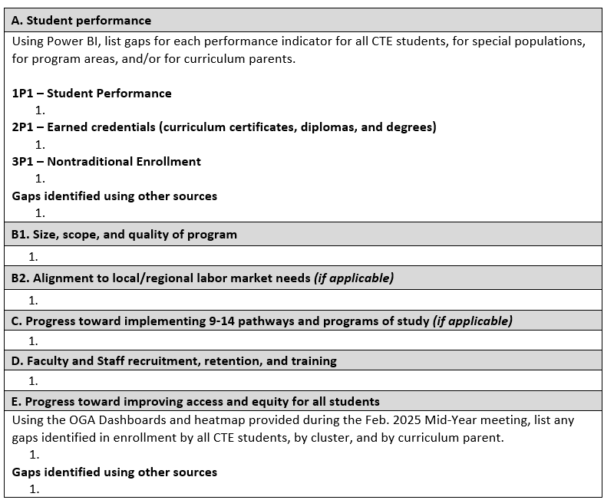
Updated all CTE CLNA Template
Section A now includes performance indicator prompts
Section E now includes OGA prompts
Requires signatures

Slide 6
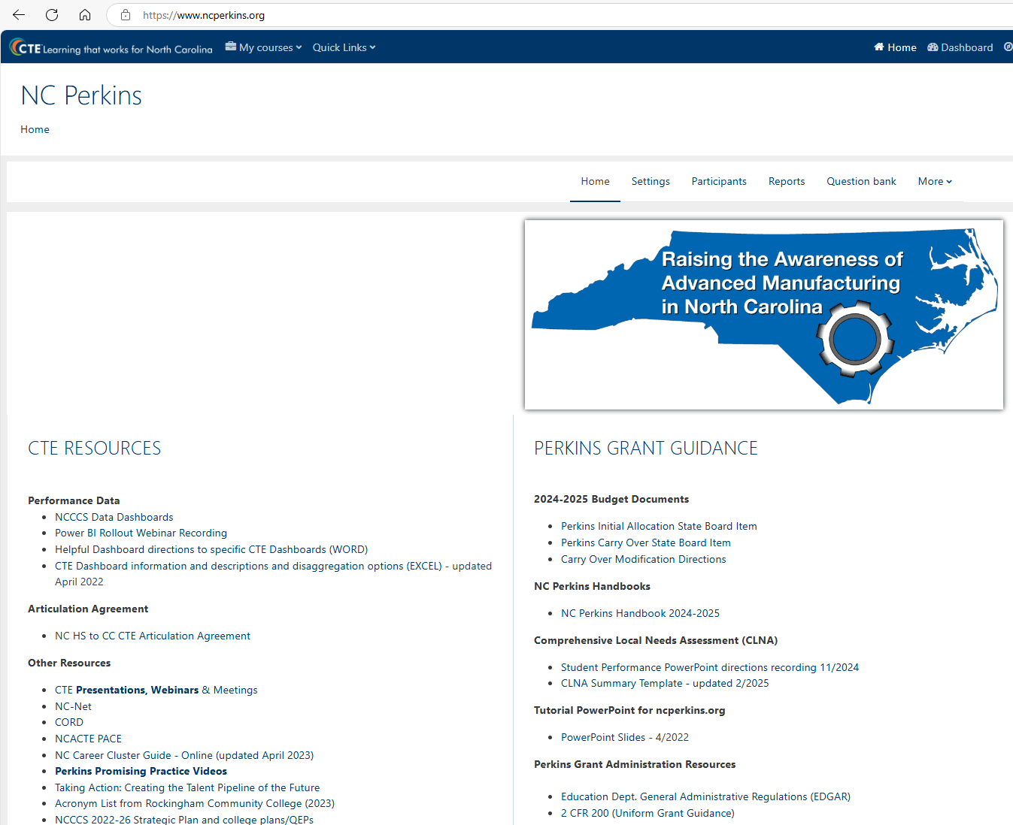
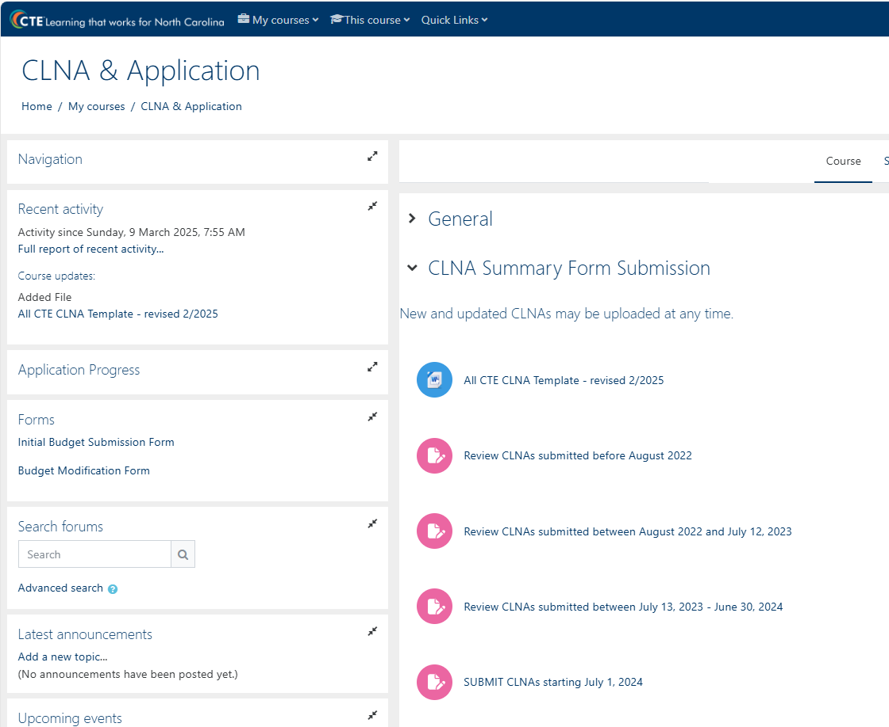
CLNA Template on ncperkins.org

Slide 7
Perkins Annual Meeting for 2025-2026
April 9th Koury Convention Center, Greensboro
Registration coming in soon
9am – 12pm Education Department General Administrative Regulations (EDGAR) presented by Bruman Group, LLC
12-1pm – Lunch on your own
1-4pm – Preparing for Perkins 2025-2026 year facilitated by Team Perkins

Slide 8
SKILLSUSA NC State Conference
April 8-10 Greensboro Convention Center
Postsecondary Competitions: April 10
Visit : State Conference | skillsusanc

Slide 9
Teaching with AI Webinar
If you have any questions, contact Jonathan Howle, Ed.D. Director for Teaching Excellence jhowle@mitchellcc.edu

Slide 10
Promising Practice Video from 2023-2024
Catawba Valley Community College
Apprenticeship Opportunities
The link to all EOY videos is www.ncperkins.org/video

Slide 11
Perkins Monthly Updates 2024-25
4/8/2025 canceled
5/13/2025
6/10/2025
Attendance (or viewing the recording within 30 days) is recorded on the monitoring rubric. Recording may be accessed at the same link as the registration.
You can register for these now at
www.ncperkins.org/presentations
and put them on your calendar
Notes:
Register now and let the system remind you.

Slide 12
Technical Assistance is available
We are here to help!
Team Perkins is available by phone, email, virtually, or in-person

