Slide 1
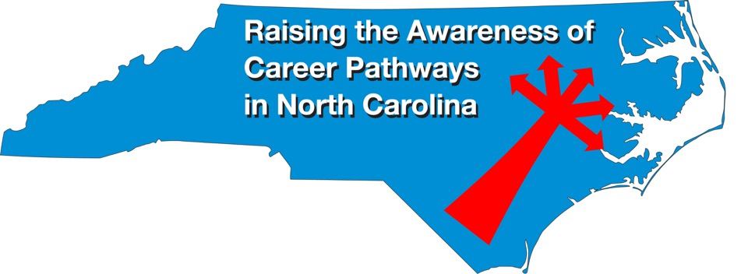
June 18, 2020 Careers in Healthcare
Download the PowerPoint and access the recording: www.ncperkins.org/presentations
Notes:
Chris
We are here to help promote the great jobs, often unknown, in the great state of North Carolina.
Through these monthly meetings, we are going to let you know about some great career opportunities in North Carolina.
And bring in special guests to let you know about the great career opportunities in North Carolina.
Please download this PowerPoint file and use it anyway you can to help get folks on a career pathway.
The reference showing from where the information was found, as well as the contact information for our guests is in the Notes section under each slide.
Get the PowerPoint on our NCPerkins.org website on our Presentations and Webinars page.
Here is the direct address on the screen.

Slide 2
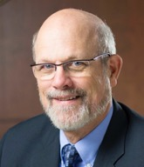
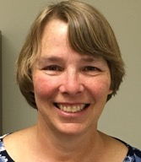
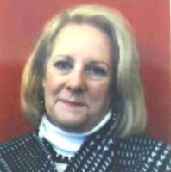
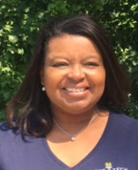
Raising the Awareness of Career Pathways in North Carolina
Bob Witchger
Patti Coultas
Tony Reggi
Cheryl Cox
NC Dept of Public Instruction
Michelle Lair
Mary Olvera
Chris Droessler
Notes:
Chris
I always say our webinars are like radio but with pictures.
And here are a few pictures of your hosts for these monthly explorations into career pathways.
(Why does the photographer have the best photo?)
Our contact information is in the notes section under this slide.
Dr. Bob Witchger
919-807-7126
WitchgerB@nccommunitycolleges.edu
Dr. Tony R. Reggi
919-807-7131
ReggiA@nccommunitycolleges.edu
Patti Coultas
919-807-7130
CoultasP@nccommunitycolleges.edu
Dr. Mary Olvera
919-807-7120
OlveraM@nccommunitycolleges.edu
Michelle Lair
919-807-72227
LairM@nccommunitycolleges.edu
Chris Droessler
919-807-7068
DroesslerC@nccommunitycolleges.edu
Cheryl Cox
919-807-3814
Cheryl.Cox@dpi.nc.gov

Slide 3
Notes:
www.ncperkins.org/presentations

Slide 4
Tuesday, June 23, 2020
10:00 a.m. – 1:00 p.m.
Notes:
https://guilfordworks.org/guilfordworks-healthcare-fair-registration/
Tuesday, June 23, 2020
10:00 a.m. – 1:00 p.m.
Schedule:
10:00am – 10:30am — Career & Job Fair Event Kick Off (GuilfordWorks)
10:30am-1:00pm — Healthcare Employers Job Fair (Well-Spring, Duke Health, Wake Forest Baptist Health, Cone Health, Novant Health, Bayada, Eagle Physicians, Home Instead Senior Care & Comforcare)
10:30am-1:00pm — Education & Career Development (UNCG School of Nursing, UNCG Career & Professional Development, GTCC Nursing)
10:30am-1:00pm — Training & Job Placement Resources (NCWorks Career Center-Greensboro)
Employers Will Cover:
Types of jobs currently available
Skills and training necessary for those roles
Hiring and interview process

Slide 5
Notes:
www.ncperkins.org/presentations

Slide 6
Edward E. Gordon
Imperial Consulting Corporation
Notes:
http://www.imperialcorp.com/
Gordon is the author or co-author of 21 books including Future Jobs: Winning the Global Talent Showdown, Divided on D-Day, The 2010 Meltdown, Skill Wars, FutureWork, Closing the Literacy Gap in American Business, Opportunities in Training and Development Careers, Literacy in America, The Tutoring Revolution, Peer Tutoring, and Tutor Quest.

Slide 7
“The Workforce Road Ahead” Edward E. Gordon Webinar Series
Fourth Thursday at 2pm
May 28 – Expect the Unexpected
June 25 - The Failure of Current Talent Strategies
July 23 - The Talent Desert
August 27 - Rebuilding Workforce Knowledge
https://www.imperialcorp.com/whats-new/webinars/
Notes:
https://www.imperialcorp.com/whats-new/webinars/

Slide 8
Notes:
https://www.imperialcorp.com/books/
https://www.amazon.com/kindle-dbs/entity/author/B001IODRLG
https://www.amazon.com/kindle-dbs/entity/author/B001IODRLG?_encoding=UTF8&node=283155&offset=0&pageSize=12&searchAlias=stripbooks&sort=author-sidecar-rank&page=1&langFilter=default#formatSelectorHeader

Slide 9
Notes:
www.ncperkins.org/presentations

Slide 10
NCcareers.org
Notes:
This is the latest update in a series of Career Cluster Guides.
Just inside the front cover is the web address NCcareers.org
That is the place where we, along with several other state agencies are building a career information portal.
Right now you can access an interactive version of this Cluster Guide, as well as many other useful tools that relate to career development.
====
https://nccareers.org/

Slide 11
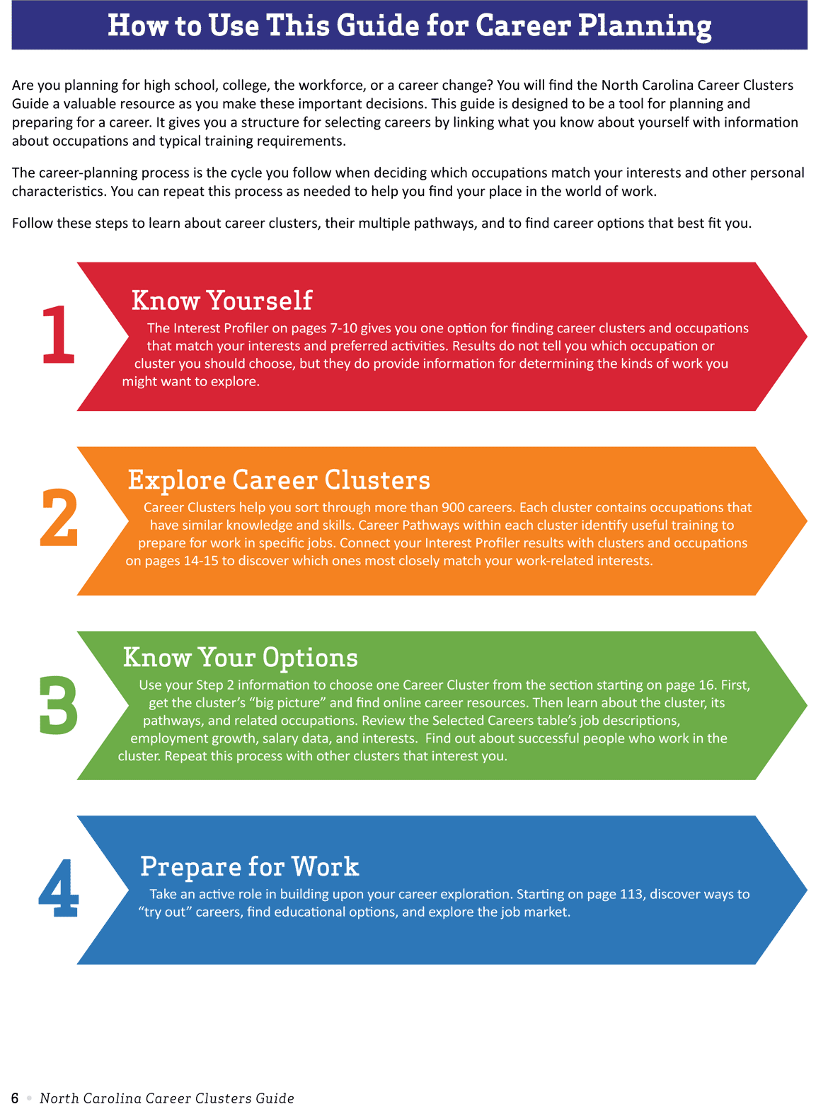
Page 6
NCcareers.org
Notes:
NC Career Cluster Cuide
Page 6.
Here is the four-step process to go from zero to career.
First step is to know yourself.
Most people have no idea of who they are!
Then the second is to explore the career clusters. Nobody knows about all of the many careers that are out there.
Third is to know your options.
Then fourth is to actually get on that Career Pathway and prepare for work.
This is the basic design for the Career Cluster Guide
===
https://nccareers.org/

Slide 12
Notes:
www.ncperkins.org/presentations

Slide 13
Raising the Awareness of Career Pathways in North Carolina
Next meeting is July 16, 2020
www.ncperkins.org/presentations
Notes:
Our next meeting like this one will be on ------.
(We will skip December and be back in January.)
You can go to the NCPerkins website to register for that meeting.
We'll also send you a reminder, since you are now on our mailing list.
So go ahead and sign up for all the meetings, and you'll be reminded the day before.
If you liked something you saw here, send folks to the recording. Find it at that same web page.

Slide 14
Notes:
www.ncperkins.org/presentations

Slide 15
Barbara Burt
Health Science, Nurse Aide Specialist
Department of Public Instruction
Notes:
Barbara.Burt@dpi.nc.gov

Slide 16
Dr. Lori Byrd
Associate Director, Academic Programs - Health Sciences
Notes:
Dr. Lori Byrd
Associate Director, Academic Programs - Health Sciences
byrdl@nccommunitycolleges.edu
919-807-7118

