Slide 1
Reshaping the Collision Repair Industry One Student at a Time

Slide 2
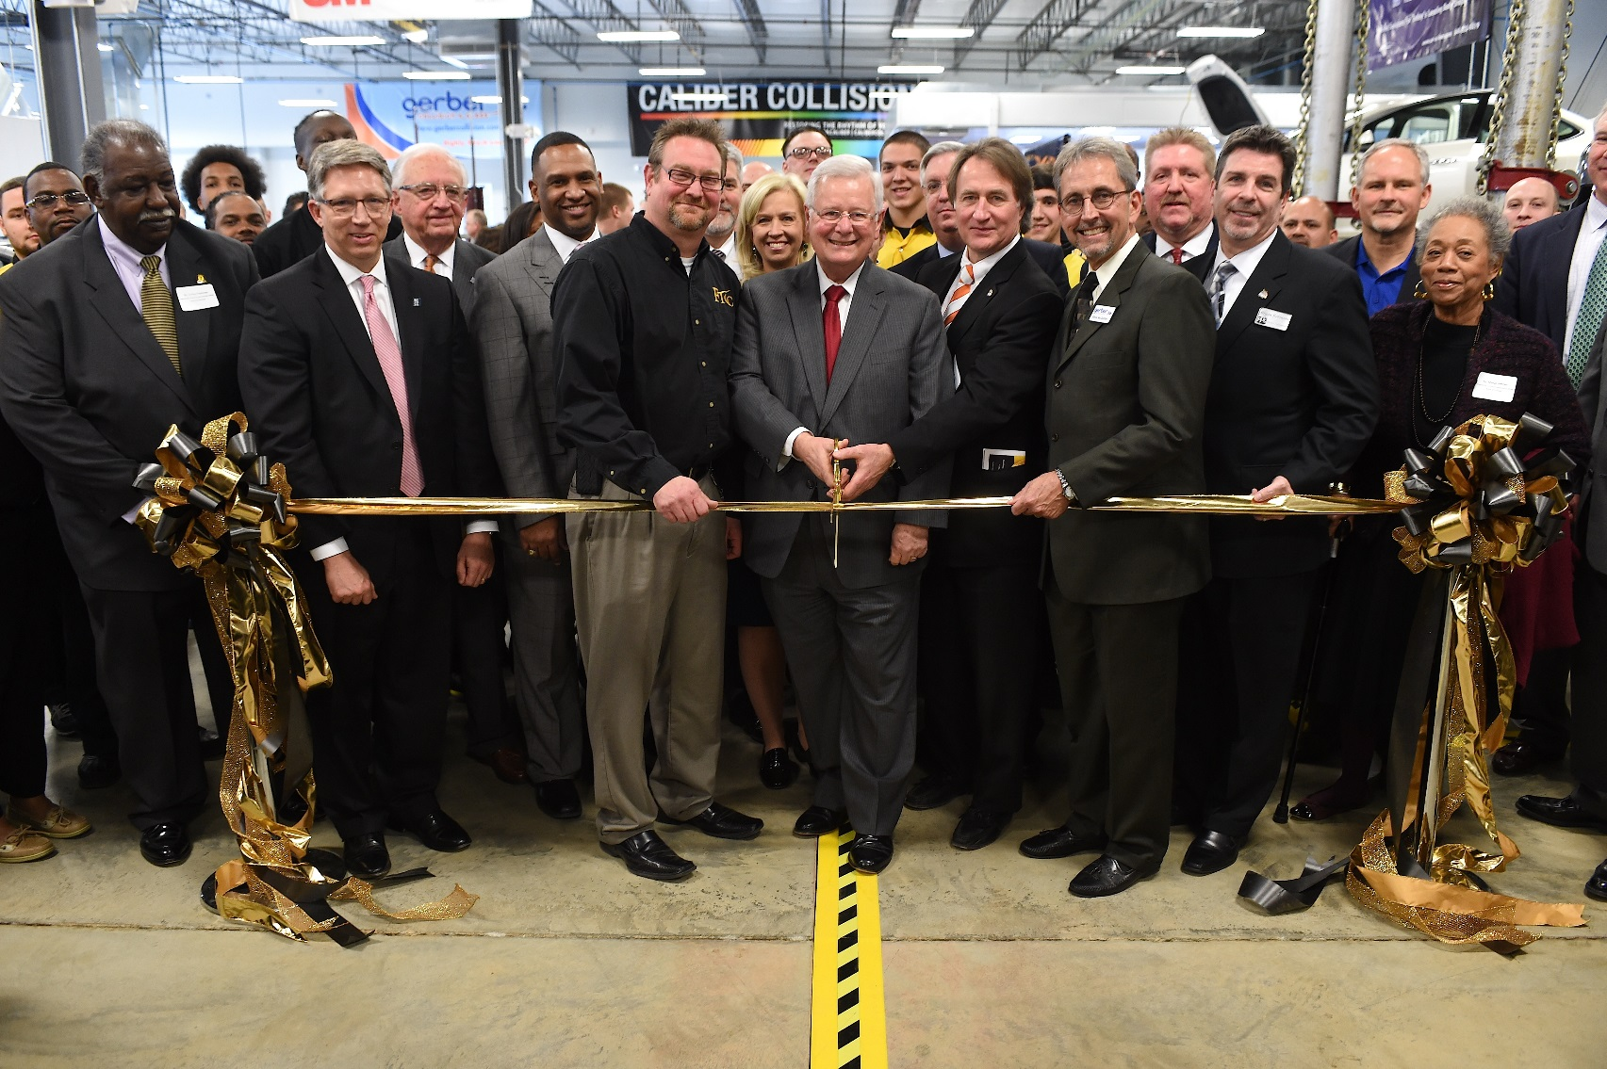
Grand Opening

Slide 3
How Do You Engage An Industry?
Understand the industry need
Work with industry to create the solution
Keep industry engaged before, during and after
Leverage the industry

Slide 4
Understanding an Industry Need
Industry has to tell you how the need should be met
Industry has to tell you what an employable graduate looks like
Credentials
Don’t forget soft skills
You are not just providing an education, you are providing CAREER TRAINING

Slide 5
Working with Industry to Create Solutions
Bringing industry to the table
“If you build it…” they probably won’t come
Be a business partner - become an education distribution center
Speak the industry language
Credibility
Look like the businesses you serve
Be responsive – don’t delay!

Slide 6
CollisionU Facility

Slide 7
CollisionU Facility

Slide 8
CollisionU Facility

Slide 9
Keeping Industry Engaged
Go where they are
Conferences
Give them a reason to come to you
Draft Days
Guest Speakers
Find out what other needs you can meet for them
Corporate Training

Slide 10
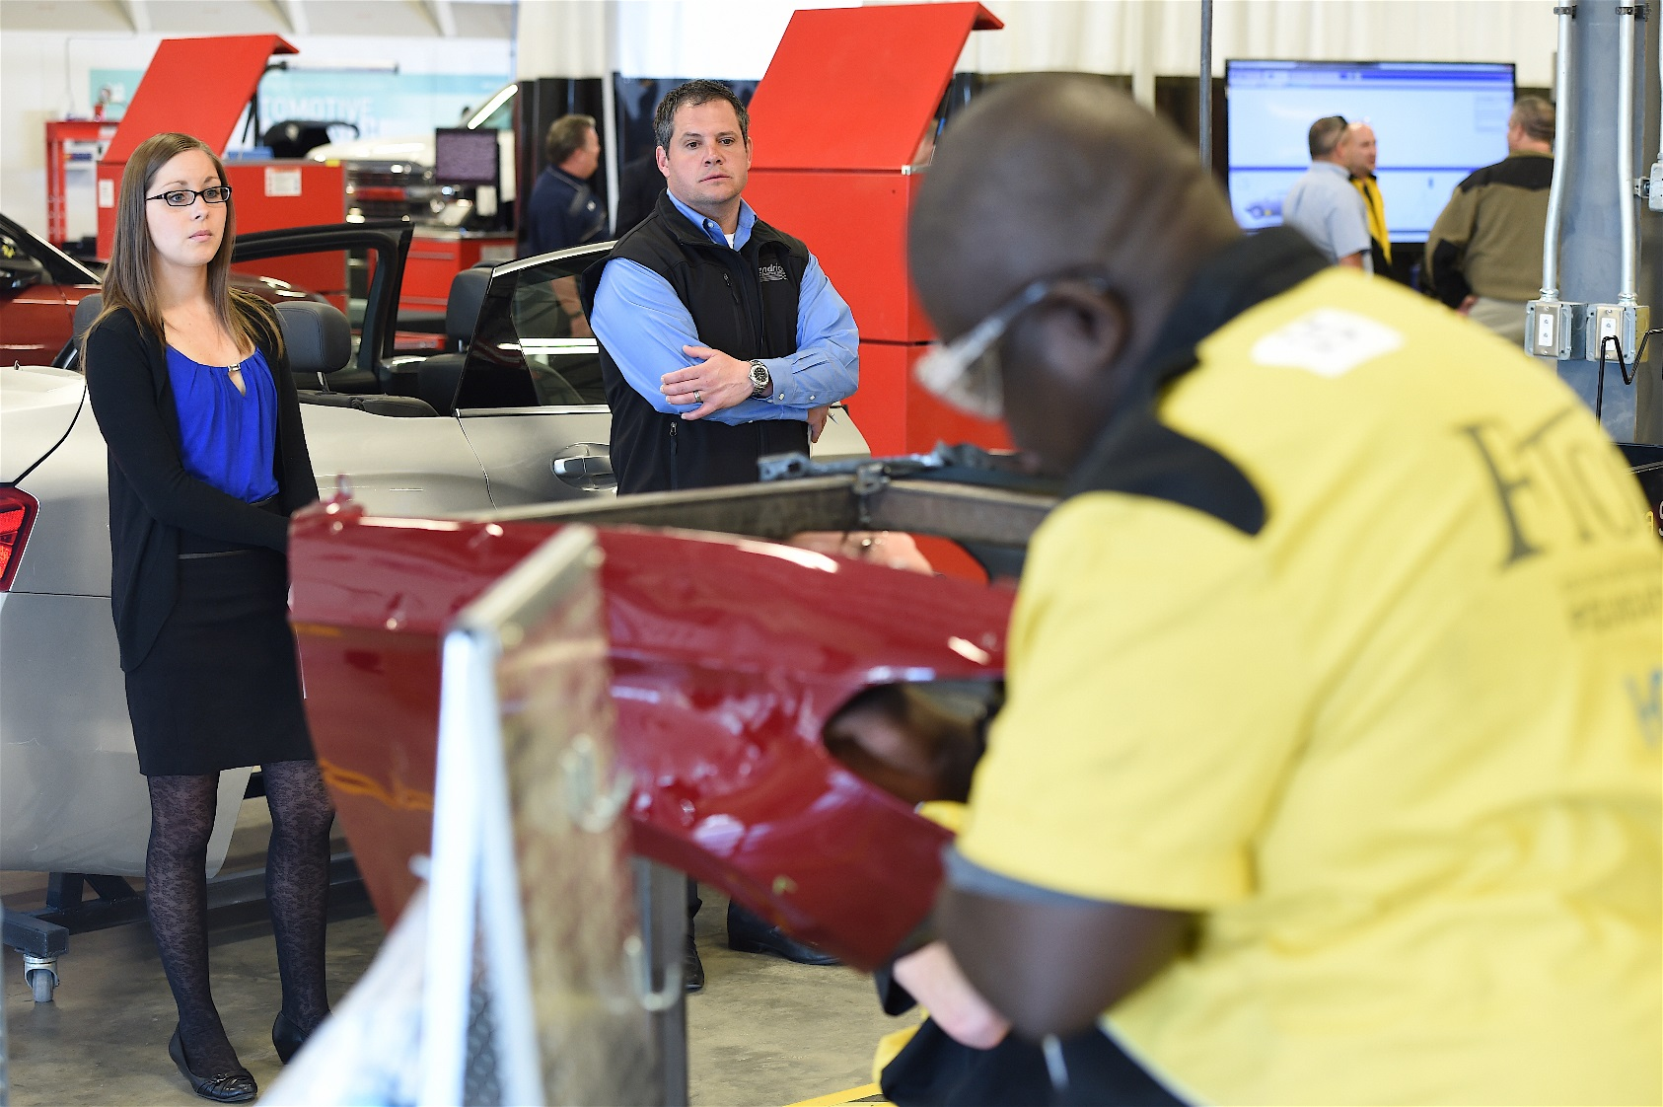
Draft Days

Slide 11
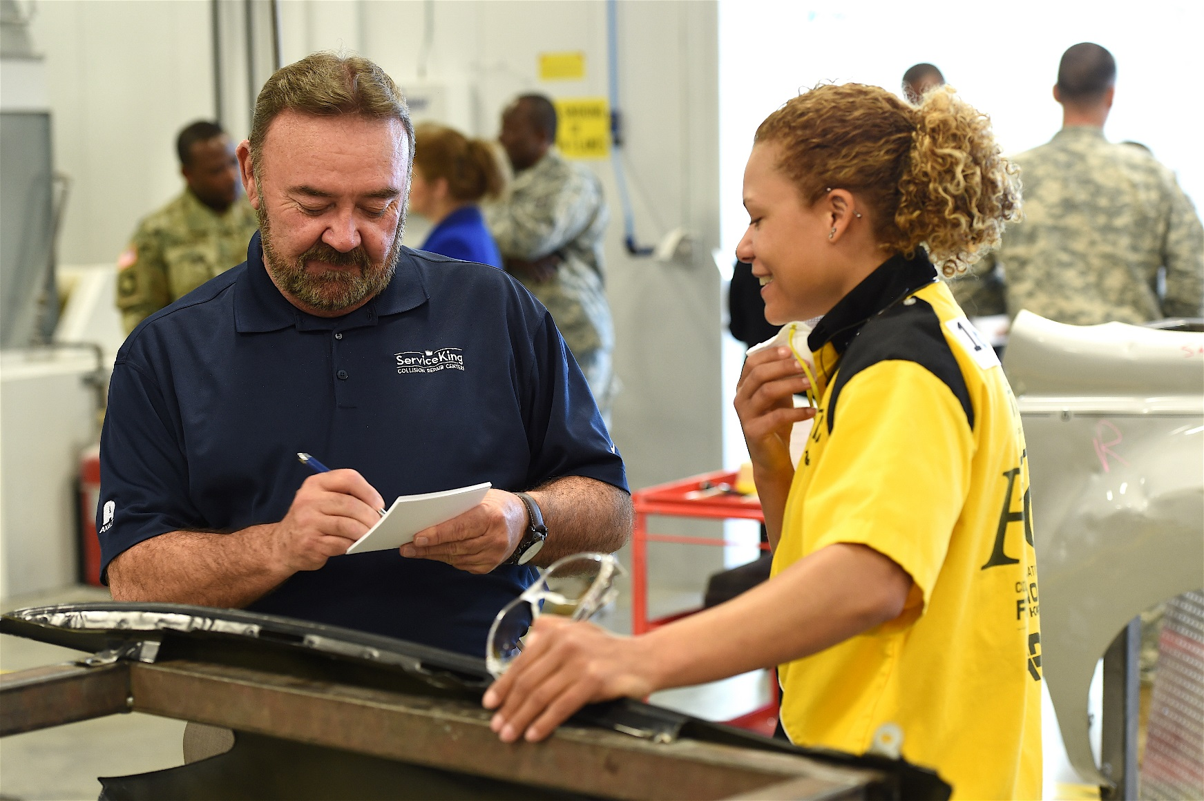
Draft Days

Slide 12
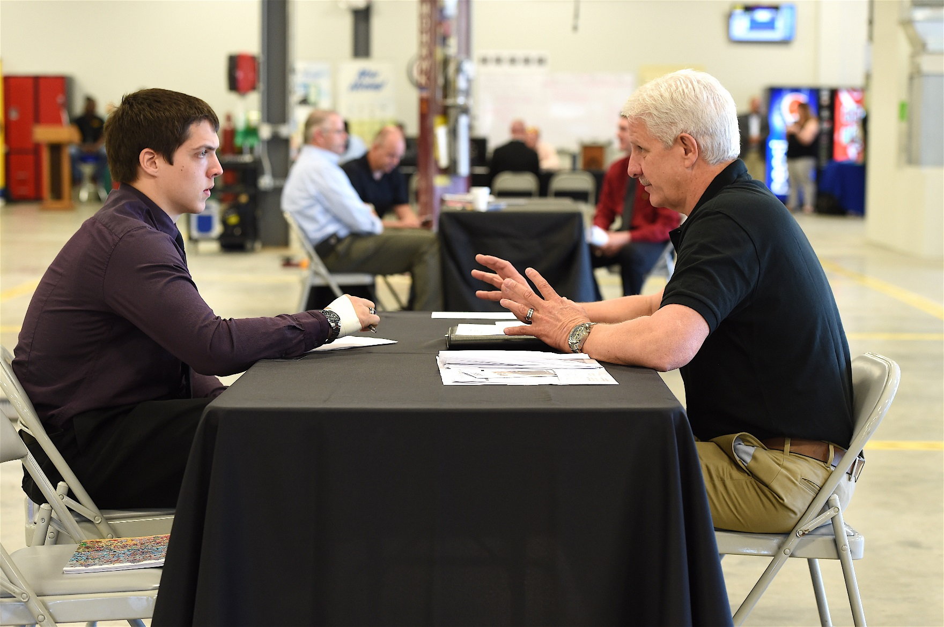
Draft Days

Slide 13
Leveraging an Industry
Resources
Job Placement & Experience
Internships & Apprenticeships
Tools/Equipment
Grant opportunities
Keeping curriculum current

