Slide 1
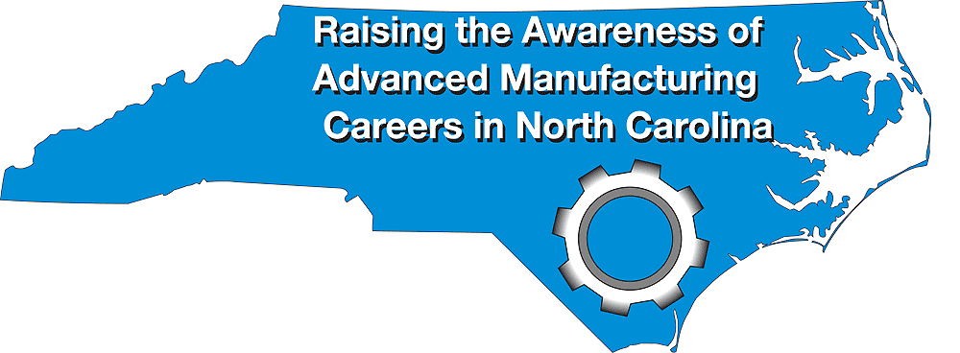
October 2-6, 2017
Bob Witchger
Chris Droessler
NC Community Colleges
Cheryl Cox
NC Department of Public Instruction
www.ncperkins.org/manufacturing
Notes:
Thanks to all of you who have helped plan open house events the last four years.
We believe we have done very well getting the word out about the great careers in Advanced Manufacturing.
The state of North Carolina is actively recruiting manufacturing companies to move to our state,
And what you all are doing is helping to create the talent pool necessary to staff the manufacturing plants.
====
August 24, 2017

Slide 2
Dr. Gary M. Green
President
Forsyth Technical Community College

Slide 3
October 2-6, 2017
www.ncperkins.org/manufacturing
Notes:
In case you haven’t heard, The sixth-annual North Carolina Advanced Manufacturing Careers Awareness Week will be October second through the sixth.
National Manufacturing day (that’s their logo on the left) will be that Friday, October 6. Always the first Friday in October.
And that’s our website at the bottom of the screen.

Slide 4
Background
Manufacturing has changed
Old perceptions of back-breaking dirty jobs
NC Adv. Manufacturing Week started in 2013
Manufacturers and training programs open their doors to the public
Notes:
Manufacturing has changed drastically over the last few decades.
Our NC Manufacturing Awareness Week started at the same time as the national Manufacturing day.
It's not just North Carolina, it's a national movement to show off advanced manufacturing and to attract new employees who can perform the high-tech tasks in modern manufacturing.

Slide 5
Why Get Involved?
Activities/tours were engaging – 90%
More aware of manufacturing jobs in my community – 89%
More convinced manufacturing provides careers that are interesting/rewarding – 84%
More motivated to pursue a career in manufacturing – 64%
More likely to tell friends, family, parents or colleagues about manufacturing – 71%
Notes:
Here is what the national Manufacturing day found after polling all of the host sites.
They found that having these open houses was important to the manufacturing industry.

Slide 6
What?
Plant Tours
Open House
Job Fair
Presentations to students
Day-time events and evening events
Invite the media
Let the community know what goes on behind that big exterior wall
Notes:
There are all kinds of evets you can hold during this week to promote what you are doing and hopefully get your future employees interested.

Slide 7
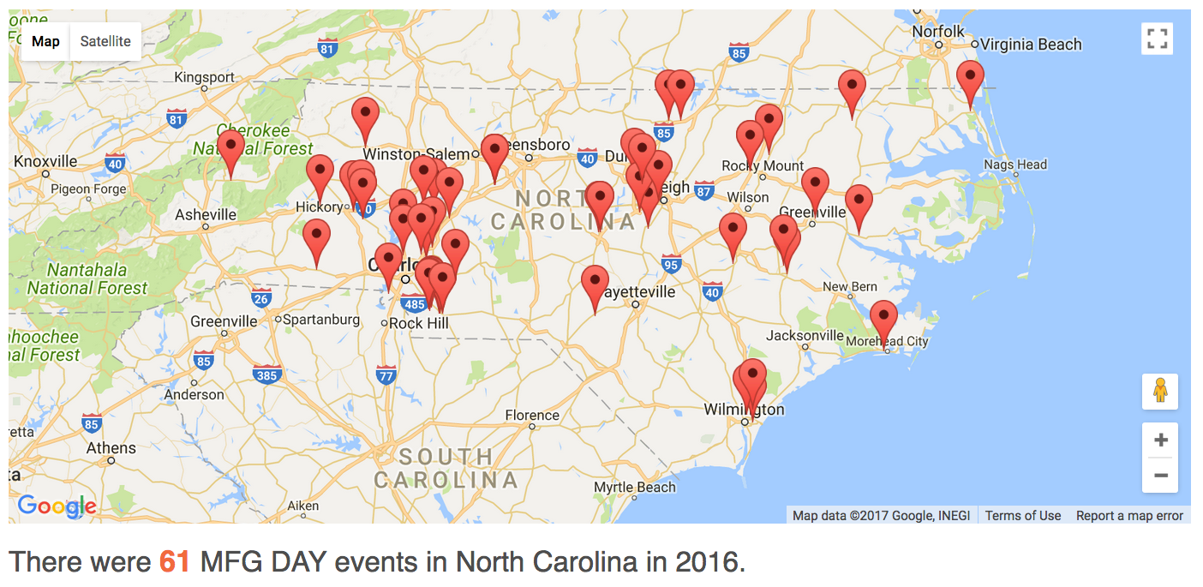
2016 Calendar
Notes:
Last year, there were 61 Manufacturing Week events in North Carolina.
All spread out across the state.
We are hoping to see over 60 events again this year.
======
http://www.mfgday.com/events/2016?country=US&state=NC#filter

Slide 8
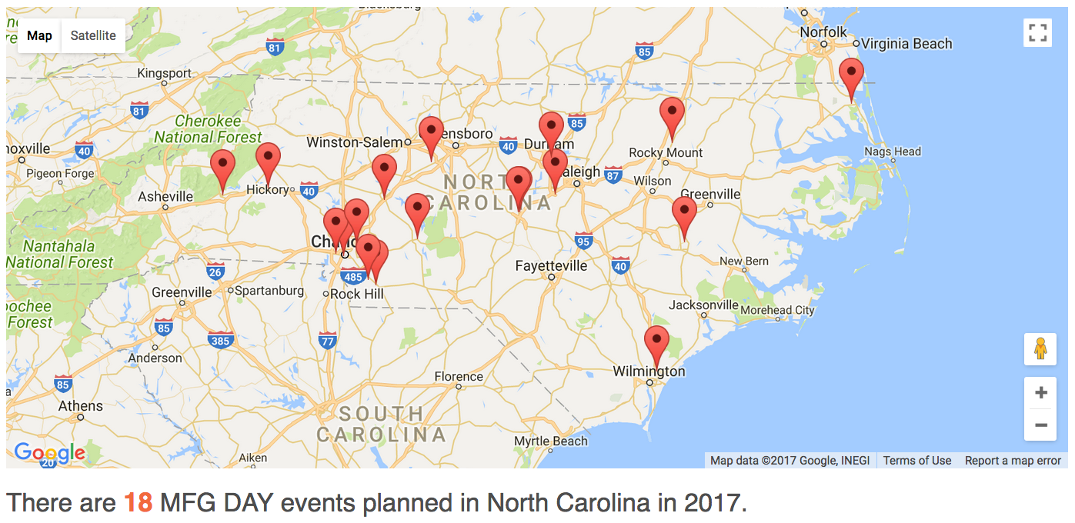
2017 Calendar
Notes:
Right Now, there are already 19 events planned for North Carolina and entered on the national calendar. Alamance Community College just added their event after I captured this map.
Most of those events are at manufacturers. Many are at community colleges. Some are at community centers.
It’s not just businesses and colleges, The Charlotte Chamber is sponsoring a symposium and an expo.
=======
If you are in a border county, be sure to check out the events in the neighboring states. The map on the website will let you see the events in all of the states.
Most of these events are open to the public. Some require advanced notice, and some may be by-invitation-only.
Some might allow school groups during the day and open to the public in the evening. Be sure to check out the requirements.
Also, some may have age restrictions or restrictions on what to wear, like shoes that might be required to walk around the factory.
Each of the events has a contact person, so call to make sure that you will be able to get the most out of the visit.
There are also some virtual events that might show up in your search. Some of these are large events that have an internet connection to allow you to connect from the classroom. If you can’t send the kids to the event, maybe you can bring the event to the classroom.
======
http://www.mfgday.com/events?country=US&state=NC#filter

Slide 9
NC Website
www.ncperkins.org/manufacturing
Event Calendar is at mfgday.com
Promotional Materials - mfgday.com
Planning Meetings/webinars
Partners
Participating Colleges
Notes:
The go-to website for all events in North Carolina is
NC Perkins dot org slash Manufacturing
There you will find the calendar of events, promotional materials, information about our planning meetings, like this one, and our partners and our participating colleges.
Lots of good stuff on that web site.
Stick a bookmark on that page, so you can keep checking it as we get closer to the big week.
======
www.ncperkins.org/manufacturing

Slide 10
October 2-6, 2017
www.ncperkins.org/manufacturing

Slide 11
Grant Godwin
Polaris Associates, LLC

Slide 12
Kathryn P. Castelloes
Apprenticeship Director
North Carolina Department of Commerce
David G. Taylor
Cummins Inc, Charlotte

Slide 13
Kathryn P. Castelloes
Apprenticeship Director
North Carolina Department of Commerce

Slide 14
Thomasine Lewis
Alamance Community College

Slide 15
Michelle Waters
College of the Albemarle

Slide 16
Carolyn Davis Susan Medlin
Davidson County Community College

Slide 17
Kevin Donovan
Dell, Apex
Notes:
https://www.mfgday.com/events/2017/dell-6

Slide 18
Cathy Swindell
Central Carolina Community College

Slide 19
xxx
xxx

Slide 20
xxx
xxx

Slide 21
xxx
xxx

Slide 22
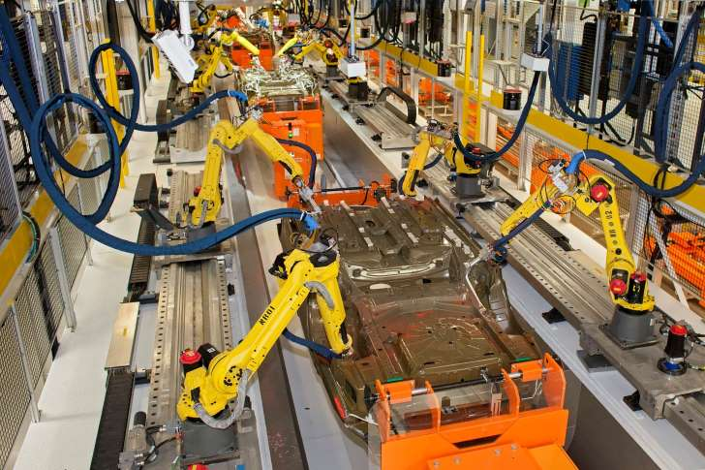
Notes:
© Jim West—Getty Images/imageBROKER RM
http://www.msn.com/en-us/money/markets/half-of-americas-robot-workforce-is-located-in-just-10-states/ar-AAq9TkL?li=AA4Zjn&ocid=spartandhp

Slide 23
October 2-6, 2017
Bob Witchger
Chris Droessler
NC Community Colleges
Cheryl Cox
NC Department of Public Instruction
www.ncperkins.org/manufacturing
Notes:
Thanks

