Slide 1
Overview and Elements of Career Pathways
Presentation to
Southeastern Employment and Training Association,
September 2017 - Louisville, KY
www.ncperkins.org

Slide 2
History of Pathways
Pathways to Prosperity - A framework for all
Meet future employer demand with credentials
Offer postsecondary Certificates and Licenses
Encourage Technical-Skill building for the "Forgotten Half"
Stress Foundational "Soft Skills" and Learning on the job

Slide 3
Job Driven Training
Engage Employers
Earn and Learn
Smart Choices
Measurement Matters
Stepping Stones
Open Doors
Regional Collaboration

Slide 4
Types of Pathways within the NCCCS
Basic Skills Pathways
Career & College Promise
Perkins CTE 9-14 Pathways
Certified Pathways
GPS (NC Student Success Center)

Slide 5
Components of Pathways
Engaged Employers
Infused Career Advising
Coordinated Education/Training
Planned Work-Based Learning
Placement into Work

Slide 6
Understanding Pathways
Basic Skills Pathways

Slide 7
Basic Skills Plus Pathways
Align with the skills needed by industries in the state or regional economy
Prepare individuals to succeed in a range of education options, including apprenticeships
Include counseling to support an individual in achieving the individual’s education and career goals
Include, as appropriate, concurrent education and training opportunities for a specific occupation or occupational cluster
Organize education, training, and support services to meet individual needs, and accelerate the educational and career advancement
Enable individuals to attain a high school diploma or equivalent, and at least one recognized postsecondary credential
Help individuals enter or advance within an occupation or occupational cluster.

Slide 8
Workforce Innovation & Opportunity Act (WIOA)
Title II Adult Education and Family Literacy Act
Signed into law July 22, 2014
Designed to help job seekers access:
Employment
Education
Training
Support services
Goal – Help job seekers succeed in the labor market and to match employers with the skilled workers they need to compete in the global economy.

Slide 9
Basic Skills Plus Pathway Example Computer Integrated Machining
Entry Process
Recruiting
Screening
Assessments:
Service Delivery
Contextualized HS Equivalency and AHSD
ACA 115, BPR 111, MAC 121, DRE and/or DMAs
Orientation
TABE
Needs Assessments
Career Assessments
Dream Catcher’s Transitions Course
Career Assistance
Career Readiness Certification
Outcomes
HSE or AHSD
Machining or CNC Certificate
Computer Integrated Machining Diploma
Core Courses for AAS in Computer Integrated Machining

Slide 10
Basic Skills Plus Pathways
For more information:
Dr. Cassandra Atkinson College and Career Readiness Transitions Coordinator atkinsonc@nccommunitycolleges.edu 919-807-7144

Slide 11
Understanding Pathways
Career and College Promise

Slide 12
Career & College Promise
CCP Legislation
CCP Transfer Pathway
CCP Technical Pathway
Curriculum
Workforce Continuing Education (Fall 2018)
Leads to an Associate in Arts
Leads to an Associate in Science
Leads to an Associate in Engineering
Leads to Associate Degree Nursing
Leads to a Visual Arts Transfer
Legislation
Career & College Promise (CCP) – Session Law 2011-145
Updated in 2017 to allow Workforce Continuing Education pathways the lead to a recognized industry credential

Slide 13
Transfer Pathway
Associate in Arts
The CCP College Transfer Pathway Leading to the Associate in Arts is designed for high school juniors and seniors who wish to begin study toward the Associate in Arts degree and a baccalaureate degree in a non-STEM major.
Associate in Science
The CCP College Transfer Pathway Leading to the Associate in Science is designed for high school juniors and seniors who wish to begin study toward the Associate in Science degree and a baccalaureate degree in a STEM or technical major.
Associate in Engineering
The College Transfer Pathway (CCP) leading to the Associate in Engineering is designed for high school juniors and seniors who wish to begin study toward the Associate in Engineering degree and a baccalaureate degree in a STEM or technical major.

Slide 14
Transfer Pathway (Cont)
Associate Degree Nursing
The Career and College Promise (CCP) ADN Pathway is designed for high school juniors and seniors who wish to pursue a career in nursing. Student who complete this pathway are prepared to apply for admission into community college or university nursing programs.
Associate in Fine Arts in Visual Arts
The CCP College Transfer Pathway Leading to the Associate in Fine Arts in Visual Arts is designed for high school juniors and seniors who wish to begin study toward the Associate in Fine Arts in Visual Arts and a baccalaureate degree in Fine Arts-Visual Arts.

Slide 15
CCP Career & Technical Education Pathways
Curriculum
Workforce/Continuing Education
Must be in compliance with current curriculum standard
Must contain either a minimum of 12 SHC derived from core of curriculum standard or consist of courses in a local traditional certificate as listed in the college’s catalog.
Must be approved to offer the traditional program.
No course pick lists in any CTE program of study (including local certificates submitted as CTE programs of study).
Must have System Office approval prior to implementation. Local certificates submitted as CTE programs of study must include a statement that verifies the courses are listed in the college's catalog for a traditional certificate
Must be in compliance with State or industry-recognized training standards
Must have System Office approval prior to implementation
While changes have been made to CCP Procedures, State Board code still prevents colleges from developing instruction for high schools students.
Revision of State Board code is underway and it is anticipated that students may begin in the Spring 2018.
Colleges can begin the planning process now.

Slide 16
CCP Information
Career & College Promise Operating Procedures
http://www.nccommunitycolleges.edu/sites/default/files/basic-pages/academic-programs/attachments/section14_18aug2017_operating_procedures_v2.pdf
Career & College Promise FAQs for Parents
http://www.nccommunitycolleges.edu/sites/default/files/basic-pages/academic-programs/attachments/ccp_parent_faq_8.11.14v3.pdf
For more information:
Dr. Lisa Eads Program Coordinator Early Childhood, Public Service Technologies, Career & College Promise
eadsl@nccommunitycolleges.edu 919-807-7133
Workforce Continuing Education CCP
Margaret Roberton
Associate Vice President for Workforce Development – Continuing Education
robertonm@nccommunitycolleges.edu
919-807-7159

Slide 17
Understanding Pathways
Guided Pathways (NC-GPS)

Slide 18
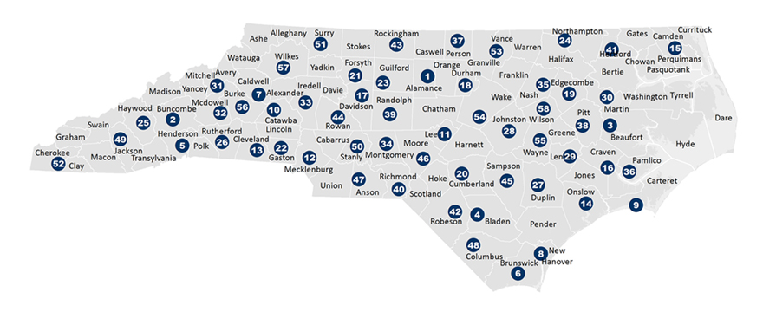
The NC Student Success Center:
Provides support for all 58 colleges to advance, scale, and sustain student success efforts.
Helps colleges align policies and practices to ensure access, equity, significant learning, and completion of credentials.
Represents the collective voice of NCCCS practitioners in state-level and national-policy discussions.
Serving 58 Community Colleges

Slide 19
NC-GPS: Coordinate 1
Clarify paths to student end goals

Slide 20
NC-GPS: Coordinate 2
Help students choose and enter a pathway

Slide 21
NC-GPS: Coordinate 3
Help students stay on path

Slide 22
NC-GPS: Coordinate 4
Ensure that students are learning

Slide 23
NC-GPS works to help 58 colleges. . .
align policies and practices with the NCCCS mission and our values to ensure
access
equity
significant learning
completion of credentials

Slide 24
NC-GPS
For more information:
Dr. Roxanne Newton Executive Director, NC Student Success Center newtonr@nccommunitycolleges.edu 919-807-7107

Slide 25
Understanding Pathways
CTE Pathways

Slide 26
Career Pathways - Key Elements
Career Advising
Education &
Skill Training
Work

Slide 27
2014 Vision Overview
CTE Career Pathways
Advising
Program of Study
Assessment Interest, Ability, Skills
HS - Academic and Technical
Comprehensive Career advising
Credentials
Work
CC - Academic and Technical
Interviews
Labor Market Information
Experiential/Work Based Learning
Career Plan
Certifications
Diploma
Degree
9, 10, 11, 12, 13, 14
Engaged Employers
Assessment of Competencies,
& Credentials,
Placement in Education / Training

Slide 28
Sample CTE Program of Study with CCP Pathway
HS Graduation
Requirements
Electives
(Articulation)
Credentials
Grade
9 | Math | English | Social Studies | Science | CTE Elective Word/Publisher | CTE Elective Excel and Access | Certification
10 | Math | English | Social Studies | Science | CTE Elective Word/Publisher | CTE Elective Excel and Access | Certification
11 | Math | English | Social Studies | Science | CCP CTS - 115 | CCP CTI - 110 ACA-111
12 | Math | English | Physical Education | World Language | CCP CTI - 120 | CCP CIS-110 | Certificate | 13cr
13 | NOS - 110 CET - 110 | NET - 225 NET - 226 | ENG - 111 HUM - 115 | NET -125 NET - 1 26 | SEC - 110 |  | DIPLOMA | 27cr
14 | ENG - 112 ECO - 251 | MAT 143 ECO - 251 | CIS 115 CET - 111 | NOS-130 NOS- 230 | DBA - 110 |  | AAS | 27cr
High School
Jobs $
College
Jobs $$
Jobs $$$

Slide 29
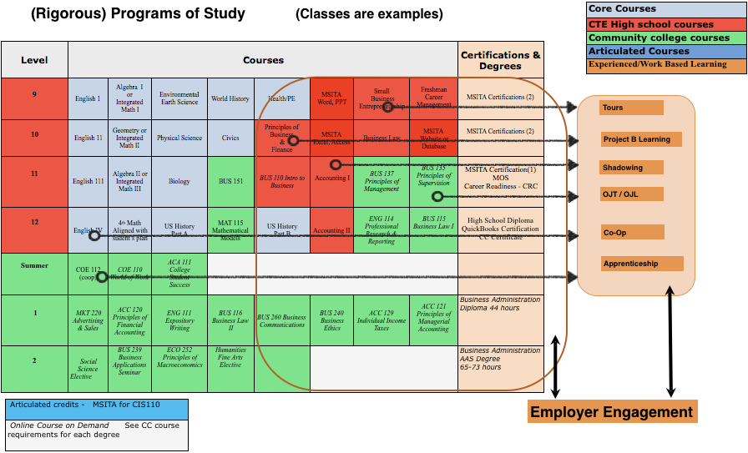
Building the Pathway Engaging Employers

Slide 30
Pathways – Characteristics
Seamless framework in demand-driven, data-informed clusters
Engage employers
Offer Career Development & Awareness
Coordinate training and Programs of Study that:
accept credit and articulated credit for prior leaning,
integrate work-based learning,
contain multiple entry and exit points,
award credentials, certificates, diplomas, and degrees that meet workforce needs
Place individuals in full-time jobs

Slide 31
Evaluation
Labor Market Demand
Certified Career Pathway
Employer Engagement
Career Awareness
Articulation Coordination
Program of Study
Work
Work Based Learning
Collaboration

Slide 32
Employer Engagement – Involved Employers
Assist in developing the pathways
Offer suggestions, strategies, and opportunities for work-based learning (WBL)
Work with program designers in determining learning outcomes
Education and training for certificates and credentials
Provide for, and serve as, mentor
Interview and hire completers

Slide 33
Labor Market Demand
Employer Engagement
Career Advising
Education &
Skill Training
Work
Demand
Hire
GAP - Shortage of Qualified Workers
NEED & GROWTH - Quantity of Workers
Credentials
Skills
Work-Based Learning
Learning Outcomes

Slide 34
Career Development - Integrated Career Counseling and Coaching
Coordinates intentional advising for middle school, high school, college, and career centers in a region to share labor market information and pathways to careers
Provides career assessments such as interest, abilities, and skills to assist in career planning
Provides career advising, coaching, and planning
Works with individuals to develop and integrated career plan leading to employment, including classroom training and on the job training, and training that is integrated into an existing pathway framework.

Slide 35
Career Advising Selecting Pathway, Education, & WBL
Advising Team
Middle School
High School
Community College
University
Career Center
Professional Development
Joint staff
Advising on Certified Pathways
Setting Career Goals
WBL Explore, Experience, Engage
Advising Skills
CDF - Listening,, Sharing LMI, Sharing Options
Individual Assessment of Interest, Abilities, Skills
Sharing Labor Market Information: Projections; Pathway Requirements; Certifications; & Employment Options
Career Planning & Goal Setting

Slide 36
Individual Career or Employability Plan
Career Awareness
Career Plan
Assessment of Interests, Abilities, Skills
Assessment of Prior Learning, Credentials
Assessment of Pathway Identified Skills
Identification of Individual Career Goal
Articulation Coordination
Program of Study Academic and Techincal Training
Academic & Technical Courses
Education and/or Training Program
Credit for: Experiences, Articulated Course Plan, and Path Streamlined for Individual
Work-Based Learning
Exploratory - Shadowing, Mentoring
Experiential - Work Foundational Skills
Engaged - Supportive of Classroom Education
Career Goal
Work
Jobs within the Cluster
Ability to Engage in Work
Reengage in Education or Training
Continuous Education /Training to Meet Career Goal

Slide 37
Education and Training Rigorous Programs of Study
A comprehensive structured approach for delivering career and technical education to prepare students thorough secondary and postsecondary education for work
Typically a grade 9-14 framework of classroom and experiential learning
May include HS to CC articulated credit, opportunity for secondary students to earn postsecondary credit (CCP)
Programs of study may be aligned to regional industry needs, integrate technical and academic courses resulting in a certificate, diploma and/or degree
Programs of study within the pathway framework include intentional career advising, integrated work-based learning and accruing stackable credentials

Slide 38
Building the Pathway - Short Term Career Center / Continuing Education
Level | Courses |  |  |  |  | Certifications & Degrees
Career Center Coordinator | Basic Reading and Math | Health | LPN |  |  | Certifications (2)
2
Tours
Project B Learning
Shadowing
OJT / OJL
Co-Op
Apprenticeship
Employer Engagement

Slide 39
Building the Pathway Credentials
(Rigorous) Programs of Study (Classes are examples)
Level | Courses |  |  |  |  |  |  |  | Certifications & Degrees
9 | English 1 | Algebra I or Integrated Math I | Environmental Earth Science | World History | Health/PE | MSITA Word, PPT | Small Business Entrepreneurship | Freshman Career Management | MSITA Certifications (2)
10 | English 11 | Geometry or Integrated Math II | Physical Science | Civics | Principles of Business & Finance | MSITA Excel, Access | Business Law | MSITA Website or Database | MSITA Certifications (2)
11 | English 111 | Algebra II or Integrated Math III | Biology | BUS 151 | BUS 110 Intro to Business | Accounting I | BUS 137 Principles of Management | BUS 135 Principles of Supervision | MSITA Certification(1) MOS Career Readiness - CRC
12 | English IV | 4th Math Aligned with sudent’s plan | US History Part A | MAT 115 Mathematical Models | US History Part B | Accounting II | ENG 114 Professional Research & Reporting | BUS 115 Business Law I | High School Diploma QuickBooks Certification CC Certificate
Core Courses
CTE High school courses
Community college courses
Articulated Courses
Labor Market Value $$
Articulated credits - MSITA for CIS110
Online Course on Demand See CC course requirements for each degree

Slide 40
Building the Pathway 9-14 High School and Community College
(Rigorous) Programs of Study (Classes are examples)
Level | Courses |  |  |  |  |  |  |  | Certifications & Degrees
9 | English 1 | Algebra I or Integrated Math I | Environmental Earth Science | World History | Health/PE | MSITA Word, PPT | Small Business Entrepreneurship | Freshman Career Management | MSITA Certifications (2)
10 | English 11 | Geometry or Integrated Math II | Physical Science | Civics | Principles of Business & Finance | MSITA Excel, Access | Business Law | MSITA Website or Database | MSITA Certifications (2)
11 | English 111 | Algebra II or Integrated Math III | Biology | BUS 151 | BUS 110 Intro to Business | Accounting I | BUS 137 Principles of Management | BUS 135 Principles of Supervision | MSITA Certification(1) MOS Career Readiness - CRC
12 | English IV | 4th Math Aligned with sudent’s plan | US History Part A | MAT 115 Mathematical Models | US History Part B | Accounting II | ENG 114 Professional Research & Reporting | BUS 115 Business Law I | High School Diploma QuickBooks Certification CC Certificate
Summer | COE 112 (coop) | COE 110 World of Work | ACA 111 College Student Success
1 | MKT 220 Advertising & Sales | ACC 120 Principles of Financial Accounting | ENG 111 Expository Writing | BUS 116 Business Law II | BUS 260 Business Communications | BUS 240 Business Ethics | ACC 129 Individual Income Taxes | ACC 121 Principles of Managerial Accounting | Business Administration Diploma 44 hours
2 | Social Science Elective | BUS 239 Business Applications Seminar | ECO 252 Principles of Macroeconomics | Humanities Fine Arts Elective |  |  |  |  | Business Administration AAS Degree 65-73 hours
Core Courses
CTE High school courses
Community college courses
Articulated Courses
Labor Market Value $$
Articulated credits - MSITA for CIS110
Online Course on Demand See CC course requirements for each degree

Slide 41
Education and Training Other Options to Build Into Framework
Multiple options for education and training are built into the Career Pathway Framework. These include and are not limited to:
Apprenticeship
Continuing Education Certificate Programs
Vendor Training
Short-Term Targeted Training
Basic Skills Plus
Curriculum, Diploma, & Degrees

Slide 42
Training / Programs of Study
Programs mapped to Labor Market Needs
Academic & Technological courses work together
Work Based Learning opportunities integrated
Employability skills into classroom study
Credentials recognized by education & industry
Courses articulated HS-CC &/or Training-CC

Slide 43
Articulation and Coordination Program of Study / Training
Middle School
High School Diploma
Customized Training
Student
Graduate
Dislocated
Worker
Under Employed
Unemployed
Career Changer
W o r k
Certificate
Diploma
Degree
Continuing Ed
Basic Skills Plus
Proprietary School / Training
Community College AAS
Community College AA
University
Apprenticeship

Slide 44
Certifications Stackable - Certificates, Diplomas, Degrees, Credentials
Stackable - Certificates, Diplomas, Degrees, Credentials
Credentials can be gained from education, employers, and third-party vendors. The pathways leadership team will determine which credentials are appropriate for each pathway.
Certifications can be stackable and accruing allowing for open entry and open exit in the program of study of the pathway.
Recognizing the value of independent learning, OJT, and other forms of skill development in each pathway, Credit for prior learning can be acknowledged and credited to the individual within the framework of the pathway.

Slide 45
Work-Based Learning With Engaged Employers
Exploratory
Provides on worksite orientation to an occupation,
Helps in setting career direction and/or career major
Offers a systematic way to sample and observe a variety of work
Offers the individual the opportunity to gain knowledge about the nature and characteristics of work
Offers a comprehensive and accurate knowledge of the world of work
May include activities such as: Industry Tours, Job Shadowing, Mentor, Service Learning, Volunteer, Junior Achievement

Slide 46
Work-Based Learning With Engaged Employers
Experiential
Provides hands on experience on the general nature of work
Provides opportunity to experience and learn soft skills
Provides opportunity to experience and learn foundational/employability skills such as: Teamwork, Following Directions, Communication, on the job behaviors
May include activities such as: PT Work, Project Based Learning, Service Learning, OJT, Structured Volunteer Experiences, Student Organizations

Slide 47
Work-Based Learning With Engaged Employers
Engaged/ Integrated / Immersed
Work experience related to classroom instruction,
Expands theory and enhances skills learned in the classroom
Integrates life and learning at the worksite
May include activities such as: Cooperative Education, Internships, Pre-Apprenticeship, Apprenticeships, On-the-Job Training.

Slide 48
Work-Based Learning
Exploratory
Exploring Work
Job Shadowing
Employer Videos
Employer Projects in Class
Industry Tours
Junior Achievement
Experiential
Fundamental Skills & Soft Skills
Part Time Work
Volunteer
Projects in Class
Internship
Service Learning
Junior Achievement
CTSO
Engaged
Classroom learning applied on the job.
Cooperative Education
Apprenticeship
Internship
Structured Volunteer
Structured Service Learning

Slide 49
Job Placement
Provides for experiential learning at various worksites during classroom training
Offers assistance in interviewing and direct job placement with employers engaged in the pathway framework.
Meets the employment demands of the local labor market.

Slide 50
Work
Career Pathways offer:
Career Ladder
Job opportunities based on Skills & Credentials
Opportunity to develop skills & advance through the pathway
Jobs identified by employers
Example Jobs in a Career Pathway
Welder
Machine Operator
Machine Maintenance
Machinist
Engineering Tech
Mechanical Engineer
Example Jobs in a Career Pathway
CNA
LPN
RN
Nurse Practitioner

Slide 51
Intermediary Coordinator
Coordinating pathways in the future with, by, and for our employers;
Focusing by employment sectors;
Informing education and training providers;
Linking education/training Programs of Study with employment opportunities.

Slide 52
Employment Sector Intermediary Coordinator
Provides the employers voice in pathway development
Has a working knowledge of job and career opportunities in the pathway
Offers suggestions, strategies, and coordinates opportunities for WBL
Works with program designers in determining education, training, certificates, credentials as well as learning outcomes for classroom training and work based learning.
Assists students in gaining meaningful exploratory, experiential, & engaged WBL
Works with employer before students are placed into WBL, informs faculty of industry needs,
Coordinates mentoring and interviews for a program of study completer
Typically works in one industry sector with multiple employers

Slide 53
Future Work Skills
Critical Thinking and Analytical Reasoning
Emotional Intelligence
Novel and Adaptive Thinking
Cross Cultural Competency
Computational Thinking

Slide 54
Future Work Skills (cont)
News Media Literacy
Trans Disciplinary Thinking
Design Mindset
Cognitive Load Management
Virtual Collaboration

Slide 55
Certified Career Pathways
ç
Labor Market Demand
Employer Engagement
Career Advising
Ed. Program of Study /
Skill Training
Work
Work Based Learning
Collaboration

Slide 56
Understanding Pathways
Pathway Resources

Slide 58
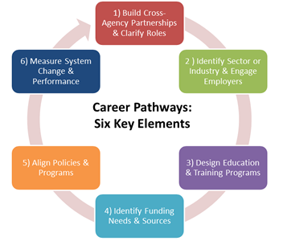

Slide 61
Certified Career Pathways
ç
Labor Market Demand
Employer Engagement
Career Advising
Ed. Program of Study /
Skill Training
Work
Work Based Learning
Collaboration

