Slide 1
Perkins Core Indicators of Performance Report
August 8, 2016

Slide 2
Perkins Performance Indicators
1P1 - Students who attain a 2.5 GPA or higher
2P1 - Students who complete a credential, certificate, diploma or degree
3P1 - Students who continue in CTE (retention or transfer)
4P1 - Students who are placed in a job (employment)
5P1 - Students who enroll in nontraditional program of study
5P2 - Students who complete a nontraditional program of study

Slide 3
1P1 Technical Skill Attainment
Source
Curriculum Registration, Progress, Financial Aid Report (CRPFAR) data file
Details
Numerator – Students who have a GPA of 2.5 or higher on courses at the 100 level or higher
Denominator – A concentrator is defined as any student enrolled in any semester during the reporting year in a non-transfer program area and by the end of the current reporting year has completed 12 non-developmental credit hours, 6 of which are CTE.
The curriculum program area is the primary active program code for the student listed in the CRPFAR file

Slide 4
1P1 – Technical Attainment

Slide 5
2P1 Credential, Certificate or Degree
Source
CRPFAR
Details
Numerator – Students who graduated with a certificate, diploma, or a degree
Industry-recognized credentials are not possible at the individual level for data matching to our students, so completion is based solely on credentials awarded by the individual colleges.
Denominator – CTE Concentrators from the previous year who did not re-enroll in the current reporting year

Slide 6
2P1 – Credential, Certificate, or Degree

Slide 7
3P1 Student Retention or Transfer
Source
CRPFAR
National Student Clearninghouse
Details
Numerator – Students who did not graduate the previous year are sent to the National Student Clearninghouse to see if they transferred during the current year. The enrollment at the transfer institution must begin between August 1 and May 31.
Denominator – CTE Concentrators who are enrolled in the fall of the previous year and who did not earn any credential during the previous year. Credentials are those awarded by the individual colleges and listed in the CRPFAR

Slide 8
3P1 – Student Retention or Transfer

Slide 9
4P1 – Student Placement
Source
CRPFAR
Employment Wage Records (Common Follow-up System)
Details
Numerator – CTE Concentrators who were found to have a record of employment in the second quarter following the program year in which the student exists
Denominator – CTE Concentrators from the previous year who did not return during the current year. These individuals are checked for employment records using the Employment Wage Records from the Department of Commerce
Inmates are NOT included in 4P1

Slide 10
4P1 – Placement into the Labor Force

Slide 11
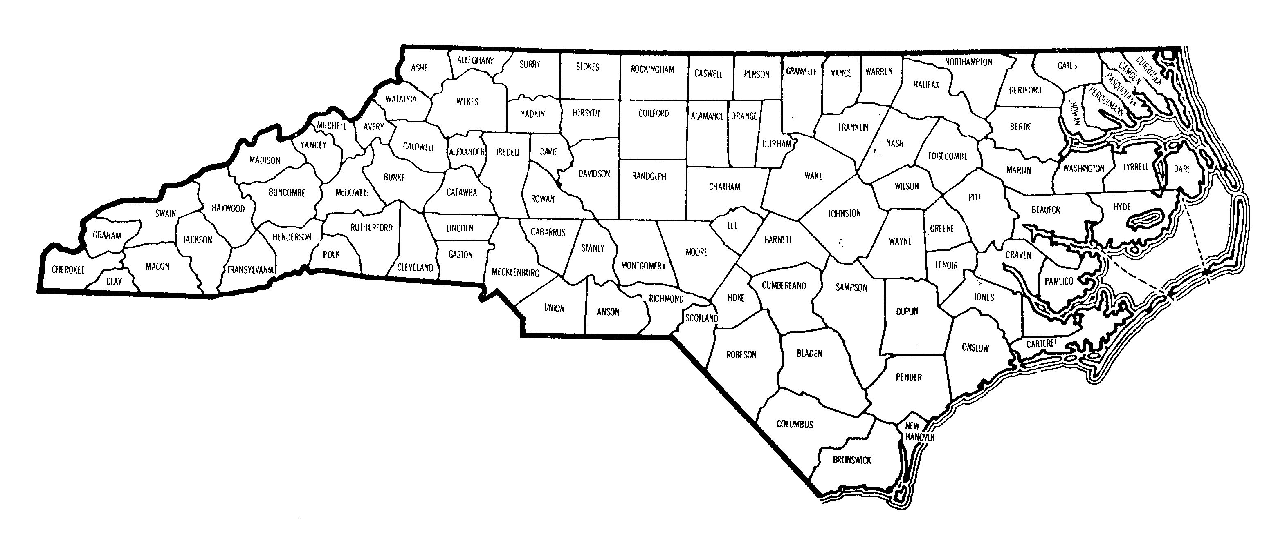
4P1 – Border Counties & Military Installations
Colleges that missed 4P1 by more than 10%
Military Installations

Slide 12
5P1 – Non-Traditional Participation
Source
CRPFAR
National Alliance for Partnerships in Equity (NAPE) Nontraditional Crosswalk
Details
Numerator – Students who’s gender does not match the majority gender in the program area as noted by NAPE
Denominator – CTE Participants are identified using the following methodology:
Not enrolled in a primary active program code of A10, C10, D10, T90, or P10.
Students must attempt 6 hours of CTE
College letter grades of NA and NS are not included, but W grades are included
Inmates are NOT included in 5P1

Slide 13
Non-Traditional Programs NOT included in the 2007 NAPE Crosswalk
A15230 – Golf Course Mgt Tech
A15420 – Viticulture & Enology Tech
A15410 – Sustainable Agriculture
A20150 – Environmental Bio Tech
A20190 – Nanotechnology
A25110 – Hospitality Mgt
A40120 – Automation Engineering Tech
A45110 – Associate Degree Nursing
C45180 – Central Sterile Processing
A45190 – Clinical Trials Research Associate
A45630 – Health & Fitness Science
A45430 – Healthcare Interpreting
A4538F – Human Services Tech/Animal Assisted Interactions
C45390 – Licensed Practical Nurse Refresher
A45800 – Magnetic Resonance Imaging
C45380 – Mammography
C45480 – Nursing Assistant
D45930 – Nursing Assistant
C45650 – Polysomnography
A45670 – Polysomnography
D45660 – Practical Nursing
A45730 – Speech-Language Pathology Assistant
A50510 – Electric Utility Substation & Relay Tech
A55370 – Community Spanish Interpreter
A55210 – Cyber Crime Tech
A55460 – Emergency Mgt
A55300 – Interpreter Education
A55220 – Outdoor Leadership
A60150 – Aviation Electronics (Avionics) Tech
D60310 – Recreational Vehicle Maint & Repair Tech

Slide 14
5P1 – Nontraditional Program Participation

Slide 15
5P2 Non-Traditional Completion
Source
CRPFAR
NAPE Crosswalk
Details
Numerator – Students whose gender does not match the majority gender in the program area as noted by NAPE
Denominator – CTE Concentrators for the current reporting year completing a non-traditional program. Completion is identified as those having a graduate record in the CRPFAR during the current program year.
Note: Programs that finish during that summer semester are counted during the following academic year.
Inmates are NOT included in 5P2

Slide 16
5P2 – Nontraditional Program Completion

Slide 17
2015 Perkins Core Indicators of Performance Report
The complete report can be downloaded from www.ncperkins.org under Performance Data

