Slide 1
Perkins Update
March 8, 2022
Notes:
Good Morning and welcome to our 8th Perkins Update provide technical assistance to the field on line.
Sharing promising practices with our colleges
Highlighting various elements of the grant to improve grant performance.
Perkins V asks us to strengthen our nations workforce, through academic, technical, and employability skills
Level the playing field for Special Populations as we work for continuous improvement with our local stakeholders.

Slide 2
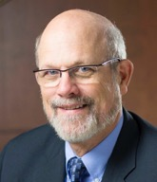
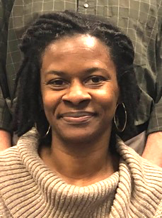
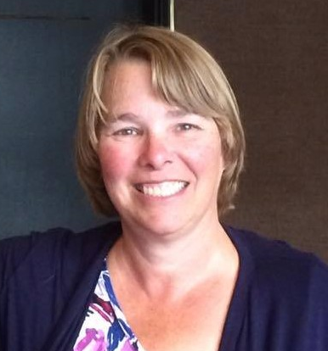
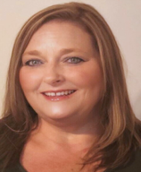
Team Perkins
Bob Witchger
Tony Reggi
Darice McDougald
Patti Coultas
Mary Olvera
Notes:
Dr. Bob Witchger
919-807-7126
WitchgerB@nccommunitycolleges.edu
Dr. Tony R. Reggi
919-807-7131
ReggiA@nccommunitycolleges.edu
Patti Coultas
919-807-7130
CoultasP@nccommunitycolleges.edu
Dr. Mary Olvera
919-807-7120
OlveraM@nccommunitycolleges.edu
Darice McDougald
919-807-7219
McDougaldD@nccommunitycolleges.edu
Here’s our Staff

Slide 3
Purpose of Perkins
Develop more fully the academic knowledge and technical and employability skills of secondary education students and postsecondary education students who elect to enroll in CTE curriculum programs and programs of study
Notes:
The Strengthening Career and Technical Education for the 21st Century Act reauthorized and updated the Carl D. Perkins Career and Technical Education Act of 2006 to become the current Carl D. Perkins Career and Technical Education Act of 2006 as amended by the Strengthening Career and Technical Education for the 21st Century Act (Perkins V)
This updated act stresses:
- Academic, Technical, and Employability Skills
- Funding Secondary and Postsecondary CTE
- Focusing on Students who elect to enroll in CTE Programs of Study

Slide 4
Promising Practice Video 2021
Nash Community College
New Computers for the Gaming Simulation Programming Program
https://www.ncperkins.org/video/video.php?v=Nash-2021&y=2021
See all the videos:
https://www.ncperkins.org/video/
Notes:
Nash Community College provides us with the promising practice today.

Slide 5
NCCCS Wants to know…
Notes:
Poll Attendees
From time to time we get asked questions on how things are going.
Special population are up front in our mission to build the future workforce.
The question today does you college have a food pantry for students.

Slide 6
Federal Perkins Audit
Please submit any outstanding
2020-21 End-of-Year documents
especially plan update/status and XDBR

Slide 7
Postsecondary Perkins Subrecipient Monitoring
Personnel – Time and Effort
Equipment – List and Images
Site Monitoring - CLNA Elements and Interviews
Notes:
NCCCS conducts ongoing monitoring based on required activities in the Carl D. Perkins V Career and Technical Education Act to ensure sub recipients are administering programs that are in compliance with federal and state requirements.
This monitoring is performed through “desktop” and “on-site” reviews.
Colleges are selected for monitoring based on risk factors identified around federal statues, state regulations, and terms and conditions of the sub-award.
All colleges receiving funds under the Carl D. Perkins V will be reviewed at least once during the life of the act.
NOTE: Sub-Recipient monitoring will be adjusted based on updates or changes in the federal legislation. Colleges will be notified of these updates in a timely manner to facilitate the comprehensive monitoring process.
Technical assistance to colleges on grant administration is provided when requested or required.

Slide 8
Determining Risk Factors
Attendance at monthly technical assistance updates
Identification of 5 Contacts
Grant Size
Submission of Pathways
New Coordinator
Notes:
We have determined risk factors for identification of colleges to review.
Attendance at our Monthly Perkins Meeting – this is our opportunity to share with our colleges updates, promising practices, ideas for professional development and general improvement of the Basic Grant.
Contact information – to keep the college engaged with will communicate with various staff from time to time
The allocation of size of the grant,
Submission of your 9-14 pathways, your depiction on how students move from secondary to postsecondary education toward that postsecondary credential
New Coordinator, that may be in need of technical assistance.

Slide 9
Postsecondary Perkins V Site Monitoring 2021-2022 Program Year Carl D. Perkins V, Section 134 (C.1)
With disruptions in program services due to COVID many colleges were challenged in addressing all the elements identified in the Comprehensive Local Needs Assessment (CLNA).
The 2021-22 monitoring will continue program reviews and technical assistance to determine how colleges are implementing Perkins V at the postsecondary level.
Notes:
Site Monitoring
North Carolina Postsecondary Perkins V site monitoring places emphasis on the comprehensive local needs assessment (CLNA) as the college works to identify and address gaps in program of study while using funds to enhance pathways, align programs of study, and provide faculty professional development with accountability measures.
Throughout all elements of the review and implementation of the act emphasis is placed on leveling the “playing field” for special populations who elect to enroll in CTE programs of study as well as marketing to special populations in efforts to include them in a technical programs of study.
As colleges continue the implementation of Perkins V, the NCCCS Perkins team will monitor in the spirit of the new legislation with emphasis on “discovery with technical assistance.”

Slide 10
Postsecondary Perkins V Site Monitoring 2021-2022 Program Year Carl D. Perkins V, Section 134 (C.1)
For each section, we will ask the monitored college to provide
A bulleted list or paragraph on the process your college followed in addressing each part of the assessment
How it has informed your local Perkins Plan.
During the monitoring you will be asked to provide additional back up documentation to support your CLNA summary submitted in the application process.
Notes:
Postsecondary site monitoring for the 2021-2022 Program Year will center around the Carl D. Perkins V, Section 134 (c) 1- (e) 4).
Monitoring will seek to determine how the college is making a difference in student achievement by addressing key elements in the Comprehensive Local Needs Assessment (CLNA).

Slide 11
Site Monitoring Areas
Student Performance in CTE programs with respect to state determined and local levels of performance.
The CTE programs offered are of sufficient size, scope, and quality to meet the identified labor market need
Progress in implementing and/or enhancing Programs of Study/Career Pathways with high skill, high wages, or in-demand occupations that are aligned to local labor market.
Faculty Professional Development, Recruitment, Retention, and Placement.
Notes:
The monitoring will review the areas of: student performance; CTE program size, scope and quality; progress in implementing and enhancing programs of study leading to attainment of high skill, to earn higher wages or in-demand occupations identified by regional stakeholders aligned to the labor market; faculty skill development to enhance instruction, including recruitment, retention, and placement; and equal access to high quality CTE programs of study for all students.

Slide 12
Site Monitoring Areas continued:
Equal Access to high-quality CTE programs of study for all students Budget – How are funds allocated based on CLNA gaps, and how are funds allocated in a timely manner to have a positive effect on programs of study aligned to meet labor market needs?
Budget: How are funds allocated based on CLNA gaps, and how are funds allocated in a timely manner to have a positive effect on programs of study aligned to meet labor market needs?
Notes:
As the Pandemic allows, interviews with faculty and staff will be conducted to determine activities and strategies the college has implemented with the use of Perkins and local college funds to assist faculty in developing in improving instruction leading to new skills for our students and credentials to enhance Career and Technical Education at the college.

Slide 13
How we will monitor
Document Review
Interviews
Faculty Professional Development
Career Pathways
Performance
Notes:
Interviews will take place with deans or vice presidents to learn of progress in working with high schools as well as outlining and implementing career pathways that are documented on a variety of matrices.
Interviews with our local college Perkins coordinators will help us better understand the college annual negotiated levels of performance around (1P1) Students placed in employment; (2P1) Students earning a postsecondary credential and (3P1) Students enrolled in and participating in non-traditional programs of study.

Slide 14
1. Student Performance in CTE programs with respect to state determined and local levels of performance Section 134 (c) (A)
How are students progressing on CTE Programs of Study
Review
Students Placement by Program of Study
Students earning certificates, diplomas, and degrees by Program Area
Student participation in programs that are non-traditional for their gender.
Gaps identified in serving Special Populations.
Support Documentation.
Review of process for student performance data and source
Identified gaps in student performance with strategies for improvement
College plan to address strategies for improvement
Notes:
In the past we placed emphasis on the monitoring for the required activities, now our local plan provides us with an outline of your college Activities addressing Core Indicators with identified sources of Funds. During the past several years, our staff frequently reviews these plans in such identified areas as Administration, Career Exploration, Professional Development, student Skill Attainment, Academic Integration to Increase Students Achievement, Evaluation of CTE Programs, Equipment, Faculty and Staff, integrations of CTE Organizations aimed at better engaging employers and enhancing the curriculum through projects and contests.
Let’s take a quick look at the rubric that will be guiding us during a site monitoring.
When conducting the CLNA we seek to determine how the college reviewed Student Performance in “Pathway or Programs of study” identified as high need areas, looking at student Placement, Non-Traditional Participation, and Gaps in serving Special Populations:

Slide 15
2. The CTE programs offered are of sufficient size, scope, and quality to meet the identified labor market need - Section 134 (c) (B)
Is the college offering a sufficient number of programs and courses in each reviewed pathway?
Is the college meeting employer and student needs for courses in the pathway?
Is the quality of instruction leading students to earn postsecondary credentials for jobs with sustainable wages?
Are the employers satisfied with recent graduates?
Review
The CTE programs offer adequate number of classes and seats/space for student enrollment?
Program offers a sequence of courses and have sufficient equipment to teach the skills?
Do employers feel the graduates are prepared to go to work?
Dashboard data on completion and placement.
Support Documentation
Need evidenced in the CLNA and reflected in the Local Plan
Curriculum Standards are approved and in place; Advisory Committee Notes
Performance Data on Graduates ; Employer Interviews
Notes:
Next we will ask did the CTE programs reviewed meet : Size enough seats or courses to address student demand for that field of study; Scope in incorporating high school and colleges programs or study, and quality in graduating students, employed in related areas earning a sustainable wage
During the CLNA process, we will seek to understand what you learned from your stakeholders about improving the programs of study, aligned to the labor market providing employers with qualified graduates work ready.

Slide 16
3. Progress in implementing and/or enhancing Programs of Study/ Career Pathways with high skill, high wages, or in-demand occupations that are aligned to local labor market needs Section 134 (c) (C.)
How does the college enhance programs and learning outcomes to meet employer needs?
How did you determine equipment to be purchased to better prepare students to meet employer identified needs?
How does institutional effectiveness/evaluations inform programs of study aligned to industry needs?
Review
College Programs of Study Grades 9-14 ; College Programs of Study Grades 13-14
Plans for additional programs of study
Support Documentation
Advisory Committee Notes
College Matrix outlining Programs of Study
College Brochures outlining Programs of Study
Elements of Programs of Study Evident: Career Counseling, Curriculum Approved Courses, Work-Based Learning, Job-Placement Services, engaged employers, credentialing, articulated credit
Evidence of work to build out additional 9-14 Pathways
Notes:
During the CLNA process, we will seek to understand what you learned from your stakeholders about improving the programs of study, aligned to the labor market providing employers with qualified graduates work ready.

Slide 17
4. Faculty Professional Development, Recruitment, Retention, and Placement Section 134 (c) (D)
How is support for faculty teaching in identified Programs of Study supported?
What are the college strategies for faculty skill development, recruitment, and retention?
Review
Professional Development Workshops
Faculty Professional Development Plans
Advertisements for Faculty
Strategies for faculty retention
Are faculty upgrading their skills to enhance courses in the programs of study?
Support Documentation
Professional Development Plans
Retention plan and wellness plan
Outline/Agenda of Workshops
Position Announcements
Notes:
Next the CLNA recognizes that qualified and certified faculty are key to program success. What light did the CLNA shed on Faculty skill development, recruitment strategies, and retention of faculty, what suggestions did our stakeholders have and what progress are you making in that area.

Slide 18
5. Equal Access to high-quality CTE programs of study for all students Section 134 (c) (E)
How does the college identify and serve the nine identified special populations in Perkins V?
How does the college reach out to support and garner support from agencies serving these students enrolled in CTE programs of study?
What resources does the college provide to special population students to address their needs and promote success.
What community partnerships exist for student support and how are students informed of these services.
Review
Programs designed to enable special populations to meet local levels of performance
Activities for Special Populations
Strategies to overcome barriers in enrollment for special populations are evident.
Support Documentation
Redesigned Curriculum for Special Populations
Tutoring Programs to enable special populations to compete
Notes:
Reaching out to all students is an underlying theme of Perkins V. Engaging with Stakeholders representing the 9 special populations is key in the CLNA process as it is key to the recruitment and retention of students.

Slide 19
6. Budget – How are funds allocated based on CLNA gaps, and how are funds allocated in a timely manner to have a positive effect on programs of study aligned to meet labor market needs?
How does the college Perkins Coordinator and college budget department communicate on purchasing services, equipment, and supplies aligned to the Section 135 to meet the needs in the CLNA?
How is the budget department informed of Perkins V and the importance of the CLNA in informing the CTE enhancement work of the college?
Review
Evidence of on-going communication/meetings with CTE faculty, deans, CAO, Budget Officials, and Perkins contact
Evidence of budget modifications
Support Documentation
Evidence of on-going communication/meetings with CTE faculty, deans, CAO, Budget Officials, and Perkins contact
Evidence of budget modifications
Notes:
Allocating funds based on the CLNA gaps drives the local Perkins V plan.
We will look at how your college allocated both state and federal dollars to meet the identified needs

Slide 20
Interviews: Faculty Professional Development
Professional development activities and strategies your college has implemented with the use of Perkins and Local College funds to assist faculty in enhancing their Career and Technical Education Programs.
How is the college enhancing faculty knowledge and skills of local industry practices?
How are faculty making students aware of all aspects of industry in their teaching?
How are faculty improving their teaching using technology?
How are faculty discovering opportunities for students to engage in work-based learning including 1) exploring careers, 2) experiencing work, and 3) enhancing instruction through work experience related to classroom learning?
Notes:
Finally, we will conduct a series of interviews with
Faculty to learn from them how Perkins V is meeting their needs to enhance the teaching and incorporating WBL into their classroom

Slide 21
Interviews: Career Pathways: Chief Academic Officer or CTE Dean
Over the past years, colleges have been working with high schools to outline a minimum of three career pathways that are documented on a variety of matrices. Tell us how Perkins funds have been used to develop new and/or enhance existing career pathways, programs of study, and their elements.
Activities implemented to:
How is the college building relationships between secondary and postsecondary faculty?
How is the college building relationships between high school and college counselors?
How are employers engaged in the process of initiating and carrying out programs of study?
How is Career Advising informing students of these pathways?
How does the college coordinate the secondary to postsecondary pathway for students in pathways?
What are different strategies the college is using to infuse work-based learning into programs of study?
Notes:
From the CAO or CTE Dean on how 9-14 pathways, the scope of programs of study have been laid out to show a seamless pathway to a postsecondary credential (our certificate, diploma, or degree) , communicat4ed to students, parents, counselors, and stakeholders,

Slide 22
Interview on Performance: Perkins Contact
The federal Perkins act calls for postsecondary institutions receiving federal funds to have a plan for continuous improvement. This is reflected in our annual negotiated levels of performance around these three indicators: (1P1) Post program Placement (placement in employment or further education), (2P1) Earned Recognized Postsecondary Credential, and (3P1) Nontraditional Program Concentration (concentration in program nontraditional for student’s gender)
Presentation of CTE performance Measures to Senior College Leadership and to the College Board of Directors
Presentation of CTE Performance Measures to Faculty and developing strategies for continuous improvement
Providing for Faculty and Staff Professional Development around performance measures that are below the negotiated level of performance
Notes:
Finally, Perkins v calls for continuous improvement, we negotiate will colleges every year around 3 postsecondary indicators, Placement, Credentials, and non- traditional participation. We will talk with our Perkins contacts on how college are progressing in program improvement through these three data elements.

Slide 23
Employee Monitoring
Employees spending 100% on CTE/Perkins approved activities
July – December semi-annual time certification
Split Time and Effort Employees
February XDBR
Planned or Budgeted Time
Actual Time Spent on Perkins Activities
Supporting Documentation
Notes:
That about wraps it up for Site Monitoring,
We will conduct a short exit interview following our visit and follow up with a letter of findings and technical assistance as needed.

Slide 24
Equipment Monitoring
List of Equipment
Photos of equipment in Place/Use
Asset Tag
Over $25,000 not purchased from a business that is debarred
College Monitoring Process for Equipment

Slide 25
Upcoming Spring Perkins Workshops
Perkins 101
Highlighting history
Perkins V Act
EDGAR
Operational procedures
Annual Meeting
Procedures for Applying for Funding for 2022-23
Procedures for managing the grant
How to use the NCPerkins moodle

Slide 26
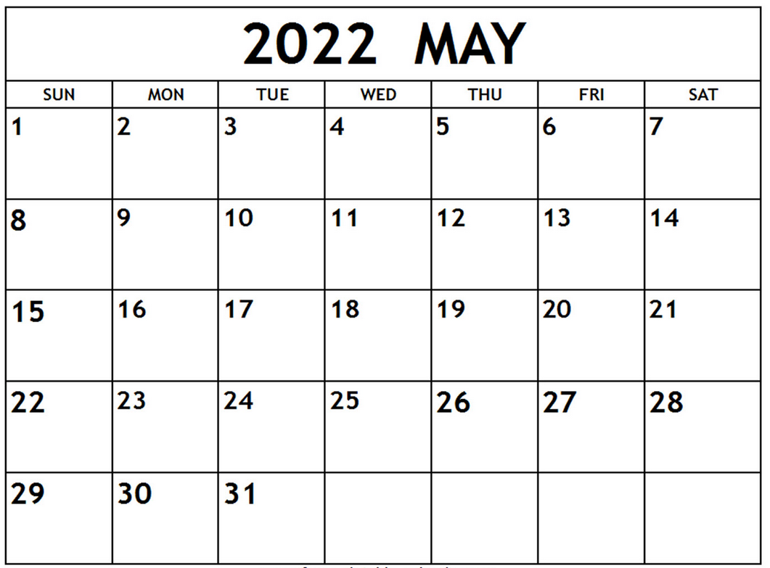
Deadline coming!
All modifications
must be
submitted by
May 15th

Slide 27
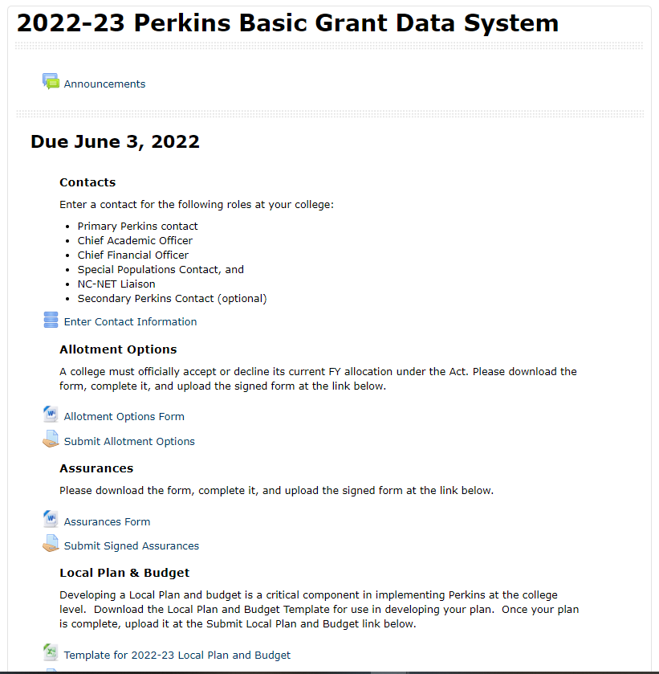
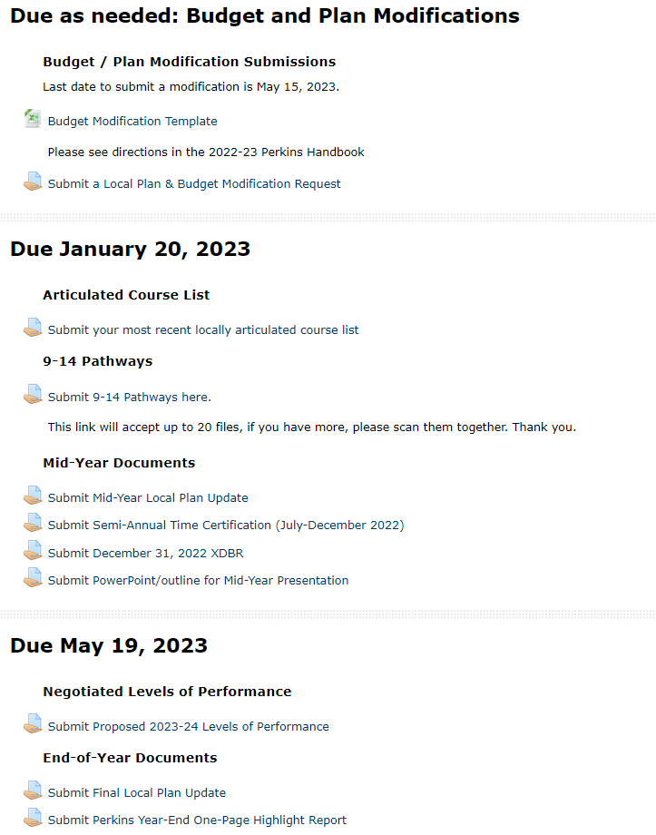
Improved Organization of the 2022-23 Moodle
Hear more at the Annual Meeting

Slide 28
Perkins 101 Workshop and Annual Meeting
Virtually:
Perkins 101 Workshop: Wednesday, April 13 from 9am-12pm Annual Meeting: Tuesday, April 19 from 9am-12pm
** Register now ncperkins.org/presentations
In-Person with SkillsUSA: Koury Center, Greensboro Perkins 101 Workshop: April 27 1-4pm Annual Meeting: April 28, 9am-12pm
** Register now

Slide 29
End-Of-Year Promising Practice Video
Hold horizontally when filming

Slide 30
Leadership Projects
Current Projects
Upcoming
CORD
SkillsUSA-NC
EDU Curriculum Alignment Project
ABLR Disability Inclusion Project
Career Cluster Guide
Immersive Learning Conference
Cyber Security (EC-Council/Cisco)
Apple Swift
Success Coach training with Student Services
BLET Curriculum Development

Slide 31
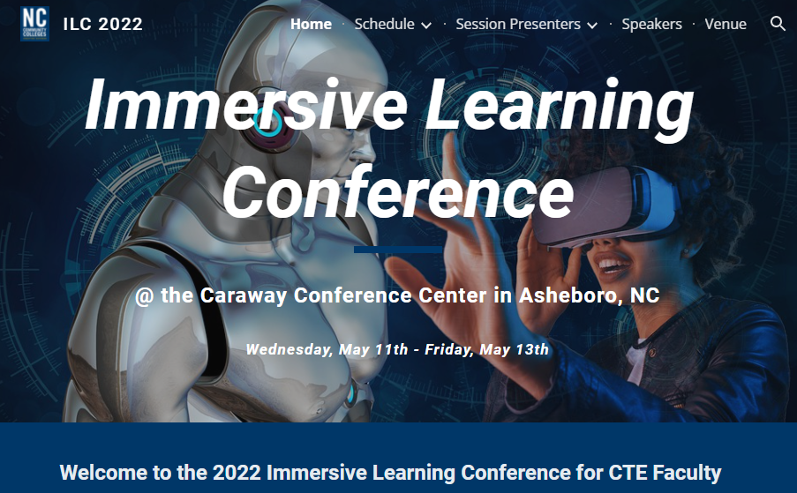
Immersive Learning Conference
Career Cluster Focus
Transportation, Distribution & - (Automotive Services, Collision Repair, Diesel)
Architecture & Construction - (Carpentry, Electrical, HVAC, Masonry, Plumbing)
Manufacturing - (Advanced Manufacturing, Metals, Welding, Woodworking)

Slide 32
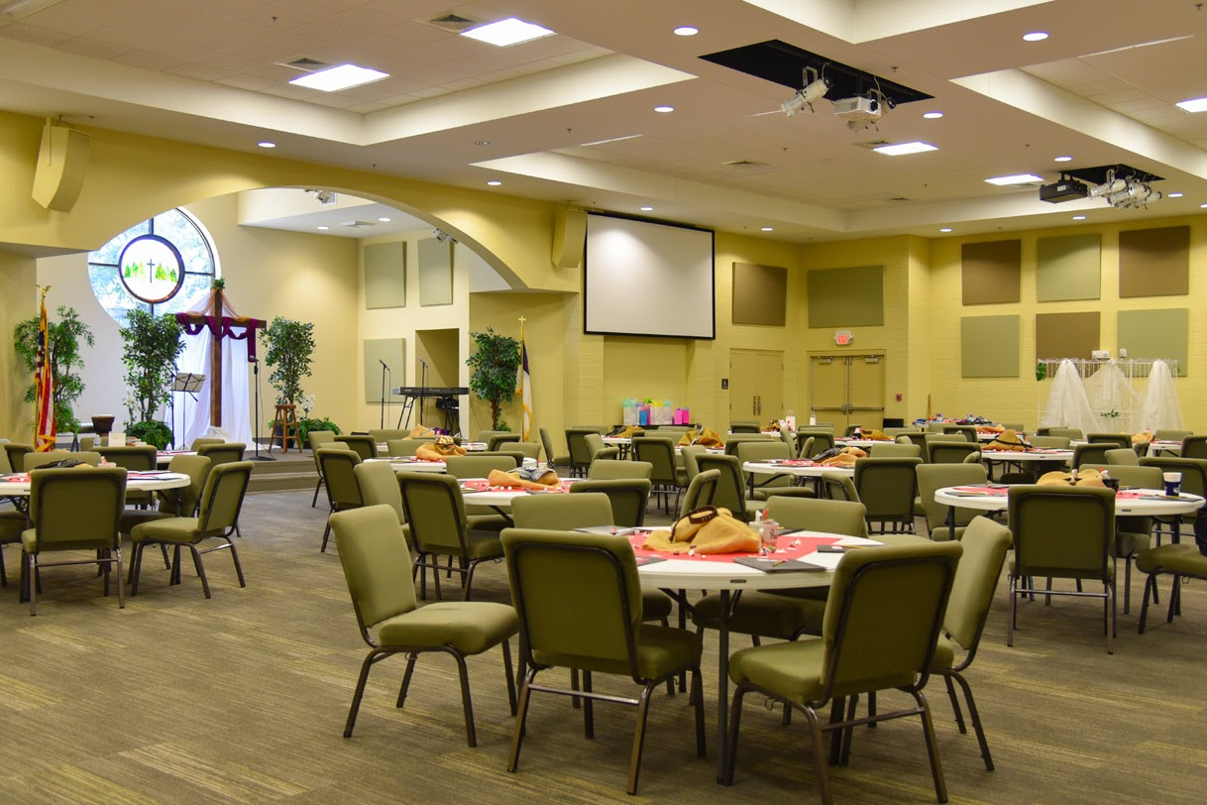
Immersive Learning Conference
Wednesday, May 11th – Friday, May 13th
Caraway Conference Center, Asheboro, NC
Perkins Funded:
Registration
Lodging
Meals
ALL attendees and participants will be responsible for paying for transportation to and from the Caraway Conference Center

Slide 33
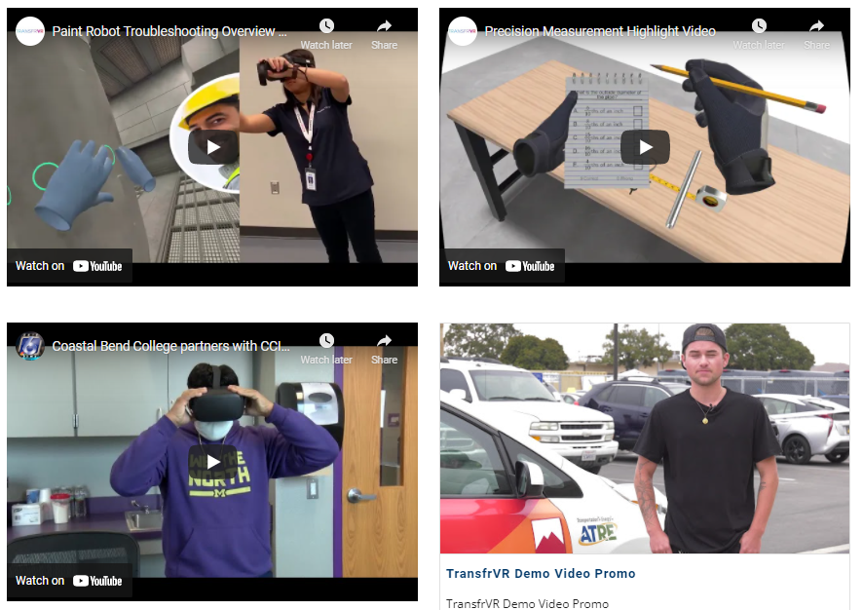
Speakers
Dr. Lane Freeman – Evaluating Immersive Learning Technology for the CTE Classroom
Dr. Joe Parlier and Michael Carbenia – Augmented and Virtual Reality Transform Teaching and Learning in CTE Classrooms
Hall Charter and Katelyn Cutshall – Implementing “Diesel by Distance” in Alabama
Scott Rawlings and Thomas Winkely – The Future of VR, MR, and AR and how to Scale these Technologies

Slide 34
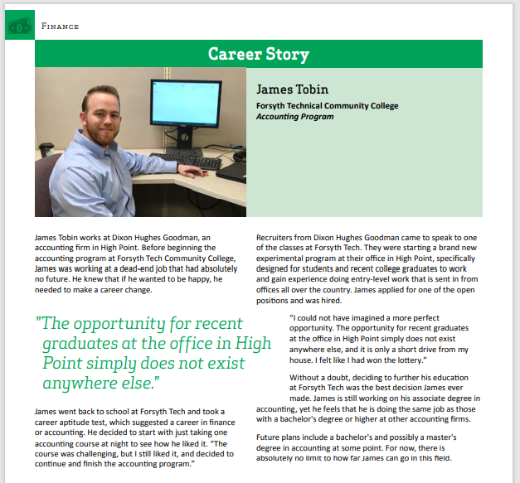
Career Cluster Guide – 2022
Stay tuned!
We will need new success stories from your graduates

Slide 35
Performance Partnership Webinars
March 17 3-4pm: Promising Practices for Minority Student Recruitment
April 14 3-4pm: Promising Practices to Close Equity Gaps Associated with Student Completion
June 16 3-4pm: Personas Project: Personifying Student Data to Improve Performance
For descriptions and registration see flyer uploaded on NCPerkins.org/presentations for February 8, 2022

Slide 36
NACTEi Spring Conference
https://nactei.org/conference/
May 9th is a preconference with Brustein and Manasevit on EDGAR. This is a separate registration & fee www.bruman.com

Slide 37
NCWorks Partnership Conference
https://www.nccommerce.com/jobs-training/workforce-professionals-tools-resources/ncworks-training-center/ncworks-partnership
Notes:
https://www.nccommerce.com/jobs-training/workforce-professionals-tools-resources/ncworks-training-center/ncworks-partnership

Slide 38
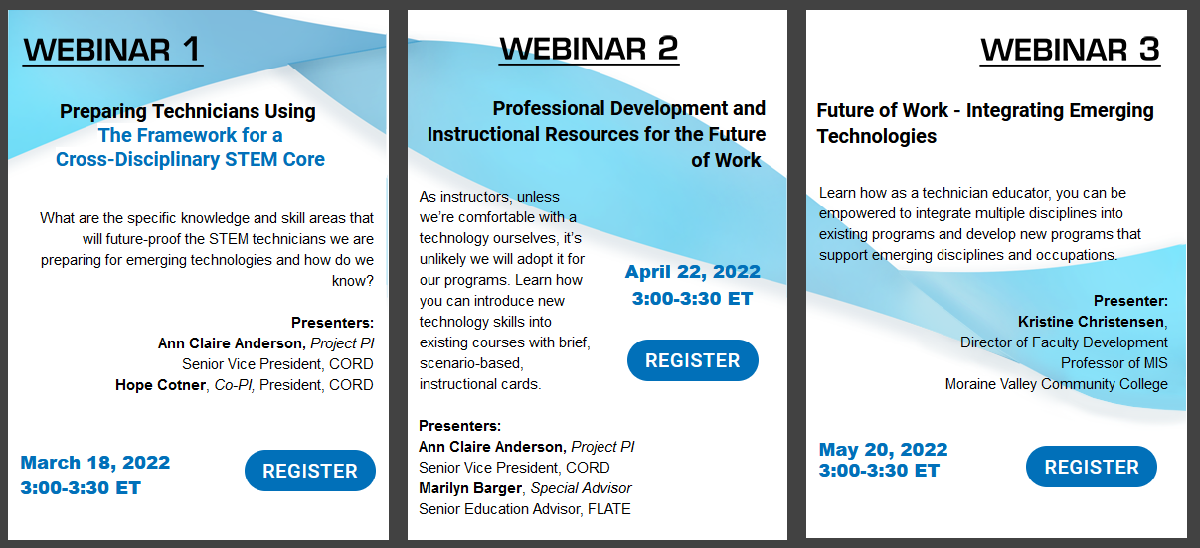
From CORD
https://www.preparingtechnicians.org/webinars/
Notes:
https://www.preparingtechnicians.org/webinars/

Slide 39
Perkins Monthly Updates
2nd Tuesday of the month (not December) from 9-10 am
Next update is April 12, 2022
Registration link https://www.ncperkins.org/presentations/
Attendance (or viewing the recording within 30 days) is recorded on monitoring rubric. Recording may be found at same link as registration.
Notes:
Register now and let the system remind you.

Slide 40
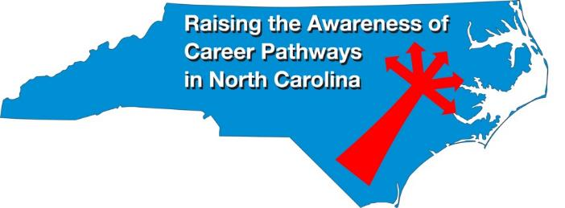
Raising the Awareness of Career Pathways Webinars
3rd Wednesday of the month from 9-10am
Next webinar is March 23, 2022 – Note Date Change!
Come explore careers in AC, Heating, & Refrigeration
Registration link: https://www.ncperkins.org/presentations/

Slide 41
NC*NET
NC-NET (NC Network for Excellence in Teaching) Professional learning in partnership with CORD
www.nc-net.info
Offerings:
NC Academy - facilitator-led online courses for faculty, upcoming offering on Curriculum Development for Integrated Instruction.
Self-Paced Professional Development: Teaching Contextually, Teaching Employability Skills, Adjunct Faculty Roadmap, and Exploring Stackable Credentials
Online instructor resources
Notes:
https://www.ncperkins.org/presentations/

Slide 42
Promising Practice Video 2021
Mayland Community College
Peer tutoring program for students in the Nursing Program
https://www.ncperkins.org/video/video.php?v=Mayland-2021&y=2021
See all the videos:
https://www.ncperkins.org/video/
Notes:
Stop video at 3:55
March 2022
Nash
Mayland
April 2022
Lenoir
Johnston
May 2022
James_Sprunt
Halifax
Gaston
Forsyth
Fayetteville
Edgecombe
Durham
Davidson
Craven
Coastal_Carolina
Central_Piedmont
Carteret
Cape_Fear
Caldwell
Brunswick
Blue_Ridge
Beaufort
AB_Tech

Slide 43
Technical assistance is available
We are here to help!
Team Perkins is available by phone, email, TEAMS, or in-person

Slide 44
Perkins/CTE Team
Dr. Bob Witchger Director, Career & Technical Education WitchgerB@nccommunitycolleges.edu 919-807-7126
Dr. Tony R. Reggi Coordinator, Career & Technical Education ReggiA@nccommunitycolleges.edu 919-807-7131
Patti Coultas Coordinator, Career & Technical Education CoultasP@nccommunitycolleges.edu 919-807-7130
Dr. Mary Olvera Coordinator, Career & Technical Education OlveraM@nccommunitycolleges.edu 919-807-7120
Darice McDougald CTE Administrative Assistant McDougaldD@nccommunitycolleges.edu 919-807-7219
Notes:
http://www.ncperkins.org/course/view.php?id=6

