Slide 1
Perkins Update
December 10, 2024

Slide 2
Bob’s retiring!
February 1, 2025

Slide 3
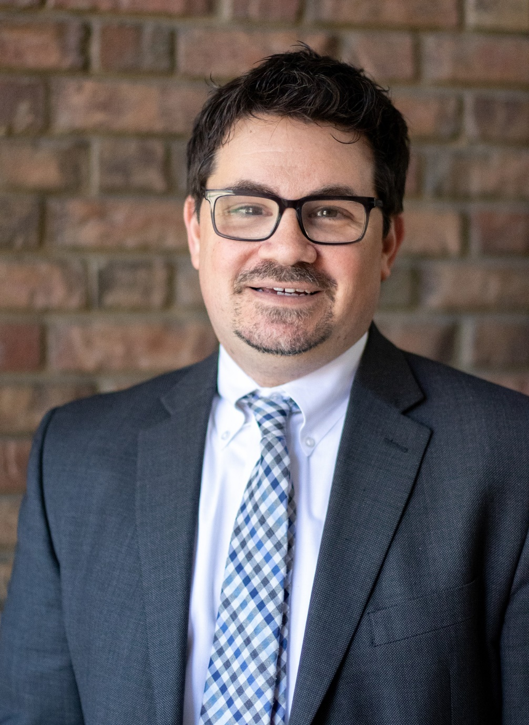
Dr. Seth Kamen
State Director of Credit Mobility
kamens@nccommunitycolleges.edu

Slide 4
NCCCS Programs/Perkins Staff
Peyton Bell Director of Curriculum Management
Patti Coultas Assistant Director of Perkins CTE - East
Dr. Lisa Eads Associate Vice President of Programs
Dr. Lane Freeman Director of Online Learning Programs and Student Services
Dr. Trudie Hughes State Director of Disability Services and Title IX
Dr. Seth Kamen State Director of Credit Mobility
Dr. Hilmi Lahoud Sr State Director of Business & IT and Academic Programs Operations
Aaron Mabe State Director of Dual Enrollment and Ag & Natural Resources Technology
Darice McDougald Perkins Program Specialist
Dr. Jennifer McLean State Director of Advising and Coaching
Dr. Mary Olvera State Director of Teacher Ed., Public Services, & Perkins Special Populations
Ashley Parrott State Director of College Ready Graduates and Developmental Education
Dr. Tony Reggi Associate Director of Perkins CTE
Reyna Rodriguez Director of Course Management and Credentialing
Todd Roth State Director of Skilled Trades and Work Based Learning
Stefanie Schroeder Assistant Director of Perkins CTE – West
Melissa Smith Senior State Director of Health Science Programs
Dr. Bob Witchger Executive Director of Perkins CTE

Slide 5
Purpose of Perkins V
Develop more fully the academic knowledge and technical and employability skills of secondary education students and postsecondary education students who elect to enroll in CTE curriculum programs and programs of study.

Slide 6
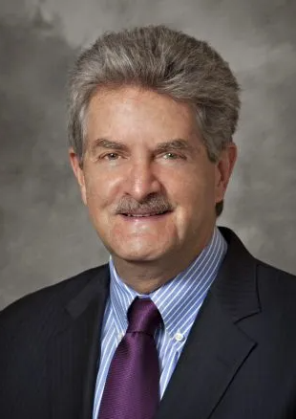
Michael Brustein, Esquire
Having served as an attorney adviser to the former United States Office of Education, and Chief of the Adult and Vocational Education Branch in the HEW Office of General Counsel / Education Division, Michael Brustein served on the transition team to establish the United States Education Department. Following the opening of the new federal department in May 1980, he founded the firm Brustein & Manasevit with Leigh Manasevit (retired) in July 1980. In 2023, the Firm changed it name to The Bruman Group, PLLC paying homage to both founding partners.
Over the past 40 years, the Firm has worked with all 50 states, many school districts, postsecondary institutions, and national education organizations on issues related to federal support of education and workforce development. Over this period of time Michael Brustein has been recognized as one of the nation’s leading experts on federal grants management, audit resolution, as well as workforce education and development issues.

Slide 7
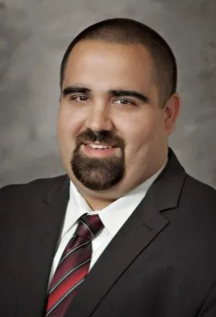
Steven Spillan, Esquire
Mr. Spillan joined the Firm in January 2006 as a Legislative Assistant. In 2011, Mr. Spillan became as Associate with the Firm and in 2020 he became a Partner. Mr. Spillan assists clients with federal grants management and various federal education programs, including the Elementary and Secondary Education Act, the Strengthening Career & Technical Education for the 21st Century Act, the Workforce Innovation & Opportunity Act, the Federal Funding Accountability & Transparency Act, the Digital Accountability & Transparency Act, and the Family Educational Rights and Privacy Act.
Mr. Spillan also works with clients on compliance with applicable rules and regulations under the Uniform Grant Guidance (UGG), as adopted by the Education Department General Administrative Regulations (EDGAR). This includes providing training on applicable grants management rules, assisting clients with drafting/updating written policies and procedures for their federal grants, conducting mock monitoring reviews to detect any material weakness in a non-federal entity’s internal controls, and assisting clients in resolving any audit or monitoring findings.

Slide 8
Michael Brustein, Esquire
bruman.com
Steven Spillan, Esquire

Slide 9
In-Person Mid-Year Review
February 4-5, 2025​
​Caraway Conference Center​
You may arrive the evening of Feb. 3rd​
All expenses are covered (lodging & meals) except travel (mileage & meals during ​travel)​

Slide 10
Optional Perkins 101 on February 3rd
Optional
February 3, 2025​
3:00 – 5:00 pm
​Caraway Conference Center​
Registration is separate on the form​

Slide 11
Mid-Year Agenda
Tuesday, February 4th 8:30 – 5:00
Advance CTE Opportunity Gap Analysis for CLNA Section E: Progress toward Improving access and equity for all students
Wednesday, February 5th 8:30 – 3:00
Debrief Opportunity Gap Analysis training
Connections between Propel NC and Perkins
Credit Mobility
Round Table discussions and sharing

Slide 12
Round Table Topics
Mid-Year registration email will include a form asking for round table discussion topics you would like to discuss with your colleagues.
Please complete this so we can design sessions that will be valuable to you.

Slide 13
Mid-Year Documents
Local Articulated Course List (or document stating your college doesn’t have one)
9-14 Career Pathways
Local Plan status update (Excel file with last two columns updated to current status)
December 31, 2024, XDBR Budget Report
Semi-annual time certifications for July-December 2024
Mid-Year Report
Due
January 10,
2025

Slide 14
Carry-Over Modifications
Due by Dec. 18th to be approved before the holidays
Please submit your modification as soon as possible.
Contact us if you need assistance.

Slide 15
Mid-Year Report
A brief written update on
How is the implementation of your college's local plan going? Please include if spending is on track – bullets, or no more than 500 words, and
Is there anything the Perkins Team can do to assist your college?
** No PowerPoint or video

Slide 16
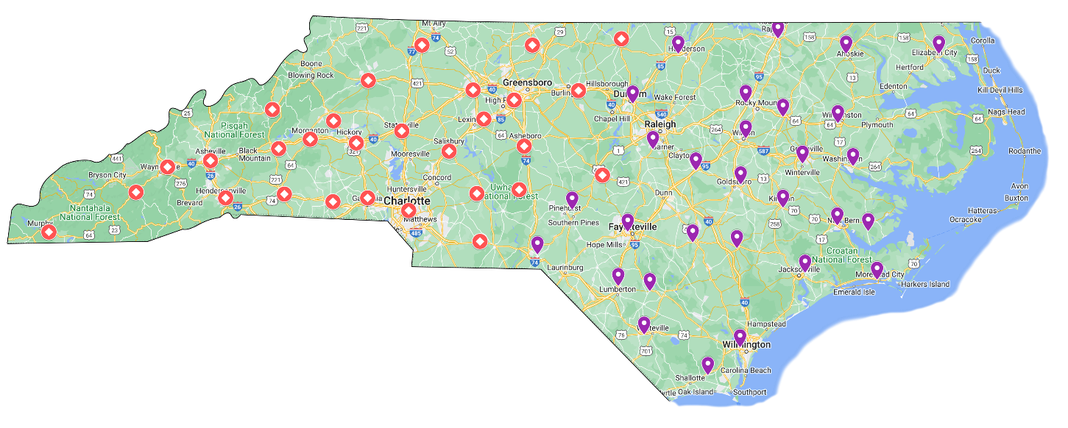
Contact us with your questions!
MAIN CONTACTS
West: Stefanie Schroeder schroeders@nccommunitycolleges.edu
East: Patti Coultas coultasp@nccommunitycolleges.edu

Slide 17
Virtual Office Hours for Technical Assistance
Need help?
Let's meet!
2nd Tuesday of the month 1-2pm
4th Wednesday of the month 9-10am
** Teams link at the top of NCPerkins.org/presentations
Drop in to ask the NCCCS CTE Perkins Team your questions

Slide 18
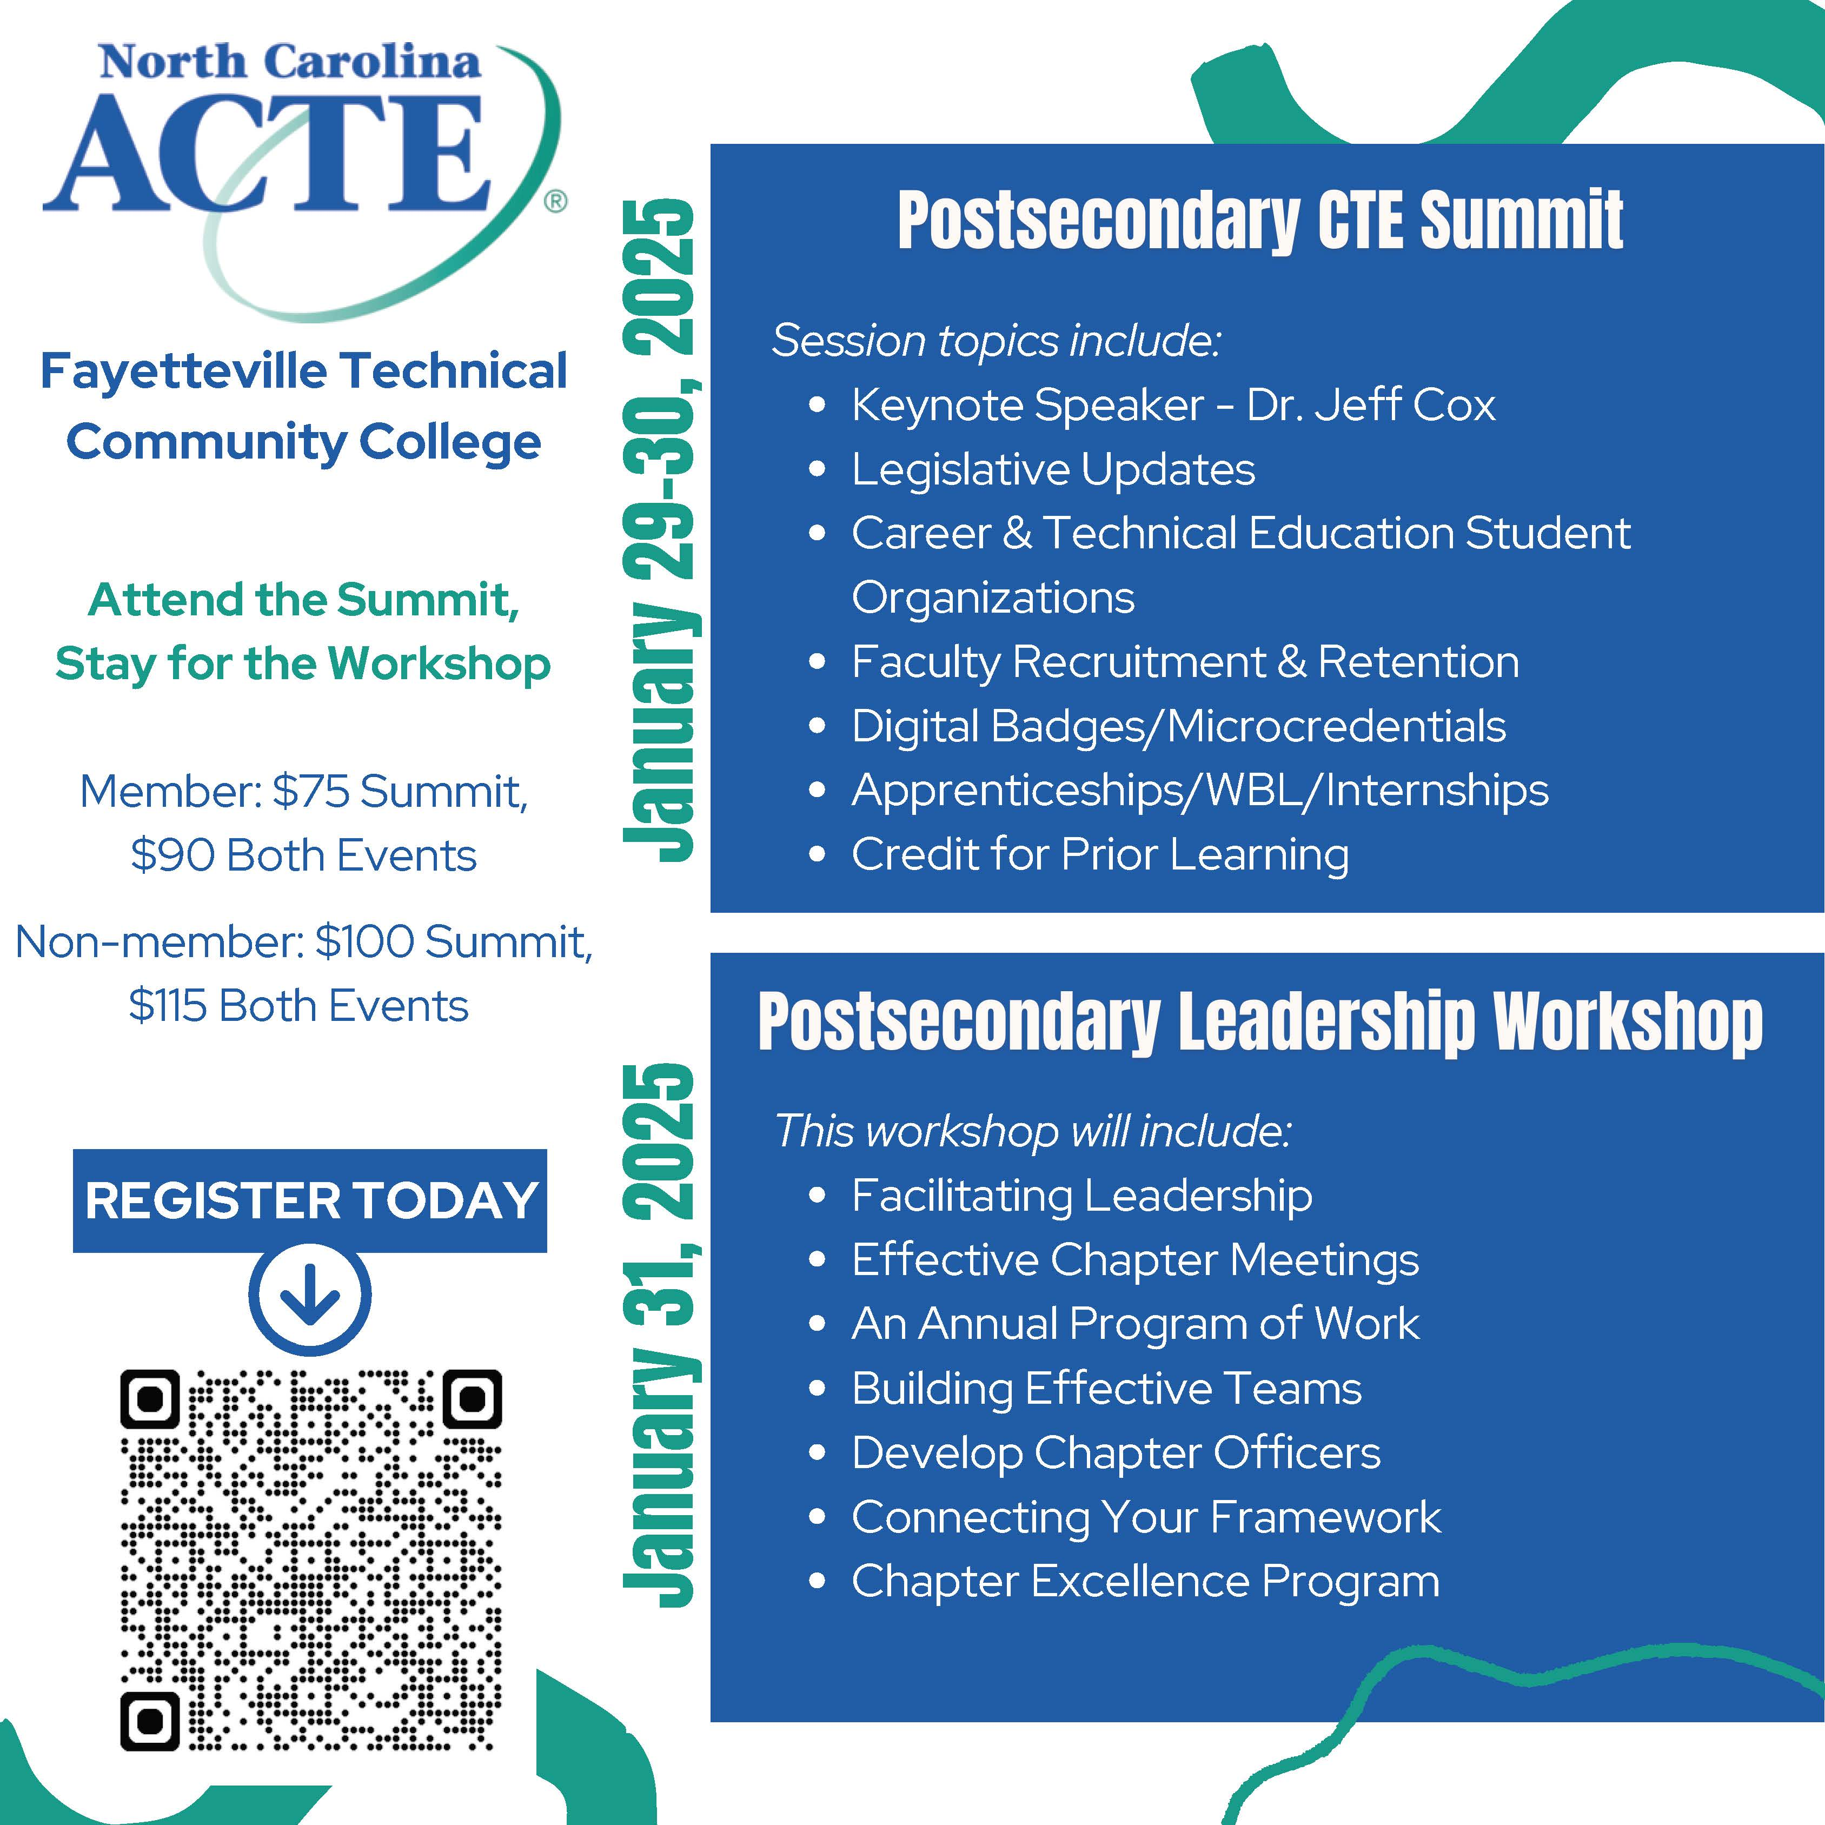

Slide 19
THANK YOU!

