Slide 1
Occupational Therapy & OT Assistants March 15, 2023
Download the PowerPoint and access the recording: www.ncperkins.org/presentations

Slide 2
Career & Technical Education Team
Bob Witchger
Tony Reggi
Patti Coultas
Mary Olvera
Anne Bacon
Darice McDougald
Lane Freeman
Aaron Mabe

Slide 3
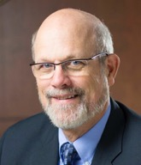
Dr. Bob Witchger
CTE Director, Team Perkins
Notes:
Dr. Robert (Bob) Witchger
NCCCS, CTE Director
919-807-7126
witchgerb@nccommunitycolleges.edu

Slide 4
Dr. Tony Reggi
CTE Associate Director,
Notes:
Tony Reggi
919-807-7131
reggia@nccommunitycolleges.edu

Slide 5
Dr. Mary Olvera
CTE Coordinator and Program Administrator
Public Service Technologies, Agriculture and Natural Resources Technologies, and Commercial Artistic Productions
Notes:
Dr. Mary Olvera
Career and Technical Education Coordinator & Program Administrator
Public Service Technologies, Agriculture and Natural Resources Technologies, and Commercial Artistic Productions
North Carolina Community College System Office
919-807-7120
olveram@nccommunitycolleges.edu

Slide 6
Dr. Lori Byrd
Associate Director Academic Programs – Health Sciences
Notes:
Dr. Lori Byrd
Associate Director, Academic Programs - Health Sciences
byrdl@nccommunitycolleges.edu
919-807-7118

Slide 7
Aaron Mabe
Coordinator for Career and College Promise
Notes:
Aaron Mabe
919-807-7098
mabea@nccommunitycolleges.edu

Slide 8
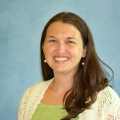
Anna Walls
Southwestern Community
College
Occupational Therapy Assistant Program Coordinator/Instructor
Notes:
a_walls@southwesterncc.edu
828-339-4334

Slide 9
Jessica Koch
Southwestern Community College
OTA Student
Notes:
a_walls@southwesterncc.edu
828-339-4334

Slide 10
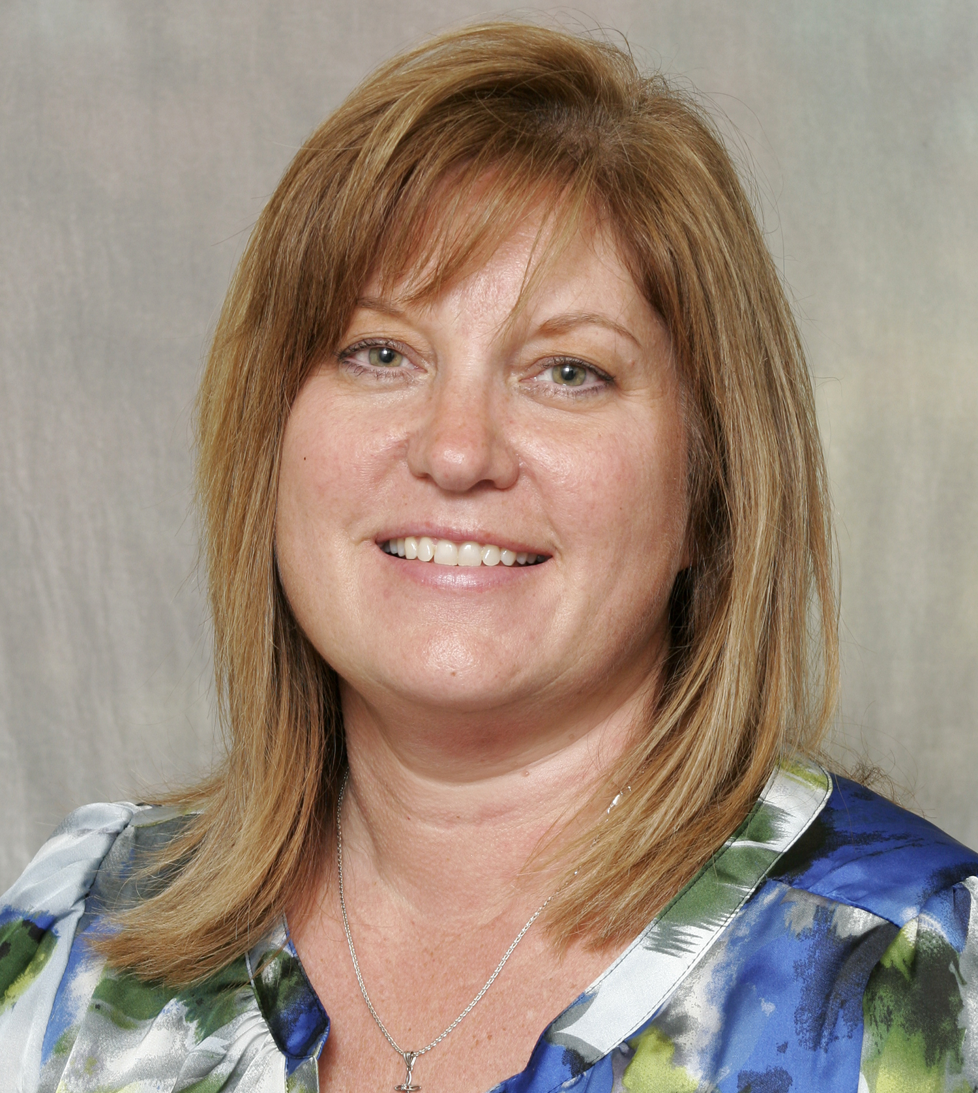
Wendy Perrini
Pitt Community College
Occupational Therapy Assistant Program Coordinator/Instructor
Notes:
Work Phone: 252-493-7458
Work Email: wmperrini197@my.pittcc.edu

Slide 11
Career Pathways
Notes:
From nccareers.org

Slide 12
Occupational Therapy Assistant
The Occupational Therapy Assistant curriculum prepares individuals to work under the supervision of a registered/licensed OT in screening, assessing, planning, and implementing treatment and documenting progress for clients receiving occupational therapy services.
Course work includes human growth and development, conditions which interfere with activities of daily living, theory and process of occupational therapy, individual/group treatment activities, therapeutic use of self, activity analysis, and grading/adapting activities and environments.
Graduates may be eligible to take the national certification examination for practice as a certified occupational therapy assistant. Employment opportunities include hospitals, rehabilitation facilities, long-term/extended care facilities, sheltered workshops, schools, home health programs, and community programs.

Slide 13
Offered at the following NC Community Colleges
Asheville-Buncombe Technical Community College
Cape Fear Community College
Central Piedmont Community College
Durham Technical Community College
Pitt Community College
Rowan-Cabarrus Community College
Southwestern Community College
Notes:
Total 32 colleges

Slide 14
Raising the Awareness of Career Pathways Webinars
April 19 Food Industry Attend SkillsUSA Competition
May 17 Entrepreneurship
June 21 Nonprofit Leadership and Management
Register for all webinars at
www.ncperkins.org/presentations

