Slide 1
Perkins Mid Year Review Tri-County Community College Stephen Wood

Slide 2
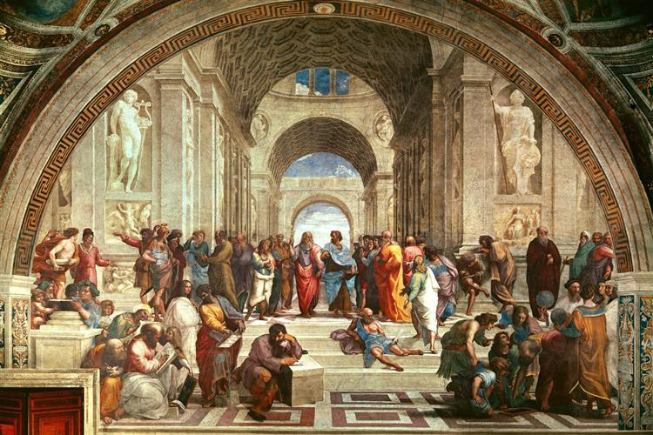
Life at TCCC – SACS Visit Late October 2019

Slide 3
Life at TCCC – SACS Visit Late October 2019

Slide 4
To engage students in learning,
help students succeed,
and enrich the communities we serve

Slide 5
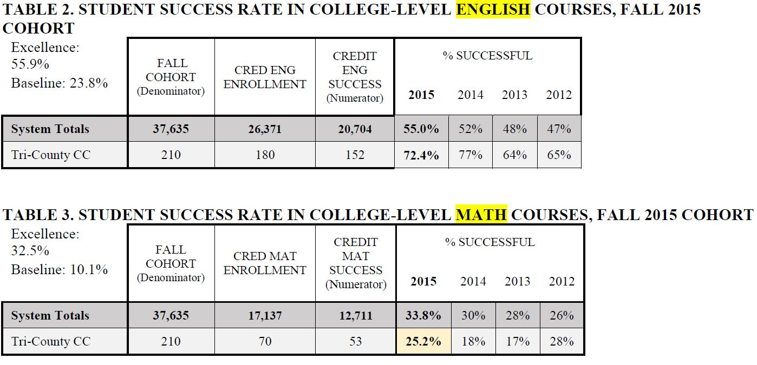
4

Slide 6
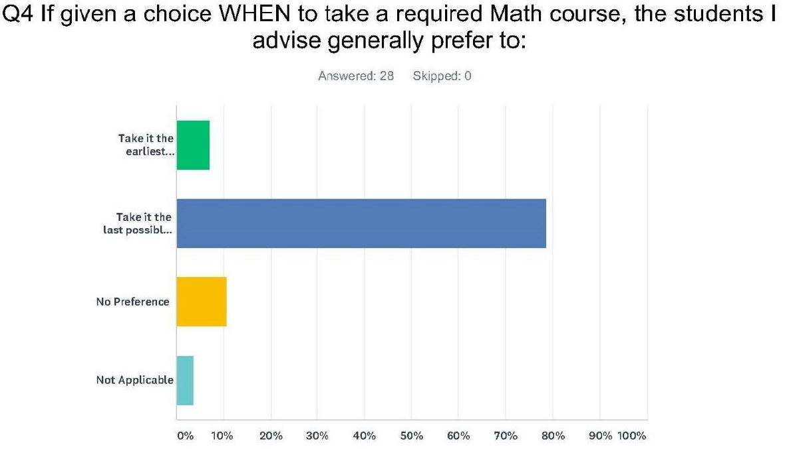

Slide 7
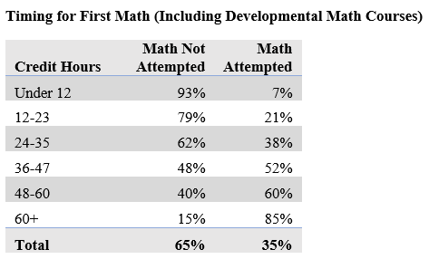
Institutional Data Research
74% delaying Math
Delaying College Placement Test

Slide 10
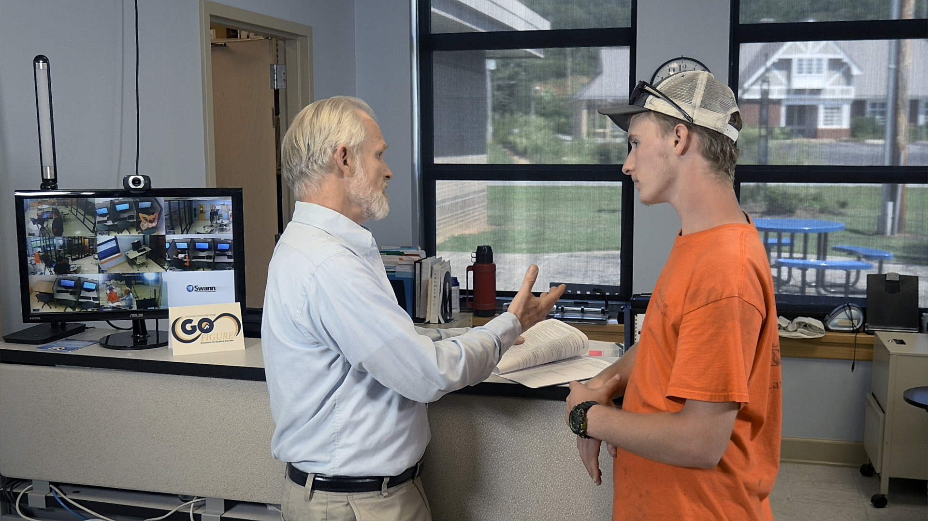

Slide 11
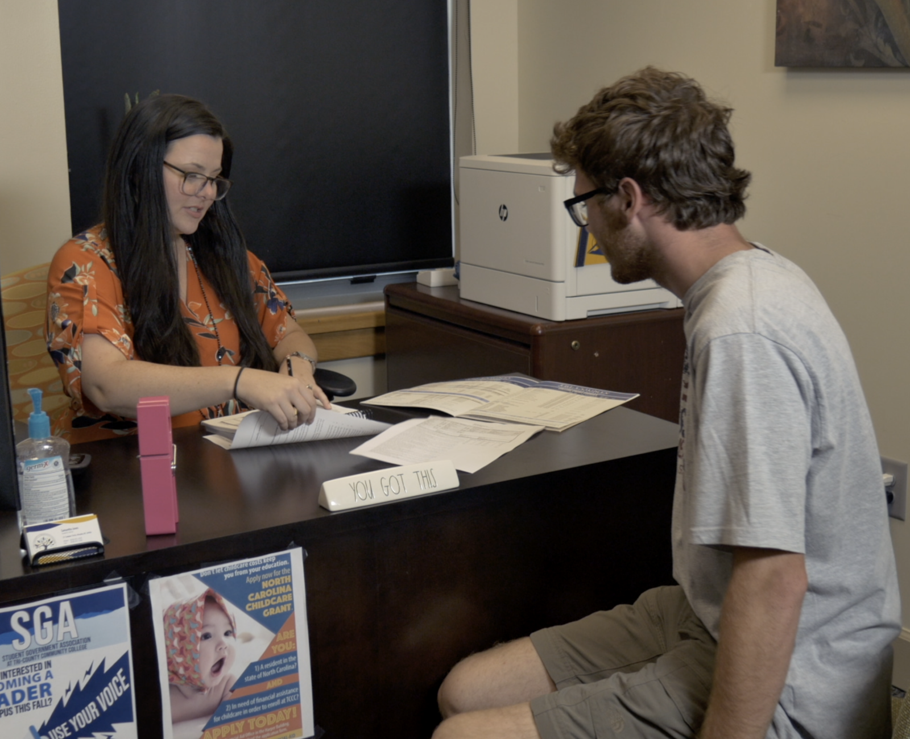

Slide 12
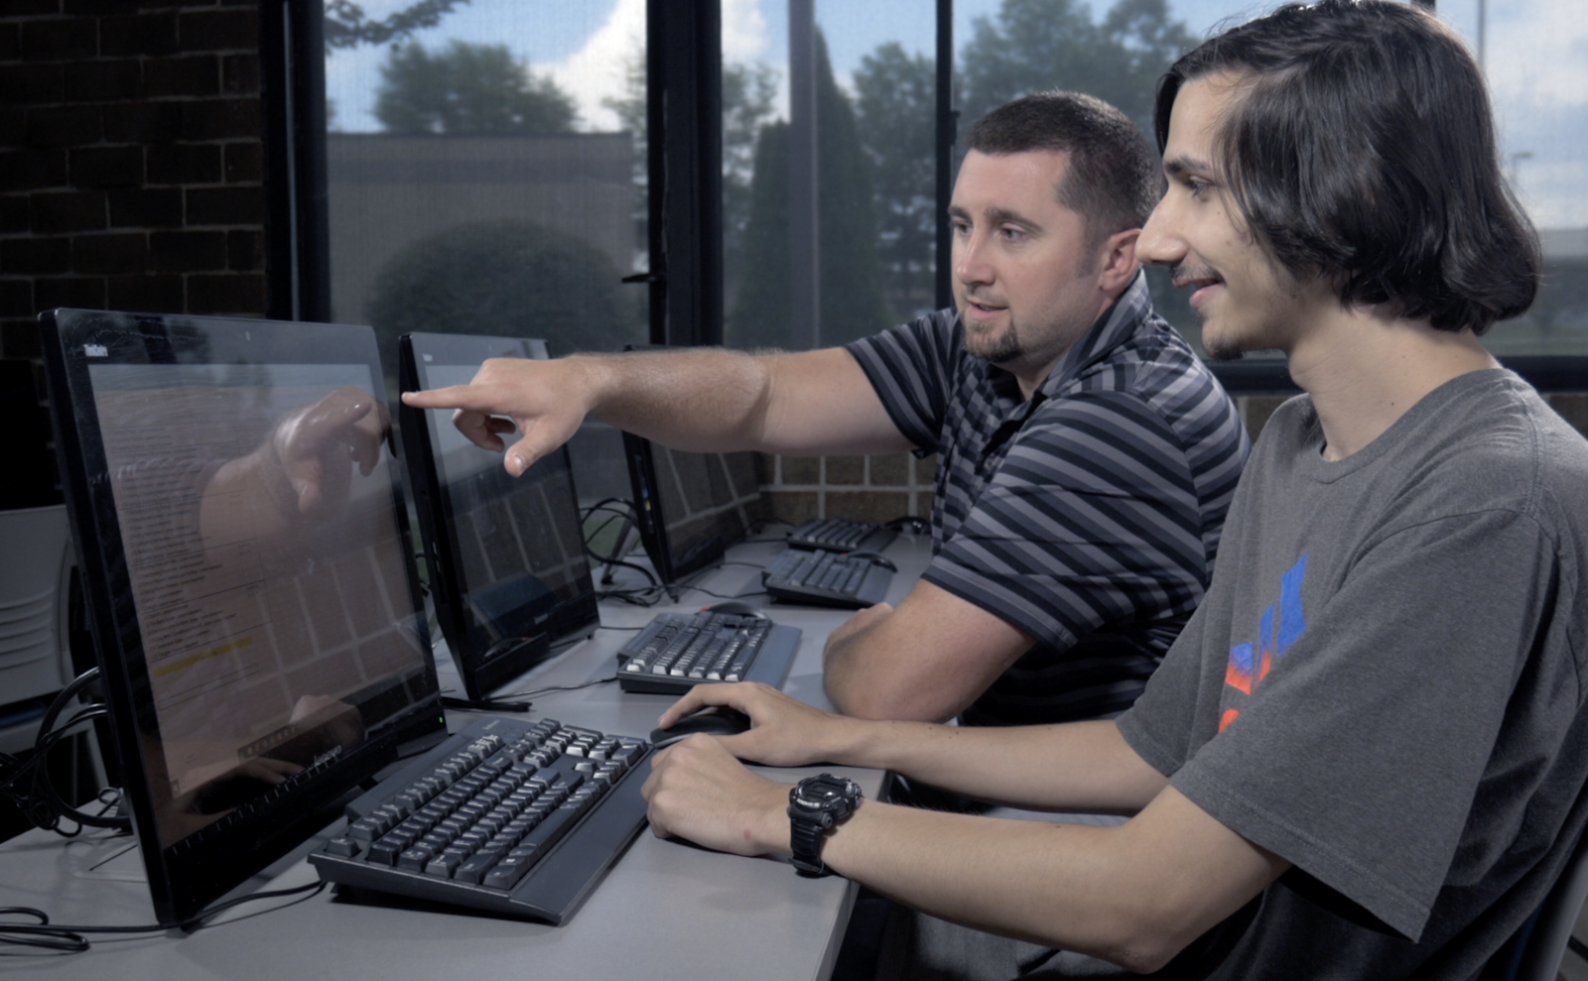

Slide 13
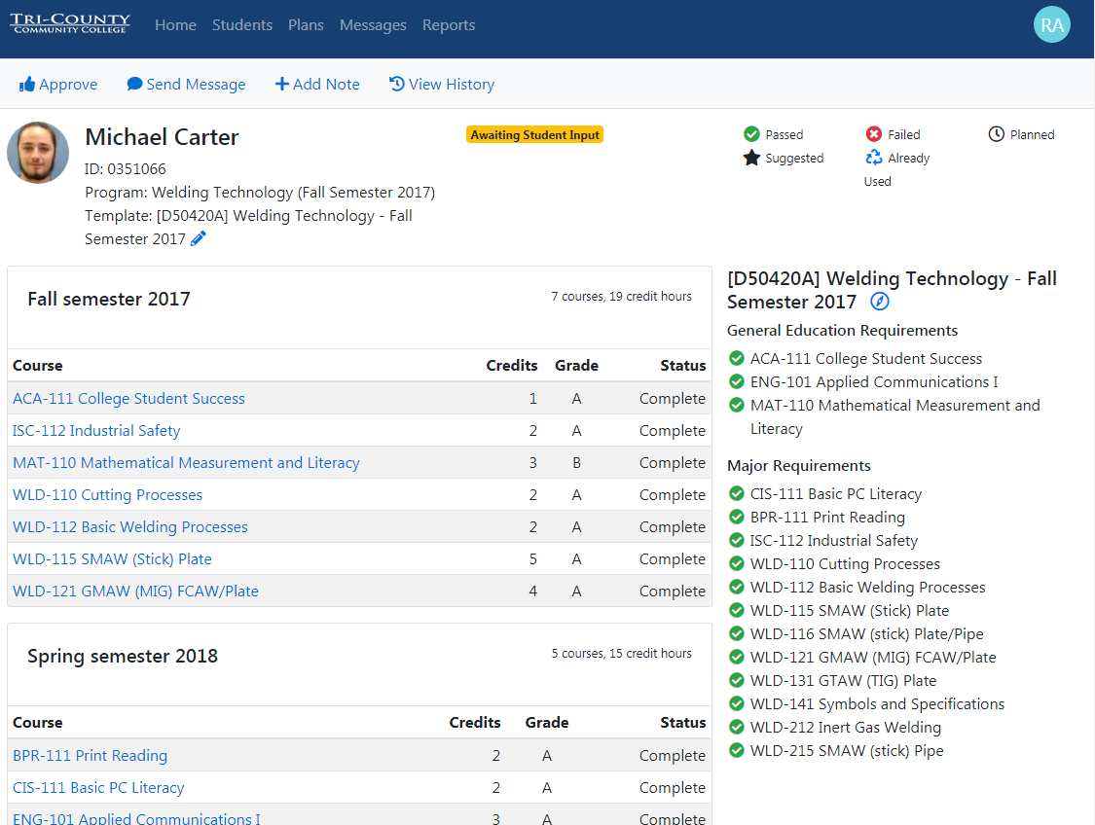
AVISO

Slide 14
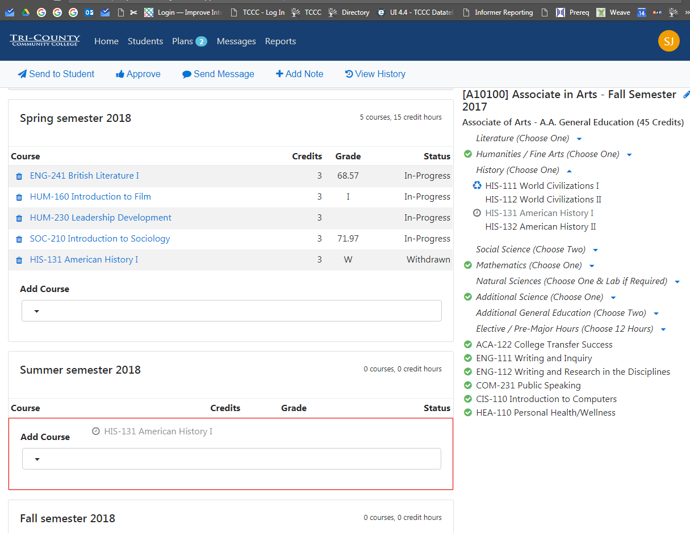

Slide 15
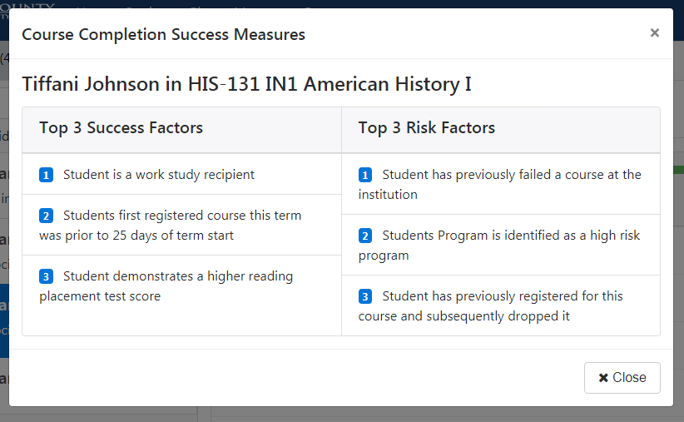
Aviso

Slide 16
1) Professional Development – February 2020 2) Pi(e) Week – March 9-13 – Guests from local industry and employers to talk about math on the job, industry tours for faculty and students, AND Pie
Other Go Figure Perkins Expenses (In Progress)

