Slide 1
Perkins 101 Toward a better understanding and local Implementation of the Carl D. Perkins Career and Technical Education Act
Bob Witchger Career and Technical Education Director
Ashley Bowling Administrative Assistant
Julia Hamilton, Tony Reggi, & Chris Droessler Career and Technical Education Coordinators
Get the PowerPoint → www.ncperkins.org/presentations
Notes:
Welcome
We post all of our presentations on the NC Perkins dot org website. Feel free to use anything we present here to educate the rest of your staff and community.
====
Perkins 101 Webinar
July 26, 2016

Slide 2
Role of the Local Coordinator
NC
Community
College System
Local
Community
College
Local Coordinator

Slide 3
Perkins Coordinator
Facilitate the implementation of the Perkins grant
Ensure college is addressing all required activities and are meeting the intent and spirit of the law
Engage faculty and CTE deans in planning and implementing the local college CTE plan
Insure proper use of Perkins funds allocated to college
Enhance CTE links between HS and CC – Rigorous Programs of Study
Support development of pathways and collaboration with partners

Slide 4
History of Perkins

Slide 5
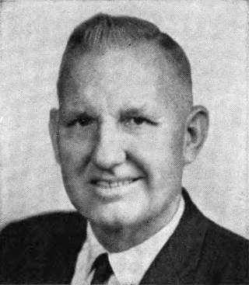
Carl Dewey Perkins
Representative from Kentucky
1949-1984
Legacy of support to education and the underprivileged
Perkins Student Loan
Carl D. Perkins CTE Program
Notes:
Here is the History

Slide 6
Evolution of Perkins Program
1905: Advocates for practical education argue for broader public school curriculum that prepares graduates for jobs
1917: Smith-Hughes Vocational Education Act ($1.7M)
1936: George-Deen Act increased funding ($14.5M)
1968: Replacement legislation introduced by Rep. Perkins ($365M)

Slide 7
Evolution of Perkins Program
1984: Perkins I - vocational education improvement, special populations
1990: Perkins II - integration of vocational and academic education
1998: Perkins III - technology and workforce preparation
2006: Perkins IV - career and technical education with increased academic preparation; preparation for high wage, high skill occupations for tomorrow’s workforce through programs of study
2016-17 : Closer alignment with Workforce Innovation & Opportunity Act (WIOA) emphasis on workforce preparation

Slide 8
Purpose of Perkins Program
To develop more fully the academic, vocational and technical skills of students to elect to enroll in CTE:
Develop challenging and rigorous academic and technical standards so that students are prepare for high skill, high wage, high demand, and emerging occupations
Link secondary and postsecondary education for effective student transition to work
Develop, implement, and improve Career and Technical Education Programs of Study
Notes:
From our Legislation

Slide 9
Purpose of Perkins Program
Professional development and other activities that improve the quality of CTE teachers, faculty, administrators and counselors
Partnerships among educational institutions, state agencies, and business and industry
Provide lifelong learning opportunities that will produce the knowledge and skills needed to keep the U. S. competitive.
Working with employers is implied throughout the Act

Slide 10
Perkins Emphasis
1964 - State Planning – Set Up Vocational Education
1968 - Include Special Populations in Voc. Ed.
1984 - Equal Access to CTE - Affirmative Action
1990 - Link High School and Community College - Tech Prep Innovation
1998 - Intense work through Programs of Study
2006 - Rigorous Programs of Study, High Skill Training
2015 - Pathways, Work Based Learning, Employability Skills
2016 - 3P’s - Pathways, Professional Development, Performance
Notes:
Summary See how the emphasis has changed from the Beginning

Slide 11
The Carl D. Perkins CTE Act of 2006
Is a workforce development program delivered through educational institutions.
To keep U.S. competitive by providing a national and local highly skilled, sustainable workforce
Notes:
Develop more fully the academic and technical skills of students enrolled in CTE:
Develop challenging and rigorous academic and technical standards so that students are prepare for high skill, high wage, high demand, and emerging occupations
Link secondary and postsecondary education for effective student transition
Develop, implement and improve CTE
Professional development and other activities that improve the quality of CTE teachers, faculty, administrators and counselors
Partnerships among educational institutions, state agencies, and business and industry
Provide lifelong learning opportunities that will produce the knowledge and skills needed to keep the U. S. competitive

Slide 12
Mission
Enhance Postsecondary Career & Technical Education (CTE)
Level the playing field for those who elect to enroll in CTE programs of study and increase enrollment
Actively engage employers in the development and implementation of CTE programming leading to employment
Notes:
Our mission deals with enhancing leveling the field and engaging the employers
Our authority comes from the legislative act of 2006
fine-tuned for North Carolina in our state plan

Slide 13
Oversight and Authority
Federal
U.S. Department of Education
Office of Career Technical and Adult Education (OCTAE)
Carl D. Perkins Act of 2006
State
Eligible agency
Sole state agency responsible for administering program
State Plan/Improvement Plan
Local
Eligible Institution (postsecondary)
Eligible Recipient (secondary)
Local Plan/Annual Plan/Improvement Plan – (2015-16 Template)
Notes:
Here is the Perkins Tree of Funding, Authority

Slide 14
Our CTE Plan of Work
Spelled out in Carl D. Perkins Career and Technical Education Act of 2006
Outlined in the North Carolina Five-Year State Plan
Reflected in your community college Local Plan
Notes:
Our mission deals with enhancing leveling the field and engaging the employers
Our authority comes from the legislative act of 2006
fine-tuned for North Carolina in our state plan

Slide 15
CTE Definitions
Postsecondary CTE Participant is an AAS non-transfer student enrolled in six credit hours (during the program year) in any CTE program area.
Postsecondary CTE Concentrator is a CTE participant who completes a minimum of 12 academic and technical hours, 6 hours will be in CTE coursework.

Slide 16
Perkins Funding

Slide 17
Perkins Flow of Funding
North Carolina
NCCCS
Local CC
OVAE
OCTAE
Community Colleges
$
State Leadership $
College - % of CTE Pell
Basic Grant to Colleges $$$$$$$$
$
College - % of CTE BIA
High Schools
$$
Notes:
Some say follow all of the money but this is a quick breakdown on how the federal government through the office of adult vocational education pass the Perkins act money to the state department of public instruction through the community colleges to our local community colleges

Slide 18
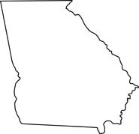
Secondary vs Postsecondary
Perkins is “split funded” between the secondary and the postsecondary programs
The average split nationally is 59.24% secondary and 38.89% postsecondary
GA
NC
WA
50% Postsecondary
50% Secondary
33.3% Postsecondary 66.6% Secondary
56% Postsecondary
44% Secondary

Slide 19
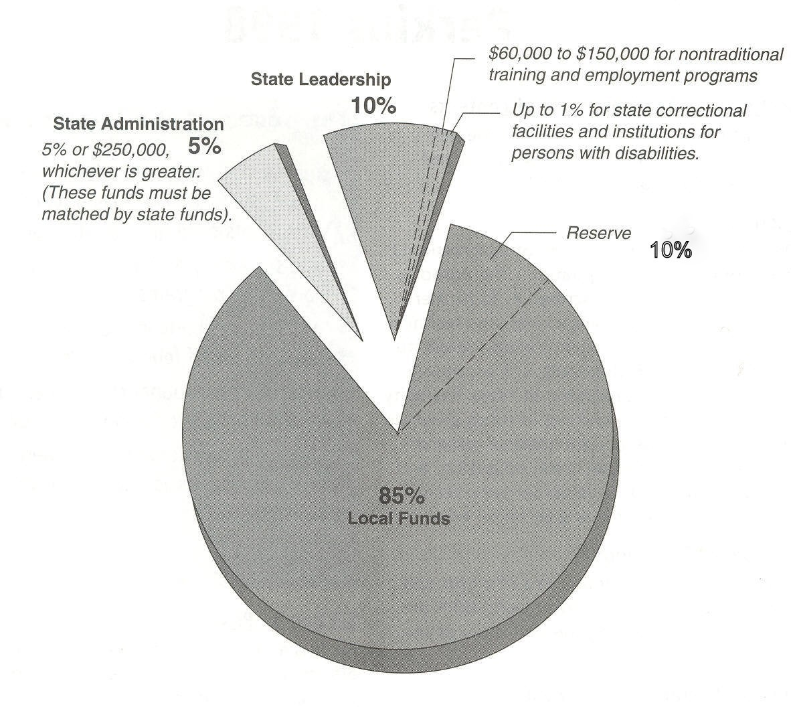
Distribution of Funds
Split of local funds between secondary and postsecondary determined by State Eligible Agency and described in State Plan
Consortia
$66,000 Secondary
$33,000 Postsecondary

Slide 20
Consortium Distribution of Funds
Funding formula must result in minimum level in order for recipient to be awarded funds: Postsecondary $50,000
Used only for purposes and programs that are mutually beneficial to all members of the consortium
May not be distributed based upon amounts determined by the funding formula

Slide 21
Section 131 & 132 – Consortia Requirements
May not be reallocated to individual members of the consortium for purposes or programs benefitting only one member of the consortium
Must have a fiscal agent responsible for grant management and compliance
Fiscal agent receives the 5% administrative
Determine how to handle recipients on the bubble
Notes:
Work as a Team, share resources, benefit both colleges.

Slide 22
State Allocation
State Allocations Are Census Based
In-State Allocation
Secondary census data
70% based on school-aged kids 5-17 census count at or below poverty guidelines
30% total district census data (Section 131 (a)(b))
Postsecondary
College’s (or consortium’s) percent of state-wide Pell & BIA recipients from CTE programs. (Section 132(a)(2))

Slide 23
WIOA Board Input
State Plan
Perkins IV 5-Year Local Plan
Future
WIOA infrastructure funding
WIOA impact and increased collaboration and direction

Slide 24
Use of Funds

Slide 25
Use of Funds
Local
State
Administration
5% of funds used or awarded
Program Improvement
Annual Plan
Required use of funds
Permissive use of funds
Improvement Plan
Administration
5% of grant
State Leadership
Required use of funds
Permissive use of funds
Improvement plan
Reserve Funds

Slide 26
Use of Funds: Administrative
How will you use administrative funds (5% maximum)?
Amount of the 5% set aside for administration
None/All/Portion
5% of actual spent; Indirect is part of the administrative costs
Use of admin funds
Limited to activities related to administering the grant
Can use admin $ for program improvement but cannot use program improvement $ for admin
Coordinator who is paid through a Perkins activity
Portion for administering the grant must come from admin 5% or from institution;

Slide 27
Section 133 – Redistribution of Unspent Funds
When an eligible recipient does not expend all of its allocated amount, those funds are returned to the state
The state retains such amounts for distribution in the following academic year.

Slide 28
Nine Required Activities and other permissive uses

Slide 29
Required Uses of Funds Section 135. Local Use of Funds
Strengthen CTE through integration of academics and technical programs
Link secondary and postsecondary through programs of study
Experience and understand all aspects of industry
Develop, improve, or expand the use of technology in CTE
Faculty Professional Development
Evaluate CTE programs
Initiate, improve, expand and modernize CTE programs including technology
Support programs that are of sufficient size, scope and quality to be effective
Activities for special populations enrolled in CTE Programs
Recipient is required to address with either Perkins or institutional funds as outlined in 5-Year Plan
Notes:
Strengthen CTE
Link with High Schools
Teach the Occupation
Improve CTE
Provide Opportunities for Faculty Skill Updating
Collaborate with Evaluation and provide faculty feedback
Infuse Technology
Assist Special Populations enrolled in CTE
Ensure Programs Size, Scope quality

Slide 30
Local Perkins Application Plan
The law is just the minimum requirements
States can add more requirements, set parameters, restrictions, etc..
Prioritize uses of funds
Connect Local Plan to uses of funds
Pathways
Professional Development
Performance
Notes:
Next week’s webinar will be about the local plan.

Slide 31
1. Integration of Academic & Technical Programs
Required: Strengthen academic and technical skills of students participating in CTE programs through the integration of academics with CTE programs.
Related Permissive: Teacher preparation programs that address the integration of academic and CTE and that assist individuals with experience in business and industry who are interested in becoming CTE faculty.
Notes:
Purpose

Slide 32
2. Secondary - Postsecondary Linkages
Required: Link secondary and postsecondary levels, including not less than 1 CTE program of study containing both secondary and postsecondary elements that are coordinated, non-duplicative and aligned.
Related Permissive: Developing initiatives that facilitate the transition of sub-baccalaureate CTE students into baccalaureate degree programs, including articulation agreements, dual and concurrent enrollment programs, academic and financial aid counseling and other initiatives to overcome barriers and encourage enrollment and completion.
Related Permissive: Improving or developing new CTE courses, including the development of programs of study and courses that prepare individuals academically and technically for high-skill, high-wage and high-demand occupations and dual or concurrent enrollment opportunities.
Notes:
Perkins V focus
Decrease remedial/developmental

Slide 33
3. All Aspects of an Industry
Required: Provide students with strong experience and understanding of all aspects of an industry, which may include work-based learning experiences.
Related Permissive: Create business-education partnerships, including work-related experiences for students, adjunct faculty arrangements for qualified industry professionals and industry experience for faculty.

Slide 34
4. Develop, improve, or expand the use of technology in CTE
Required: Develop, improve, or expand the use of technology in CTE
Training faculty in use of technology
Includes distance learning
Provide students with technical skills
Collaborate with industry through internships, mentoring

Slide 35
5. Professional Development
Required: Provide in-service and pre-service professional development programs to faculty, administrators, and career guidance and academic counselors who are involved in integrated career and technical education programs, on topics including:
effective integration of academics and CTE.
effective teaching skills based on research.
effective practices to improve parental and community involvement.
effective use of scientifically based research and data to improve instruction.
Professional development should:
ensure that instructors and personnel stay current with all aspects of an industry.
involve internship programs that provide relevant business experience.
train teachers specifically in the effective use and application of technology to improve instruction.

Slide 36
6. CTE Program Evaluation
Required: Develop and implement evaluations, including an assessment of how the needs of special populations are being met.
Consistent with the three-to-five-year college evaluation process (SACS)
Key is engagement of faculty to review and improve CTE programs to meet employer needs

Slide 37
7. Program Improvement / Technology
Required: Initiate, develop, improve, modernize, or expand, including the relevant use of technology in CTE which may include:
training of career and technical education teachers, faculty, and administrators to use technology, and which may include distance learning
providing career and technical education students with the academic and career and technical skills (including the mathematics and science knowledge that provide a strong basis for such skills) that lead to entry into the technology fields
encouraging schools to collaborate with technology industries to offer voluntary internships and mentoring programs, including programs that improve the mathematics and science knowledge of students

Slide 38
8. Size, Scope & Quality
Required: Provide services and activities that are of sufficient size, scope, and quality to be effective

Slide 39
9. Special Populations
Required: Provide activities to prepare special populations who are enrolled in CTE programs for high-skill, high-wage, and high-demand occupations that will lead to self-sufficiency.
Notes:
Note at the post secondary level students self identify.
Monitor to insure if staff are supporting programs there are students in these program.

Slide 40
9. CTE Special Populations
Students enrolled in CTE programs:
with disabilities
who are economically disadvantaged
who are preparing for non-traditional fields (25% gender minority)
who are single parents and pregnant women
who are displaced homemakers
who are individuals with limited English speaking proficiency
Help students move to self sufficiency

Slide 41
Other Permissive Uses of Funds Section 135. Local Use of Funds
Involve stakeholders
Career guidance and academic counseling
Business partnerships
Programs for special populations – Enrolled in CTE leading to employment
CTE student organizations
Mentoring and support services – CTE Students
Equipment and instructional materials
Teacher preparation
Accessibility of postsecondary instruction
Transition to baccalaureate
Entrepreneurship, family and consumer science, automotive
New courses
Career-themed learning communities
CTE for adults and dropouts to complete secondary or to upgrade skills
Career assistance
Activities for nontraditional fields
Pooling of funds (teacher prep/data collection/POS/technical assessments)

Slide 42
Stakeholder Involvement
Permissive:
Involve stakeholders (parents, businesses and labor organizations, etc.) in the design, implementation, and evaluation of CTE programs.

Slide 43
Student Success
Permissive: Provide services that contribute to CTE student success including:
career guidance and counseling to postsecondary CTE students
mentoring and support services of CTE Students
small personalized career-themed learning communities
assistance to CTE students in continuing their education or training or in finding an appropriate job
nontraditional training and employment activities such as mentoring and outreach

Slide 44
Program Accessibility
Permissive: Developing and expanding postsecondary program offerings at times and in formats that are accessible for all students, including through the use of distance education.

Slide 45
Targeted Program Areas
Permissive: Support targeted program areas that contribute to workforce preparation including:
entrepreneurship education and training
family and consumer science programs
automotive technologies

Slide 46
Programs of Study & Career Pathways

Slide 47
Programs of Study
Must be offered in order to be eligible for funding
Incorporate secondary/postsecondary elements
Coherent and rigorous content aligned with challenging academic standards in a coordinated, non-duplicative progression of courses that prepare students to succeed at postsecondary level
May include opportunity for dual/concurrent credit
Faculty Coordinated Pathways
Lead to an industry recognized credential or postsecondary degree
Articulation agreements:
Local Agreements renewed each year unless there are statewide articulation agreements in place;
Articulation alone does not meet requirements
Template for mapping the Program of Study
Focus is on collaboration - Faculty, Directors, Deans, Employers

Slide 48
Program of Study / Career Pathways
Colleges developed 1 pathway in 2014-15
Colleges developed 2 additional pathways in 2015-16
In 2015-16 NCDPI required local LEAs to submit 3 pathways
For 2016-17 - Colleges and LEAs will be required to submit 3 additional pathways
These pathways should be developed in conjunction with your LEA partners
(For colleges who have submitted more than the required number of pathways between 2014 and 2017, updated pathways demonstrating LEA collaboration will be accepted.)
Notes:
3 Pathways
CTE directors were asked to develop these many lack postsecondary as some of our lack secondary involvement.
Key to Career Ready – Pathway Strategy

Slide 49
CTE Career Pathways / Programs of Study
Can include articulated and career and college promise courses
Begin in High School and continue through CC completion (9 -14)
Engage employers up front
Engage Faculty in coordinating classes
Offer work-based learning experiences at each grade level
Build in ongoing career advising
Provide program open entry and open exit for students
Offer the opportunity to build (stack) credentials along the way

Slide 50
Building the Program of Study • 9-14 High School and Community College
(Rigorous) Programs of Study (Classes are examples)
Level | Courses |  |  |  |  |  |  |  | Certifications & Degrees
9 | English 1 | Algebra I or Integrated Math I | Environmental Earth Science | World History | Health/PE | MSITA Word, PPT | Small Business Entrepreneurship | Freshman Career Management | MSITA Certifications (2)
10 | English 11 | Geometry or Integrated Math II | Physical Science | Civics | Principles of Business & Finance | MSITA Excel, Access | Business Law | MSITA Website or Database | MSITA Certifications (2)
11 | English 111 | Algebra II or Integrated Math III | Biology | BUS 151 | BUS 110 Intro to Business | Accounting I | BUS 137 Principles of Management | BUS 135 Principles of Supervision | MSITA Certification(1) MOS Career Readiness - CRC
12 | English IV | 4th Math Aligned with sudent’s plan | US History Part A | MAT 115 Mathematical Models | US History Part B | Accounting II | ENG 114 Professional Research & Reporting | BUS 115 Business Law I | High School Diploma QuickBooks Certification CC Certificate
Summer | COE 112 (coop) | COE 110 World of Work | ACA 111 College Student Success
1 | MKT 220 Advertising & Sales | ACC 120 Principles of Financial Accounting | ENG 111 Expository Writing | BUS 116 Business Law II | BUS 260 Business Communications | BUS 240 Business Ethics | ACC 129 Individual Income Taxes | ACC 121 Principles of Managerial Accounting | Business Administration Diploma 44 hours
2 | Social Science Elective | BUS 239 Business Applications Seminar | ECO 252 Principles of Macroeconomics | Humanities Fine Arts Elective |  |  |  |  | Business Administration AAS Degree 65-73 hours
Core Courses
CTE High school courses
Community college courses
Articulated Courses
Labor Market Value $$
Articulated credits - MSITA for CIS110
Online Course on Demand See CC course requirements for each degree
Notes:
The College Certificate, Diploma, and Degree Courses would be added to the Program of Study
Key Faculty Engaged in the Process

Slide 51
Building the Pathway Engaging Employers
Core Courses
CTE High school courses
Community college courses
Articulated Courses
(Rigorous) Programs of Study (Classes are examples)
Level | Courses |  |  |  |  |  |  |  | Certifications & Degrees
9 | English 1 | Algebra I or Integrated Math I | Environmental Earth Science | World History | Health/PE | MSITA Word, PPT | Small Business Entrepreneurship | Freshman Career Management | MSITA Certifications (2)
10 | English 11 | Geometry or Integrated Math II | Physical Science | Civics | Principles of Business & Finance | MSITA Excel, Access | Business Law | MSITA Website or Database | MSITA Certifications (2)
11 | English 111 | Algebra II or Integrated Math III | Biology | BUS 151 | BUS 110 Intro to Business | Accounting I | BUS 137 Principles of Management | BUS 135 Principles of Supervision | MSITA Certification(1) MOS Career Readiness - CRC
12 | English IV | 4th Math Aligned with sudent’s plan | US History Part A | MAT 115 Mathematical Models | US History Part B | Accounting II | ENG 114 Professional Research & Reporting | BUS 115 Business Law I | High School Diploma QuickBooks Certification CC Certificate
Summer | COE 112 (coop) | COE 110 World of Work | ACA 111 College Student Success
1 | MKT 220 Advertising & Sales | ACC 120 Principles of Financial Accounting | ENG 111 Expository Writing | BUS 116 Business Law II | BUS 260 Business Communications | BUS 240 Business Ethics | ACC 129 Individual Income Taxes | ACC 121 Principles of Managerial Accounting | Business Administration Diploma 44 hours
2 | Social Science Elective | BUS 239 Business Applications Seminar | ECO 252 Principles of Macroeconomics | Humanities Fine Arts Elective |  |  |  |  | Business Administration AAS Degree 65-73 hours
Tours
Project-Based Learning
Shadowing
OJT / OJL
Co-Op
Apprenticeship
Employer Engagement
Notes:
Here we see how employers or their intermediary would review
CTE Learning Outcomes, Certificates, and again review the certificates.
This is a draft to get you thinking and to receive your comments as we finish developing the proposal.

Slide 52
Perkins Core Indicators of Performance

Slide 53
Accountability Section 113 Core Indicators of Performance
Secondary
Postsecondary
1S1: Academic Attainment | Reading/ Language Arts
1S2: Academic Attainment | Mathematics
2S1: Technical Skill Attainment
3S1: Secondary School Completion
4S1: Student Graduation Rates
5S1: Secondary Placement
6S1: Nontraditional Participation
6S2: Nontraditional Completion
1P1: Technical Skill Attainment
2P1: Credential, Certificate, or Diploma
3P1: Student Retention or Transfer
4P1: Student Placement
5P1: Nontraditional Participation
5P2: Nontraditional Completion

Slide 54
Accountability Measures
1P1 - Students who attain a 2.5 GPA or higher
2P1 - Students who complete a credential, certificate, diploma or degree
3P1 - Students who continue in CTE (retention or transfer)
4P1 - Students who are placed in a job (employment)
5P1 - Students who enroll in nontraditional program of study
5P2 - Students who complete a nontraditional program of study
Notes:
Clean up data – identify all CTE students
Increase student advising for completion and placement
Award students certificates when they are earned
Set up retention task force
Flag completers and monitor progress
Set up early alert system

Slide 55
2016-17 Negotiated State-Wide Levels
1P1 Technical Skill Attainment 80.20%
2P1 Credential, Certificate, or Degree 54.90%
3P1 Student Retention or Transfer 67.00%
4P1 Student Placement 67.70%
5P1 Non-traditional Participation 22.70%
5P2 Non-traditional Completion 17.85%

Slide 56
Final Agreed-Upon Performance Level (FAUPL)
The FAUPL is an agreement between the Department and the state on the student and performance definitions, measurement approaches, and performance targets for each of the core indicators.
State FAUPLs are attached to your state’s July 1 grant award. State FAUPLs are also posted on PCRN.
In using the FAUPL, consider:
How you might negotiate CTE performance with local districts and postsecondary programs; and
How you might integrate analysis of local performance data to Perkins applications.

Slide 57
Use of Data
Remember, Perkins data is to be used for continual improvement.
Don’t just write a report / plan and leave it on the shelf.
You should always be working your plan to improve student outcomes.

Slide 58
Section 123: Improvement Plans
If a state does not meet at least 90% of its agreed-upon state adjusted level of performance on a core indicator, it must prepare a Perkins Improvement Plan.
Similarly, if a local does not meet at least 90% of its agreed-upon adjusted level of performance on a core indicator, it must prepare a Perkins Improvement Plan.
When a Perkins Improvement Plan is required, if any special population does not perform to at least 90% of the statewide/institutional rate, then you must perform a Gap Analysis to determine the barriers to success.

Slide 59
Consolidated Annual Report (CAR)
The CAR is a data collection and reporting format that allows states to submit their required data to the Department of Education (DOE) and allows reports to be generated from that data source.
The CAR is made up of three parts:
1) the narrative,
2) accountability data—enrollment & performance, and
3) financial status reports

Slide 60
Monitoring
Ensure Effective CTE Programs
Technical Assistance
Desk Audits
On-site Monitoring Visits
Ensure Equity and Diversity
MOA – Civil Rights/ ADA Monitoring

Slide 61
Perkins Helpful Resources

Slide 62
The Act The Bible
Notes:
======
https://iweb.acteonline.org/Purchase/ProductDetail.aspx?Product_code=BPERKINS06

Slide 63
Brustein & Manasevit
Notes:
====
http://www.bruman.com/publications/

Slide 64
Omni Circular (The OMB Super Circular)
http://sites.ed.gov/octae/2014/03/07/the-omb-super-circular-is-now-the-omni-circular/
https://www.federalregister.gov/articles/2013/12/26/2013-30465/uniform-administrative-requirements-cost-principles-and-audit-requirements-for-federal-awards
http://www.gpo.gov/fdsys/pkg/FR-2013-12-26/pdf/2013-30465.pdf
http://www.caplaw.org/resources/PublicationDocuments/updatenewsletter/2014/CAPLAW_NavigatingtheOMBSuperCircularChanges_SpecialEdition2014.pdf
Notes:
The OMB “Super Circular” is now the Omni Circular.
As part of an effort to reform and strengthen Federal grant making, the Office of Management and Budget (OMB) published new guidance for the Federal award programs, OMB Uniform Guidance: Administrative Requirements, Cost Principles, and Audit Requirements for Federal Awards, commonly referred to as the Omni Circular.

Slide 65
Perkins 101 Toward a better understanding and local Implementation of the Carl D. Perkins Career and Technical Education Act
Bob Witchger Career and Technical Education Director
Ashley Bowling Administrative Assistant
Julia Hamilton, Tony Reggi, & Chris Droessler Career and Technical Education Coordinators
Get the PowerPoint → www.ncperkins.org/presentations
Notes:
Do you have any questions for us?

