Slide 1
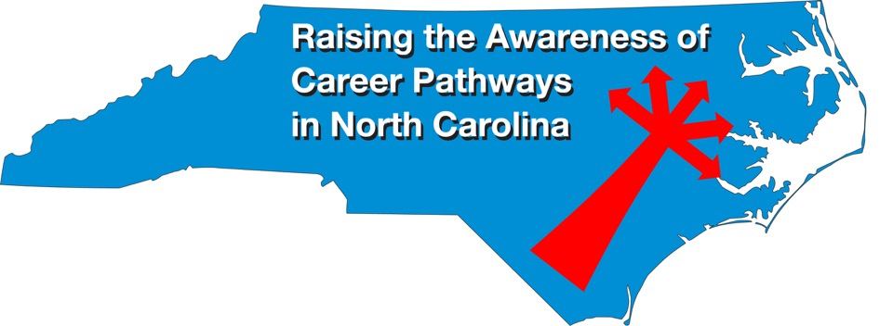
April 21, 2021 Careers in Transportation
Download the PowerPoint and access the recording: www.ncperkins.org/presentations
Notes:
Chris
We are here to help promote the great jobs, often unknown, in the great state of North Carolina.
Through these monthly meetings, we are going to let you know about some great career opportunities in North Carolina.
And bring in special guests to let you know about the great career opportunities in North Carolina.
Please download this PowerPoint file and use it anyway you can to help get folks on a career pathway.
The reference showing from where the information was found, as well as the contact information for our guests is in the Notes section under each slide.
Get the PowerPoint on our NCPerkins.org website on our Presentations and Webinars page.
Here is the direct address on the screen.
-----
Many of the videos shown during this webinar can be found here:
https://www.ncperkins.org/video/

Slide 2
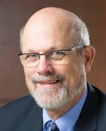
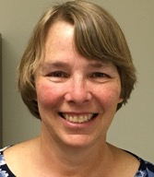
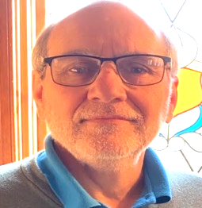
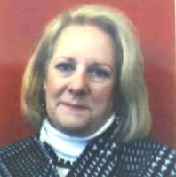
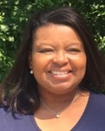
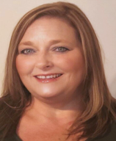
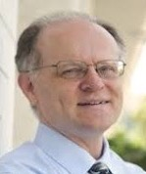
Raising the Awareness of Career Pathways in North Carolina
Bob Witchger
Patti Coultas
Tony Reggi
Cheryl Cox
NC Dept of Public Instruction
Michelle Lair
Mary Olvera
Chris Droessler
Notes:
Chris
I always say our webinars are like radio but with pictures.
And here are a few pictures of your hosts for these monthly explorations into career pathways.
(Why does the photographer have the best photo?)
Our contact information is in the notes section under this slide.
Dr. Bob Witchger
919-807-7126
WitchgerB@nccommunitycolleges.edu
Dr. Tony R. Reggi
919-807-7131
ReggiA@nccommunitycolleges.edu
Patti Coultas
919-807-7130
CoultasP@nccommunitycolleges.edu
Dr. Mary Olvera
919-807-7120
OlveraM@nccommunitycolleges.edu
Michelle Lair
919-807-72227
LairM@nccommunitycolleges.edu
Chris Droessler
919-807-7068
DroesslerC@nccommunitycolleges.edu
Cheryl Cox
NC Department of Public Instruction
919-807-3814
Cheryl.Cox@dpi.nc.gov

Slide 3
Community College Transportation Programs
Agricultural Systems Technology
Alternative Transportation Technology
Automotive Customizing Technology
Automotive Light-Duty Diesel Technology
Automotive Restoration Technology
Automotive Systems Technology
Aviation Electronics (Avionics) Technology
Aviation Management and Career Pilot Technology
Aviation Systems Technology
Boat Manufacture and Service
Collision Repair and Refinishing Technology
Construction Equipment Systems Technology
Diesel and Heavy Equipment Technology
Marine Propulsion Systems
Motorcycle Mechanics
Motorsports
Race Car Technology
Truck Driver Training
Supply Chain Management
Notes:
www.ncperkins.org/presentations

Slide 4
Frank Scuiletti
Program Coordinator: Construction, Engineering, Industrial, Transportation, Criminal Justice, Fire Protection, & Work-Based Learning
Notes:
Frank Scuiletti
scuilettif@nccommunitycolleges.edu

Slide 5
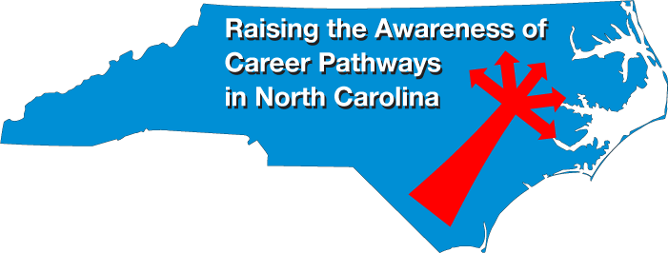
Notes:
www.ncperkins.org/presentations

Slide 6
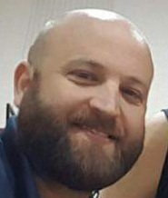
Jeremy Taylor
Program Chair, Instructor HET Transportation System Technologies
Central Piedmont Community College
Notes:
Jeremy Taylor Program Chair - Instructor HET, Transportation Systems Technology Division Central Piedmont Community College Merancas Campus, TS Building P.O. Box 35009 Charlotte, NC 28235 t 704.330.4181 | f 704.330.xxxx cpcc.edu
jeremy.taylor@cpcc.edu
704.330.4181
transport.systems@cpcc.edu

Slide 7
CUMMINS INC Technician Apprentice Program
The Cummins Technician Apprentice Program is a four year government-registered apprentice program. A collaboration between Cummins, community colleges, the U.S. Department of Labor and, in some states, the local department of labor. Students must have an unweighted high school GPA of 2.8 to participate.
Notes:
Jeremy Taylor Program Chair - Instructor HET, Transportation Systems Technology Division Central Piedmont Community College Merancas Campus, TS Building P.O. Box 35009 Charlotte, NC 28235 t 704.330.4181 | f 704.330.xxxx cpcc.edu
jeremy.taylor@cpcc.edu
704.330.4181
transport.systems@cpcc.edu

Slide 8
PROGRAM OVERVIEW
A formal written apprenticeship agreement with Cummins ensures students receive the following upon successful completion of the program:
» Hired as a full time employee with benefits on your date of hire
» Progressive wage scale
» Snap-on® tool box and tools when you begin the program
» Earn an Associate of Applied Science degree during first 2 ½ years
» Last 18 months of program is career focused
» Assigned mentor to support career development
» No college debt – all tuition and travel costs are paid for by Cummins
Notes:
Jeremy Taylor Program Chair - Instructor HET, Transportation Systems Technology Division Central Piedmont Community College Merancas Campus, TS Building P.O. Box 35009 Charlotte, NC 28235 t 704.330.4181 | f 704.330.xxxx cpcc.edu
jeremy.taylor@cpcc.edu
704.330.4181
transport.systems@cpcc.edu

Slide 9
ENGINE TECHNICIAN APPRENTICE PROGRAM Offered at Central Piedmont Community College, Vincennes University, and Salt Lake Community College
When in the program, you will graduate from college with an Associate of Applied Science degree in Diesel Engine and Heavy Equipment Technology.
Following college graduation, you will take additional classes at one of our Service Training Centers for advanced training providing you an opportunity to:
» Continue in the shop as a technician for diesel and natural gas engines
» Attend service leadership training classes to prepare for leadership opportunities
» Move into a service truck as a field service technician for agriculture, construction, logging, mining or power generation planned maintenance
Notes:
Jeremy Taylor Program Chair - Instructor HET, Transportation Systems Technology Division Central Piedmont Community College Merancas Campus, TS Building P.O. Box 35009 Charlotte, NC 28235 t 704.330.4181 | f 704.330.xxxx cpcc.edu
jeremy.taylor@cpcc.edu
704.330.4181
transport.systems@cpcc.edu

Slide 10
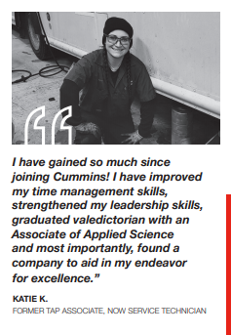
Notes:
Jeremy Taylor Program Chair - Instructor HET, Transportation Systems Technology Division Central Piedmont Community College Merancas Campus, TS Building P.O. Box 35009 Charlotte, NC 28235 t 704.330.4181 | f 704.330.xxxx cpcc.edu
jeremy.taylor@cpcc.edu
704.330.4181
transport.systems@cpcc.edu

Slide 11
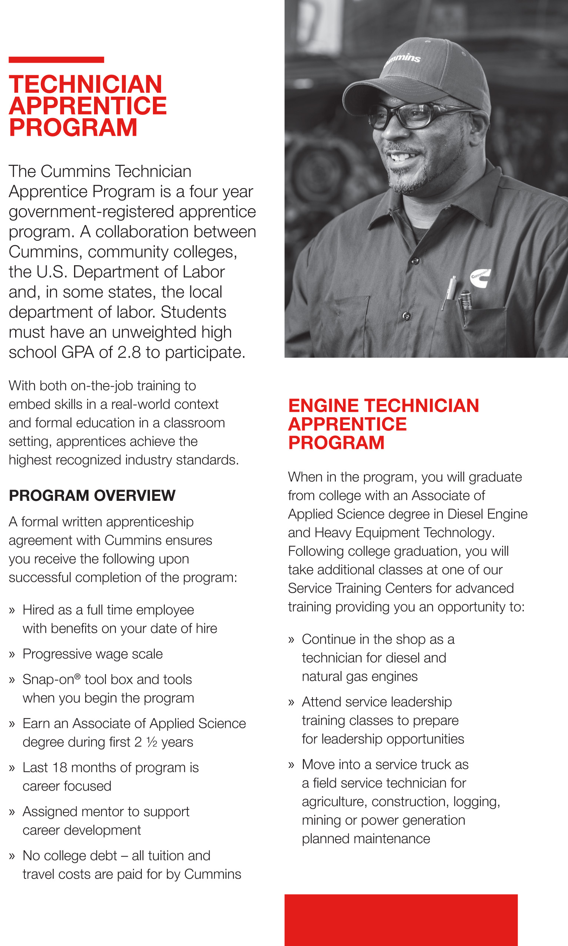
Notes:
Jeremy Taylor Program Chair - Instructor HET, Transportation Systems Technology Division Central Piedmont Community College Merancas Campus, TS Building P.O. Box 35009 Charlotte, NC 28235 t 704.330.4181 | f 704.330.xxxx cpcc.edu
jeremy.taylor@cpcc.edu
704.330.4181
transport.systems@cpcc.edu

Slide 12
Notes:
www.ncperkins.org/presentations

Slide 13
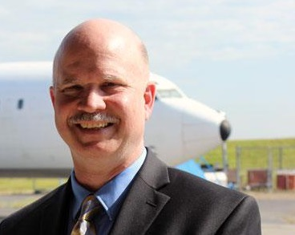
Nicolas (Nick) Yale
Director of Aviation Programs
Guilford Technical Community College
Notes:
Nicolas (Nick) Yale
GTCC Director of Aviation Programs
Guilford Technical Community College
336-334-4822, ext 59014
nayale@gtcc.edu
Aviation Campus

Slide 14
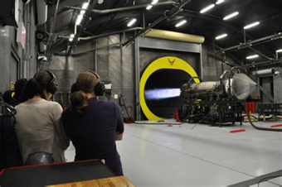
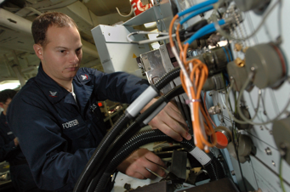
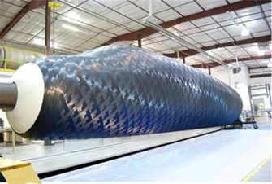
Guilford Technical Community College
How Aviators Do More Than Fly
Nicolas Yale, Director of Aviation Programs GTCC
Notes:
Nicolas (Nick) Yale
GTCC Director of Aviation Programs
Guilford Technical Community College
336-334-4822, ext 59014
nayale@gtcc.edu
Aviation Campus

Slide 15
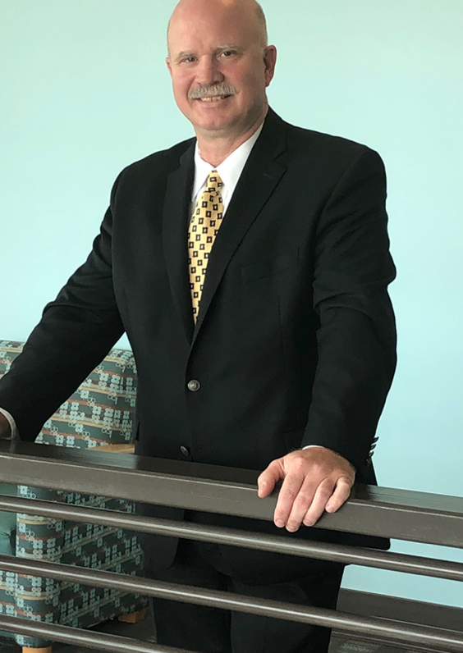
Introductions
My name is Nicolas (Nick) Yale and I am the director of Aviation Programs at GTCC.
I have spent the last 30 years in the aviation industry working as a technician, reliability engineer, instructor, logistics planner, leader and mentor. I am a private pilot, Airframe and Powerplant Technician, Avionics (FCC) Technician, and have specialized credentials in multiple areas. I have held various positions at Delta Airlines, FedEx Express Air Operations, Boeing Military Services, and now GTCC.
I truly enjoy seeing new students find their way into a successful rewarding career.
Notes:
Nicolas (Nick) Yale
GTCC Director of Aviation Programs
Guilford Technical Community College
336-334-4822, ext 59014
nayale@gtcc.edu
Aviation Campus

Slide 16
What we Do at GTCC Aviation
GTCC Aviation offers 5 degree options, and 4 ConEd offerings all aligned with regional Aviation industry.
Before I review those options and answer questions, here are a few facts:
1- Our Faculty and Staff in Aviation (24) have hundreds of years of experience as pilots, technicians, inspectors, manufacturing specialist, and in military air operations.
2- We have one goal, offer successful programs where upon completion students can and will be hired by local/regional/national aviation employers.
3- We have between 425-500 students in programs every Fall/Spring Combined.
4- We have successful apprenticeships set up with multiple employers in the region so students can be gaining real experience while they are in classes.
5- Our equipment/facilities/programs/faculty are impressive enough that they are used to recruit more aviation businesses to the region regularly.
Notes:
Nicolas (Nick) Yale
GTCC Director of Aviation Programs
Guilford Technical Community College
336-334-4822, ext 59014
nayale@gtcc.edu
Aviation Campus

Slide 17
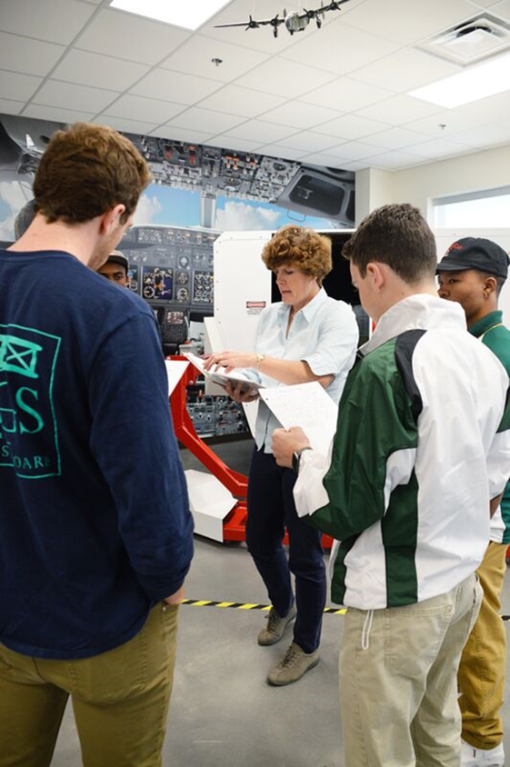
Aviation Management and Career Pilot
The Aviation Management offering of this program trains management personnel to work in the aviation industry in a variety of areas. Graduates take positions in sales, planning, scheduling, and logistical support.
The Career Pilot offering of this program is designed to prepare those building hours towards their pilot ratings to become professional pilots. Industry requires a minimum of an Associates degree for regional carriers and a Bachelors degree for main line carriers.
This program is regulated by the FAA under Part 141 of Federal Code.
Notes:
Nicolas (Nick) Yale
GTCC Director of Aviation Programs
Guilford Technical Community College
336-334-4822, ext 59014
nayale@gtcc.edu
Aviation Campus

Slide 18
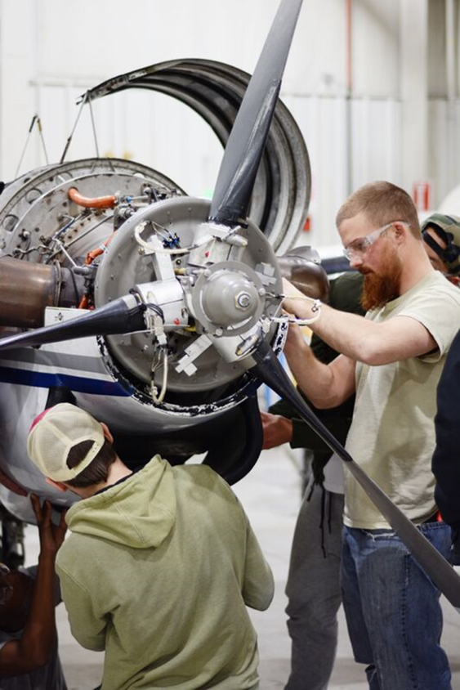
Aviation Systems Technology
This program trains the future Aviation Airframe and Powerplant technicians that work in a variety of industry locations.
Students interested in an aircraft maintenance position in industry must gain their Airframe “A”, and Powerplant “P” license to legally work independently on aircraft.
Students gain employment in all areas of aviation from aircraft manufacturing, to maintenance repair and overhaul facilities (MRO), to component manufacturing and repair facilities. Many also work in General aviation on private aircraft.
This program is regulated by the FAA under Part 147 of the Federal Code.
Notes:
Nicolas (Nick) Yale
GTCC Director of Aviation Programs
Guilford Technical Community College
336-334-4822, ext 59014
nayale@gtcc.edu
Aviation Campus

Slide 19
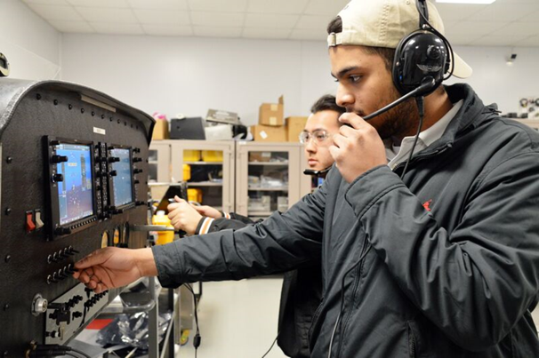
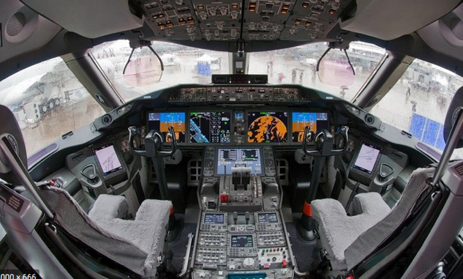
Aviation Electronics (Avionics) Technology
This program trains future Aviation Avionics and Electronics technicians.
Students interested in avionics technical positions in industry must gain the experience and knowledge to support the rapidly changing and highly complex avionics installed on modern aircraft. Students gain this knowledge along with gaining FCC licensing required in most positions in industry.
Most students work either in MRO activities or Avionics installation shops performing upgrades and repairs to avionics systems.
There are more jobs available than graduates, high demand career path.
Notes:
Nicolas (Nick) Yale
GTCC Director of Aviation Programs
Guilford Technical Community College
336-334-4822, ext 59014
nayale@gtcc.edu
Aviation Campus

Slide 20
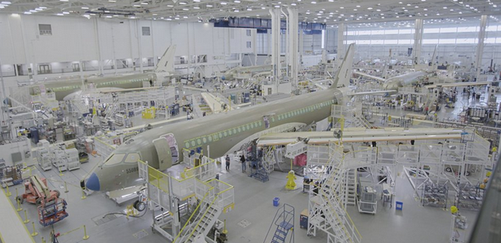
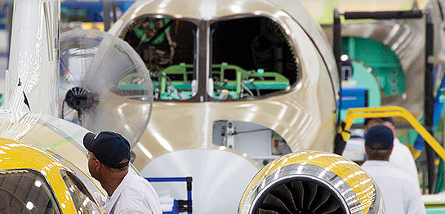
Aerospace Manufacturing Technology
This program trains the future Aviation Manufacturing Technicians to work in local and regional Original Equipment Manufacturing (OEM) locations.
Students gain the skills in Sheet metal manufacturing and repair along with Composites manufacturing and repair.
There are 3 pathways in the Associates offerings for AST.
AST Operations Management Option
AST CNC Operator Option
AST Manufacturing Engineer Option
Notes:
Nicolas (Nick) Yale
GTCC Director of Aviation Programs
Guilford Technical Community College
336-334-4822, ext 59014
nayale@gtcc.edu
Aviation Campus

Slide 21
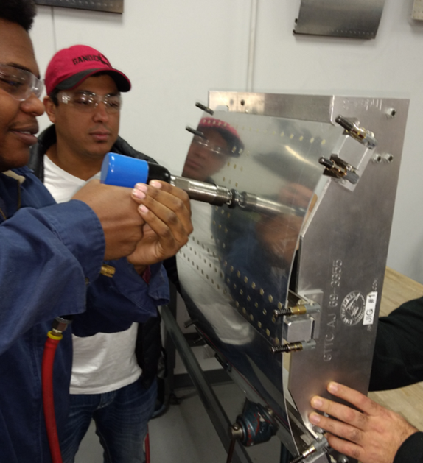
Aviation Manufacturing Quick Careers
STRUCTURES ASSEMBLY
This program is a 12-17-week course, divided into 3 main technically certificated areas; ‘Introduction to Structures’(IS), ‘Manufacturing Core Skills ‘(MCS) and ‘Structures Assembly’ (SA), and Aircraft Structures Repair.
‘Careers Readiness Certificate’ (CRC) and ‘Human Resource Development’ (HRD) components are introduced in the 4th week of the course .
Graduates of this program will be readily prepared for entry-level employment in the sheet metal structures environment. The course introduces the fundamentals of aviation, supported with practical exposure to the skills necessary to be a successful structures technician.
Students now work and not limited to Honda, HAECO, Boeing, SpaceX.
Notes:
Nicolas (Nick) Yale
GTCC Director of Aviation Programs
Guilford Technical Community College
336-334-4822, ext 59014
nayale@gtcc.edu
Aviation Campus

Slide 22
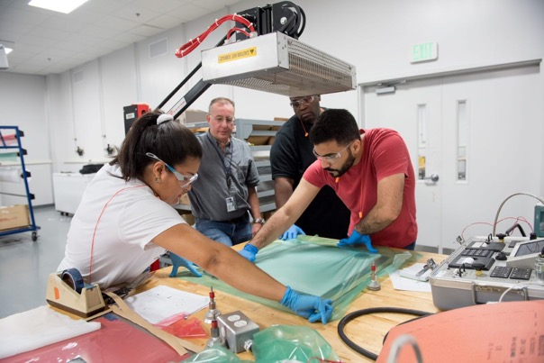
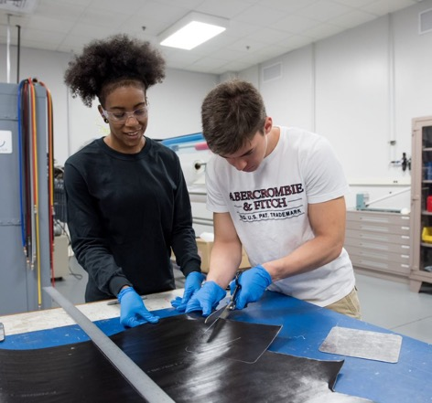
Aviation Manufacturing Quick Careers
Adanced COMPOSITE TECHNOLOGY 1, Vacuum Infusion Process, Composite Molding Fabrication
These programs are 1-4 week courses that instruct the layman and skilled professionals the fundamentals of advanced composite fabrication, repairs, infusion molding, bonding, and composite manufacturing processes.
Introduced Sept 2017 to meet the needs of local industry due to the lack of local composite training, it has been expanded to add more advanced industry needs.
Graduates of the program will be readily prepared for entry-level employment in the composite manufacturing environment.
The course introduces the many fundamentals of advanced composites and upon completion of the course, the successful graduate will be able to demonstrate a thorough understanding of advanced composite structure fabrication, repair methods, materials and application techniques.
Notes:
Nicolas (Nick) Yale
GTCC Director of Aviation Programs
Guilford Technical Community College
336-334-4822, ext 59014
nayale@gtcc.edu
Aviation Campus

Slide 23
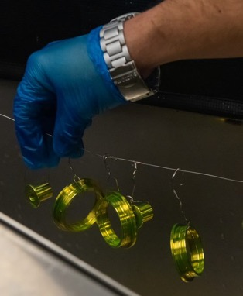
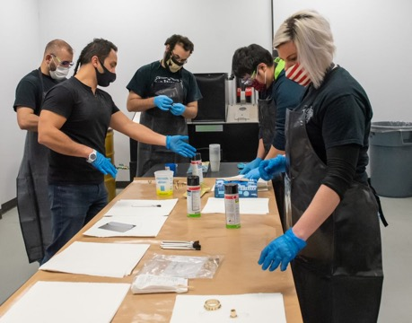
NDI/NDT Non-Destructive Testing
GTCC offers Level I, Level II specialized inspector training using ASNT guidelines and regional industry approved training guidelines for;
Dye/Florescent Penetrant Inspection
Eddy Current Inspection
Ultra Sonic Inspection
Magnetic Particle Inspection
This training provides the basis for inspectors to gain credentialing and certification for industries such as Aviation, Manufacturing, Oil and Gas, Nuclear, Pipeline Inspection, and a variety of critical industries.
Courses are offered under ConEd, and can be specialized to meet industry Federal/State approved training curriculums.
Notes:
Nicolas (Nick) Yale
GTCC Director of Aviation Programs
Guilford Technical Community College
336-334-4822, ext 59014
nayale@gtcc.edu
Aviation Campus

Slide 24
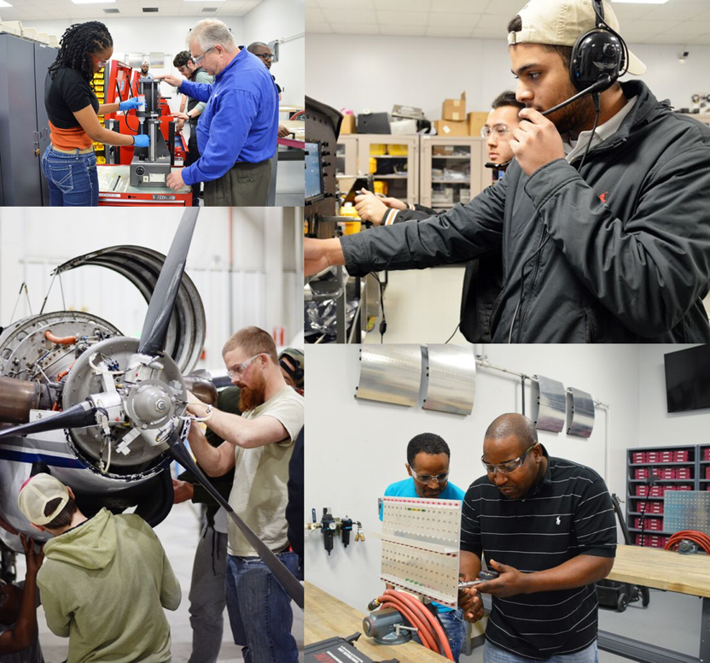
Specialized Industry Training
Specialized industry training is supported through the state of NC workforce development boards and economic development efforts.
When industry is starting, or growing they can request training in the specific areas they need new hire employees to be skilled in. The Community College system supports these efforts working closely with industry to ensure growth plans are a success.
GTCC trained 500 students for the start up at Honda, and have trained hundreds of other Aviation specific students for local industry over the last 4 years.
GTCC provided the training for 150 positions needed by HAECO for the new hangar opening in 2018. .
Notes:
Nicolas (Nick) Yale
GTCC Director of Aviation Programs
Guilford Technical Community College
336-334-4822, ext 59014
nayale@gtcc.edu
Aviation Campus

Slide 25
Then When You are Ready……
Come see us at GTCC in one of our monthly program open-house tour events. Sign up here.
It does not take 4-5 years to get a skill, a license, and a good job with higher than average pay.
You don’t need to complete school with debt to pay back.
Remember that Aviation is a lot more than just flying Aircraft, there are hundreds of jobs in aviation to meet operational needs.
This industry is hiring now, demand is higher than the total program student completion rate. Start now to take advantage of it.
18
Notes:
Nicolas (Nick) Yale
GTCC Director of Aviation Programs
Guilford Technical Community College
336-334-4822, ext 59014
nayale@gtcc.edu
Aviation Campus

Slide 26
When you are done, move up……
GTCC is partnered with ERAU (Embry Riddle Aeronautical University) Worldwide Campus. ERAU offers programs for Bachelors of Science, and Masters level programs that accept the transfer of our Associates Degree offerings.
- Professional Aeronautics
- Aviation Management
- Aviation Technical Management
Why move out of state when the jobs, training, and advanced career path is here at GTCC?
18
Notes:
Nicolas (Nick) Yale
GTCC Director of Aviation Programs
Guilford Technical Community College
336-334-4822, ext 59014
nayale@gtcc.edu
Aviation Campus

Slide 27
For a couple semesters, or a couple years, here is what you can expect to make:
Professional Pilots- After 4-6 years preparation and building hours, starting around $85k. 10 year professional $150-180K
Structures Technicians- After 1 year of specialized training, from $15 to $35 per hour. $50-75K per year.
Manufacturing Technicians- After 2 years, with a given specialty from $22 to $35 per hour.$50-75K per year. Ten year professionals >$100k.
Airframe and Powerplant Mechanics- After two years of training starting between $18-28 per hour. 10 year professional $120-145K per year.
18
Notes:
Nicolas (Nick) Yale
GTCC Director of Aviation Programs
Guilford Technical Community College
336-334-4822, ext 59014
nayale@gtcc.edu
Aviation Campus

Slide 28
Notes:
www.ncperkins.org/presentations

Slide 29
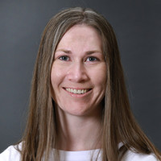
Amanda Good, PMP
Project Manager and Associate
Kimley-Horn
Notes:
Amanda Good
Kimley-Horn
amanda.good@kimley-horn.com
1 919 653 5849

Slide 30
Notes:
Amanda Good
Kimley-Horn
amanda.good@kimley-horn.com
1 919 653 5849
Data – Big Data and how to capture this data, store this data, use this date is a growing discussion – where and how can we get data to evaluate performance and our return on investments
Communications – how does everyone talk to each other? Putting in the infrastructure for rural and urban communications (FIBER project in NC)
Security – all new protocols and new devices, how do you keep TMC’s operating securely; how do you keep devices working securely.
Video Analytics – using artificial intelligence to track and identify the potential of a crash – whether this is pedestrian and vehicular or V2V – to be more proactive to responding versus reactive in responding to incidents
Mobility as a Service (Maas) – having one platform that provides all transportation options of B to C – geared more toward mobility provided by a service and away from personally owning a vehicle
Connected – the V2X connection with devices and vehicles; states are deploying technology on arterials to connect with vehicles (pilots) and signals or rail – but these are still pilots and use cases haven’t quite been worked out thoroughly
Automation/Autonomous – AV’s are the rave right now – where are the pilot shuttles, where are the driverless vehicles, and when will they be arriving. Current AV shuttles and driverless vehicles are in small urban areas with great weather – the use cases need to evolve and then we’ll learn more to deploy more; they’ll be deployed greater number in the freight industry

Slide 31
Notes:
Amanda Good
Kimley-Horn
amanda.good@kimley-horn.com
1 919 653 5849

Slide 32
Notes:
www.ncperkins.org/presentations

Slide 33
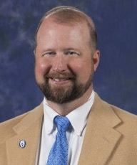
Joe D. Shook, M.A.Ed.
Dean of Advanced Technologies
Blue Ridge Community College
Notes:
Joe D. Shook M.A. Ed
Dean of Advanced Technologies
Blue Ridge Community College
Joe D. Spearman Building - Room 102A
(828)694-1686
jd_shook@blueridge.edu

Slide 34
Alternative Transportation Technology
This program prepares individuals to apply technical knowledge and skills to the maintenance of alternative fuel vehicles (AFV), hybrid electric vehicles and the conversion of standard vehicles to AFV status.
Topics of instruction include electrical vehicles, hybrid electric vehicles, liquefied petroleum gas (LPG) vehicles, compressed natural gas (CNG) vehicles, hybrid fuel technology, electrical and electronic systems, engine performance, diagnosis and repair, and conversion/installation.
Blue Ridge CC Alternative Transportation Technology Program
Notes:
Joe D. Shook M.A. Ed
Dean of Advanced Technologies
Blue Ridge Community College
Joe D. Spearman Building - Room 102A
(828)694-1686
jd_shook@blueridge.edu

Slide 35
Notes:
Joe D. Shook M.A. Ed
Dean of Advanced Technologies
Blue Ridge Community College
Joe D. Spearman Building - Room 102A
(828)694-1686
jd_shook@blueridge.edu

Slide 36
Notes:
www.ncperkins.org/presentations

Slide 37
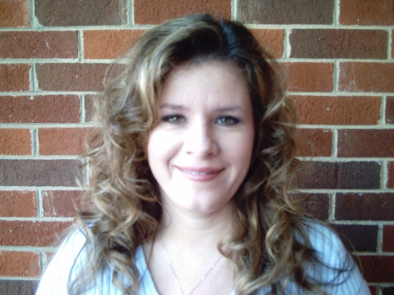
Linda Whitlow
Director of K-12 Partnerships
Guilford Technical Community College
Notes:
Linda Whitlow
Director of K-12 Partnerships
lswhitlow@gtcc.edu
GTCC Career and College Promise
https://www.gtcc.edu/academics/high-school-programs/career-and-college-promise.php
Automotive Systems Technology Diploma - CCP
https://catalog.gtcc.edu/preview_program.php?catoid=8&poid=3084

Slide 38
CCP at GTCC
GTCC Career and College Promise
https://www.gtcc.edu/academics/high-school-programs/career-and-college-promise.php
Automotive Systems Technology Diploma - CCP
https://catalog.gtcc.edu/preview_program.php?catoid=8&poid=3084
Notes:
Linda Whitlow
Director of K-12 Partnerships
lswhitlow@gtcc.edu
GTCC Career and College Promise
https://www.gtcc.edu/academics/high-school-programs/career-and-college-promise.php
Automotive Systems Technology Diploma - CCP
https://catalog.gtcc.edu/preview_program.php?catoid=8&poid=3084

Slide 39
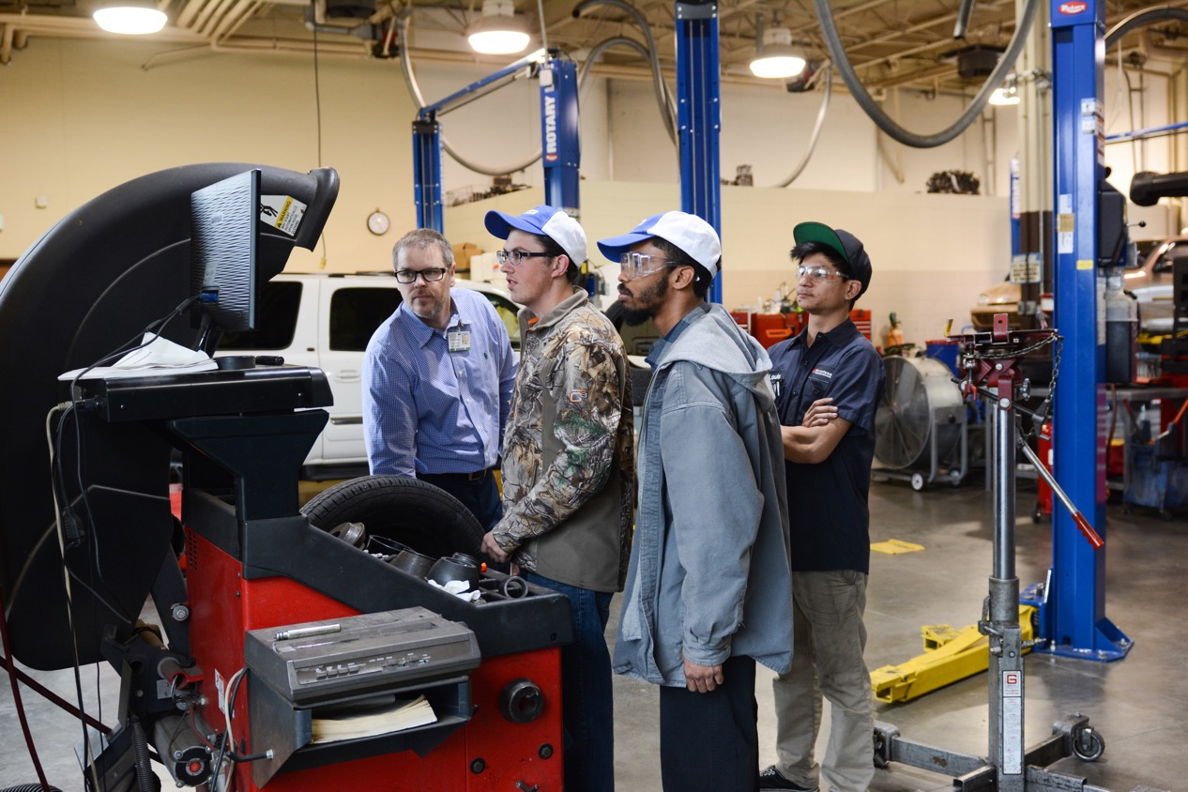
Notes:
Linda Whitlow
Director of K-12 Partnerships
lswhitlow@gtcc.edu
GTCC Career and College Promise
https://www.gtcc.edu/academics/high-school-programs/career-and-college-promise.php
Automotive Systems Technology Diploma - CCP
https://catalog.gtcc.edu/preview_program.php?catoid=8&poid=3084

Slide 40
Notes:
Linda Whitlow
Director of K-12 Partnerships
lswhitlow@gtcc.edu
GTCC Career and College Promise
https://www.gtcc.edu/academics/high-school-programs/career-and-college-promise.php
Automotive Systems Technology Diploma - CCP
https://catalog.gtcc.edu/preview_program.php?catoid=8&poid=3084

Slide 41
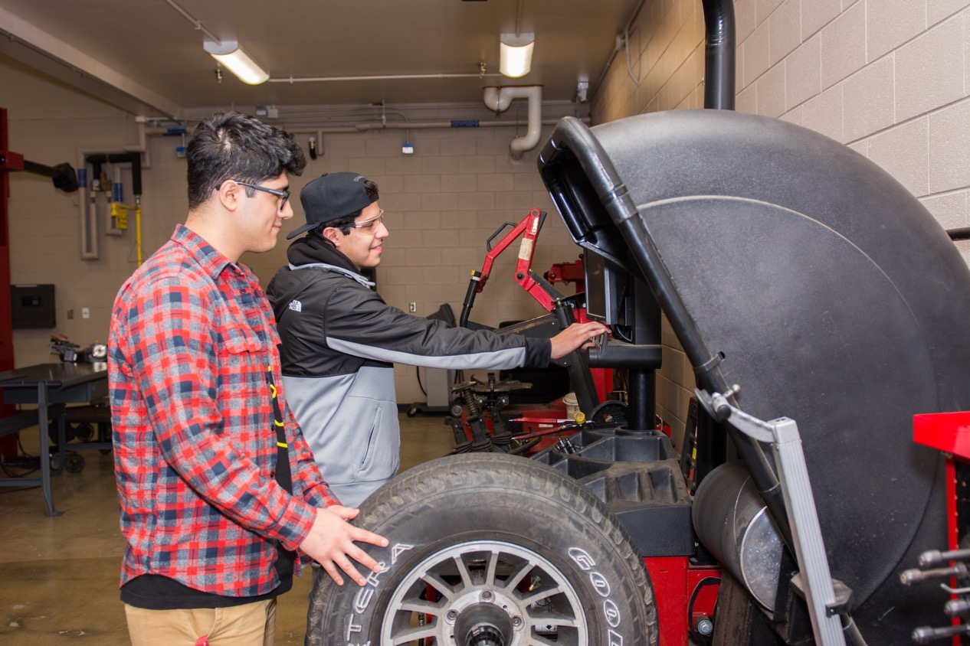
Notes:
Linda Whitlow
Director of K-12 Partnerships
lswhitlow@gtcc.edu
GTCC Career and College Promise
https://www.gtcc.edu/academics/high-school-programs/career-and-college-promise.php
Automotive Systems Technology Diploma - CCP
https://catalog.gtcc.edu/preview_program.php?catoid=8&poid=3084

Slide 42
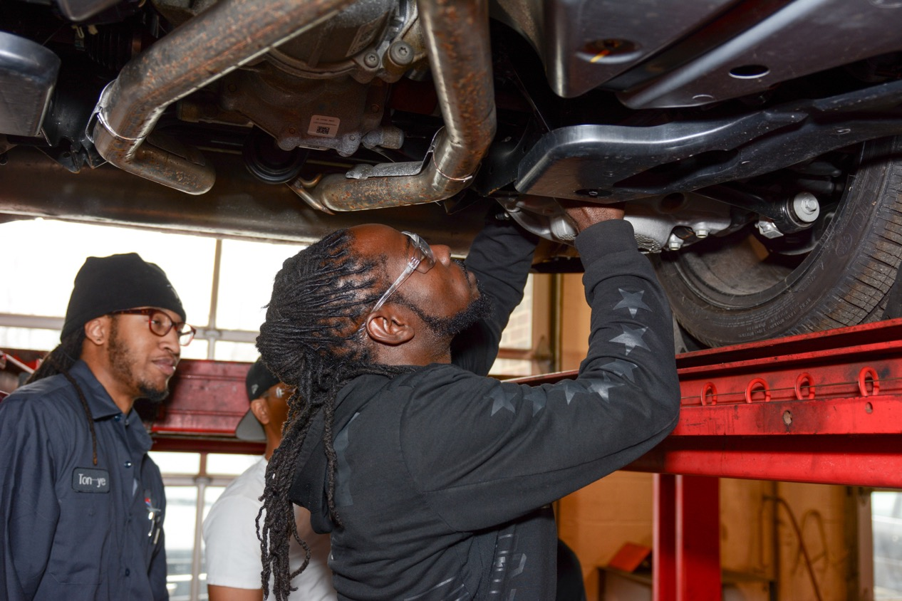
Notes:
Linda Whitlow
Director of K-12 Partnerships
lswhitlow@gtcc.edu
GTCC Career and College Promise
https://www.gtcc.edu/academics/high-school-programs/career-and-college-promise.php
Automotive Systems Technology Diploma - CCP
https://catalog.gtcc.edu/preview_program.php?catoid=8&poid=3084

Slide 43
Notes:
www.ncperkins.org/presentations

Slide 44
2021 ApprenticeshipNC Annual Conference
April 27, 28, 2021
8:30 am to 12:30 pm each day
Free
https://register.gotowebinar.com/register/7684553148246083597
Notes:
Registration page
https://register.gotowebinar.com/register/7684553148246083597

Slide 45
2021 ApprenticeshipNC
Annual Conference
April 27-28, 2021
8:30 am to 12:30 am each day
Notes:
Registration page
https://register.gotowebinar.com/register/7684553148246083597

Slide 46
Raising the Awareness of Career Pathways in North Carolina
Next meeting is May 19, 2021 – Careers in Agriculture
Download the PowerPoint and access the recording: www.ncperkins.org/presentations
Notes:
Our next meeting like this one will be on ------.
(We will skip December and be back in January.)
You can go to the NCPerkins website to register for that meeting.
We'll also send you a reminder, since you are now on our mailing list.
So go ahead and sign up for all the meetings, and you'll be reminded the day before.
If you liked something you saw here, send folks to the recording. Find it at that same web page.

