Slide 1
Stacking: Programs of Study, College and Career Promise, and Career Pathways
Dr. Bob Witchger
Director of Career and Technical Education
NC Community College System
WitchgerB@nccommunitycolleges.edu
Notes:
=====
NCWorks Partnership Conference
Tursday, October 6, 2016 @ 3:00 p.m.

Slide 2
Pathways - Components
Engaged Employers
Infused Career Development
Programs of Study – Classroom Teaching/Learning
Work-Based Learning
Placement into Work
Notes:
What do we my by each one of these area?
Discuss in Groups Report Out

Slide 3
Pathways - Characteristics
Seamless framework in demand-driven, data-informed clusters
Engage employers
Offer Career Development & Awareness
Coordinate training and Programs of Study that:
accept credit and articulate credit for prior leaning,
integrate work-based learning,
contain multiple entry and exit points,
award credentials, certificates, diplomas, and degrees that meet workforce needs
Place individuals in full-time jobs

Slide 4
Employer Engagement
Assist in developing the pathways
Offer suggestions, strategies, and opportunities for work-based learning (WBL)
Work with program designers in determining learning outcomes
Education and training for certificates and credentials
Provide for and serve as mentor
Interview and hire completers as appropriate
May work with groups of employers to hire an intermediary

Slide 5
Career Development
Integrated Career Counseling and Coaching
Coordinates intentional advising for middle school, high school, college, and career centers in a region to share labor market information and pathways to careers
Provides career assessments such as interest, abilities, and skills to assist in career planning
Provides career advising, coaching, and planning
Works with individuals to develop an integrated career plan leading to employment, including classroom training and on the job training, and training that is integrated into an existing pathway framework.

Slide 6
Education and Training
Rigorous Programs of Study
A comprehensive structured approach for delivering career and technical education to prepare students thorough secondary and postsecondary education for work
Typically a grade 9-14 framework of classroom and experiential learning
May include HS to CC articulated credit, opportunity for secondary students to earn postsecondary credit (CCP)
Programs of study may be aligned to regional industry needs, integrate technical and academic courses resulting in a certificate, diploma and/or degree
Programs of study within the pathway framework include intentional career advising, integrated work-based learning and accruing stackable credentials

Slide 7
Education and Training
Other Options to Build Into Framework
Multiple options for education and training are built into the Career Pathway Framework. These include and are not limited to:
Apprenticeship
Continuing Education Certificate Programs
Vendor Training
Short-Term Targeted Training
Basic Skills Plus

Slide 8
Rigorous Education and Training
A comprehensive, structured approach for delivering education and training to prepare individuals for work.
Typically a framework of classroom and on-the-job learning.
May include credit for previous life/work experience
Acknowledgement of certifications.
Training is aligned to regional industry needs, and may integrate technical and academic courses resulting in a certificate, diploma and/or degree.
Education and training within the pathway framework includes intentional career advising, integrated work-based learning, and accruing stackable credentials.

Slide 9
Certifications
Stackable - Certificates, Diplomas, Degrees, Credentials
Credentials can be gained from education, employers, and third-party vendors. The pathways leadership team will determine which credentials are appropriate for each pathway.
Certifications can be stackable and accruing allowing for open entry and open exit in the program of study of the pathway.
Recognizing the value of independent learning, OJT, and other forms of skill development in each pathway, Credit for prior learning can be acknowledged and credited to the individual within the framework of the pathway.

Slide 10
Work-Based Learning with Engaged Employers
Exploratory -
Provides on-worksite orientation to an occupation
Helps in setting career direction and/or career major
Opportunity to systematically sample and observe a variety of work
Obtain knowledge about the nature and characteristics of work
Offers a comprehensive and accurate knowledge of the world of work
May include activities such as: Industry Tours, Job Shadowing, Mentorship, Service Learning, Volunteer, Junior Achievement

Slide 11
Work-Based Learning with Engaged Employers
Experiential -
Provides hands-on experience on the general nature of work
Provides opportunity to experience and learn soft skills
Provides opportunity to experience and learn foundational skills
Skills such as: teamwork, following directions, communication, on-the-job behaviors,
May include activities such as: PT Work, Project-Based Learning, Service Learning, OJT, Structured Volunteer Experiences, Student Organizations

Slide 12
Work-Based Learning with Engaged Employers
Integrated –
Work experience related to classroom instruction,
Expands theory and enhances skills learned in the classroom
Integrates life and learning at the worksite
May include activities such as: Cooperative Education, Internships, Apprenticeships, Pre-Apprenticeship, On-the-Job Training

Slide 13
Job Placement
Provide for experiential learning at various worksites during classroom training
Offer assistance in interviewing and direct job placement with employers engaged in the pathway framework
Meet the employment demands of the local labor market

Slide 14
Intermediary - Coordinator
Provides the employer’s voice in pathway development
Has a working knowledge of career opportunities in the pathway
Offers suggestions, strategies, and coordinates opportunities for WBL
Works with training program designers in determining education, training, certificates, credentials, as well as learning outcomes for classroom training and work-based learning
Assists individuals in gaining meaningful WBL, works with employer before students are placed into WBL, informs faculty of industry needs
Coordinates mentoring and interviews for completers
Typically works in one industry sector with multiple employers

Slide 15
Why Pathways?
Framework
Common Language
Streamline Education and Training Process
Address Labor Shortage in a Region

Slide 16
History of Pathways
Pathways to Prosperity
College is not for all
Emphasis on education and work
Skill building for the forgotten half
Learning on the job

Slide 17
Pathways to Prosperity
Emphasis school-to-work
Education and skill development
Postsecondary credential
Skills beyond high school
Articulated, focused

Slide 18
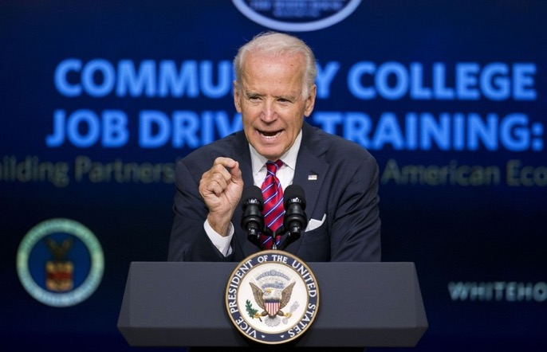
Job-Driven Training
Engage Employers
Earn and Learn
Smart Choices
Measurement Matters
Stepping Stones
Open Doors
Regional Collaboration
Notes:
Joe Biden offered us Elements, Strategies, and Philosophy to be build into Career Pathways through his principles of Job Drive Training.

Slide 19
Job-Driven Training
“Training that is responsive to the needs of employers in order to effectively place ready-to-work Americans in jobs that are available now or train them in the skills needed for better jobs.”
“FACT SHEET: Ready to Work At a Glance: Job-Driven Training and American Opportunity,”
Notes:
====
“FACT SHEET: Ready to Work At a Glance: Job-Driven Training and American Opportunity,”

Slide 20
1. Engage with Employers
Involve employers up front
Determine local and regional hiring needs
Get the employer’s perspective
Adapt training to meet employer / labor market needs
Advisory and beyond
Notes:
Element 1 – Work up-front with employers to determine local or regional hiring needs and design training programs that are responsive to those needs.

Slide 21
2. Earn and Learn
Offer work-based learning
Exploratory - Look at work
Experiential - Experience work
Engaged/Involved - Integrate work and education
Paid OJT
Notes:
“Earn and Learn” means that individuals should receive training that is outside the classroom and in the work- place. In addition, they should receive a livable wage for their training. Some examples include paid internships, pre-apprenticeships, Registered Apprenticeships (RA), and on-the-job training (OJT).Element 2 – Offer work-based learning opportunities with employers—including on-the- job training, internships, and pre-apprenticeships and Registered Apprenticeship as training paths to employment.
=====
Graphic
http://noteinvestors.com/blog/wp-content/uploads/2016/02/learn-and-earn1.png

Slide 22
3. Use Data – Smart Choices
Data-driven accountability
What it taught - Programs of Study related to work
Likelihood of getting a job
Notes:
The third principle of job driven training asks that employment and training programs use data to drive accountability and inform employer engagement strategies. Comprehensive and accessible labor market data can facilitate two important processes: this data can drive your employer outreach, and it can inform consumers on real opportunities.

Slide 23
4. Measurement Matters
Earnings and employment
Employment by sector
Employer by training group, program, class
Retention
Notes:
The fourth principle of job-driven training states that programs should measure and evaluate the employment outcomes of participants to assess the quality of training programs. Having this information, the report states, allows training providers and job seekers to make informed choices about the training they choose. break your data down by employer and sector. Trainees, retention,

Slide 24
5. Stepping Stones
Seamless progression
Steps, progression
Advancement, credentials
Come and go -- open entry and open exit
Notes:
The fifth principle of job-driven training requires that employment placement show a stepping stone approach to success. In practice, this means a training process shows a progression and advancement, with integration of training and education activities as needed.
=====
Graphic
http://www.bie.org/images/uploads/objects/blog_stepping_stones.png

Slide 25
6. Opening Doors
Chipping away at barriers to employment
Serve those with barriers
Collaboration and extra tools for job developers, trainers, and employers
Notes:
Principle six, “opening doors,” speaks to the heart of organizations executing HVRP: organizations doing employment services should do whatever possible to remove barriers to employment. This principle demands that programs help open access to employment opportunities for those who are most in need and who have the most signicant barriers.
=====
graphic
http://www.terrancefrederick.com/wp-content/uploads/2015/11/opendoors.jpg

Slide 26
7. Regional Collaboration
Workforce Boards
Job Centers
Chambers of Commerce
Community Colleges
Labor Organizations
Philanthropic Organizations
Human Service Agencies
Vocational Rehabilitation
Independent Living Centers
Community Organizations
Notes:
The final principle of job-driven training asks providers to coordinate major players in local and regional employment services. The list of partners is long, including: Workforce Investment Boards and the American Job Centers they oversee, higher education institutions, labor organizations, philanthropic organizations, state and local human service agencies, vocational rehabilitation agencies, Medicaid agencies, centers for independent living, sup- ported employment providers, community- and faith-based organizations, and other nonpro t organizations.

Slide 27
Job-Driven Training
Impacts:
employers,
training providers, and
unemployed workers.
“FACT SHEET: Ready to Work At a Glance: Job-Driven Training and American Opportunity,”
Notes:
=====
Photo
http://www.nationalskillscoalition.org/news/blog/image/training.jpg

Slide 28
2014 Vision Overview
CTE Career Pathways
Advising
Program of Study
Assessment Interest, Ability, Skills
HS - Academic and Technical
Comprehensive Career advising
Credentials
Work
CC - Academic and Technical
Interviews
Labor Market Information
Experiential/Work-Based Learning
Career Plan
Certifications
Diploma
Degree
9, 10, 11, 12, 13, 14
Engaged Employers
Assessment of Competencies,
& Credentials,
Placement in Education / Training
Notes:
Graphic Highlighting Three Main Components
Career Advising
Programs of Study – Work Based Learning, Stackable Credentials, Multiple Entry and Exit,

Slide 29
Building the Pathway: Credentials
(Rigorous) Programs of Study (Classes are examples)
Level | Courses |  |  |  |  |  |  |  | Certifications & Degrees
9 | English 1 | Algebra I or Integrated Math I | Environmental Earth Science | World History | Health/PE | MSITA Word, PPT | Small Business Entrepreneurship | Freshman Career Management | MSITA Certifications (2)
10 | English 11 | Geometry or Integrated Math II | Physical Science | Civics | Principles of Business & Finance | MSITA Excel, Access | Business Law | MSITA Website or Database | MSITA Certifications (2)
11 | English 111 | Algebra II or Integrated Math III | Biology | BUS 151 | BUS 110 Intro to Business | Accounting I | BUS 137 Principles of Management | BUS 135 Principles of Supervision | MSITA Certification(1) MOS Career Readiness - CRC
12 | English IV | 4th Math Aligned with sudent’s plan | US History Part A | MAT 115 Mathematical Models | US History Part B | Accounting II | ENG 114 Professional Research & Reporting | BUS 115 Business Law I | High School Diploma QuickBooks Certification CC Certificate
Core Courses
CTE High school courses
Community college courses
Articulated Courses
Labor Market Value $$
Articulated credits - MSITA for CIS110
Online Course on Demand See CC course requirements for each degree
Notes:
As opportunities for credentials are identified, they would be integrated into the matrix as an option and part of the path.

Slide 30
Building the Pathway 9-14 High School and Community College
(Rigorous) Programs of Study (Classes are examples)
Level | Courses |  |  |  |  |  |  |  | Certifications & Degrees
9 | English 1 | Algebra I or Integrated Math I | Environmental Earth Science | World History | Health/PE | MSITA Word, PPT | Small Business Entrepreneurship | Freshman Career Management | MSITA Certifications (2)
10 | English 11 | Geometry or Integrated Math II | Physical Science | Civics | Principles of Business & Finance | MSITA Excel, Access | Business Law | MSITA Website or Database | MSITA Certifications (2)
11 | English 111 | Algebra II or Integrated Math III | Biology | BUS 151 | BUS 110 Intro to Business | Accounting I | BUS 137 Principles of Management | BUS 135 Principles of Supervision | MSITA Certification(1) MOS Career Readiness - CRC
12 | English IV | 4th Math Aligned with sudent’s plan | US History Part A | MAT 115 Mathematical Models | US History Part B | Accounting II | ENG 114 Professional Research & Reporting | BUS 115 Business Law I | High School Diploma QuickBooks Certification CC Certificate
Summer | COE 112 (coop) | COE 110 World of Work | ACA 111 College Student Success
1 | MKT 220 Advertising & Sales | ACC 120 Principles of Financial Accounting | ENG 111 Expository Writing | BUS 116 Business Law II | BUS 260 Business Communications | BUS 240 Business Ethics | ACC 129 Individual Income Taxes | ACC 121 Principles of Managerial Accounting | Business Administration Diploma 44 hours
2 | Social Science Elective | BUS 239 Business Applications Seminar | ECO 252 Principles of Macroeconomics | Humanities Fine Arts Elective |  |  |  |  | Business Administration AAS Degree 65-73 hours
Core Courses
CTE High school courses
Community college courses
Articulated Courses
Labor Market Value $$
Articulated credits - MSITA for CIS110
Online Course on Demand See CC course requirements for each degree
Notes:
The College Certificate, Diploma, and Degree Courses would be added to the Program of Study

Slide 31
Building the Pathway Engaging Employers
(Rigorous) Programs of Study (Classes are examples)
Core CoursesE
CTE High school courses
Community college courses
Articulated Courses
Experienced/Work Based Learning
Level | Courses |  |  |  |  |  |  |  | Certifications & Degrees
9 | English 1 | Algebra I or Integrated Math I | Environmental Earth Science | World History | Health/PE | MSITA Word, PPT | Small Business Entrepreneurship | Freshman Career Management | MSITA Certifications (2)
10 | English 11 | Geometry or Integrated Math II | Physical Science | Civics | Principles of Business & Finance | MSITA Excel, Access | Business Law | MSITA Website or Database | MSITA Certifications (2)
11 | English 111 | Algebra II or Integrated Math III | Biology | BUS 151 | BUS 110 Intro to Business | Accounting I | BUS 137 Principles of Management | BUS 135 Principles of Supervision | MSITA Certification(1) MOS Career Readiness - CRC
12 | English IV | 4th Math Aligned with sudent’s plan | US History Part A | MAT 115 Mathematical Models | US History Part B | Accounting II | ENG 114 Professional Research & Reporting | BUS 115 Business Law I | High School Diploma QuickBooks Certification CC Certificate
Summer | COE 112 (coop) | COE 110 World of Work | ACA 111 College Student Success
1 | MKT 220 Advertising & Sales | ACC 120 Principles of Financial Accounting | ENG 111 Expository Writing | BUS 116 Business Law II | BUS 260 Business Communications | BUS 240 Business Ethics | ACC 129 Individual Income Taxes | ACC 121 Principles of Managerial Accounting | Business Administration Diploma 44 hours
2 | Social Science Elective | BUS 239 Business Applications Seminar | ECO 252 Principles of Macroeconomics | Humanities Fine Arts Elective |  |  |  |  | Business Administration AAS Degree 65-73 hours
Tours
Project B Learning
Shadowing
OJT / OJL
Co-Op
Apprenticeship
Articulated credits - MSITA for CIS110
Online Course on Demand See CC course requirements for each degree
Employer Engagement
Notes:
Here we see how employers or their intermediary would review
CTE Learning Outcomes, Certificates, and again review the certificates.
This is a draft to get you thinking and to receive your comments as we finish developing the proposal.

Slide 32
Building the Pathway Short Term Career Center / Continuing Education
Level | Courses |  |  |  |  | Certifications & Degrees
Career Center Coordinator | Basic Reading and Math | Health | LPN |  |  | Certifications (2)
2
Tours
Project B Learning
Shadowing
OJT / OJL
Co-Op
Apprenticeship
Employer Engagement
Notes:
This is a graphic demonstrating how short term training or continuing education may be displayed in the pathway,
The Upfront career advising, upgrading of basic reading and math skills for a specific pathways and then immediate or concurrent integration to specific skill training leading to certificated and work…
Note exploratory, experiential, and infused work based learning can be integrated into the pathway.
Lets take a quick breath….
In its most recent career pathway tool kit the department of education and department of labor identifies 6 characteristics of pathways,
See how these build on the work of the vice president and see how they parallel some of our current work and future certified pathways
These characteristics are:
1.
2.
3.
4.
5.
6.

Slide 33
Labor Market Demand
Employer Engagement
Career Advising
Skill Training
Work
Collaboration

Slide 34
Evaluation
Labor Market Demand
Certified Career Pathway
Employer Engagement
Career Awareness
Articulation Coordination
Program of Study
Work
Work Based Learning
Collaboration

Slide 35
Labor Market Demand
Employer Engagement
Career Advising
Education &
Skill Training
Work
GAP - Shortage of Qualified Workers
Demand
Need & Growth - Quantity of Workers
Hire
Credentials
Skills
Work-Based Learning
Learning Outcomes

Slide 36
Commitment & Support
Buy into Model & Process
Deliver a Consistent Message
LEA
CC
WDB
Univ
Community
Industry
Collaboration

Slide 37
Career Advising
Selecting Pathway, Education, & WBL
Advising Team
Professional Development
Advising Skills
Middle School
High School
Community College
University
Career Center
Joint staff
Advising on Certified Pathways
Setting Career Goals
WBL Explore, Experience, Engage
CDF - Listening,, Sharing LMI, Sharing Options
Individual Assessment of Interest, Abilities, Skills
Sharing Labor Market Information: Projections; Pathway Requirements; Certifications; & Employment Options
Career Planning & Goal Setting

Slide 38
Individual Career or Employability Plan
Career Awareness
Career Plan
Assessment of Interests, Abilities, Skills
Assessment of Prior Learning, Credentials
Assessment of Pathway Identified Skills
Identification of Individual Career Goal
Articulation Coordination
Program of Study Academic and Techincal Training
Academic & Technical Courses
Education and/or Training Program
Credit for: Experiences, Articulated Course Plan, and Path Streamlined for Individual
Work-Based Learning
Exploratory - Shadowing, Mentoring
Experiential - Work Foundational Skills
Engaged - Supportive of Classroom Education
Career Goal
Work
Jobs within the Cluster
Ability to Engage in Work
Reengage in Education or Training
Continuous Education /Training to Meet Career Goal

Slide 39
Career Development - Career Advising
Career Advising
Individual Career Path
Work
College
Advanced
Training
High School
At Work
Individual Career Path

Slide 40
Informed Career Advisors High School - College - Career Center
High School
College
Share Pathway Information
Labor Market Information
Support Services
Communication
Advanced Training
At Work
Individual Career Path

Slide 41
Articulation and Coordination Program of Study / Training
Student
Graduate
Dislocated Worker
Under- employed
Unemployed
Career Changer
Middle School
High School Diploma
Community College AAS
W O R K
Certificate
Diploma
Degree
Basic Skills Plus
Community College AA
Continuing Education
Customized Training
University
Proprietary School / Training
Apprenticeship

Slide 42
Articulation and Coordination Program of Study / Training
Student
Graduate
Dislocated Worker
Under- employed
Unemployed
Career Changer
Middle School
High School Diploma
WBL
Community College AAS
W O R K
Certificate
Diploma
Degree
Basic Skills Plus
Community College AA
Continuing Education
Customized Training
University
Proprietary School / Training
Apprenticeship
Notes:
Note work-based learning is integrated across and through all programs of study or training

Slide 43
Articulation and Coordination Program of Study / Training
Build to meet employer’s need
Stackable credentials
Open entry /exit
Exit to work
Articulate back to training
Stack toward a degree
Certificate
Diploma
Degree

Slide 44
Work-Based Learning
Exploratory
Exploring Work
Experiential
Fundamental Skills & Soft Skills
Engaged
Classroom learning applied on the job.
Structured OJL
Job Shadowing
Employer Videos
Employer Projects in Class
Industry Tours
Junior Achievement
Part Time Work
Volunteer
Projects in Class
Internship
Service Learning
Junior Achievement
CTSO
Cooperative Education
Apprenticeship
Internship
Structured Volunteer
Structured Service Learning

Slide 45
Work-Based Learning
Engages Employers along the pathway
Offers opportunities to explore careers and work first hand
Provides for guidance from mentors
Stresses the culture of work
Builds Foundational Skills: Communication, Team work, On Time, Sharing
Enhances Classroom Instruction
Focuses on skills identified by employers, educators and training providers

Slide 46
Work
Career Pathways offer:
Example Jobs in a Career Pathway:
Career ladder
Job opportunities based on skills & credentials
Opportunity to learn new work skills & advance through the pathway
Identified by engaged employers in a region
Welder
Machine Operator
Machine Maintenance
Machinist
Engineering Tech
Mechanical Engineer

Slide 47
Future Ideas: Intermediary
Industry Associations
Workforce Development Boards
Chambers of Commerce
Economic Development Organizations
Non-Profit Employer-focused Organizations
College Continuing Education Unit
Notes:
Knowledge of this Business or Industry
Understand Culture of this type work
Support of and understand of employers and their needs

Slide 48
Lessons Learned
Employer Engagement /Work-Based Learning
Communications: Education jargon vs workforce jargon
Traditional academic calendar
Course credit, timing, and internship hour requirement (e.g. student receives incomplete if summer course allows inadequate time to meet required internship hours)
Student availability
Lack of employability skills by students

Slide 49
Lessons Learned
Employer Engagement /Work-Based Learning
Fear of liability issues
Time constraints on the part of industry or education
Employer with bad previous experience
Adaptability of different generations in the workforce
Confidentiality / proprietary industry information

Slide 50
Strategies for Engaging Employers
Develop key relationship with CEO or other company leadership.
Build database of employers, opportunities available by employer, goals & objectives.
Maintain constant contact with student, employer engaged in work-based learning.
Develop work plan with employer to alleviate any trepidation in working with student. Ways to increase Employer Engagement/Work-Based Learning.
Make it easy for employer to reduce documentation or time.
Give employers advance notice of when you need their involvement.
Help employers see long-term benefit to them in terms of future talent pool.

Slide 51
Strategies for Engaging Employers
Encourage employers and schools to be flexible in scheduling.
Give employers specifics about what is expected to build mutual understanding (Who, what, when, where, why).
Encourage meaningful experiences. For example, instead of field trip or tour, add a hands-on learning experience to make it a field study. Instead of guest speaker, facilitate a class project.
Be flexible with industry and take what they offer.
Be persistent; do not give up.
Success breeds success. Use willing partners. Publicize and spotlight their effort.

Slide 52
Strategies for Engaging Workforce Development Boards
Pull them into the career pathway planning from the beginning
Include them as part of the pathways leadership team
Involve their business services team
Ask that they serve as a convener of key stakeholders
Enlist their help in connecting with employers
Offer representatives to serve on their board (Mountain area board includes superintendents)
Invite workforce board representation on CTE advisory boards

Slide 53
Strategies for Engaging Workforce Development Boards
Collaborate to create regionally certified pathways
Invite them to tour community college / high school campuses
Suggest that they include pathways progress on their meeting agendas; offer to speak at their meeting
Explore fully the new federal Workforce Investment and Opportunity Act (WIOA); encourage their help in building understanding of how that law supports pathway development
Set aside past perceptions of the board; build new relationships with an open mind; board members change

Slide 54
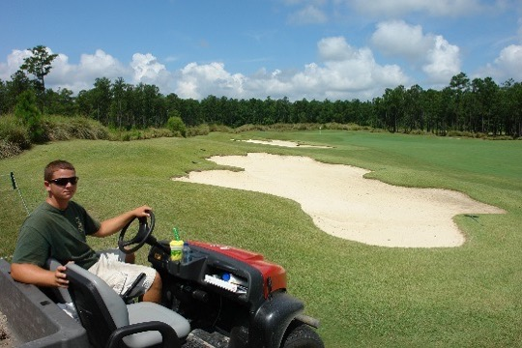
Project Overview: Partners, Pathways and Collaboration
Cape Fear Workforce
Development Board
Over 75 local and regional horticulture and turfgrass management related business and agency participants

Slide 55
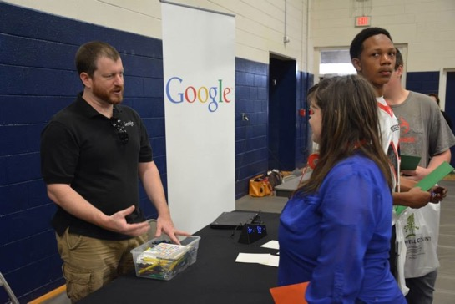
CCC&TI and Industry Partners
Sattler Corporation
Bakers Waste Equipment
Exela Pharma Sciences
Howard’s Brewing
Google
Sealed Air Corporation
Bemis Manufacturing
Bernhardt Furniture
Greer Laboratories
Atlantic Caviar and Sturgeon
Continental Teves

Slide 57
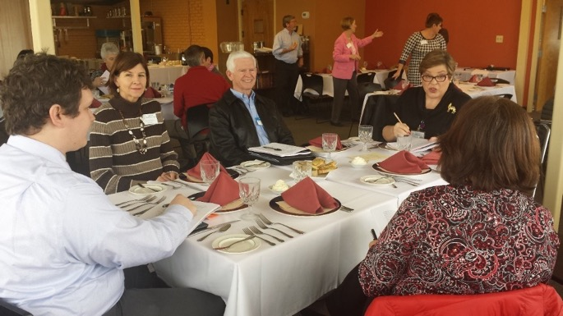
Partnerships include: Carteret General Hospital, Eastern Carolina Workforce Development Board, Carteret County Chamber of Commerce, Safrit’s Building Supply, FRC East, Carteret County Government, Big Rock Sports.
Our first focus group was held on January 28, 2015 at Culinary School facility on campus.

Slide 58
Who’s Engaged?

Slide 59
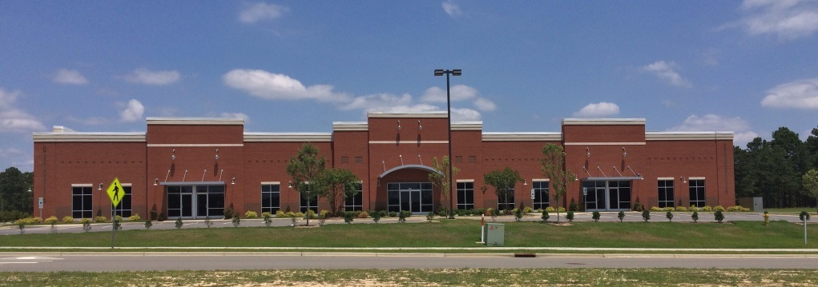
Associate in Post-Collision Remanufacturing
Reshaping the Collision Repair Industry…
… One Student at a Time.

Slide 60
The Mission
To create an industry-specific educational culture owned by the industry and facilitated by the Community College System
Notes:
Paul Gage, program director for the I-CAR Collision Repair program at North Carolina's Fayetteville Technical Community College.
Auto makers are creating more sophisticated vehicles that require knowledge of the latest technologies used for state-of-the-art car repairs. A new two-year program from Fayetteville (N.C.) Technical Community College (FTCC) and the Collision Repair Education Foundation (CREF) is a collaboration between state government, private industry and education to create a curriculum that will provide the knowledgeable technicians the collision industry requires.
====
Photo
http://media.propertycasualty360.com/propertycasualty360/article/2015/01/22/paul-gage-at-ftcc-collision-remanufacture-bldgmini-crop-600x338.JPG

Slide 61
Why Does the Industry Need this Program?
Corporate Average Fuel Economy Standards
Federal Motor Vehicle Safety Standards
Current Technological Advancements
Future Technological Advancements
Average technician age of 49 – 51
Lack of young people coming into the industry
Notes:
=====
Photo
http://wactal.com/wp-content/uploads/2015/02/featured1.jpg

Slide 62
New Automotive Technology
Advanced Construction Materials
Advanced Engineering
LED and Laser Headlamps
Night Vision
GPS Guided Headlamps
Waterborne and Ceramic Finishes
Notes:
====
Photo
http://www.yellowpagecollegedirectory.com/images/articles/collision-repair-schools.jpg

Slide 63
An Industry in Need
The issue of unfilled positions in the industry has reached crisis levels
No one left to “steal”
14% of shops invest in any type of training or equipment
10% of technicians have any certification
2% are certified to weld
Salaries range from $45,000 to $100,000+

Slide 64
Employer Engagement
Development of Curriculum
Donations of time, equipment, and funds
Guest instructors
Internships/Apprenticeships
Gerber Collision and Glass
Nationwide Insurance
PPG Coatings
Notes:
===
Gerber
http://teamjdmotorsports.com/wp-content/uploads/2013/07/GerberLogo.jpg
Nationwide
http://www.petinsurance.com/images/VSSimages/consumer/v5/NationwideLrgFormat.png
PPG
http://www.ppgac.com/images/logos/ppg-paints.png

Slide 65
Industry Approved Curriculum
I-CAR Certifications
ASE Certifications
Manufacturer Certifications
Curriculum and facility that are easily reconfigured to keep pace with technology
Qualified and compensated instructors
Notes:
====
I-CAR
http://www.5starautobody.com/userfiles/images/logo-icar_techs1.png
ASE
https://upload.wikimedia.org/wikipedia/en/7/71/ASE_certified.png

Slide 66
Creating a Pipeline
Middle School – Videos, New Technology Elective
High School – NCDPI, PDP-EE, realistic training
I-CAR – Associates degree curriculum
Manufacturer-Based Continuing Education
Workforce Development Career Center
Military and Disabled Veterans
Community College Recruiting Staff

Slide 67
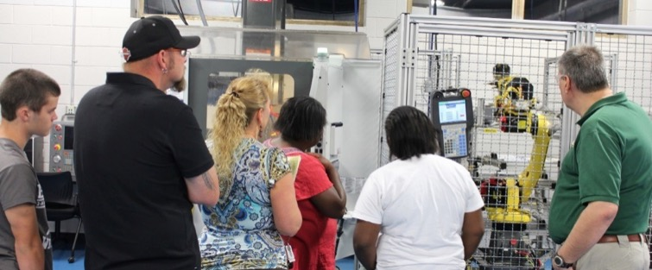
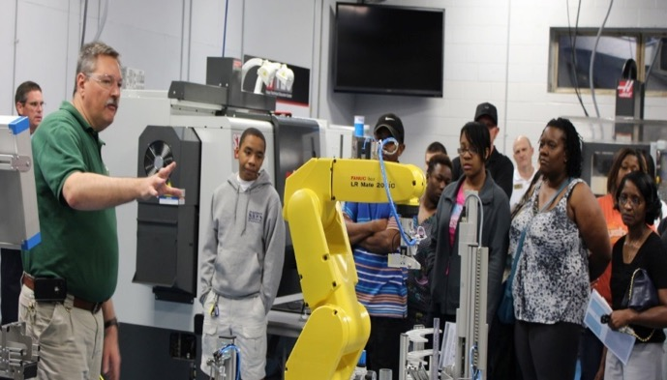
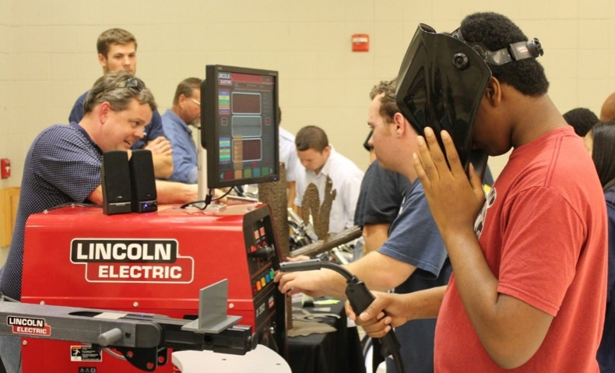
Career Awareness
CTE Showcase
October 2014

Slide 68
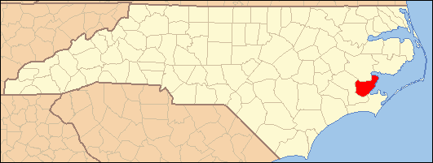
Growth and Employment in Pamlico County (GEPC) NCWorks Career Pathways Program Workshop and Evaluation (June 2015)

Slide 70
Employer Relationships
Face-to-Face Visits
Phone Calls
Computer Surveys
Consultation with Pamlico County Chamber of Commerce & Economic Developer
GEPC Steering Committee

Slide 71
AIR: Aviation in Rockingham

Slide 72
Original Grant Partners

Slide 73
New/Potential Grant Partners
Notes:
Discuss Workforce Needs – Over 30 Aviation Companies in the Triad with over 6000 employees and they are growing. North State Aviation had 100 employees two years ago and they have over 400 today.

Slide 74
Our Pathway
Career | Freshman | Sophomore | Junior | Senior | Year 13 | Year 14 *
Aviation Machinist | Math I English I World History Earth Science PE Drafting TED Elective | Math II English II American History I Physical Science *Drafting II TED II Robotics Elective | Math III English III American History II Biology Advanced Studies Drafting III Robotics II Elective | (Fall) English IV Physics Blue Print Reading Industrial Safety Machining Technology 1A Intro to Metrology (Spring) Advanced Study Civics Machining Technology 1B CNC Turning CNC Milling | (Fall) Math 110 Humanities Elective Industrial Spec. Advanced CNC Turn (Spring) Machining Tech II BP reading mech. Expository Writing Social Science Elective (Summer) Machining III | (Fall) CAM: CNC Turning Intro to Solid Modeling Prof. Research & Reporting Welding 112 or Work-base (Spring) Work-based learning Adv. Machining Calculations Advanced CNC Milling 224 CAM: CNC Milling 232 Advanced Solid Modeling
* Year 15 & 16 Option available through East Carolina University degree completion program – Bachelor of Science in Industrial Technology ** Students who complete certificate program will also be given WorkKeys assessment in soft skills performance, talent and teamwork. In addition, they will be assessed in the North Carolina Career Readiness Certificate. Job shadowing opportunities will also be available. *** Continuation through the diploma program will provide at least two assessments in the National Institute of Metalworking Skills (NIMS) certification. ****Completion of the associate degree will provide students the opportunity to receive certification in SolidWorks. Students receiving the associate degree will also have opportunities for Work-based learning.
High School Diploma
Diploma***
Associate****
Certificate**

Slide 75
Stacking: Programs of Study, College and Career Promise, and Career Pathways
Thanks for all you do !
Dr. Bob Witchger
Director of Career and Technical Education
NC Community College System
WitchgerB@nccommunitycolleges.edu

