Slide 1
Perkins Update Webinar
October 6, 2020

Slide 2
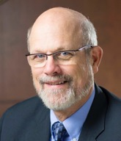
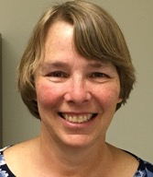
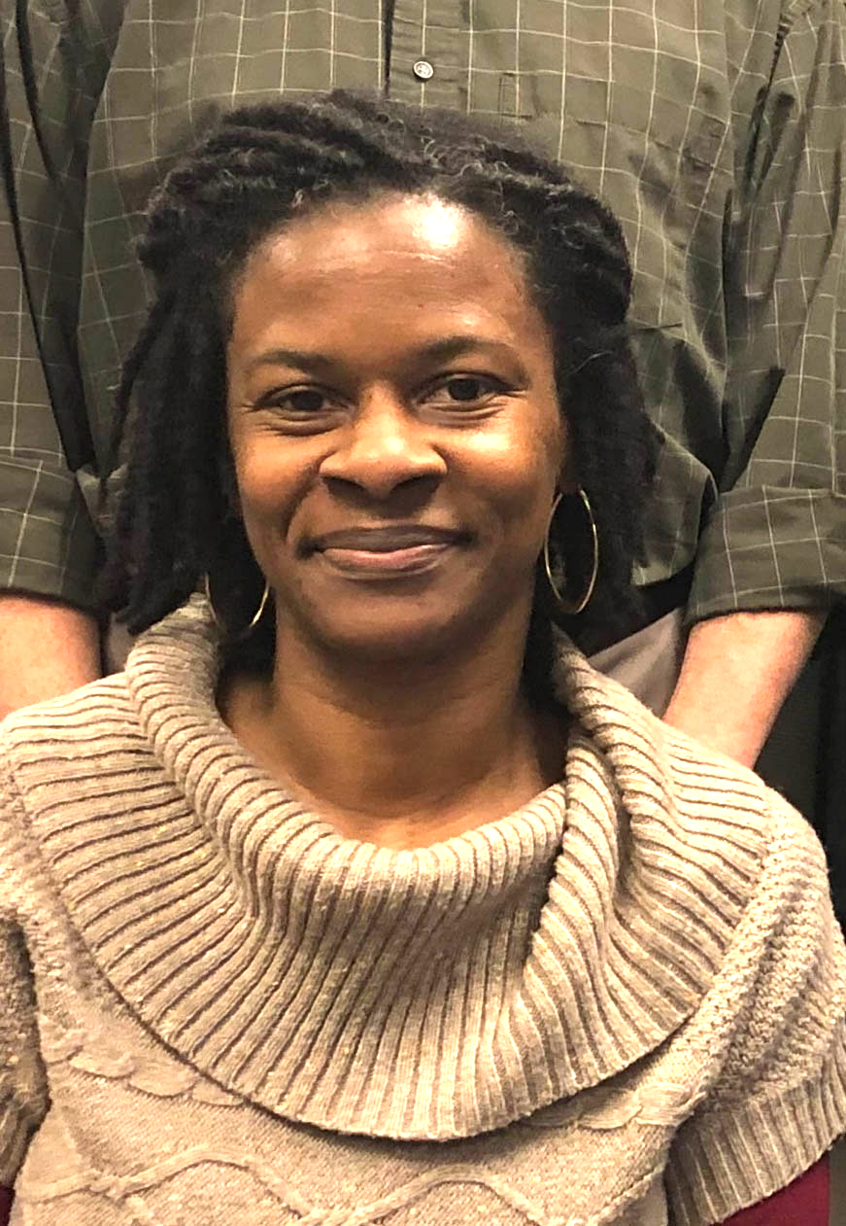
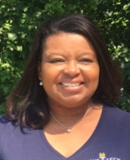
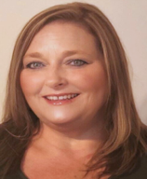
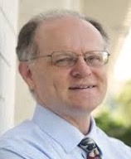
Team Perkins
Bob Witchger
Patti Coultas
Tony Reggi
Darice McDougald
Michelle Lair
Mary Olvera
Chris Droessler
Notes:
Dr. Bob Witchger
919-807-7126
WitchgerB@nccommunitycolleges.edu
Dr. Tony R. Reggi
919-807-7131
ReggiA@nccommunitycolleges.edu
Patti Coultas
919-807-7130
CoultasP@nccommunitycolleges.edu
Dr. Mary Olvera
919-807-7120
OlveraM@nccommunitycolleges.edu
Michelle Lair
919-807-72227
LairM@nccommunitycolleges.edu
Chris Droessler
919-807-7068
DroesslerC@nccommunitycolleges.edu
Darice McDougald
919-807-7219
McDougaldD@nccommunitycolleges.edu

Slide 3
COVID-19 Follow Up
How are you all doing?
What’s happening at your College?
What can we do to assist you?

Slide 4
Purpose of Perkins
Develop more fully the academic knowledge and technical and employability skills of secondary education students and postsecondary education students who elect to enroll in CTE programs and programs of study
Notes:
The Strengthening Career and Technical Education for the 21st Century Act reauthorized and updated the Carl D. Perkins Career and Technical Education Act of 2006 to become the current Carl D. Perkins Career and Technical Education Act of 2006 as amended by the Strengthening Career and Technical Education for the 21st Century Act (Perkins V)
This updated act stresses:
- Academic, Technical, and Employability Skills
- Funding Secondary and Postsecondary CTE
- Focusing on Students who elect to enroll in CTE Programs of Study

Slide 5
Promising Practice Videos 2020
Mitchell Community College
Registered Apprenticeship in Mechatronics
COVID Interruption
Need to hire a coordinator
https://www.ncperkins.org/video
Notes:
Sept 2020
AB-Tech
Coastal Carolina
October 2020
Mitchell
Tri-County
November 2020
Haywood
Pamlico
December 2020
Rowan-Cabarrus
Isothermal
Johnston
Randolph
Pitt
Blue Ridge
Cape Fear
Mayland
Carteret
Sandhills
Central Piedmont
Wilson
Cleveland
Craven
Wilkes
Durham
Forsyth
Southwestern
Halifax
McDowell
Nash
Richmond
Wayne
Robeson
Caldwell
Rockingham
South Piedmont
Edgecombe
Western Piedmont
Southeastern
Catawba Valley
Stanly
Surry
Wake Tech
Fayetteville
Gaston
Vance-Granville
Sampson
Guilford
Central Carolina
Lenoir
Martin
Brunswick
Davidson
Roanoke-Chowan
James Sprunt
Bladen
College of Albemarle

Slide 6
Free Universal Design for Learning On-line Workshop Series
Notes:
www.ncperkins.org/udl/

Slide 7
UDL Workshop Series sessions 1 & 2
www.ncperkins.org/udl/
Workshop # 1: October 20, 2020 2:30-3:30
UDL 101: What is Universal Design for Learning and Why Do We Need It Right Now?
With the wide variety of students now entering higher education who have constant and varying demands on their time and attention, how can we reach and teach everyone? Even more so, how can we leverage the diversity of learners in our classes to create a better learning experience for all students with a richer, more nuanced understanding of our world? This workshop will introduce participants to the neuroscience based principles of Universal Design for Learning, how these principles are applied, and why it should matter to us and our students.
Workshop # 2: October 27, 2020 2:30-3:30
The WHY of Learning: Engaging ALL Students (not just the ones you wish were in your class)
How can you motivate and engage all of the students in your classroom? What strategies can help right away and what can we plan for long term to help struggling students? How can we motivate students to want to learn the material in the first place, even when they have a hard time motivating themselves? This workshop presents participants with neuro-science based UDL strategies to motivate and engage students!
Notes:
www.ncperkins.org/udl/

Slide 8
UDL Workshop Series sessions 3 & 4
www.ncperkins.org/udl/
Workshop # 3: November 3, 2020 2:30-3:30
The HOW of Learning: Assessment with UDL Principles in Mind
What are executive functions and how do they affect student learning? This presentation helps instructors to create new ways of thinking about assessments and course design to get better results from students right away! Let's learn how to best help our students and make our lives a lot easier in the process!
Workshop # 4: November 10, 2020 2:30-3:30
The WHAT of Learning: Creating Resourceful, Knowledgeable Learners
How can we make sure that we take down all barriers to learning so that our students can learn and thrive? What little things can we do, what big ideas should we keep in mind? This presentation will guide instructors in how to best offer information to students in a way that reaches and teaches a diverse array of learners.
Notes:
www.ncperkins.org/udl/

Slide 9
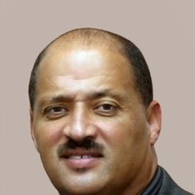
Victor Marrow
WIOA Program Assistant
NCWorks Career Center - Weldon, NC
Notes:
Put victor first
Victor Marrow WIOA Program Assistant/Lead TechHire Coordinator vmarrow668@halifaxcc.edu 252-536-7283

Slide 10
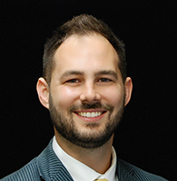
Andrew Gardner
Dean, Continuing Education Montgomery Community College
Notes:
Andrew Gardner
Dean of Continuing Education
910-898-9670
gardnera8147@montgomery.edu
Department: Continuing Education

Slide 11
Comprehensive Local Needs Assessment
For new programs, for new equipment, for enhanced services, to fill gaps or address a need that will help build the local workforce, with the support of your stakeholders
Completed every two years and can be updated as needed

Slide 12
Comprehensive Local Needs Assessment
Drives your CTE activities
Guides spending under Perkins
Identifies gaps or needs in education and training programs
Involves our employment and training stakeholders

Slide 13
Assessment of CTE Programs and Pathways
Student performance in CTE programs
Programs that are in demand and of sufficient size, scope, quality
Implementing new CTE programs to meet workforce needs
Provide for equal access to CTE programs/pathways
Stakeholders
CTE Deans, Faculty, Workforce Boards, Employers, Businesses, Industries, Parents, Students, Representatives of Special Populations, Out-of-school, Homeless, Foster, & Indian Tribes

Slide 14
The Why, What, and How of Time and Effort Documentation when using Perkins Funds for Faculty and Staff

Slide 15
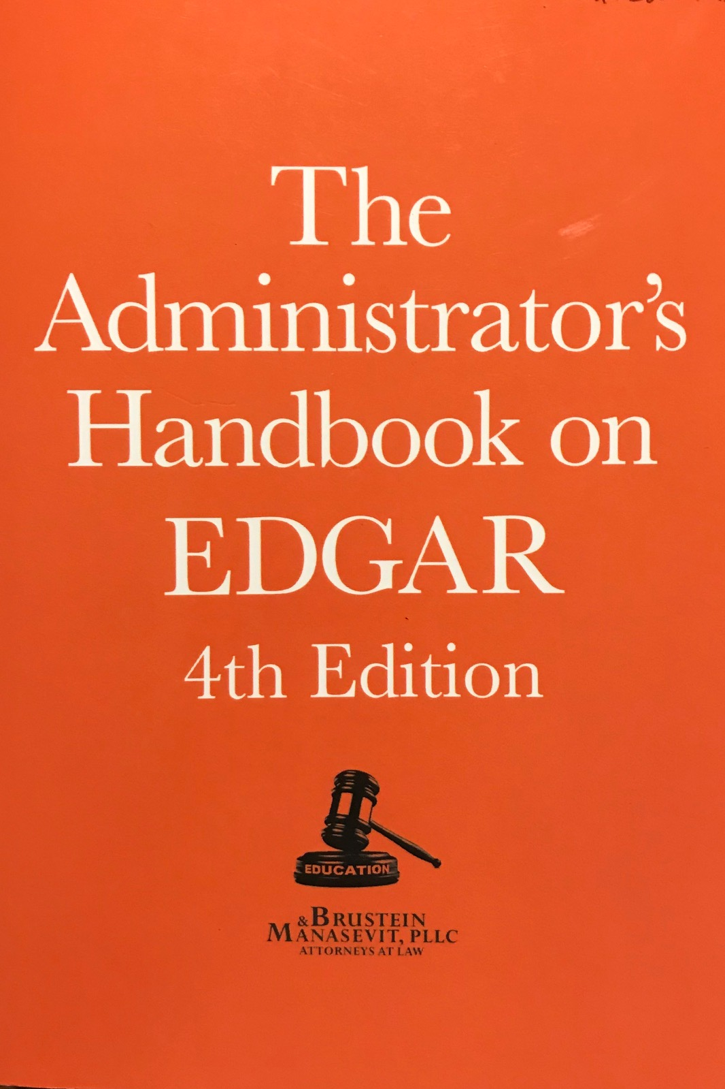
Why document employee time & effort if they are paid with Perkins Funds?
The Uniform Administrative Requirements, Cost
Principles, and Audit Requirements for Federal
Rewards 2 CFR Part 200.430(i) Standards for
Documentation of Personnel Expenses states
that “charges to [Perkins] for salaries and
wages must be based on records that
accurately reflect the work performed.”
Starts on page 141

Slide 16
Three Types of Employees
100%/100%: 100% CTE/Perkins approved activities paid 100% through the college’s Perkins grant.
100% CTE/Split Funded: 100% CTE/Perkins approved activities paid partially through the college’s Perkins grant and partially through another source.
Split Time and Effort: Activities are split between CTE/Perkins approved activities that are paid through the college’s Perkins grant and other activities paid for by other sources.

Slide 17
How to complete the Local Plan’s wages tab
This is the percent of time spent on CTE activities/students, not how the position is funded.
100%/ 100%
Split Time/ Split Funded
100% CTE/ Split Funded

Slide 18
A. 100% CTE activities and 100% Perkins funded
Employees must complete the Semi-Annual Certification Form for Employees working from a “Single Federal Award” certifying they worked 100% of their time on CTE/Perkins activities and are paid 100% with Perkins funds.
The form is completed in January for the previous 6 months (July – December) and in July for the previous 6 months (January – June).
Store completed forms at the college for at least 3 years.

Slide 19
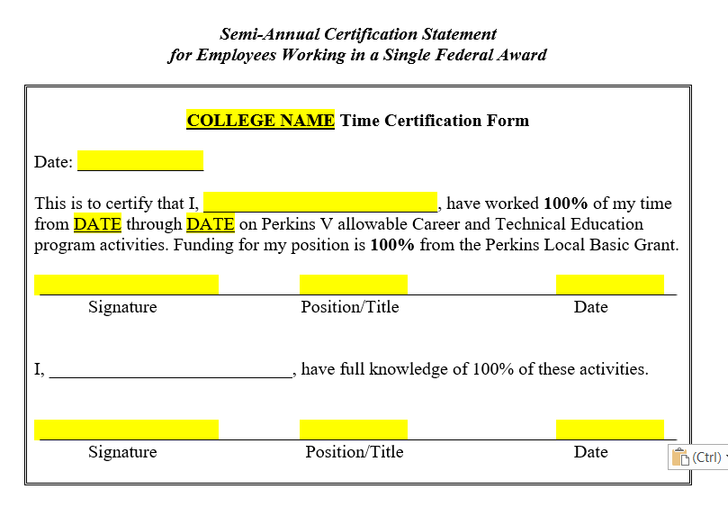
Semi-annual 100%/100% Form

Slide 20
B. 100% CTE activities but split funded
Employees must complete the Semi-Annual Certification Form for Employees working from a “Single Federal Award” certifying they worked 100% of their time on CTE/Perkins activities and but their pay comes from both Perkins and other funds.
The form is completed in January for the previous 6 months (July – December) and in July for the previous 6 months (January – June).
Store completed forms at the college for at least 3 years.

Slide 21
Semi-annual 100%time/split funded form

Slide 22
Split Time and Effort
Employees who split their time between CTE/Perkins activities and non-CTE/Perkins activities must keep more detailed records of their time. This is to ensure that non-CTE/Perkins activities are not paid for by the Perkins grant.
They must keep records of their time and then summarize it monthly on the Split Time and Effort form.
The monthly forms and the back-up documentation must be kept in case the college is monitored or audited for at least 3 years. The back up records maybe calendars, sign-in sheets, or whatever method the employee implements.

Slide 23
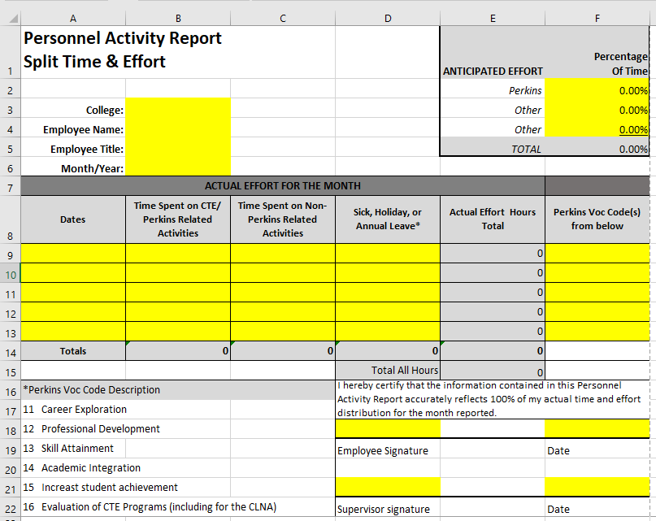
Split Time and Effort Form

Slide 24
Where are the forms on NCPerkins.org?

Slide 25
NCPerkins.org step 2
Select the appropriate form

Slide 26
Using Perkins to pay for Fringe Benefits
EDGAR 200.431 (starting on page 143)
Fringe includes the costs of leave (vacation, family-related, sick or military), employee insurance, pensions, and unemployment benefit plans.
Permissible as long as they are reasonable and required by law, non-Federal entity-employee agreement, or an established policy of the non-Federal entity.
Employee monitoring will include a review of HR Policies in the future.

Slide 27
Let us know if you have questions!

Slide 28
Perkins Monitoring Update
Monitoring Dates – January through May 2021
Equipment
Time and Effort
Site

Slide 29
Promising Practice Videos 2020
Tri-County Community College
Special Population identification and messaging through Aviso
https://www.ncperkins.org/video
Notes:
Sept 2020
AB-Tech
Coastal Carolina
October 2020
Mitchell
Tri-County
November 2020
Haywood
Pamlico
December 2020
Rowan-Cabarrus
Isothermal
Johnston
Randolph
Pitt
Blue Ridge
Cape Fear
Mayland
Carteret
Sandhills
Central Piedmont
Wilson
Cleveland
Craven
Wilkes
Durham
Forsyth
Southwestern
Halifax
McDowell
Nash
Richmond
Wayne
Robeson
Caldwell
Rockingham
South Piedmont
Edgecombe
Western Piedmont
Southeastern
Catawba Valley
Stanly
Surry
Wake Tech
Fayetteville
Gaston
Vance-Granville
Sampson
Guilford
Central Carolina
Lenoir
Martin
Brunswick
Davidson
Roanoke-Chowan
James Sprunt
Bladen
College of Albemarle

Slide 30
NCETA Workshops
Thursday, October 8 @ 10 am
Solomon McAuley, empowerment speaker, author, entrepreneur.
Solomon McAuley will speak about WIOA Youth Services and how we promote what we do in our community.
Monthly webinar series for workforce professionals
Replaces the spring NCETA Conference
https://register.gotowebinar.com/register/8280290536260357645
Notes:
https://register.gotowebinar.com/register/8280290536260357645
NCETA Workshop -
For over 50 years, the North Carolina Employment and Training Association (NCETA) has been helping front-line workforce development professionals by sponsoring an annual conference, workshops, and networking opportunities.
We are launching a new series of workshops designed to improve workforce development in North Carolina.

Slide 31
NCETA Workshops
Friday, October 9 @ 10 am
Building North Carolina’s Workforce in the Time of COVID
Five front-line workers and career center managers will discuss experiences and challenges operating a career center during the Covid pandemic.
Monthly webinar series for workforce professionals
Replaces the spring NCETA Conference
https://register.gotowebinar.com/register/8977394103554712076
Notes:
https://register.gotowebinar.com/register/8977394103554712076
NCETA Workshop -
For over 50 years, the North Carolina Employment and Training Association (NCETA) has been helping front-line workforce development professionals by sponsoring an annual conference, workshops, and networking opportunities.
We are launching a new series of workshops designed to improve workforce development in North Carolina.

Slide 32
CTE Training
Training online - www.ncperkins.org
Perkins Update Webinars - Second Tuesday
Career Pathways Webinars - Third Wednesday
At your College by request
https://www.ncperkins.org/presentations/

Slide 33
Perkins Updates
2nd Tuesday of the month
9 am
Via GoToWebinar
Find the registration links at NCperkins.org/presentations
Next Update: Tuesday, November 10, 2020
Notes:
Register now and let the system remind you.

Slide 34
Perkins/CTE State Staff
Dr. Bob Witchger Director, Career & Technical Education WitchgerB@nccommunitycolleges.edu 919-807-7126
Dr. Tony R. Reggi Coordinator, Career & Technical Education ReggiA@nccommunitycolleges.edu 919-807-7131
Patti Coultas Coordinator, Career & Technical Education CoultasP@nccommunitycolleges.edu 919-807-7130
Dr. Mary Olvera Coordinator, Career & Technical Education OlveraM@nccommunitycolleges.edu 919-807-7120
Michelle Lair Coordinator, Career & Technical Education LairM@nccommunitycolleges.edu 919-807-7227
Chris Droessler Coordinator, Career & Technical Education DroesslerC@nccommunitycolleges.edu 919-807-7068
Darice McDougald CTE Administrative Assistant McDougaldD@nccommunitycolleges.edu 919-807-7219
Notes:
http://www.ncperkins.org/course/view.php?id=6

