Slide 1
Perkins Update
November 8, 2022

Slide 2
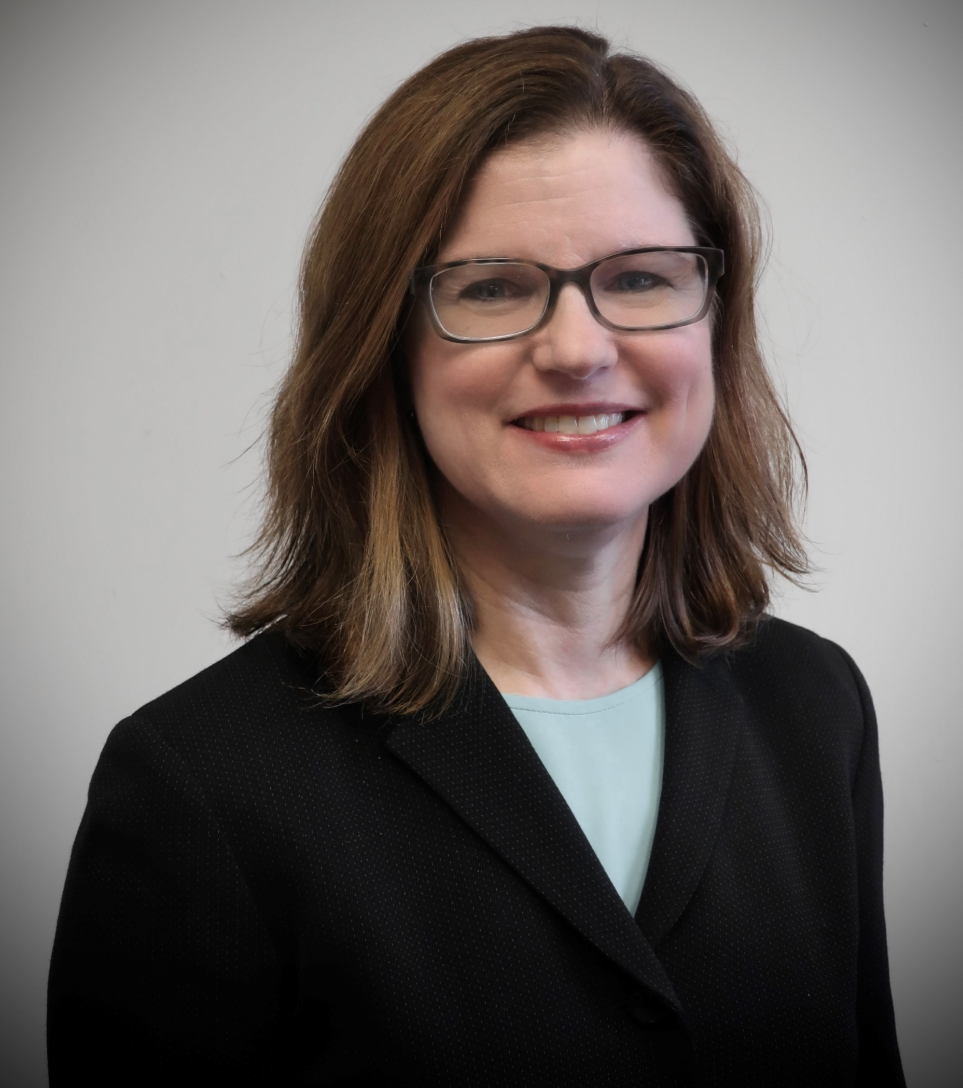
Our new CTE Coordinator has started!
W
E
L
C
O
M
E
!
Anne Bacon
CTE Coordinator
bacona@nccommunitycolleges.edu
919-807-7232

Slide 3
Career & Technical Education Team
Bob Witchger
Tony Reggi
Patti Coultas
Mary Olvera
Anne Bacon
Darice McDougald
Lane Freeman
Aaron Mabe

Slide 4
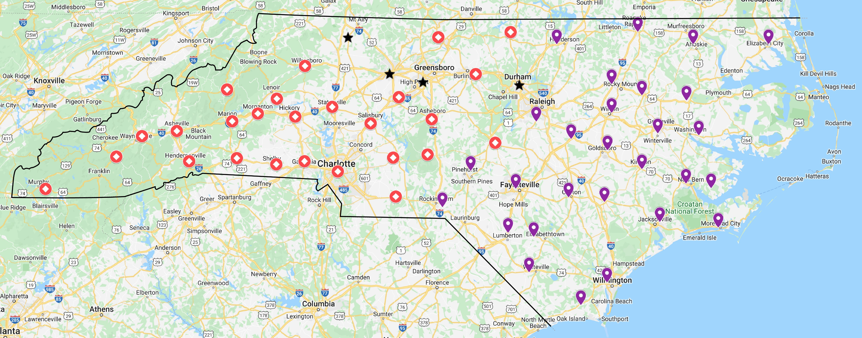
Colleges by CTE Coordinator
CTE COORDINATOR – MAIN CONTACT
Anne Bacon
Patti Coultas
Mary Olvera
You may also call Bob or Tony with any question or comment

Slide 5
Our colleagues in Academic Programs
Michelle Lair
Lori Byrd
Hilmi Lahoud
Gail Robertson
Reyna Rodriguez
Peyton Bell
Vacant (Frank’s)
Nedra Dixon

Slide 6
New Curriculum Compliance Coordinator
Support for Programs of Study
Curriculum Procedures Manual updates
Curriculum Standards in Colleague
Welcome!
Peyton Bell
Starting December 1,2022

Slide 7
Hiring a Program Administrator
This position will be responsible for the following Program Areas:
Construction Technologies
Engineering Technologies
Industrial Technologies
Transportation Systems Technologies
Currently

Slide 8
Purpose of Perkins
Develop more fully the academic knowledge and technical and employability skills of secondary education students and postsecondary education students who elect to enroll in CTE curriculum programs and programs of study
Notes:
The Strengthening Career and Technical Education for the 21st Century Act reauthorized and updated the Carl D. Perkins Career and Technical Education Act of 2006 to become the current Carl D. Perkins Career and Technical Education Act of 2006 as amended by the Strengthening Career and Technical Education for the 21st Century Act (Perkins V)
This updated act stresses:
- Academic, Technical, and Employability Skills
- Funding Secondary and Postsecondary CTE
- Focusing on Students who elect to enroll in CTE Programs of Study

Slide 9
Promising Practice Video 2022
Southwestern Community College
Peak Explorers Initiative: early career exploration
See all the videos: https://www.ncperkins.org/video/
Notes:
August:
Catawba Valley Nash
September
Alamance
October – no video
November
Southwestern

Slide 10
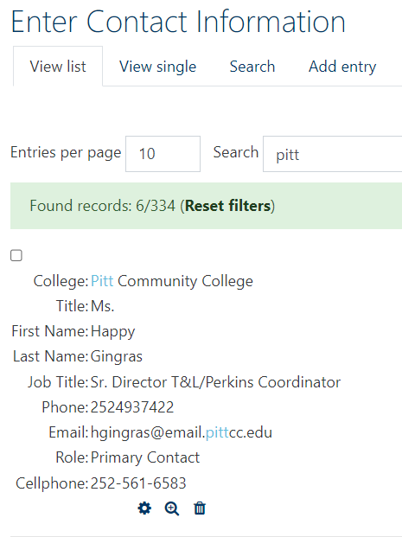
Have your Contacts changed?
Please check contacts in NCPerkins!
Primary
CAO
CFO
Special Populations
NC-NET
Secondary (optional)
EDIT

Slide 11
Perkins Carry Forward
Approved by the SBCC in October
Focus on Special Populations
Increase the Awareness of Special Populations in CTE Programs of Study
Enhance our work on the CLNA around Special Population Student Performance
Identify Special Population students in CTE Programs of Study
Develop programs to address needs of special populations

Slide 12
Collecting Special Pops Data
Working with CFNC & NCCCS to collect the data
Attend Special Called meeting (TBD) on addressing the needs of special populations CTE Programs of Study

Slide 13
Perkins V Special Populations
Disabilities;​
Economically disadvantaged
Non-traditional fields ​
Single-parents, including single pregnant women​
Out-of-workforce individuals
English learners
Homeless individuals
In, or aged out of, the foster care system
Youth with a parent who is in armed forces
J. Major racial and ethnic groups (Added from ESEA)

Slide 14
Disabilities
Individual who has a physical or mental impairment that has substantial and long-term adverse effect in ability to carry out normal day to day activities
Student must have a 504 and has identified themselves to Disability Services

Slide 15
Economically Disadvantaged
Current metric: Students who are Pell recipients

Slide 16
Non-Traditional Fields
Individuals from one gender comprise less than 25% of the individuals employed in an occupation or field of work
Students identified as non-traditional in 3P1

Slide 17
Single Parents, including pregnant women
Individual with a dependent child or children who is unmarried, widowed or divorced and not remarried, including pregnant women

Slide 18
Out-of-workforce individuals
Individual who is a displaced homemaker, who has worked primarily with our enumeration to care for a home and family and for that reason has diminished marketable skills.

Slide 19
English Learners
English is not their primary language, and they have difficulty communicating effectively in English.

Slide 20
Homeless Individuals
CFNC defined as “An individual who lacks a permanent place to live (i.e. shelter or temporary housing facility) or lives in a location that is not typically used as a residence (i.e. bus station, campground, car, or park).”

Slide 21
In, or aged out of, the foster care system
An individual who is currently in foster care or has aged out of the foster care system.

Slide 22
Youth with a parent who is in armed forces
Youth with a parent who meets these criteria:
101(a)(4) – Army, Navy, Air Force, Marine Corps, and Coast Guard
101(d)(1) - Full-time duty in the active military service of the United States. Such term includes full-time training duty, annual training duty, and attendance, while in the active military service, at a school designated as a service school by law or by the Secretary of the military department concerned. Such term does not include full-time National Guard duty.

Slide 23
Major racial and ethnic groups
CFNC (and Census) asks for Race by:
White
Black or African American
American Indian or Alaska Native
Asian
Native Hawaiian or Other Pacific Islander
Ethnicity: Hispanic or non-Hispanic

Slide 24
Supporting Special Populations Webinar
November 14 12:30-2pm
Hosted by Trudie Hughes, NCCCS Associate Director of Disability Services and Title IX
On the NCPerkins.org/presentations page, or directly at
https://register.gotowebinar.com/register/656383578766841101

Slide 25
Strategies for recruiting and supporting Special Populations
From Illinois
https://icsps.illinoisstate.edu/equity/super-strategies

Slide 26
Carry-forward Modification needed
CTE Perkins Allotment was approved on August 19, 2022
Attachment FC 01
The approved budget is probably less than planning budget
Carry Forward was approved on October 21, 2022
Attachment FC 06
Approved allotment + approved carry forward = Total allotment
Total allotment – planning budget = amount of modification
Put your activity update on the modified plan so you don’t have to do a mid-year plan update
Contact your Perkins Coordinator with questions or to confirm the amount of your modification
Notes:
Initial Allotment FC 01 page 38
https://www.nccommunitycolleges.edu/sites/default/files/state-board/finance/fc_01_-_fy_2022-23_state_aid_allocations_and_budget_policies_0.pdf
Carry Forward FC 06 page 43
https://www.nccommunitycolleges.edu/sites/default/files/state-board/agenda/sbcc_package_-_october_21_2022.pdf

Slide 27
Leadership Projects for 2022-23
CORD – NC-NET
SkillsUSA
Career Counseling
Updated Career Exploration Guide
Curriculum Alignment Projects: Cybersecurity, Biopharmaceutical Technology
Elementary Education Residency licensure certificate
Virtual Reality
Pathways

Slide 28
Postsecondary Association of CTE (PACE)
Division of the Association for Career and Technical Education (ACTE)
Exploring postsecondary involvement in NC

Slide 29
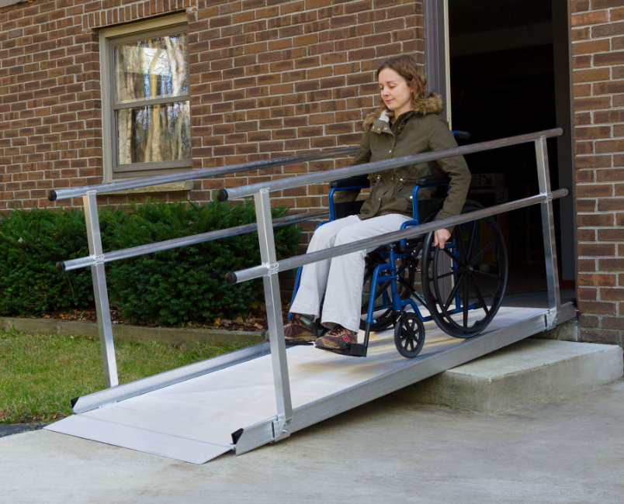
MOA – Civil Rights Reviews
College Reviews
Call if you want a review
Fall Reviews
Montgomery (Oct 24)
James Sprunt (Nov 9 - 10)
We appreciate colleges working to complete their voluntary compliance plans

Slide 30
Mid-Year Review Plans
Please complete emailed survey
January 10-12
Caraway Conference Center (Sophia, NC)
Accommodations available
Notes:
4756 Caraway Mountain Road, Sophia, NC 27350
https://caraway.org
Survey Link: https://forms.office.com/Pages/ResponsePage.aspx?id=KmtvYa_4JUW2yPdMaisYLY4GpX31oYZLssoguBhqPHtURTcwS1NLUExHVjVUSlpUSzYyVjIzTjkwRi4u

Slide 31
Mid-Year Review Preparation
PowerPoint
How are the findings of the CLNA being addressed?
Plan updates: activities, anticipated problems/issues, successes
Share a CTE Promising Practice that you’re doing this year
Budget Update – Has equipment been ordered? On track to spend it all?
Questions, comments, suggestions
And there are other documents due in Moodle too

Slide 32
Application due May 19, 2023

Slide 33
Perkins Monthly Updates
2nd Tuesday of the month from 9-10 am
Register now for all of them https://www.ncperkins.org/presentations/
Upcoming dates:
Jan. 10, 2023 canceled
Feb. 14, 2023
Mar. 14, 2023
April 11, 2023
May 9, 2023
June 13, 2023
Attendance (or viewing the recording within 30 days) is recorded on monitoring rubric. Recording may be accessed at the same link as the registration.
Notes:
Register now and let the system remind you.

Slide 34
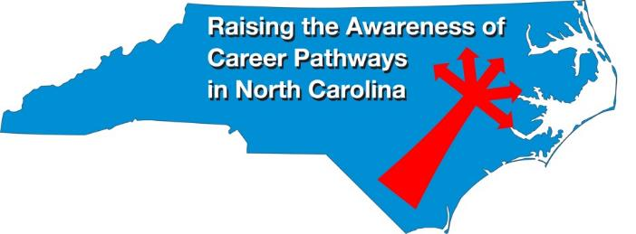
Raising the Awareness of Career Pathways Webinars
November 16 Software Developers
December 14 Heavy Equipment and Tractor Trailer Truck Drivers
January 18 Teacher Preparation
February 15 Machine Programming (CNC)
March 15 Occupational Therapy Assistants
April 19 Food Industry
May 17 Entrepreneurship
June 21 Non-Profit Leadership and Management
Register for all webinars at www.ncperkins.org/presentations

Slide 35
Technical Assistance is available
We are here to help!
Team Perkins is available by phone, email, virtually, or in-person

