Slide 1
Perkins Update Webinar
January 14, 2020

Slide 2
Purpose of Perkins
Develop more fully the academic knowledge and technical and employability skills of secondary education students and postsecondary education students who elect to enroll in CTE programs and programs of study
Notes:
Perkins V “Strengthening Career and Technical Education” is an enhancement of The Perkins IV act of 2006
Stressing Academic, Technical, and Employability Skills
Funding Secondary and Postsecondary CTE
Focusing on Students who elect to enroll in CTE Programs of Study

Slide 3
Promising Practice Videos 2019
Pitt Community College
College created outreach materials that could be used through social media and could be emailed to interested students.
https://www.ncperkins.org/video
Notes:
August 2019
Alamance CC
Sept 2019
Blue Ridge CC
Brunswick CC
Oct 2019
Caldwell CC & TI
Carteret CC
November 2019
AB-Tech CC
Coastal CC
January 2020
Pitt CC
Rowan-Cabarrus CC
February 2020
Craven CC
Fayetteville Tech CC
March 2020
Gaston CC
Halifax CC
April 2020
Haywood CC
Isothermal CC
May 2020
James Sprunt CC
Johnston CC
June 2020
Lenoir CC
Nash CC
2020
Southwestern CC
Stanly CC
Surry CC
Wilkes CC
Wilson CC

Slide 4
Welcome Mary Olvera
From Surry CC
Programs/Perkins Coordinator
Agricultural and Natural Resources
Commercial and Artistic Production
Public Services Technologies
Emphasis - Programs of Study
Invite Mary to visit your college
919-807-7120
OlveraM@nccommunitycolleges.edu
Notes:
Mary for Surry – Past Experiences and Committees
Planned work – Committees
Pathways Perkins –
Monitoring Programs of Study
Consulting with College
Invite for Site Visit, Advisory Committee Meetings
Engages with Colleges

Slide 5
Welcome Michelle Lair
From Wake Tech
Career and College Promise
CTE Coordinator
Invite Michelle to visit your college
919-807-7227
LairM@nccommunitycolleges.edu

Slide 6
Mid-Year Reviews - 4 Locations
East: Tuesday, January 21, 2020 -- Nash Community College
South: Thursday, January 23, 2020 -- Fayetteville Technical Community College
West: Tuesday, January 28, 2020 -- Asheville-Buncombe Technical Community College
North: Wednesday, January 29, 2020 -- Forsyth Technical Community College
Two Sign Ups !!-
Presentation date: https://www.ncperkins.org/review/mid_year.php
Attendance: https://www.ncperkins.org/meeting/
Submit PowerPoint or Outline five days before

Slide 7
Mid Year Review – what to expect
Drive-in Meeting
8 AM to 1 PM
Share Promising Practices
Comprehensive Local Needs Assessment
Writing the 2020-21 Plan and Budget
Notes:
Emphasis on Face to Face
Share Promising Practices
Smaller Groups more time to Share
Regional meetings to save you time
Gaps
Need

Slide 8
Monitoring Perkins Basic Grant
Time and Effort for Split Positions
Equipment for college allocating over 50% of Perkins funds spent in 2018-2019
Site Monitoring – Look at process, procedures, and integration into the college fabric
Notes:
Memos will be coming out shortly
Split time and effort will look at proper documentation in place for Split and 100% funded Faculty and staff funded with Perkins $
Equipment Monitoring will look at
Colleges exceeding the benchmark of 50% during 2018-19 program year
Ensure equipment planned for purchase in in place – copy of paid invoice
Ensure college has a plan to track equipment – copy of college tracking log
Ensure Equipment is in place for CTE Programs of study – Photo
Site Monitoring
Review Comprehensive Local Needs Assessment, talk with faculty, HS CTE, Workforce Development Professionals
Ensure they have knowledge of Perkins and have looked as ways to integrate programs, services, and staff.
Look at mid year Progress on Current Grant, Spending, Meeting intent of legislation in Required Activitiesi
Meeting with College Adminsitration

Slide 9
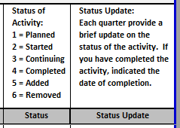
2nd Quarter Local Plan Update due now
Use most recent approved local plan spreadsheet.
Complete the right two columns on the Local Plan tab
Don’t forget to update equipment and salary tabs

Slide 10
NCETA Conference
April 1-3, 2020, in Wilmington, NC
Showcase best practices
Encourage collaboration with Workforce System
Better understanding of Perkin V and WIOA
https://nceta.org/
Notes:
https://nceta.org/
Encourage colleges to present
Gaps in service

Slide 11
Raising the Awareness of Career Pathways - Webinar
Third Thursday @ 9am
January 16, 2020
Careers in Automotive Technology
ncperkins.org/presentations

Slide 12
Budget
Do you have a Plan?
Spend your funds to enhance your CTE Programs.

Slide 13
Funding for 2020-21
Complete the Comprehensive Local Needs Assessment
Complete the Perkins 2020-24 Application - due March 6, 2020
Complete a Plan for 2020-21 - due May 15, 2020
Complete a Budget for 2020-21 - due May 15, 2020

Slide 14
Public Comments wanted on Perkins V
Released in December
On-line comments

Slide 15
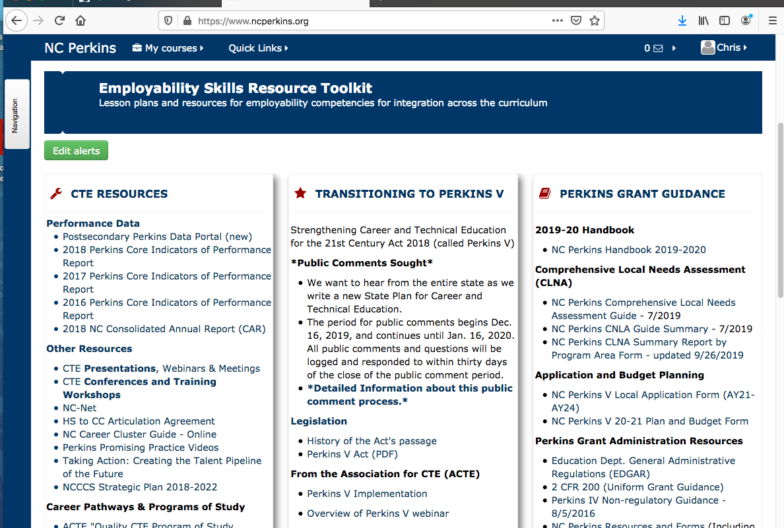
Public Comments wanted on Perkins V
Notes:
www.ncperkins.org

Slide 16
Public Comments wanted on Perkins V

Slide 17
Introduction to Universal Design for Learning for CTE Faculty
Perkins V emphasizes leveling the playing field for all CTE students, including those from nine special populations. Universal Design for Learning (UDL) is an instructional strategy specifically referenced in Perkins V to effectively teach all students.
We know from experience and neuroscience that individuals learn in varied ways. UDL provides educators with practical strategies and techniques to ensure that all learners can meet high expectations. In this introductory workshop, participants learn the research basis for UDL, practical applications of UDL for lesson design, and helpful technology tools that support flexible, inclusive instruction.
Using the UDL framework and its practical guidelines, participants will gain:
A working knowledge of the neuroscience of learning and how individual variability plays out in different educational environments
Guidelines and techniques to apply UDL principles to the design of lessons and curriculum units
Strategies on how to improve classroom practice and college culture by raising awareness of variability and UDL
College faculty will learn about:
How to address the learner variability in every classroom
How to support students to become expert learners
Cutting-edge research from the learning sciences
How to implement UDL strategies into their practice.
For more information www.ncperkins.org/udl
A Perkins V State Postsecondary Leadership Project Offering
When: April 1-2, 2020
Where: Hawthorne Inn & Conference Center, Winston-Salem, NC
Tuition: Free (includes morning coffee and afternoon break)
Attendance: Limited to 50 CTE faculty
You may use local Perkins funds to pay for travel, hotel & meals

Slide 18
Perkins Annual Meeting
Date: March 26, 2020
Time: 9am – 4pm ??
Location: TBD
We will review the CLNA & application process and discuss the plan/budget step

Slide 19
Promising Practice Videos 2019
Rowan-Cabarrus Community College
Simulation, portable X-ray, and other new equipment to enhance Nursing student's clinical experiences.
https://www.ncperkins.org/video
Notes:
August 2019
Alamance CC
Sept 2019
Blue Ridge CC
Brunswick CC
Oct 2019
Caldwell CC & TI
Carteret CC
November 2019
AB-Tech CC
Coastal CC
January 2020
Pitt CC
Rowan-Cabarrus CC
February 2020
Craven CC
Fayetteville Tech CC
March 2020
Gaston CC
Halifax CC
April 2020
Haywood CC
Isothermal CC
May 2020
James Sprunt CC
Johnston CC
June 2020
Lenoir CC
Nash CC
2020
Southwestern CC
Stanly CC
Surry CC
Wilkes CC
Wilson CC

Slide 20
CTE Training
Training online - www.ncperkins.org
Perkins Update Webinars - Second Tuesday
Career Pathways Webinars - Third Thursday (January 16)
At your College by request
https://www.ncperkins.org/presentations/

Slide 21
Perkins Updates
2nd Tuesday of the month
9 am
Via GoToWebinar
Find the registration links at NCperkins.org/presentations
Next Update: Tuesday, February 11, 2020
Notes:
Register now and let the system remind you.

Slide 22
Perkins Updates -- second Tuesday at 9am
Register now and get reminder emails
Feb 11, 2020
Mar 10, 2020
Apr 14, 2020
May 12, 2020
Jun 9, 2020
https://www.ncperkins.org/presentations

Slide 23
Perkins/CTE State Staff
Dr. Bob Witchger Director, Career & Technical Education WitchgerB@nccommunitycolleges.edu 919-807-7126
Dr. Tony R. Reggi Coordinator, Career & Technical Education ReggiA@nccommunitycolleges.edu 919-807-7131
Patti Coultas Coordinator, Career & Technical Education CoultasP@nccommunitycolleges.edu 919-807-7130
Dr. Mary Olvera Coordinator, Career & Technical Education OlveraM@nccommunitycolleges.edu 919-807-7120
Michelle Lair Coordinator, Career & Technical Education LairM@nccommunitycolleges.edu 919-807-7227
Chris Droessler Coordinator, Career & Technical Education DroesslerC@nccommunitycolleges.edu 919-807-7068
Darice McDougald CTE Administrative Assistant McDougaldD@nccommunitycolleges.edu 919-807-7219
Notes:
http://www.ncperkins.org/course/view.php?id=6

